Slide 1

Print and Politics: Milton, Areopagitica (1644)

Slide 2
Week 2 Lecture
Introduction to Milton’s pamphlet: ‘not absolutely dead things’.
The Collapse and Return of Censorship: Causes and Impacts
Areopagitica: Arguments and Limitations
Notes:
Three aims today.

Slide 3
Milton, ‘On Shakespeare’ (1630)
What needs my Shakespeare for his honoured bones,
The labour of an age in pilèd stones,
Or that his hallowed relics should be hid
Under a star-ypointing pyramid?
Dear son of Memory, great heir of fame,
What need’st thou such weak witness of thy name?
Thou in our wonder and astonishment
Hast built thyself a live-long monument.
For whilst to th’ shame of slow-endeavouring art,
Thy easy numbers flow, and that each heart
Hath from the leaves of thy unvalued book
Those Delphic lines with deep impression took,
Then thou, our fancy of itself bereaving,
Dost make us marble with too much conceiving;
And so sepúlchred in such pomp dost lie,
That kings for such a tomb would wish to die

Slide 4
“not absolutely dead things”
“…books are not absolutely dead things, but do contain a potency of life in them to be as active as that soul was whose progeny they are; nay, they do preserve as in a vial the purest efficacy and extraction of that living intellect that bred them.”
Milton, Areopagitica, pp. 239-40 (all page references to the Orgel and Goldberg edition)

Slide 5
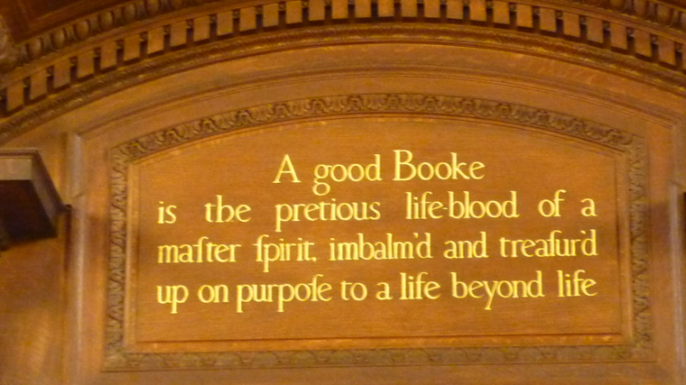
Notes:
New York Public Library

Slide 6
“not absolutely dead things”
“I deny not but that it is of greatest concernment in the church and commonwealth to have a vigilant eye how books demean themselves, as well as men; and thereafter to confine, imprison and do sharpest justice on them as malefactors; for books are not absolutely dead things, but do contain a potency of life in them to be as active as that soul was whose progeny they are; nay, they do preserve as in a vial the purest efficacy and extraction of that living intellect that bred them.”
Milton, Areopagitica, pp. 239-40.

Slide 7
Pre-Civil War Print Culture
Books required a license of approval before being entered into the Stationers’ Register.
This process was overseen and enforced by Star Chamber which convened at the royal prerogative.
Consequences?
  Some state oversight of what can and cannot be printed.
  Some print publications banned.
  Some more seditious literature gets pushed underground
    http://www.earlystuartlibels.net/htdocs/index.html

Slide 8
The Collapse of Licensing
December 1640: Parliament forms a committee to investigate the abuses of the Court of Star Chamber
July 1641: Parliament abolishes Star Chamber. This leads to the de facto cessation of state licensing of books.
  NB. Note how Milton ironically comments that the 1643 Licensing Act he writes against is “the immediate image of a Star Chamber decree…she is now fallen from the stars with Lucifer” (Areopagitica, p. 272).
1641 and 1642: there is a huge spike in the volume of print publication.
  2177 items printed in 1641
  4188 items printed in 1642 (figures from Cressy, England on Edge).

Slide 9
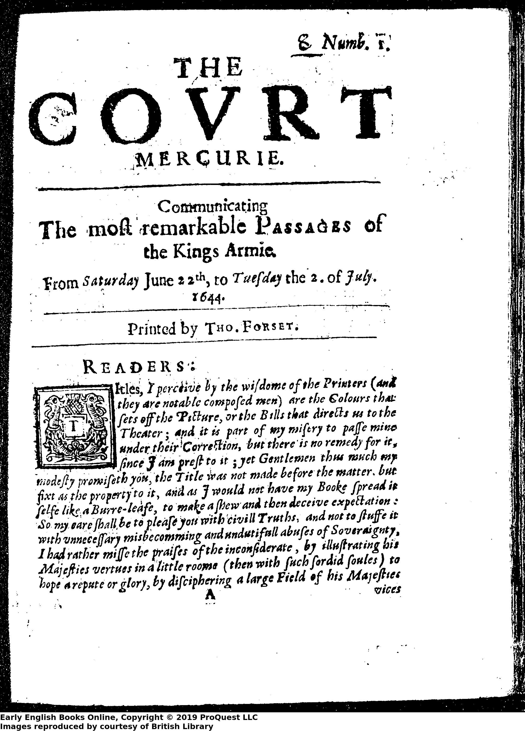
Newspapers
“Do we not see, not once or oftener, but weekly, that continued court- libel against the parliament and city, printed, as the wet sheets can witness, and dispersed among us for all that licensing can do?” (Areopagitica, p. 253).

Slide 10
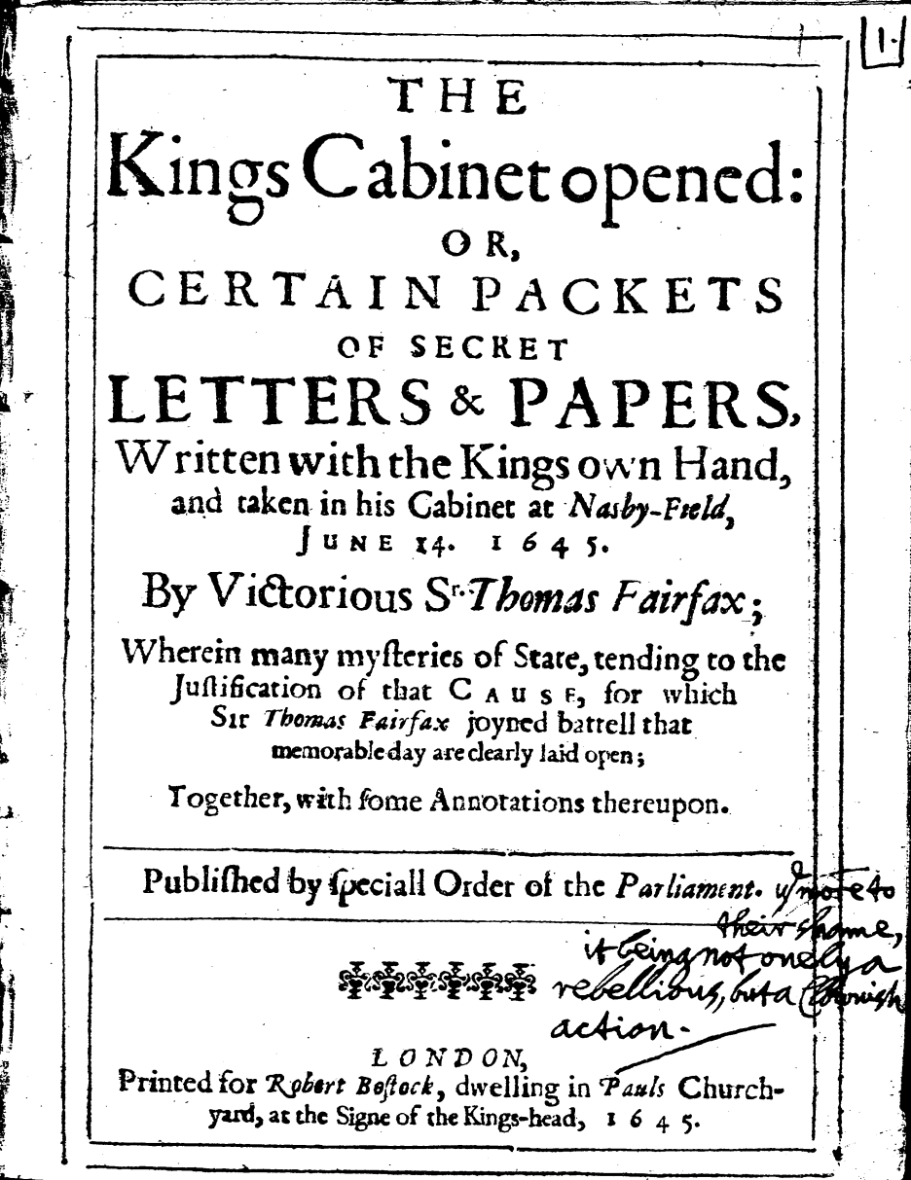
A Case Study: The Kings Cabinet opened (1645)
“It were a great sin against the mercies of God, to conceale those evidences of truth, which hee so graciously (and almost miraculously) by surprizall of these papers hath put into our hands; nor dare we smother this light under a Bushell, but freely hold it out to our seduced bretheren.”

Slide 11
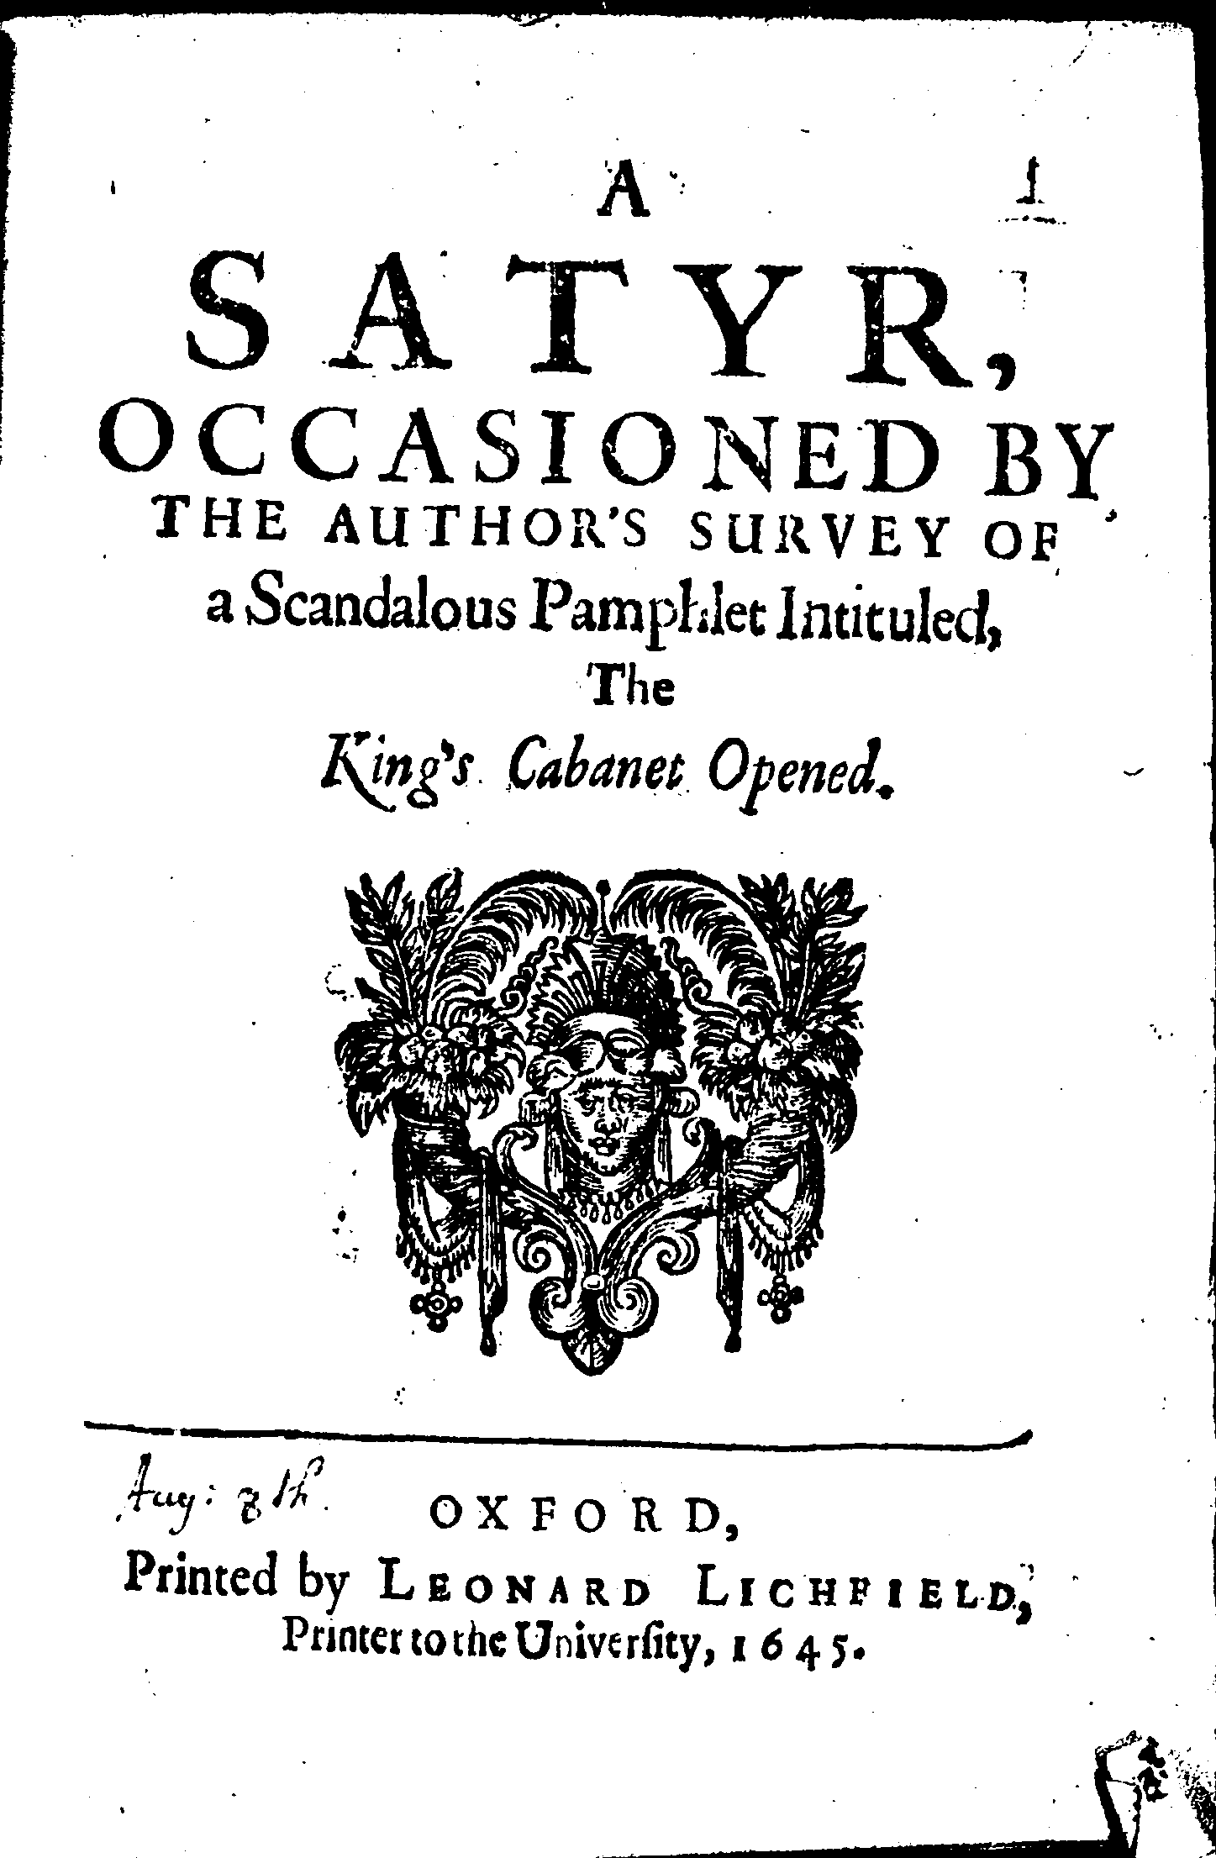
Royalist Responses to The King’s Cabinet
Poore Cheap Designes! The Rebell now must flie
To Packet Warre, to Paper-Treacherie.
The Basiliskes are turn’d to Closset-Spies,
And to their Pois’nous adde Enquiring Eyes.
[Martin Lluelyn], A Satyr (1645)

Slide 12
1643 Order and Anxieties about Print
June 1643: Parliament passes a new order to regulate printing. It is this to which Milton objects in Areopagitica, though this pamphlet isn’t published until November 1644.
“Whereas divers good orders have been lately made by both Houses of Parliament, for suppressing the great late abuses and frequent disorders in Printing many false, forged, scandalous, seditious, libelous, and unlicensed Papers, Pamphlets, and Books to the great defamation of Religion and Government. Which Orders … have taken little or no effect.”

Slide 13
Censorship and Catholicism
“Which course Leo X and his successors followed, until the Council of Trent and the Spanish inquisition, engendering together, brought forth or perfected those catalogues and expurging indexes that rake through the entrails of many an old good author with a violation worse than any could be offered to his tomb.
Nor did they stay in matters heretical, but any subject that was not to their palate they either condemned in a prohibition, or had it straight into the new purgatory of an index.” (Areopagitica, pp. 242-3).

Slide 14
Areopagitica and the Protestant Nation
“Lords and Commons of England, consider what nation it is whereof ye are, and whereof ye are the governors: a nation not slow and dull, but of a quick, ingenious and piercing spirit; acute to invent, subtle and sinewy to discourse, not beneath the reach of any point the highest that human capacity can soar to…
…Why else was this nation chosen before any other, that out of her, as out of Sion, should be proclaimed and sounded forth the first tidings and trumpet of reformation to all Europe?” (Areopagitica, pp. 264-5).

Slide 15
Areopagitica and Free Speech
        This is true liberty, when free-born men,
        Having to advise the public, may speak free,
        Which he who can, and will, deserves high praise;
        Who neither can, nor will, may hold his peace:
        What can be juster in a state than this?’
        Euripid. Hicetid. (Areopagitica p.237)
Isocrates, The Areopagite Discourse (c. 355BCE)
  Addressed to the Athenian Court of the Areopagus.

Slide 16
Press Freedom and the Role of the Citizen
“Good and evil we know in the field of this world grow up together almost inseparably; and the knowledge of good is so involved and interwoven with the knowledge of evil and in so many cunning resemblances hardly to be discerned, that those confused seeds which were imposed upon Psyche as an incessant labour to cull out and sort asunder were not more intermixed…He that can apprehend and consider vice with all her baits and seeming pleasures, and yet abstain, and yet distinguish, and yet prefer that which is truly better, he is the true war-faring Christian.”

Slide 17
Areopagitica and the Limits of Freedom?
“I mean not tolerated Popery, and open superstition, which as it extirpates all religions and civil supremacies, so itself should be extirpate, provided first that all charitable and compassionate means be used to win and regain the weak and the misled” (p. 270).

Slide 18
Some further questions…
What are Milton's main arguments against pre-publication censorship?
Areopagitica is described and framed as a speech to Parliament. Why do you think Milton wanted to present this pamphlet as a speech? What effect does thinking about its presentation like this have on your understanding of the text?
What different images and metaphors does Milton use to describe books? What’s their impact and how do they add to his argument?
Do you think there are limits to Milton’s argument for freedom of speech? If so, what are they and why do you think Milton needed them?
Does Milton anywhere take account of the possibility that the people might not live up to the high standards he sets out for them?

