Slide 1

Literature and Revolution Week 9 Anna Trapnel, The Cry of a Stone (1655)

Slide 2
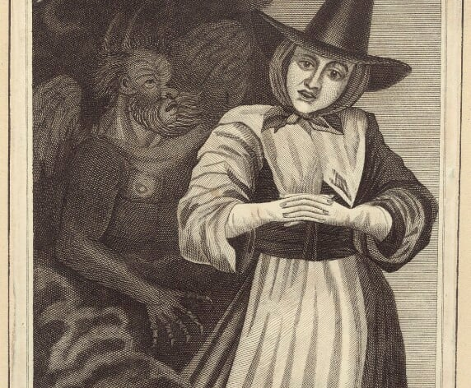


Slide 3
Prophecy in the 17th Century (a recap)
‘[P]rophecy was any utterance produced by God through human agency’ (Dianne Purkiss).
Prophecy is linked to preaching except that prophecy probably has a greater authority attached to it because it is seen as different to any ordinary speech associated with human agency.
‘words inspired by or emanating from God, where the human medium was no more than a mouthpiece for his words’ (Hilary Hinds).
‘And suddenly there came a sound from heaven as of a rushing mighty wind, and it filled all the house where they were sitting. And there appeared unto them cloven tongues like as of fire, and it sat upon each of them. And they were all filled with the Holy Ghost, and began to speak with other tongues, as the Spirit gave them utterance.’ (Acts 2: 2-4)
‘And it shall come to pass afterward, that I will pour out my spirit upon all flesh; and your sons and your daughters shall proph­esy, your old men shall dream dreams, your young men shall see visions’ (Joel 2:28).

Slide 4
Prophecy and Gender
Women in the early C17 were typically discouraged from printing their writing and from writing original works; translation and biblical paraphrase were more acceptable.
The breakdown of censorship in the 1640s, the ‘democratization’ of print, and the emergence of a politicised reading public helps more women’s writing to appear in print.
The 1650s provided a period of relative freedom for women who wanted to print their works, especially if they were connected to a religious sect or a political group.
Women played important roles in groups like the Quakers and the Levellers, where women drew public attention to the Leveller men who had been imprisoned.
Trapnel benefits from this context as well as from the Puritan churches where, paradoxically, women’s voices were marginalised at the same time as enabling women’s prophecy.
‘[A]lthough Puritan divines habitually urged female submission and subordination, the daily consequences of Puritan pastoral divinity – intense experiences of divine love or union, reciprocal and almost egalitarian lay-clerical relationships, a sense of spiritual or moral authority, and an almost inevitable civic awareness and immersion in politics – tended to empower women whilst subtly eroding patriarchal dominance.’ (Como, 2000: 203-204)

Slide 5
Prophecy and Gender
“Oh thou knowest that thy servant hath often wrestled with thee, that thou wouldst employ some other, but thou hast overruled her, and hast put her to silence; and shall I not be willing to do or suffer thy will?
[…]
Oh it is for thy sake, and for thy servants’ sakes, that thy servant is made a voice, a sound, it is a voice within a voice, another’s voice, even thy voice through her” (The Cry of a Stone, p. 45).

Slide 6
The Politics of Prophecy
“Wherefore in the Name and Power of the eternall God, I charge thee burn it not, tear it not, for if thou dost, I will tear thee to pieces (saith the Lord) and none shall be able to deliver thee…Read it through, and laugh not at it; if thou dost I’l destroy thee, and laugh at thy destruction.” (Coppe, A Second Fiery Flying Roule, Chap. 1)
“The basis for Coppe’s rant…is a warning to those in power that they will go the same way as the dead King Charles if they do not give their money to the poor” (Nigel Smith)

Slide 7
Attacking Prophecy
Laws passed against prophesying (see Katharine Gillespie’s article for details)
Prophecy as vulgar: ‘The vulgar dote on vain prophecies’ (Nedham)
Medicalisation: “They say these are convulsion-fits, and sickness, and diseases that make thy handmaid to be in weakness. But oh they know not the pouring forth of thy spirit, for that makes the body crumble, and weakens nature. In these extraordinary workings thou intendest to show what is coming forth hereafter” (Trapnel, CS, p. 29).

Slide 8
Trapnel’s Biography
Date of birth unknown; first appears in the record in 1642. Father, William Trapnel, is a shipwright. Her godly mother exerted a strong influence (see CS).
Trapnel’s first vision occurred in 1642 during a sermon preached by John Simpson. In CS she records details of the visions she received from 1647 to 1654, all of which are linked to the political events of the period.
In 1654 she accompanied the Welsh millenarian preacher Vavasor Powell to Whitehall where he was to be examined on charges of treason. There she fell into an 11-day trance during which time she prophesied about the coming millennium. CS is largely a record of these prophecies.
Later in 1654, Trapnel travelled to Cornwall to meet fellow Fifth Monarchist preachers. These events were recorded in her Report and Plea (1654). She was arrested and sent to prison in London only to be released in July.
She experienced further trances in the later 1650s that are recorded in a 1000-page printed volume now held in the Bodleian Library. There is no record of Trapnel’s life after 1660.

Slide 9
Fifth Monarchism
“And in the days of those kings the God of heaven will set up a kingdom that shall never be destroyed, nor shall the kingdom be left to another people. It shall break in pieces all these kingdoms and bring them to an end, and it shall stand forever” (Daniel 2:44)
Cf. Daniel Chapter 8 for the vision of the four horns and compare to Trapnel’s vision of the horn in CS.
For a good overview of Fifth Monarchist beliefs see Andrew Bradstock, Radical Religion in Cromwell’s England (2011), Ch. 6.

Slide 10
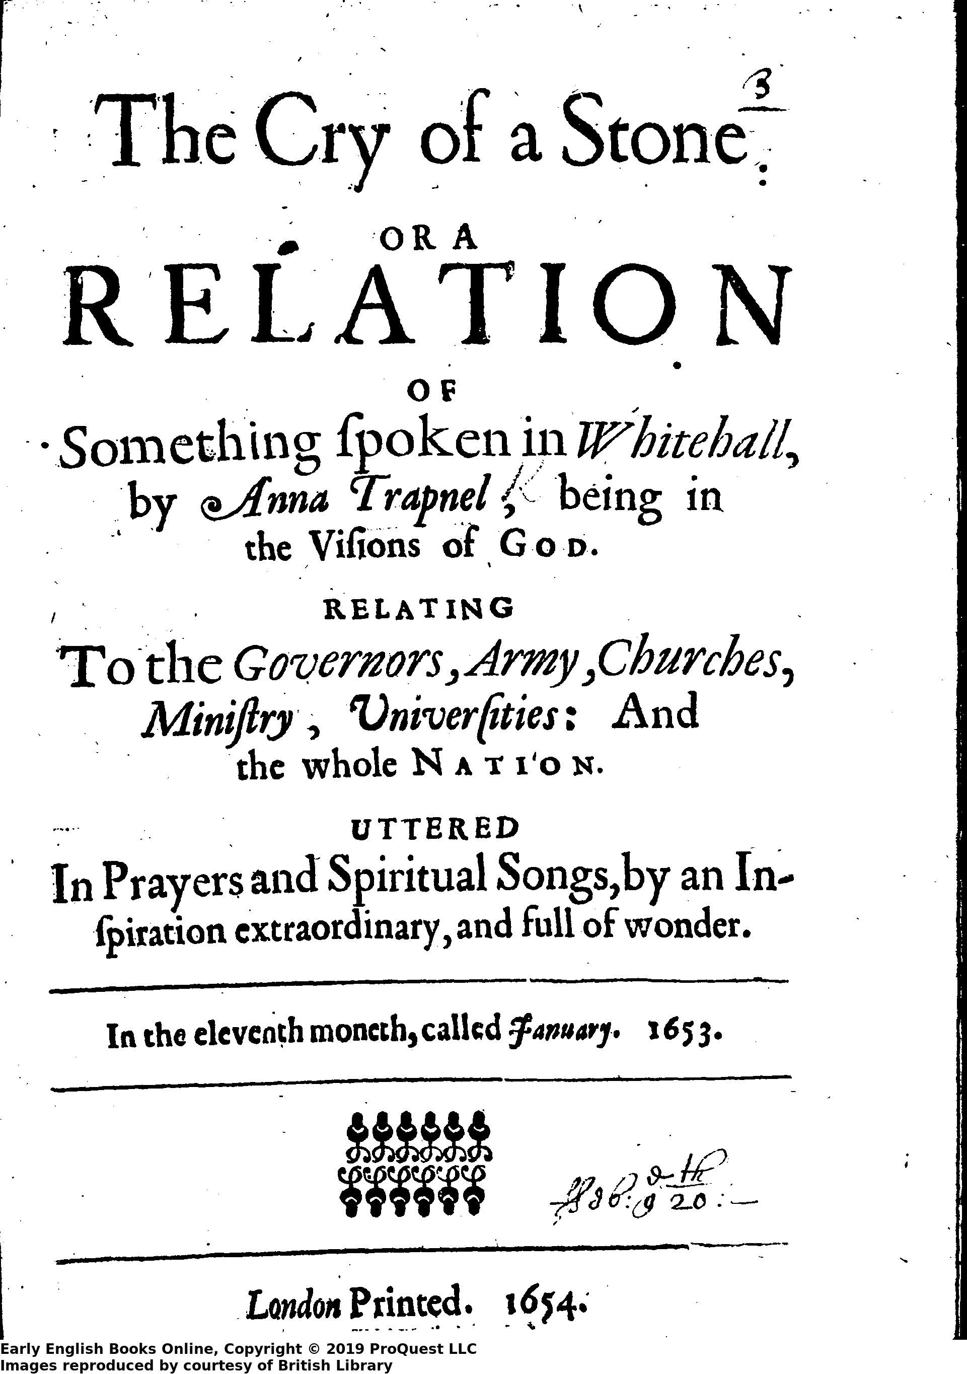
The Cry of a Stone (1654)
The title refers to the apocryphal Second Book of Esdras, or The Apocalypse of Ezra. The moment when ‘the stone shall give his voice’ is a sign of the impending end times.
Trapnel’s songs and prophetic utterances were recorded by an observer from the 5th day onwards.
The text of CS, then, consists of the recorder’s account of Trapnel’s speech plus Trapnel’s own account of her earlier visions and trials. It thus reads as prophecy intermingled with spiritual autobiography. The autobiographical parts are strongly influenced by the Bible.
Trapnel figures herself as the ‘handmaid’ of God. The title has a biblical heritage but it also marks out Trapnel’s class: she is of a lower class than some other women prophets (e.g. Lady Eleanor Davies).

Slide 11
Trapnel’s Visions
1647: the vision of the New Model Army entering London.
1650: the vision of Cromwell’s victory over the Royalists at the Battle of Dunbar
1652: the vision of the victory over the Dutch
March / April 1653: the vision of Cromwell expelling the Rump Parliament.

Slide 12
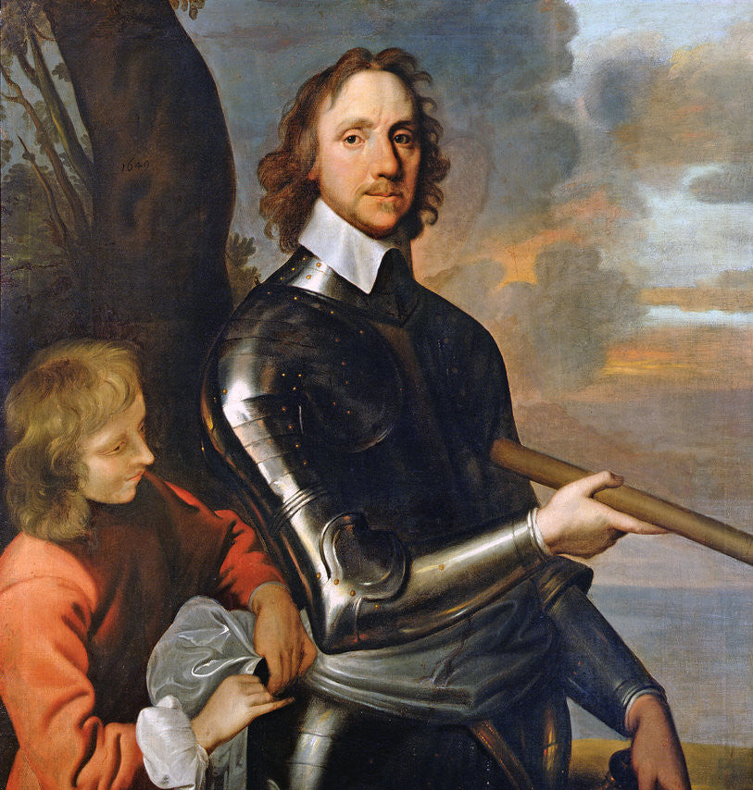
Cromwell and the Protectorate
April 1653: Cromwell dissolved the Rump Parliament; the Barebones Parliament is inaugurated and includes more radical MPs.
December 1653: Cromwell dissolved the Barebones Parliament. He was set up as Lord Protector. Thus, the Republic (1649-53) becomes the Protectorate (1653-59).
The Fifth Monarchists see Cromwell’s adoption of the title of Protector as a betrayal.
Note that the Fifth Monarchists’ opposition to Cromwell is part of the context for Marvell’s poem The First Anniversary (1655)

Slide 13
Trapnel and Cromwell
“In honour and great dignity,
Which Christ here doth afford;
Oh let us have one only King,
Always t’write our record.
Oh do not thou aspire, for to
So high a title have,
As King, or Protector; but oh
Unto Christ that do leave.” (CS p. 29).

Slide 14
On women prophets of the early C17 see, for example, David Como, ‘Women, Prophecy, and Authority in Early Stuart Puritanism’ HLQ 61 (2000), 203-222.

