Slide 1
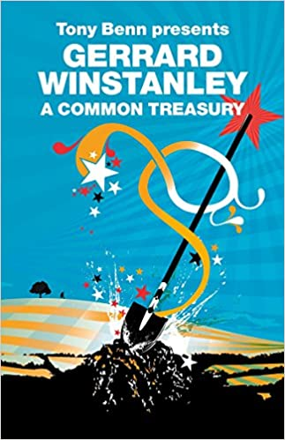
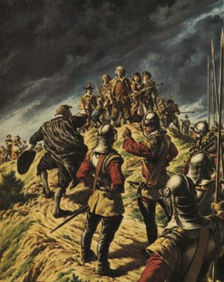
Early Modern Communism: The Diggers
Literature and Revolution: Week 7
Mini-Lecture 1: Introduction and Influence

Slide 2
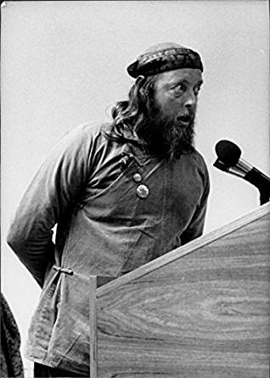
Digger Activism in the Late 20th Century
Hyde Park Diggers (1960s)
The San Francisco Diggers, a theatre group who set up a commune in 1966 in Haight-Ashbury.
Digger Action Group (1970s)
The Land is Ours (1990s land rights group who in 1999 occupied St. George’s Hill on the 350th anniversary of the Digger commune being set up there).
The Diggers’ Song has been re-recorded by various artists, including Chumbawumba.
Sid Rawle, founder of the Hyde Park Diggers and the Digger Action Group

Slide 3
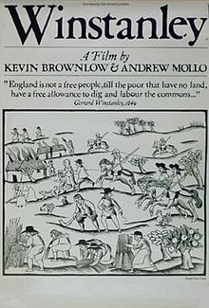
“Winstanley isn’t really a political film. It is a trip in a time machine back to the seventeenth century; a glimpse of a heroic attempt to change the way people lived. The fact that Winstanley was a couple of hundred years ahead of his time in his political thinking gives it the political relevance.”
Kevin Brownlow, from a 1980 interview:
https://cdn.shopify.com/s/files/1/0150/7896/files/WinstanleyPK.pdf?1010
NB. On ‘authenticity’ in the True Levellers Standard, think about the idea of ‘plain-hearted people’ (e.g. Abel is a ‘plain-hearted man’ (p. 7)); the poor are ‘plain-hearted’ (p. 11); the rich have oppressed and flattered the ‘plain-hearted’ (p. 11 and 12).

Slide 4
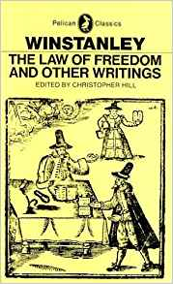
“Previous radical thinkers had postulated a past golden age; Winstanley believed in the possibility of human progress, and looked to a future in which reason and international brotherhood would prevail”.
Hill, “Introduction” to Winstanley: The Law of Freedom and Other Writings (Pelican, 1975).
NB. An excellent article about the relationship between Digger literature and ideas and 20th-century left-wing historiography and criticism is John Gurney, “Gerrard Winstanley and the Left” Past and Present 235 (2017), 179-206.
Front cover of Hill’s 1975 edition of Winstanley’s works

Slide 5
Gerrard Winstanley
Born in 1609 in Wigan.
In 1630 he becomes an apprentice in London.
From 1639 he lived in the parish of St. Olaves near to the Guildhall and adjacent to Stephen Coleman Street, which was known to be a centre of London radicalism (cf. the Restoration comedy Cutter of Coleman Street).
In 1643 he appears to have suffered severe financial setbacks.
By 1648, he begins to organise the Digger communities. Why then?
  The resurgence of war in 1648.
  Poor harvests from 1646-9.
  Religious motivations.

Slide 6
Winstanley’s Call to Dig the Land
“As I was in a trance not long since, divers matters were present to my sight, which here must not be related. Likewise I heard these words, Worke together; Eat bread together; declare this all abroad … And when the Lord doth shew unto me the place and manner, how he wil have us that are called common people, to manure and work upon the common Lands, I wil then go forth and declare it in my action, to eat my bread with the sweat of my brows, without either giving or taking hire, looking upon the Land as freely mine as anothers.”
Winstanley, The New Law of Righteousness (late January, 1649)

Slide 7
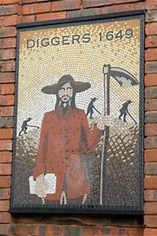
One response to the defeat of the Levellers comes from the Diggers who seek to turn private land into a common treasury for everyone.
Coppe wrote “give up your houses, horses, goods, gold, Lands, give up, account nothing your own, have ALL THINGS common”. But he also says ‘digging-levelling’ is not God’s way (see Week 7).
Winstanley’s writing stresses the importance of deeds not just words. Perhaps a slight at the Levellers whose ideas remained largely theoretical?
The title The True Levellers Standard should have an apostrophe in it, so it means: the standard of the True Leveller. The True Leveller in this context is Jesus (again, cp. Coppe in Week 7).
The Levellers proposed a radical extension of the franchise and of religious toleration, but they never argued for redistribution of property. The Diggers did.

Slide 8
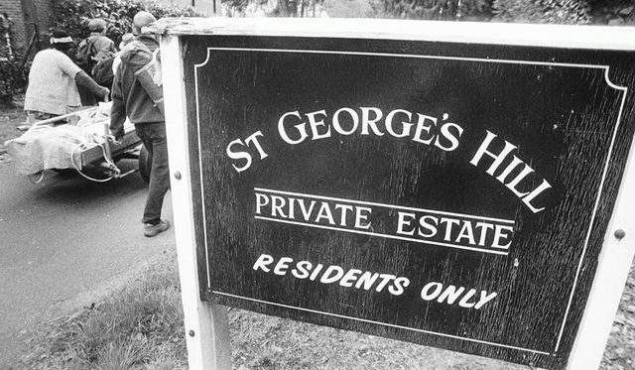
St George’s Hill, Surrey
The Diggers, led by Winstanley and the prophet William Everard, start digging on St George’s Hill in April 1649.
Other digger communities emerge (e.g. in Wellingborough).
Initially they are dismissed by the new authorities as harmless and ‘mad’. But after a year they are forced off the land.

Slide 9
The Winter's past, the Spring time now appears,
Be gone thou Kingly Tyrant, with all thy Cavaliers.
Thy day is past, and sure thou dost appear
To be the bonds-mans son, and not the free-born Heir.
Winstanley’s poem on the regicide
“But for the present state of the old world that is running up like parchment in the fire, and wearing away, we see proud imaginary flesh, which is the wise Serpent, rises up in flesh, and gets dominion in some to rule over others, and so forces one part of the Creation man, to be a slave to another; and thereby the Spirit is killed in both.”
The True Levellers Standard, p. 6 (all quotes from the Oxford edition)
cf. Isaiah 34:4: “All the stars in the sky will be dissolved and the heavens rolled up like a scroll; all the starry host will fall like withered leaves from the vine, like shriveled figs from the fig tree.”

Slide 10
Today’s Texts
A declaration to the powers of England and to all the powers of the world, shewing the cause why the common people of England have begun, and gives consent to dig up, manure, and sow corne upon george-hill in surrey (April 1649) – also printed as The True Levellers Standard.
‘The Diggers Song’
  “There self will is theire law, stand up now stand up now,
  theire self will etc.
  since Tyrany came in, they count it now no sin
  to make a Gaole a gin, to sterve poor men therein
  Stand up now stand up now.”

Slide 11
True Levellers?
“If you cast your eye a little backward, you shall see, that this outward teaching and ruling power, is the Babilonish yoke laid upon Israel of old, under Nebuchadnezar; and so successively from that time, the conquering enemy, have still laid these yokes upon Israel to keep Jacob down: And the last inslaving Conquest which the enemy got over Israel, was the Norman over England; and from that time Kings, Lords, Judges, Justices, Bayliffs, and the violent bitter people that are Freeholders, are and have been successively. The Norman Bastard, William himself, his Colonels, Captains, inferior Officers, and common Souldiers, who still are from that time to this day in pursuit of that Victory, imprisoning, robbing and killing the poore inslaved English Israelites.”
True Levellers Standard, p. 12

Slide 12
God / Reason
“In the beginning of time, the great Creator Reason, made the Earth to be a common Treasury, to preserve Beasts, Birds, Fishes, and Man, the Lord that was to govern this Creation; for Man had Domination given to him, over the Beasts, Birds, and Fishes; but not one word was spoken in the beginning, that one branch of mankind should rule over another.
And the reason is this, Every single Man, Male, and Female, is a perfect Creature of himself; and the same Spirit that made the Globe, dwells in man to govern the Globe; so that the flesh of man being subject to Reason, his Maker, hath him to be his Teacher and Ruler within himself, therefore needs not run abroad after any Teacher and Ruler without him, for he needs not that any man should teach him, for the same Anoynting that ruled in the Son of man, teacheth him all things.” (True Levellers Standard, p. 1).

Slide 13
Winstanley and the Bible
“But this coming in of Bondage, is called A-dam, because this ruling and teaching power without, doth dam up the Spirit of Peace and Liberty; First, within the heart, by filling it with slavish fears of others. Secondly, without, by giving the bodies of one to be imprisoned, punished, and oppressed by the outward power of another.”
“And since the coming in of the stoppage, or the A-dam, the earth hath been inclosed, and given to the elder brother Esau, or man of flesh, and hath been bought and sold from one to another; and Jacob, or the younger brother, that is to succeed or come forth next, who is the universall spreading power of right-eousnesse that gives liberty to the whole Creation, is made a servant.”

