Slide 1
Visiting Students Welcome session
English & Comparative Literary Studies
Professor Stephen Shapiro
30th September 2026: SO.13: 1-2 pm

Slide 2

Professor Stephen Shapiro
Director of Study Abroad Programme
Your Personal Tutor
Office FAB 22
Office hours: 1-2pm Wednesday
9-10pm Thursday
I will be in touch to arrange on-on-one meetings with each of you over the next few weeks.
Please record our meetings on Tabula – under the Personal Tutor tab – Record meeting button at the bottom. This will meet your personal tutor monitoring point for the term.
Contemporary American Studies

Slide 3
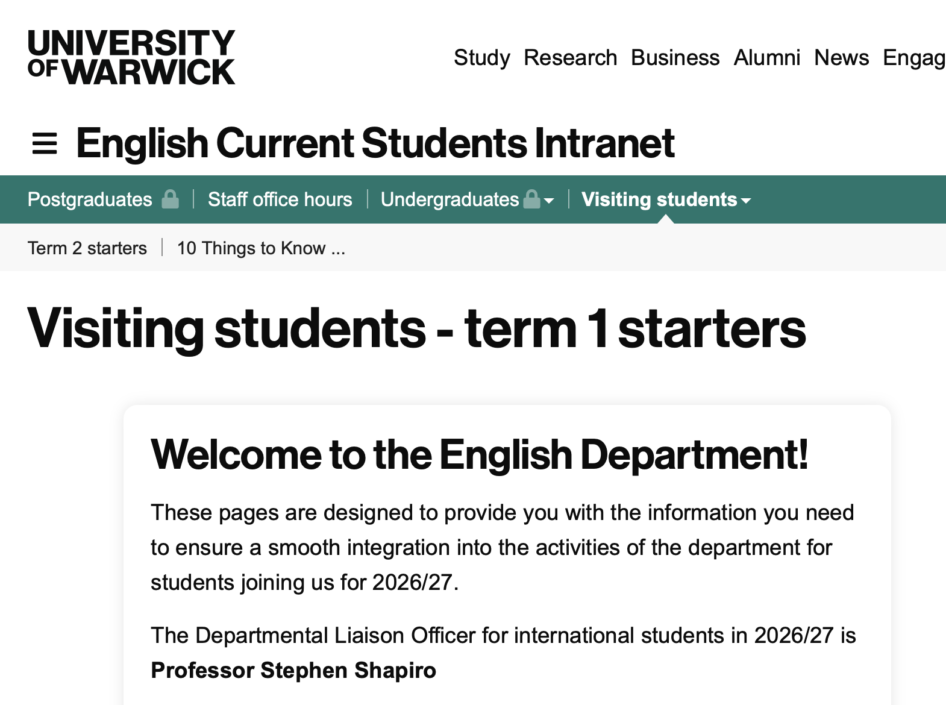
Resources:
ECLS Visting Student webpages:
https://warwick.ac.uk/fac/arts/english/currentstudents/visiting/

Slide 4
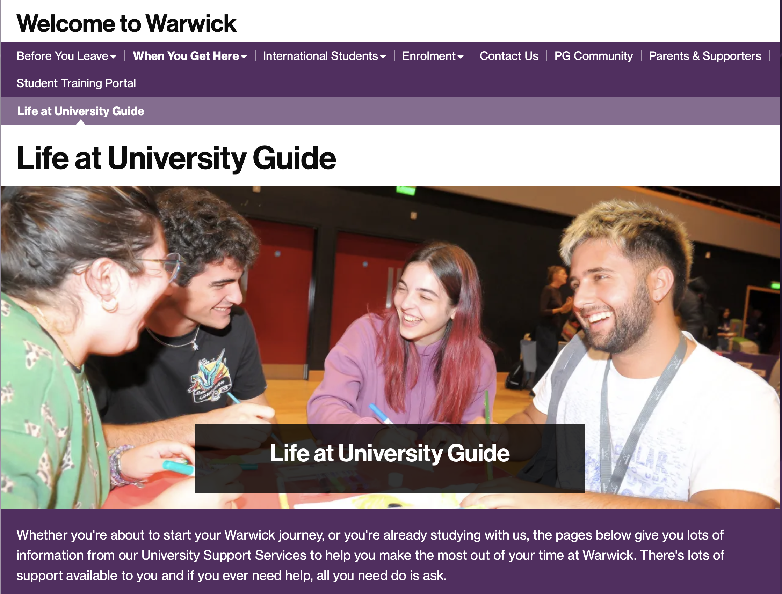
Life @ Warwick Guide
https://warwick.ac.uk/students/together/welcome/whenyougethere/livingatuniversity/

Slide 5

Student Mobility
https://warwick.ac.uk/services/studentopportunity/studentmobility/studyatwarwick/

Slide 6
Learning agreements and arrival forms
Ask me (or the ECLS dept office) to sign your learning agreement
(Academic Placement plan)
If you need an official university stamp for your arrival form, please get it from the student mobility team.
https://warwick.ac.uk/services/studentopportunity/studentmobility/studyatwarwick/incomingattanedanceforms/

Slide 7
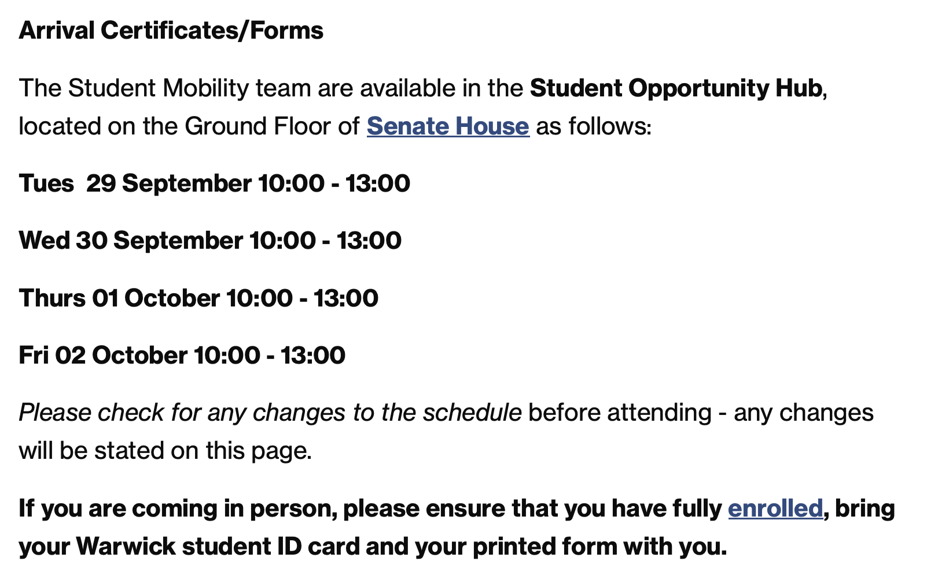

Slide 8
Modules
You have now been registered for your modules.
Please select seminar times (see email from the office sent today for more information).
Your timetable will appear on Tabula
Some modules (Epic to Novel, Modern World Literature, States of Damage...) have a lecture and a seminar; others just seminars.
Check on the module webpage to find out.

Slide 9
Modules
Check the lectures for your chosen modules in case they are not yet on Tabula timetable.
(They will appear once registration has been completed on eVision.)
Sign up for an assessment pattern (more next…)
Ask me or the English office to sign your learning agreement (Academic Placement plan)

Slide 10
Modules Outside ECLS
If you want to take a module in another department,
contact their Undergraduate office/administrators
If doing a module outside the department causes timetable issues,
come to our office to resolve them

Slide 11
Assessments and deadlines
Part-year students are required to submit essays totalling 2,000 words per module for each term they attend. These assessments will equate to 12 CATS (credits on Warwick system).
If you complete assessments for spring and summer terms, that will be 24 CATS.
If you take a one-term module (marked * on the sheet), you can take this for 15 CATS with the standard module assessment, or 12 CATS as per visiting student variant – 2,000 words.

Slide 12
Assessments and deadlines
Deadlines for part-year students: essays for the autumn term and spring term will be due by 12 noon on the Tuesday of week 12 of these terms.
As discussed, office colleagues will inform your seminar tutors if you have a non-standard (i.e. part-year/visiting) assessment for the module.

Slide 13



Writing Essays
Copies for reading (not loan) in ECLS student Hub. Library. Used copies

Slide 14
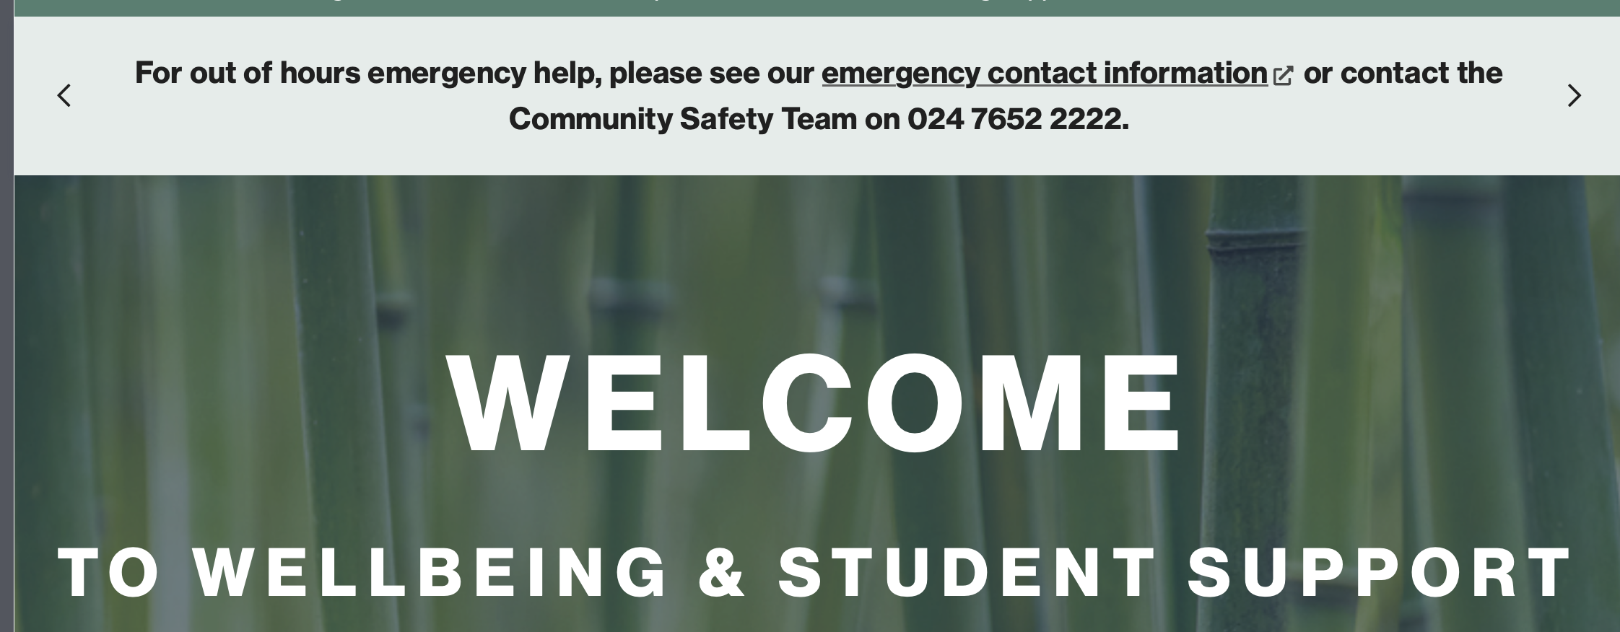
Don’t Suffer in Silence!
https://warwick.ac.uk/services/wss/

Slide 15
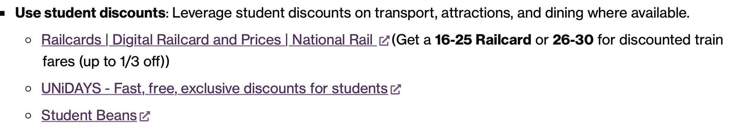
Explore!
https://warwick.ac.uk/students/together/welcome/internationalstudents/traveluk/?selectedLetter=h#how-to-travel-on-a-budget

