Slide 1
Transformations: Gender, Reproduction, and Contemporary Society
Week 8: Giving Birth to Children and Mothers
Dr Sherah Wells
Sherah.Wells@warwick.ac.uk
Notes:
The title for this week’s lecture is intended to suggest that in the process of giving birth, it is not simply children who are produced (or reproduced) but mothers also. That is, in giving birth a woman is assumed to become a mother by virtue of one specific act, changing – apparently irrevocably – the way she can think of herself and the way she is thought of by others.

Slide 2
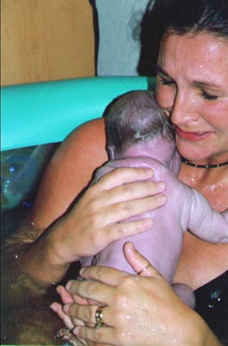
Structure of the Lecture
Homebirth – a debate
The Medicalisation of Childbirth
Women’s experiences of birth
Midwifes at Work
The future…
International Perspectives

Slide 3

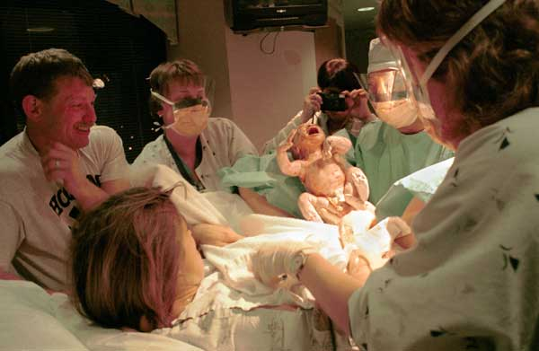
The Homebirth Debate
Homebirth
vs.
Hospital birth
Notes:
Why might women want a home birth?
Why might women want a hospital birth?
Which is best (for the baby, for the mother) and why?
Homebirth: familiar surroundings; don’t want strangers there; worry about hospital acquired infections; want a natural birth without lots of technology; want a calm and relaxed environement; want to feel in control; had a bad experience with a previous hospital birth; feel pain less in a familiar environment,
Hospital birth: all the medical technology is at hand if something goes wrong; feel s safer; don’t want mess and stress at home;
Study of over 5000 low-risk planned home and hospital births: home birth isn’t riskier for low risk women as long as midwives are well trained and there’s a good transport and referral system if needed. (British Journal of Obstetrics and Gynaecology, 2009)

Slide 4
The Rise and Rise of Hospital Births
1920s: 80% of UK births at home
1991: 1% of UK births at home
2006: 2.6% of UK births at home
Medicalisation of Childbirth
Notes:
Home birth used to be the norm in the UK but today it is very much the exception, reaching a low of 1% nationally in 1991 and then going up slightly recently to 2.6% in 2006. There are significant regional variations eg. higher in Wales. As Cahill explains, hospitals are seen as the best and safest places for childbirth. Childbirth has been medicalised - process by which human conditions and problems come to be defined and treated as medical conditions and problems, and thus come under the authority of doctors and other health professionals. Instead of a normal and attended life event, childbirth is pathologised, that is conceptualised as a clinical crisis demanding active intervention.

Slide 5
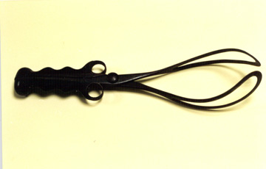
Feminist Critique of the Medicalisation of Childbirth
17th century conceptualisation of the body as a machine in need of regulation
Boundaries around medicine discredited midwives
New surgical instruments
Women denied access to medical training
19th century forceps
Notes:
The work of second wave feminists in the UK and the USA has been vital in exploring the degree to which the experiences of pregnancy and childbirth have been regulated by the medical gaze. Key feminist researchers in this area include Anne Oakley, Meg Stacey, Barbara Ehrenreich, Deirdre English and the Boston Women’s Health Book Collective. Their work has been built on by contemporary feminist researchers, who include – just to give a few examples – Sarah Franklin, Rayna Rapp, Helen Ragone and Emily Martin.
17th Century was key turning point with Descartes conception of the body as a machine subject to the laws of physics and in need of regulation if it went wrong
In 17th and 18th centuries, medicine’s legal monopoly over healing practice was secured by the creation of distinct medical professions; physicians, surgeons and apothecaries. Professional boundaries were established by discrediting other groups practicing healing, including ‘wise women’ and midwives.
The process of wresting control of childbirth from midwives included the invention of surgical instruments such as forceps
The professions, whilst constituted as gender-neutral, were effectively exclusive of women as women could not access training as doctors.

Slide 6
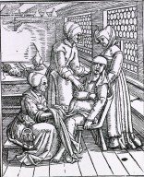
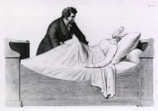
Professionalisation and Gendered Exclusion
Obstetrical examination
1822 engraving
3 midwives attending to a
pregnant woman
1500s woodcut
Notes:
The battle between midwives and obstetricians goes back about 400 years when the first male obstetricians began to get involved in birth. Up until that time women in labour were tended to by other women from the community who were experienced in birth. Midwives had no equipment and no formal training but were trained through apprenticeships. As midwives continued to practice into the 18th and 19th centuries physicians and obstetricians started to debate ways in which they could be controlled. Midwives, as educated, financially independent women, posed a threat to the gender order of that time. The British chose to regulate. In the UK, midwifery remains one of the most tightly regulated professions with a system of supervision which is unique.
The feminist critique of medicalised childbirth argues that the appropriation of women’s bodies by male doctors was not empowering from women, and this is clearly illustrated through Emily Martin’a work, one of the core readings for this week.
Did you manage to read it? It’s an e-book and access is more difficult off campus. Also I noticed that the images are absent from the page as it’s reproduced on the screen – did you find that? I’ll get some copies made so you can look at them in seminars.

Slide 7
Martin’s Medical Metaphors
‘the womb and the uterus were spoken of “as though they formed a mechanical pump that in particular instances was more or less adequate to expel the foetus”’ (Martin, 1992, p. 54).
Birth as factory production: ‘the uterus is held to a reasonable “progress”, a certain “pace” and not allowed to stop and start with its natural rhythm’ (ibid, p. 59).
Notes:
Emily Martin’s work on medical metaphors of women’s bodies has been very influential. She argues that an understanding of these metaphors is key to an understanding of the medical treatment of birth, and locates their genesis in seventeenth and eighteenth century French hospitals where: “the womb and uterus were spoken of ‘as though they formed a mechanical pump that in particular instances was more or less adequate to expel the fetus’”(Martin 1992). She suggests that this mechanical understanding of the womb is linked to the introduction of mechanical devices like forceps and that the machine metaphor is a continuing current in medical practice which underlies and accounts for our willingness to accept technological intervention in the process of childbirth.
Martin suggests that is useful to expand the examination of medical metaphors beyond the body and to look at the ways in which they are used in descriptions of the processes of work in which obstetricians are involved. She examines these metaphors through close textual analyses of several editions of a leading obstetrics textbook. Her examination leads her to suggest that:
reproduction is being treated as a form of production
that these metaphors are rooted in an analogy with factory production in US society
that the doctor can be seen as a factory supervisor or owner
that the pregnant women might be a ‘laborer’ whose ‘machine’ (uterus) produces the ‘product’, babies.
The aim is a standardized rate of production, with the uterus making ‘reasonable progress’ and the doctor intervening to ensure this – the uterus will not be allowed to stop and start.

Slide 8
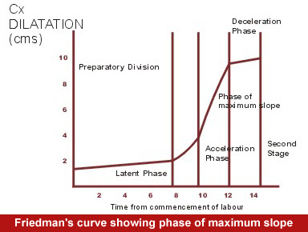
Regulating the ‘Machine’
Discourse of time and motion
Emphasis on efficiency, predictability, productivity
Deviation = intervention
Notes:
Martin is very clear that this metaphorical treatment of the processes of childbirth by analogy to factory production has material effects in terms of the ways in which women are treated in childbirth. She points out that industrial time and motion studies have been imported into obstetrics via textbooks which use the discourse of time and motion to privilege issues of efficiency, predictability and productivity . Women’s labour in childbirth has been subdivided into stages and substages, each with their statistically normal duration in time. Here we see the Friedman curve, which plots the ‘normal’ passage of time on the x axis and dilation in centimetres of the woman’s cervix on the y axis. Once you have a norm, women’s labour can be constructed as conforming with it or deviating from it, and every deviation can be used as justification for medical management and intervention into the process. For example, breaking the waters; administering drugs to induce labour, ventouse (soft plastic cup put on baby’s head and attached to a vacuum pump to help suck the baby out), forceps delivery, caesarean. 1 in 4 babies in the UK are born by caesarean, a rising proportion. Draft guidelines by NICE say all pregnant women should get information about C-sections, and if they request one should be told of the risks and, if request is because of fear of the pain of ‘natural’ childbirth, be referred for additional support. If thereafter they still want a caesarean then it should be offered as long as suitable. (Widely reported at end of October 2001 as women will get right to caesarean even if don’t need it – over generalisation and over simplification).

Slide 9
Women’s Experiences of Childbirth
‘The main trauma for me was all the intervention: being induced, having my waters broken for me and being examined all the time… my labour didn’t progress well because I didn’t dilate enough. In the end they had to use both forceps and a ventouse suction cup to get Amelie out, which was frightening and stressing… Staff were too busy to explain what they were doing and why. I didn’t know what was happening or going to happen, and I didn’t like that lack of control’
(Guardian, 15 November 2010)
Notes:
I’ve selected 3 first person narratives from women about their experiences of medicalised childbirth. Read them through and think about what made them good or bad.
Here: lack of control, things being done to you that weren’t explained, frightening

Slide 10
Women’s Experiences of Childbirth
‘I really felt a lot of control all the way through, and I think one of my biggest fears about hospitals was not being in control… I felt like I was making the decisions’.
(Fox and Worts, 1999, p. 335)
Notes:
Here control – being involved in decisions
Below control is associated with a high degree of medical intervention alongside nurture and reassurance, care

Slide 11
Women’s Experiences of Childbirth
‘I had a highly medicated birth--pitocin to induce contractions because my water was leaking, then Stadol for the pain… and then (hooray!) the epidural. And episiotomy. Lots of medical intervention. And it was actually a pretty great experience because the people around me were sensitive to my needs and desires and cared for me in the way that I personally needed. My nurse was fantastic--very nurturing and reassuring. At all times I felt like I had control of the situation…’
http://mommyphd.blogspot.com/2006/10/positive-birth-experience-can-happen.html

Slide 12
Control and Decision-making
Fox and Worts: Control and autonomy are crucial to women having a positive experience of birth – even with intervention
Technology: Empowering or Disempowering? Both?
Notes:
Fox and Worts show in the second core reading that control and autonomy are crucial if women are to have good experiences of childbirth, whether or not they have a lot of medical intervention.
Pain relief - readily available to women in this country and so medicalized childbirth is expected to be relatively pain free. Some midwives and child birth activists would argue that pain during childbirth is productive and not a sign that anything is wrong which makes it more manageable than other kinds of pain.
Technology as empowering: Feeling in best place, for baby if intervention needed?
Disempowering - Pain relief can result in numbness, not feeling or knowing what’s going on, out of touch. A lot of intervention may leave women feeling they’ve failed.
What’s interesting about the Fox and Worts research is their finding that women’s social context determines at least in part how they feel about a medicalised childbirth. Where women have little social support at home, they generally welcome medicalisation, taking on the identity of a patient who is looked after, cared for etc. Where women have partners sharing in housework and childcare and offering support in general women are less likely to want a highly medicalised experience.

Slide 13
Resisting Medicalisation of Birth
Similar to strategies used by workers
Covert resistance
Experiences differentiated by ‘race’ and class
Notes:
Martin is also interested in the ways in which women might resist such medicalisation of birth. Of course women might try to have a home birth to do this, but Martin finds that women also find ways to resist during a hospital birth. Moreover she suggests that their strategies for resisting unwanted medical interventions are very similar to those that workers have used in the workplace to resist new technology or attempts to increase productivity. The modes of resistance are covert – it is difficult to openly resist medical science just as the worker isn’t generally in a position to openly resist management. Martin documents some women who have deliberately delayed going to hospital and/or misreported the timing of their contractions in order to prevent being defined as being at a particular stage of labour and then risking being given hormonal injections to stimulate contractions or having their waters broken manually because they are judged not to be progressing fast enough. Martin also refers to women who remove foetal monitors as soon as the medical professionals leave the room or who keep on the move around the hospital so monitors can’t be fixed to them in the first place. In this later chapter in The Woman in the Body Martin also pays closer attention to ‘race’ and class, arguing that at least from her sample the black women seem to experience less respect and less autonomy during childbirth than the white women. Middle class women generally feel more entitled to assert themselves. Martin’s research was in the 1980s and in the US, but overall the same is likely to be true in the UK, particularly if black women and working class women are constructed as already having too many children and do not have the same resources or forms of cultural capital to get the birthing experience they want.

Slide 14
Woman-centred vs. Institution centred Midwifery
Conflict between teaching and practise of midwifery
‘With woman’ vs ‘With Institution’
Authoritative knowledge about childbirth is with the system of production and not with the women
Notes:
Billie Hunter in the final core reading identifies an ideological conflict between the kind of midwifery taught in universities, woman-centred, and the way midwifery is practised in a hospital setting – institution centred, following a universal, medical model.
Midwives working in community environments were more able to follow a woman-centred approach, what Hunter calls a ‘with woman’ approach. This was individualised to the particular woman, who the midwife generally got to know well, and resulted in congruence between training and practice and emotional fulfilment.
On the other hand midwives working in a hospital environment were interchangeable, didn’t build up the same relationships with their clients, and had to get through the work by providing a standard package of care that managed pregnancy. They were unsettled by the gap between theory and practice and had to do considerable emotion-work to manage this conflict.
Midwifes who shuttled between the two environments, community and hospital, experienced the greatest conflict and confusion.
The authoritative knowledge about childbirth is with the idea of birth as a system of production and not with the women, whether midwife or childbearer, as this quote from a midwife indicates:

Slide 15
‘I’m aware when I’m measuring a woman’s fundus, I’m not free…I want it to measure what it’s supposed to measure on the chart erm, I don’t want to have to send her in because it’s a little bit bigger or it’s a little bit small. I want to protect her, I want to protect her from feeling worried. I mean it’s ridiculous, I mean you can know if a baby’s too big or too small, just by looking at a woman when she’s lying down and you know how many weeks she is, you know if she’s too big or too small, usually, you know’.
(Mia, midwife, interview 30.06.2005)
Notes:
This slide is a quote from an interview Juliet Rayment did with a midwife about her experiences at work. Juliet did her PhD in Sociology. Here the midwife talks about what it’s like to practice within what she sees as the confines of pre-prescribed progress charts.
Authoritative knowledge.
midwifery skills of observation and touch vs measurement and charts.
Fundus – top part of uterus. Height of fundus, from top of pubic bone, routinely measured in pregnancy to determine growth rate. If larger or smaller than expected could be referred for further tests, eg. ultrasound.

Slide 16
Childbirth and Midwifery Policies
1993 Department of Health report Changing Childbirth
1997 Audit Commission report First Class Delivery: Making it Better for Mothers and Babies
2007 Department of Health guidance Maternity matters: choice, access and continuity of care in a safe service
2008 Healthcare Commission report Towards Better Births: A review of maternity services in England
£330 million extra funding over 3 years from 2008
Cameron: accused of breaking pre-election promise to recruit an additional 3000 midwives
Notes:
In 1993, a Department of Health report Changing Childbirth was published that advocated a return to community based antenatal care as well as putting the pregnant woman at the centre of maternity care, rather than the obstetrician.
The 1997 the Audit Commission published its report First Class Delivery: Making it Better for Mothers and Babies, the first audit of maternity services from women’s point of view. This found that while 90% of women were happy with the maternity care they received, they wanted more and better information about services and their options.
The Maternity Matters report in 2007 gave a new national choice guarantee for women. This was to ensure that by the end of 2009, all women would have choice around the type of care that they receive, together with improved access to services and continuity of midwifery care and support.
The 2008 Healthcare Commission report Towards Better Births, found concerns in some hospital trusts about staffing levels, in-post training, communication with women and continuity of care, ie it was insufficient. Continuity of care refers to women seeing the same health professionals repeatedly throughout pregnancy, so they get to know them and feel that they are known, not just a unit, a body.
New money: £330 million announced in January 2008 over 3 years to provide women and babies with best care and with a full range of choices.
Change of govt in May 2010 – before being elected David Cameron promised to increase the number of midwives in England by 3 000, describing them as ‘overworked and demoralised’. Head of Royal College of Midwives has accused him of breaking this promise, with NHS cuts only making things worse.
Meanwhile rates of delivery by caesarean section and rising use of epidurals suggests that the medicalisation of childbirth is increasing. Some women will be happy with that, but there is often little real choice for those who would like a home birth or to have continuity of care from one midwife throughout.

Slide 17
Is there a Crisis in Midwifery?
Midwives leaving the profession, leaving training
Walters: midwives are ‘popping in and out of three or four labour rooms and filling out endless forms while women yell for them’ (Guardian, 2003).
Recruitment has increased but birth-rate has also increased
Royal College of Midwives: 66% of midwifery heads report insufficient staff (November 2009)
Notes:
When we hear talk of a ‘crisis in midwifery’ part of the focus is always on the shortage of midwives, such that most units are understaffed at any one time. There is evidence that some midwives are leaving the profession because they are unable to provide the standard of intensive one-to-one care of pregnant women that is central to their job satisfaction. This Autumn the Royal College of Midwives have reported student midwives abandoning their course due to high fees and fear that they will have no job at the end due to cuts.
Natasha Walters writing in the Guardian in 2003 discussed the shortage of midwives and the impossible conditions under which those remaining in the NHS work: “popping in and out of three or four labour rooms and filling out endless forms while women yell for them” (Walter 2003).
While new money has gone into recruiting new midwives, in the meantime the UK birthrate has increased, which has put further pressure on maternity services. A survey by the Royal College of Midwives in November 2009 found that two-thirds of local heads of midwifery reported having insufficient midwives to copy with the workload in their unit (Guardian, 11 Dec 2009). Things were worst in the southeast with over 12% of midwifery posts unfilled.
Meanwhile women who can afford it are finding their own solution to the midwife shortage – hiring doulas. Labour coaches, birthing assistants, women with no medical training but paid to be with the woman throughout and help her, whether with massage, shopping or just ‘being there’. They focus on emotional support, giving encouragement, listening, helping the woman in labour to stay calm.

Slide 18
Campaigns for continuity of care
Independent Midwives UK www.independentmidwives.org.uk
  Community Midwifery Model
Association of Radical Midwives (ARM) http://www.midwifery.org.uk/
  Taking midwifery ‘back to the roots’
  Re-skilling midwives
  ukmidwifery yahoo group
Association for Improvements in Maternity Services (AIMS) www.aims.org.uk
  Pressure group
  Offers advice to women
Notes:
Midwives are organising to defend their profession against the power of obstetric medicine and to defend woman-centred models of practice and a continuity of care model. Here are some of these organisations so if you’re interested you can look into them further.

Slide 19
‘Dying to have a baby’: International Perspectives
Chance of dying in childbirth:
Niger: 1 in 7
Sweden: 1 in 29,800 (Save the Children, 2006)
More than 340 000 women die in pregnancy or childbirth annually around the globe
Many deaths are from treatable conditions such as high blood pressure
15 million women endure injuries, infection and disabilities in pregnancy and childbirth
Notes:
I’ve been talking about childbirth in a UK context during this lecture. However before we finish it’s important to recognise that childbirth can be a very dangerous occupation in other parts of the world, particularly in sub-saharan Africa. A Save the Children Report in 2006 compared the odds of women dying in childbirth in Niger and in Sweden and we see a phenomenal difference. Just over a third of a million women die in pregnancy or childbirth every year around the world. In fact this has dropped in the last decade of so, from about half a million. Many of these deaths would have been avoidable with basic medical treatment, eg. For high blood pressure. The risk of injuries as a result of pregnancy and childbirth is also very significant – 15 million women affected globally each year.

Slide 20
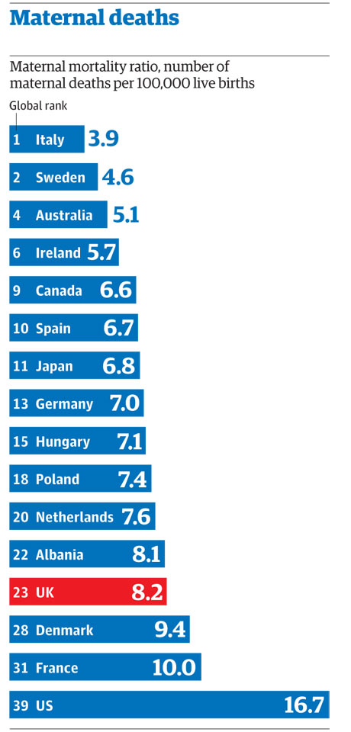
The bottom 10 countries:
Afghanistan
Central African Republic
Malawi
Chad
Sierra Leone
Lesotho
Cote d’Ivoire
Timor-Leste
Guinea
Liberia
Source: The Lancet, 12 April 2010
Notes:
The Lancet published a league table of maternal deaths by country in 2010. On the left are the top ranking countries, in terms of having the lowest maternal mortality ratio. UK ratio hasn’t changed for 20 years or so, and UK has been overtaken by 3 former Communist countries, Albania, Poland and Hungary. Note US position.
On right I’ve listed the bottom 10 countries, and beyond Afghanistan the centrality of sub-saharan Africa is evident. 60 000 deaths are related to advanced HIV/AIDS, especially in SSA.
Putting childbirth in international perspective like this is not to take away from important debates and challenges in the UK if all women are to have genuine choice in childbirth and the opportunity to develop meaningful relationships with midwives that will offer a continuity of care.
Next week we’ll look at having children beyond the nuclear family, focusing on single mothers and gay and lesbian parents.

