Slide 1
Transformations: Gender, Reproduction, and Contemporary Society
Lecture 3: Who Owns Women’s Bodies? Who Needs Children?
Dr Sherah Wells
Sherah.Wells@warwick.ac.uk

Slide 2
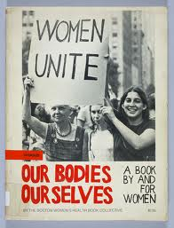
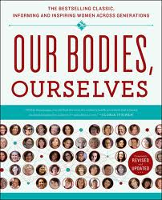

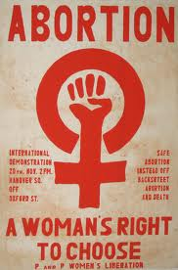
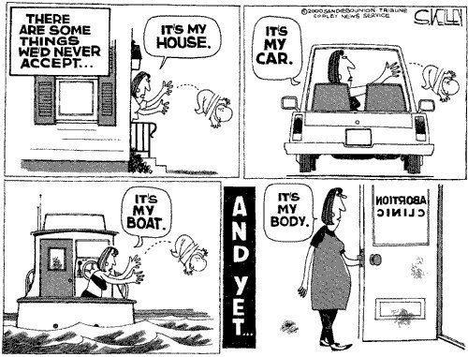

Slide 3
The Right to Own One’s Body
Possessive Individualism
Original contract/Sexual contract

Slide 4
Difference and Equality
Biological difference and political equality
Competing demands between ownership of an individual body and society’s need for children

Slide 5
Stakeholders in Children
Falling birth rates means fewer tax-payers and threatens the capacity of the welfare state to pay living pensions.
She chose to have the child, so she is responsible for it.

Slide 6
Why do we need children?
Avoid species extinction
At the national level
At the community level

Slide 7
Pro-natalism
Carrots
Sticks
Financial incentives
Time incentives
Service incentives
Propaganda
Banning abortion
Unavailability of contraception
Financial penalties

Slide 8
Conclusions
Possessive individualism provides a language for claiming the right to women’s bodies
Contests to this
Struggles to possess and control reproductive capacity are socially, historically and geographically contextual

