Slide 1
Transformations: Gender, Reproduction, and Contemporary Society
Lecture 4: Femininity and Motherhood: Towards an Uncoupling?
Dr Sherah Wells
Sherah.Wells@warwick.ac.uk

Slide 2
… a house without a child is like a garden without a flower, or like a cage without a bird. The love of offspring is one of the strongest instincts implanted in women; there is nothing that will compensate for the want of children. A wife yearns for them; they are as necessary to her happiness as the food she eats and the air she breathes.
(An unnamed doctor, 1911, cited in Oakley, Ann (1979) Becoming a Mother, p. 9).

Slide 3
We refuse to believe that women are hollow shells unless and until we have brought forth issue.
(Letty Pogrebin, a feminist journalist (no date) cited in Neustatter, Angela (1989) Hyenas in Petticoats, p. 78).

Slide 4
I long for them to go. I can’t wait to see the back of them. When was the last time I had ten days all to myself? But I also feel terrible about it. I’m scared of losing them … It’s terrible to want to get rid of them and to want so much to hold on to them
(Quote from an informant in R.Parker (1997) ‘The production and purpose of maternal ambivalence’ in W. Hollway, & B. Featherstone, B (eds) (1997) Mothering and Ambivalence, Routledge, p 30.

Slide 5
I began to realise that there wasn’t going to be a right decision or a wrong one for me. Whatever I did, there would be costs and benefits … my ambivalence continued throughout the pregnancy.
Kathy West, in S. Dowrick and S Grundberg (1980) Why Children? Women’s Press.

Slide 6
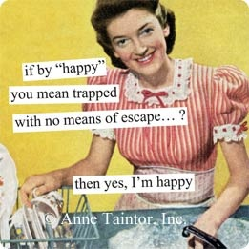
Shulamith Firestone, The Dialectic of Sex (1970)
“Women must be freed from the tyranny of their biology by any means available.”

Slide 7
Critiques of Firestone
Poses one overarching, universal explanation for women’s oppression
Assumes that state-organized reproduction in labs would be benign
Overlooks the strategic power their capacity to bear children gives women
Overlooks women’s investment in and pleasure from giving birth

Slide 8
Motherhood
Institution
Social Construction
Experience

Slide 9
“Patrolling the boundaries of motherhood”
Welfare discourses: for example the poor law which saw unwed mothers as an economic problem
Moral + legal discourses: for example the rise of the Endowment of Motherhood campaign
Psychological discourses: maintaining that mothers’ presence is important for well-being of small children

Slide 10
Good Mothering
Motherhood represents the ultimate fulfillment for real women
All real women want to be mothers as a natural expression of their femininity
Children need their mother’s undivided attention to develop ‘normally’
Mothering is best done in the heterosexual nuclear family
Good mothers are naturally selfless and self-sacrificing
Good mothers do not have paid work

Slide 11
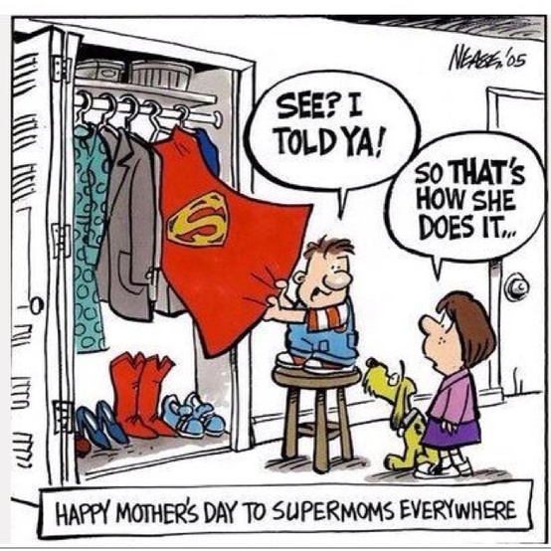

Slide 12
A thirty-ish woman who may be exhausted from a bad day at the office but is still wearing a neat, fashionable suit and a tolerant smile. That’s her in the kitchen now, wholesomely sexy in jeans and an oversize sweater, whipping up a tasty, nutritious meal for the family. Her kids wear adorable, unbesmirched outfits and possess perennially sunny natures…
http://www.cybermommy.com/Commentary/commentary.html
If you’ve ever thumbed through the pages of a popular women’s magazine, you know [her] – she’s the athletically slender, well groomed, perennially smiling woman with attractive, clean, happy kids who amuse themselves will all sorts of non-messy developmentally-appropriate activities and enjoy eating a perfectly balanced diet – especially veggies and organic fat-free tofu cut into animal shapes or little smiley faces…….
I hate to be the one to break it to you, but those mothers aren’t real – the kind of motherhood you see in glossy magazines and on TV doesn’t exist, not anywhere on planet earth
http://www.mothersmovement.org/books/reviews/mommy_myth.htm

Slide 13

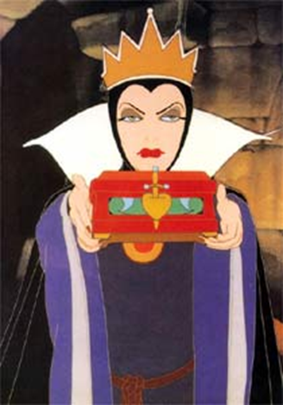



Slide 14
Conclusions
Women can now choose whether or not to have children. Decoupling femininity and motherhood allows us to explore the constructed aspects of the institution and recognize there are dominant discourses which influence our perceptions.

