Slide 1
Transformations: Gender, Reproduction, and Contemporary Society
Lecture 5: Masculinity and Fatherhood: Beyond the breadwinner role?
Dr Sherah Wells
Sherah.Wells@warwick.ac.uk

Slide 2
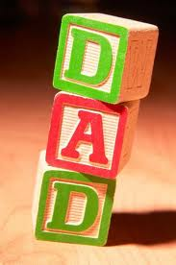
Today’s lecture
Dominant discourses of good fathering
Fear of fatherlessness
Redefining fatherhood

Slide 3


Slide 4
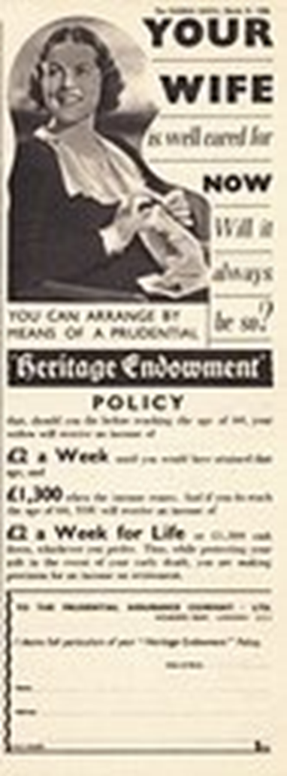
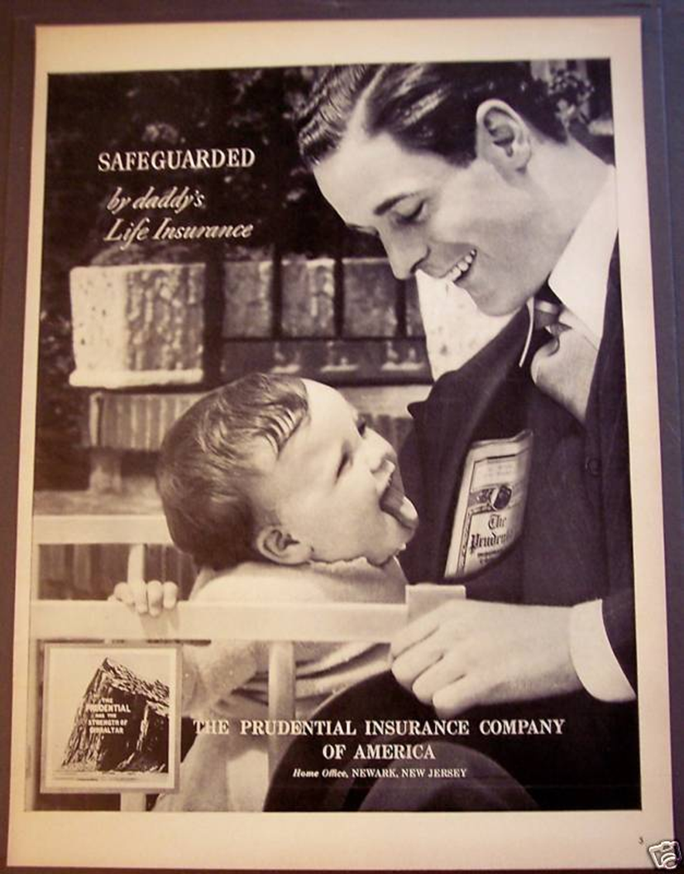
Traditional discourses
Provision
Protection
Authority

Slide 5
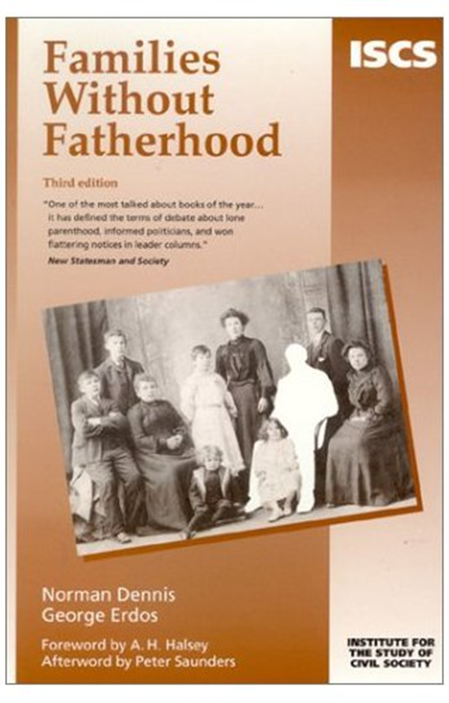
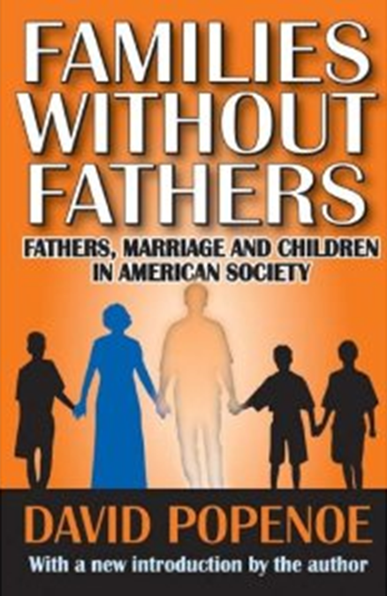

Fear of fatherlessness

Slide 6
Roles for men and women
Tyneside 1991 Riots
Summer 2011 Riots
It is ‘the progressive liberation of young men … from the expectation that adulthood involves life-long responsibility for the well-being of their wife, and 15 or 20 years of responsibility for the well-being of their children’ that is responsible for the crime-wave . ‘…young men who are invited to remain in a state of permanent puerility [childishness] will predictably behave in an anti-social fashion’.
Dennis & Erdos, 2000, p. 4
The causes of this sickness are many and complex. But three things can be said with certainty: every one of them is the fault of the liberal intelligentsia; every one of them was instituted or exacerbated by the Labour government; and at the very heart of these problems lies the breakdown of the family.
For most of these children come from lone-mother households. And the single most crucial factor behind all this mayhem is the willed removal of the most important thing that socialises children and turns them from feral savages into civilised citizens: a father who is a fully committed member of the family unit.
Melanie Phillips, The Daily Mail, 11 August 2011

Slide 7
Child Support Agency (CSA)
Fiscal and legal attempt to re-attach absent fathers to their children
Main protest from white, middle class men
Affronted by state interference
Resistant to ‘feckless’ suggestion
Angered by association with shame and guilt
Convinced CSA incompetent and unjust

Slide 8
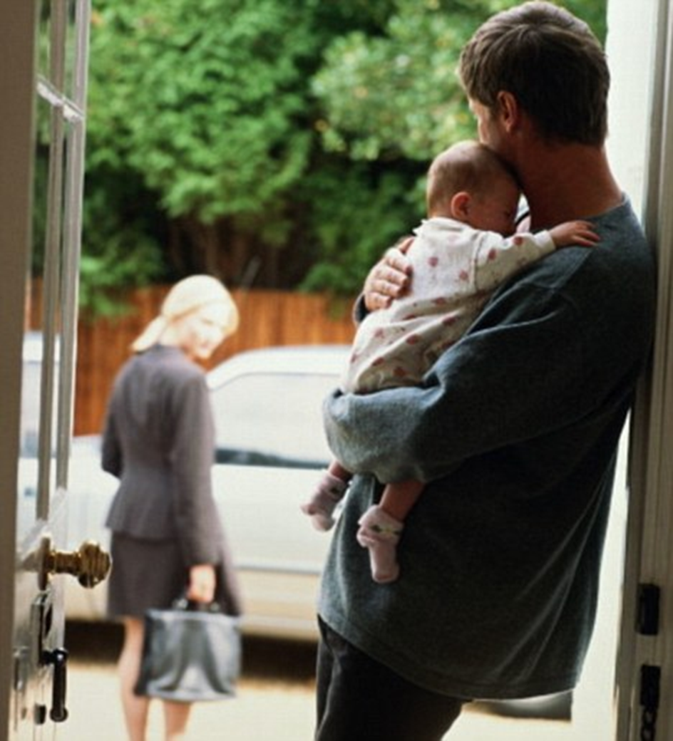
Redefining fatherhood around nurturing activities

Slide 9
Constraints
Hegemonic Masculinity
Violence
Labour Market

Slide 10

Empirical Research into Fathering Practices

Slide 11
Conclusions
Discourses related to ‘good’ fathering
Fathering is still about help not responsibility
Why is the incompatibility of paid work outside the home and caring work inside the home still a problem for women more than it is for men?

