Slide 1
Transformations: Gender, Reproduction, and Contemporary Society
Lecture 8: Beyond the Nuclear Family: Can parenting ‘be’ what parenting ‘is’?
Dr Sherah Wells
Sherah.Wells@warwick.ac.uk

Slide 2
What is parenting?
Gap between ideal and actuality
‘Types’ of parents:
  Lone
  Married
  Step
  Lesbian
  Resident
  Absent
  Co-habiting
  Gay

Slide 3
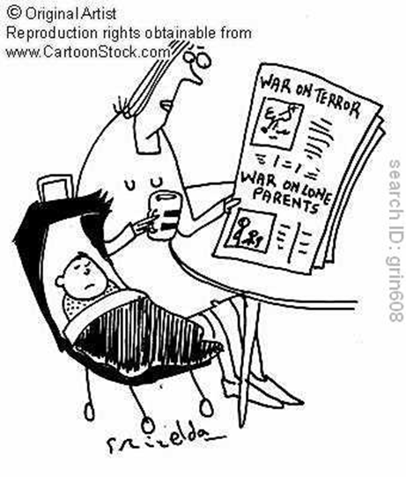
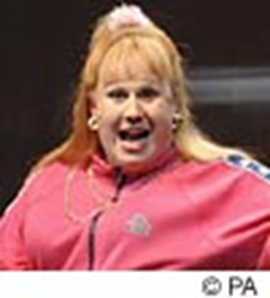
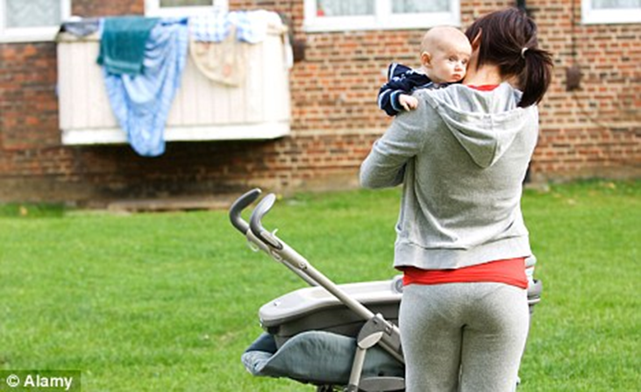
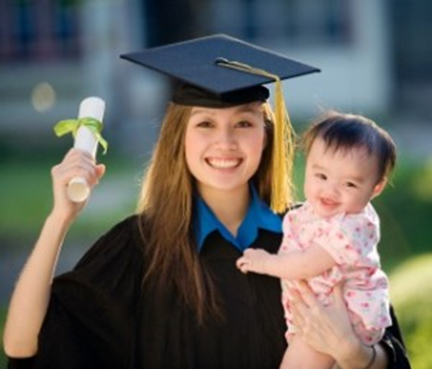
Lone Motherhood

Slide 4
Lone Motherhood
Routes
“Problems”
Separation, Divorce, Widowhood (outcome)
Choice
Donor Sperm
Adoption/fostering
Moral: engender criminality in boys
Economic: drain to the welfare state

Slide 5
Jon Davies
Family as a lifestyle choice
Subsidized Matriarchy

Slide 6
Bock
Choice due to circumstances, not a critique of nuclear family
Discourses to claim a right to motherhood
  Age valuable
  Responsible job equals responsible mother
  Emotionally mature
  Economic means to support a child

Slide 7
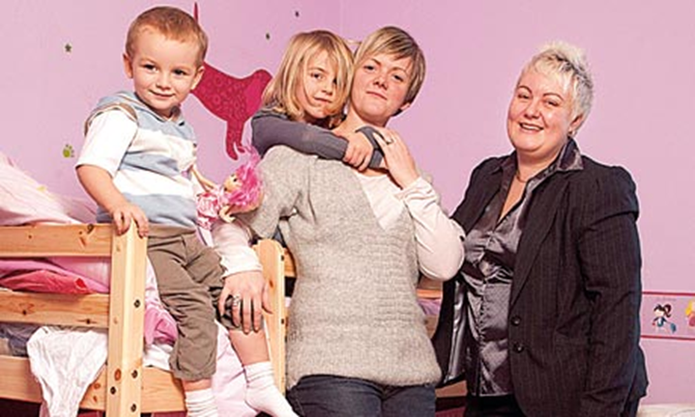
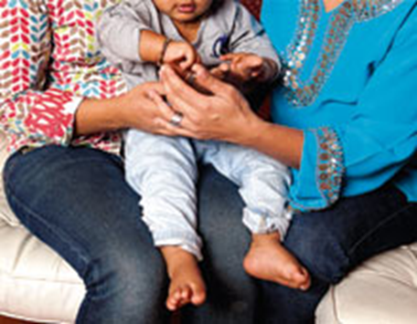
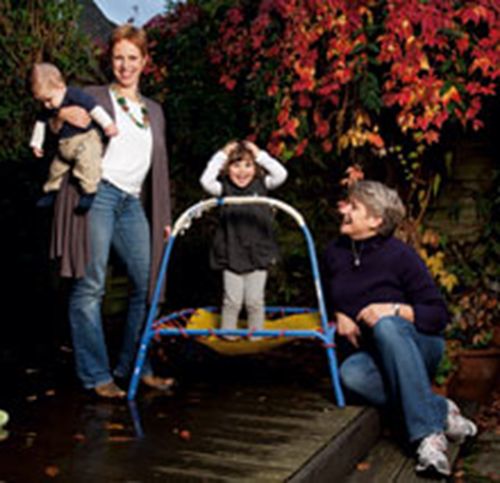
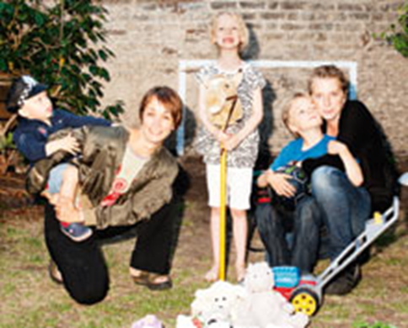

Slide 8
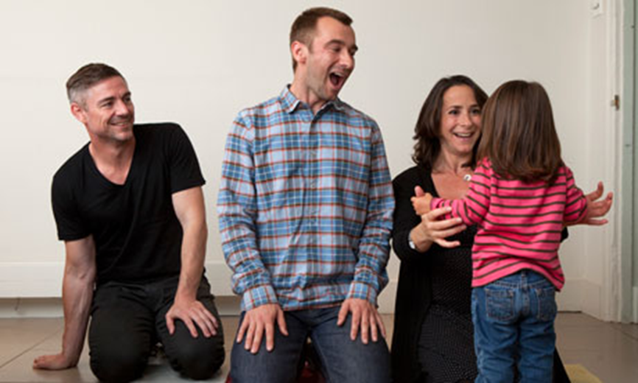
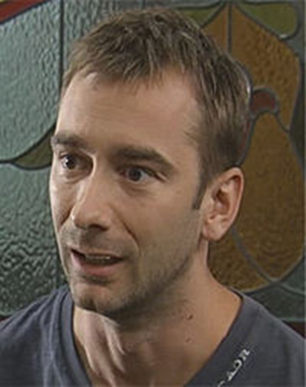
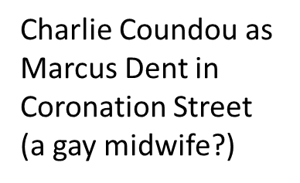
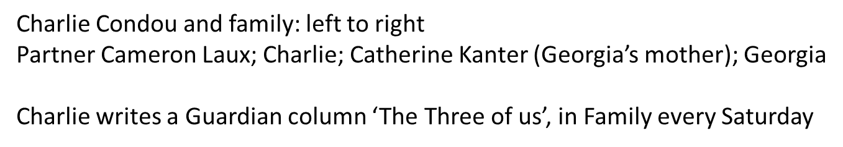

Slide 9
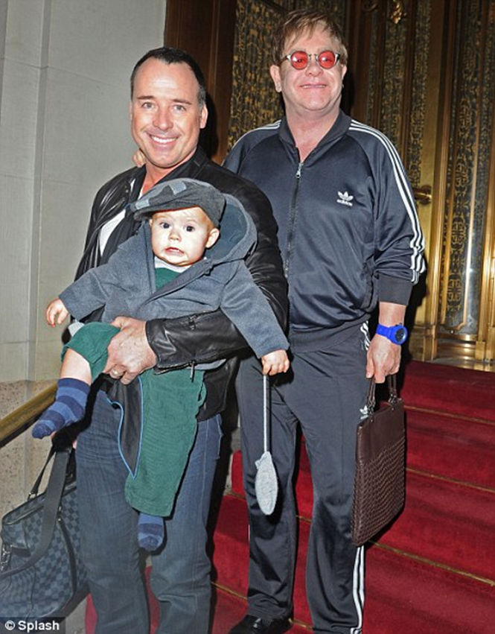
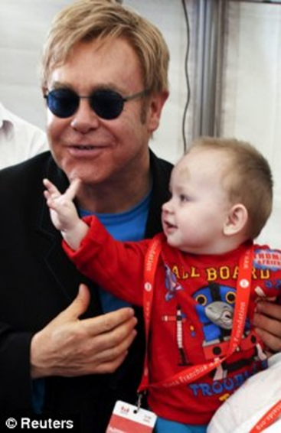
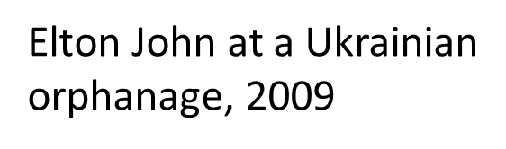


Slide 10
Campion, critiquing grounds for unfit parenting
Psychiatrically ill
Against nature
Need mother and father to develop gender identities
Confusion about sexuality
Stigma and victimization
See things they shouldn’t see
Risk of abuse

Slide 11
Tasker, Fiona (2005) ‘Lesbian Mothers, Gay Fathers, and Their Children: A Review’, Journal of Developmental and Behavioral Pediatrics, vol. 26, no. 3, pp. 224-240
‘Findings from research suggest that children with lesbian or gay parents are comparable with children with heterosexual parents on key psychosocial developmental outcomes. In many ways, children of lesbian or gay parents have similar experiences of family life compared with children in heterosexual families’ (Tasker, 2005, p. 224).

Slide 12
Resources
http://www.stonewall.org.uk/at_home/parenting/default.asp
http://www.prideangel.com/p4/about-us.aspx
http://www.donor-conception-network.org/index.htm
http://www.newfamilysocial.co.uk/

Slide 13


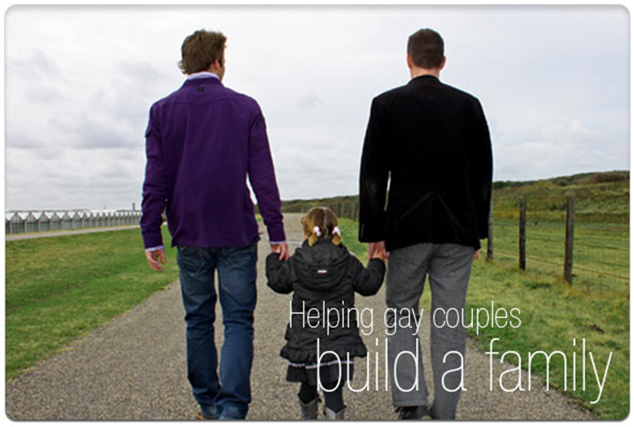

Conclusions

