Slide 1
Transformations: Gender, Reproduction, and Contemporary Society
Lecture 9: The Social and Cultural Politics of Adoption
Dr Sherah Wells
Sherah.Wells@warwick.ac.uk

Slide 2
Structure of the lecture
Media interest in adoption
Legal and policy context
Who’s fit to parent?
Transracial adoption
Inter-country adoption

Slide 3

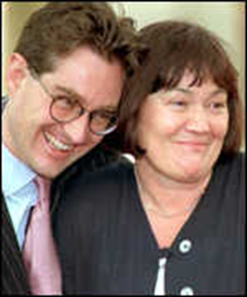
Media interest
‘Internet adoption’ by the Kilshaws (2001)
November 2010 – a Christian adoption advisor dismissed for refusing to recommend same-sex couples as suitable adoptive parents lost claim for religious discrimination

Slide 4
Legal and policy context
Adoption = legal process by which a child becomes a permanent member of a new family. Birth (biological) parents' rights and legal responsibilities are transferred to adoptive (social) parents.

Slide 5
History of adoption in the UK
1926: Adoption legalized
1920s-1970s: Adoption is primarily about finding babies for childless couples
1970s: Dramatic drop in number of babies available for adoption

Slide 6
Current Dilemmas
Identifying circumstances that justify permanently removing children from their birth parents
Finding permanent families for very traumatised children
Resolving policy dilemmas around transracial placements
Ensuring intercountry adoption is carried out in the best interests of the child.

Slide 7
Children in Care in March 2010 Source: http://www.baaf.org.uk/res/statengland#pc

Slide 8
Children in Care by age group Source: http://www.baaf.org.uk/res/statengland#pc

Slide 9
Children in care by where they live Source: http://www.baaf.org.uk/res/statengland#pc

Slide 10
Adoptions in 2009/10

Slide 11
Statistics

Slide 12
Types of adopters Source: http://www.baaf.org.uk/res/statengland#pc

Slide 13
Adoption and Care
‘Today’s social workers ....are rushing cases through to meet new government imposed targets for improving adoption rates just as social workers decades ago hurried to fulfil the dreams of childless couples waiting in the wings’ (Guardian, 5 January 2008 ‘Unfit to be a Mother?’)

Slide 14
Who’s fit to parent?
Case of ‘Baby G’
Mukhti Campion (1995) argues that historically adoptive parents must show themselves to be extraordinary parents.
Jane Rowe: Adoptive parents should be married couples of good standing and health, lacking neuroses

Slide 15
Current guidelines
Since 2005 legislation in England defines any family structure as appropriate for a child's upbringing
Gender differences
a single woman may adopt children of either sex and of all ages
a single man can only adopt a male child, and generally single men are excluded from adoption of very young children, babies or toddlers

Slide 16
Adoption by gay partners
2007 Equality Act
Religious opposition
Still controversial: Catholic Care lost appeal

Slide 17
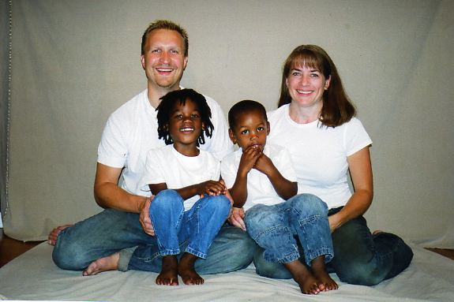
Transracial Adoption
Transracial or transcultural adoption means placing a child who is of one race or ethnic group with adoptive parents of another race or ethnic group
In the UK and US usually refers to adoption of black children by white adoptive parents
Political minefield

Slide 18
‘love doesn’t see colour’
In 1950s and 1960s black children were considered 'unadoptable'.
In 1965 a recruitment drive to find parents willing to adopt transracially - mainly middle-class, educated, already parents, living in predominantly white areas
By the 1970s there were three factors backing transracial adoption:
it was seen as successful,
there was a shortage of black adopters
the thinking was that 'permanency' was best

Slide 19

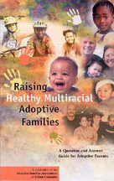
For or against transracial adoption?

Slide 20
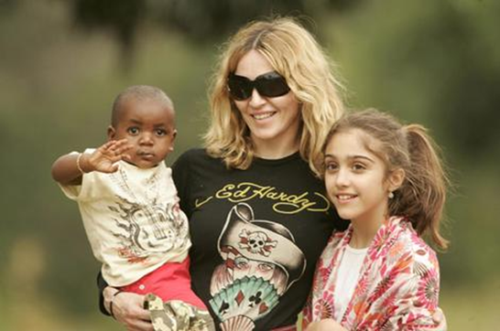
Intercountry adoption
Adoption of a child by adoptive
parents who are residents of
another country
Began in North America as philanthropic response to devastation following World War II, initially involved children moving from orphanages in Europe to North America
As a more global phenomenon, it has grown rapidly since 1990 when the world first discovered Romanian orphans
Global movement annually of about 30,000 children per year moving between 100 different countries

Slide 21
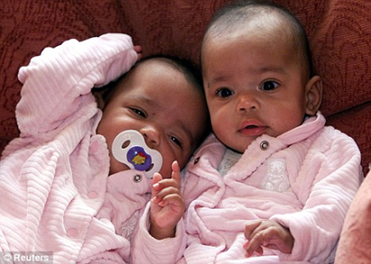
The Kilshaw case

Slide 22

Child trafficking
Poverty and war are biggest reasons for children being put up for intercountry adoption
UNICEF’s guidelines: ‘In natural emergencies or even armed conflicts there is a very clear guideline that no intercountry adoptions must be allowed for at least two years if a child's family, its wider family, has not been traced.’
Zoe’s ark

Slide 23
Conclusions
What is a ‘good enough’ parent?
Society is economically structured to allow some parents to cope with parenting and others not
Sexual orientation and parenting
Commodification of children
Race, class, biological and social parenting

