Slide 1

Michael Gardiner CRPLA
m.gardiner@warwick.ac.uk

Slide 2

Frank R. Stockton, The Great War Syndicate (New York: P. F. Collier, 1889)
Newcombe, Simon, His Wisdom, the Defender (New York: Harper and Brothers, 1900)
London, Jack, 'The Unparalleled Invasion', San Francisco Examiner, 27 January 1910
H. G. Wells, The World Set Free (London: Ernest Benn, 1927 (1914))
John Stewart Barney, LPM: The End of the Great War (New York: G. P. Putnam, 1915)
Hector C. Bywater, The Great Pacific War: A History of the American– Japanese Campaign of 1931–33 (London: Constable, 1925)
Nicolson, Harold, Public Faces (London: Constable and Co., 1932)
MacIlraith, Frank, and Roy Connolly, Invasion from the Air: A Prophetic Novel (London: Grayson and Grayson, 1934)
J. B. Priestley, The Doomsday Men: An Adventure (London: Heinemann, 1938)
Robert Heinlein (as Anson MacDonald), 'Solution Unsatisfactory', Astounding 27-3 (1941)
Malcolm Jameson, 'The Giant Atom', Startling Stories, 10.2 (December 1943)

Slide 3

PHASE ZERO:
. 1900s atom splitting leads to pop physics and speculative culture
. Speculative fiction considers weapons aimed at populations for aerial delivery
. Unification of space for automation
. Japan already target by 1930s (Kyoto School crux)
. Anglosphere cosmotechnics are natural and anterior

Slide 4
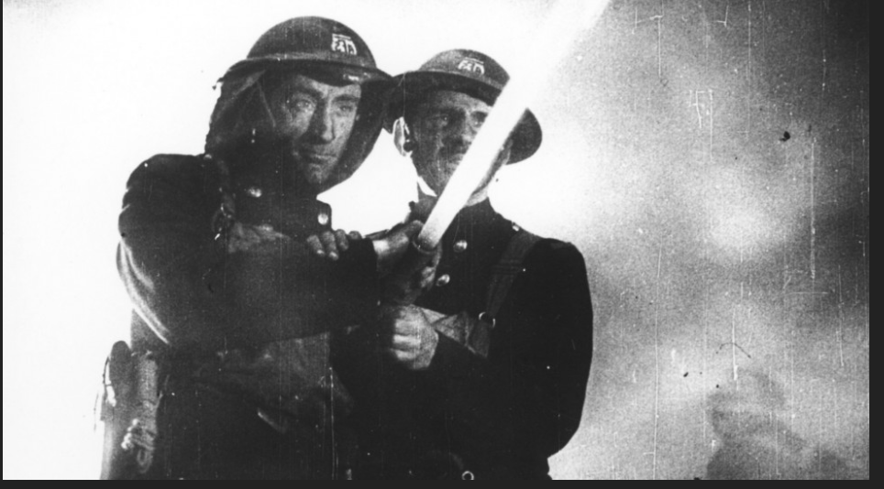

Slide 5
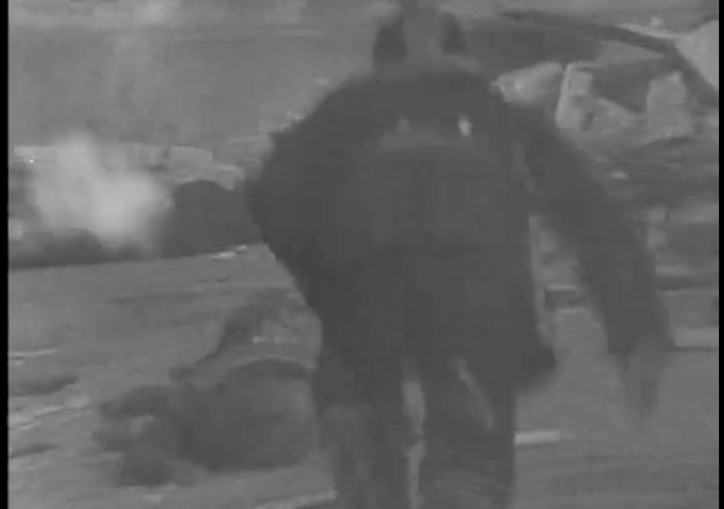

Slide 6

PHASE 1:
. X Risk and cognitive dissonance
. Dialectic of Enlightenment
. Nukes and UK Welfare State/ US Golden Era
. Citizenship towards automation
. Extinction weapons as missing term of cybernetics

Slide 7

Elaine Scarry, Thermonuclear Monarchy: Choosing Between Democracy and Doom (New York: Norton, 2014)
Theodor Adorno and Max Horkheimer, Dialektik der Aufklärung, trans. As Dialectic of Enlightenment, 1972
William Chaloupka, Knowing Nukes: The Politics and Culture of the Atom (Minneapolis: University of Minnesota Press, 1992)
John Kinsella and Drew Milne, 'Nuclear Theory Degree Zero', in eds. Kinsella and Milne, Nuclear Theory Degree Zero: Essays Against the Nuclear Android (Abingdon: Routledge, 2021), 1-16

Slide 8

Martin Heidegger, ‘Die Frage nach der Technik’, 1949/ 1954, trans. as ‘The Question Concerning Technology’, 1977
Martin Heidegger, 'Nur noch ein Gott kan uns retten', Der Spiegel interview, 23 Sept 1966, publ. 1976, trans. as 'Only a God Can Save Us'
William Chaloupka, Knowing Nukes: The Politics and Culture of the Atom (Minneapolis: University of Minnesota Press, 1992)
Friedrich A. Hayek, Law Legislation and Liberty vol.1 (London: Routledge Kegan Paul, 1973)
John Hoskyns, Norman S. Strauss et al, Stepping Stones (London, self-published, 1977)
Thomas Moynihan, X-Risk: How Humanity Discovered Its Own Addiction (Falmouth: Urbanomic, 2020)
François Bonnet, Après la mort (Paris: Éditions l'Éclat, 2017), trans. as After Death, 2021
Grafton Tanner, Foreverism (Cambridge: Polity, 2023)

Slide 9

Ken Booth, 'Unilateralism: A Clausewitzian Reform?', in Dangers of Deterrence: Philosophers on Nuclear Strategy, ed. Nigel Blake and Kay Pole (London: Routledge and Kegan Paul, 1983), 41–83
ed. Tony Hendra, Meet Mr. Bomb: A Practical Guide to Nuclear Extinction (London: High Meadow and Suron International, 1983)
Mary Midgley, 'Deterrence, Provocation and the Martian Temperament', ed. Fred Holroyd, Thinking about Nuclear Weapons: Analyses and Prescriptions (Beckenham, Kent: Croom Helm, 1985), 73–90
Martin Ryle, Towards the Nuclear Holocaust (London: Menard Press, 1980)
E. P. Thompson, 'Notes on Exterminism, the Last Stage of Civilization', New Left Review, 1.121 (May–June 1980), 3–31
Raymond Williams, 'The Politics of Nuclear Disarmament', in Exterminism and Cold War, ed. E. P. Thompson (London: New Left Review, 1982 (1980)), 65–85

Slide 10

Wr. and dir. Peter Watkins, The War Game (BBC, 1966)
Wr. Jeremy Paxman, dir. Louise Capel, 'If the Bomb Drops', Panorama (BBC, 1980)
Wr. Nigel Calder etc., dir. Peter Batty, Nuclear Nightmares (BBC, 1980)
Protect and Survive Ltd, Protect and Survive Monthly and British Civil Defence News, 1981–82
Wr. and dir. Mick Jackson, QED: A Guide to Armageddon (BBC, 1982)
Wr. Tom McGrath, dir. John Glenister, The Nuclear Family (BBC, 1982)
wr. John Pilger, dir. David Munro, The Truth Game (Central Independent, 1983)
Wr. Barry Hines, dir. Mick Jackson, Threads (BBC/ Nine, 1984)
Wr. Albert Ruben, dir. Fred Barzyk, Countdown to Looking Glass (HBO, 1984)
Wr. Troy Kennedy Martin, dir. Martin Campbell, Edge of Darkness (BBC, 1985)
Wr. Duncan Campbell, dir. Dennis Cosgrove, Secret Society, episode 2, 'In Time of Crisis', (BBC TV, 1987)
Wr. and dir. Derek Jarman, The Last of England (Anglo International/ British Screen, 1987)

Slide 11


Slide 12
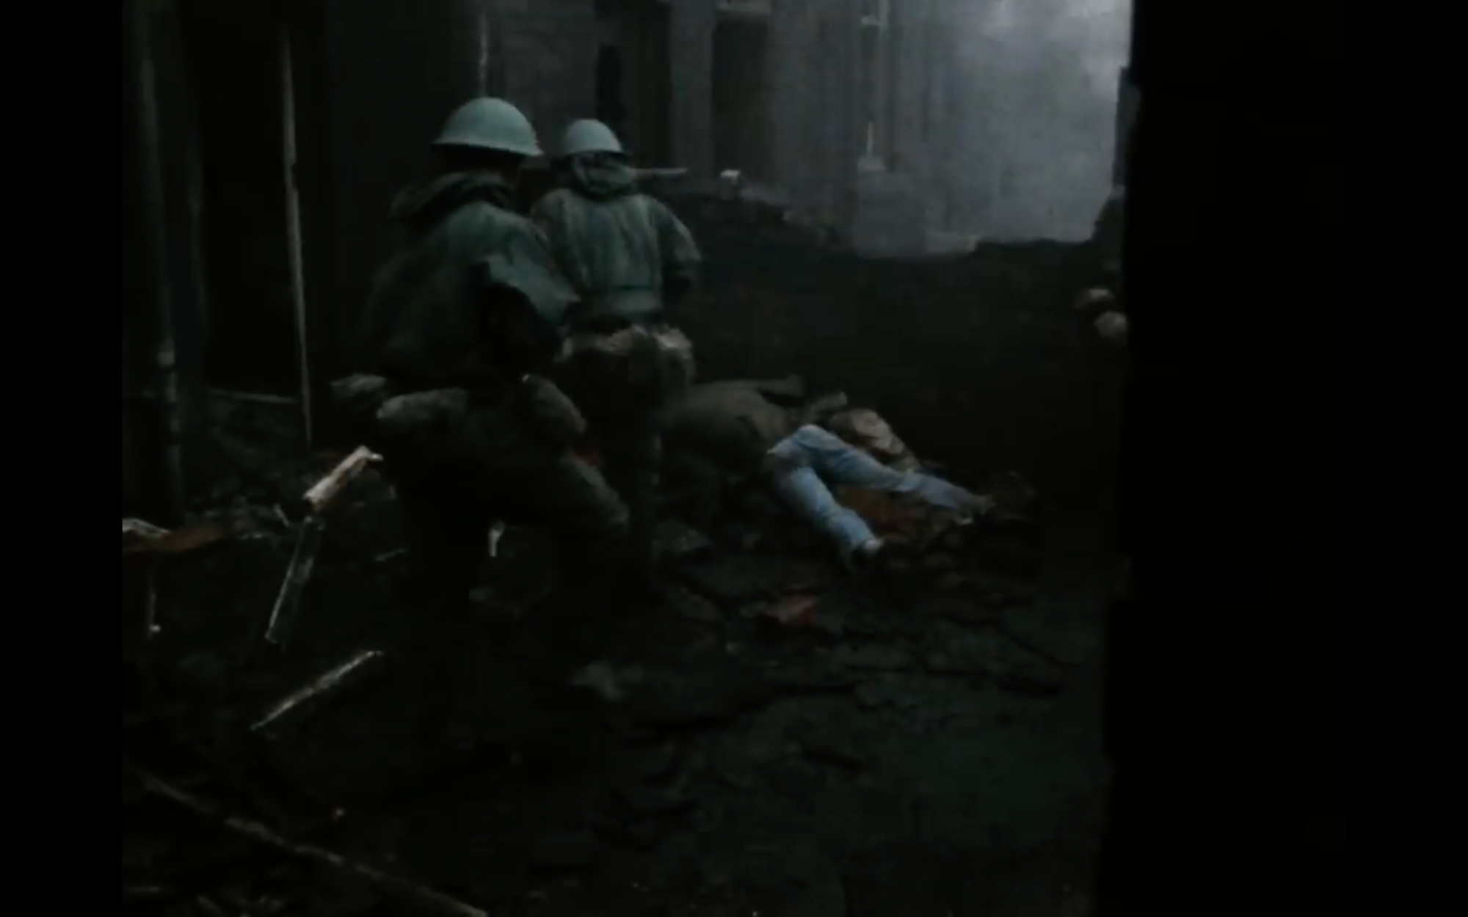

Slide 13

(PHASE 2) NUCLEAR GOTHIC
. Horror of phsyical violence within total abstraction
. Relation to classic Gothic and the British response to the French Revolution
. The deathly, the embodied, the physical v the continuous, the abstracted, the eternal

Slide 14

Paul Virilio, Vitesse et Politique: essaie dromologie (Paris: Galilée, 1977), trans. as Speed and Politics: An Essay on Dromology, 1986
Paul Virilio, Guerre et Cinema: Logique de la perception (Paris: Cahiers du Cinéma, 1991)
Jacques Derrida, 'No Apocalypse, Not Today (Full Speed Ahead, Seven Missiles, Seven Missives', Diacritics, 14.2 (Summer 1984), 20–31
Frances Ferguson, 'The Nuclear Sublime', Diacritics, 14.2 (Summer 1984), 4–10
Jean Baudrillard, L'Échange symbolique et la mort (Paris, Gallimard, 1976), trans. as Symbolic Exchange and Death, 1983
Jean Baudrillard, trans. Paul Foss, Paul Patton, and Philip Beitchman, Simulations (New York: Semiotext[e], 1983)

Slide 15

NUCLEAR CRITICISM
. Atlantic weapons and 1970s continental philosophy
. 'Remainderless destruction'
. Comparative eschatology
. 'Nuclearism' - everyday language normalises X-threat
. Serious theorisation of post-truth condition
. Declines mid-1990s, push to extractible typology politics

Slide 16

Benoît Pelopidas, 'The Birth of Nuclear Eternity', in ed. Sandra Kemp and Jenny Andersson, Futures (Oxford: Oxford University Press, 2021), 484–500
George P. Schultz, William J. Perry, Henry A. Kissinger, and Sam Nunn, 'A World Free of Nuclear Weapons', Wall Street Journal, 4 Jan 2007
Federico Campagna, Technic and Magic: The Reconstruction of Reality (London: Bloomsbury, 2018)
Yuk Hui, The Question Concerning Technology in China (Falmouth: Urbanomic, 2016)

Slide 17
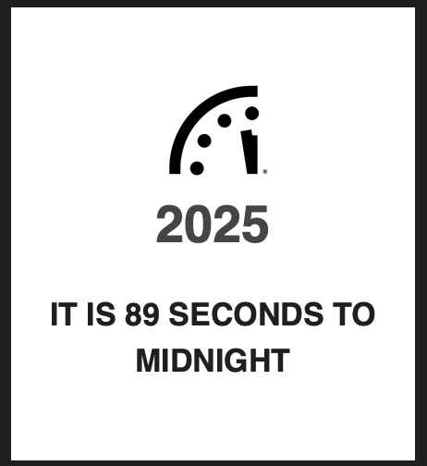
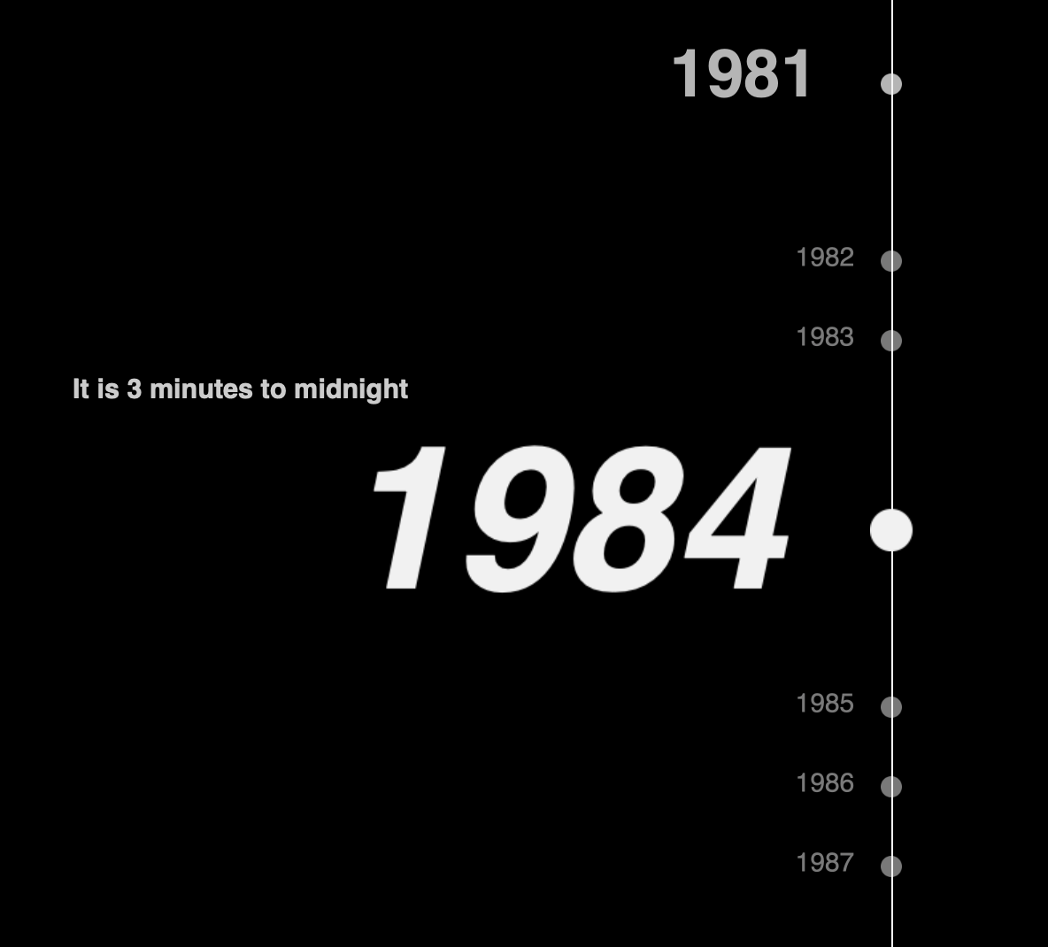

Slide 18

Patricia Lewis, Heather Williams, Benoît Pelopidas and Sasan Aghlani, Too Close for Comfort: Cases of Near Nuclear Use and Options for Policy (London: Royal Institute for International Affairs, 2014)
Benoît Pelopidas, ‘Imaginer la possibilité de la guerre nucléaire pour y faire face’, Cultures et Conflits 123-124, Autumn-Winter 2021, 173-212

Slide 19

Ed. Ele Carpenter, The Nuclear Culture Handbook (London: Black Dog, 2016)
Paul Virilio, Vitesse et Politique: essaie de dromologie (Paris: Galilée, 1977), trans. as Speed and Politics: An Essay on Dromology, 1986
Nick Land, ‘Teleoplexy’, 2012
Drew Milne, 'Poetry after Hiroshima? Notes on Nuclear Implicature', Angelaki, 22.3 (2017), 87–102

Slide 20

Mark Fisher, Ghosts of My Life: Writings on Depression, Hauntology and Lost Futures (Winchester: Zer0, 2014)
Franco Berardi, After the Future (AK, 2011)
David Graeber, The Utopia of Rules (London: Melville House, 2016)
Grafton Tanner, Foreverism (Cambridge: Polity, 2023)
Byung-Chul Han, Transparenzgesellschaft (Berlin: Matthes and Seitz, 2012), trans. as The Transparency Society, 2015

Slide 21

(PHASE 3) COGNITIVE/ NUCLEAR ECONOMY
. Cognitive economy and the rise of retro
. Post-Cold War tech convergence
. Algo siloing/ reward-addiction/ Gestell/ teleoplexy…
. Screen continues standardisation of space
. Realism as the hyperpresent

Slide 22

THINKABILITY
. Retro/ Gestell/ future-folding
. Deep Americanisation… and after
. The Question Concerning Deterrence Technology
. Displacement / X-risk soup
. Post-truth has always been nuclear
. Nuclear realism as destiny

Slide 23

f

