Slide 1
EN122: Modes of Reading
Marx and Engels on ideology and history
Nick Lawrence (n.lawrence@warwick.ac.uk)

Slide 2
Lecture outline
Background to The German Ideology
The historical materialist method
‘The point is to change it’

Slide 3
“The Man with the Blue Guitar”
The man bent over his guitar,
A shearsman of sorts. The day was green.
They said, “You have a blue guitar,
You do not play things as they are.”
The man replied, “Things as they are
Are changed upon the blue guitar.”
— Wallace Stevens (1937)

Slide 4
1. Background to The German Ideology
• Marx and Engels wrote The German Ideology in 1846, two years prior to the Communist Manifesto
• The GI is widely read as an early attempt at formulating what became Marx’s materialist conception of history, or ‘historical materialism’
• The main focus of the GI is not Germany’s political status per se, but rather the ‘German ideology’ of those thinkers who called for change in their country

Slide 5
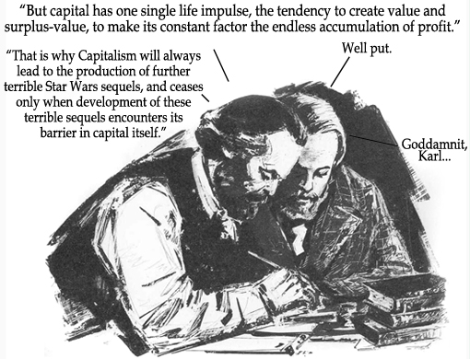

Slide 6
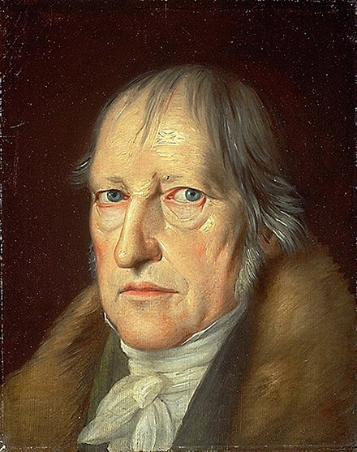
G. W. F. Hegel (1770-1831)

Slide 7
Hitherto men have constantly made up for themselves false conceptions about themselves, about what they are and what they ought to be. (Marx and Engels, The German Ideology)

Slide 8
The Young Hegelians
Let us teach men, says one [young German thinker], to exchange these imaginations for thoughts which correspond to the essence of man; says the second, to take up a critical attitude to them; says the third, to knock them out of their heads; and – existing reality will collapse. (The German Ideology)

Slide 9
Once upon a time a valiant fellow had the idea that men were drowned in water only because they were possessed with the idea of gravity. If they were to knock this notion out of their heads, say by stating it to be a superstition, a religious concept, they would be sublimely proof against any danger from water. His whole life long he fought against the illusion of gravity, of whose harmful results all statistics brought him new and manifold evidence. This honest fellow was the type of the new revolutionary philosophers in Germany. (The German Ideology)

Slide 10
The inverted world
Das ist ja die verkehrte Welt,
Wir gehen auf den Köpfen!
This is certainly the inverted world,
We go about on our heads!
(Heinrich Heine, 1791-1856)

Slide 11
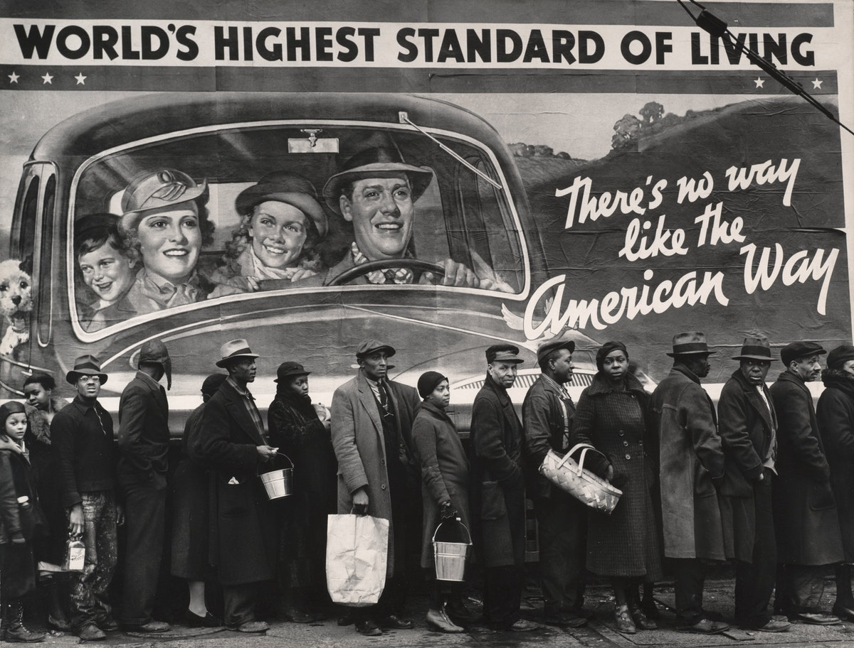
2. The historical materialist method

Slide 12
We do not set out from what men [sic] say, imagine, conceive … We set out from real, active men, and on the basis of their real life-process we demonstrate the development of the ideological reflexes and echoes of this life-process. The phantoms formed in the human brain are also, necessarily, sublimates of their material life-process. (The German Ideology)

Slide 13
Consciousness can never be anything else than conscious existence, and the existence of men is their actual life-process. If in all ideology men and their circumstances appear upside-down as in a camera obscura, this phenomenon arises just as much from their historical life-process as the inversion of objects on the retina does from their physical life-process. (The German Ideology)

Slide 14
Camera obscura:
A darkroom made for seeing the light
If the facade of a building, or a place, or a landscape is illuminated by the sun and a small hole is drilled in the wall of a room in a building facing this, which is not directly lighted by the sun, then all objects illuminated by the sun will send their images through this aperture and will appear, upside down, on the wall facing the hole. (Leonardo da Vinci, Codex Atlanticus)

Slide 15
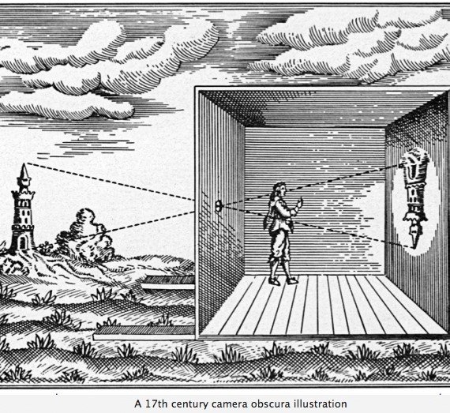

Slide 16
Life is not determined by consciousness, but consciousness by life. In the first method of approach [i.e., idealism] the starting-point is consciousness taken as the living individual; in the second method [i.e., materialism], which conforms to real life, it is the real living individuals themselves, and consciousness is considered solely as their consciousness. (The German Ideology, emphasis added)

Slide 17
Forces and relations of production
In the social production of their life, men enter into definite relations that are indispensable and independent of their will; these relations of production correspond to a definite stage of development of their material forces of production.
The sum total of these relations of production constitutes the economic structure of society — the real foundation, on which rises a legal and political superstructure and to which correspond definite forms of social consciousness.
(Marx, Preface to A Contribution to the Critique of Political Economy,1859)

Slide 18
Material forces = labour, natural resources, energy systems, technologies; ways of producing
Social relations = division of labour, class structures, political arrangements
Forces + relations = the mode of production

Slide 19
Mode of production
The mode of production of material life determines the social, political and intellectual life process in general. It is not the consciousness of men that determines their being, but, on the contrary, their social being that determines their consciousness. (Marx, Preface to A Contribution to the Critique)

Slide 20
Historical change
History happens, for Marx, when the forces of production (productive capacities of a society, allowing it to maintain its existence) develop to the point where they outgrow the relations of production (social organization, class structures)
Classic instance: the transition from feudalism to early modern capitalism

Slide 21


Class struggle
The result of the division of labour in society is conflict between objectively opposed interests: “The history of all hitherto existing society is the history of class struggles” (Marx and Engels, Communist Manifesto)

Slide 22
Ruling ideas
In each stage of history, the ‘ruling ideas’ of a society are those of its ruling class: “The ruling ideas are nothing more than the ideal expression of the dominant material relationships, the dominant material relationships grasped as ideas; hence of the relationships which make the one class the ruling one, therefore, the ideas of their dominance.” (The German Ideology)

Slide 23
Consciousness is never ‘independent’ of an individual’s performed role in the overall social process
if ‘language is practical consciousness,’ it must be the case that the forms of expression that we use reflect, and arise from, the material life-processes in which we’re embedded

Slide 24
In other words, it may not be just overtly held beliefs that are at issue when discussing ‘ideology,’ but instead the hidden, repressed or unconscious aspects of life as it is lived

Slide 25

3. ‘The point is to change it’

Slide 26
Plato’s cave
Imagine a number of men living in an underground chamber, with an entrance open to the light, extending along the entire length of the chamber, in which they have been confined, from their childhood, with their legs and necks so shackled, that they are obliged to sit still and look straight forwards, because their chains render it impossible for them to turn their heads round. (Plato, Book VII, The Republic)

Slide 27
… and imagine a bright fire burning some way off, above and behind them, and an elevated roadway passing between the fire and the prisoners, with a low wall built along it … let me ask you, in the first place, whether persons so confined could have seen anything of themselves or of each other, beyond the shadows thrown by the fire upon the part of the chamber facing them? (The Republic)

Slide 28
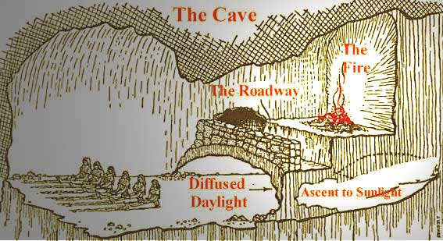

Slide 29
We are finally living in Plato’s cave, if we consider how those who were imprisoned within the cave – who could do nothing but watch those shadows passing on the back wall – were convinced that those shadows were their one and only reality. I see a profound similarity to all this in the epoch we're now living in. We no longer live simply through images: we live through images that don’t even exist, which are the result not of physical projection but of pure virtuality. (José Saramago)

Slide 30
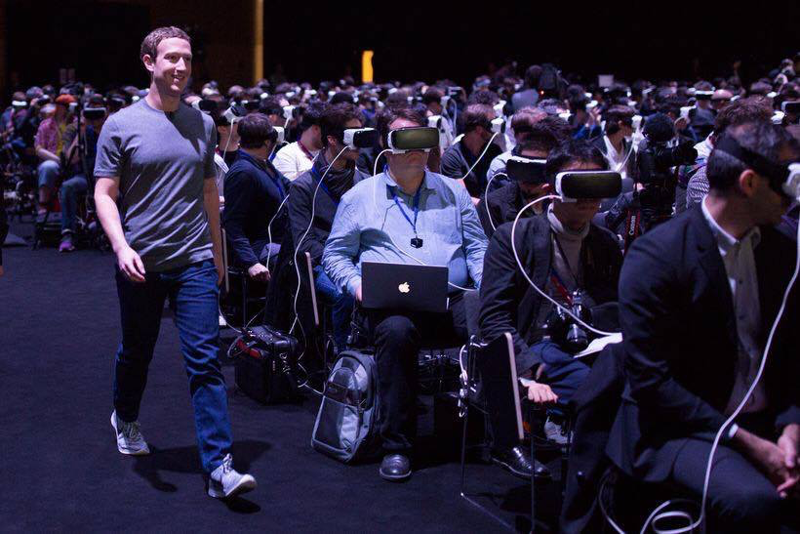
Mark Zuckerberg leading the blind

Slide 31
So that’s life, then: things as they are?
It picks its way on the blue guitar.
A million people on one string?
And all their manner in the thing,
And all their manner, right and wrong,
And all their manner, weak and strong?
(“The Man with the Blue Guitar”)

Slide 32
The ideological unconscious
A commodity is therefore a mysterious thing, simply because in it the social character of men’s labour appears to them as an objective character stamped upon the product of that labour …This is the reason why the products of labour become commodities, social things whose qualities are at the same time perceptible and imperceptible by the senses. (Marx, “On the Fetishism of Commodities,” Capital Vol. 1)

Slide 33
To fetishize = invest something with power that it doesn’t intrinsically possess
But fetishization isn’t just ‘ideological’ – it is part of our objective reality
The fetishization of ‘value’ is not just a phenomenon of the superstructure; it is instead ‘baked in’ to objective processes of the material world

Slide 34
The ideological status of genre, like that of all conceptual categories, lies in its explanatory and problem-“solving” capacities.
[T]he genre of the novel can be understood comprehensively as an early modern cultural instrument designed to confront, on the level of narrative form and content, both intellectual and social crisis simultaneously.
The fetishism of the commodity under capitalism transforms it from a social relation into a mysterious social thing. In an analogous fashion, we might say, the result of the fetishization of Protestant allegory is that mysterious yet familiar thing, the novel.
(Michael McKeon, The Origins of the English Novel 1660-1740)

Slide 35
All I’d wanted was to be blonde and otherwise hairless with a name like Amy. While it was not that remarkable to encounter foreign surnames on a class register in Glasgow, mine glowed radioactive in the nineties. Certain teachers looked up from the list in horror — as if I myself was violently disintegrating. (Olivia Sudjic, Asylum Road)

Slide 36
Recent developments
Racial capitalism
Social reproduction theory
Eco-Marxism

Slide 37


Slide 38


Slide 39


Slide 40
The philosophers have only interpreted the world, in various ways. The point, however, is to change it. (Marx, “Theses on Feuerbach: XI”)

