Slide 2
‘Nothing of theological content will persist without being transformed; every content will have to put itself to the test of migrating into the realm of the secular, the profane’
– Adorno, ‘Reason and Revelation’ (1957)

Slide 3
‘The only philosophy which can responsibly be practiced in the face of despair is the attempt to contemplate all things as they would present themselves from the standpoint of redemption. Knowledge has no light but that shed on the world by redemption: all else is reconstruction, mere technique. Perspectives must be fashioned that displace and estrange the world, reveal it to be, with its rifts and crevices, as indigent and distorted as it will appear one day in the messianic light’
– Adorno, Minima Moralia (1951)

Slide 4
‘The class struggle . . . is a struggle for the rough and material things, without which there is nothing fine and spiritual. Nevertheless these latter are present in the class struggle as something other than mere booty, which falls to the victor. They are present as confidence, as courage, as humour, as cunning, as steadfastness in this struggle . . . They will, ever and anon, call every victory which has ever been won by the rulers into question.’
– Benjamin ‘Theses on the Philosophy of History’ (1940)

Slide 5
‘a hymnic and an elegiac form. The one is the unheard-of, the unprecedented, the height of bliss; the other, the eternal repetition, the eternal restoration of the original, the first happiness. It is this elegiac idea of happiness . . . which for Proust transforms existence into a preserve of memory’
– Benjamin ‘The Image of Proust’ (1929)

Slide 6
‘In mystical heresy, the unsatisfiable purification of the divine from myth, which loves to tremble in the gesture of deeply involved questioning, hands the divine over to whoever relates to it in any way. Liberal theology is suddenly reborn . . .’
– Adorno, The Jargon of Authenticity (1964)

Slide 7
‘modern man . . . can neither believe nor contain himself in unbelief and who searches desperately, feeling about in all experience for the lost God . . . Today’s reader, if he believes in grace at all, sees it as something which can be separated from nature and served to him raw as Instant Uplift.’
– Flannery O’Connor, ‘Novelist and Believer’ (1962)

Slide 8
‘less trifling with the label “atheism” (which reminds one of children, assuring everyone who is ready to listen to them that they are not afraid of the bogey man)’
– Karl Marx, letter to Arnold Ruge, November 24, 1842

Slide 9
Wes Anderson
Bottle Rocket (1996)
Rushmore (1998)
The Life Aquatic with Steve Zissou (2004)
The Darjeeling Limited (2007)
Fantastic Mr Fox (2009)
The Royal Tenenbaums (2001)
Moonrise Kingdom (2012)
The Grand Budapest Hotel (2014)

Slide 10
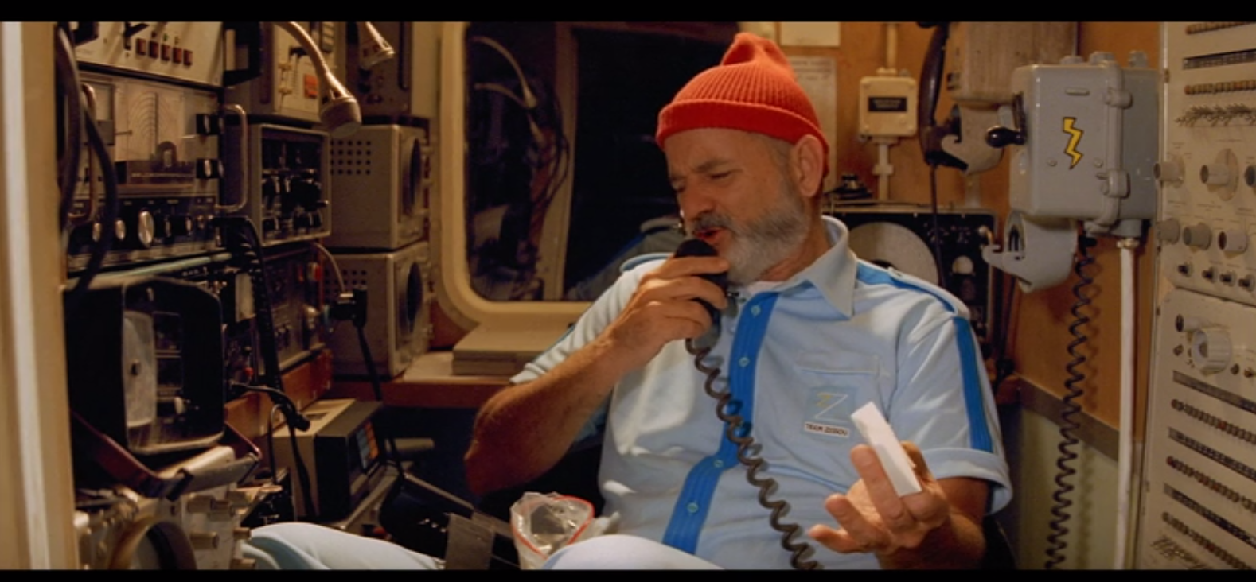

Slide 11
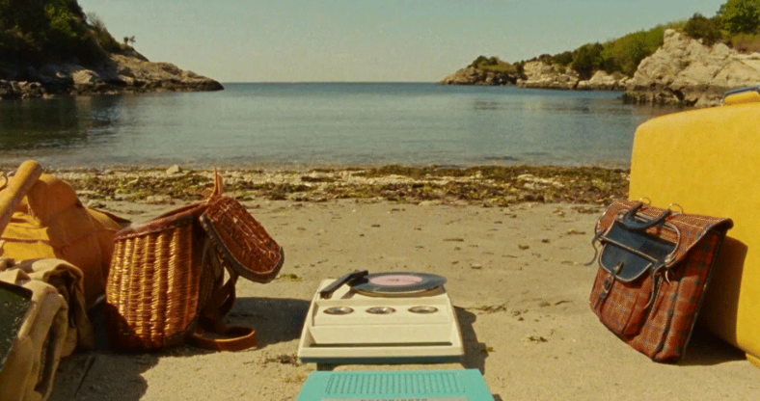

Slide 12
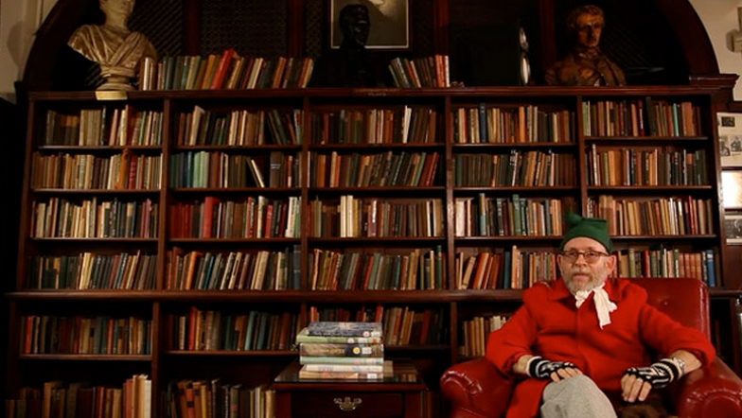

Slide 13
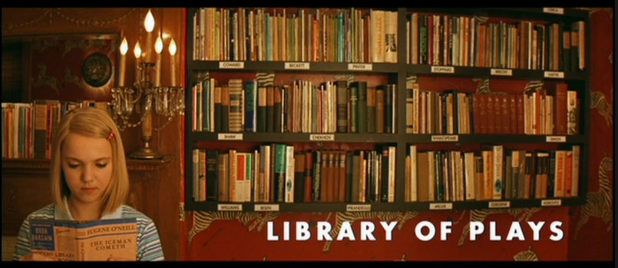

Slide 14
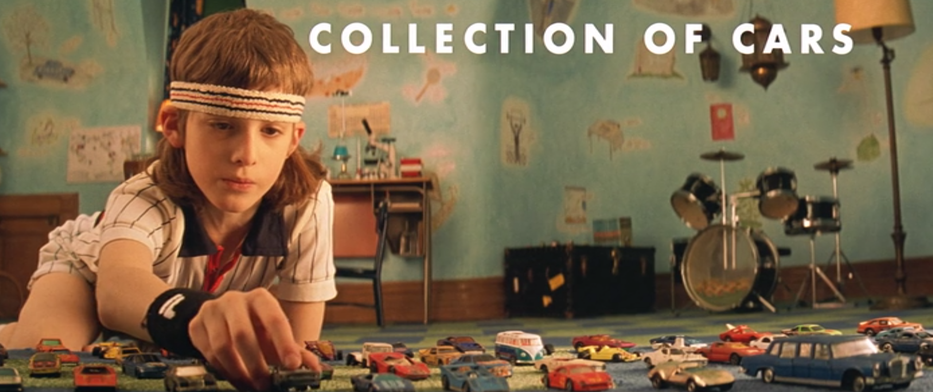

Slide 15
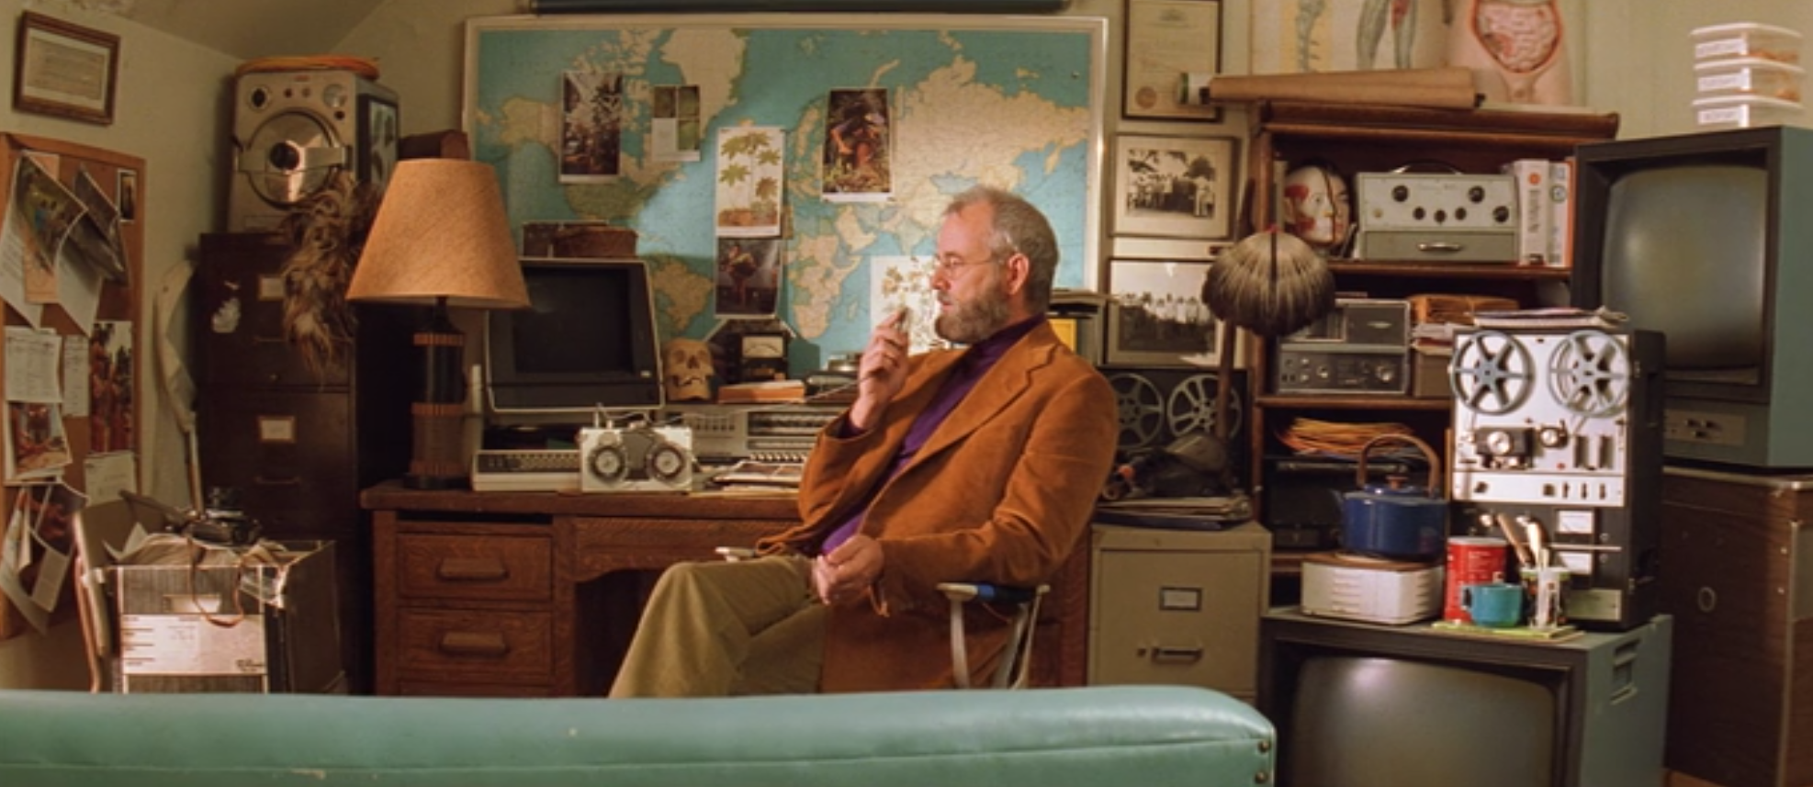

Slide 16
