Slide 1
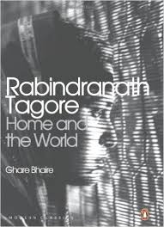
(1915)

Slide 2
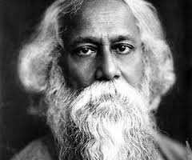
Born: 7th May 1861
Died: 7th August 1941
First non-European to win the Nobel Prize in Literature in 1913
Highly influential in introducing the authenticity of Indian culture to Western Culture and vice versa.
Involved in the re-shaping of literature, music and Indian art through contextual modernism
Humanist, universalist internationalist and strident nationalist
Spurned the rigid, classical forms of Bengali writing by using new forms of prose writing and use of colloquial language

Slide 3
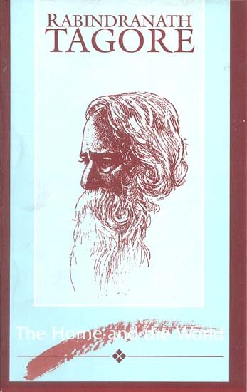
The Home and the World (1915)
‘Ghare Baire’ – in the literal translation means “At Home and Outside” -denotes the more secular problem that Bimala faces; the battle between self-belief and conflicting traditions.
Three main characters: Bimala, Nikhilesh and Sandip – love triangle w/ each character narrating the novel through first person narrative in diary-entry types.
Set in early twentieth century against the backdrop of the Indian Independence Movement.

Slide 4
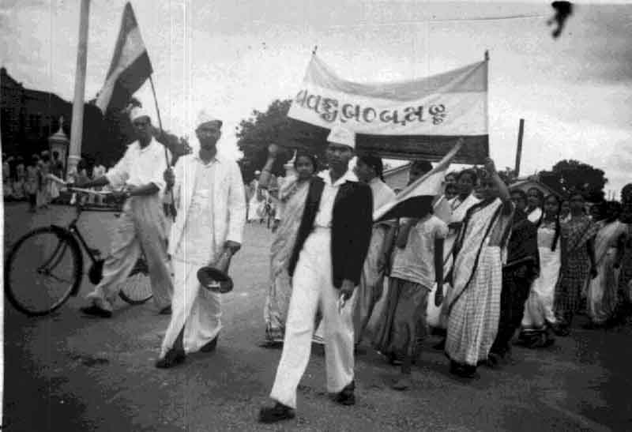
The Swadeshi Movement
The “new spirit of India”
Arose out of national reaction to the 1905 Partition of Bengal by Lord Curzon, which separated Hindus and Muslims into different geographical areas. Through dissatisfaction with this law, both religions unified to create the Swadeshi Movement.
Aimed to remove British Imperial control over India and its citizens
  Wanted to end East India Company rule and then the British Raj.
Discontent with representation of the Indian people within government
Encouraged the people to boycott British products, entailing a revival for domestic products

Slide 5
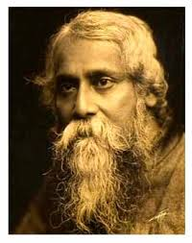
Tagore and the Swadeshi Movement
During the movement’s early period, Tagore was an enthusiastic advocate. He wrote songs that served to inspire and encourage the people of Bengal to join the cause.
However, as the movement spread and became more radicalised, Tagore became disillusioned – the glorification of violence as means to an end caused many to self-criticise and entailed Tagore’s retreat from the movement.
By 1915, Tagore had become a staunch opponent of the Indian Nationalist Movement.
In 1917, in a series of lectures (published in Rabindranath Tagore. Nationalism. London: Macmillan, 1917) argued that only a universal humanism could possibly solve the social problems that lay at the heart of the country’s misery or any political problem that pits people against each other.
How far can the novel be seen as a warning for the dangers of Nationalism?

Slide 6
Mirroring the European novel
First person diary-like entries with themes of love and betrayal, often with a love-triangle at the core of the narrative, are a common trait of nineteenth century literature.
E.g. Leo Tolstoy’s Anna Karenina (1877); Gustave Flaubert’s Madam Bovary (1856); Theodor Fontane’s Effi Briest (1894)
The romantic melodrama amidst the liberation of India in the novel becomes metaphoric and contributes to Tagore’s belief that harmony amongst individuals needs to exist in order for larger scale problems to be consoled.
The shift in first person narrative between the three characters then displays the complexity of differentiating beliefs and individuals.
Can it be said that imperial and colonial control are then embedded within the novel because of the structure and conventions found within it?
Does this initial mirroring of European tradition then subtly persuade the reader to side with Nikhilesh and his beliefs?

Slide 7
The battle between FIRE and WATER
“[Bimala] is the moth that singed her wings in the flame of my unreserved masculinity” pg 84
“Sandip’s eyes burnt bright. I couldn’t figure out if it was the fire of reverence or hunger that burnt in his eyes… I’d forgotten if he was a live flame or a human being… His hands were shaking just like the trembling flames and his gaze rested on me like the sparks of fire” pg 71 & 72
“Up until then I had been a nameless river in a village… But suddenly, with no warning, the ocean flooded me and my breast swelled and heaved, my banks overflowed and on their own, my waves pulsated to the rhythm of the ocean’s drumbeat” pg 42
“Perhaps this is woman’s nature… We are like flowing water – when we flow between the two shores, we nurture with all our might and when we overflow the banks, we destroy with equal vehemence.”

Slide 8
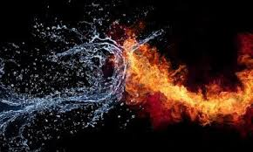
Cont.
Throughout the novel, Sandip is likened to fire and Bimala (or women) to water.
How are these elements representative of the relationship between the two lovers? And can they be seen as metaphorical for the wider context in the novel?

Slide 9
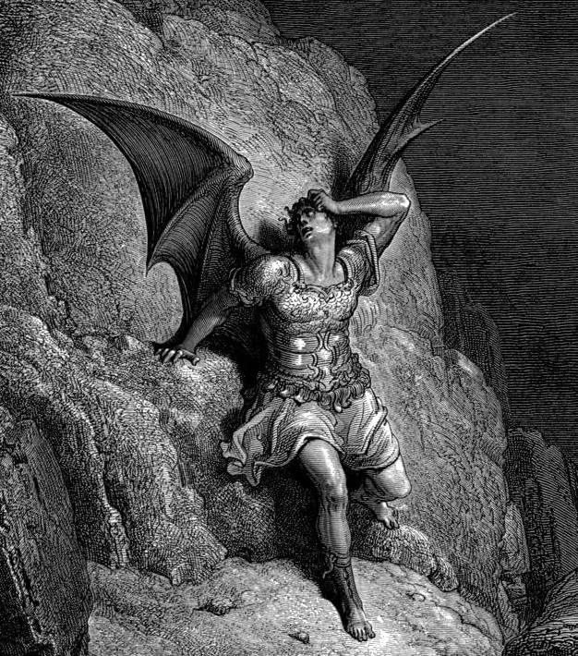
A Paradise Lost?
“This is hypnotism indeed – the charm of which can subdue the world!” (85)
“Bee was not conscious, because she was ashamed of the reality; to which men have given a bad name, calling it Satan; and so it has to steak into the garden of paradise in the guise of a snake and whisper secrets into the ears of man’s chosen consort and make her rebellious” (33)
Has the potential for paradise been lost? If so, who or what is responsible? Or has it been saved? Who or what saves it?
How far can Paradise Lost be seen as a mirror for the representation of Indian nationalism and it’s wavering potential?

Slide 10
Illusion vs. Truth
“...visualise the motherland. We must make a goddess of her”... “Let us devise an appropriate image”(82)
“Man’s goal is not truth but success” (71)
“Is the thing that happens the only truth?”/ “What other truths can there be?” (70)

Slide 11
Marriage/ True love vs created love
“How many years, how many ages, aeons, must pass before I can find my way back to that day of nine years ago?” (132)
“How little these two persons, who have been together, day and night, for nine whole years, know of each other!” (87)
“The real fact is that Bimala has only come into my home, not into my life” (59)

Slide 12
‘The Home and the World’
“I could not think of my house as separate from my country; I had robbed my house, I had robbed my country. For this sin my house had ceased to be mine, my country also was estranged from me” (100)
“on the threshold” (100)
“They all seek to reform something outside themselves. But reforem is wanted only in one’s own desires, nowhere else, nowhere else!” (92)

Slide 13
The Woman’s position
“In trying to manufacture a helpmate, we spoil a wife.” (141)
“...Let me do my worship.” ... Who was I to stop her? Was I the god of her worship that I should have qualms?” (142)
“She had been hurt at every turn and yet had not the right to complain” (135)
“Queen Bee sent for me early this morning. And I, the humble worker of the hive, left all else to attend her summons.” (124)
“I am a woman; the outside world is closed to me” (122)
“Oh, the weak! the weak! At last Sandip has realized that he is weak before me!” (108)
“What am I to them [men] but a meadow flower in the path of a torrent in a flood?” (101)
“We women are sitting there, on one side, behind a screen” (14)
“I remember I once told him: Women’s minds are so petty, so crooked!” (8)
Given that Bimala vocalises and performs many of the stereotypes given to women, how might this be problematic to mainstream ‘modern’ western views of the oppressed ‘traditional# Indian woman under purdah? Does the novel support this view? Or challenge it?
What is the ‘woman’s position’ by the end of the novel? Empowered? Free?

Slide 14
Aestheticism of the woman
“To try to keep Bimala as a garland round my neck, would have meant keeping a weight hanging over my heart” (92)
“That which before had the mystery of her personality about it, and was priceless to me, was now able to sell itself cheap” (74)
“But a woman is not built that way . She is soft and supple, so that she may bend without being crooked” (64)
“They are goddesses!” (103)
To what extent are women aestheticised for the nationalist campaign?

Slide 15
Indian ‘Tradition’ vs Western ‘Modernism’
“I tell you, Nikhil, man’s history has to be built by the united effort of all the races in the world, and therefore this selling of conscience for political reasons – this making a fetish of one’s country won’t do. I know that Europe does not at heart admit this, but there she has not the right to pose as our teacher. Men who die for the truth, it will also achieve immortality in the history of humanity. Here, in this land of India, amid the mocking laughter of Satan piercing the sky, may the feeling for this truth become real! What terrible epidemic of sin has been brought into our country from foreign lands...” (116)
“These things, which are so simple to ordinary folk, get so twisted in the minds of our B.A.’s and M.A.’s, the only purpose of whose historical quibbles seems to be the torture of the truth!” (90)
What issues are raised about the problem of readily trusting the History books? What does this say about representation of the so-called ‘third world’ woman in Western discourse?

Slide 16
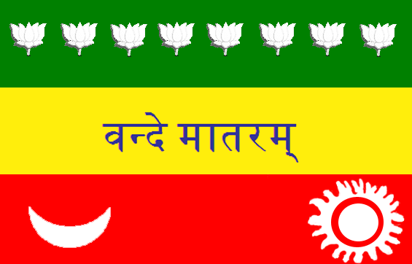
Nationalism vs Righteousness
“But it was not also this very thing I had done a robbing of the whole world – not only of money, but of trust, of righteousness?” (100)
“Why does not my country become, for once, a real Mother” (97)
“The Mother cares not for mere success, however great – she wants to give life, to save life. My very soul, today, stretches out its hands in yearning to save this child.” (97)
“The Mother in me awoke.” (96)
“The day that we seek the good of the country along the path of righteousness, He who is greater than our country will grant us true fruition” (84)

Slide 17
Discussion Questions
How far can the novel be seen as a warning for the dangers of Nationalism?
Can it be said that imperial and colonial control are then embedded within the novel because of the structure and conventions found within it?
Does this initial mirroring of European tradition then subtly persuade the reader to side with Nikhilesh and his beliefs?
How are these elements representative of the relationship between the two lovers? And can they be seen as metaphorical for the wider context in the novel?
Has the potential for paradise been lost? If so, who or what is responsible? Or has it been saved? Who or what saves it?
How far can Paradise Lost be seen as a mirror for the representation of Indian nationalism and it’s wavering potential?
Given that Bimala vocalises and performs many of the stereotypes given to women, how might this be problematic to mainstream ‘modern’ western views of the oppressed ‘traditional# Indian woman under purdah? Does the novel support this view? Or challenge it?
To what extent are women aestheticised for the nationalist campaign?
What issues does Tagore raise about the problematic issue of readily trusting the History books? What does this say about the problem of representation of the so-called ‘third world’ woman in Western discourse?

