Slide 1
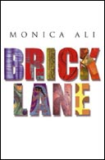
Monica Ali’s Brick Lane

Slide 2
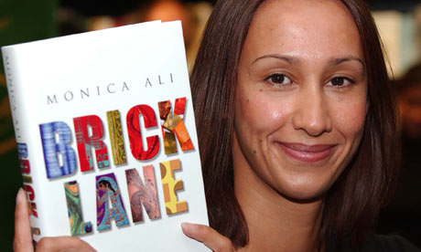
Ali asserts in 'Where I'm Coming From'
"I can write about it because I do not truly belong. Growing up with an English mother and a Bengali father means never being an insider. Standing neither behind a closed door, nor in the thick of things, but rather in the shadow of the doorway, is a good place from which to observe."

Slide 3
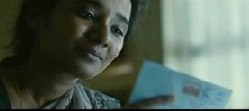
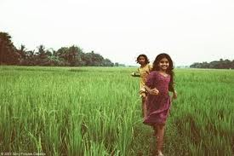
Hasina’s Letters
Some critics suggest poor English is thus associated with "primitiveness" and "problematically representing [a] failure to escape from barbarity and persecution." (Michael Perfect 112)
However, if the letters are interpreted as Nazneen paraphrasing illiterate Bengali they could be considered a literary device intending to incite a response. Particularly if we are to accept Michela Canepari Labib's suggestion that it is "an attempt to dislocate, both syntactically and lexically, the language of the former [colonial] master” (212).

Slide 4
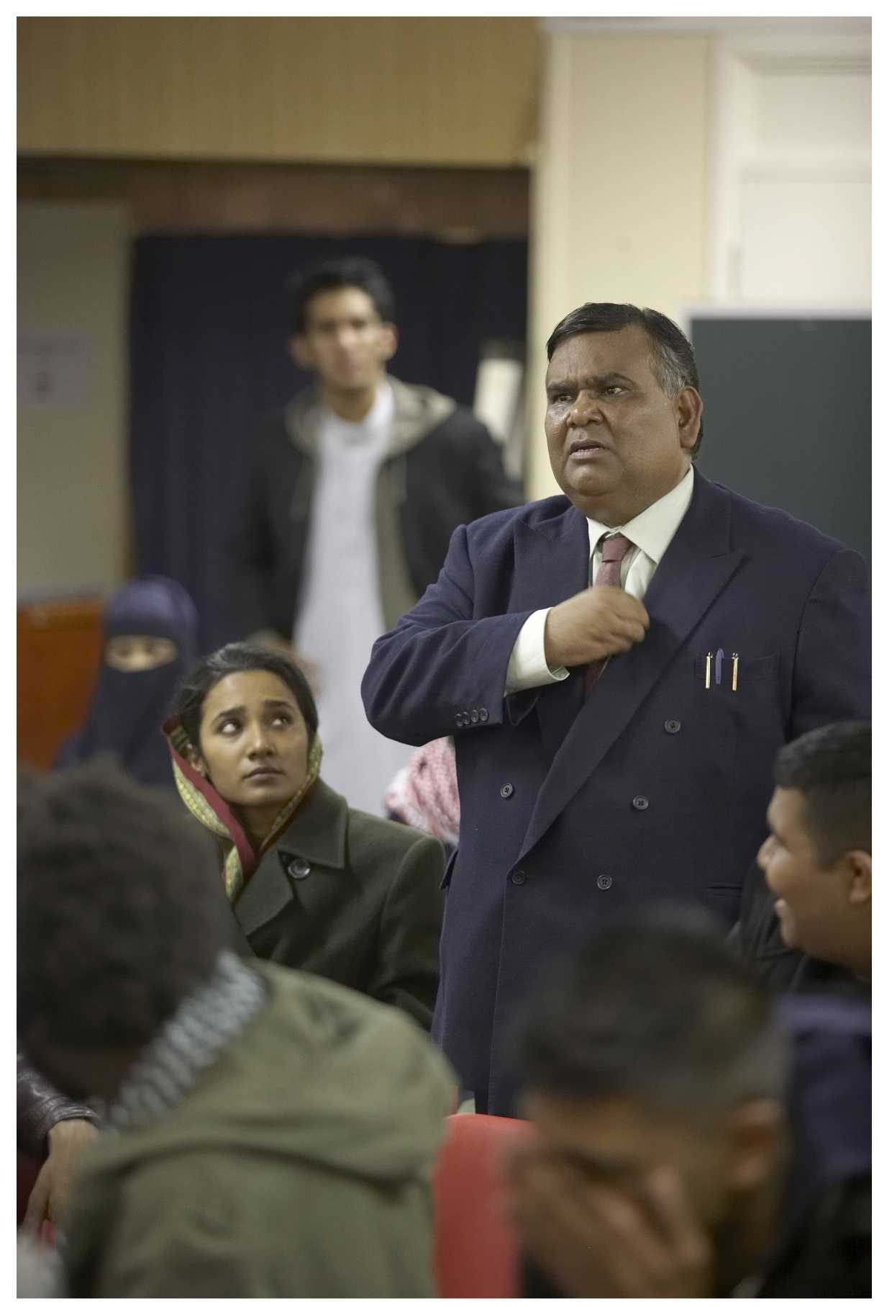
In Brick Lane, Chanu (Nazneen’s husband) is desperate to preserve his cultural heritage.
“I’m talking about the clash between Western values and our own. I’m talking about the struggle to assimilate and the need to preserve one’s identity and heritage. I’m talking about children who don’t know what their identity is. I’m talking about feelings of alienation engendered by a society where racism is prevalent. I’m talking about the terrific struggle to preserve one’s sanity while striving to achieve the best for one’s family.” (113)

Slide 5
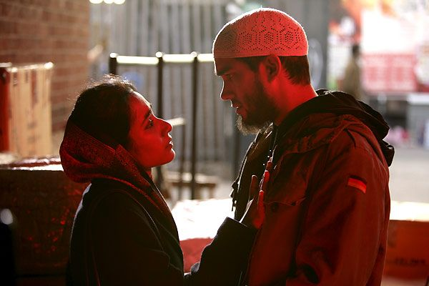
Karim and Nazneen’s relationship
“She was his real thing. A Bengali wife. A Bengali mother. An idea of home. An idea of himself that he found in her.”
Nazneen realises by the end of the novel that they had “made each other up”.

Slide 6
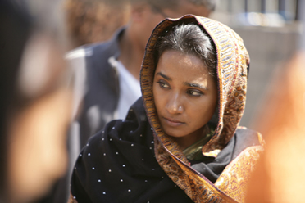
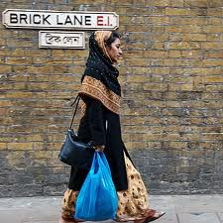
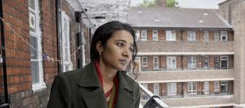
“[M]ulticultural Bildungsroman"
Michael Perfect argues that Brick Lane can be termed a "multicultural Bildungsroman". He cites the stereotypes the novel opens with as "counterpoints" to the narrative of empowerment.

