Slide 1
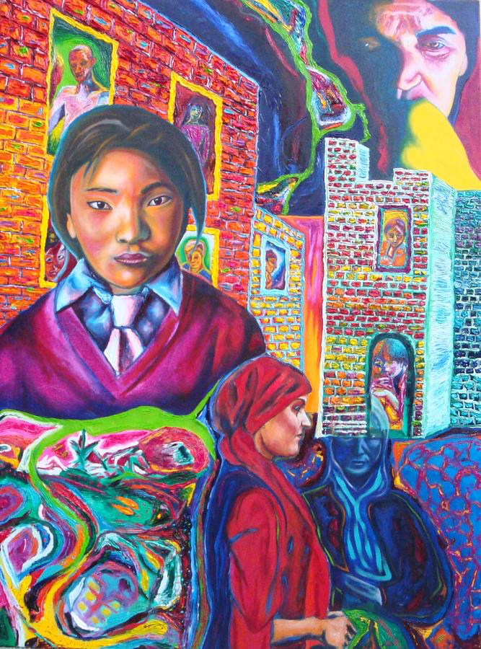
Welcome to
Transnational Feminism:
Literature, Theory and Practice
Roxanne Bibizadeh R.E.Bibizadeh@warwick.ac.uk
Office Hour: Wednesdays 12:00 -13:00 (H538 T1 / H517 T2).

Slide 2
Ice Breaker
Group Story Telling
Name and degree
Why did you decide to take the module?
Pick a random red question to answer!

Slide 3
Admin
Resources: www.warwick.ac.uk/rebibizadeh
Reading: Collect the essays from the office.
Course Structure and Assessments Online: http://www2.warwick.ac.uk/fac/arts/english/currentstudents/undergraduate/modules/fulllist/special/transnational/
Please join the facebook group Warwick Transnational Feminism: www.facebook.com/groups/564720470211785/?fref=ts
Class Presentation: Each seminar participant will be required to sign up for at least one class presentation on the week’s readings. Please pick a week to present.

Slide 4
General Expectations
Attendance: Attendance at each seminar is mandatory. If there is a medical reason or any other urgent situation, a written note should be submitted for record. You must arrive on time to seminars.
Seminar Participation: Seminars generally succeed or fail because of the quality of group participation. This means that you must keep on top of the required readings—reading thoroughly, carefully and in a timely manner.

Slide 5
Questions to consider when reading:
What is the salient argument that the reading/s are making? Is the argument consistent?
If not, are there productive or useful gaps and contradictions for discussion?
In the case of a fictional text, what are the key issues that might emerge as the framing ones for the text?
Do the readings provide an important intervention in our thinking about feminism as a trans-national project?
How can we evaluate the intervention?
What assumptions are the readings making in terms of audience/subject matter/discipline, etc.?
Is there scope for making useful comparisons with other texts that we are reading?

Slide 6
Any Questions?

Slide 7
How would you define feminism?
Note it down on your whiteboard ready to share.

Slide 8
What are the differences between first and second wave feminism?

Slide 9

Week 1: Introduction to Transnational Feminisms: key concepts and debates
‘First wave’ Feminism was principally concerned with women’s material disadvantages compared to men, they were focused on social, political and economic reform.

Slide 10


‘Second wave’
‘Second wave’ feminism focused on the politics of reproduction, women’s ‘experience’, sexual ‘difference’ and ‘sexuality’, both as a form of oppression and something to celebrate.

Slide 11
What is the difficulty with Anglo-American and European feminist literary theory?
How might first and second wave feminism differ from Third World feminist criticism?

Slide 12
Third World feminist criticism focuses on three major issues:
The politics of universalism
On current controls and misrepresentations
On the homogeneity of the canon

Slide 13
Why might the term feminist be refused by some women?

Slide 14
Features of Third World
Feminist Criticism:
Focus on place and displacement
The creation of a positive model of ‘Otherness’
The reading of history as if history is a language
The focus on myth, allegory and the use of un-translated words, footnotes or addresses to a reader
The refusal to create a hierarchy of texts

Slide 15
How can we avoid creating monolithic images of women? Like “veiled women, the powerful mother, the chaste virgin, the obedient wife”?

Slide 16
What are the dangers of a universal sisterhood?

Slide 17
How does Transnational Feminism differ from Global Feminism?
The term “global feminism” favours a universalized western model of women’s liberation that celebrates individuality and modernity.
The term “transnational” implies “across borders”, “transnational” recognizes inequalities arising out of women’s differences that frame these border crossings. Transnational feminism is committed to activism that encourages dialogue for change. Transnational feminism avoids universalizing women in its rejection of a universal sisterhood, this movement also rejects a universal notion of patriarchy that affects all women the same.

Slide 18
How can we avoid rearticulating stereotypes?

Slide 19
Recasting Women
Kumkum Sangari and Sudesh Vaid “ Recasting Women: An Introduction,” in Recasting Women assert “If Feminism is to be different, it must acknowledge the ideological and problematic significance of its own past. Instead of creating yet another grand tradition or a cumulative history of emancipation, neither of which can deal with our present problems, we need to be attentive to how the past enters differently into the consciousness of other historical periods and is further subdivided by a host of other factors including gender, caste, and class.” (18)

Slide 20
Mountain Moving Day by Yosano Akiko
“The mountain moving day is coming
I say so yet others doubt it…
All sleeping women now awake and move
All sleeping women now awake and move.”
What are the similarities between this poem and Transnational Feminism?

Slide 21
How would you define Transnational Feminism in your own words?

Slide 22
Patriarchy
Have you or someone you know experienced patriarchy?
What forms of patriarchy have you experienced?
Do you consider yourself a feminist?
What is your opinion of the differences between global feminism and transnational feminism?

