Slide 1
Gloria Anzaldua
Borderlands/La Frontera: The New Mestiza

Slide 2
Notices
Please collect next term’s reading pack.
Please sign up for a presentation next week.

Slide 3
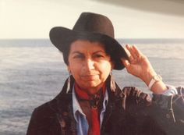
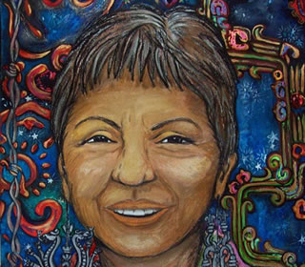
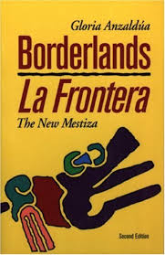
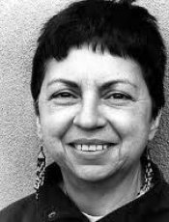
Anzaldua, scholar of Chicana cultural theory, feminist and queer theory
“feminist visionary spiritual activist poet-philosopher fiction writer”

Slide 4
“new mestizas” and a
“mestiza consciousness”
People who inhabit multiple worlds because of their gender, sexuality, ethnicity, class, body, personality, spiritual beliefs, and/or other life experiences.
“more whole perspective, one that includes rather than excludes”.

Slide 5
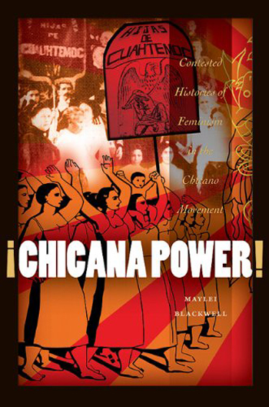
Chicana Feminists
The Chicana feminist acknowledges the often vast historical, class, racial, and ethnic differences among women living on the border.
Gloria Anzaldua’s work was crucial in advancing, and takes a prominent place, in Chicana feminist theory because she argues for multiple subject positions – race, class, gender, sexuality, immigration, language, religion and nationality.

Slide 6
Form
Based on her personal experiences of growing up on the US-Mexican border
1st part of the book: essays that are variations on the theme of borderlands
2nd part of the book: poetry written in English and Spanish, each with variations
Form of the text: uneven and multi-genre—poetry, memoir (“autohistoria”), testimony, history, critical commentary

Slide 7
Spatial Borderland
Physical/spatial/geographical—borderlands as a transnational space: a third country
Spaces b/w nations: US/Mexico border
Spanish colonization in the 16th c; US colonization of Mexico in the 19th c (1848); 1910: Mexican revolution
Neoliberal economic regime inaugurated by NAFTA (North American Free Trade Agreement) that gave rights to US corporations to set up factories in the borderlands
Correspondingly, an increased surveillance of borders and migrants, undocumented workers impoverished under global capitalism (loss of land)

Slide 8
Language
Bilingualism/multilingualism is an important aspect of transnational feminism
“How to tame a wild tongue”—critique of domination through official languages
to speak is to transgress, to cross borders; writing as an act of self-creation
language and experience; questions of literacy—alphabetic and pictorial languages

Slide 9
Borderlands of history and fiction
History, not linear but serpentine: using indigenous icons, traditions and rituals, from before European colonisation
Material/ist history
Histories of subaltern resistance
Reinterpreting female figures from history, marked as traitors
“Autohistoria-teoria”

Slide 10
Borders…
Borderlands as margins that have an epistemic privilege, a critical edge
Breaking down of dualisms—a new hybrid identity (native to America, but non-Western)
a new hermeneutics
The new subjectivity and consciousness of the borderlands
A new cartography
A new transnational feminist consciousness

Slide 11
Discussion Questions
Read through the discussion questions in pairs or small groups and get ready to share some ideas.

