Slide 1
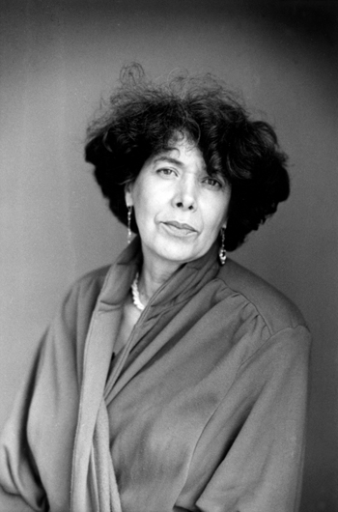
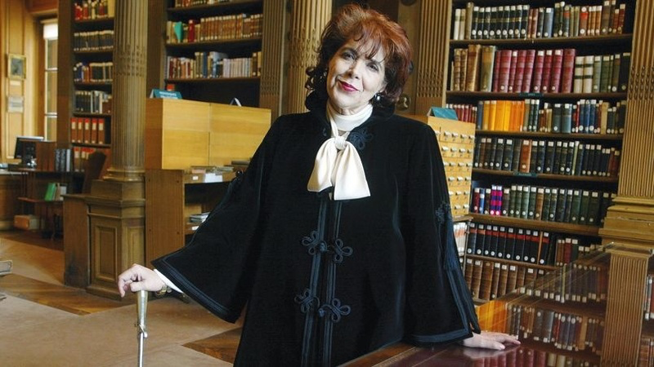
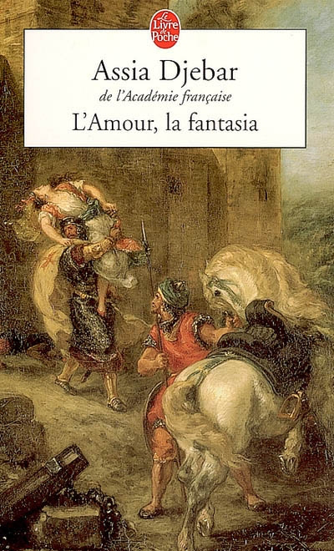
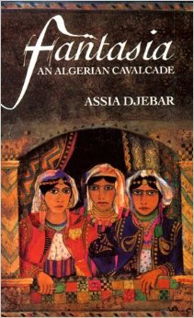
Week 5: Assia Djebar’s Fantasia: An Algerian Cavalcade

Slide 2
Silenced and Absent
Djebar successfully represents what was formerly silenced and absent from representation, the participation of Algerian women in resistance struggles against French colonization of Algeria, and politicizes the everyday experiences of Algerian women in their global and historical contexts.
Djebar does not position herself as a vehicle for silenced women, instead she illustrates the process whereby their stories inform her own search for voice and self.
Representation becomes a deliberately political act for Djebar

Slide 3
Self-Identification
Djebar identified herself as a Western-educated, Algerian, feminist, Muslim intellectual.
She is considered a spokesperson for Algerian women, and women in general.
She uses aphasia and silence as a form of expression and resistance against male societal structures which paradoxically are said to promote this.
Djebar also connects language to a woman’s body.

Slide 4
Carrier of Fire
Mildred Mortimer contends “Djebar uses oral history to give voice to surviving heroines, the porteuses de feu of the Algerian revolution, and allows them to tell their own stories”.
Soheila Ghaussy concludes “By deliberately blending fiction and experience, fictionality and language, and especially by gendering writing (ecriture) as male and orality (Kaalam) as female, moreover associating the former with French and the latter with Arabic, Djebar creates subtle and complicated links between the “feminine” spheres of oral languages and the “male” domain of writing.”

Slide 5
Doubly Subjugated
Within her own culture, an Arab woman is already the Other. By the French, she is subjugated because she is a woman and an object of colonisation.
If writing is embedded in, or is dominated by, discourses of the hegemonic Other, how can one not belonging to the dominant group find modes of expression that reflects the specificity of one’s own experiences?

Slide 6
Djebar’s Concerns:
“Can I, twenty years later, claim to revive these stifled voices? And speak for them? Shall I not at best find dried-up streams? What ghosts will be conjured up when in this absence of expression of love (love received, ‘love’ imposed), I see the reflection of my own barrenness, my own aphasia”.
“To attempt an autobiography using French words alone is to lend oneself to the vivisector’s scalpel, revealing what lies beneath the skin”.
“Autobiography practiced in the enemy’s language has the texture of fiction”.
How would you respond to these concerns?

Slide 7
Translating
The act of translating Arabic into French, translating Kaalam (the female) into ecriture (the male), puts Djebar in the position of an interpreter who has the power of eradicating clear-cut boundaries.
Nicole Ward Jouve explains “For many bilingual women… translation is an activity by means of which the “natural” bond “meaning-language” can be transgressed. It is a state of continued suspension, allowing, in Walter Benjamin’s words, the “post-maturation of the foreign speech, the birth throes of one’s own speech.” The process is therefore eminently “feminine”. When you translate, the absolute status of nouns, the “Name-of-the-Father” is shaken. Exchanges between words are no longer “full”, that is guaranteed by the law which rules and partitions women, which prevents femininity from coming into being.”
Explore the theme of translation in the novel.

Slide 8
Cultural Memory
Cultural memory has been defined as the way a group of people with shared experiences, history and cultural identity construct ways of perceiving themselves.
Cultural memory can also be described as the way the past is understood in a society at certain times and places.
It is not restricted to presenting accurate and truthful testimonies of the past, but makes meaningful statements about the past in a given context of the future.
Cultural memory is not exclusively concerned with valid facts, or even coherent methodology, but rather with the consensus of assumptions and prejudices shared by a culture or society.
Thus, as interpretations of the past change, so do cultural memories.
How does Djebar construct a new cultural memory?

Slide 9
Adlai Murdoch explains
The colonisers discourse “becomes so pervasive that it is systematically accepted as the final and authoritative definition of the culture in whose name it purports to speak and which in effect it circumscribes. It is the subversion and reversal of this practice, the putting in place of a new form of writing that will speak to the anguish of alienation and the desire for recognition and identity on the part of the dispossessed, that Djebar attempts to effect here.”
A question that stems from this is, who is entitled to speak for past events in the present?

Slide 10
Murdoch believes Djebar makes her novel problematic
“For, in situating herself as a writer who must come to terms with the history of Algeria and with herself as a postcolonial, Arab, female subject writing in French about women who do not speak French and cannot speak for themselves, Djebar’s narrative will inevitably problematize its own discourse to the point where its own tenuous coherence threatens to dissolve.”

Slide 11
Feminine Language
How would you define “feminine language” or what French feminists define as “ecriture feminine”?
How is “feminine language” used in Fantasia? Is it used as a feminist strategy?
What are the difficulties and limitations of positing a “feminine language”?

Slide 12
Polarities
Explore the theme of subjugation and resistance.
Explore the theme of sound and silence in the novel.
How does Djebar fuse his-story with her-story?
What effect does it have to mix the written narratives by men and the oral accounts by women?

Slide 13
Djebar asks:
If Woman is defined as Other, can she then speak?
Can she express herself and her specifically female experiences?
And if so, whose language, whose voice is she using in doing so?
How does Otherness and appropriation affect Algerian women in light of colonisation?

Slide 14
Structure
Why does Djebar shift between the distant past, recent past, and autobiographical accounts of coming of age? What effect does this shift have on the reader?
Fantasia blurs genres by incorporating travel narratives, historical colonial documents, interviews and autobiography. What is the purpose of crossing genres? How can we interpret this?

