Slide 1
A Thousand and One Nights/The Arabian Nights

Slide 2
orientalism and imaginative imperialism
The kind of political questions raised by Orientalism, then, are as follows: What other sorts of intellectual, aesthetic, scholarly, and cultural energies went into the making of an imperialist tradition like the Orientalist one? How did philology, lexicography, history, biology, political and economical theory, novel-writing, and lyric poetry come to the service of Orientalism’s broadly imperialist view of the world? (15)
--- Said, Edward. Orientalism. London: Penguin, 2003. Print.

Slide 3
orientalism and imaginative imperialism
Despite his claims for scholarship and semantic equivalence, Burton's translation is a creative production that discloses more about English sexual preoccupations than it does about Arab sexuality. His translation demonstrates how his transformation of the Arab text elicited a debate about pornography agitated by English nationalism, by anxiety about English sexual prudery, and by prurient interest in Arab sexuality. Most importantly, it shows how the literary and cultural concept of pornography emerged with the expansion of travel, empire, and globalisation.
--- Colligan, Colette. ““Esoteric Pornography”: Sir Richard Burton’s Arabian Nights and the Origins of Pornography” Victorian Review. 28.2(2002): 31-64. (34)

Slide 4
Orientalism and Imaginative imperialism
“[Burton] gives it his opinion that ‘the student who adds the notes of Lane (“Arabian Society”) to mine will know as much of the Moslem East and more than many Europeans who have spent half their lives in Orient lands.’ When we examine the notes we can readily believe this curiously expressed statement. Probably no European, even if he have live half a century ‘in Orient lands’, has ever gathered together such an appalling collection of degrading customs and statistics of vice as is contained in the notes to Captain Burton’s translation of the ‘Arabian Nights’. It is bad enough in the text of the tales to find that Captain Burton is not content with plainly calling a spade a spade, but will have it styled a dirty shovel; but in his notes he goes beyond this, and the varied collection of abominations which he brings forward with such gusto is a disgrace and a shame to print literature.” (183)
--- Lane-Poole, Stanley. “The Arabian Nights” The Edinburgh Review 164.135(1886): 166-199.

Slide 5
Orientalism and imaginative imperialism
[The Nights is] a compound text; on the one hand a medieval popular literature built upon a self-image now alien in European culture, and on the other an integral element and source for Romanticism and European imperial politics. The Nights is not a compound text only because of the uneasy links between the Arabic and English versions. The European texts were accommodating to a confused and compound reception and flexible enough to be convincing in almost contradictory interpretations. The Nights [were] the indulgence of lawless imagination and immorate improbability, the ultimate in flights of fantastic unreality [but were also used] as an accurate picture of the manners and customs of the Other. The two readers , the armchair traveller and the reader in search of exotic and enchanting unreality, existed side by side, even at times as one person. (6)
--- Sallis, Eva. Sheherazade Through the Looking Glass: The Metamorphosis of the ‘Thousand and One Nights’. London: Routledge, 1999. Print.

Slide 6
AlaDdin and The middle east
https://www.youtube.com/watch?v=Aw8Do64bEtU
(Aladdin Disney Intro)
https://www.youtube.com/watch?v=U-aVkMClvBs
(Honest Trailer)

Slide 7
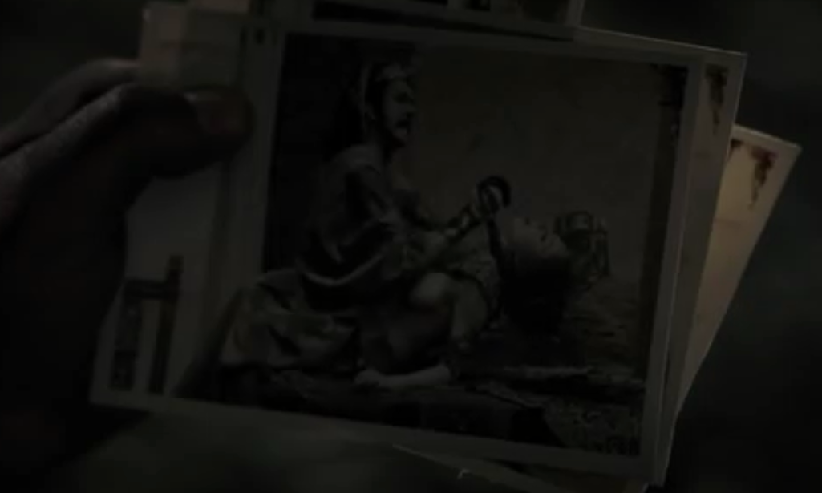
Ripper street, s1, e1 “I need light”

Slide 8
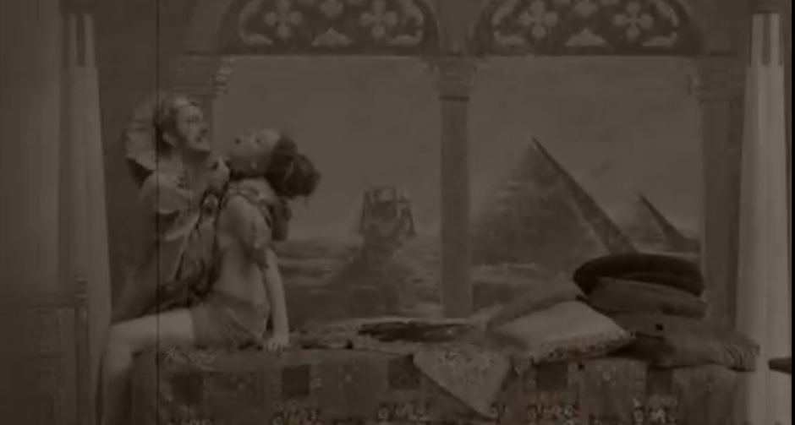
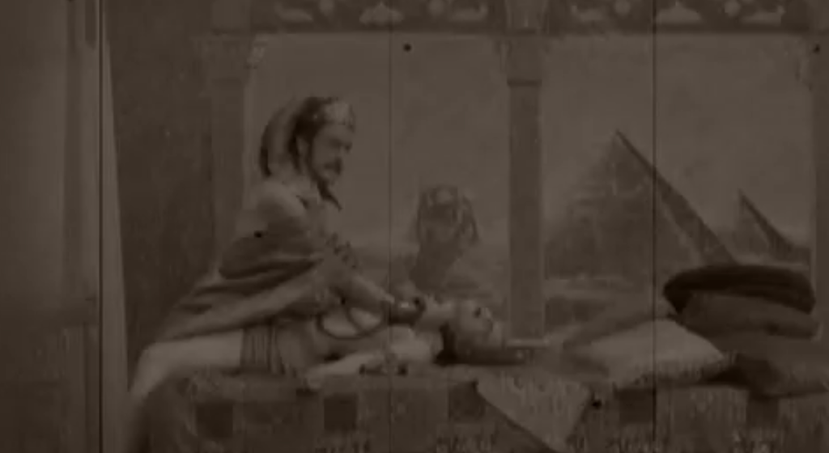
Ripper street, s1, e1 “I need light”

