Slide 1
A Child of the jago
Arthur Morrison

Slide 2
The Legacy of The Jago
Some of the symmetry
Between the rooftop pools in the sewer
It's easy to disappear
When you know that nobody would miss you
Like a child of the Jago
A child of the Jago
Yeah yeah
There’s always been weary souls
That look like they're straight out of fiction
Wretched and weather-beaten
With the wind blowing rain in their faces
It always disgraces
In most modern places
Yeah yeah
There's always a worse kind of place
Where it will shock even the sick and the twisted
Pocket is there for the picking
And the clothes are for living on church day
The difference is minor
To a child of the Jago

Slide 3
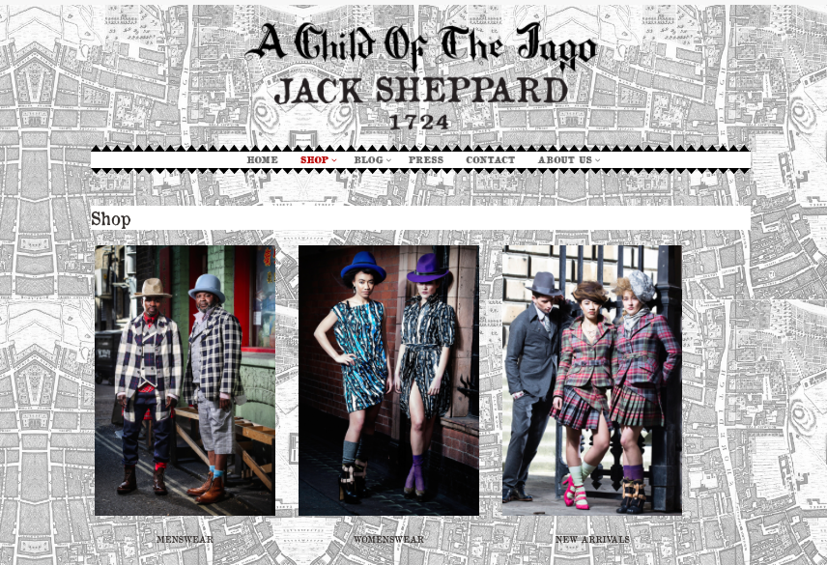
The Legacy of the jago

Slide 4
Responses to A Child of the Jago
“It was my fate to encounter a place in Shoreditch, where children were born and reared in circumstances which gave them no reasonable chance of living decent lives: where they were fore-damned to a criminal or semi-criminal career” (Preface)
“A Child of the Jago [leaves] the impression of extraordinary unreality […the reader] comes out from the Jago with the feelings, not as he had expected, of a man who has just paid a visit to the actual district under the protection of the police, but of one who had just awakened from the dream of a prolonged sojourn in some fairyland of horror…” H. D. Traill, ‘The New Realism’ Fortnightly Review)

Slide 5
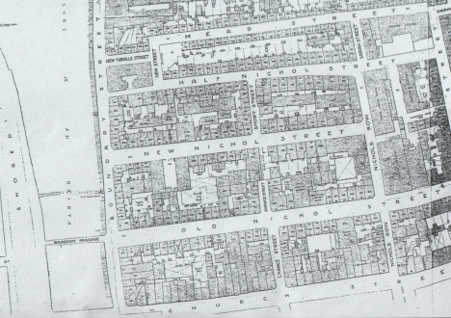
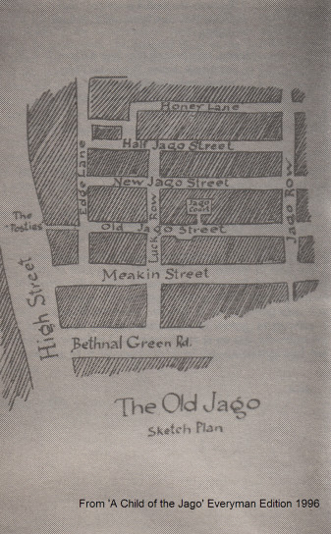
Framing the jago

Slide 6
Framing the Jago
“Below, the hot, heavy air lay, a rank oppression, on the contorted forms of those who made for sleep on the pavement: and in it, and through it all there rose from the foul earth and the grimed walls a close, mingled stink—the odour of the Jago”. (11)
“It was past the mid of a summer night in the Old Jago. The narrow street was all the blacker for the lurid sky; for there was a fire in a farther part of Shoreditch, and the welkin was an infernal coppery glare […]'Hell? And how far's that? You're in it!’ […] My God, there can be no hell after this!" (11-12)
“Every moving creature in this, the Old Jago, day and night, sleeping and walking, the third plague of Egypt and more, lay unceasing” (12)

Slide 7
The Jago inhabitants
“The Ranns and the Learys, ever at war or in guarded armistice, were the great rival families—the Montagues and Capulets of the Old Jago” (27)
Josh, Hannah, Dicky, Looey, Em, and little Josh Perrott
Kiddo Cook
Pidgeony Poll
Aaron Weech
Father Sturt
Bobby Roper
Mother Gapp

Slide 8
Social/religious interventions
“The triumphs of the East End Elevation Mission and Pansophical Institute were known and appreciated far from East London, by people who knew less of that part than of Asia Minor […] there were classes, and clubs, and newspapers and games of draughts, and musical evenings, and a brass band whereby the life of the Helpless Poor might be coloured, and the Misery of the Submerged alleviated. The wretches who crowded to these benefits were trademen’s sons, small shopkeepers and their familie,s and neat little clerks […] the East End, they reported, was nothing like what it was said to be […] the people were quite a decent sort in their way.” (20)

Slide 9
Social/religious interventions
Father Sturt “For himself, he was tall and soundly built, with a certain square muscularity of face, and of age about thirty-five.” (42)
“He flung them back, commanded them, cowed them with his hard, intelligent eyes, like a tamer among beasts.” (48)
“…the East London Elevation Mission and Pansophical Institute was asking very diligently for funds—and was getting them […] there had arisen a sudden quacksalver, a Panjandrum of philanthropy, a murmur of the market-place, who undertook, for a fixed sum, to abolish poverty and sin together, and many, pleased with the new gaudery, poured out money before him that had gone to maintain hospitals and feed charities. [Father Sturt] had a club at which boxing was allowed, and dominoes—flat ungodliness.” (76)

Slide 10
Nature versus Nurture or Heredity versus environment
“The fact is that neither ignorance, wrong moral suggestions, nor parasites are inherited; the baby that survives in the Jago must needs have a good physique, the Jago people are racially indistinguishable from the people who send their children to Oxford […] the Jago is not a ‘black inheritance’, it is a black contagion.” (H. G. Wells, ‘A Slum Novel’ Saturday Review)
“…he is wrong. Just look at this book of Charles Booth’s “Pictures of Pauperism”, and see the influence of heredity. Look at these long lists of families going back to the third and fourth generation, and all criminals or lunatics. Now and again turns up a respectable artisan, but he is a freak […] and he is so rare and startling an exception that he only goes to prove the point…” (Arthur Morrison, ‘The Children of the Jago: Slum life at Close Quarters’ Daily News)

Slide 11
Nature versus Nurture or Heredity versus environment
“Were the lump once levened by the advent of any denizen a little less base than the rest, were a native once ridiculed and persuaded into a spell of work and clean living, then must Father Sturt hasten to drive him from the Jago ere its influence suck him under for ever; leaving for his own community none but the entirely vicious.” (77)
“[He was] repressed by the remembrance that albeit the Jago death-rate ruled full four times that of all London beyond, still the Jago rats bred and bred their kind unhindered multiplying apace and infecting the world” (77)

Slide 12
Eugenics and Degeneration
“A definite accusation is the that I have taken bad types from divers districts, and concentrated them in my picture of the Jago. But again Mr Traill mistakes. The original of my Jago was a place to which those types gravitated as by natural law from other parts. Not I, but their own propensity, brought these people together” (Arthur Morrison, “What is a Realist?” New Review)
“It is monstrous that the weak should be destroyed by the strong, but still more so that the strong should be destroyed by the weak. For my own part, I believe, as Father Jay does, in penal settlements; it would be far cheaper than our present prison system. Why not confine them as lunatics are confined? Let the weed die out, and then proceed to raise the raisable. That is why I killed Dicky Perrott. He could not escape from his environment, and had he lived, would have become perforce, as bad as his surroundings.”

Slide 13
Eugenics and degeneration
“Dicky grew slighter and lanker, dark about the eyes, and weaker. He was growing longitudinally, and that made his lateral wasting the quicker and the more apparent […] rarely could a meal be seen ahead; and when it came, it made Dicky doubtful whether or not hunger were really caused by eating.” (129)
“Hannah Perrott had anticipated the operation of the Maternity Society letter, and another child of the Jago had come unconsenting into its black inheritance. […] Here lies the Jago, a nest of rats, breeding, breeding, as only rats can; and we say it is well. On high moral grounds we uphold the right of rats to multiply their thousands. Sometimes we catch a rat. And we keep it a little while, nourish it carefully, and put it back into the nest to propagate its kind.” (133)

Slide 14
Jago Morals and respectability
“There was no basin there, nor any soap, nor towel; and anything savouring of moderate cleanliness was resented in the Jago as an assumption of superiority” (29)
“As for herself she was no favourite in the neighbourhood at any time. For one thing, her husband did not carry the cosh. Then she was an alien who had never entirely fallen into Jago ways; she had soon grown sluttish and dirty, but she was never drunk, she never quarrelled, she did not gossip freely. Also her husband beat her but rare; and then not with a chair nor a poker. Justly irritated by such superiorities as these, the women of the Jago were ill-disposed to brook another: which was, that Hannah Perrott had been married in church” (32)

Slide 15
Jago Morals and respectability
“He had a pale wife, disliked because of her neatly-kept clothes, her exceeding use of soap and water, her aloofness from gossip. Collectively the Ropers were disliked as strangers: because they furnished their own room, and in an obnoxiously complete style; because Roper did not drink, nor brawl, nor beat his wife, nor do anything all day but look for work; because all these things were a matter of scandalous arrogance, impudently subversive of Jago custom and precedent.” (43)
“Here were these pestilent outsiders, the Ropers, assailing the reputation of the neighbourhood by complaining of being robbed. As though their mere presence in the Jago, with their furniture and their superiority, were not obnoxious enough: they must turn about and rail their neighbours thieves! (47)

Slide 16
Hope for the jago?
Dicky’s love for Looey, the clock; music box; desire for betterment
Community spirit; Pidgeony Poll, Kiddo Cook
“It’s the best the world has for you, for the Jago’s got you, and that’s the only way out, except gaol and the gallows […] so do your devilmost, or God help you, Dicky Perrott—though he won’t: for the Jago’s got you!” (60)

