Slide 1
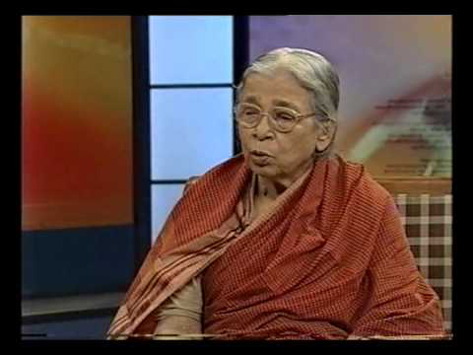
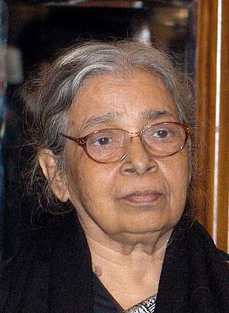
Subalternity, Solidarity and Experience
Week 1: Mahasweta Devi, “The Hunt”, “Draupadi” and “Douloti the Bountiful”

Slide 2
Mahasveta Devi
“I think and I believe of my self as an Indian writer, not as a Bengali writer at all. I am proud of this.” (Devi)
Devi is a famous writer and tribal activist.
Born in 1926, Devi has written many novels and short stories in Bengali. Her work is powerful, moving and infused with a sense of the movement of history. She is also a prolific journalist. Most of her time is given to her work among the tribal communities in the border areas of the states of West Bengal, Bihar, and Orissa.
Tribal people are often the protagonists of her writings. She attempts to speak up for the plight of tribals in India, for their exploitation, for the systematic destruction of their forests, for the oppression of bonded labour still plaguing tribals.

Slide 3
Social Conscience
She believes that a writer should have “An anger – luminous, burning, passionate – directed against a system that has failed to liberate my people from these horrible constraints, is the only source of inspiration for all my writings.”

Slide 4
Tribals
Mahasweta Devi tries to say that tribals belong to India, just like the rest of Indians.
Deforestation in India is displacing tribal communities all over the country, tribals lose their homes and their culture.
Devi explores the continuous exploitation of tribals in her fiction. She also describes the warrior-like women: women who are abused – both physically and spiritually – but who find the strength to fight back.

Slide 5
The Hunt
The Hunt comes from an anthology Imaginary Maps: Three Stories.
The story explores gender identity, and whether masculinity and femininity are a social construction.
It describes the life of Mary Oraon, the illegitimate daughter of an Australian white man and a tribal woman.
Tehsildar, an exploiter of tribal forest, starts bothering Mary, who uses the occasion of the tribal hunt festival recurring every 12 years to kill him.
The festival allows women to hunt, drink and dance like men.
When she kills him, the forest becomes feminine and brutal deforestation becomes a metaphor for the rape of nature, for which she takes revenge.
Mary assumes the male gender and her story is an allegory for the exploitation of tribal forests and the rape of tribal women by non-tribals.
Women have a place of honour amongst tribal communities, and insulting or raping a woman is considered the greatest crime. However, outside of tribal communities, tribal women are considered objects and commodities.

Slide 6
Draupadi
This short story deals with the dismemberment of the tribal woman, which is symbolic of the dismemberment of tribal lands, forests, culture and identity.
“Draupadi” is one of the three short-stories included in the collection Agnigarbha (Womb of fire) published in 1978.
Draupadi’s tribal name is Dopdi, thus she has a double identity: one as a woman called Draupadi and the other as a tribal woman call Dopdi.

Slide 7
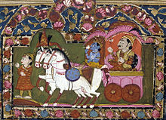
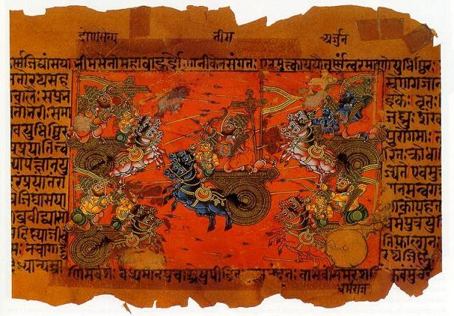
Mahabharata
The heroine of the Indian epic Draupadi is married to the five Pandava brothers. The eldest, Yudhisthira, at one point loses his kingdom and all his possessions to his cousins, the Kauravas, in a game of dice. He then stakes and loses Draupadi, who is violently dragged by the hair in front of the assembly of men. One of the Kauravas attempts to strip her. Draupadi, however, prays to Lord Krishna, who works a miracle: the more her sari is pulled, the more it grows and thus Draupadi can never be stripped. The attempt to strip Draupadi is a symbol of women’s humiliation, harassment and violence.

Slide 8
Draupadi-Dopdi
Draupadi is hunted down, caught and arrested by the police. She is tortured, gang-raped and stripped in front of the policemen.
Her ravaged and tortured body becomes a weapon. Draupadi uses it against Senanayak.
Draupadi refuses to cover herself or be ashamed, her mangled body terrifies Senanayak, as it becomes a symbol of male force and institutionalised authority.
She uses her body as a means of resistance.

Slide 9
In “Women in Difference: Mahasweta Devi’s “Douloti the Bountiful”” Spivak contends:
“Her material is not written with an international audience in mind. It often contains problematic representations of decolonization after a negotiated political independence.” (105)
What problems does Devi explore in the three texts you’ve read this week?

Slide 10
Bonded Labour
Spivak goes on to explain: “in modern “India,” there is a “society” of bonded labour, where the only means of repaying a loan at extortionate rates of interest is hereditary bond-slavery. Family life is still possible here, the affects taking the entire burden of survival. Below this is bonded prostitution, where the girls and women abducted from bonded labor or kamiya households are thrust together as bodies for absolute sexual and economic exploitation.” (111-112)
Devi explains this through Douloti “Why grieve, Uncle Bono? Bondslavery loan is never repaid. A three hundred rupee loan becomes infinite in eight years. The boss has raised more than forty thousand rupees wringing this body of mine. Still I owe. There will be a loan as long as my body is consumable. Then I’ll leave as a beggar.” (87)

Slide 11
Spivak concludes:
“Douloti, like the unresisting majority of the male outcasts, comes to terms with her existence by accepting bond-slavery as a law of nature. Mahasweta does not represent Douloti as an intending subject of resistance. Her ego splits at her first rape and stays split until nearly the end. We will see at the end that Douloti is not represented as the intending subject of victimization either. The coding of intention into resistance and the resisting acceptance of victimization animates the male militants and the fierce bonded prostitutes, for whom this is no opportunity for collective resistance.” (125)
Devi “presents Douloti’s affect and ultimately Douloti herself, as the site of a real aporia” (126).
Is Douloti representative of a question, for which Devi seeks answers?
Notes:
According to Spivak “An aporia is not a statement of preference, certainly not a dismissal. One genuinely cannot decide between the two determinants of an aporia. It is the undecided in the face of which decisions must be risked.” (23)

Slide 12
Douloti’s Death and
Independence Day
The rural schoolmaster Mohan Srivastava “tries to teach his students nationalism by inscribing a large map of India in the clay courtyard of school, in preparation for Independence Day. Douloti finds the clean clay comforting in the dark and lies down to die there. In the morning the schoolmaster and his students discover Douloti on the map.” (Spivak 127)
“Filling the entire Indian peninsula from the oceans to the Himalayas, here lies bonded labour spread-eagled, kamiya-whore Douloti Nagesia’s tormented corpse, putrefied with venereal disease, having vomited up all the blood in its desiccated lungs. Today, on the fifteenth of August, Douloti has left no room at all in the India of people like Mohan for planting the standard of the Independence flag. What will Mohan do now? Douloti is all over India.” (92)
How can we interpret this?

Slide 13
Indian Independence Day
Douloti’s death according to Spivak “makes the agenda of nationalism impossible” (128).
Why do you think Devi decides to close the short story with two short sentences: a rhetorical question and a statement that is not an answer? – “What will Mohan do now? Douloti is all over India.”
If Douloti can be made to mean “traffic in wealth” what might the final sentence mean?

Slide 14
Doulot
“The word doulot means wealth. Thus douloti can be made to mean “traffic in wealth”. Under the last sentence - “Douloti is all over India” [Bharat jora hoye Douloti] – one can hear that other sentence: Jagat [the globe] jora hoye Douloti. What will Mohan do now? – the traffic in wealth [douloti] is all over the globe.” (Spivak 128)
Spivak concludes that the final sentence pushes the reader from the local to national to the neocolonial globe.
Douloti’s body is encrypted with the agendas of nationalism and sexuality and showcases the indifference towards super-exploitation.

Slide 15
Discussion Questions
Read through the discussion questions and share your ideas with the group.

