Slide 1
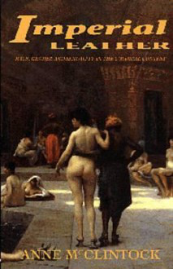
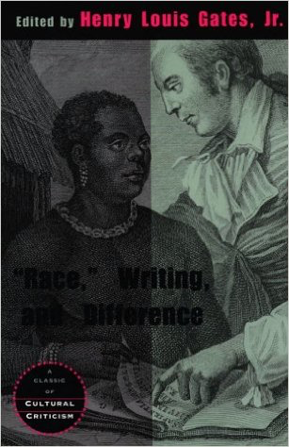
Week 3
Sander L. Gilman, “Black Bodies, White Bodies: Toward an Iconography of Female Sexuality in Late Nineteenth-Century Art, Medicine, and Literature”
Anne McClintock, “’Massa’ and Maids: Power and Desire in the Imperial Metropolis”

Slide 2
Representation
Ideological, relying on stereotypes (conventions based on class, race, gender, ways of seeing that are invisible, unexamined and naturalized)
Observers and producers of images—both shaped by history
Icons: representing a whole class/category; all visual representation uses icons

Slide 3
Three themes emerge in the history of Black feminist theory:
The construction of the black female as the embodiment of sex and the attendant invisibility of black women as unvoiced, unseen and everything that is not white.
The resistance of black women both to negative stereotypes of their sexuality and the material effects of those stereotypes on black women’s lives.
The evolution of a ‘culture of dissemblance’ and the ‘politics of silence’ by black women on the issue of their sexuality.

Slide 4
Hottentot Female
The Hottentot female most vividly represented in this iconography was Sarah Baartmann (before 1790 – 29 December 1815), known as the “Hottentot Venus”. Baartmann was crudely exhibited and objectified by European audiences and scientific experts.
https://www.youtube.com/watch?v=r-7bKi5MFWI

Slide 5
Hottentot Venus
Icon of the Hottentot Venus/icon of the prostitute
Essence of the black woman; absolute difference/sexualized woman; reduced to her sexual parts
Evidence of racial difference (inferiority): as different from the European as the orangutan; sign of the primitive.

Slide 6
Black figures/prostitutes/primitives
Source of pollution
Illness of society/the diseased prostitute
Children of alcoholics
Concern with the prostitute’s physical features (plump/fat; lazy); signs at the lower end of the scale of beauty
Why was/is there such a negative construction of black women’s sexuality?

Slide 7
To put it simply:
Ideologically, these sciences reflected European males’ fear of difference in the period of colonialism and their consequent need to control and regulate the sexuality of those rendered ‘other’.
Thus racial difference was linked to sexual difference to maintain white male supremacy during the period of slavery.

Slide 8
Discussion Questions Gilman
How did something that was initially adopted as a political strategy to maintain white male supremacy during the period of slavery become so ingrained in society as to be recognizable as a culture?
Can you think of any contemporary examples?
Or was it a result of an absence of detailed historical studies that little is known about the social constructions of sexuality changing over time alongside changing social conditions?
How can feminists dislodge the negative stereotyping of a black woman’s sexuality and the attendant denials of citizenship and protection?
Has Jean Rhys contributed to this project in any way?

Slide 9
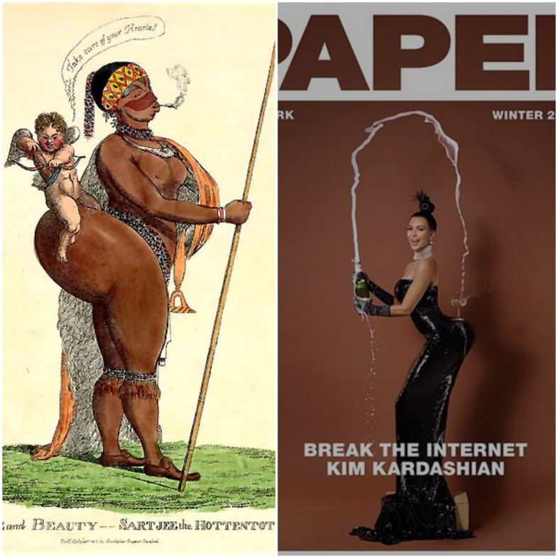
Imagery that is steeped in centuries of racism, oppression and misogyny

Slide 10
Anne McClintock, “’Massa’ and Maids: Power and Desire in the Imperial Metropolis”
Articulation of class, gender, race
Gender: an articulated category, constructed through and by class (feminine women vs masculine women), just as gender is used as a regulatory discourse to manage class (working class women unrefined, not at home)
Class and sexuality managed and policed by discourse on race
Analogue between working-class women and black men; between prostitutes and black women (dangerous criminality); between slum and colony

Slide 11
Discussion Questions
McClintock contends Munby equated female sexuality with servitude (80), is Anna’s sexuality servile or does she demonstrate some agency?
“Walking bespoke leisure and male class power.” (81) Analyse the figure of the Flaneur in Voyage in the Dark, what characters are seen to leisurely walk through the turmoil of the city? What does this tell us about their position within society?
‘If the woman’s body is the child’s first space for knowledge and self-discovery, later the city, as the first space of modern self-knowledge, was mapped as a feminine space. Once feminized, the city was more easily represented and made docile for male knowledge and power, for such representations could depend on the prior fact of the social subordination of women.” (82) Explore whether the city is a feminine space in Voyage in the Dark?

Slide 12
Discussion Questions
“[G]ender is an articulated category, constructed through and by class.” (94) How is Anna’s gender articulated and constructed through her class?
Munby admired women who wore trousers but he was alone, most considered women in male attire as a threat to the “moral fiber of the nation”, “absolutely unsexing the women” and making them “utterly coarse and unfeminine” (117). Compare this to the way in which Rhys describes the importance of clothes in the novel?

Slide 13
Discussion Questions
“In the last decades of nineteenth century, the urban crowd became a recurring fetish for ruling-class fears of social unrest and underclass militancy. Lurking in the resplendent metropolis, the crowd embodied a “savage” and dangerous underclass waiting to spring upon the propertied classes. As the embodiment of deviant agency, the crowd became the metonymic symbol of the unemployed and unruly poor; who were associated with criminals and the insane; who were in turn associated with women, particularly prostitutes and alcoholics; who were in turn associated with children; who were associated with “primitives” and the realm of the empire. The degenerate crowd […] violently irrational yet hypnotically ductile, savage and bestial, inherently criminal and, above all, female” (119). Why is a masculine crowd feminized? Why is gender used as a regulatory discourse to manage class? Apply this to Anna, where is she positioned within the “urban crowd”?

