Slide 1
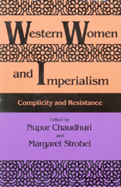
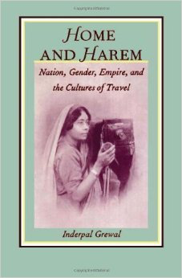
Feminism and Colonialism
Antoinette Burton, “The White Woman’s Burden: British Feminists and ‘the Indian Woman’, 1865-1914”
Inderpal Grewal, “The Culture of Travel and the Gendering of Colonial Modernity in Nineteenth-Century India”

Slide 2
Burton posits:
British feminists were imbued with an imperialist consciousness of racial hierarchy.
  Superiority of white women as morally pure, nurturing
  Race preservation—women as mothers of the race
  Vessels of society; responsible imperial citizens
The very existence of their feminist movement depended on the racialized construct of the colonized other.

Slide 3
Imperial context of feminism
“Acknowledging the impact of empire on the British women’s movement is one of the most urgent projects of late twentieth-century Western feminism”.
Liberal bourgeois feminism—its premises compatible with an imperial ethos; Structured around the idea of moral responsibility (aid, charity)
Empire—a fact of life; imbued a sense of national and racial superiority an organizing principle of Victorian society;
F Nightingale: India as “a home issue”
Empire—an integral and enabling part of the woman question (cleared ideological and practical space for women)

Slide 4
Indian woman—white woman’s burden
Not seen as equals, but in need of saving (ignoring the feminist reform activities of Indian women); larger belief that British presence would improve India
A foil against which to gauge their own progress
Modern Western feminism influenced by imperial assumptions of the day—a secular burden; maternal feminism
Colony—site of reform

Slide 5
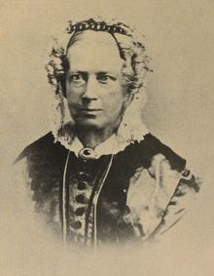
Mary Carpenter (1807-1877) educational and social reformer
Mary Carpenter visited India in 1860s and promoted Hindu female education.

Slide 6
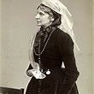
Josephine Butler (1828-1906)
British feminist and social reformer

Slide 7
Activity
Read the extract from Mary Carpenter’s Six Months in India.
How does she describe Indian women and their position in society?
What role do women like Mary Carpenter and Josephine Butler play in the colonial project?
Did these movements improve conditions for women?
What do the studies of colonizing women fail to consider or incorporate in their analysis?
According to Burton Indian women did not have an opportunity to speak for themselves, British feminists robbed them of their power. Do you agree?

Slide 8
Maintaining the Empire
Burton highlights the role women played in creating, sustaining and maintaining Britain’s empire, which you could say was disguised as a feminist project or “white woman’s burden” to save the enslaved Indian women.
Feminism is and always will be a quest for power as much as it is a battle for rights. Do you agree with Burton’s statement?
What is the significance of Anna (metaphorically) inheriting the historical ruin of her father’s estate?
Why might Jean Rhys have chosen for her character to have this historical framework behind the story of her slide into prostitution?

Slide 9
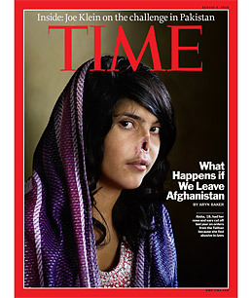
Can you think of any contemporary manifestations of saving women?
Why do you think indigenous women are associated with colonizing land/space?

Slide 10
Inderpal Grewal, “The Culture of Travel and the Gendering of Colonial Modernity in Nineteenth-Century India”
Inderpal Grewal contends the colonial modernity is a gendered issue.
Production of gendered selves-reconstitution of domestic space under colonialism
Opposition of home and the world
Pre-existing caste, class, familial and gender demarcations reworked
Indian men: equality with the British—new modes of patriarchal power (discovering an ancient past; mapping the nation); reform

Slide 11
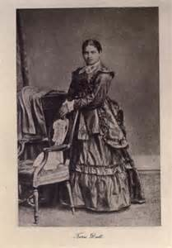
Toru Dutt (1856-1877) writer, traveller, first Indian woman to publish poetry in English

Slide 12
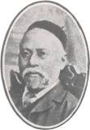
Behramji Malabari
Indian poet, publicist, author, and social reformer best known for his ardent advocacy for the protection of the rights of women.

Slide 13
Discussion Questions:
How does Anna’s journey to England compare to Toru and Behramji journey?
How is Rhys presenting travel?
Do you consider Voyage in the Dark to have any similarities with travel literature?

Slide 14
Irony
Grewal contends it is ironic that nineteenth century England was considered a superior civilization to India.
Find some evidence from the text which examines the irony Grewal discusses.

Slide 15
Discussion Questions
Does Anna perceive England to be the land of freedom?
Why might Rhys have chosen not to portray an idealized experience of London?
Does Anna become a victim of travel?
Does Anna construct a new identity and self through her journey to England?

Slide 16
Discussion Questions
Do you feel Anna speaks for herself? How is she defined by those around her?
What is Anna’s sense of self? How is it constructed?

Slide 17
Plenary
Can you sum up the thesis from each essay? – Write one sentence for each essay.
Can you identify how these essays might be used to interpret Rhys?

