Slide 1
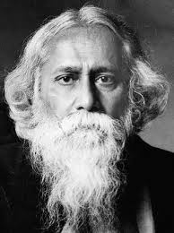
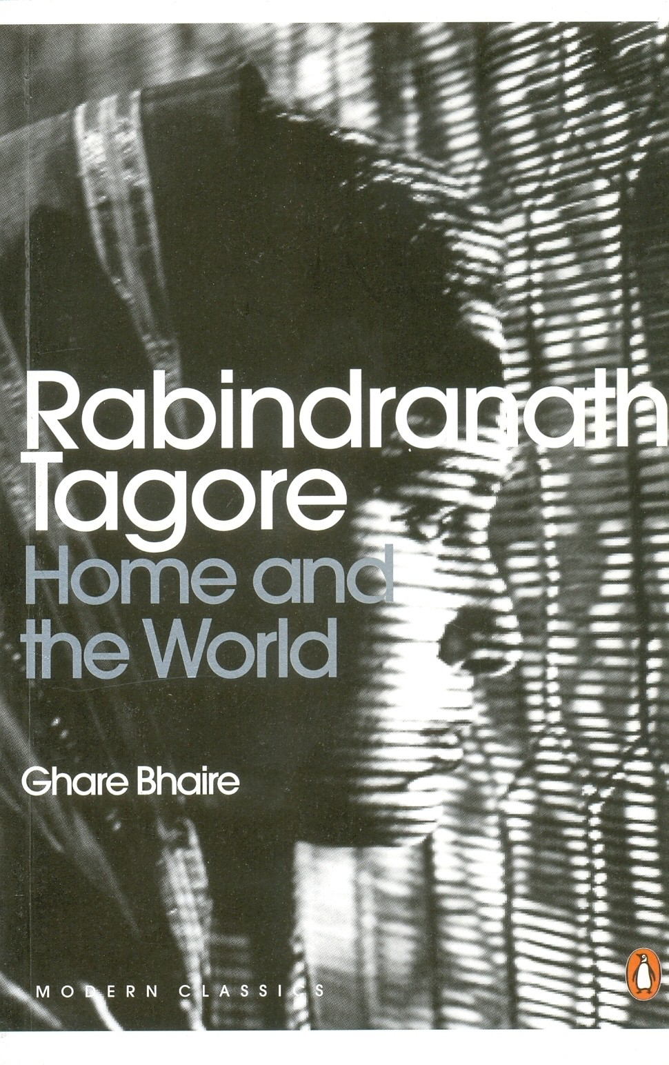
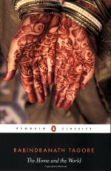
Rabindranath Tagore
The Home and the World (1916)

Slide 2
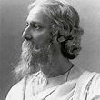
Tagore

Slide 3
Tagore 1861-1941
Poet, novelist, painter
Iconic man of letters—Nobel Prize for literature in 1913
A modernist, humanist and internationalist (anti-imperialist and critic of extremist, violent nationalism)
Benevolent paternalism: born into an elite Bengali family; landed gentry that combined traditional zamindari (landlordism) with modern education and progressive ideals and politics (rural upliftment). Tagore’s father was a leading proponent of the Brahmo Samaj, a reformist Hindu movement)
Renounced his knighthood following the 1919 Jallianwala Bagh massacre

Slide 4
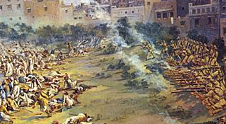
Jallianwala Bagh Massacre (1919)

Slide 5
Historical background to the novel
1905: Lord Curzon’s Partition of Bengal, along communal lines (“divide and rule”)
1905-1908: The Swadeshi movement—first popular anti-colonial movement in India that took place in Bengal
Extremists and moderates
Criticised for being elitist
Boycott of foreign goods (cloth imported from Britain that impoverished local weavers)
Stirred nationalist sentiment but also aroused communal tension between Hindus and Muslims (middle-class Swadeshi activists and peasants and petty traders)

Slide 6
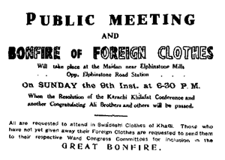
Swadeshi Movement

Slide 7
Nikhil and Bimala
Modern conjugal love that is based not on worship and devotion, but on love and companionship
“I would have you come into the heart of the outer world and meet reality. Merely going on with your household duties, living all your life in the world of household conventions and the drudgery of household tasks—you were not made for that! If we meet, and recognise each other, in the real world, then only will our love be true” (Nikhil to Bimala, 23)

Slide 8
Sandip and Bimala
Bimala personifies Bengal, she is torn between the values of the two men. She becomes the terrain on which the two men fight and she serves as their prize. She also serves to represent public opinion of their competing world views.
The eroticization of Bimala’s relationship with Sandip is meant to represent the seductiveness of the Swadeshi movement’s promise to deliver the nation from imperialist subjugation.

Slide 9
Gendering modernity
Women as individual subjects negotiating tradition and modernity
Women’s roles in building the nation—goddess and the everyday woman
Politics and desire—merging of the erotic and the nationalist
Setting up a conjugal home in the city

Slide 10
Bimala: ideal wife/modern woman
Bimala: imagining different possibilities
Traditional heroine of Hindu revivalism who is also modern
“ideal wife” (devotion) led into modernity by her progressive husband
“Everyone says that I resemble my mother. In my childhood I used to resent this. It made me angry with my mirror… All that remained for me to ask of my God in reparation was, that I might grow up to be a model of what woman should be, as one reads it in some epic poem.
  When the proposal came for my marriage, an astrologer…said, ‘This girl has good signs. She will become an ideal wife” (17).
Literate; reads stories from English books to the grandmother; writes: self-representation
Public role for domestic virtues; wife and nationalist icon
Self-assertion, but becomes an instrument for male power

Slide 11
The “Home” and the “World”
The “world” came to be representative of native people humbled in the colonial encounter, while the “home” became a symbolic space of unconquered and uncompromised national identity.
Tanika Sarkar in Nationalist Iconography contends:
“The woman’s body was the ultimate site of virtue, of stability, the last refuge of freedom… Through a steady process of regression, this independent self-hood had been folded back from the public domain to the interior space of the household, and then further pushed back into the hidden depths of an inviolate, chaste, pure female body.”

Slide 12
Nikhil and Sandip
Nikhil: a wealthy landowner who is modern—educated in the city, rational, benevolent, decent, believes in equality b/w men and women in conjugal life and love; in women’s education; modern dressing bought from European shops; modern house
Desire to take wife to the threshold of the home and the world
Looks at himself through Bimala’s eyes
Possibilities and limits of male reformism
Sandip: fiery revolutionary for whom ends justify the means; charismatic but unscrupulous
Novel mounts a critique of his nationalism based on ideas of divinity
The erotic: test of his power (control over women/control over life)
Bimala confirms his power (even as he is servile towards her)
Masculinity at the heart of his nationalism
Lives on Nikhil’s patronage—does not “work”
Confronts his lack through violence

Slide 13
Bimala’s Education
Figure of Miss Gilby: transnational feminism
  Brought in by Nikhil to teach Bimala and to be her companion
  “I had never bothered myself before whether Miss Gilby was European or Indian, but I began to do so now. I said to my husband, ‘We must get rid of Miss Gilby’.
  “I cannot look upon Miss Gilby through a mist of abstraction, just because she is English” (28).

Slide 14
Discussion Questions
Read through the questions and discuss how you might respond to them in small groups and pairs ready to share your ideas with the group.

