Slide 1
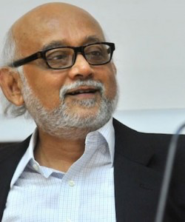
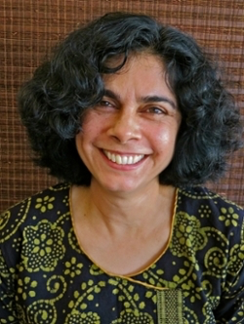

Gendering Nationalism
Session Aims:
To examine the connections between Tagore, Chatterjee, Gould, and Visweswaren.
To feel confident establishing and discussing the thesis presented by these writers.

Slide 2
Partha Chatterjee
“The Nation and its Women”

Slide 3
Nationalism and the women’s question
The ideological sieve through which European ideas of reform passed through
Emphasis on difference with the West
Women’s question situated in an inner domain of sovereignty, away from the political contest with the colonial state
Discovery of tradition (contra to the civilising mission of colonial rule)
Women’s question taken out of the realm of negotiation with the colonial state

Slide 4
Saving brown women
For the colonialists, the degraded condition of Indian women came to stand in for the inferiority of the entire cultural tradition of India
The problem of tradition already constituted by the colonial state (ratified a minority, entrenched tradition as hegemonic)

Slide 5
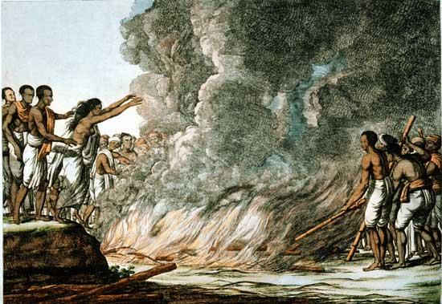
A Woman Leaping into the Flames to the Corpse of her Husband, etching by Solvyng 1799.

Slide 6
Two spheres
Material sphere: science, technology; economics; statecraft. Okay to imitate the West in this domain
Spiritual sphere: east superior; national culture; women as nurturers of this realm
Superimposed onto concepts of outer and inner; social space of home and the world

Slide 7
The new woman in a new patriarchy?
Neither westernized nor the oppressed object of indigenous patriarchy
The new middle class
Education for women—as against that introduced by Christian missionaries—became widespread (before British women were admitted to universities)
The virtues of (spiritual) freedom and self-emancipation, linked with national sovereignty
Inculcation of virtues—discipline, thrift, cleanliness, accounting
New forms of dressing/clothing
Refined tastes

Slide 8
Nationalist ideology
Fixing of masculine/feminine qualities; home and the world; material and spiritual spheres
Woman as goddess/mother (erasure of sexuality in the outside world)
Woman as sign of nation
Seeming absence of autonomous women’s movements
Feminist struggles waged in the home (not much evidence in the archives)—letters, art, cultural artifacts, literature
The nationalist discourse was about women; women did not speak

Slide 9
Kamala Visweswaran
“Betrayal: An Analysis in Three Acts”

Slide 10
Doing feminist research
Assumption of alliance between feminist researcher and her female subjects
Production of knowledge is situated and relational
A less authoritative account/a partial account—not a choice, but a necessity
Agency as performance
Identity as constructed and staged

Slide 11
Gender and Indian nationalism
The family: contained, arena of silence
Family as metaphor of the nation
The limits of the archive
Uma’s silence: around her child marriage
“Don’t tell her I told you so”
Janaki’s marriage: a secret
Tangam’s interception, in English: “she only wants to understand”
(anthropologist as agent of betrayals among women)
Self-staging and self-fashioning

Slide 12
Tools of feminist ethnography
Shifting identities– identities as multiple, contradictory, partial and strategic; conflicting social and linguistic forces
Temporality—contingency of speech: when is something said
Silence: as a marker of women’s agency; silence as resistance (Uma and Janaki’s refusals to speak of their child marriage; Janaki’s refusal to be slotted as spinster or widow)
By disavowing identification as child widows, U and J give shape to their agency

Slide 13
Rebecca Gould “Engendering Critique: Postnational Feminism in Postcolonial Syria”
The woman’s question is being posed from within nationalist discourses even while remaining on the peripheries of political discourses in the postcolony.
She suggests feminism when effectively deployed can disrupt the homogenous and overwhelmingly masculine solidarity inculcated by the nation-state.

Slide 14
Discussion Questions
How can we compare the relationship between the women’s question and nationalism that Chatterjee explores with Tagore’s characters Sandip and Nikhil? How do the two men use Bimala as a terrain on which to debate their politics?
Bhabha suggests “People are the historical ‘objects’ of a nationalist pedagogy”. Explore whether Bimala becomes a historical object of nationalist pedagogy?
Examine whether Bimala ever speaks for herself, who represents her? How is she constructed? Who constructs her?
How can we read Bimala’s relationship with Nikhil and Sandip in relation to the Syrian students analysis of gendered nationalism?

Slide 15
Thesis Statement
Can you sum up the thesis of each of the three theories in one/two sentences.
Divide into three groups and create your thesis.

Slide 16
Partha Chatterjee
Discourses of nationalism were gendered. Nationalism created a “new patriarchy” which fused national integrity with female chastity. Preservation of the home or the nation was embodied in the physical person of the woman.

Slide 17
Kamala Visweswaran
When a subject refuses to historicise themselves they are refusing to tell their own history and that of the nation. To refuse to be a subject is to refuse the nation, the work of the subject is inevitably the work of the collective.

Slide 18
Rebecca Gould
Nationalist agenda subjugated female sexuality and women’s demand for freedom. It requires the sacrifice of female lives and bodies to a cause that violated the interests and desires of individual women. It expects women to conform to a national construct within which men reigned supreme.

