Slide 1
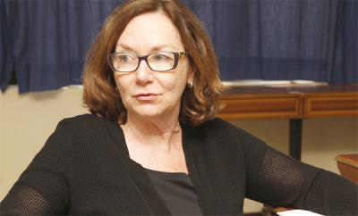

The World, the Body, the Text
Week 8: Donna Haraway, “A Manifesto for Cyborgs”
Francoise Lionnet, “Feminisms and Universalisms: ‘Universal Rights’ and the Legal Debate Around the Practice of Female Excision in France”

Slide 2

Donna Haraway,
“A Manifesto for Cyborgs”
What is a “Cyborg”?
“A cyborg is a cybernetic organism, a hybrid of machine and organism, a creature of social reality as well as a creature of fiction.” (191)
What does this mean?
“the utopian tradition of imagining a world without gender” (192).
“The cyborg is a creature in a postgender world” (192)

Slide 3
Fractured Identity
“It has become difficult to name one’s feminism by a single adjective – or even to insist in every circumstance upon the noun. Consciousness of exclusion through naming is acute. Identities seem contradictory, partial, and strategic. […] There is nothing about being “female” that naturally binds women. There is not even such a state as “being” female, itself a highly complex category constructed in contested sexual scientific discourses and other social practices. Gender, race, or class consciousness is an achievement forced on us by the terrible historical experience of the contradictory social realities of patriarchy, colonialism, racism and capitalism.” (196-7)
Can you identify any possible problems with Haraway’s ideas?

Slide 4
What boundaries have been breached already according to Haraway?

Slide 5
“breached boundary” (193)
Animal and Humans – “the boundary between human and animal is transgressed” (193).
Organism and machines – “Late twentieth-century machines have made thoroughly ambiguous the differences between natural and artificial, mind and body, self-developing and externally designed, and many other distinctions that used to apply to organisms and machines. Our machines are disturbingly lively, and we ourselves frighteningly inert.” (193-4)
Physical and non-physical – TV is an example (195) because you can see it but you can’t touch it.

Slide 6
Cyborg and Power
“Cyborg writing is about power to survive not on the basis of original innocence, but on the basis of seizing the tools to mark the world that marked them as other. The tools are often stories, retold stories, versions that reverse and displace the hierarchical dualisms of naturalized identities. In retelling origin stories, cyborg authors subvert the central myths of origin of Western culture. We have all been colonized by those origin myths, with their longing for fulfillment in apocalypse.” (217)

Slide 7
What is her thesis?
“Cyborg imagery can suggest a way out of the maze of dualisms in which we have explained our bodies and our tools to ourselves. […] It means both building and destroying machines, identities, categories, relationships, spaces and stories. Although both are bound in the spiral dance, I would rather be a cyborg than a goddess.” (223)

Slide 8
Francoise Lionnet, “Feminisms and Universalisms: ‘Universal Rights’ and the Legal Debate Around the Practice of Female Excision in France”
Does universal respect for human rights pose a threat to the value of non-western cultures?

Slide 9
Further questions to consider:
According to the communitarian critique, the idea of rights implies a misguided view of the relation between individuals and their community. Do you agree? Has the legalisation of human rights led to an impoverished political culture?
Is the notion of human rights a western concept?
What are the problems with human rights?

Slide 10

Critique of Human Rights:
“[W]hile the rhetoric of human rights has historically had a positive and liberating effect on societies, once rights become institutionalised as a central part of political and administrative culture, they lose their transformative effect and are petrified into a legalistic paradigm that marginalizes values or interests that resist translation into rights-language. In this way the liberal principle of the ‘priority of the right over the good’ results in colonization of political culture by a technocratic language that leaves no room for the articulation or realisation of conceptions of the good.” Discuss
M. Koskenniemi ‘The Effects of Rights on Political Culture’ in P. Alston (ed.) The EU and Human Rights (Oxford: OUP, 1999)

Slide 11
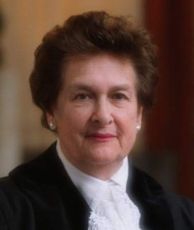
“…I believe, profoundly, in the universality of the human spirit. Individuals everywhere want the same essential things: to have sufficient food and shelter; to be able to speak freely; to practice their own religion or to abstain from religious belief; to feel that their person is not threatened by the state; to know that they will not be tortured, or detained without charge, and that, if charged, they will have a fair trial. I believe there is nothing in these aspirations that is dependent upon culture, or religion, or stage of development. They are as keenly felt by the African tribesman as by the European city-dweller, by the inhabitant of a Latin American shanty-town as by the resident of a Manhattan apartment.” Discuss
R. Higgins, Problems and Process: International Law and How We Use It (Oxford: Clarendon Press, 1994) 96

Slide 12
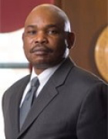
“As currently constituted and deployed, the human rights movement will ultimately fail because it is perceived as an alien ideology in non-Western societies. The movement does not deeply resonate in the cultural fabrics of non-Western states, except among hypocritical elites steeped in Western ideas. In order to ultimately prevail, the human rights movement must be moored in the cultures of all peoples.”
Do you agree with this statement? Give reasons for your response?
M. Mutua, ‘Savages, Victims and Saviors…’ 42 (2001) Harvard International Law Journal 201 at 208

Slide 13
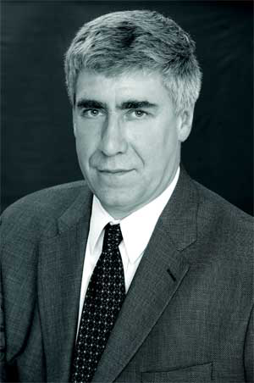
“On the other hand, and we should never forget this, female genital mutilation is not just intended as a tribal mark or tattoo (say, like male circumcision in the Jewish world). The doctrine behind it contains an implicit reproach to some of our Western views about women and sexuality. It may not be a valid or convincing reproach, but certainly there is disagreement or competition between the views about women and sexuality that these practices represent and the views about women and sexuality that are presupposed when we make our criticism of these practices. And even if no one is proposing to extend the practice of clitorectomy to the West, these opposing views cannot be treated relativistically. They have to be seen as confronting one another, each on the other’s turf, and they cannot both be right.” Discuss
J. Waldron, ‘How to argue for a universal claim’ 30 (1999) Columbia Human Rights Law Review 305 at 310

Slide 14
Francoise Lionnet,
“Feminisms and Universalisms”
There are insurmountable differences between:
“‘Western’ modes of analysis of the concrete status of women in various non-Western cultures, on the one hand, and non-Western women’s subjective experience of their position, on the other hand.” (368)

Slide 15
Moving beyond one interpretation
“I think that the only way out of that fundamentalist feminist impasse is, and will continue to be, through the awareness of the multicultural dimensions of women’s real lives in and out of the academy”.
What does she mean by this?

Slide 16
How do you respond to this?
“By criminalizing the practice and sending to jail the parents of the excised girls the French courts have judged individuals guilty of an act of violence which they had, in fact, no intention of committing, since their behaviour was in accordance with deeply-held-socio-cultural and religious beliefs about the nature of femininity and the function of sexuality in their respective collectives. Anthropologists and social critics have argued that such sanctions will have little if any positive impact, since families may continue to have the excision performed” (370).
Does this signify the problems with universal human rights?

Slide 17
Discuss the following:
On page 371 Lionnet contends:
“the French legal system has victimized three individuals who were not themselves treated as persons in their own right during the trial, since it was clear that intentions, motivations and responsibility - which are the foundations of individual guilt before the law – could not be interpreted as criminal.”
Examine Michel Erlich’s explanations, how do you respond to this?

Slide 18
“education remains an essential tool”
“only education and information combined with an open and tolerant approach to different definitions of identity and sexuality will eventually help eradicate excision.” (373)
Do you agree?

Slide 19
Levi-Strauss
To conclude:
“The barbarian is first and foremost the one who believes in barbarism” (379)
What therefore is Lionnet’s thesis in your words?
What is Lionnet’s opinion of universalism and universal human rights?

Slide 20
Connections
Can you draw any connections between this theory and the literature we have read over the course of this module?

