Slide 1

ECLS Induction 2024
Tuesday, 24 September
Lunch, 12-12:45pm, Student Hub
MA and PhD Student Induction, 12:45-3pm, FAB2.43

Slide 2
Today’s Lineup
Welcome (Paulo de Medeiros, HOD/Michael Niblett, Deputy HoD)
Overview of the Induction programme and intro of PG Team (Kim/Julie/Claire) (Nick Lawrence as D-PGR, Jonathan Skinner as D-PGT)
Senior Tutor for PGTs and PGRs (Tess Grant)
Student Union (Alijah Taha)
PGSSLC and Student Life (Archana Vinod)
PGR funding and resources (Nick Lawrence)
Course Convenors (providing overview of the MA courses) Emma Francis (English MA) Christine Emmett (World Lit MA) Steve Purcell (English and Drama) Harry Warwick |(MA Critical and Cultural Theory) Nick Lawrence (MA Environmental Humanities)
A brief intro to MA Seminars/MA Dissertations (Jonathan Skinner, Nancy Haijing Jiang, Michael Meeuwis)
MA Research training and resources (open to international PhD students) (Nancy Haiing Jiang)
Widening Participation and the Transformations project for the MA students (Alex Breeze)
Library for PGTs and PGRs (Sarah Akhtaruzzaman)
PhD processes and Departmental Research Groups (Nick Lawrence)
PG Professionalization (Nancy Haijing Jiang)
Closing Thoughts and Advice (Nick Lawrence and Jonathan Skinner)
Q&A (time permitting)

Slide 3
Where to Find Key Information
ECLS:
https://warwick.ac.uk/fac/arts/english/currentstudents/postgraduate/
Doctoral College:
https://warwick.ac.uk/services/dc/
CADRE (Centre for Arts Doctoral Excellence):
https://warwick.ac.uk/fac/arts/cadre/
Disability Services (part of Wellbeing)
https://warwick.ac.uk/services/wss/students/disability

Slide 4
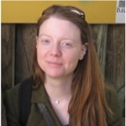
Dr Teresa Grant
Senior Tutor (also Professor in Renaissance Theatre)
My office is FAB 5.25
My email address for ST business is: englishseniortutor@warwick.ac.uk

Slide 5
SENIOR TUTOR
The Senior Tutor is responsible for overseeing student support and welfare, including:
The Personal Tutor System
Liaison with Wellbeing and Disability Services
Advice about Mitigating Circumstances and Reasonable Adjustments (if your personal tutor can’t help)

Slide 6
PERSONAL TUTOR SYSTEM
You will be allocated a Personal Tutor who is also an academic in the department and offers personal support and guidance during your degree. Their information will be on your Tabula profile.
You will meet them individually at least once a term. This is one of your monitoring points.
They can help with aspects such as general advice about studying and learning; module selection; signpost to other areas of support; provide references; communicate with other tutors if you encounter major issues.

Slide 7
University Support Services
Outside of the department there are various services that can help if you are in difficulty during your degree.
You can access them directly without speaking to the department first, but can also ask your personal tutor to help sign-post, if you are unsure what help you need or want to alert them to issues you are facing.

Slide 8
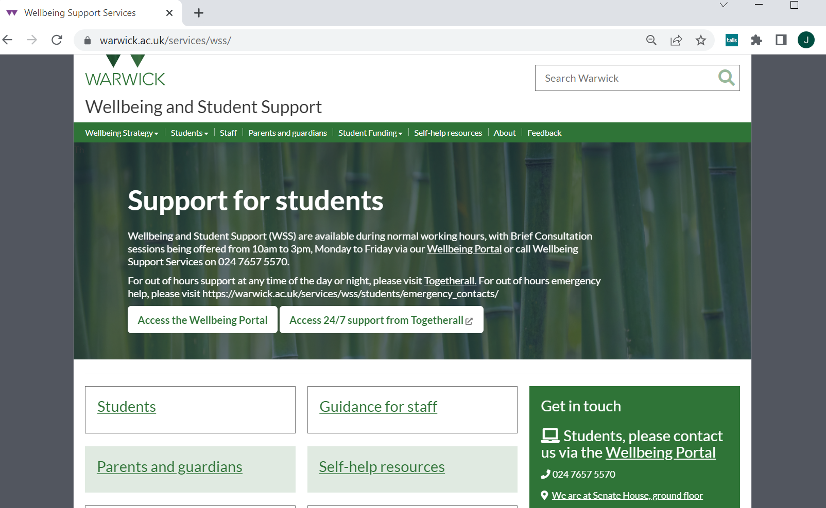
This is the place to go to get help with emotional/psychological, work/stress, study strategies, and is also the portal for Disability Support

Slide 9
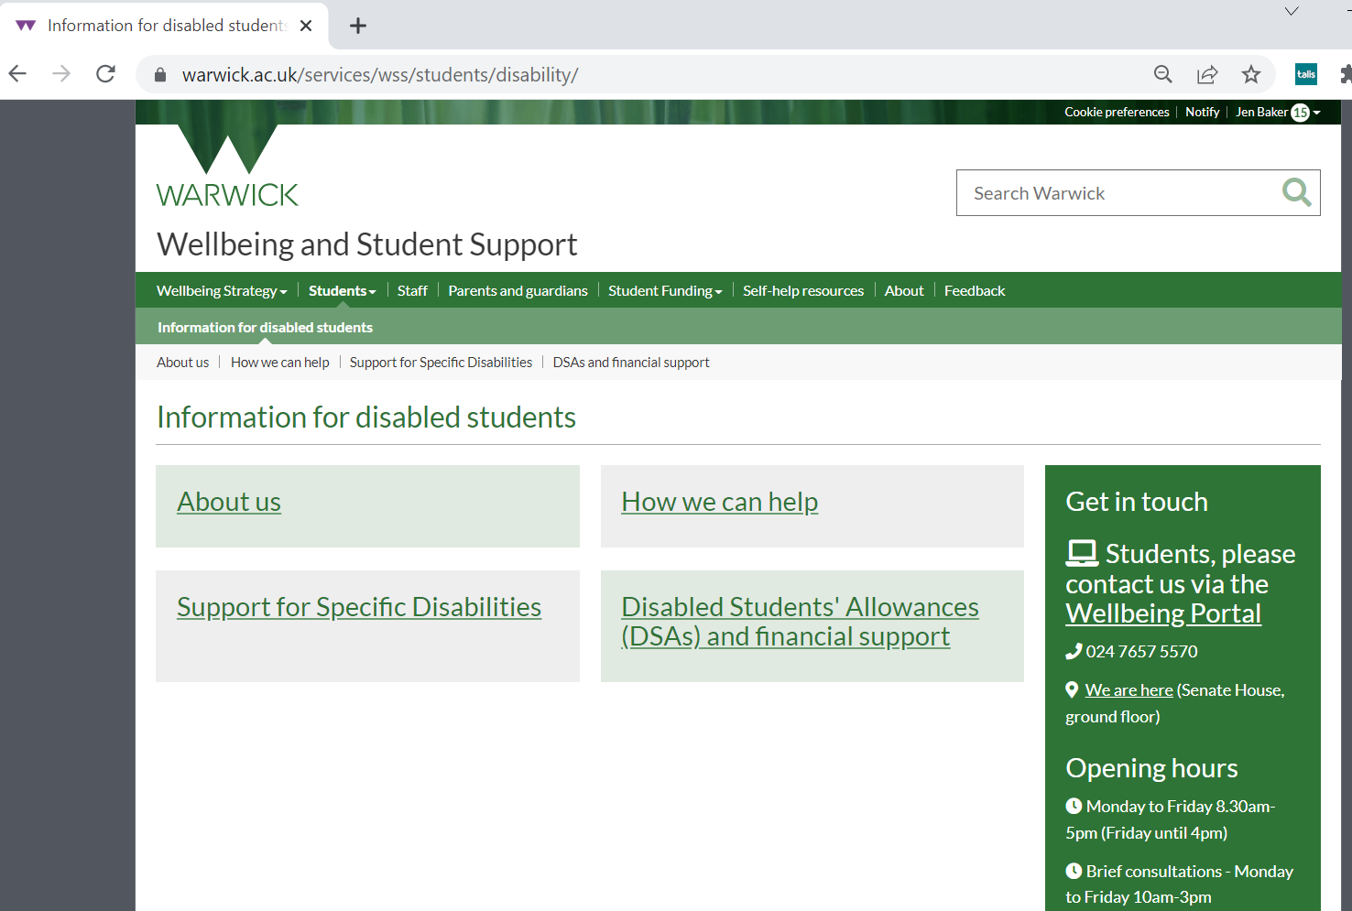
The University Disability Support team helps in various ways including mediating financial and academic support (called Reasonable Adjustments) for students with physical disabilities as well as mental health conditions and neurodiversity such as (ADHD, ASC, dyslexia).
This is the case whether you already had support pre-University or think you need to be screened for an undiagnosed condition during the degree.
The sooner these RAs are made the better!
IMPORTANT Even if you declared a condition when you applied you should still contact Disability services for a 1-2-1 so that they can discuss the right support for you.

Slide 10
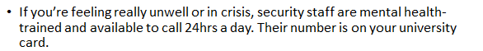
Other Support Services
Student’s Union Advice Centre (you will meet them at Induction 3)
Library Study-Happy Team (meet the Library staff and associates at Induction 2)
The Health Centre
Residential Life Team if you live on campus

Slide 11
Mitigating Circumstances
are acute, severe, exceptional circumstances outside the student’s control which affect their ability to complete work. Circumstances eligible for mitigating circumstances will usually be unforeseen and not normally of a duration greater than a term
Contact your Personal Tutor if there is some unexpected problem, illness or situation affecting your work that we should know about.
Keep dates/details as things go along, and save any external evidence (such as GP letters, hospital admissions, legal documents, supporting statements).
If you think this has affected your work significantly, you can make a claim at the end of the year for these circumstances to be taken into account by the exam board in relation to your assessment, and/or degree classification. This can lead to greater options if you have work missing or with considerable late penalties, for instance. Your Personal Tutor can help with this process.
The request is made is via the Personal Circumstances button on Tabula
There are details in the online department Handbook as to what constitutes appropriate evidence, and how sensitive information is handled in such matters.

Slide 12

Warwick Students’ Union
Always Something For You

Slide 13

Your Democratic Representation

Slide 14
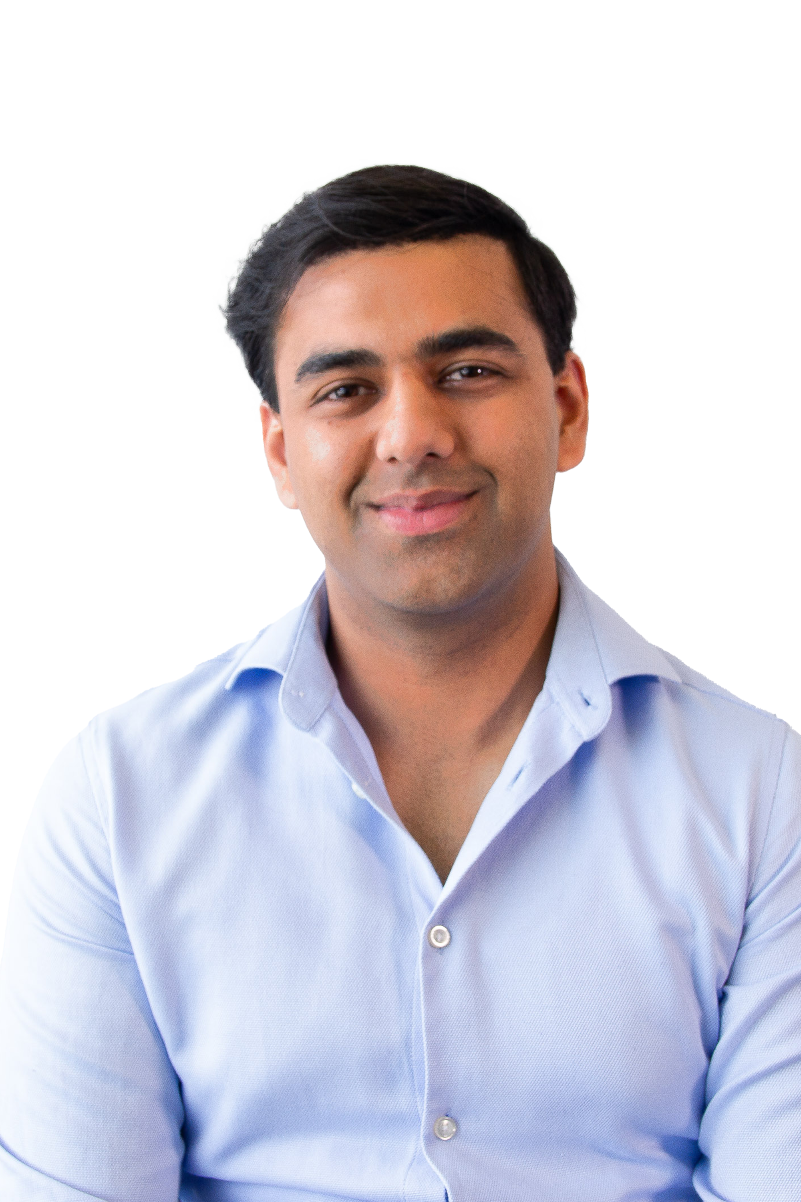

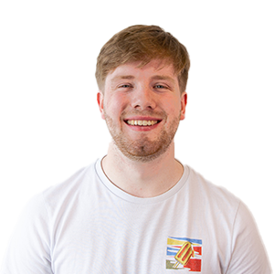
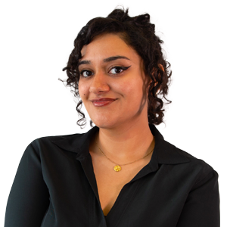
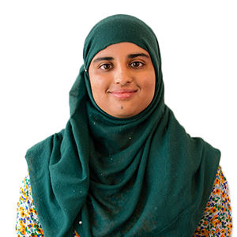
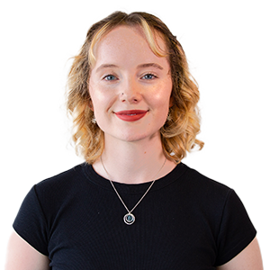
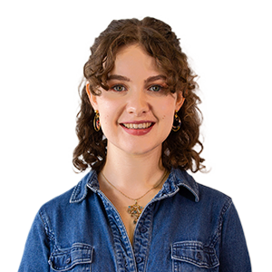
Your Democratic Representation
Officer Team
Enaya Nihal
President
She/Her
Muneeba Amjad
VP Education
She/They
Sasha King- Smith
VP Democracy & Development
Alijah Taha
VP Postgraduates
He/Him
Naomi Carter
VP Welfare & Campaigns
She/Her
Joe Stanley
VP Societies
He/Him
Louis Gosling
VP Sports
He/Him
Mature Students Officer
Ethnic Minorities Students Officer
Songjia Cao
Mads Wainman and Nye Steele
Disabled Students' Officer
Raj Hacker
Environment and Ethics Officer
Summer Jones and Ariane Dayes
LGBTQUA+ Officers
Dorian Valentine and Isra Rai
Trans Students' Officer
Mathew Stephenson and Aden Wood
Widening Participation Officers
Gurismar Kaur
Women's Officer
International
Officer (non-EU
International Officer (EU)

Slide 15
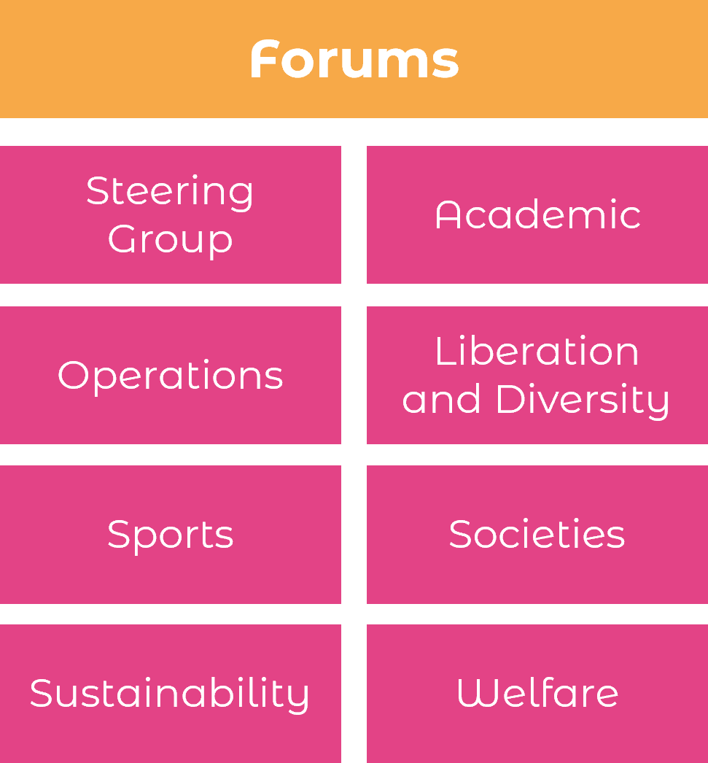
Your Democratic Representation
Forums, Student Council and ASV
Student Council
SU Policy
Students Submit Motions
All Student Vote (ASV)
Postgraduate Forum

Slide 16
Your Democratic Representation
Termly Elections
Officers
Forum Reps
Academic Reps
Society and Club Leadership
Nominations close 4th October and voting opens 7-11th October!

Slide 17
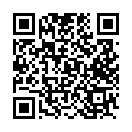
Your Democratic Representation
VOTE HERE

Slide 18
Your Academics

Slide 19
Your Academics
Course Reps
Faculty Reps
SSLC Chairs
Course Reps
Muneeba Amjad
VP Education
Student Staff Liaison Committees (SSLCs)
Exam Pressure
Self-Certs
Study Space
Lecture Capture
Access to Learning
Alijah Taha
VP Postgraduates

Slide 20
Your Support and Advice

Slide 21

Your Support and Advice
Free, confidential, impartial and non-judgemental advice, independent from the University.
Personal Issues
Housing Advice
Course-related problems
Immigra-tion issues
Finance and Funding
Support Sign-posting
University Complaints/ Disciplinary Proceedings
The service is easy to access, just fill out an enquiry form at warwicksu.com/help-support/ and one of our expert advisors will reach out within 2 working days.

Slide 22





Your Campaigns
Course Reps

Slide 23
Your Socialising

Slide 24
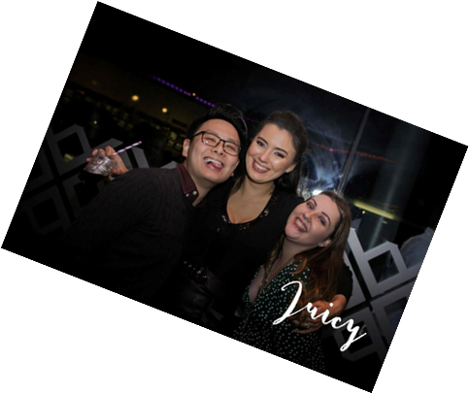







Your Socialising
Course Reps
Our Food and Drink Outlets
We run a packed programme of events throughout the year, from club nights in the Copper Rooms to our Pub Quiz in the Dirty Duck, to dog-petting sessions in exam season, as well as supporting hundreds of student groups in running their own events.
Over 60 Sports Clubs!
Over 250 Societies!
All revenue from our outlets goes straight back into delivering services for Warwick students!

Slide 25
Job Opportunities

Slide 26
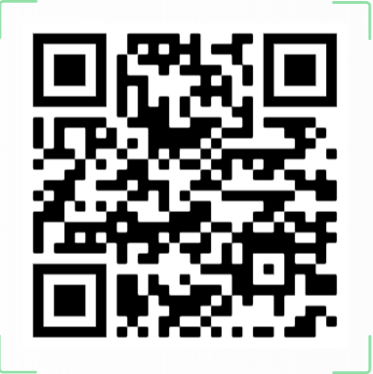
Job and Volunteering Opportunities
Course Reps

Slide 27

Any questions?
Please do drop in and say hello!

Slide 28
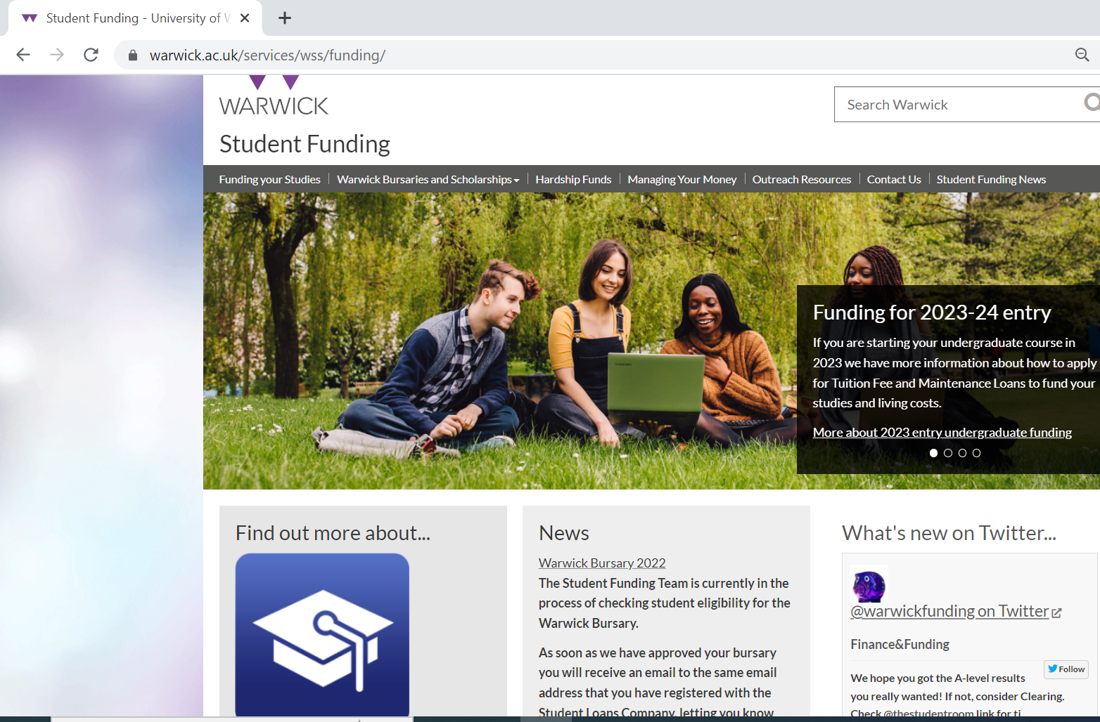
The University Student Funding pages can help with bursary applications, advice on budgeting and advice on Hardship Funds.
If you are a Widening Participation Student you can also speak to Alex Breeze, who works in the English department.

Slide 29
Postgraduate Research (PhD) Funding
https://warwick.ac.uk/fac/arts/english/postgraduatestudies/phd/scholarships
For details and support, please contact Dr Nick Lawrence, n.lawrence@warwick.ac.uk

Slide 30
Research Seminars, Training, and Support
CADRE (Centre for Arts Doctoral Research Excellence) https://warwick.ac.uk/fac/arts/cadre/
Doctoral College: Lots of upcoming events! https://warwick.ac.uk/services/dc/
Departmental Research Seminar Series & reading groups (open to all), research clusters and centres (e.g. Centre for Ecopoetics) https://warwick.ac.uk/fac/arts/english/research/
Feminist Dissent https://warwick.ac.uk/fac/arts/english/research/currentprojects/feministdissent
Specialist research centres: Includes Centre for the Study of the Renaissance; Centre for the Study of Women and Gender; Centre for the History of Medicine, Global History and Culture Centre, Borders, Race, Ethnicity and Migration Network (BREM)

Slide 31
Selected Summer Schools to Consider to Enhance Your Profile (most open to MA and PhD students)
University of Manchester Sexuality Summer School https://sexualitysummerschool.wordpress.com/
London Critical Theory Summer School, Birkbeck College, University of London https://www.bbk.ac.uk/annual-events/london-critical-theory-summer-school
School of Theory and Criticism, Cornell University https://sct.cornell.edu/
The Institute for World Literature (Harvard) https://iwl.fas.harvard.edu/

Slide 32
Alliances
EUTOPIA and EUTOPIA Student Network: https://warwick.ac.uk/global/partnerships/europe/eutopia/studentopportunities
Work with students from abroad
Improve your CV and acquire new skills and competences
Build a student network across Europe
Develop your intercultural and employability skills
Have the opportunity to get experience in working in an international team
Monash-Warwick Alliance https://warwick.ac.uk/global/partnerships/mwa/
PhD Travel Grant
Student-led Activity Fund

Slide 33
Sources of Funding: PhD Studies
M4C: First-year PhD students eligible to apply: START WHEN PROCESS OPENS IN OCTOBER! Funding open to all candidates, including PhD students in their first year.
Chancellor’s International Fellowships (for non-UK students, including EU and worldwide, around 15 across the Faculty of Arts): AUTUMN DEADLINE*
*First-year PhD students no longer eligible to apply.
Monash Warwick Alliance (3 for whole university; joint PhD)
China Scholarship Council (for mainland Chinese students, excludes Hong Kong)
EUTOPIA Alliance Co-tutelle (working with supervisors across two EUTOPIA institutions)

Slide 34
Sources of Funding: Events, Conferences, etc.
Departmental funding for conferences, events, and research expenses (£300 a year for up to four years)- PhD students only
An additional discretionary amount of up to £200 per annum may be available, with preference given to self-funded students and those without access to other sources of funding.
Funding, unfortunately, is not available to MA students.
Humanities Research Fund: https://warwick.ac.uk/services/ris/researchstrategy/researchfunding/rdf/hrf
(Some elements open to MA students.)
Humanities Research Centre Funding to organise conferences; Doctoral Fellowship Competition (small research budget, plus budget to organize conference/workshop and additional funding for blogging) https://warwick.ac.uk/fac/arts/hrc/
Doctoral College PGR Hardship Support Fund https://warwick.ac.uk/services/dc/schols_fund/current/hardship_fund

Slide 35
The MA Year at a Glance
See the PGT Handbook for full details: https://warwick.ac.uk/fac/arts/english/currentstudents/postgraduate/english-handbook-pg/policies-expectations-attendance
(Dates will differ for part-time students.)
TERM 1:
Attend and participate in seminars
Meet with personal tutor (by week 2)
Attendance at Research Methods/ Academic Enrichment seminar (during specific weeks)
Prepare and submit dissertation proposal (due 29 November)

Slide 36
The MA Year at a Glance
TERM 2:
Attend and participate in seminars
Turn in coursework for Term 1 modules (week 3)
Meet personal tutor (by end of week 4)
Initial meeting with dissertation supervisor (by week 10)
TERM 3:
Turn in coursework for Term 2 modules (week 3)
Meetings with dissertation supervisor (up to four; you are responsible for scheduling these with your supervisor)
Draft of your dissertation due to your supervisor by the end of the term
Annual Postgraduate Research Symposium (in May)

Slide 37
The MA Year at a Glance
SUMMER:
There is no supervision over the summer.
Dissertation is due 2 September 2025.
Extensions on the dissertation are very short. If you are unable to submit your dissertation for whatever reason, you will need to wait until September 2026 to do so. THROUGHOUT: Participate in Departmental and Faculty of Arts research events, to all of which you are welcome—talks, research seminars, discussion groups, symposia, etc.

Slide 38
MA Seminar Expectations at Warwick
Regular, prepared attendance
Full participation from all students involved
Conversation and debate that elevate students’ voices
Plan for essays so they do not interfere with your coursework
Student-led discussion centred on a particular issue and informed by assigned texts
Critical engagement with reading (this doesn’t mean you have to understand everything you read right away!)
Possible presentation component
Notes:
If I were to sum up what an MA seminar is, it would be a “student-led discussion focused on a particular issue pertinent to literary study and informed by that week’s assigned readings.” What does this mean? Let’s break this down a little.
The fact that MA seminars are student led discussions is going to make this learning experience a little different from what you may have encountered in an undergraduate lecture or seminar. In lectures, the primary voice comes from the lecturer who offers a particular take on the text in question, while in undergraduate seminars, the seminar leader might be more hands about how the conversation is run—either by setting very specific group activities or setting questions for the students to answer as the seminar progresses. But in an MA seminar, it is the students’ voices that are elevated. While the seminar leader will facilitate the conversation with certain questions and sharing their interpretations of the texts, the flow of the conversation is down to the students themselves. The seminar is a space of collaborative, shared discussion wherein you, your fellow students, and the instructor model for each other how to close-read, analyse and argue at a much higher critical level than undergraduate. This is why active, participation in seminar by all students is really important—both in terms of speaking out your ideas, but also in listening closely to others so that you can engage with what they’re saying (not just about making your voice heard).
The MA seminar is also informed by assigned texts. Seminar leaders will typically assign about 50-90 pages of reading per week, and you will take the ideas you’ve picked up in your weekly readings as starting off points for discussion. This might seem like quite a lot! The crucial thing to remember here is that the goal is not to completely understand everything you’ve read on the first go before seminar. I often make this mistake—where I try to take notes on absolutely everything and get stressed if I don’t understand everything. But it’s completely fine to have things you don’t understand everything at the beginning! Rather than trying to completely comprehend everything, think about certain aspects of what you’ve read that really grabbed your interest—aspects that might have raised questions for you, that you might resonate with, that you might disagree with, then think about what you have to say about them. If there are parts you don’t understand, highlight them as well—because I guarantee that there will be others who don’t understand it also (those parts of the texts are often the most interesting). Once in seminar itself, you’ll discover that your ideas will develop along with that of others, and at the end, you’ll have a far better understanding of the text itself.
Often, modules will require you to do a informal presentation about one of the assigned readings in seminar. If you are unsure of what is required in a presentation, speak to the seminar leader. But much like the readings, these presentations should be thought of as a platforms that help further discussion and debate, rather than just trying to give a complete, comprehensive summary about the text itself.

Slide 39
PG Liaison – Dr. Michael Meeuwis
m.meeuwis@warwick.ac.uk
My role: serving and facilitating responses to PG concerns throughout the year; superintending the PG symposium along with PGSSLC
PGSSLC Constitution Meeting – Wednesday 2 October, Teams (email with link to follow; free thrill in the representative process)
PG Listening Session – ECLS Study Space, Tuesday 22 October, 18:00 to 19:00 (free pizza); please bring your questions and concerns about the program

Slide 40

EN100 Research Methods
Compulsory but unassessed module that runs during even weeks of term 1 and 2
Weekly seminars on academic writing and research strategies
Formative critical review assignment (1,000 words) to get writing and referencing feedback in Term 1
Extra Support for the PG Dissertation during Term 3
Open to International PhD students
EN100 Research Methods webpages are here:EN100 Research Methods (warwick.ac.uk)

Slide 41

Additional sources of writing support
ECLS Academic Writing Moodle is here: Course: ECLS Academic Writing Resource (warwick.ac.uk)
Bookable academic writing one-to-ones are here: Academic writing one-to-one support (warwick.ac.uk)
If you have any academic writing questions, contact Nancy Haijing Jiang at haijing.jiang@warwick.ac.uk

Slide 42

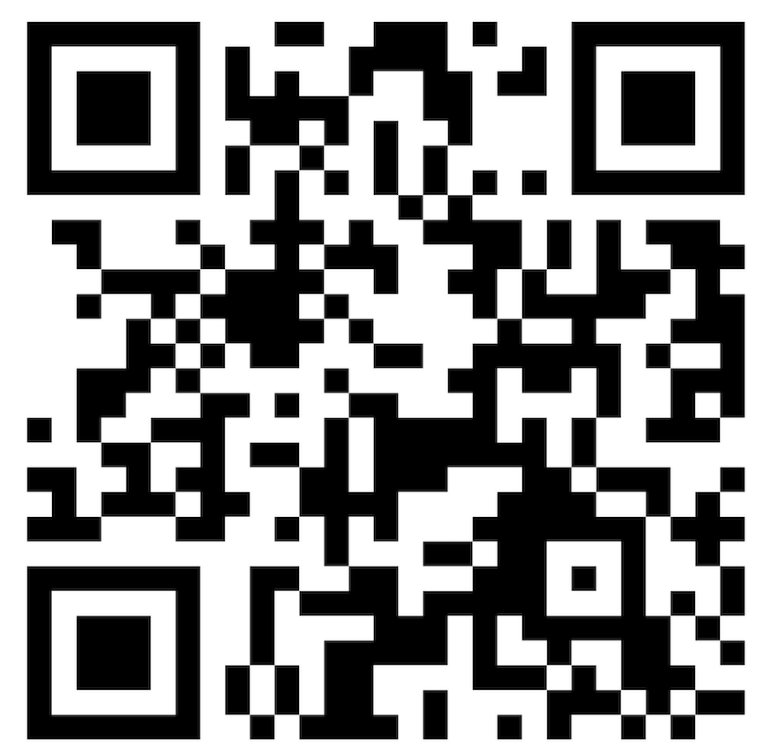
Enhancing the International PG Student experience in the Faculty of Arts In the Faculty of Arts, 52% of all PG students are international. We recognize that there are unique challenges international PG students face in the arts and humanities, whether that’s navigating life from overseas, or getting used to academic writing and study in UK higher education. To ensure that all international students succeed in their PG studies, we are running a programme of support throughout the year in the Faculty of Arts that address the distinct challenges of studying and researching overseas. If you are an international PG student, please do come along! There will be free food at each event as well as a space to feel welcomed, heard, and supported.
EVENTS
Term 1. Teaching with Confidence as an International GTA in the Arts and Humanities
Term 2. How to Navigate the Seminar Discussion as a Global Student
Term 3. TBD.

Slide 43
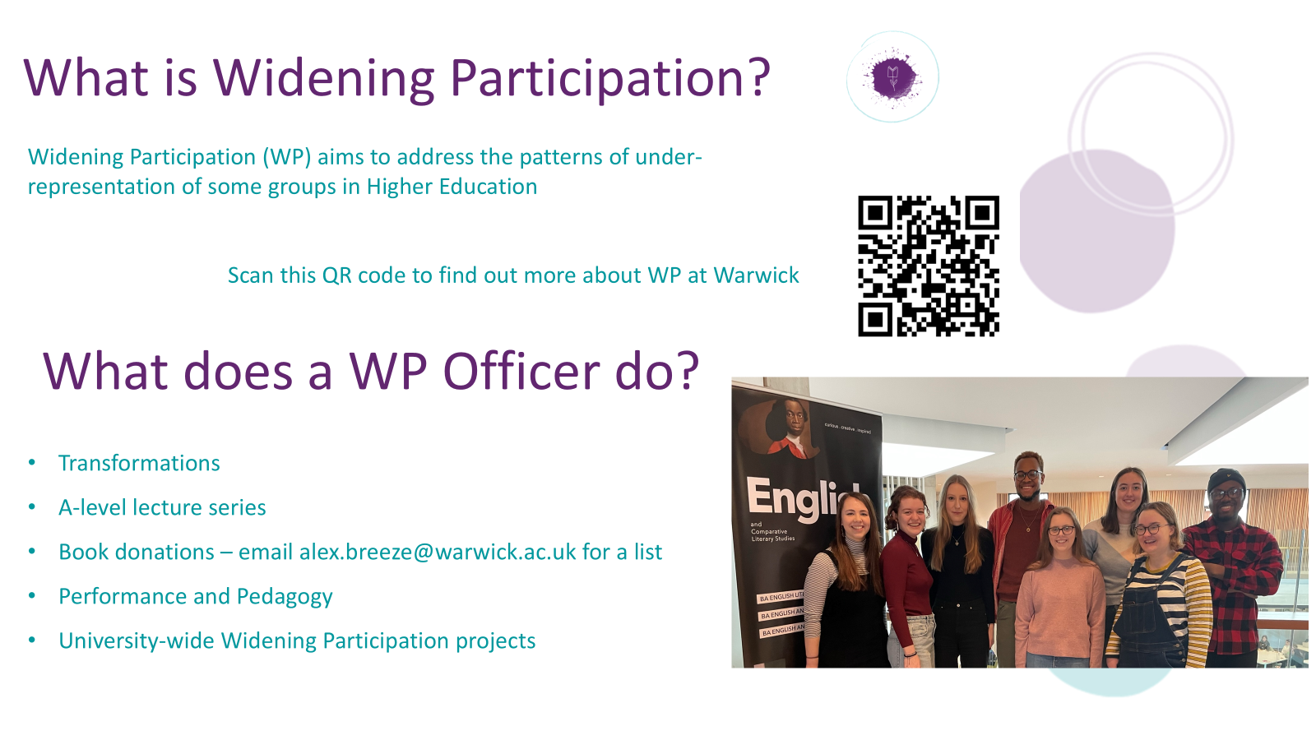

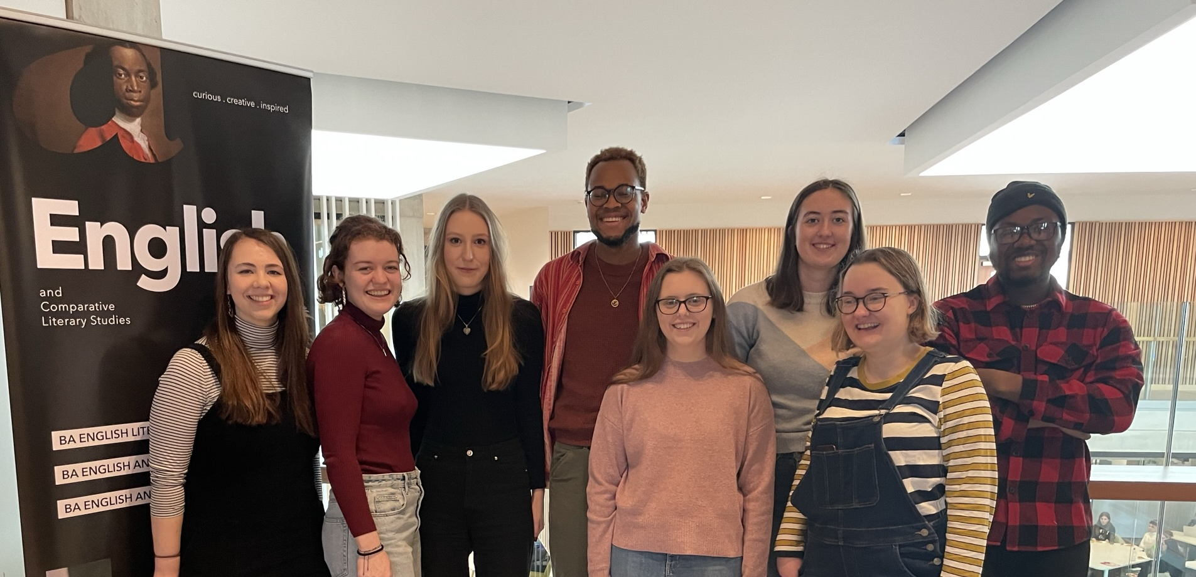

What is Widening Participation?
Widening Participation (WP) aims to address the patterns of under-representation of some groups in Higher Education
Transformations
A-level lecture series
Book donations – email Alex.Breeze@warwick.ac.uk for a list
Performance and Pedagogy
University-wide Widening Participation projects
What does a WP Officer do?

Slide 44
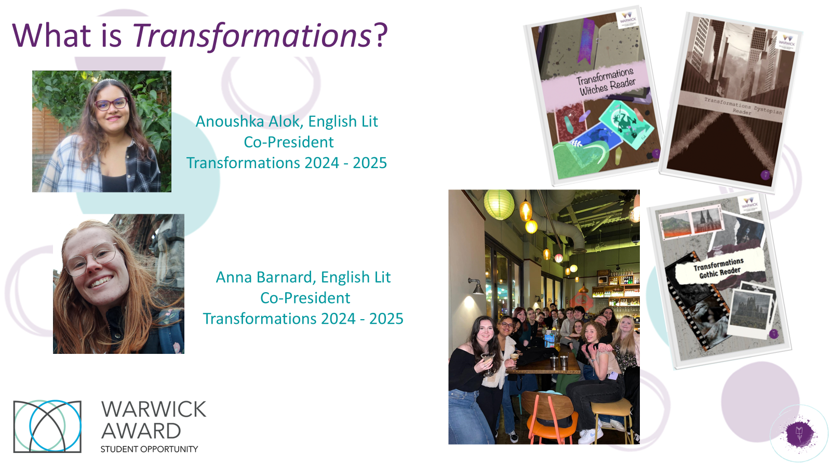



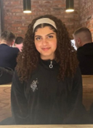

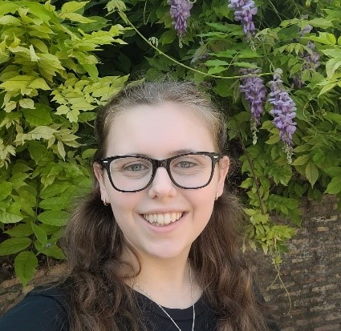
What is Transformations?
Maryam Khonat
Co-President
English Literature & History Finalist
Bethan Davies
Co-President
English Literature & History Finalist

Slide 45
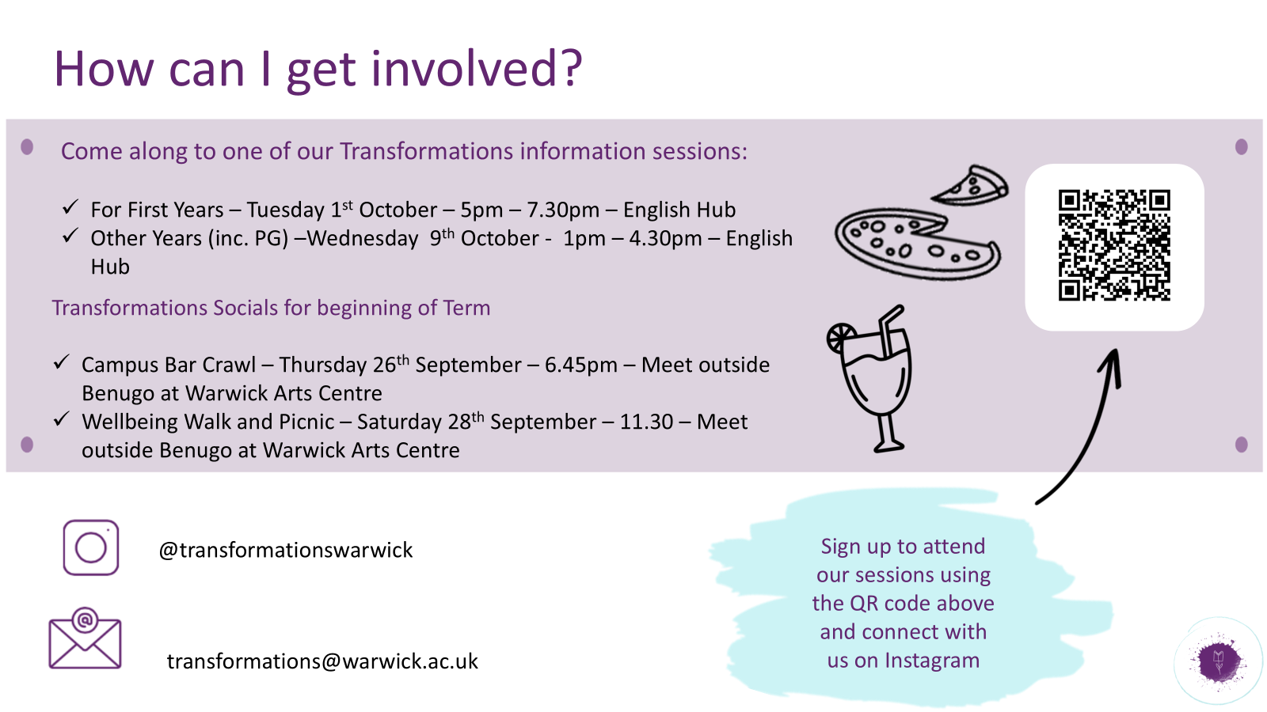

Slide 46
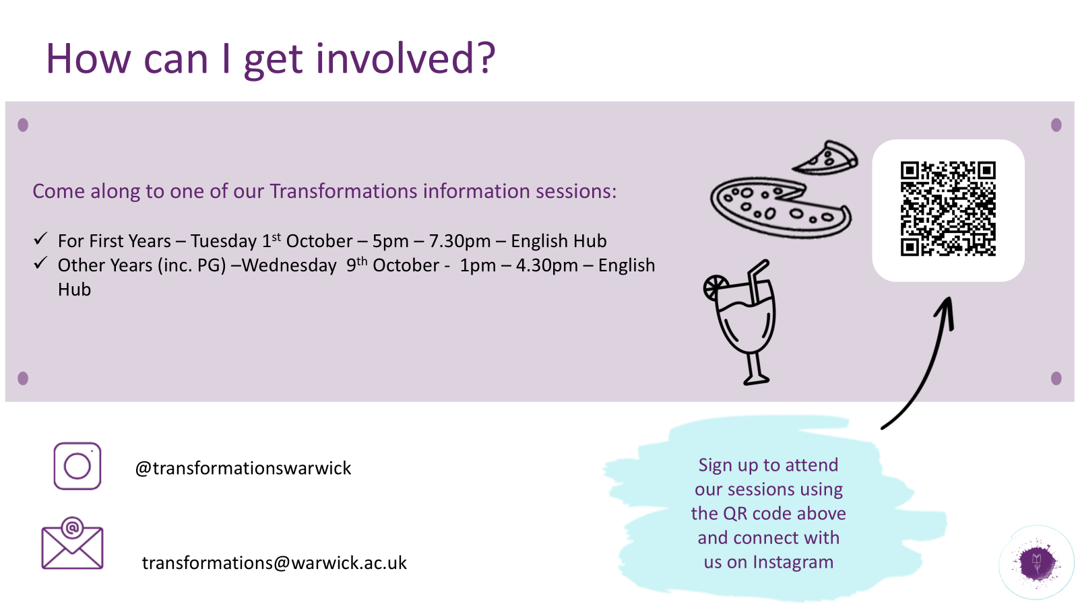


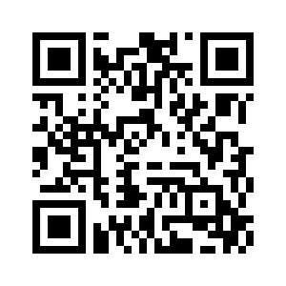

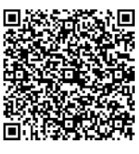
How can I get involved?
Come along to one of our Transformations information sessions:
Tuesday 3rd Oct (week 1) 5-7pm, Student Hub (FAB5.49) - Info session, pizza and chat to Transformations member
Wednesday 11th Oct (week 2) 1.45-3pm, Student Hub (FAB5.49)
transformationswarwick
For more info, including videos, take a look at the Transformations page within the ‘Your Department’ section of the ECLS website
transformations@warwick.ac.uk

Slide 47
How can the Library support your research?
Sarah Akhtaruzzaman - Academic Support Librarian for English

Slide 48

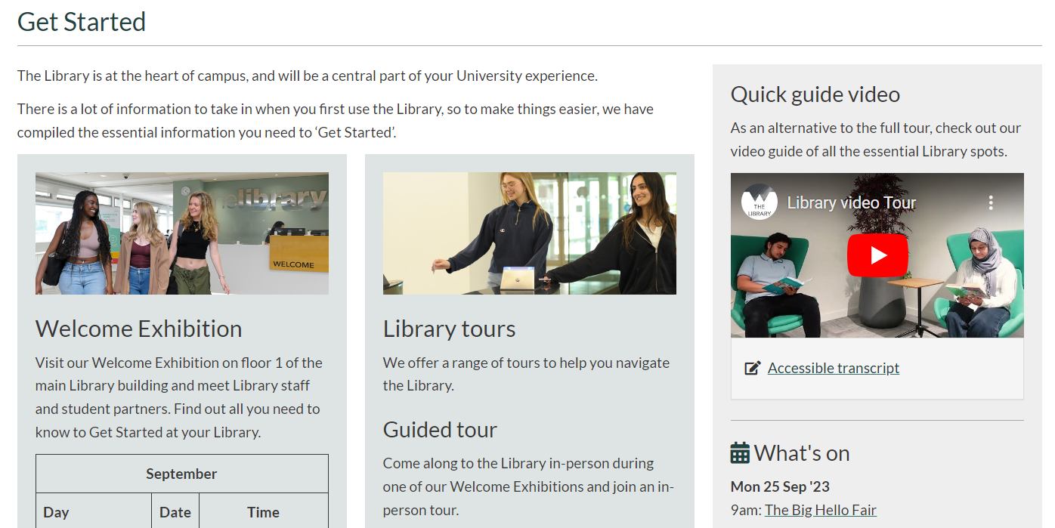
Get Started

Slide 49
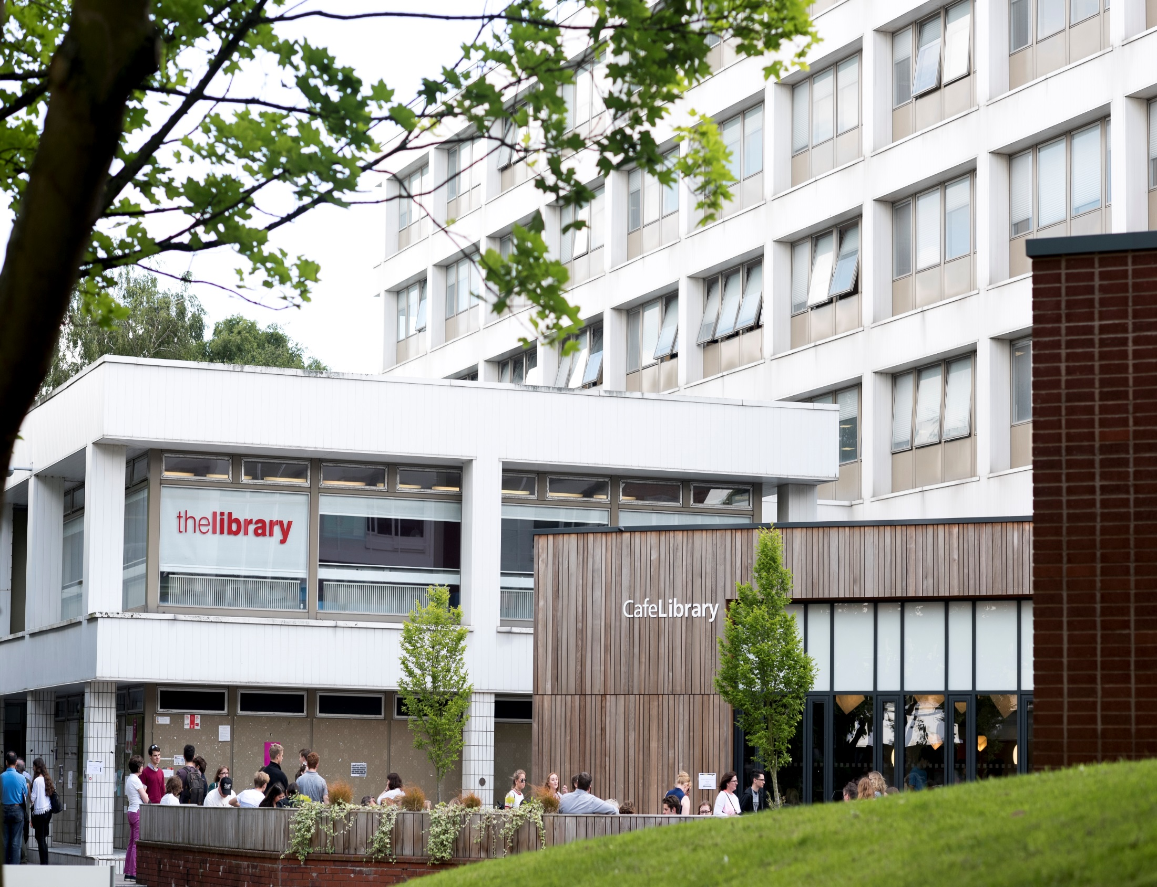
Find us! …
Open 8.30-midnight

Slide 50
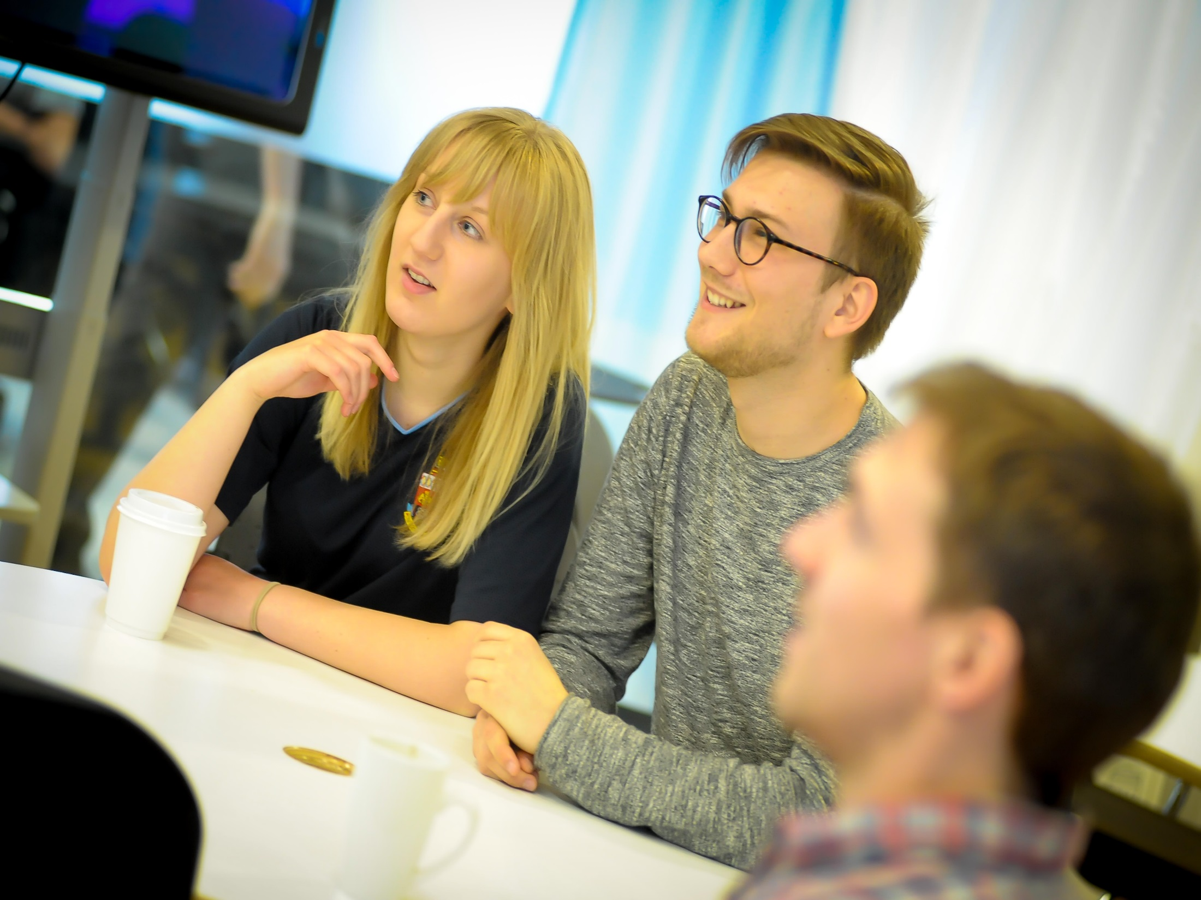
Group study

Slide 51
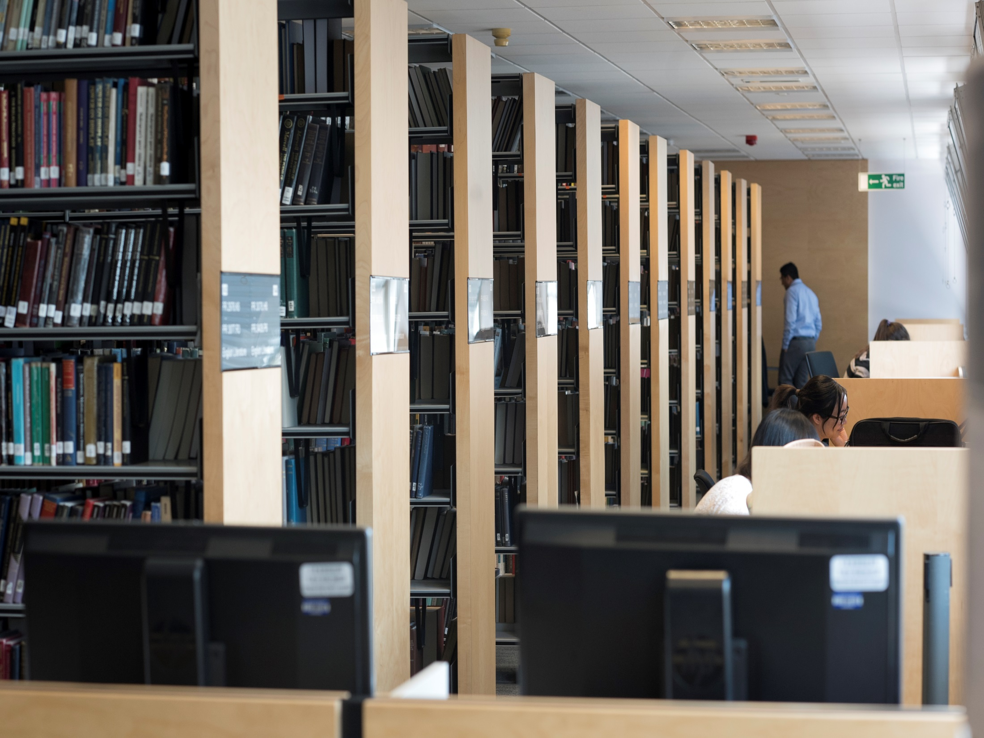
Quiet study

Slide 52
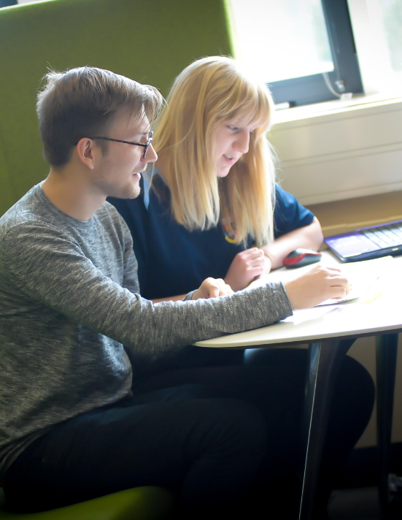

Wolfson Research Exchange
Postgraduate Hub

Slide 53
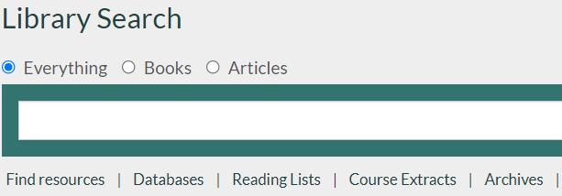
Online reading lists
Find the reading list linked from your module in Moodle
Or follow the reading list link under Library Search

Slide 54


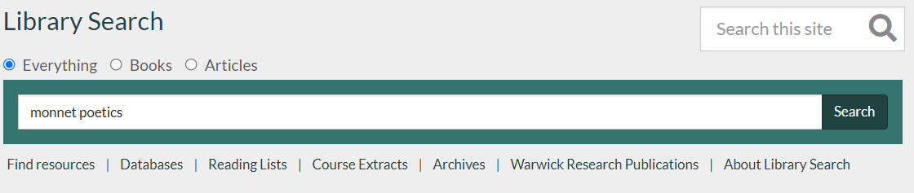
Finding books…

Slide 55

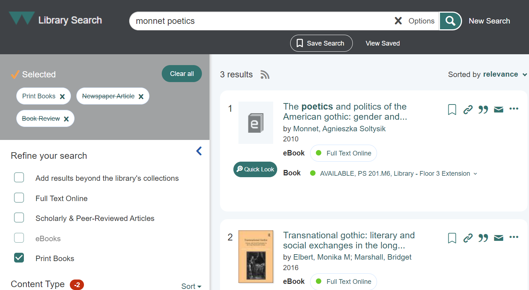

Slide 56

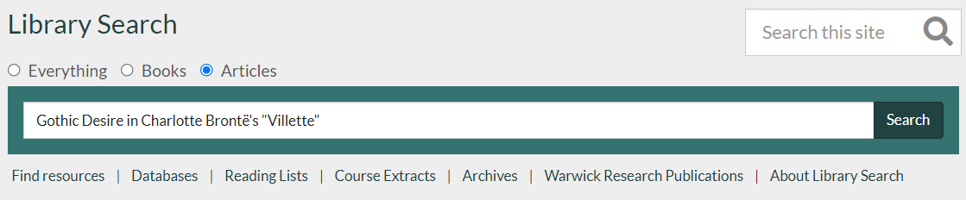

Finding specific articles and papers

Slide 57
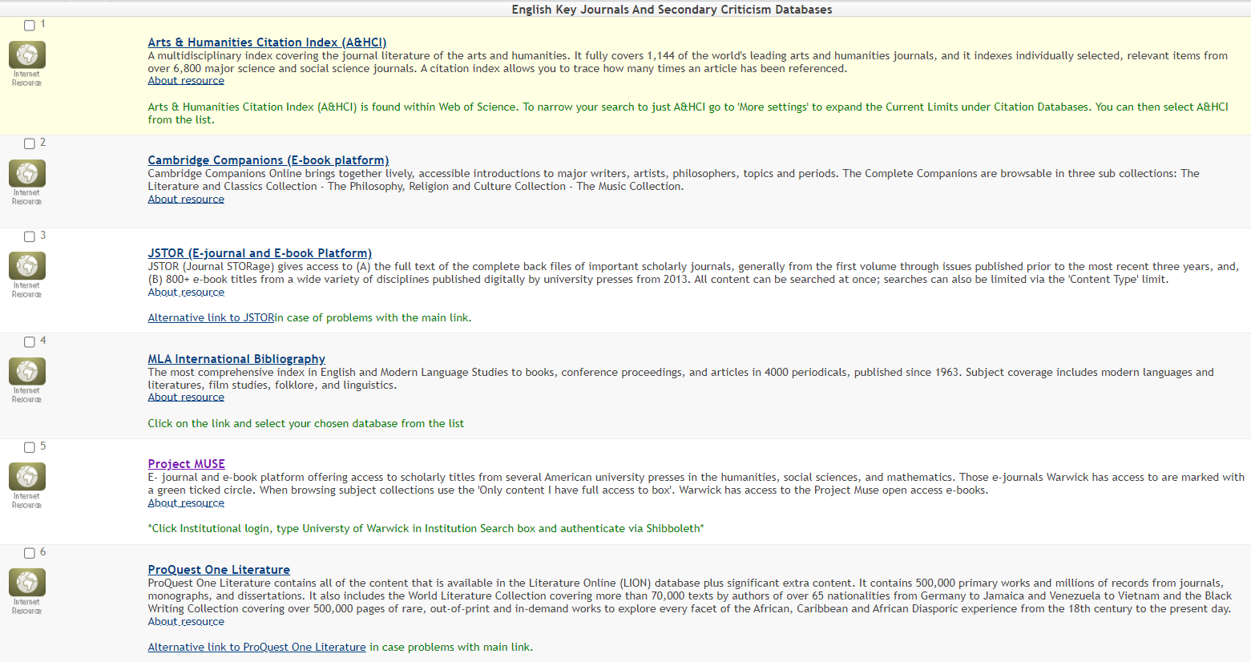



Searching academic databases

Slide 58
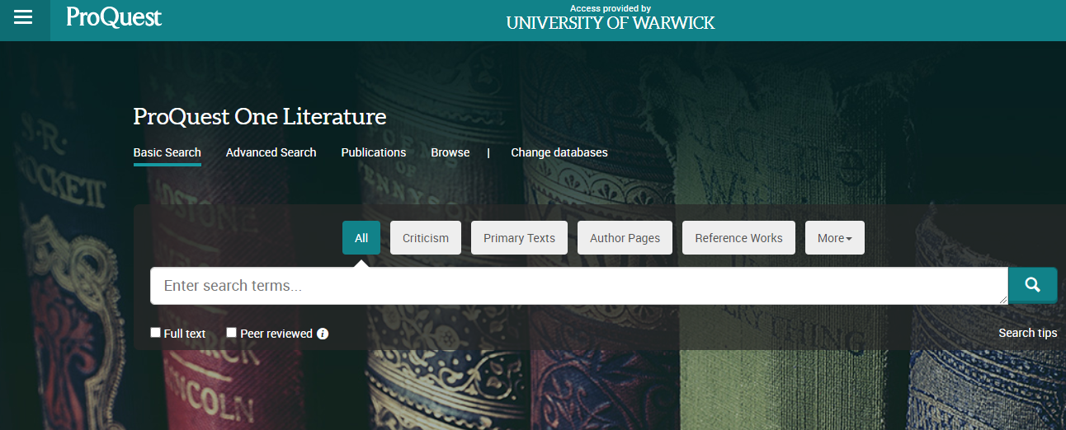


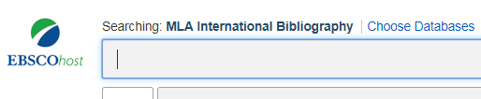
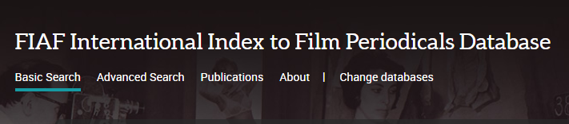

Secondary sources

Slide 59








Primary sources

Slide 60
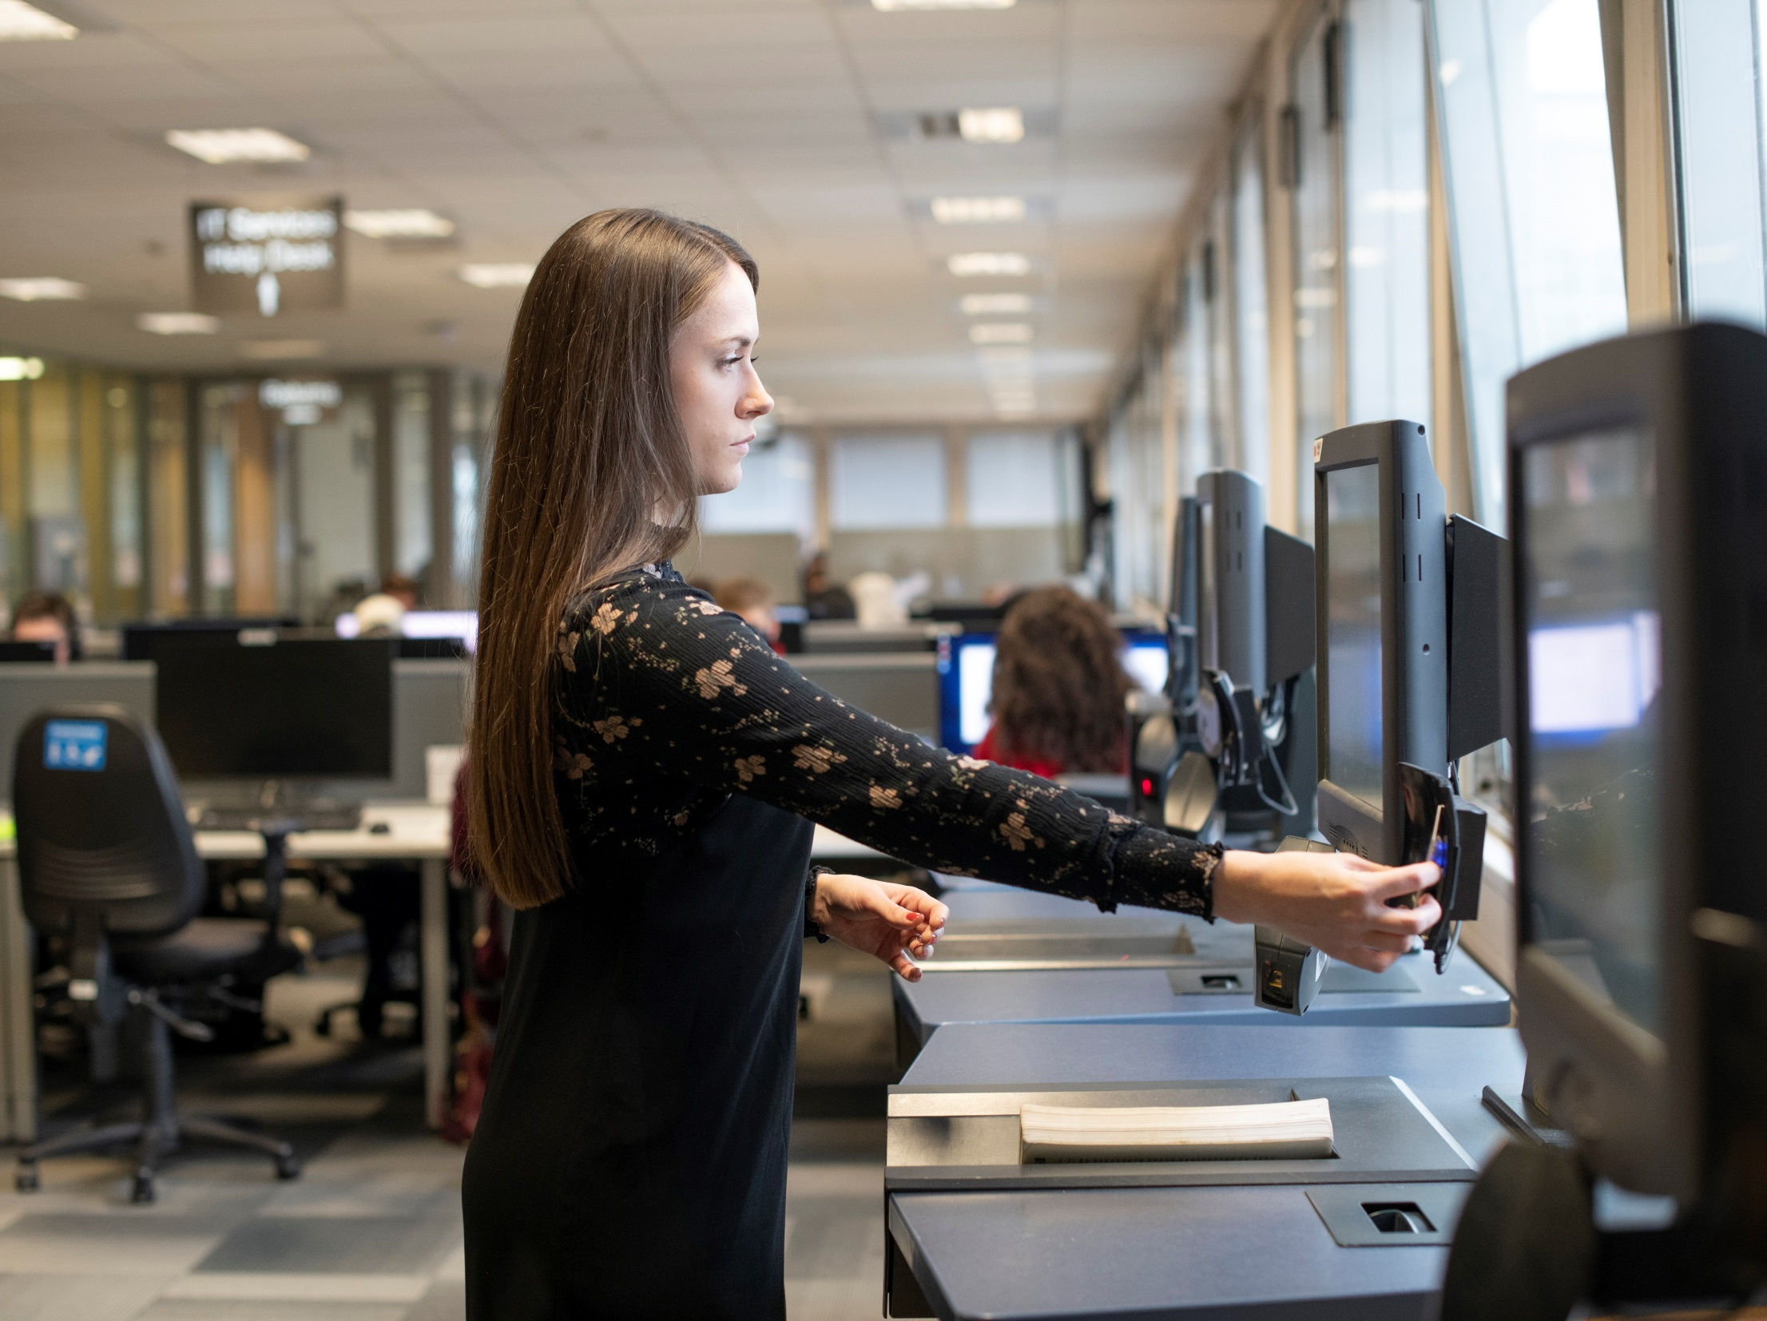
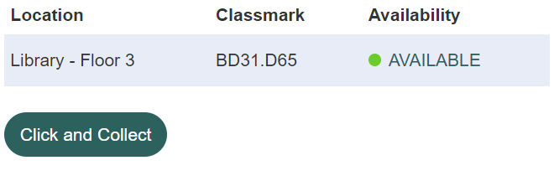

Borrowing from the Library
Up to 999 items
+ 3 Day Loans

Slide 61

Manage your Library account
My Library Account
manage your loans
keep up to date with your account

Slide 62
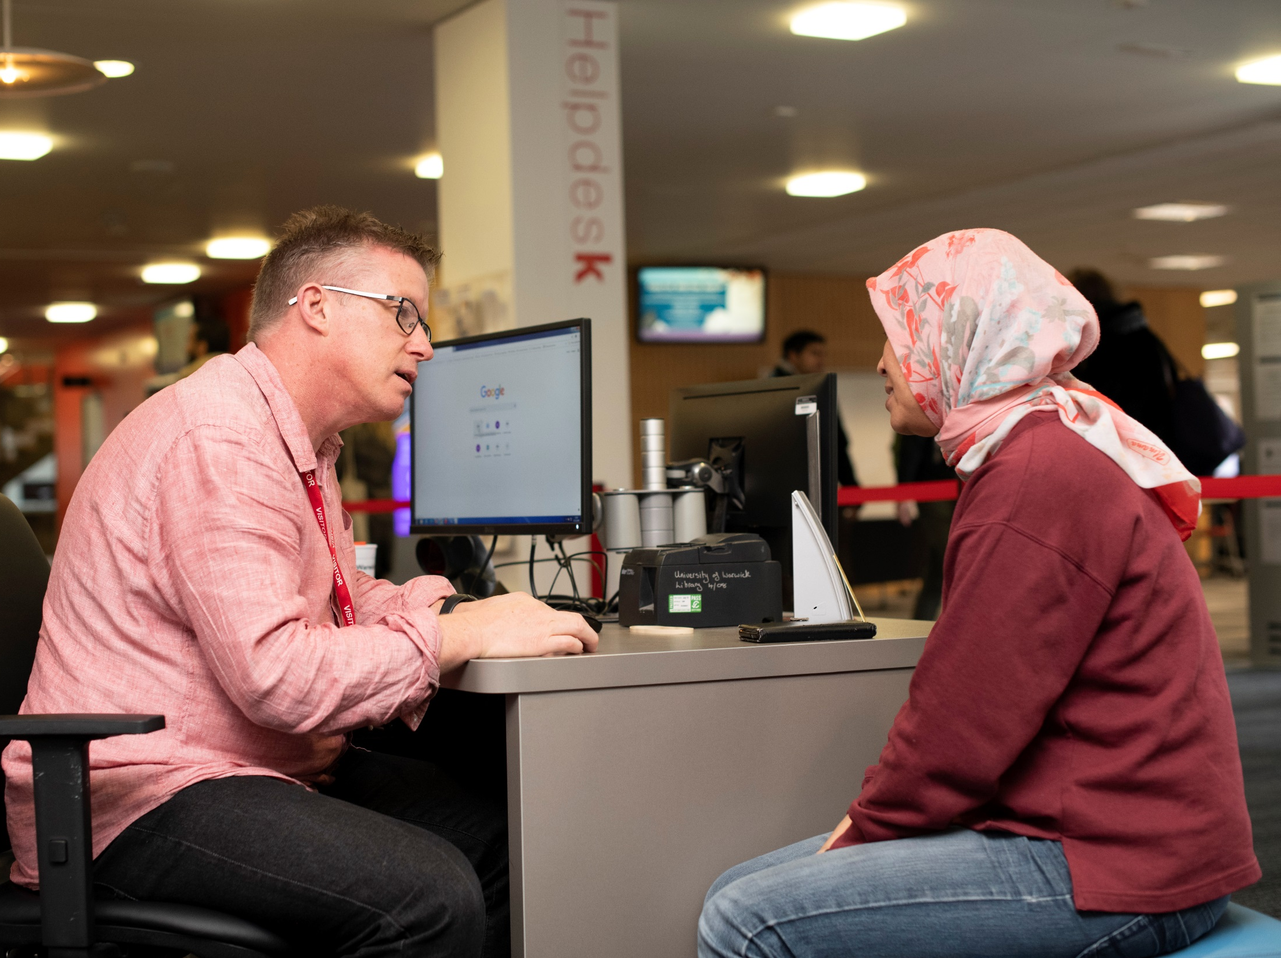
Ask for help

Slide 63






Research and Academic Services
Research support
The library has a Research and Academic Services team to support researchers:
Disseminating your research and getting published
OA: open access publishing and funding (OA journals and books)
WRAP: deposit your research in the Warwick Research Archive Portal
RDM: research data management – plan, store, preserve & share your data
Bibliometrics: using citations to measure authors, articles and journals
openaccess@warwick.ac.uk
@warwicklibrary

Slide 64
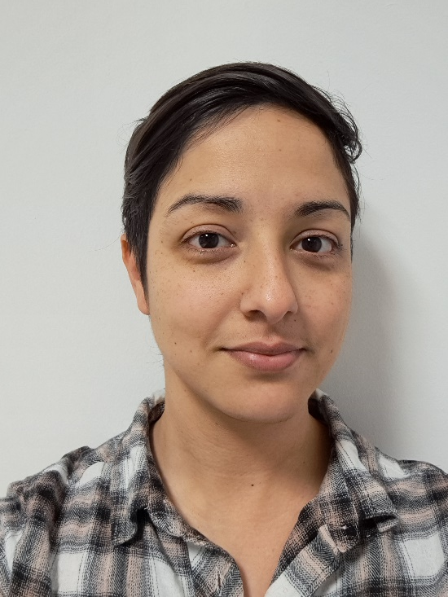
Academic Support Librarian
Sarah Akhtaruzzaman
Help with research, course-related enquiries, finding literature, referencing and resources for your subject.
s.e.akhtaruzzaman@warwick.ac.uk

Slide 65
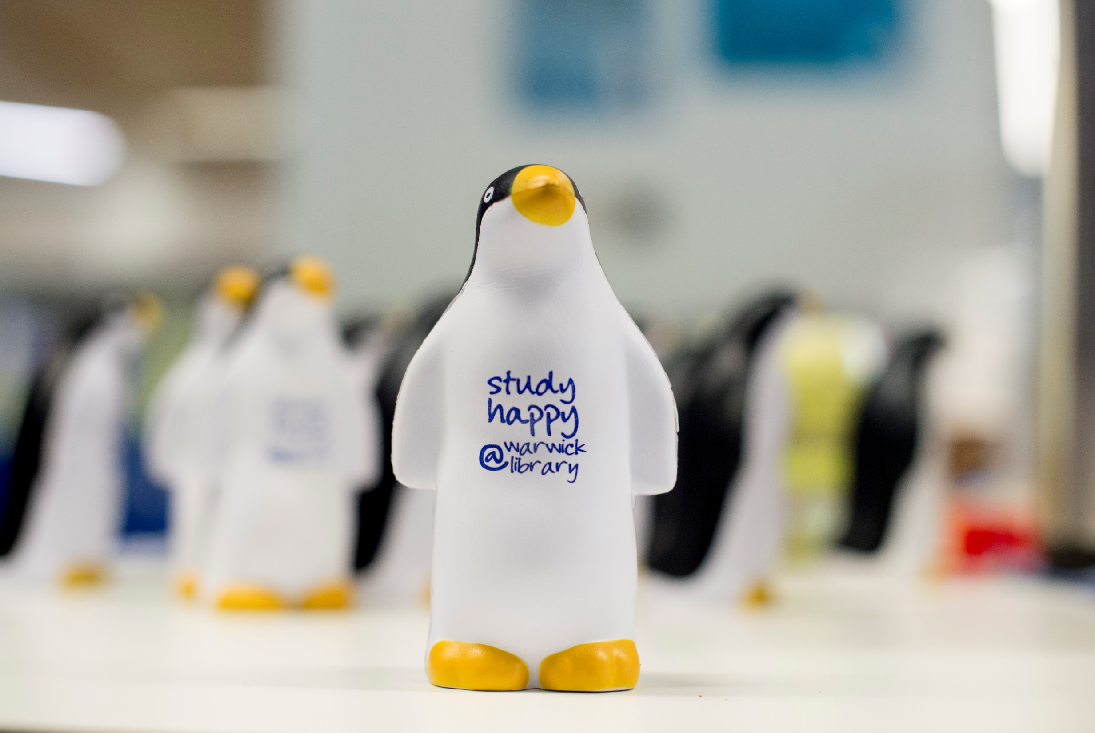
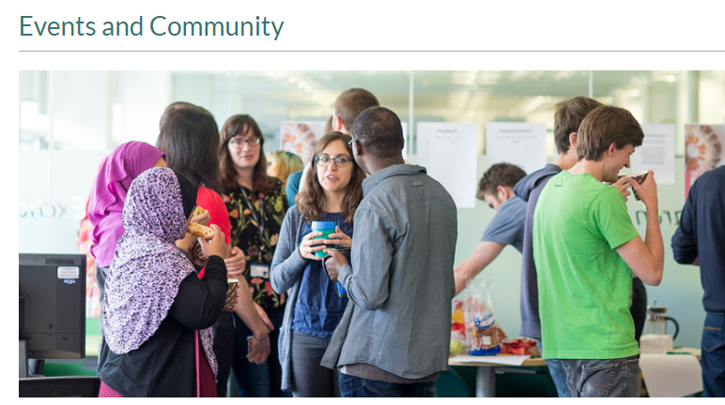

Your community in the Library
Library Online Lounge (LOL!):
Peer support
Study Happy support and events:
- Look out for Kirby!

Slide 66

Postgraduate Community
The library’s Community Engagement team run events for postgraduates:
Research Refresh: 10:30am-12:00 every Thursday in the Rex
PG Tips: 3:00pm-4:00pm every Tuesday in the PG Hub
Write Here Write Now: pomodoro style writing event (various dates)
They also run a Postgrad Realities course & PhD Life and Study Blogs

Slide 67
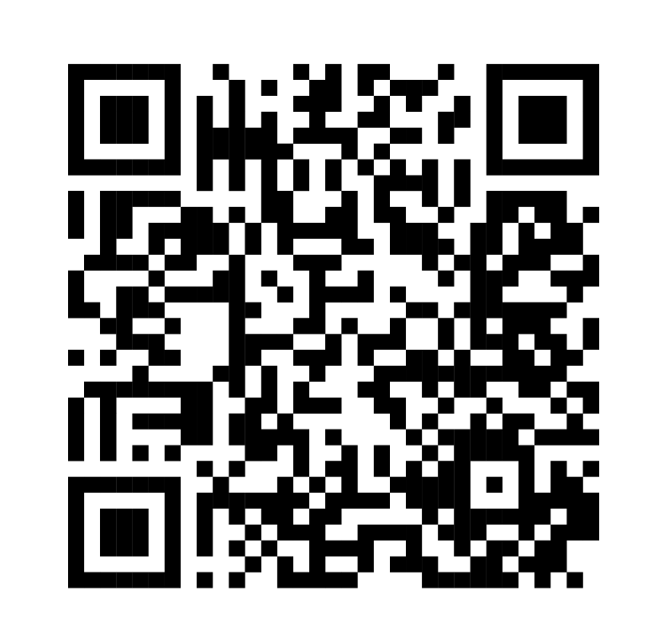




Library Student Partners
Helping us with our events and to help us improve the Library, are our Library Student Partners.
These peers are also here to help connect with you and support you during your time at the University, so if you need help or have any suggestions for making the library a better place, talk to them.
You can also connect with us on Social Media or by emailing us.
@WarwickUniLibrary
library@warwick.ac.uk
@WarwickLibrary
@WarwickLibrary
Notes:
We’re also quite active on social media and we love to connect with our students! You can find us on Facebook, Instagram and Twitter. If you follow us on there, you’ll find up to date information about our offers, initiatives and events and you can also ask us questions too. If you do need to get in touch with us for any other reason, please do feel free to reach out to us at lib-community@warwick.ac.uk.

Slide 68
Some PhD Processes/ The First Year at a Glance (see PGR Handbook for details)
PGR Handbook at https://warwick.ac.uk/fac/arts/english/currentstudents/postgraduate/english-handbook-pgr/your-degree-course
Regular monthly supervisions
Termly reviews
Attendance at departmental research seminars, CADRE events, etc.

Slide 69
Some PhD Processes/ The First Year at a Glance (See PGR Handbook for details.)
Term 2:
Mid-term Review for M4C students (D-PGR to select reviewers)
M4C applications due for self-funded students in their first year
Term 3
Upgrade dossier (due 2 May for full-time, first-year students) OR Annual Review (due 25 April, for continuing students)* *Deadlines for part-time students will vary—please consult the PG Professional Services Team.
Upgrade meetings with two members of staff from outside the supervisor/supervisory team from MPhil to PhD take place by the end of Term 3.
Teaching Eligibility Interview
Annual Postgraduate Research Symposium (in May)

Slide 70
English and Comparative Literary Studies Research Groups
Warwick Research Collective (WREC): Materialist Studies in World Literature
American Studies
Environmental Humanities/Centre for Ecopoetics
Comparative Religions and Literatures (CORAL)
Critical Theory Network
Feminist Dissent
Poetry at Warwick (PAW)
Medical Humanities

Slide 71

HINDSIGHT is 2020
Messages from ECLS staff

Slide 72
We contain multitudes…
If there is one thing I wish I had known when I started my PhD, it is that the project I started on could never be contained by a thesis. The thesis is just one draft of many to come. To paraphrase Paul Valery, a thesis is never completed, only abandoned. Also, choose your mentors wisely--their mark will live long in your work. Make the most of your mentors and take care of them--as much as you need and value their support, they value yours. And they won't be around forever. Ars longa, vita brevis!
Jonathan Skinner

Slide 73
Perfection is an illusion…
The one thing I would tell my younger self embarking on the PhD is that this is as good as it gets 🙂
But one thing a supervisor said to me right at the beginning which always stuck with me, and I now say it to my students: you never finish a PhD, you just abandon it. It sounds cynical, but actually it was very insightful -- perfection is an illusion, and there's always another book or article to read, but at some point you just have to accept it is what it is and it's time to stop!
Mark Storey

Slide 74
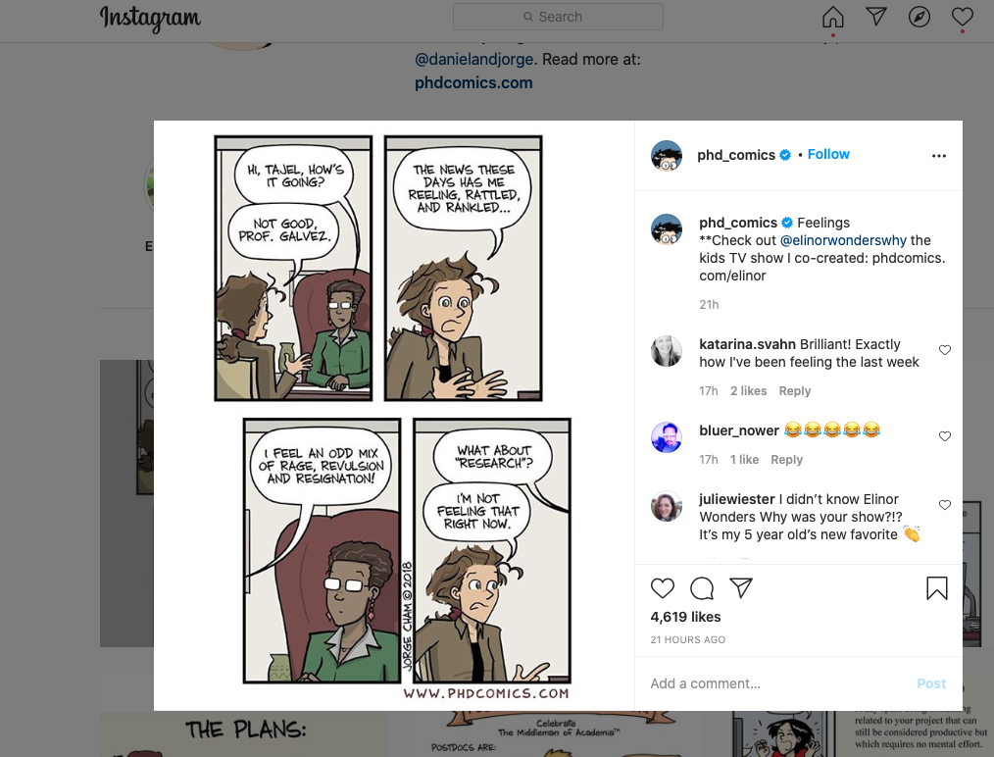
I’m not feeling that right now… from Paulo de Medeiros

Slide 75

Write, write, write
If there is one thing I wish I had known when I started my PhD, it's that it's NEVER too early to start writing. Writing always helps-- it's a process as much as a product.
E. L. Doctorow on writing: 'Writing a novel is like driving a car at night. You can see only as far as your headlights, but you can make the whole trip that way.' [Perhaps not entirely helpful for a PhD but will help them get through the first year, perhaps.]
Anne Lamott in Bird by Bird: “Almost all good writing begins with terrible first efforts. You need to start somewhere.”
Liz Barry

Slide 76
Good enough is good enough
Jenny Mak’s PhD Life Blog
“Good enough” [is] good enough.
https://www.jennywhmak.com/published-works
Check out Petra Kolber’s TED talk titled “The Perfection Detox”
for some sharp insights into the perils of perfectionism.
Piled Higher and Deeper: PHD Comics
On Twitter, Youtube and Instagram
(contributed by Liz Barry and Paulo de Medeiros )

Slide 77
Learn by making mistakes
If there is one thing I wish I had known when I started my PhD, it is... if you're anything like me, you will make many mistakes along the way, and that is completely ok, even if the stakes seem high -- be patient with yourself; you are learning, and the only way to learn is by making mistakes.
Matt Franks

Slide 78

It will come together
At the point when you're most worried your thesis is too sprawling, messy, or covers too many ideas/writers/concepts, just keep writing and it will come together.
Emma Mason

Slide 79
The ivory tower has collapsed
The one thing I would tell my younger self embarking on the PhD... I'm tempted to say: Don't listen to my older self! The situation with PhDs today is unimaginably more fraught and challenging than it was when I started out (just as our situation seemed dystopian compared to the 'golden age' of academia before us). Advice from a generation that isn't coping with what students are facing now risks becoming what Adorno (speaking of Freud) calls "the worthless wisdom of a hard-boiled old gentleman." That said ... If there's one thing I would *still* tell my younger self, it is this: remember to motivate your research as a whole-life activity. Academics, like all creative people, need one thing above all else, even more than time - and that's confidence in your work. Initially you have to supply it for yourself. That's a lot easier to do when you connect what you're working on with the issues and problems that are always uppermost in your mind, never leave you, are indeed part of who you are. The ivory tower has long since collapsed, but that's cleared the way for a much more engaged and engaging relation between academics and the wider world. Silver linings playbook of 2020 ...
Nick Lawrence

Slide 80
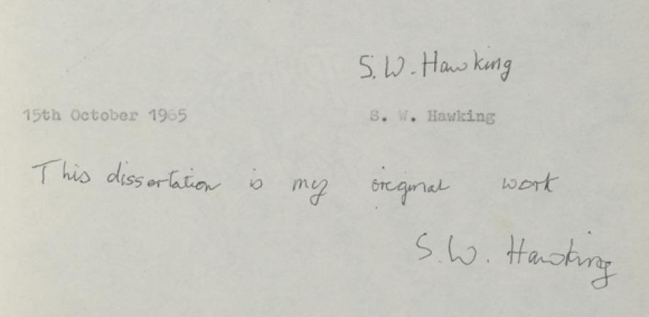
Comparison is the thief of joy
If there is one thing I wish I had known (or rather, believed) when I started my PhD, it’s that everyone journey to completion is different. Comparison is the thief of joy, so learn from others, but don’t chastise yourself for doing things differently.
Jen Baker

Slide 81
Tips from Guardian readers
https://www.theguardian.com/higher-education-network/blog/2014/aug/27/finishing-phd-thesis-top-tips-experts-advice

Slide 82

The best PhD thesis is…
A finished PhD thesis!
Good luck on your journey!!
Credits: Dr Rashmi Varma

