Slide 1

ECLS Induction 2025
Tuesday, 30 September
Lunch, 12-12:45pm, Student Hub
MA and PhD Student Induction, 1-2pm, FAB2.43
(PhD group goes to FAB0.23 for separate segment, 2-3pm)

Slide 2
Today’s Lineup
Together (1-2pm, FAB2.43)
Welcome (Paulo de Medeiros, HoD and
Michael Niblett, Deputy HoD)
Induction programme overview / PG Team intro (Kim/Julie/Claire) and Nick Lawrence as D-PGR, Jonathan Skinner as D-PGT
Senior Tutor for PGTs and PGRs (Jo Hofer-Robinson)
Student Union (Student Voice Team)
PGSSLC & Student Life (Michael Meeuwis)
Library foMA/PhD Research training and resources r PGTs & PGRs (Sarah Akhtaruzzaman)
(Rochelle Sibley)
PG Professionalization (Alirio Karina)
Careers (Ellie Wetherhill)
Separate (2-3pm)
MA (FAB2.43)
1) Course Convenors (overview of the MA courses)
Christine Emmett (World Lit MA)
Emma Francis (English MA)
Matt Franks (English and Drama)
Dan Katz (MA Critical and Cultural Theory)
Jonathan Skinner (MA Environmental Humanities)
2) A brief intro to MA Seminars/MA Dissertations (JS)
3) Widening Participation and the Transformations project for the MA students (Charlotte Pearce & Beth Hadingham)
4) Closing thoughts and advice/Q&A (Jonathan Skinner)
PhD (FAB0.23)
1) PGR funding and resources (Nick Lawrence)
2) PhD processes and Departmental Research Groups (NL)
3) Closing Thoughts and Advice (NL)

Slide 3
Where to Find Key Information
ECLS (including Student Handbooks):
https://warwick.ac.uk/fac/arts/english/currentstudents/postgraduates/
Doctoral College:
https://warwick.ac.uk/services/dc/
CADRE (Centre for Arts Doctoral Excellence):
https://warwick.ac.uk/fac/arts/cadre/
Disability Services (part of Wellbeing)
https://warwick.ac.uk/services/wss/students/disability

Slide 4

Located on the 5th Floor, FAB5.42 , Faculty of Arts Building (FAB)
pgenglish@warwick.ac.uk & pgrenglish@warwick.ac.uk
You can email us or pop in to see us we’re here to help!
We support PGT & PGR students with a range of queries, including:
Assignments
Modules & Timetabling
ARR & Upgrade processes
General course admin and support
Don't hesitate to get in touch if you need anything!
Postgraduate Admin Team

Slide 5
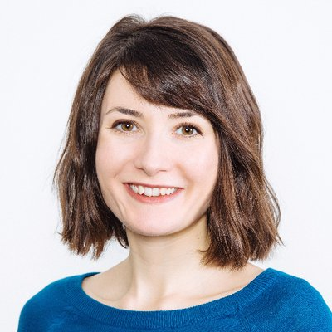
Dr Joanna Hofer-Robinson
Senior Tutor
My office is FAB 5.08
My email address for ST business is: englishseniortutor@warwick.ac.uk

Slide 6
SENIOR TUTOR
The Senior Tutor is responsible for overseeing student support and welfare, including:
The Personal Tutor System
Liaison with Wellbeing and Disability Services
Advice about Mitigating Circumstances and Reasonable Adjustments (if your personal tutor can’t help)

Slide 7
PERSONAL TUTOR SYSTEM
You will be allocated a Personal Tutor who is also an academic in the department and offers personal support and guidance during your degree. Their information will be on your Tabula profile.
You will meet them individually at least once a term. This is one of your monitoring points.
They can help with aspects such as general advice about studying and learning; module selection; signpost to other areas of support; provide references; communicate with other tutors if you encounter major issues.

Slide 8
University Support Services
Outside of the department there are various services that can help if you are in difficulty during your degree.
You can access them directly without speaking to the department first, but can also ask your personal tutor to help sign-post, if you are unsure what help you need or want to alert them to issues you are facing.

Slide 9
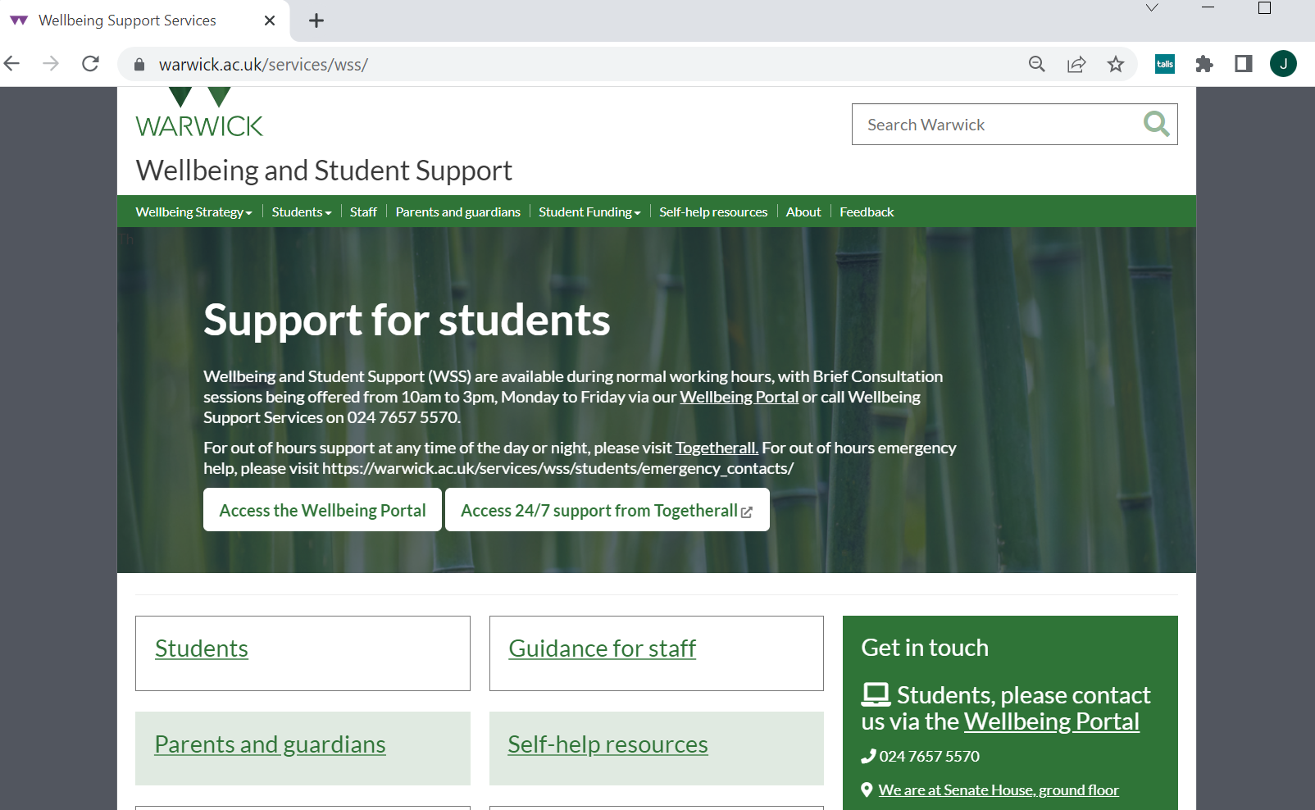
This is the place to go to get help with emotional/psychological, work/stress, study strategies, and is also the portal for Disability Support

Slide 10
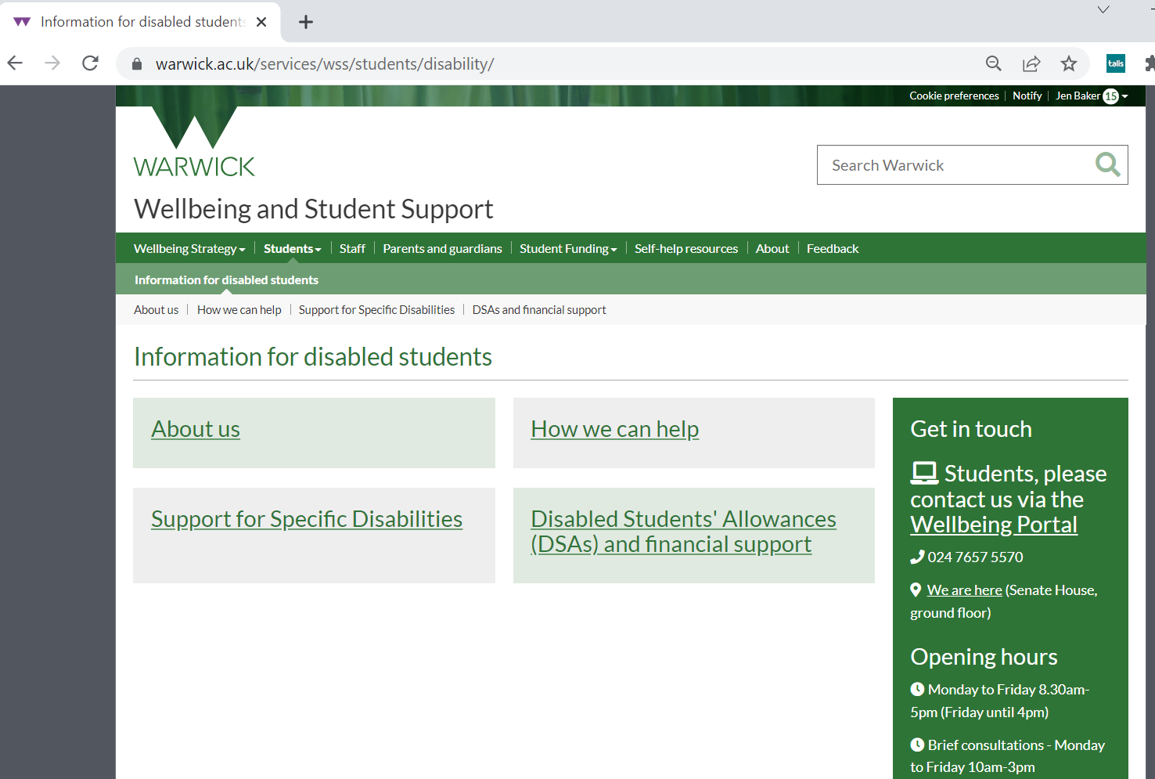
The University Disability Support team helps in various ways including mediating financial and academic support (called Reasonable Adjustments) for students with physical disabilities as well as mental health conditions and neurodiversity such as (ADHD, ASC, dyslexia).
This is the case whether you already had support pre-University or think you need to be screened for an undiagnosed condition during the degree.
The sooner these RAs are made the better!
IMPORTANT
Even if you declared a condition when you applied you should still contact Disability services for a 1-2-1 so that they can discuss the right support for you.

Slide 11
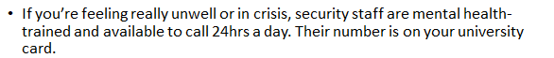
Other Support Services
Student’s Union Advice Centre (you will meet them at Induction 3)
Library Study-Happy Team (meet the Library staff and associates at Induction 2)
The Health Centre
Residential Life Team if you live on campus

Slide 12
Mitigating Circumstances
are acute, severe, exceptional circumstances outside the student’s control which affect their ability to complete work. Circumstances eligible for mitigating circumstances will usually be unforeseen and not normally of a duration greater than a term
Contact your Personal Tutor if there is some unexpected problem, illness or situation affecting your work that we should know about.
Keep dates/details as things go along, and save any external evidence (such as GP letters, hospital admissions, legal documents, supporting statements).
If you think this has affected your work significantly, you can make a claim at the end of the year for these circumstances to be taken into account by the exam board in relation to your assessment, and/or degree classification. This can lead to greater options if you have work missing or with considerable late penalties, for instance. Your Personal Tutor can help with this process.
The request is made is via the Personal Circumstances button on Tabula
There are details in the online department Handbook as to what constitutes appropriate evidence, and how sensitive information is handled in such matters.

Slide 13

Warwick Students’ Union
Always Something For You

Slide 14

Your Democratic and Academic Representation

Slide 15
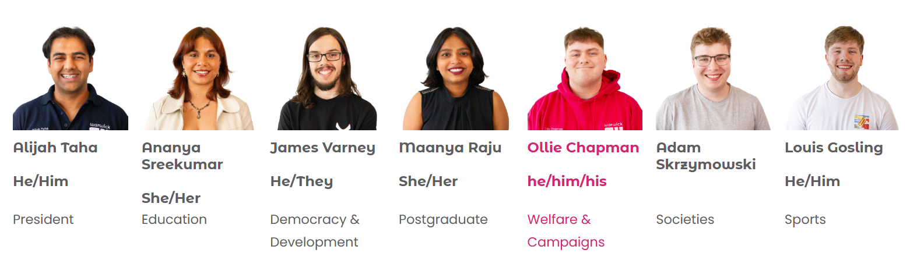
Your Democratic Representation
Officer Team

Slide 16
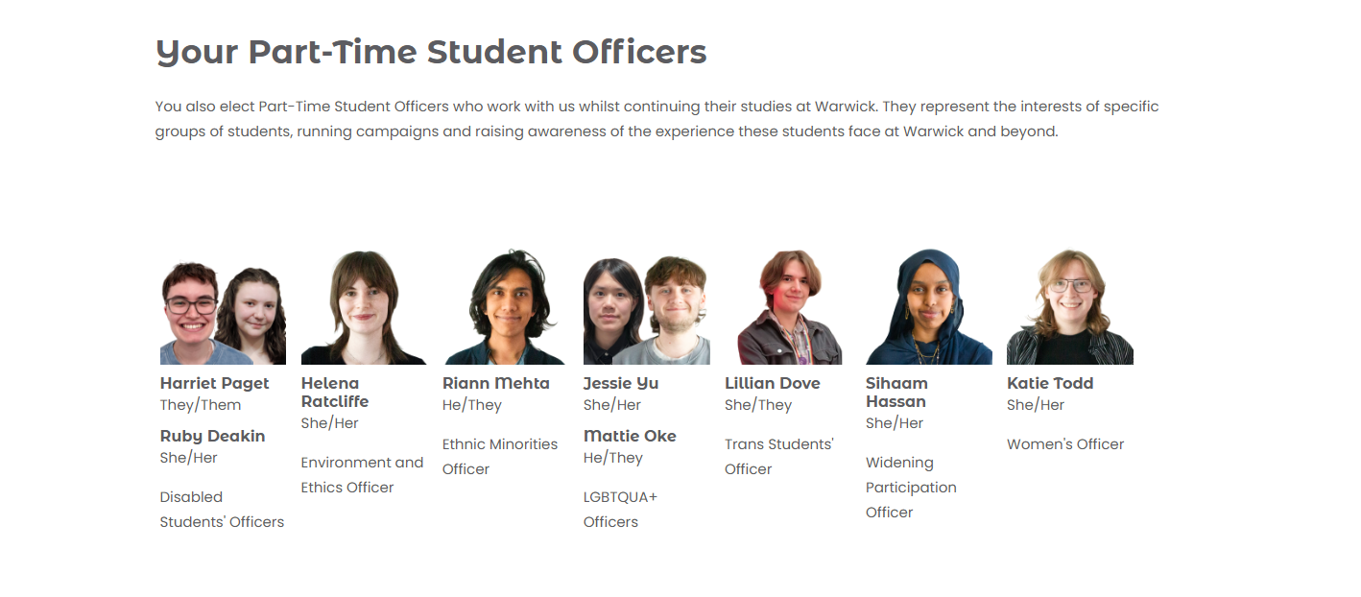
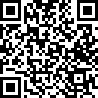
Your Democratic Representation
Elections for Forums and other PTO’s

Slide 17
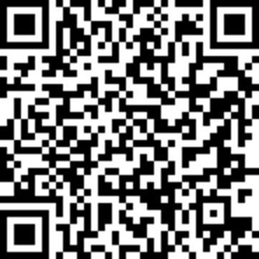
Your Academic Representation
The SU's Academic Representation system ensures that students have a say on their educational experience here at Warwick.
We currently have 300+ course reps who have been elected by students to represent the interests of those on their course.
Students can provide feedback to their Course Rep, which they then discuss with their Department at a Student Staff Liaison Committee.
This can lead to constructive changes to the course, such as receiving specific learning resources, improvements to timetabling, or continuing aspects of a course that students have enjoyed.
To nominate yourself please scan the QR code below or ask your Academic Convener about how to nominate.

Slide 18
Your Support and Advice

Slide 19

Your Support and Advice
Free, confidential, impartial and non-judgemental advice, independent from the University.
Personal Issues
Housing Advice
Course-related problems
Immigra-tion issues
Finance and Funding
Support Sign-posting
University Complaints/ Disciplinary Proceedings
The service is easy to access, just fill out an enquiry form at warwicksu.com/help-support/ and one of our expert advisors will reach out within 2 working days.

Slide 20




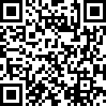

Your Campaigns and Ideas
Course Reps
Ideas Platform

Slide 21
Your Socialising

Slide 22
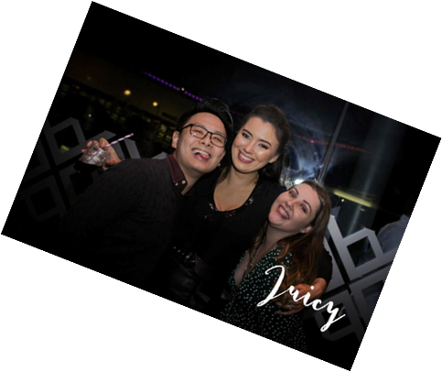







Your Socialising
Course Reps
Our Food and Drink Outlets
We run a packed programme of events throughout the year, from club nights in the Copper Rooms to our Pub Quiz in the Dirty Duck, to dog-petting sessions in exam season, as well as supporting hundreds of student groups in running their own events.
Over 60 Sports Clubs!
Over 250 Societies!
All revenue from our outlets goes straight back into delivering services for Warwick students!

Slide 23

Any questions?
Please do drop in and say hello!

Slide 24
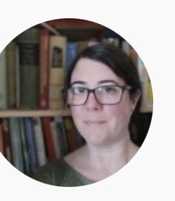
Disability Champion
The Disability Champion for ECLS is Dr. Rochelle Sibley:
Rochelle.Sibley@warwick.ac.uk

Slide 25

PGSSLC
The Postgraduate Staff-Student Liaison Committee (PGSSLC) addresses ongoing concerns among postgraduate students, both PGR and PGT
Our first meeting is Wednesday, 22 October at 13:00-14:00 on Teams--link to be circulated
In terms one and two I host listening sessions, a more informal setting for registering your comments and concerns—first of these is Tuesday 25 November, 5-6pm (week 8), location to follow
Details and links via email—check your accounts
PGSSLC is also responsible for the PG Symposium…
Your PGSSLC Cruise Director: Dr. Michael Meeuwis (m.meeuwis@warwick.ac.uk)

Slide 26
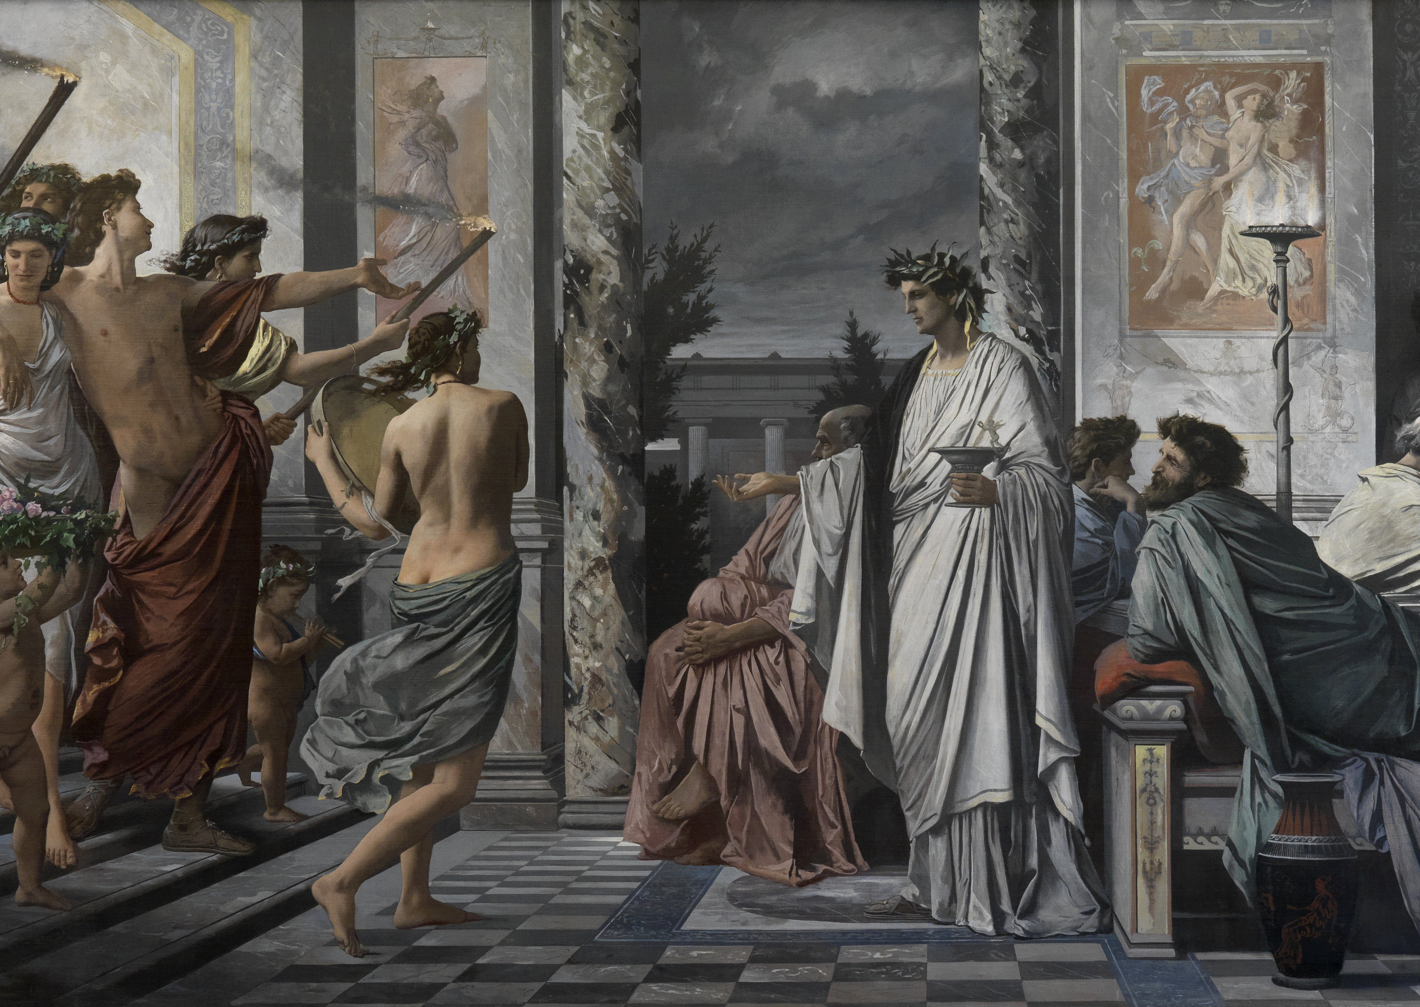
Postgraduate Symposium
Annual presentation of postgraduate research
Come to PGSSLC if you’re interested in planning
This year’s Symposium scheduled for Thursday, 21 May (tentatively—final date to be announced)
See last year’s Symposium at https://warwick.ac.uk/fac/arts/english/currentstudents/postgraduates/pgsymposiums/21pgsymposium

Slide 27
PGSSLC Schedule of Events
PGSSLC: Wednesdays at 1pm, Teams
Term one:
Wednesday 22 October (week 3)
—also, assemble PG Symposium Committee
Wednesday 3 December (week 9)
Term two:
Wednesday 28 January (week 3)
Wednesday 11 March (week 9)
Term three:
Wednesday 13 May
PG Symposium:
Tentatively Thursday 21 May (week 4)—
date may change, check your email
PG Listening session/social event:
Term one:
Tuesday 25 November, 5-6pm (week 8)
Term two:
Tuesday 3 March, 5-6pm (week 8)

Slide 28
How can the Library support your research?
Sarah Akhtaruzzaman - Academic Support Librarian for English

Slide 29

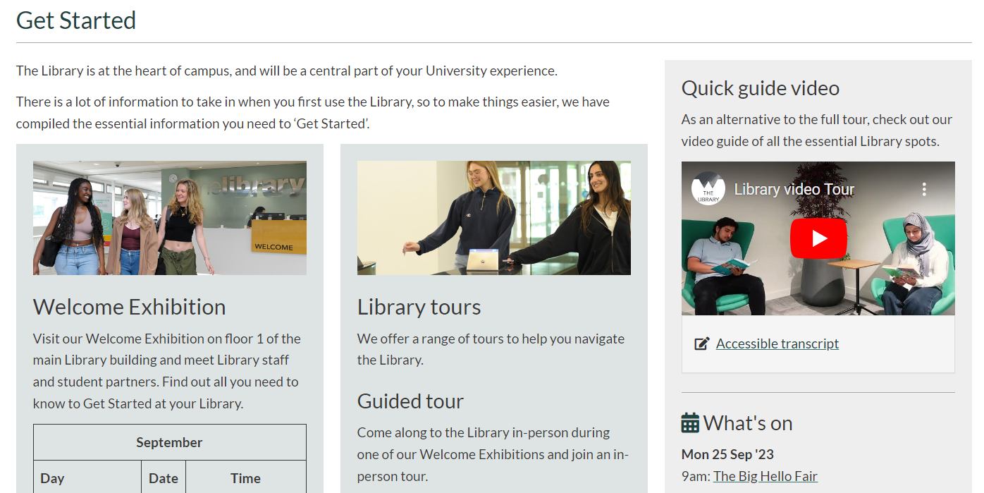
Get Started

Slide 30
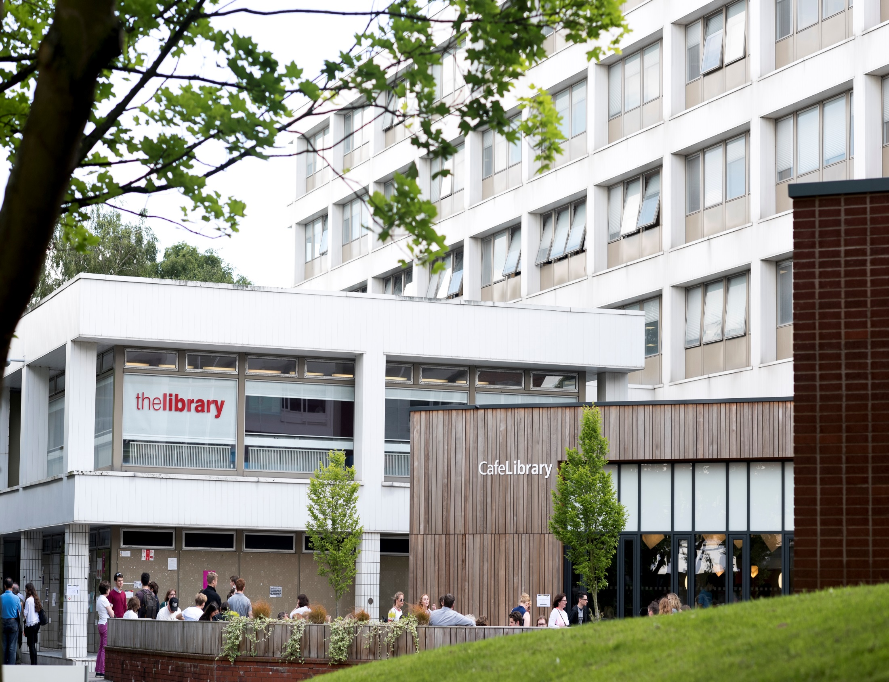
Find us! …
Open 8.30-midnight

Slide 31
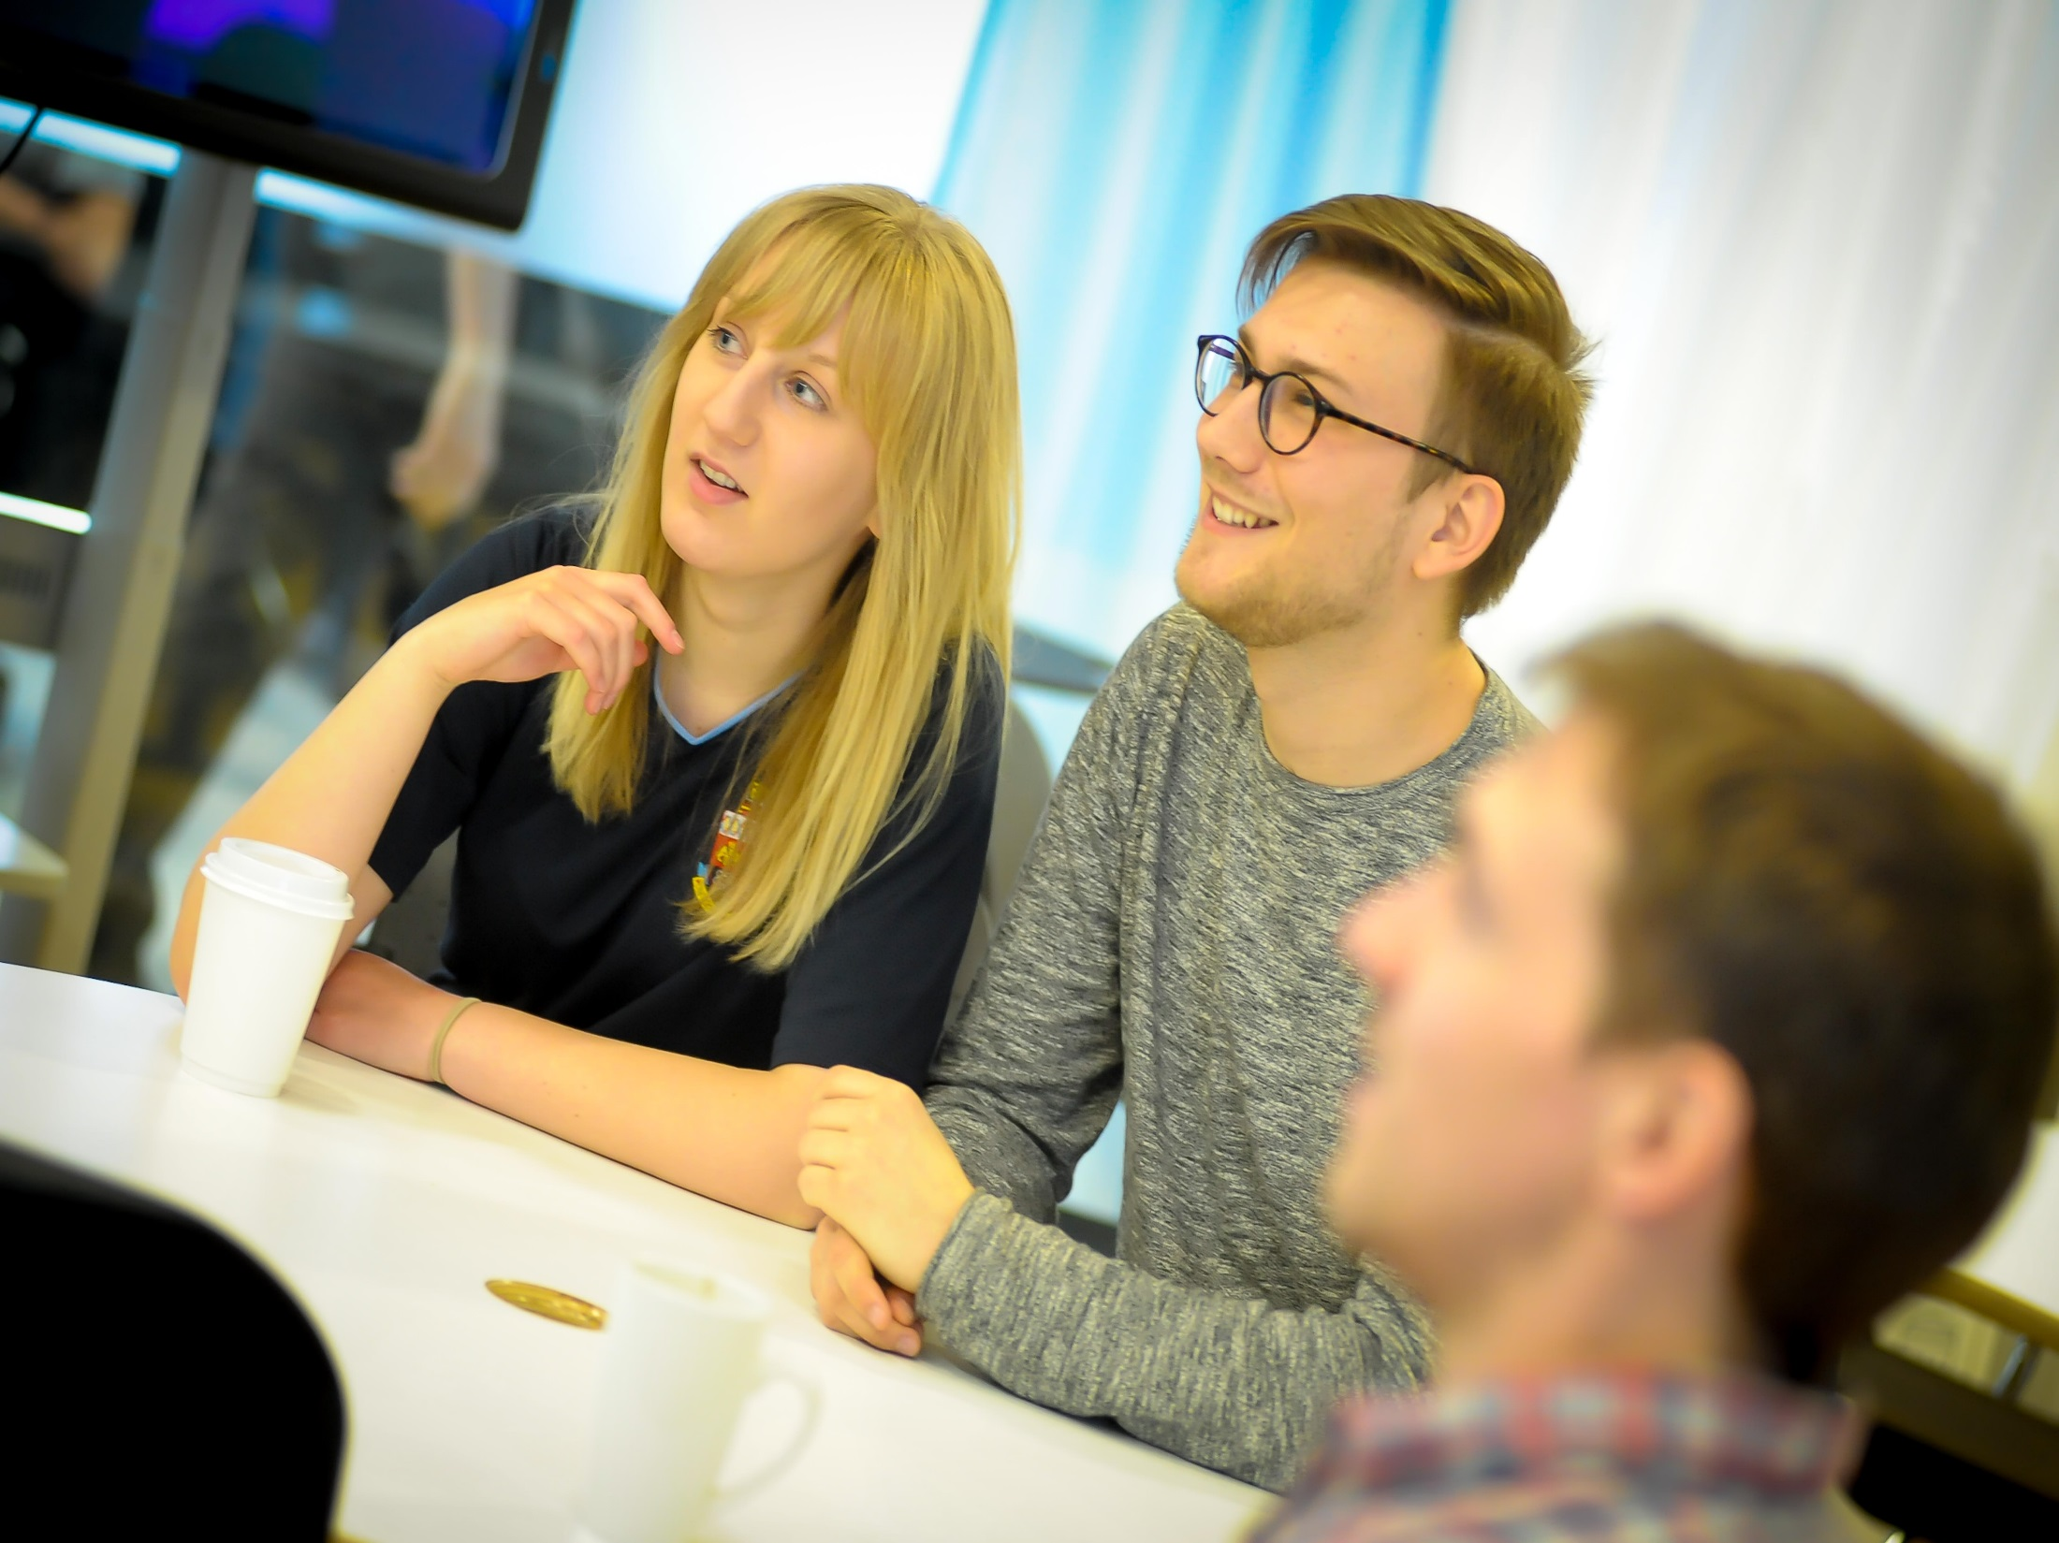
Group study

Slide 32
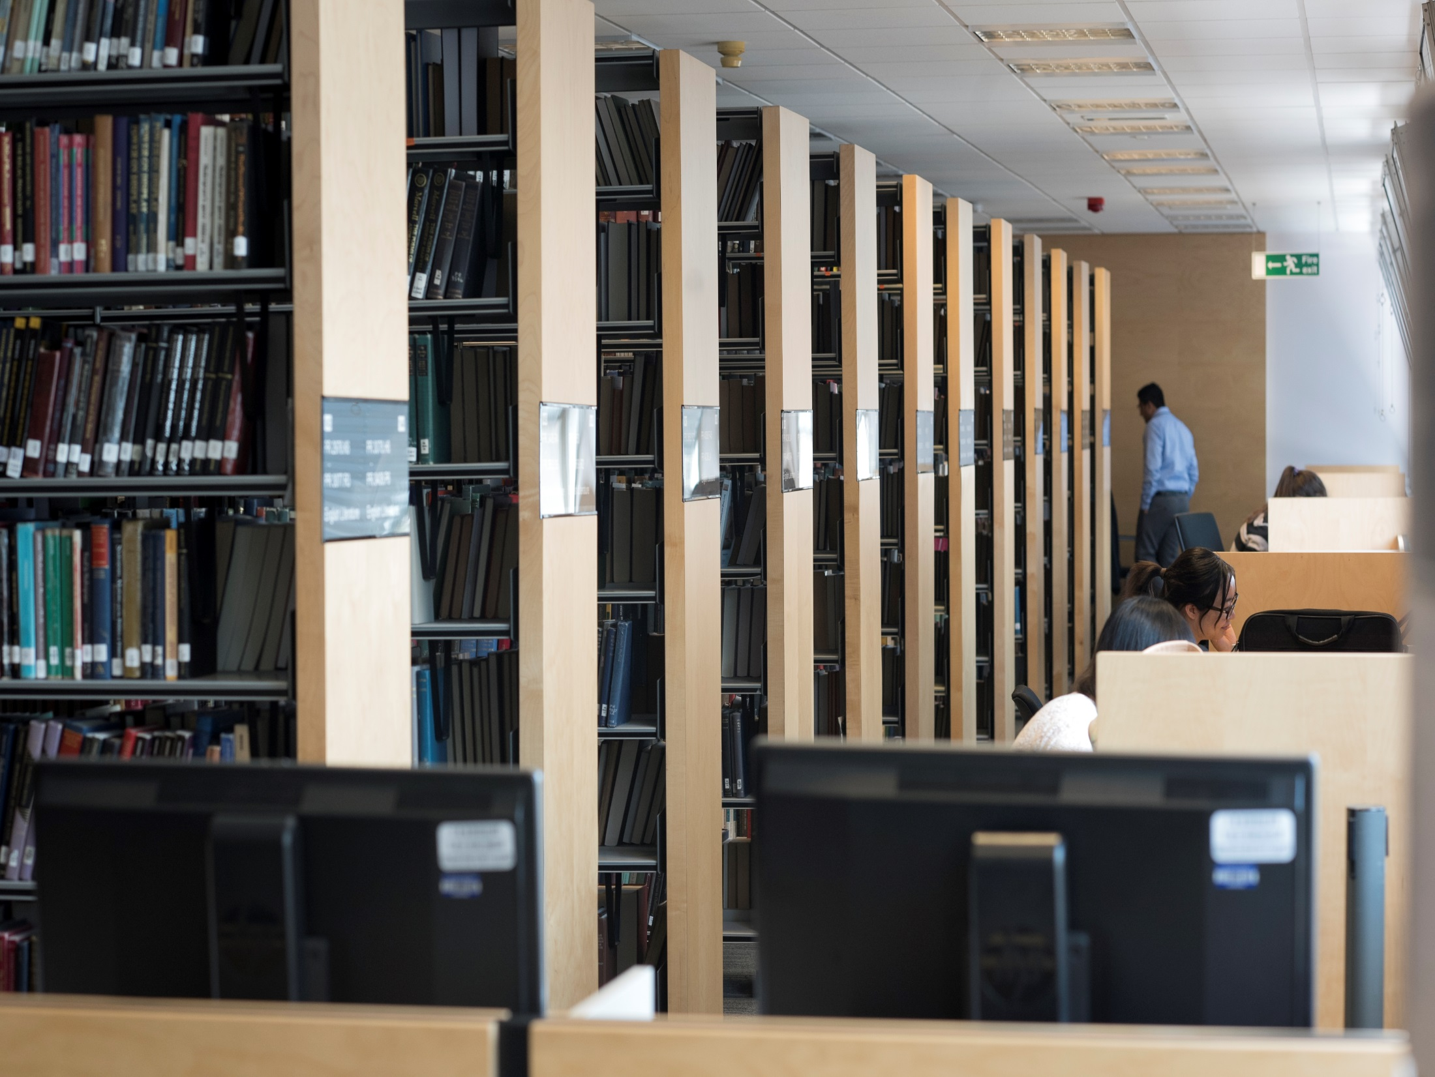
Quiet study

Slide 33
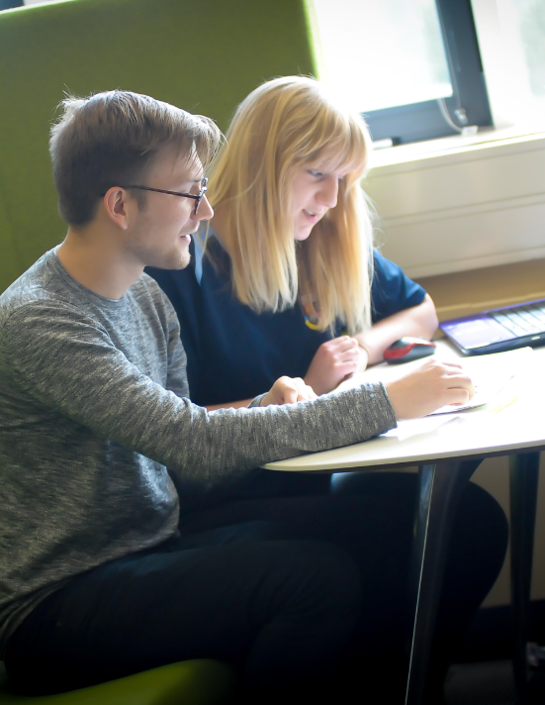

Wolfson Research Exchange
Postgraduate Hub

Slide 34
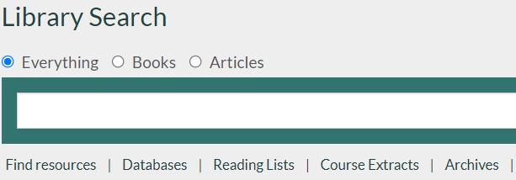
Online reading lists
Find the reading list linked from your module in Moodle
Or follow the reading list link under Library Search

Slide 35


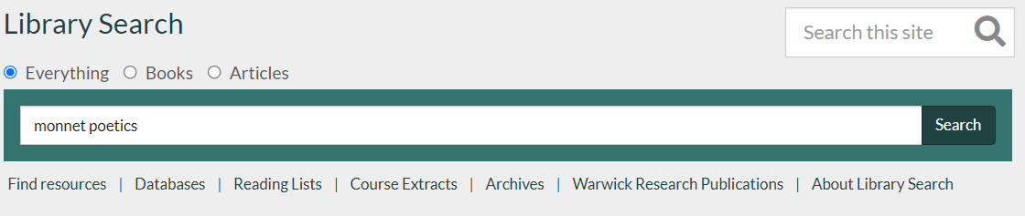
Finding books…

Slide 36

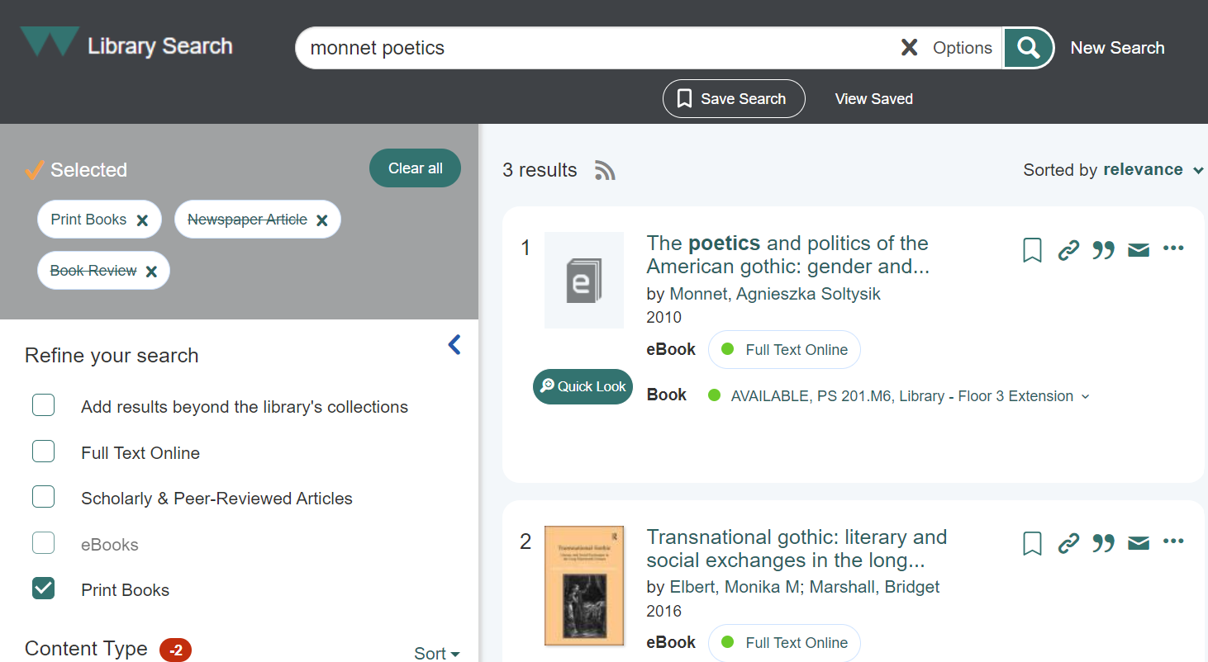

Slide 37

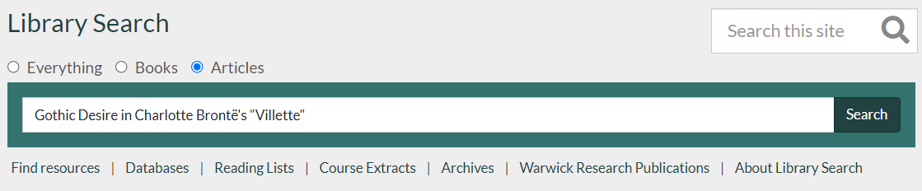

Finding specific articles and papers

Slide 38
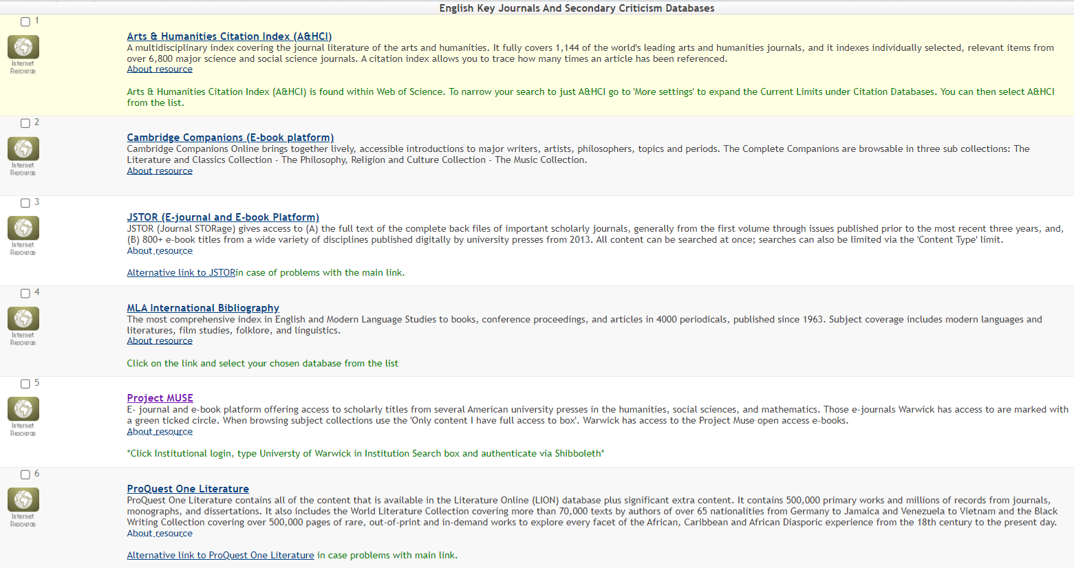



Searching academic databases

Slide 39
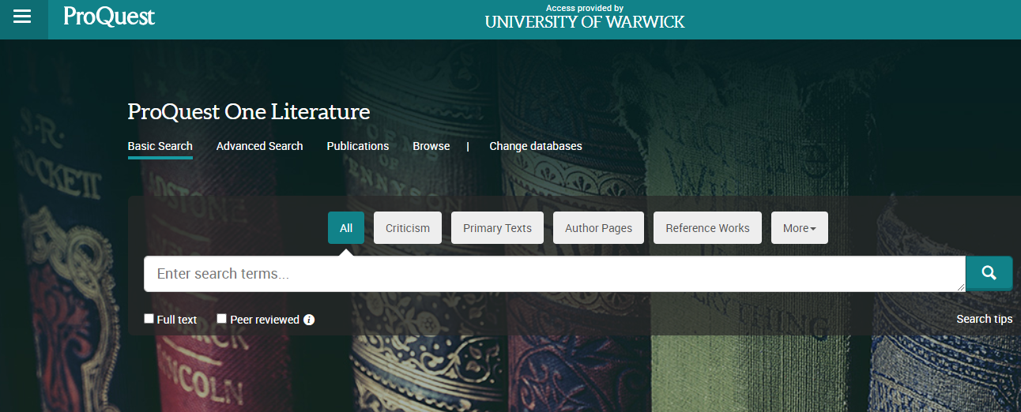


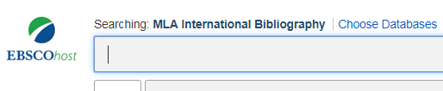
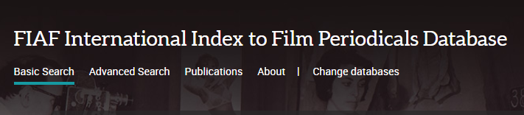

Secondary sources

Slide 40








Primary sources

Slide 41
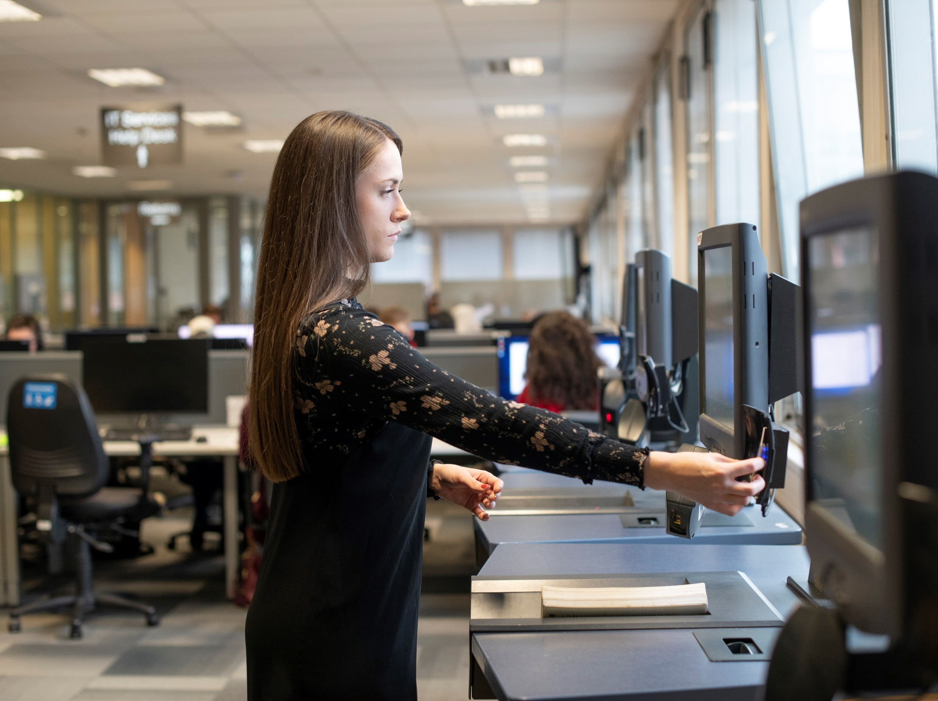
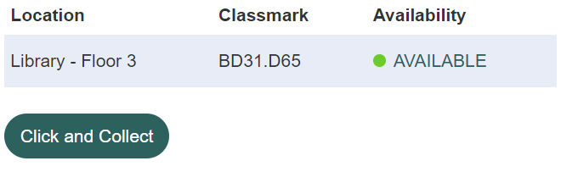

Borrowing from the Library
Up to 999 items
+ 3 Day Loans

Slide 42
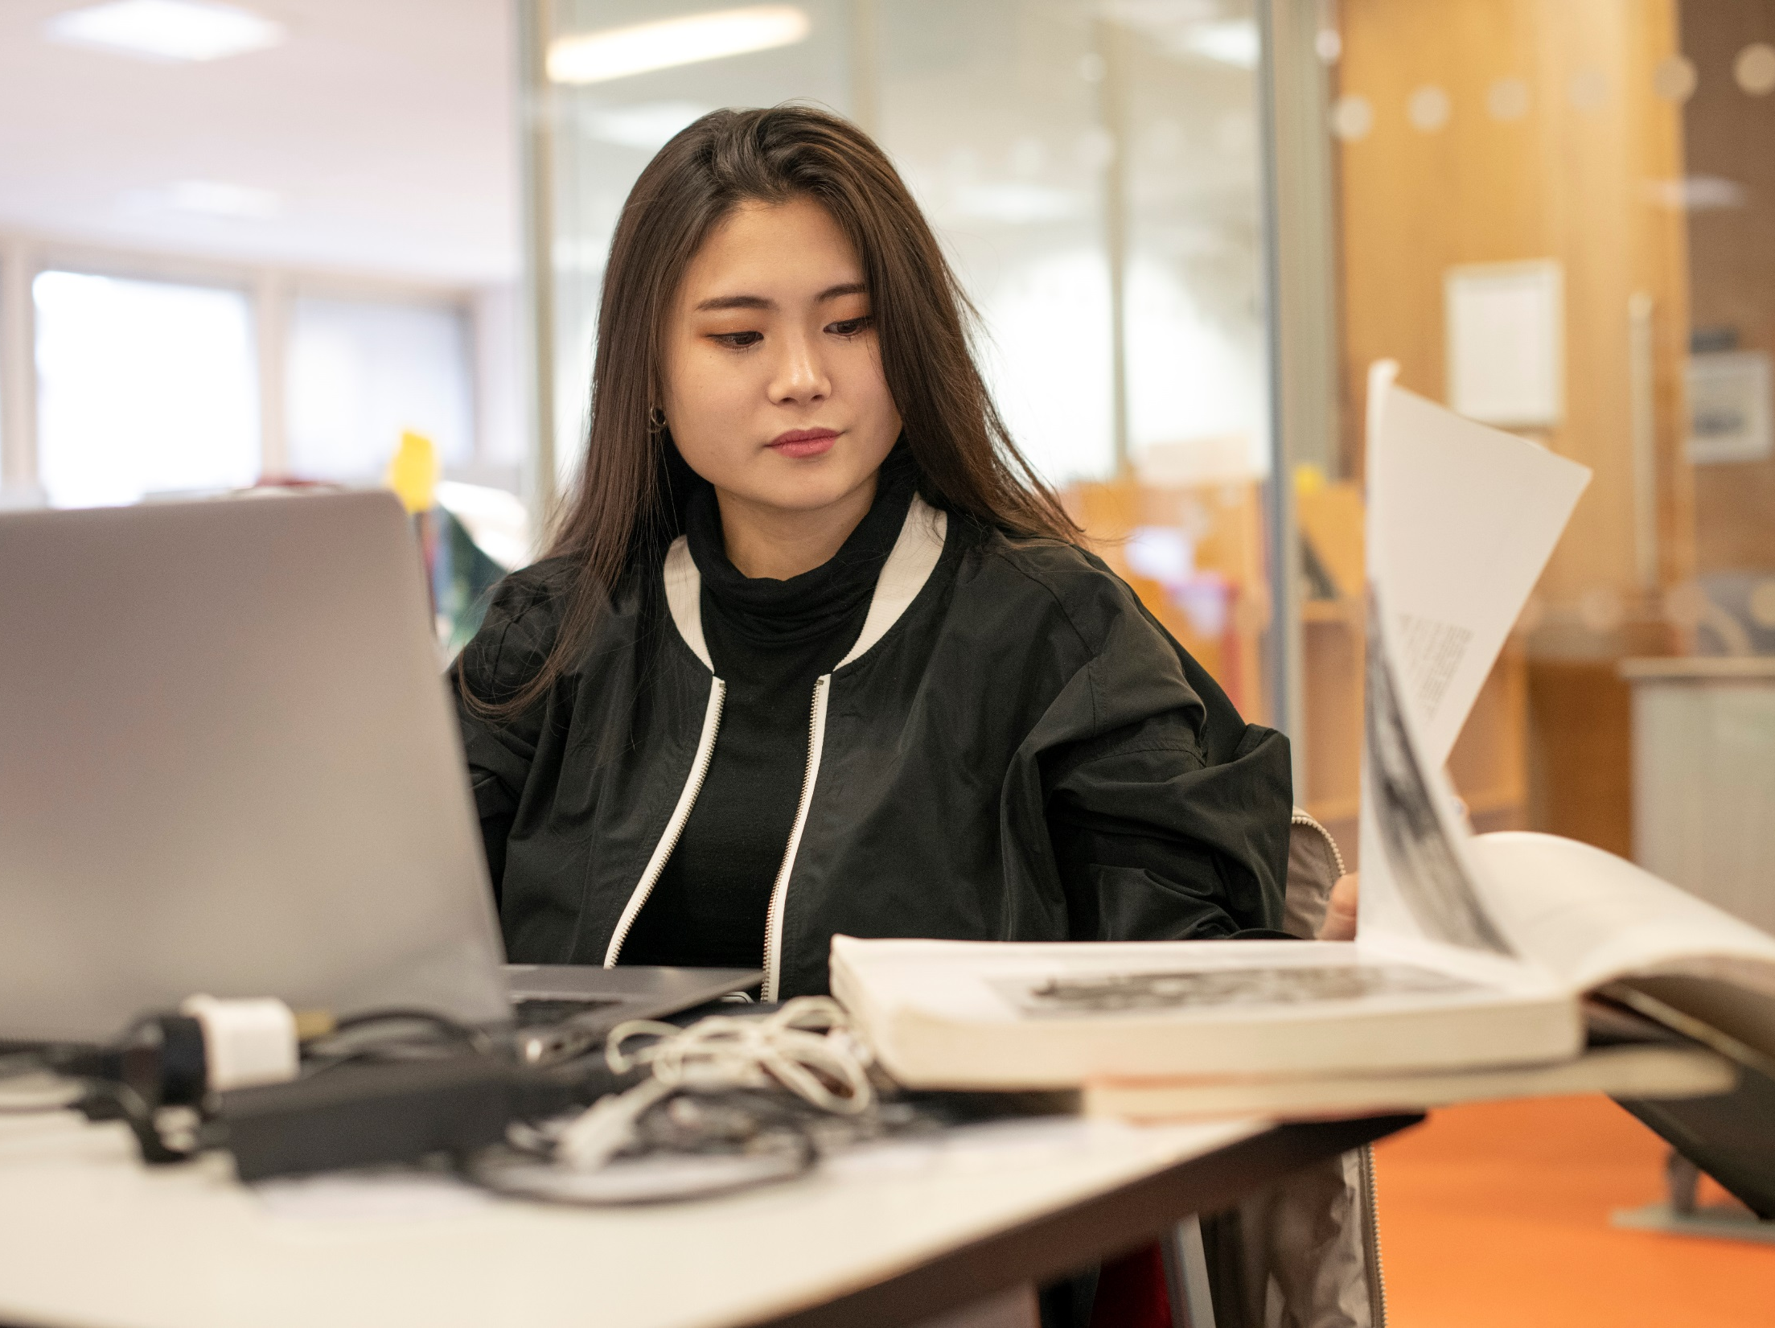
Manage your Library account
My Library Account
manage your loans
keep up to date with your account

Slide 43
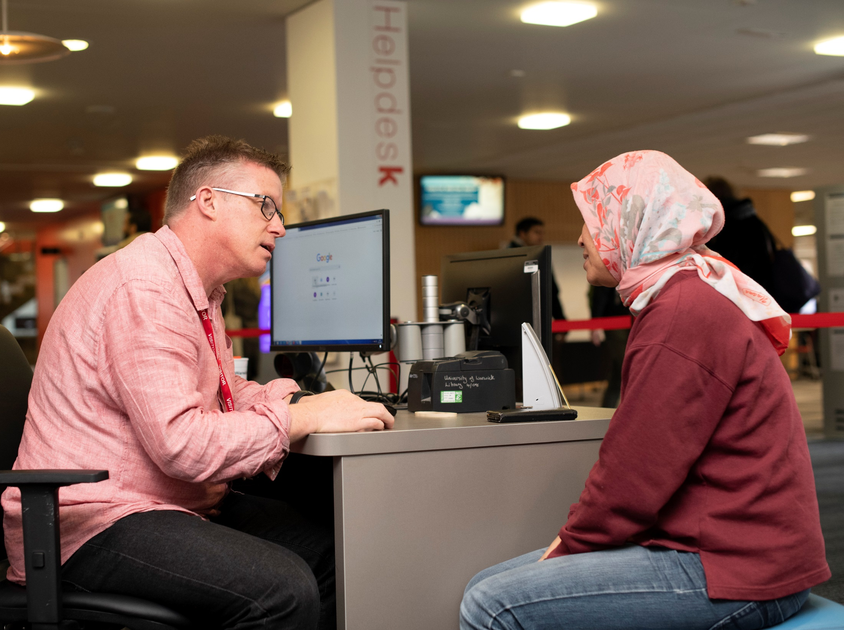
Ask for help

Slide 44






Research and Academic Services
Research support
The library has a Research and Academic Services team to support researchers:
Disseminating your research and getting published
OA: open access publishing and funding (OA journals and books)
WRAP: deposit your research in the Warwick Research Archive Portal
RDM: research data management – plan, store, preserve & share your data
Bibliometrics: using citations to measure authors, articles and journals
openaccess@warwick.ac.uk
@warwicklibrary

Slide 45
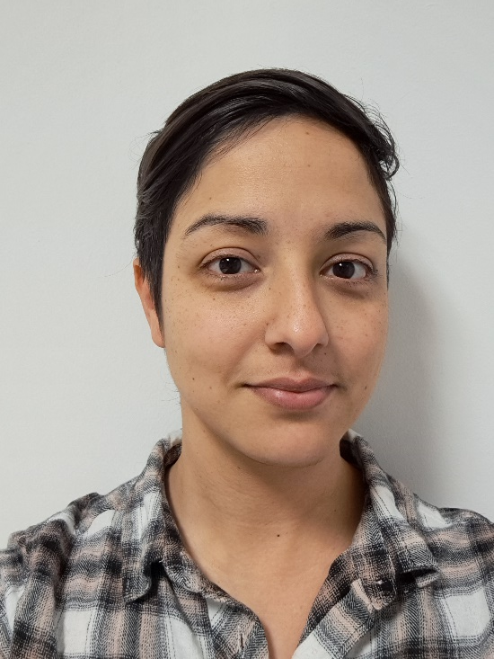
Academic Support Librarian
Sarah Akhtaruzzaman
Help with research, course-related enquiries, finding literature, referencing and resources for your subject.
s.e.akhtaruzzaman@warwick.ac.uk

Slide 46
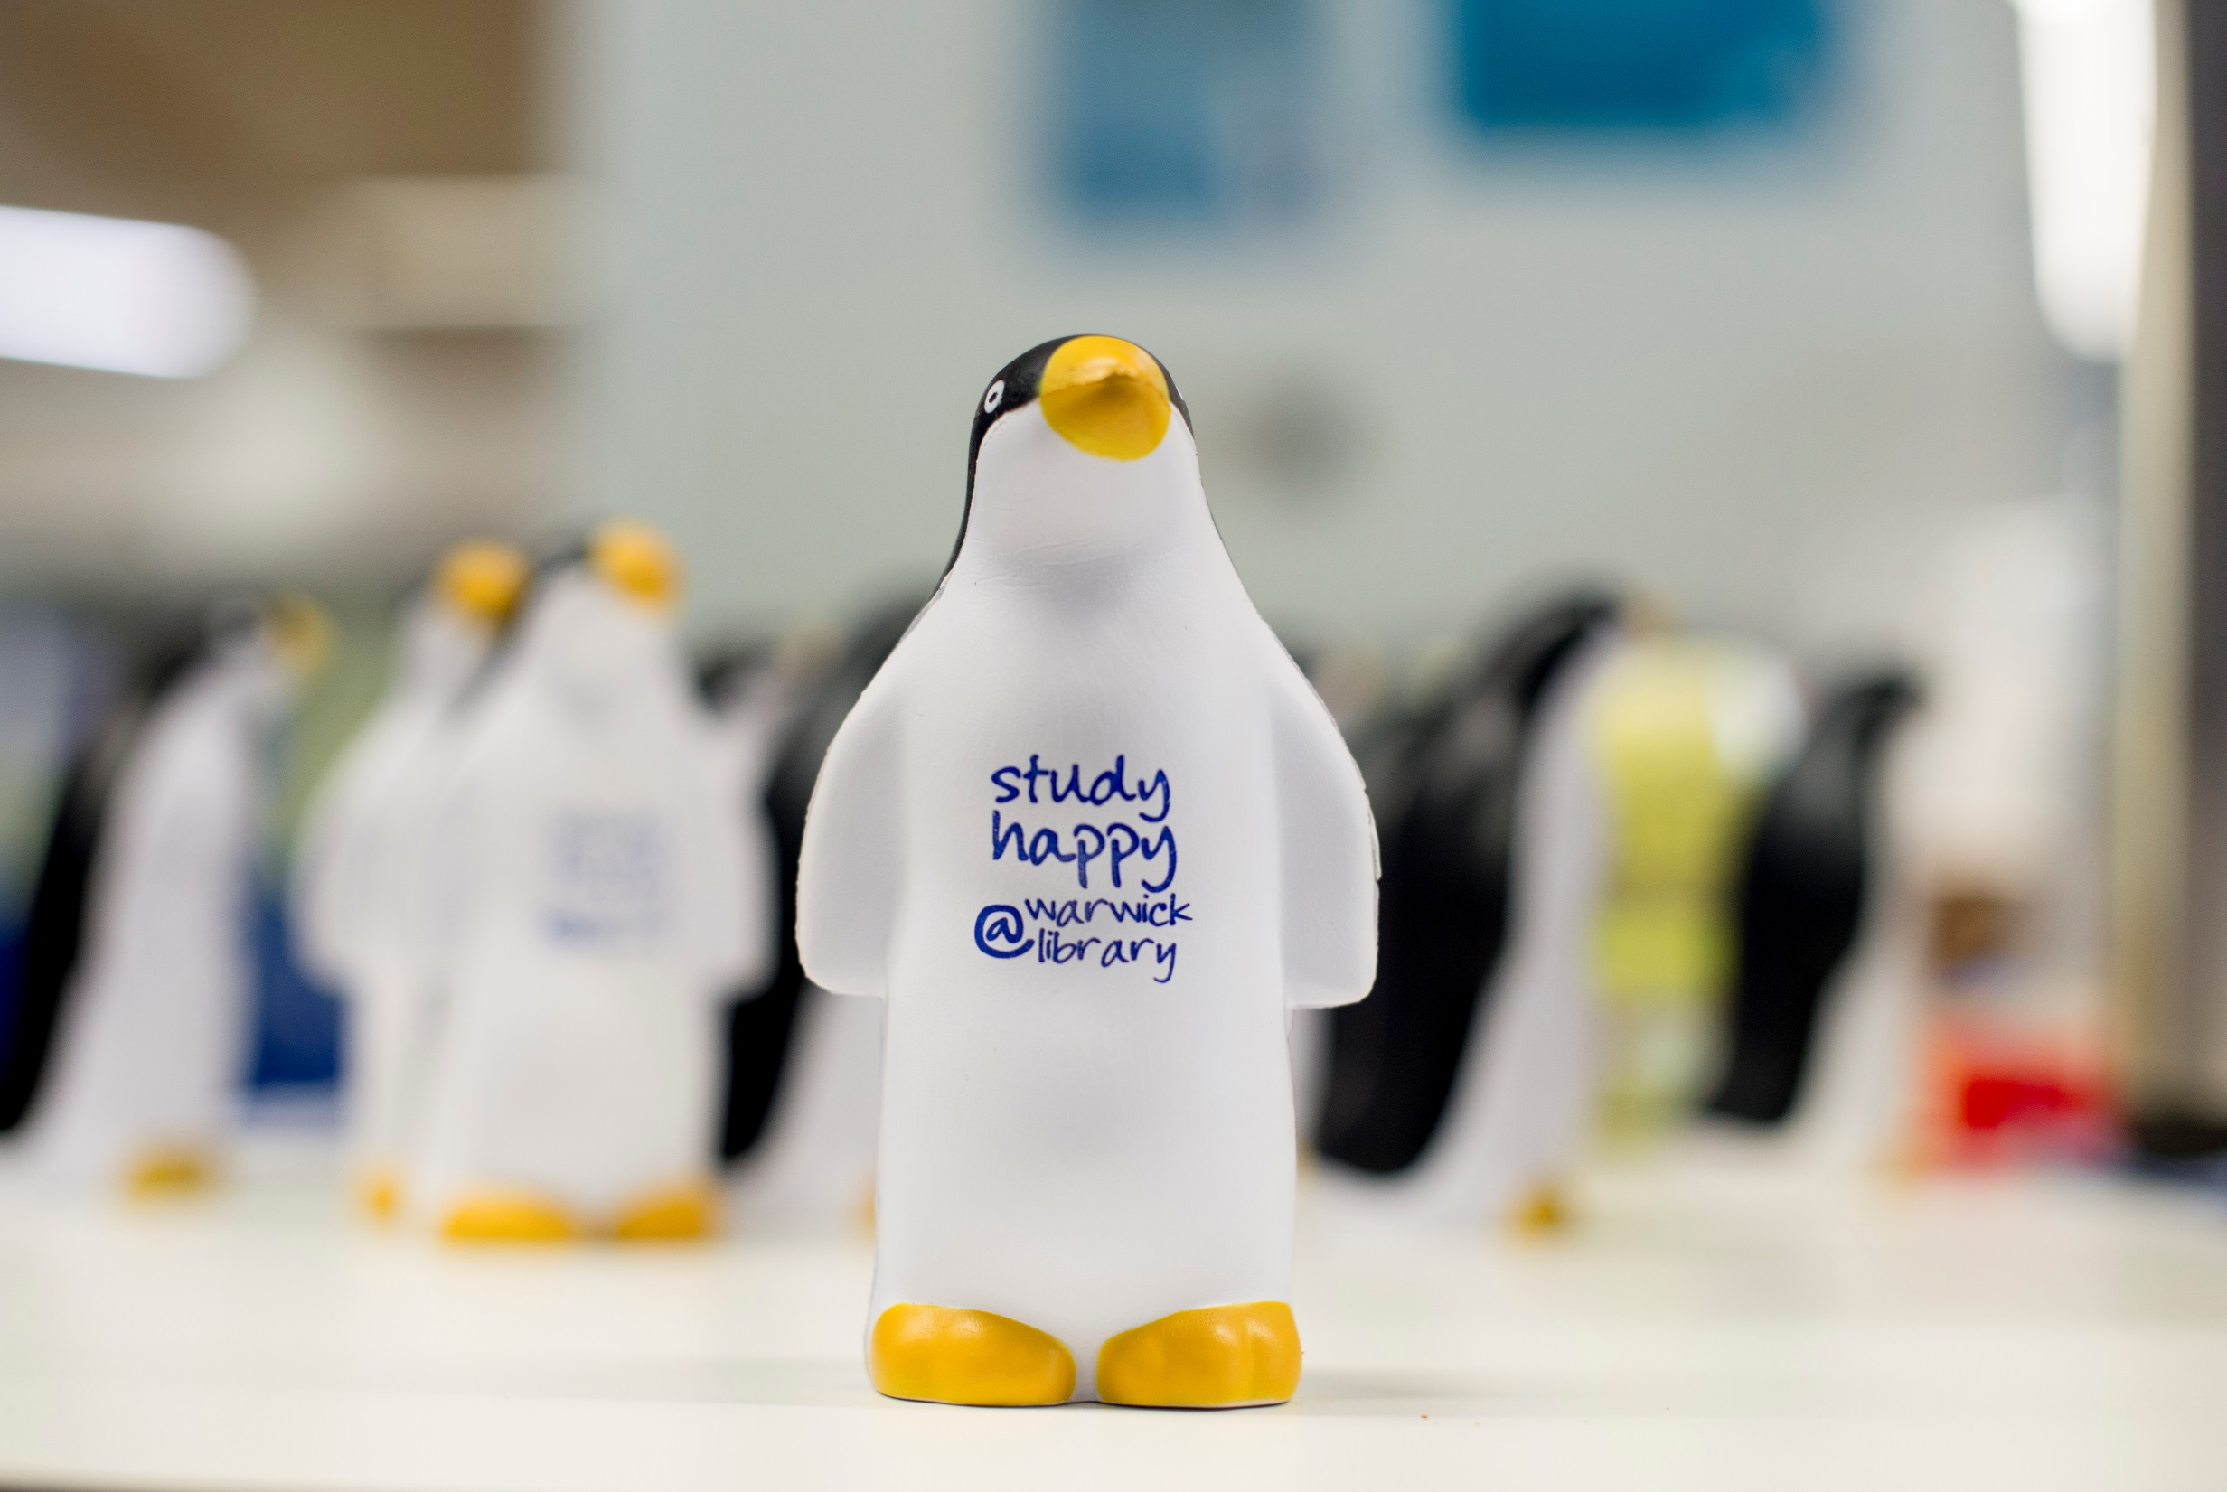
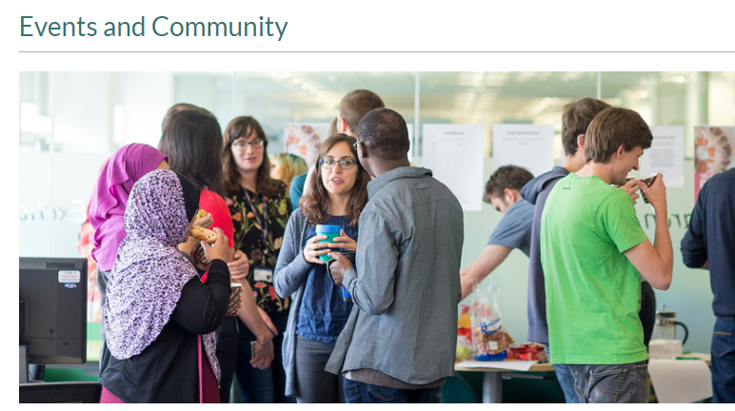

Your community in the Library
Library Online Lounge (LOL!):
  Peer support
  Study Happy support and events:
  - Look out for Kirby!

Slide 47

Postgraduate Community
The library’s Community Engagement team run events for postgraduates:
Research Refresh: 10:30am-12:00 every Thursday in the Rex
PG Tips: 3:00pm-4:00pm every Tuesday in the PG Hub
Write Here Write Now: pomodoro style writing event (various dates)
They also run a Postgrad Realities course & PhD Life and Study Blogs

Slide 48
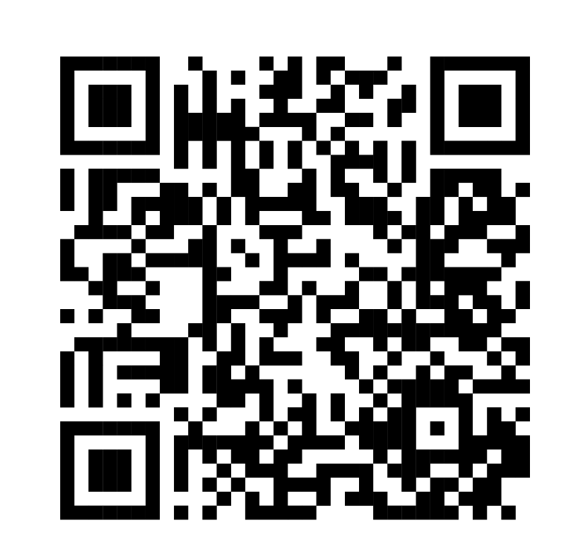




Library Student Partners
Helping us with our events and to help us improve the Library, are our Library Student Partners.
These peers are also here to help connect with you and support you during your time at the University, so if you need help or have any suggestions for making the library a better place, talk to them.
You can also connect with us on Social Media or by emailing us.
@WarwickUniLibrary
library@warwick.ac.uk
@WarwickLibrary
@WarwickLibrary
Notes:
We’re also quite active on social media and we love to connect with our students! You can find us on Facebook, Instagram and Twitter. If you follow us on there, you’ll find up to date information about our offers, initiatives and events and you can also ask us questions too. If you do need to get in touch with us for any other reason, please do feel free to reach out to us at lib-community@warwick.ac.uk.

Slide 49

EN100 Research Methods
Compulsory but unassessed module that runs during even weeks of term 1 and 2
Weekly seminars on academic writing and research strategies
Formative critical review assignment (1,000 words) to get writing and referencing feedback in Term 1
Extra Support for the PG Dissertation during Term 3
Open to International PhD students
EN100 Research Methods webpages are here:EN100 Research Methods (warwick.ac.uk)

Slide 50

Additional sources of writing support
ECLS Academic Writing Moodle is here: Course: ECLS Academic Writing Resource (warwick.ac.uk)
Bookable academic writing one-to-ones are here: Academic writing one-to-one support (warwick.ac.uk)
If you have any academic writing questions, contact Rochelle Sibley at Rochelle.Sibley@warwick.ac.uk

Slide 51
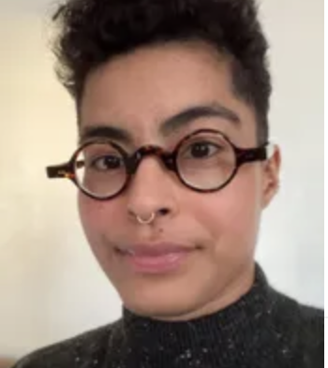
PG Professionalization – Dr. Alirio Karina
Office Hours – Mondays and Tuesdays, 12-1pm, FAB5.19
Alirio.Karina@warwick.ac.uk

Slide 52
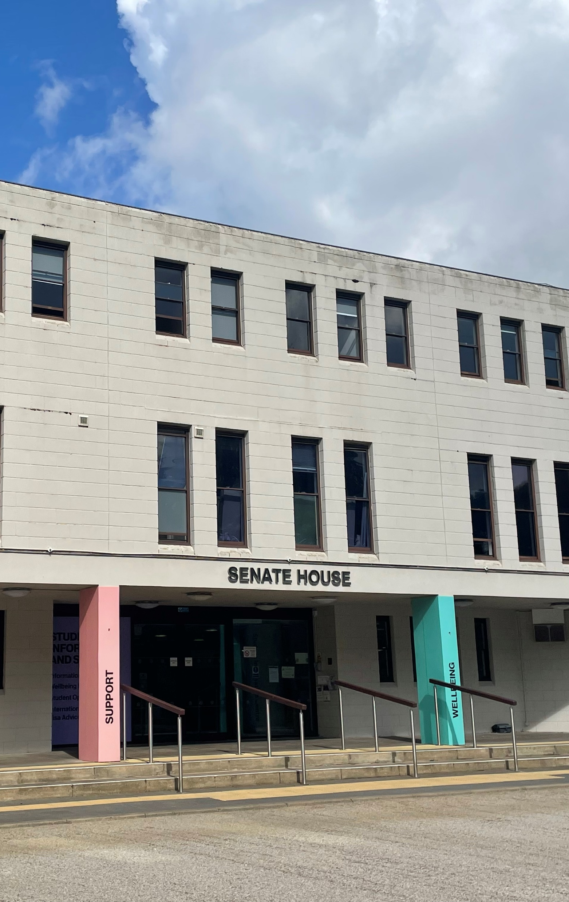
Careers Support
for English & CLS
Unsure where to start?- careers@warwick.ac.uk

Slide 53
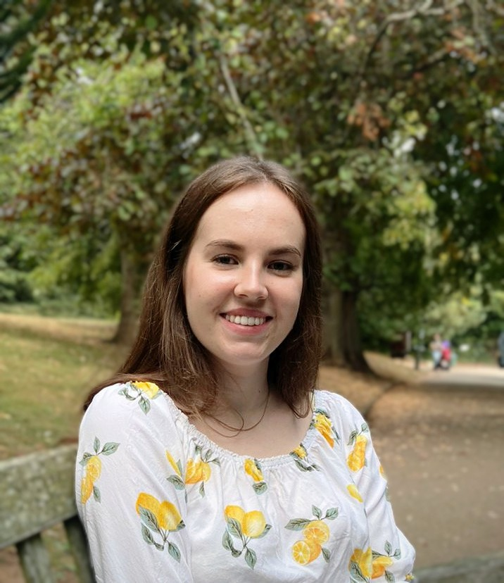
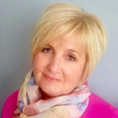
Who’s who
Ellie Wetherhill- Careers Consultant
Kay Brown- Job Search Advisor
You can see any member of the Careers Team for support- go with what time works best for you!

Slide 54
What can the Careers Team help with?
Lots!
Know what you want to do and need more information to make it happen
Have no idea what you want to do
About to finish studies and not found a job yet
Feeling a bit lost and needing to re-plan
In the middle of your studies and planning ahead
Applying to roles and hearing a lot of ‘no’s

Slide 55
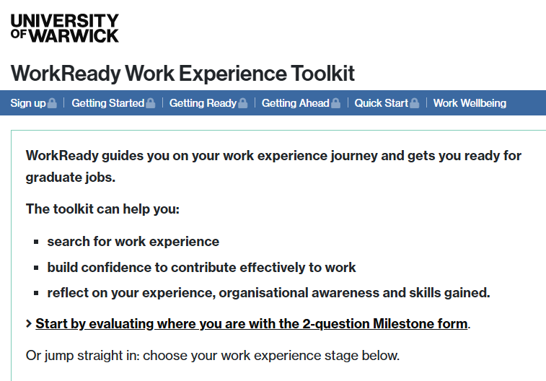
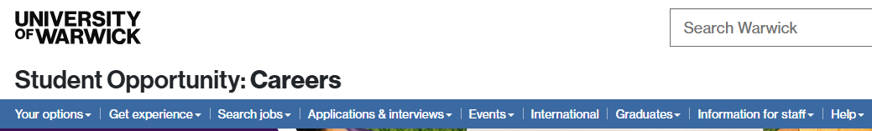
How we can help
GraduatesFirst- practice video interviews, employer-specific info
Student Circus- job search support for international students
Careers webpages
WorkReady Toolkit
Step-by-step guide to getting work experience
Careers workshops
Each stage of the process:
Stage 1: Breaking into the Job Market
Stage 2: Your Practice Space- Video Interview and Psychometric Tests
Stage 3: Interviews and Assessment Centres

Slide 56
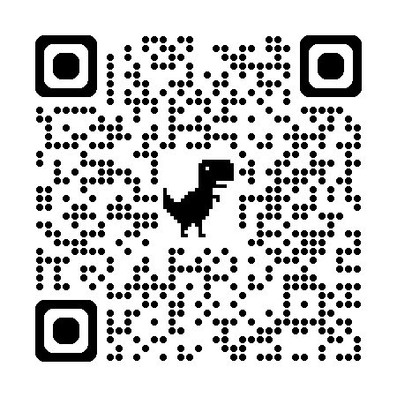
If you’ve tried all of those resources…
MyAdvantage:
Careers Guidance appointment
You are most likely to benefit from a careers guidance meeting if you are:
Unclear about what you want to do
Anxious about career planning and may benefit from reassurance and support
Making many applications but failing to progress
Having lots of ideas but not sure where to start
Thinking of leaving Warwick or changing your course
Thinking about how your disability might influence your career planning or are unsure of how to disclose this with employers
In-person on campus or via MS Teams
Bookable via MyAdvantage
Application Feedback and Interview Practice appointment
Get feedback on your CV, cover letter, application form or masters personal statement
Get advice around interviews, online tests, video interviews or have a mock interview
Via MS Teams
Bookable via MyAdvantage
Application drop-in
Have your application documents reviewed by a Job Search Advisor
Usually Tuesday, Wednesday, Thursday in term time
10:00-12:00 and 13:00-15:00
Student Opportunity Hub, Senate House (SH0.01)

Slide 57
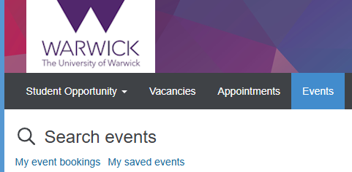
Key dates coming up
First Careers workshops:
Stand out at Careers Fairs- 7th Oct
Networking for success- 8th Oct
How to write CVs and cover letters- 9th Oct
Breaking into the job market- 10th Oct
Using AI for CVs and applications- 17th Oct
Careers fairs:
Autumn Fair- Tue 14th October (week 2)
Business, Finance and Consulting Fair- Thur 16th Oct (week 2)
Law Fair- Wed 22nd Oct (week 3)
Meet the Professionals:
Careers in the public sector- 13th Oct
Marketing- 15th Oct
HR and recruitment- 20th Oct
Careers in books- 21st Oct
Film, TV and radio- 4th Nov
Full programmes and more events on MyAdvantage

Slide 58

Let’s stick with the relevant info
You will have had an email asking you to activate your gradintelligence account
Activation of your account gives access to your HEAR and the Warwick Award
Career stage survey on registration with just 4 questions
Get specific resources relevant to you
If you’ve not already registered with gradintelligence, take a moment to do it today- we want to make sure we’re not sending you stuff you don’t want!

Slide 59
Introduction to Course Convenors
(& brief overview of the MA courses)
Christine Emmett (World Lit MA) christine.emmett@warwick.ac.uk
Emma Francis (English MA)
E.J.Francis@warwick.ac.uk
Matt Franks (English and Drama MA)
M.Franks@warwick.ac.uk
Dan Katz (MA Critical and Cultural Theory)
D.Katz@warwick.ac.uk
Jonathan Skinner (MA Environmental Humanities)
J.E.Skinner@warwick.ac.uk

Slide 60
The MA Year at a Glance
See the PGT Handbook for full details: https://warwick.ac.uk/fac/arts/english/currentstudents/postgraduates/english-handbook-pg/introduction
(Dates will differ for part-time students.)
TERM 1:
  Attend and participate in seminars
  Meet with personal tutor (by end of week 2)
  Attendance at Research Methods/ Academic Enrichment seminar (during specific weeks)
  Prepare and submit dissertation proposal (due end of week 9, 5th December)

Slide 61
The MA Year at a Glance
TERM 2:
  Attend and participate in seminars
  Turn in coursework for Term 1 modules (week 3)
  Meet personal tutor (by end of week 4)
  Initial meeting with dissertation supervisor (by week 10)
  Dissertation progress report due (by end of week 9, 13th March)
TERM 3:
  Turn in coursework for Term 2 modules (week 3)
  Meetings with dissertation supervisor (up to four; you are responsible for scheduling these with your supervisor)
  Draft of your dissertation work due to your supervisor by the end of the term
  Annual Postgraduate Research Symposium (in May)
  Dissertation draft report due (by week 10, 1st July)

Slide 62
The MA Year at a Glance
SUMMER:
  There is no supervision over the summer—last round of feedback end of T3
  Dissertation is due 1st September 2026.
  Extensions on the dissertation are very short. If you are unable to submit your dissertation within this extension, for whatever reason, you will need to wait until September 2027
  to do so.
  THROUGHOUT: Participate in Departmental and Faculty of Arts research events, to all of which you are welcome—talks, research seminars, discussion groups, symposia, etc.

Slide 63
MA Seminar Expectations at Warwick
Regular, prepared attendance
Full, active participation from all students involved
Conversation and debate that elevate students’ voices
Plan for essays so they do not interfere with your coursework
Student-led discussion centered on a particular issue and informed by assigned texts
Critical engagement with reading: attention does not mean you have to ‘master’ the text! Questions can be more valuable than answers.
Possible presentation component
Notes:
If I were to sum up what an MA seminar is, it would be a “student-led discussion focused on a particular issue pertinent to literary study and informed by that week’s assigned readings.” What does this mean? Let’s break this down a little.
The fact that MA seminars are student led discussions is going to make this learning experience a little different from what you may have encountered in an undergraduate lecture or seminar. In lectures, the primary voice comes from the lecturer who offers a particular take on the text in question, while in undergraduate seminars, the seminar leader might be more hands about how the conversation is run—either by setting very specific group activities or setting questions for the students to answer as the seminar progresses. But in an MA seminar, it is the students’ voices that are elevated. While the seminar leader will facilitate the conversation with certain questions and sharing their interpretations of the texts, the flow of the conversation is down to the students themselves. The seminar is a space of collaborative, shared discussion wherein you, your fellow students, and the instructor model for each other how to close-read, analyse and argue at a much higher critical level than undergraduate. This is why active, participation in seminar by all students is really important—both in terms of speaking out your ideas, but also in listening closely to others so that you can engage with what they’re saying (not just about making your voice heard).
The MA seminar is also informed by assigned texts. Seminar leaders will typically assign about 50-90 pages of reading per week, and you will take the ideas you’ve picked up in your weekly readings as starting off points for discussion. This might seem like quite a lot! The crucial thing to remember here is that the goal is not to completely understand everything you’ve read on the first go before seminar. I often make this mistake—where I try to take notes on absolutely everything and get stressed if I don’t understand everything. But it’s completely fine to have things you don’t understand everything at the beginning! Rather than trying to completely comprehend everything, think about certain aspects of what you’ve read that really grabbed your interest—aspects that might have raised questions for you, that you might resonate with, that you might disagree with, then think about what you have to say about them. If there are parts you don’t understand, highlight them as well—because I guarantee that there will be others who don’t understand it also (those parts of the texts are often the most interesting). Once in seminar itself, you’ll discover that your ideas will develop along with that of others, and at the end, you’ll have a far better understanding of the text itself.
Often, modules will require you to do a informal presentation about one of the assigned readings in seminar. If you are unsure of what is required in a presentation, speak to the seminar leader. But much like the readings, these presentations should be thought of as a platforms that help further discussion and debate, rather than just trying to give a complete, comprehensive summary about the text itself.

Slide 64
English and Comparative Literary Studies
Research Groups
Warwick Research Collective (WREC): Materialist Studies in World Literature
American Studies
Environmental Humanities/ Centre for Ecopoetics
Comparative Religions and Literatures (CORAL)
Critical Theory Network
Feminist Dissent
Poetry at Warwick (PAW)
Medical Humanities
Manuscript and Print Cultures

Slide 65

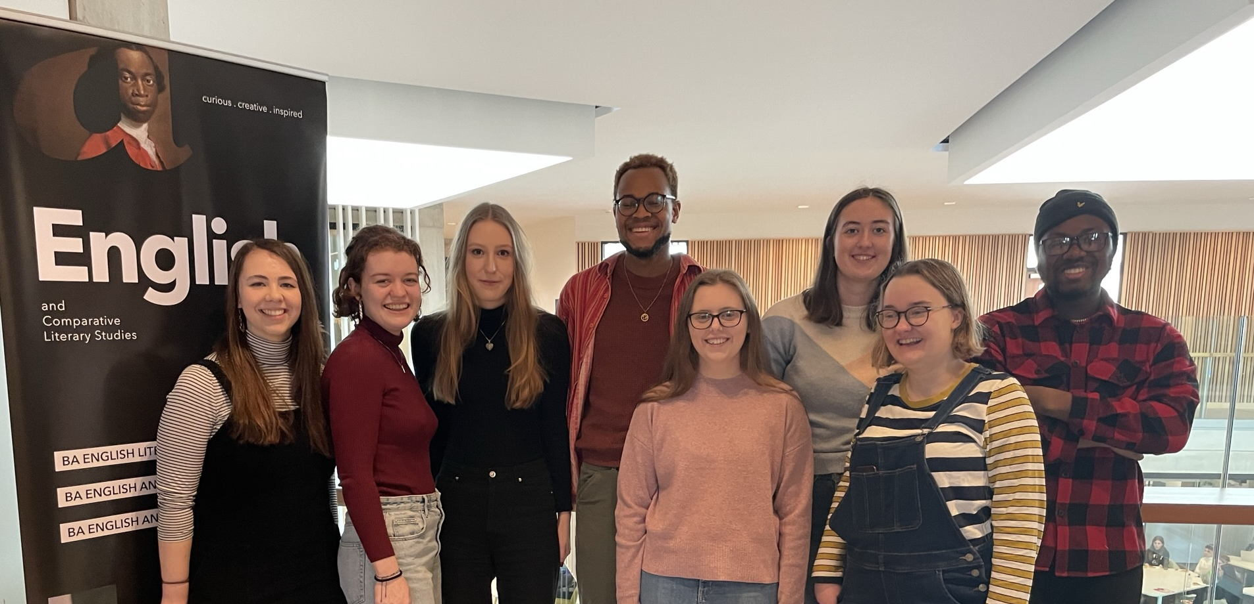
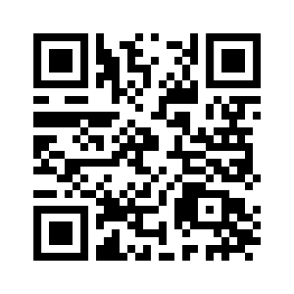
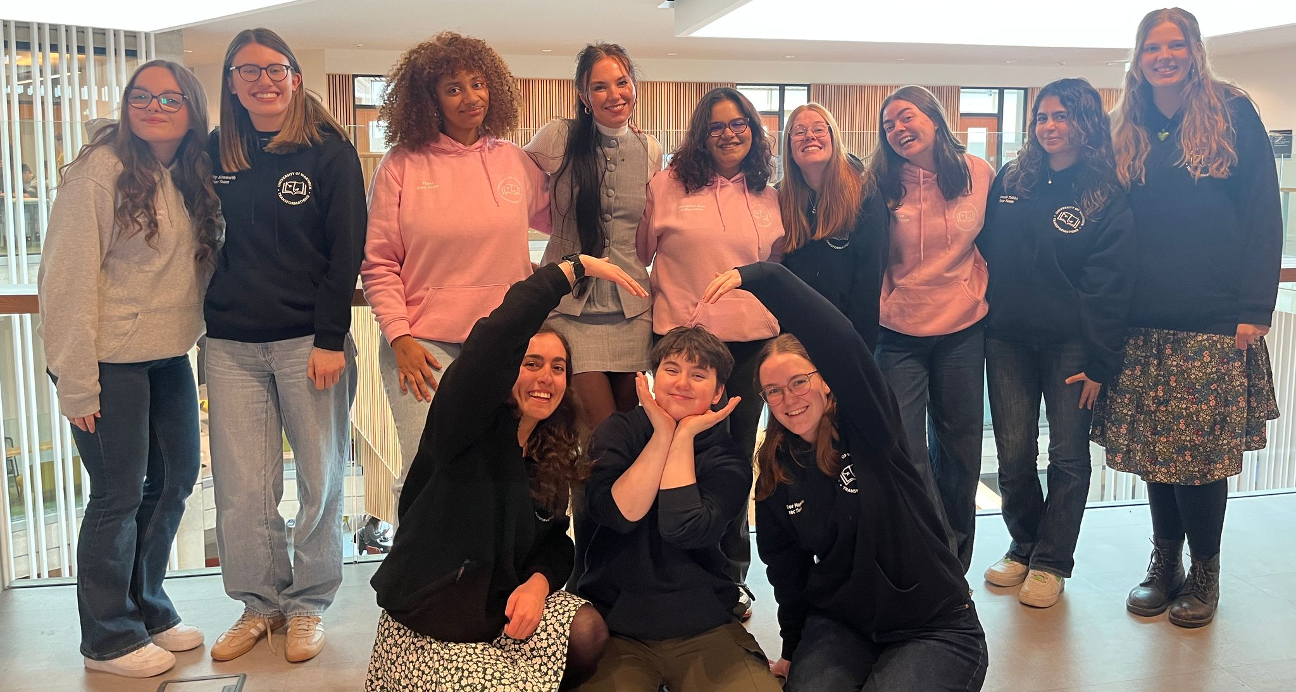
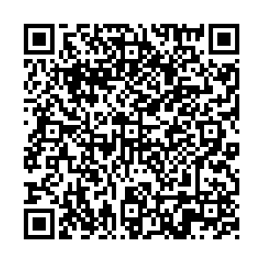
What is Widening Participation?
Widening Participation (WP) aims to address the patterns of under-representation of some groups in Higher Education
Scan the QR code to find out more about WP at Warwick
Transformations
A-level lecture series
Access to books scheme
University-wide Widening Participation projects
Charlotte.pearce@warwick.ac.uk
What does a WP Officer do?

Slide 66
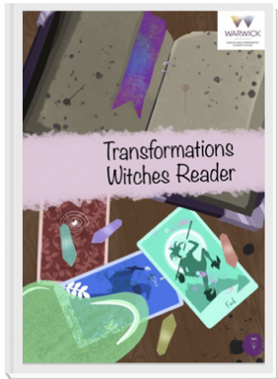


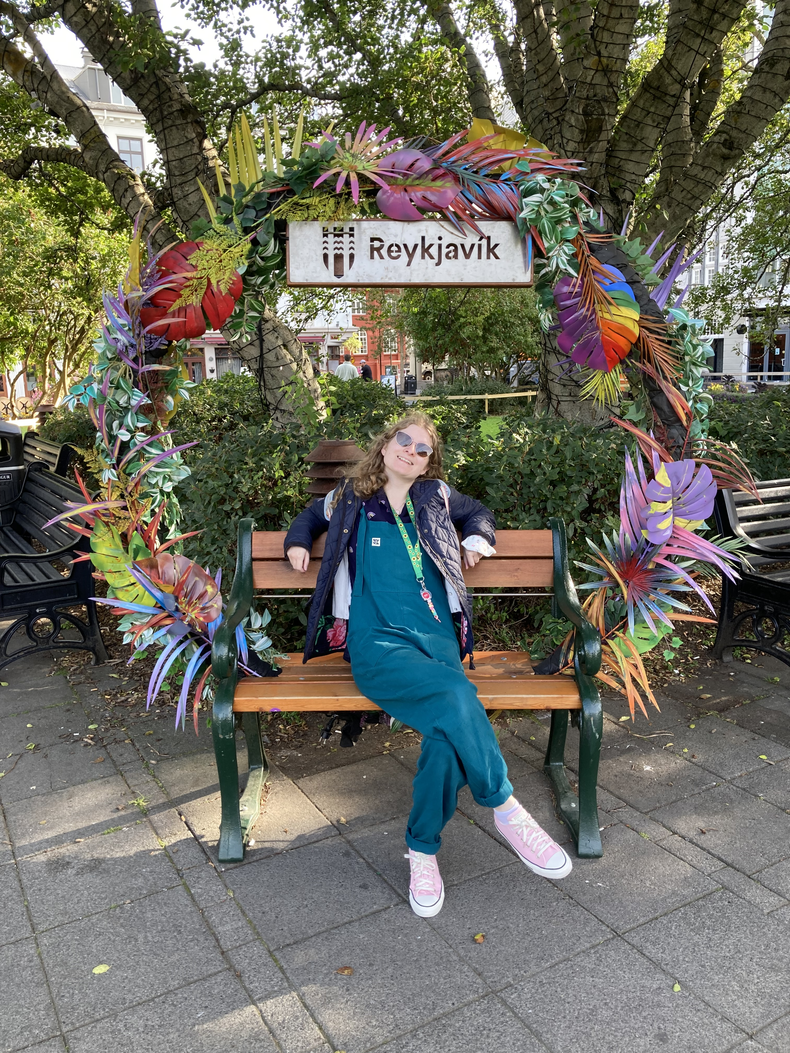

What is Transformations?
Beth Hadingham
MA English Literature
Transformations PG Link Exec

Slide 67

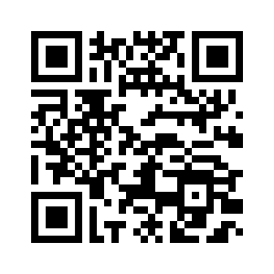

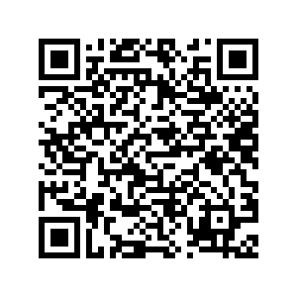

How can I get involved?
Come along to one of our Transformations information sessions:
Wednesday 8th October (week 1), 4pm Student Hub (FAB5.49)
Wednesday 15th October (week 2), 2pm Student Hub
transformationswarwick
For more info, take a look at the Transformations page within the ‘Your Department’ section of the ECLS website
ENtransformations@warwick.ac.uk

Slide 68
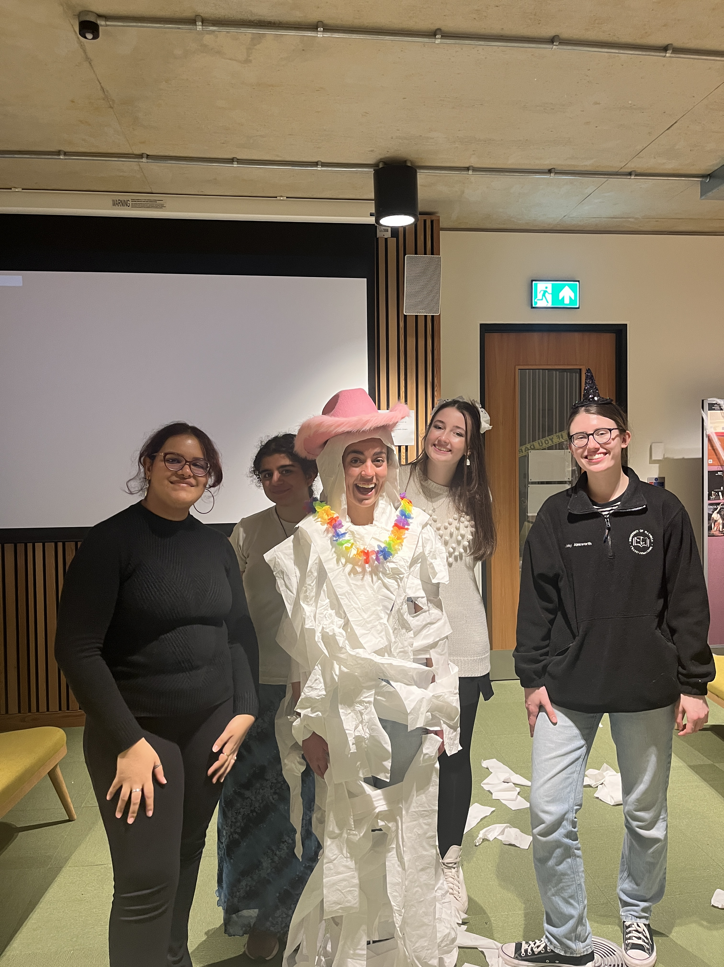

Transformations socials
Welcome week, Thursday 2nd – Bar Crawl 7pm at The Dirty Duck
Week 1, Thursday 9th – Clever Ducks Quiz
8.30pm at The Dirty Duck
Week 2, Wednesday 15th – Social and games
3pm in the Student Hub
transformationswarwick

Slide 69


Widening Participation Student Network
The WP Student Network brings together current students from a Widening Participation (WP), forming and inclusive, peer-led community.
Welcome Week intro session:
Date: Friday 3rd October
Time: 3pm – 4.30pm
Location: OC1.09 (Oculus)
For students who:
Receive a Warwick Bursary
Received a contextual offer
Come from an area with low progression rate to university
Are independent students – either as care leavers or estranged from their family
Are first generation in family to attend university
Have a disability
Are over 21 when starting university
Have caring responsibilities
Received free school meals

Slide 70
Transformations Testimonials
Being an international student in a foreign land, the Transformations programme allowed me to be a part of a diverse community that gave me a smooth pathway into the UK’s education system and a sense of functioning within the university.
For me personally, being able to teach and interact with school children gave me a sense of how best to approach my studies since the system was quite different from what I was used to in my home country. Moreover, being part of this, helped ease a sense of loneliness through the various interactions and activities we had throughout the year.
The big takeaway for me was the various indirect and direct skill sets that I acquired; like management, planning and communication. With children one needs to be creative to engage with them; communication too needs to be well thought-out. These in particular help me with my role in the publishing industry when I am engaging with authors and editors.
Prisha, MA in World Literature (2023) now Editorial Assistant with an international academic publishing company, Delhi, India

Slide 71

Closing Thoughts
Questions?

