Slide 1
PGR Induction 2026
Tuesday 28 September, 1:15-2pm
FAB5.49 (Student Hub)

Slide 2
Agenda
Your departmental team
PhD funding
PhD information and processes
Dept research and opportunities
Hindsight: tips and reminders

Slide 3
Your team
Claire Denney and Kim Bester, PG Professional Services for English & Comparative Literary Studies (pgrenglish@warwick.ac.uk)
Nick Lawrence, Director of Postgraduate Studies (PGR) (n.lawrence@warwick.ac.uk)
Paul Botley, Head of Department (Paul.Botley@warwick.ac.uk)
Steve Purcell, Deputy Head, Research (S.Purcell@warwick.ac.uk)
Mark Storey, Deputy Head, Academic Staff Development (m.storey@warwick.ac.uk)
Matt Franks (Term 1) and Jo Hofer-Robinson (Terms 2 and 3), Senior Tutor (Jo.Hofer-Robinson@warwick.ac.uk)
Alírio Karina, Postgraduate Professionalization Officer and PG Liaison Officer (Alirio.Karina@warwick.ac.uk)

Slide 4
Funding – note that applicants submit one funding application by the deadline of 10 December 2026, and are considered for all scholarships for which they are eligible
Chancellors Scholarships – The main source of PhD funding at Warwick, including both Faculty and Interdisciplinary awards. This scheme is open from October 2026 for 2027 entry.
AHRC Doctoral Scholarships – For projects meeting the current AHRC remit. Open in October 2026 for 2027 entry.
China Scholarship Council (CSC) / University of Warwick Scholarships – For PhD applicants and first year PhD students who meet the CSC criteria. Open in October 2026 for 2027 entry.
Monash Warwick Alliance Joint PhD Scholarships – For candidates of any nationality and fee status. Successful applicants will spend 2 years at Warwick and 1 year at Monash University, Australia. Open in October 2026.
EUTOPIA PhD Co-tutelle Scholarships – Joint scholarships with partner institutions across Europe. Available to enable promising researchers to be jointly supervised in order to complete their PhD. Open in October 2026 for 2027 entry.
SJTU PhD Joint PhD Scholarships - Accepts both self-funding and sponsored students; Chinese nationals should apply via SJTU. Open in January 2027 with a deadline in May 2027.
Pathway Studentships– Scholarships aimed at Warwick PhD applicants who self-identify as being either Black or of Black heritage. Students can be hosted in any department and can pursue any topic. Open in October 2026 for 2027 entry.
Sanctuary Scholarships – A range of scholarships to enable refugees to access doctoral funding. Open in October 2026 for 2027 entry.

Slide 5
Alternative funding
Use the university’s funding search tool to find other scholarships for which you may qualify: https://warwick.ac.uk/study/scholarships-and-bursaries/scholarships/
Check out the resource guide Alternative Guide to Postgraduate Funding: https://www.postgraduate-funding.com/gateway

Slide 6
Where to Find Key Information
ECLS:
https://warwick.ac.uk/fac/arts/english/currentstudents/postgraduate/
PGR Handbook: https://warwick.ac.uk/fac/arts/english/currentstudents/postgraduates/english-handbook-pgr/introduction
Doctoral College:
https://warwick.ac.uk/services/dc/
CADRE (Centre for Arts Doctoral Excellence):
https://warwick.ac.uk/fac/arts/cadre/
Disability Services (part of Wellbeing)
https://warwick.ac.uk/services/wss/students/disability

Slide 7
Some PhD Processes (see PGR Handbook for details)
PGR Handbook at https://warwick.ac.uk/fac/arts/english/currentstudents/postgraduate/english-handbook-pgr/your-degree-course
Regular monthly supervisions
Termly reviews
Attendance at departmental research seminars, professionalization events, CADRE opportunities, etc.

Slide 8
The First Year of the PhD
Term 1:
• September: Induction and PG social
• October: Beginning of Professionalization events schedule
Term 2:
Preparation of upgrade dossier; deadline for PG Symposium submissions
Term 3
May: Upgrade dossier due for full-time, first-year students (deadlines for part-time students will vary – please consult the PG Professional Services Team)
May-June: Meetings for the upgrade (from MPhil to PhD), with two members of staff outside the supervisory team, taking place by the end of Term 3
Teaching eligibility interviews for second-year teaching (in late May-early June)
Annual Postgraduate Research Symposium (13 May 2027)

Slide 9
Support for your research
The department provides you funding for conferences, events, and research expenses (£300 a year for up to four years)
An additional discretionary amount of up to £200 per annum may be available, with preference given to self-funded students and those without access to other sources of funding
Humanities Research Fund (HRF):
https://warwick.ac.uk/services/ris/researchstrategy/researchfunding/rdf/hrf
Humanities Research Centre (HRC):
Funding to organise conferences; Doctoral Fellowship Competition (small research budget, plus budget to organize conference/workshop and additional funding for blogging)
https://warwick.ac.uk/fac/arts/hrc/
Doctoral College PGR Hardship Support Fund
https://warwick.ac.uk/services/dc/schols_fund/current/hardship_fund

Slide 10
Opportunities to keep an eye on
Humanities Research Centre (HRC) – PhD and Early Career Fellowships: https://warwick.ac.uk/fac/arts/hrc/irf/wtf/
Institute for Advanced Studies (IAS) – Early Career Fellowships:
https://warwick.ac.uk/fac/cross_fac/ias/fellowships/ecf/
Institute for Advanced Teaching and Learning (IATL) – Early Career Teaching Fellowships:
https://warwick.ac.uk/fac/cross_fac/iatl/news/working_with_iatl/ectf/

Slide 11
English and Comparative Literary Studies
Research Groups
• Warwick Research Collective (WREC): Materialist Studies in World Literature
• American Studies
• Environmental Humanities, including the Critical Environments research cluster and the Centre for Ecopoetics
• Comparative Religions and Literatures (CORAL)
• Critical Theory Network
• Manuscript and Print Culture Studies (MaPC)
• Feminist Dissent journal
• Poetry at Warwick (PAW)
• Medical Humanities

Slide 12
Beyond English
Specialist research centres and networks:
Centre for Research in Philosophy, Literature & the Arts (CRPLA)
Centre for the Study of the Renaissance
Centre for the Study of Women and Gender (CSWG)
Centre for the History of Medicine
Environmental Humanities Network (EHN)
Global History and Culture Centre; Borders, Race, Ethnicity and Migration Network (BREM)

Slide 13

HINDSIGHT is 2026
Messages from ECLS staff

Slide 14
We contain multitudes…
If there is one thing I wish I had known when I started my PhD, it is that the project I started on could never be contained by a thesis. The thesis is just one draft of many to come. To paraphrase Paul Valéry, a thesis is never completed, only abandoned.
Also, choose your mentors wisely – their mark will live long in your work. Make the most of your mentors and take care of them – as much as you need and value their support, they value yours. And they won’t be around forever. Ars longa, vita brevis!
Jonathan Skinner

Slide 15
Perfection is an illusion…
The one thing I would tell my younger self embarking on the PhD is that this is as good as it gets 🙂
But one thing a supervisor said to me right at the beginning which always stuck with me, and I now say it to my students: you never finish a PhD, you just abandon it. It sounds cynical, but actually it was very insightful – perfection is an illusion, and there’s always another book or article to read, but at some point you just have to accept it is what it is, and it’s time to stop!
Mark Storey

Slide 16
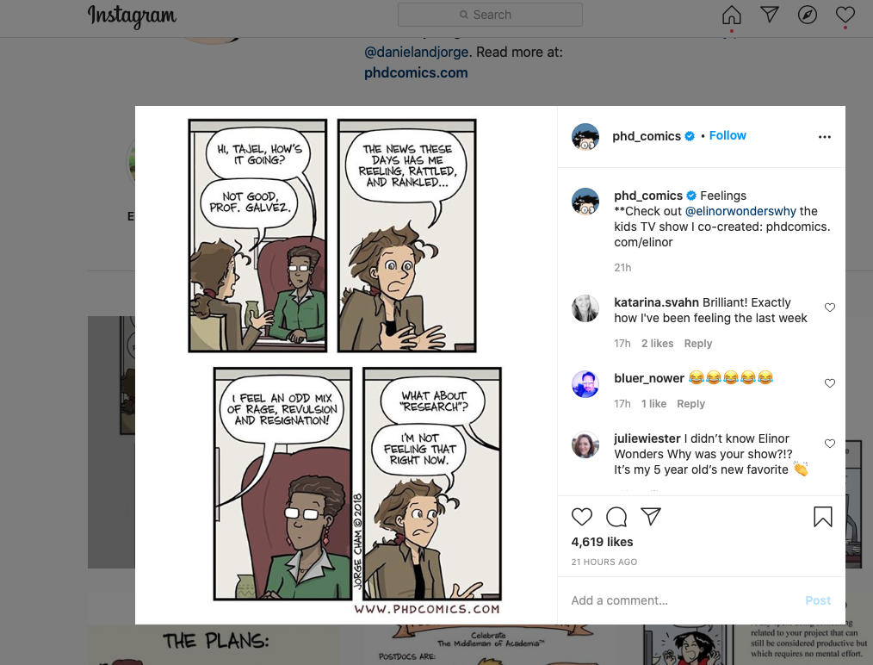
I’m not feeling that right now… from Paulo de Medeiros

Slide 17

Write, write, write
If there is one thing I wish I had known when I started my PhD, it's that it's NEVER too early to start writing. Writing always helps – it’s a process as much as a product.
E. L. Doctorow on writing: “Writing a novel is like driving a car at night. You can see only as far as your headlights, but you can make the whole trip that way.” [Perhaps not entirely helpful for a PhD, but will help you get through the first year, perhaps.]
Anne Lamott in Bird by Bird: “Almost all good writing begins with terrible first efforts. You need to start somewhere.”
Liz Barry

Slide 18
Good enough is good enough
Warwick PhD Life Blog: https://doctorallife.wordpress.com/
Check out Petra Kolber’s TED talk titled “The Perfection Detox” for some sharp insights into the perils of perfectionism
Piled Higher and Deeper: PhD Comics (also on YouTube and Instagram)
(contributed by Liz Barry and Paulo de Medeiros )

Slide 19
Learn by making mistakes
If there is one thing I wish I had known when I started my PhD, it is ... if you're anything like me, you will make many mistakes along the way, and that is completely ok, even if the stakes seem high – be patient with yourself; you are learning, and the only way to learn is by making mistakes.
Matt Franks

Slide 20

It will come together
At the point when you’re most worried your thesis is too sprawling, messy, or covers too many ideas/writers/concepts, just keep writing and it will come together.
Emma Mason

Slide 21
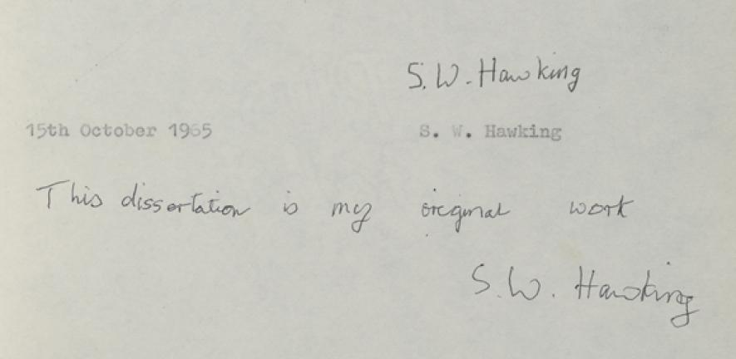
Comparison is the thief of joy
If there is one thing I wish I had known (or rather, believed) when I started my PhD, it’s that everyone’s journey to completion is different. Comparison is the thief of joy – so learn from others, but don’t chastise yourself for doing things differently.
Jen Baker

Slide 22
The ivory tower has collapsed
Let’s admit it: the situation with PhDs today is unimaginably more fraught and challenging than it was when your supervisors started out (just as our situation seemed dystopian compared to the ‘golden age’ of academia before us). Advice from a generation that isn't coping with what students are facing now risks becoming what Adorno (speaking of Freud) calls “the worthless wisdom of a hard-boiled old gentleman.”
That said, if there’s one thing I would *still* tell my younger self, it is this: remember to motivate your research as a whole-life activity. Academics, like all creative people, need one thing above all else, even more than time – and that’s confidence in your work. Initially you have to supply it for yourself. That’s a lot easier to do when you connect what you’re working on with the issues and problems that are always uppermost in your mind, never leave you, are indeed part of who you are. The ivory tower model of academia has long since collapsed, but that’s cleared the way for a much more engaged and engaging relation between academics and the wider world. Silver linings playbook of 2026.
Nick Lawrence

Slide 23
Tips from Guardian readers
https://www.theguardian.com/higher-education-network/blog/2014/aug/27/finishing-phd-thesis-top-tips-experts-advice

Slide 24

The best PhD thesis is …
a finished PhD thesis!
Good luck on your journey!

