Slide 1

PGR Induction 2025
Tuesday 30 September, 2-3pm
FAB0.23

Slide 2
Funding
PhD processes
Dept research and opportunities
Hindsight: tips and reminders

Slide 3
Your team
Claire Denney and Kim Bester, PG Professional Services for English & Comparative Literary Studies (pgrenglish@warwick.ac.uk)
Nick Lawrence, Director of Postgraduate Studies(PhD) (n.Lawrence@warwick.ac.uk)
Paulo de Medeiros, Head of Department (P.de-Medeiros@warwick.ac.uk)
Mike Niblett, Deputy Head, Academic Staff Development (m.niblett@warwick.ac.uk)
Steve Purcell, Deputy Head, Research (S.Purcell@warwick.ac.uk)
Jo Hofer-Robinson, Senior Tutor (Jo.Hofer-Robinson@warwick.ac.uk)
Alirio Karina, Postgraduate Professionalization Officer (Alirio.Karina@warwick.ac.uk)
Michael Meeuwis, PG Liaison Officer (m.meeuwis@warwick.ac.uk)

Slide 4
Funding (including for 2026 entry)
Chancellor's International Scholarships – This scheme opens in October 2025 for 2026 entry. Closing date: tba, December 2025.
Midlands4Cities – This scheme is now permanently closed.
China Scholarship Council (CSC) / University of Warwick Scholarships – For PhD applicants and first year PhD students who meet the CSC criteria. Open in October 2025 for entry in Autumn 2026. Closing date: tba, in January 2025.
Monash Warwick Alliance Joint PhD Scholarships – For candidates of any nationality and fee status. Successful applicants will spend 2 years at Warwick and 1 year at Monash University, Australia. Open in Autumn 2025. Closing date: tba, in January 2026.
EUTOPIA PhD Co-tutelle Scholarships – Joint scholarships with partner institutions across Europe. Available to enable promising researchers to be jointly supervised in order to complete their PhD. Open in Autumn 2025 for 2026 entry.
Race XChange – One scholarship to fill, awarded to PhD applicants developing leading research on improving access and participation for minority ethnic students in postgraduate research in the UK. Open in Autumn 2025. Rolling deadline until filled.
Sanctuary Scholarships – A range of scholarships to enable refugees to access doctoral funding. Open in Autumn 2025. Closing date: tba, in February 2026.

Slide 5
Alternative funding
Check out the Alternative Guide to Postgraduate Funding
https://www.postgraduate-funding.com/gateway

Slide 6
Where to Find Key Information
ECLS: https://warwick.ac.uk/fac/arts/english/currentstudents/postgraduate/
PGR Handbook: https://warwick.ac.uk/fac/arts/english/currentstudents/postgraduates/english-handbook-pgr/introduction
Doctoral College: https://warwick.ac.uk/services/dc/
CADRE (Centre for Arts Doctoral Excellence): https://warwick.ac.uk/fac/arts/cadre/
Disability Services (part of Wellbeing) https://warwick.ac.uk/services/wss/students/disability

Slide 7
Some PhD Processes/ The First Year at a Glance (see PGR Handbook for details)
PGR Handbook at https://warwick.ac.uk/fac/arts/english/currentstudents/postgraduate/english-handbook-pgr/your-degree-course
Regular monthly supervisions
Termly reviews
Attendance at departmental research seminars, CADRE events, etc.

Slide 8
The First Year, contd.
Term 2:
Mid-term Review for M4C students (D-PGR to select reviewers)
M4C applications due for self-funded students in their first year
Term 3
Upgrade dossier (due 2 May for full-time, first-year students) OR Annual Review (due 25 April, for continuing students)* *Deadlines for part-time students will vary – please consult the PG Professional Services Team.
Upgrade meetings with two members of staff from outside the supervisor/supervisory team from MPhil to PhD take place by the end of Term 3.
Teaching Eligibility Interview (in May)
Annual Postgraduate Research Symposium (in May)

Slide 9
Support for your research
Departmental funding for conferences, events, and research expenses (£300 a year for up to four years)
An additional discretionary amount of up to £200 per annum may be available, with preference given to self-funded students and those without access to other sources of funding
Humanities Research Fund: https://warwick.ac.uk/services/ris/researchstrategy/researchfunding/rdf/hrf
Humanities Research Centre Funding to organise conferences; Doctoral Fellowship Competition (small research budget, plus budget to organize conference/workshop and additional funding for blogging) https://warwick.ac.uk/fac/arts/hrc/
Doctoral College PGR Hardship Support Fund https://warwick.ac.uk/services/dc/schols_fund/current/hardship_fund

Slide 10
Opportunities to keep an eye on
Humanities Research Centre (HRC) – PhD and Early Career Fellowships https://warwick.ac.uk/fac/arts/hrc/irf/wtf/
Institute for Advanced Studies (IAS) – Early Career Fellowships https://warwick.ac.uk/fac/cross_fac/ias/fellowships/ecf/
Institute for Advanced Teaching and Learning (IATL) – Early Career Teaching Fellowships https://warwick.ac.uk/fac/cross_fac/iatl/news/working_with_iatl/ectf/

Slide 11
English and Comparative Literary Studies Research Groups
Warwick Research Collective (WREC): Materialist Studies in World Literature
American Studies
Environmental Humanities, including the Centre for Ecopoetics
Comparative Religions and Literatures (CORAL)
Critical Theory Network
Manuscript and Print Culture Studies (MaPC)
Feminist Dissent
Poetry at Warwick (PAW)
Medical Humanities

Slide 12
Beyond English
Specialist research centres and networks:
Centre for Research in Philosophy, Literature & the Arts
Centre for the Study of the Renaissance
Centre for the Study of Women and Gender
Centre for the History of Medicine
Global History and Culture Centre; Borders, Race, Ethnicity and Migration Network (BREM)
Environmental Humanities Network (EHN)

Slide 13

HINDSIGHT is 2025
Messages from ECLS staff

Slide 14
We contain multitudes…
If there is one thing I wish I had known when I started my PhD, it is that the project I started on could never be contained by a thesis. The thesis is just one draft of many to come. To paraphrase Paul Valéry, a thesis is never completed, only abandoned. Also, choose your mentors wisely – their mark will live long in your work. Make the most of your mentors and take care of them – as much as you need and value their support, they value yours. And they won’t be around forever. Ars longa, vita brevis!
Jonathan Skinner

Slide 15
Perfection is an illusion…
The one thing I would tell my younger self embarking on the PhD is that this is as good as it gets 🙂
But one thing a supervisor said to me right at the beginning which always stuck with me, and I now say it to my students: you never finish a PhD, you just abandon it. It sounds cynical, but actually it was very insightful -- perfection is an illusion, and there’s always another book or article to read, but at some point you just have to accept it is what it is and it’s time to stop!
Mark Storey

Slide 16
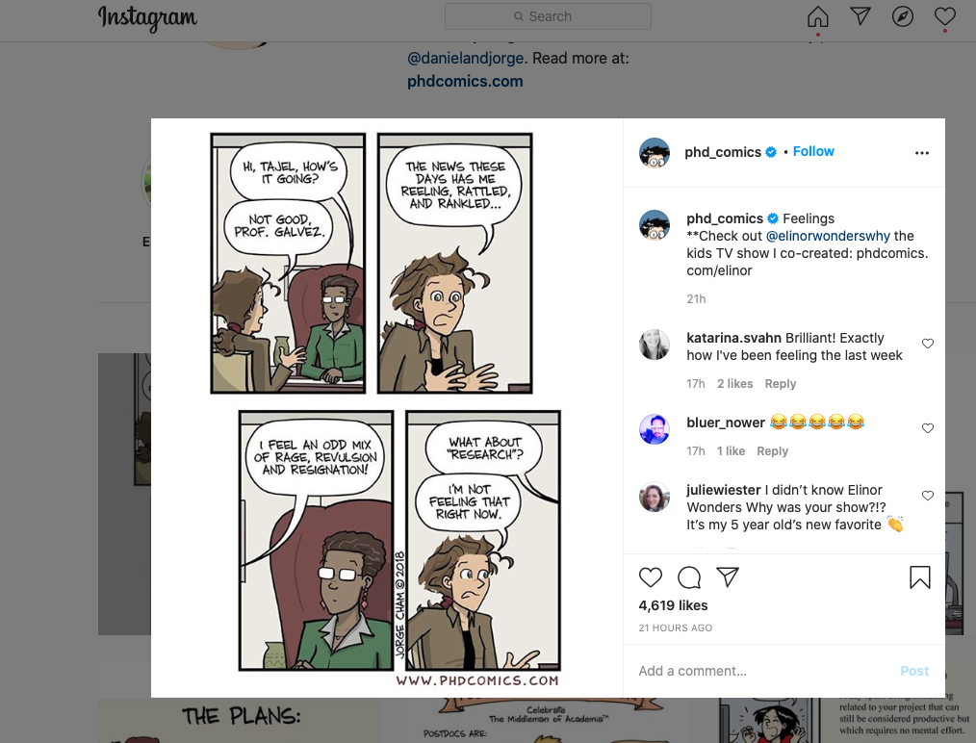
I’m not feeling that right now… from Paulo de Medeiros

Slide 17

Write, write, write
If there is one thing I wish I had known when I started my PhD, it's that it's NEVER too early to start writing. Writing always helps – it’s a process as much as a product.
E. L. Doctorow on writing: “Writing a novel is like driving a car at night. You can see only as far as your headlights, but you can make the whole trip that way.” [Perhaps not entirely helpful for a PhD, but will help you get through the first year, perhaps.]
Anne Lamott in Bird by Bird: “Almost all good writing begins with terrible first efforts. You need to start somewhere.”
Liz Barry

Slide 18
Good enough is good enough
Jenny Mak’s PhD Life Blog
“Good enough” [is] good enough.
https://www.jennywhmak.com/published-works
Check out Petra Kolber’s TED talk titled “The Perfection Detox” for some sharp insights into the perils of perfectionism.
Piled Higher and Deeper: PHD Comics
On Twitter, Youtube and Instagram
(contributed by Liz Barry and Paulo de Medeiros )

Slide 19
Learn by making mistakes
If there is one thing I wish I had known when I started my PhD, it is... if you're anything like me, you will make many mistakes along the way, and that is completely ok, even if the stakes seem high – be patient with yourself; you are learning, and the only way to learn is by making mistakes.
Matt Franks

Slide 20

It will come together
At the point when you’re most worried your thesis is too sprawling, messy, or covers too many ideas/writers/concepts, just keep writing and it will come together.
Emma Mason

Slide 21
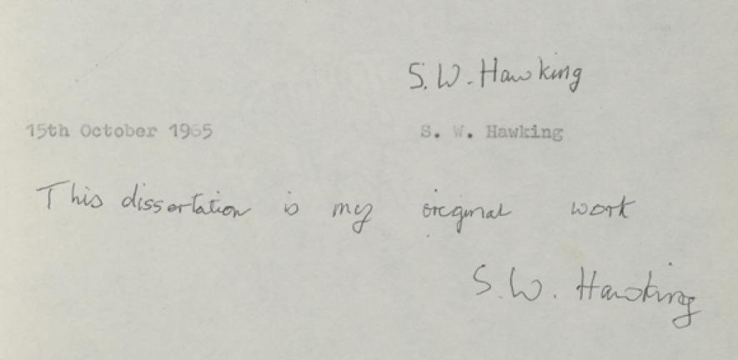
Comparison is the thief of joy
If there is one thing I wish I had known (or rather, believed) when I started my PhD, it’s that everyone’s journey to completion is different. Comparison is the thief of joy, so learn from others, but don’t chastise yourself for doing things differently.
Jen Baker

Slide 22
The ivory tower has collapsed
The one thing I would tell my younger self embarking on the PhD... I’m tempted to say: Don't listen to your older self! The situation with PhDs today is unimaginably more fraught and challenging than it was when I started out (just as our situation seemed dystopian compared to the ‘golden age’ of academia before us). Advice from a generation that isn't coping with what students are facing now risks becoming what Adorno (speaking of Freud) calls “the worthless wisdom of a hard-boiled old gentleman.” That said, if there’s one thing I would *still* tell my younger self, it is this: remember to motivate your research as a whole-life activity. Academics, like all creative people, need one thing above all else, even more than time – and that’s confidence in your work. Initially you have to supply it for yourself. That’s a lot easier to do when you connect what you’re working on with the issues and problems that are always uppermost in your mind, never leave you, are indeed part of who you are. The ivory tower has long since collapsed, but that’s cleared the way for a much more engaged and engaging relation between academics and the wider world. Silver linings playbook of 2025 ...
Nick Lawrence

Slide 23
Tips from Guardian readers
https://www.theguardian.com/higher-education-network/blog/2014/aug/27/finishing-phd-thesis-top-tips-experts-advice

Slide 24

The best PhD thesis is…
A finished PhD thesis!
Good luck on your journey!

