Slide 1
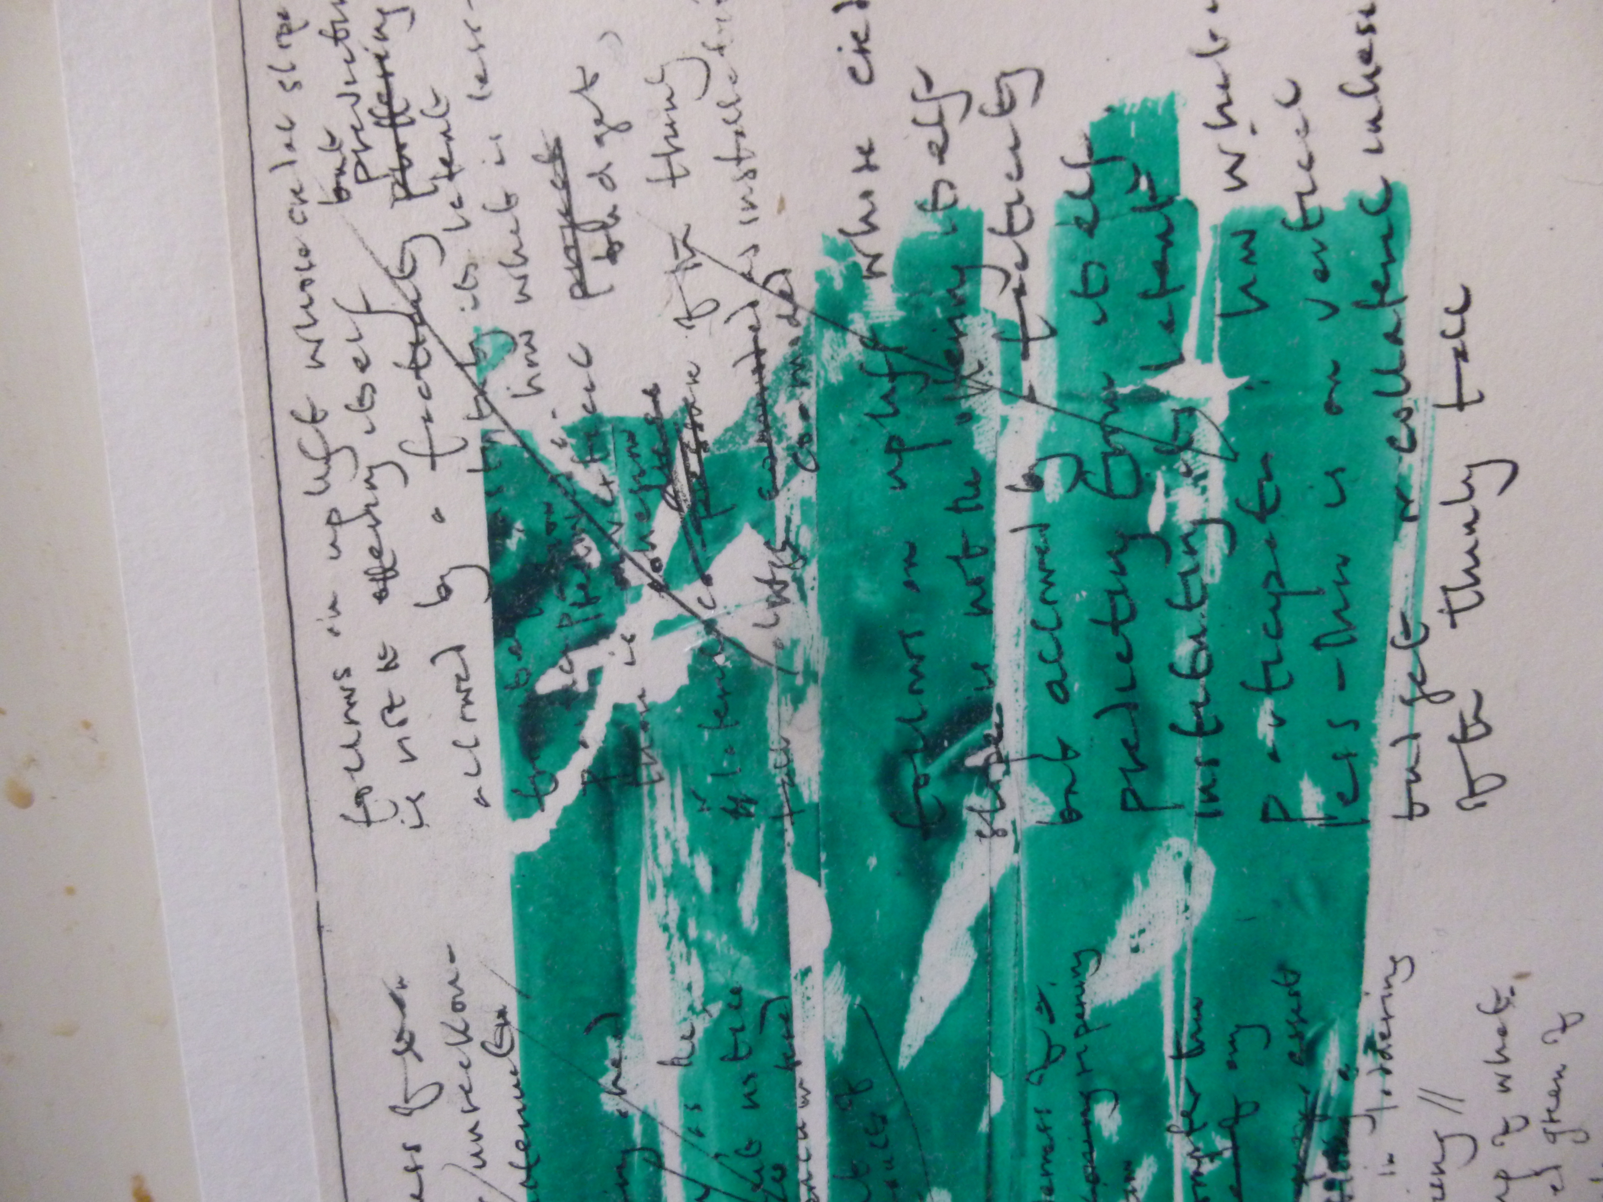
Peter Larkin: Poetry, Phenomenology, Ecology
April 26, 2018, Zeeman Building, MS.05, 10.00-17.30
A symposium bringing together poets, philosophers, ecocritics, and theologians to discuss the poetry of Peter Larkin.
Confirmed speakers: Dr Cleo Hanaway-Oakley, University of Oxford; Ian Heames, poet and bookseller at Face Press books; Dr Nick Lawrence, University of Warwick; Professor Emma Mason, University of Warwick; Professor John Milbank, University of Nottingham; Dr Jonathan Skinner, University of Warwick; Dr Harriet Tarlo, Sheffield Hallam; Dr Eoghan Walls, University of Lancaster
For more information, contact Emma Mason emma.mason@warwick.ac.uk

