Slide 1
Equality, Diversity, & Inclusion
ECLS Town Hall, term 1 2025/26
Uni Policy
Departmental Structures
University Structures
Group discussion
Town Hall discussion

Slide 2
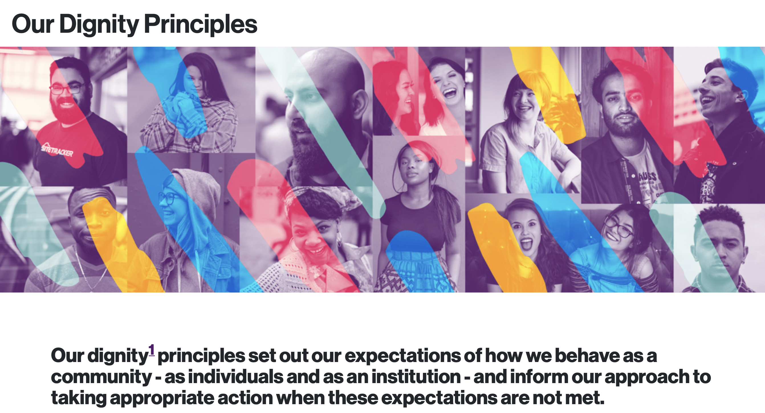

Slide 3


Slide 4
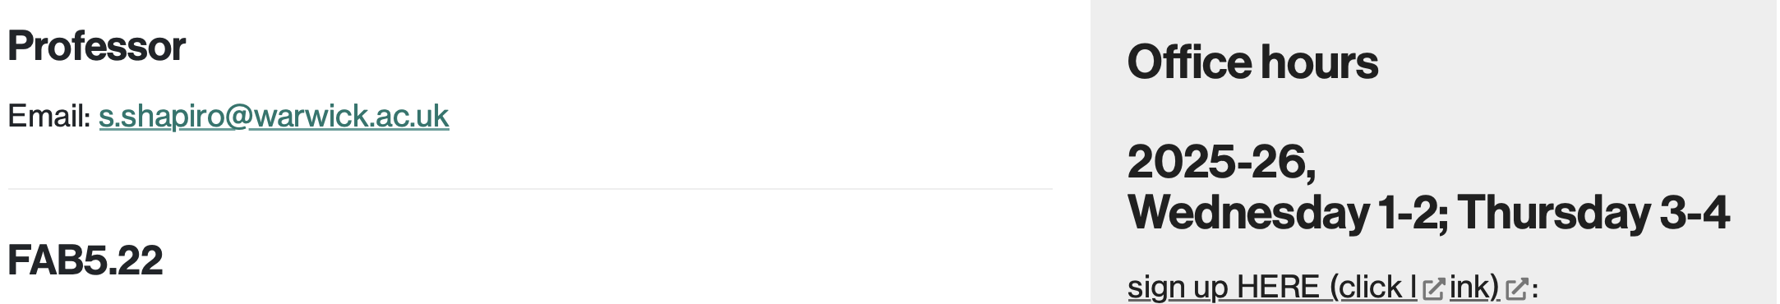
Stephen: ECLS EDI officer
https://warwick.ac.uk/fac/arts/english/people/shapirodrstephen

Slide 5
ECLS Student (UG and PG) networks – in formation
BAME
Disability
LGBTQ+

Slide 6
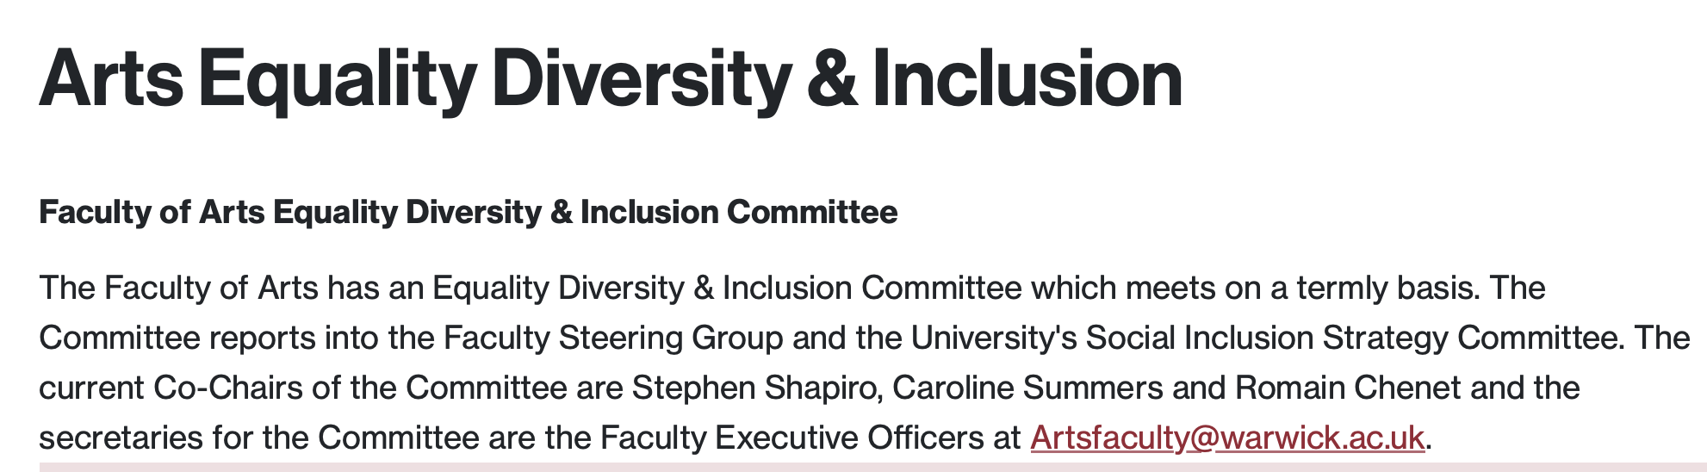
Dept to Faculty of Arts
https://warwick.ac.uk/fac/arts/people/equalityandinclusion

Slide 7
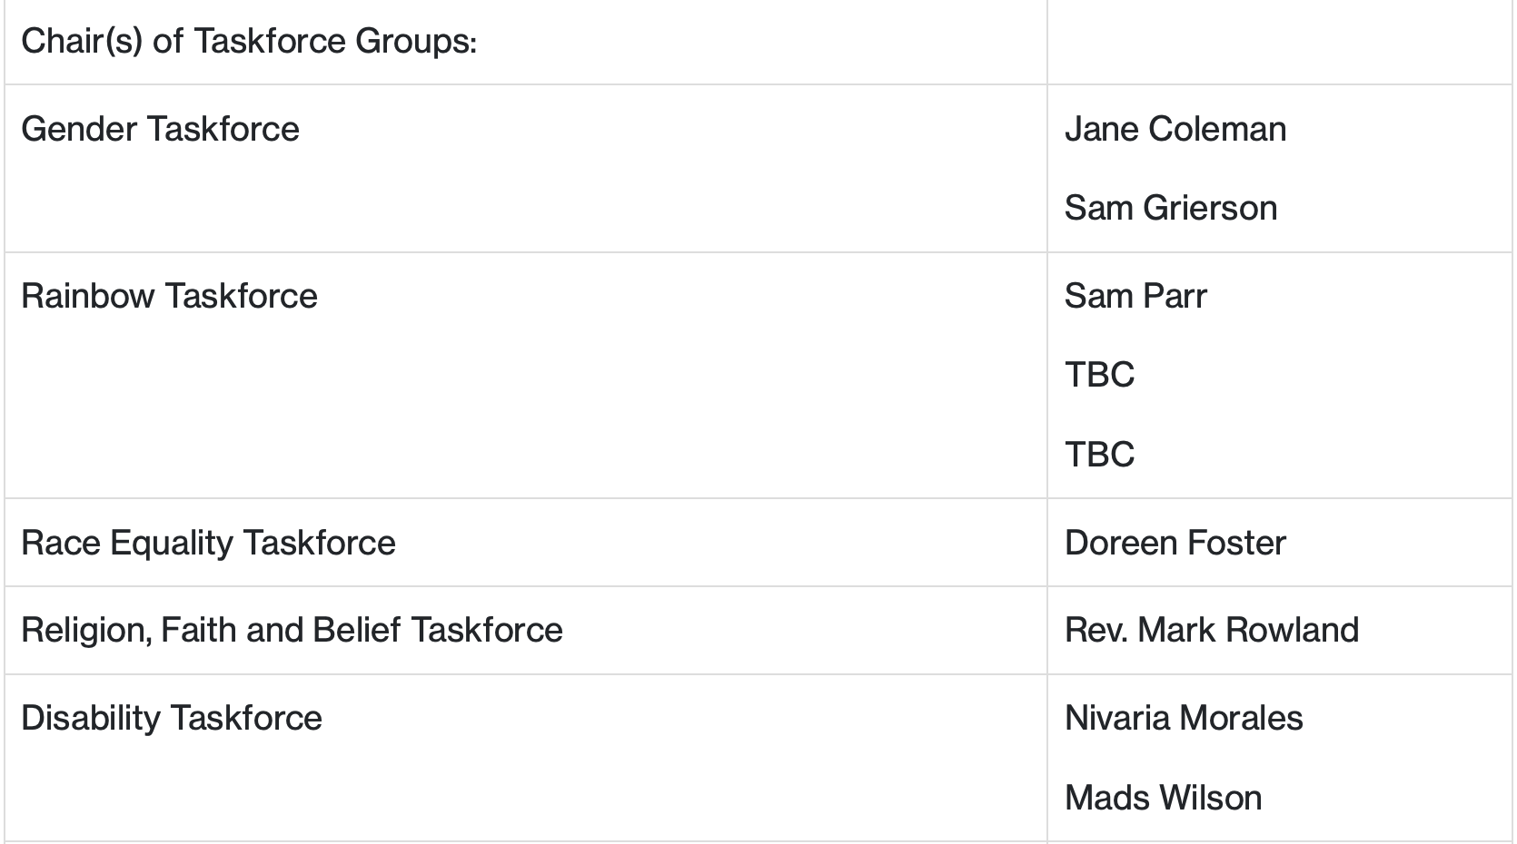
Dept to Engagement Groups (formerly Task Forces)
https://warwick.ac.uk/fac/arts/people/equalityandinclusion
https://warwick.ac.uk/services/gov/committees/gendertf/
https://warwick.ac.uk/services/gov/committees/rainbowtf/
https://warwick.ac.uk/services/gov/committees/raceequalitytf/
https://warwick.ac.uk/services/gov/committees/religionfaithandbelieftf/
https://warwick.ac.uk/services/gov/committees/disabilitytf/

Slide 8

https://reportandsupport.warwick.ac.uk

Slide 9

https://warwick.ac.uk/students/news/newsevents/report-and-support-report-23-24

Slide 10
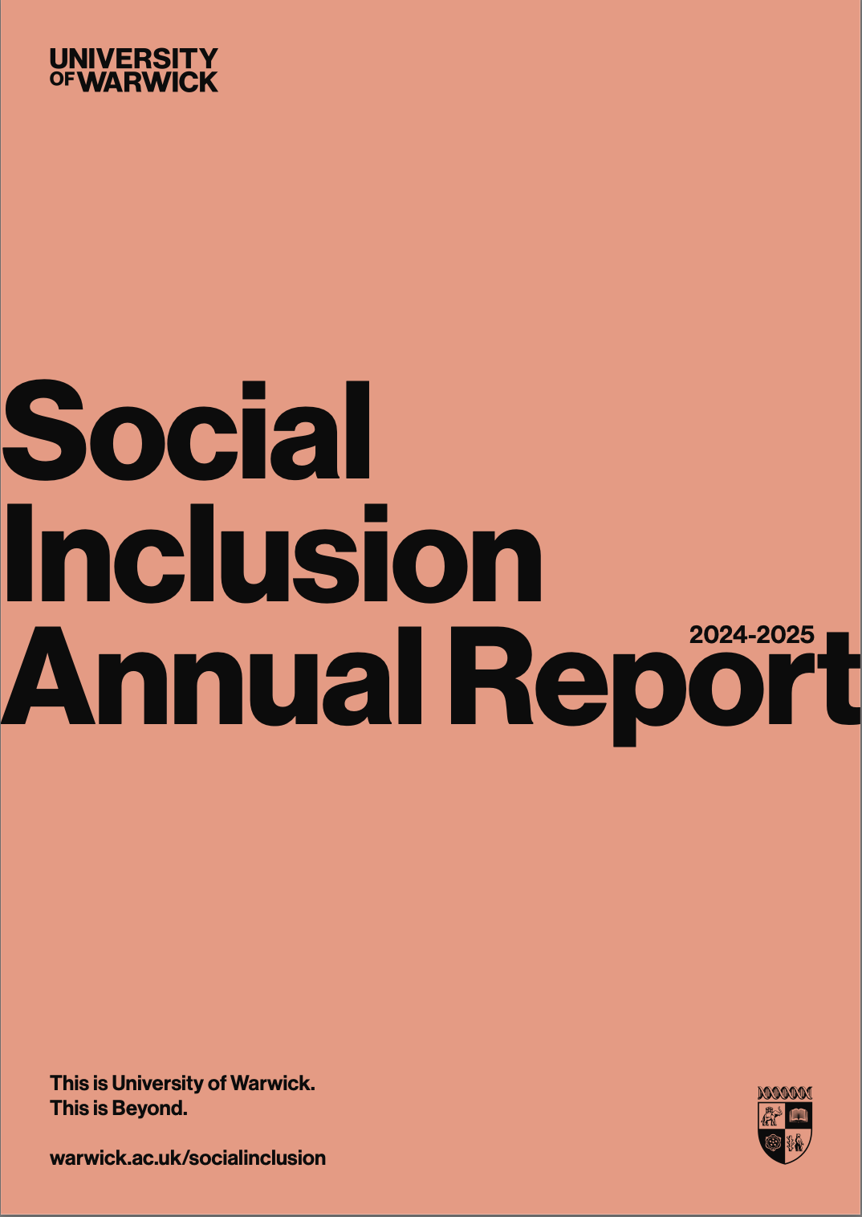
https://warwick.ac.uk/services/socialinclusion/about/annualreport/social_inclusion_annual_report_2024-25.pdf

