Slide 1

“Waves of Silver in World History”
University of Warwick
November 2010

Slide 2
Silver (Ag.)
With gold and platinum = precious metals.
Native silver rarely occurs in nature forming underground veins.
Usually in combination with lead, zinc, copper.
Coinage, ornaments, jewelry, textile embroidery (1 gr. Of pure silver = more than 1 mile of wire).
Silver as money used for at least 4,000 years and 2,600 standard coins.
China was in the silver standard until 1935.

Slide 3
Money (Collins dictionary of BUSINESS)
“An asset which is generally acceptable as a means of payment in the sale and purchase of products and other assets and for concluding borrowing and lending transactions.”
Medium of exchange.
Unit of account.
Store of value.

Slide 4
Four waves of silver in World History
Samanid (Turkestan).
Southern Song & Mongols.
Potosi-Japan.
Mexican.
Opium & Tea.

Slide 5
First Wave between the Muslim areas and Northern Europe
Baltic hoards of Muslim coins from the 8th century, with a spike, from 909 to 975 (the latest coin was from 1012).
Silver exchanged for products of the forests: furs, wax, honey, amber, and slaves.

Slide 6
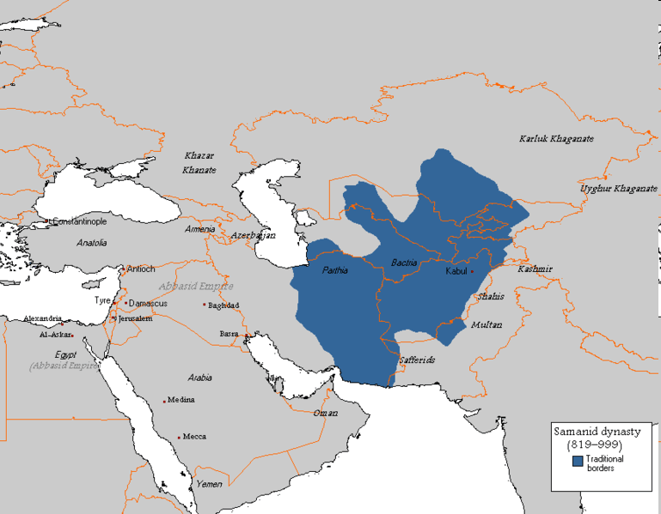
Samanid 819-999 c.e.

Slide 7
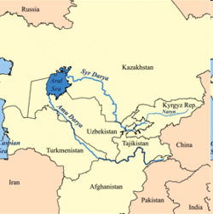

Slide 8
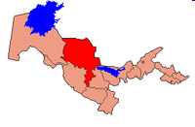
Zarafshan mines (currently located in Uzbekistan).
Located close to Samarkand capital of the Samanid.

Slide 9
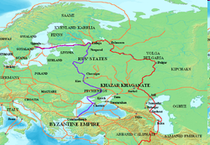
Varangians & The Volga Trade Route
In the Middle Ages, the Volga trade route connected Northern Europe and Northwestern Russia with the Caspian Sea, via the Volga River. The Rus used this route to trade with Muslim countries on the southern shores of the Caspian Sea, sometimes.

Slide 10
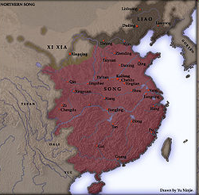
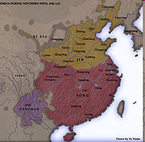
Northern Song 960-1279. Southern Song 1127-1279.

Slide 11
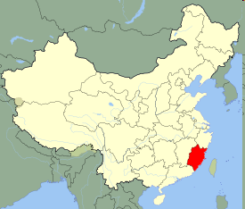
11th to 15th centuries paper money.
[Northern Song (960-1127) early 11th century the state took privately issued paper notes from (Sichuan in western China) and created the first paper currency].
Southern Song: From 1161 money backed by silver.
Silver mines located in Fujian.
Southern Song conquered in 1263.

Slide 12
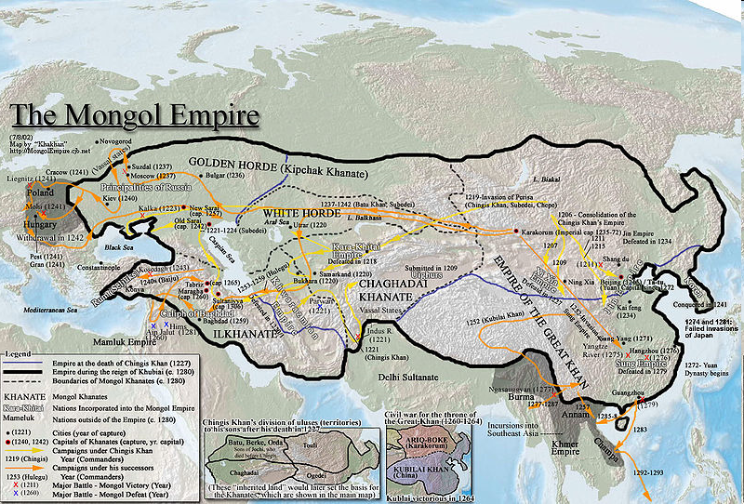
Routes under the Mongols

Slide 13
After 1260 silver suddenly reappears in Central and Western Asia.
Silver levied in China was mostly turned by the Mongols to a merchant organization (ortoq) to finance trading expeditions across Central Asia.
During the Yuan dynasty paper money was used for state payments and private transactions but Qubilai adopted silver units as money of account for paper notes and taxation.

Slide 14
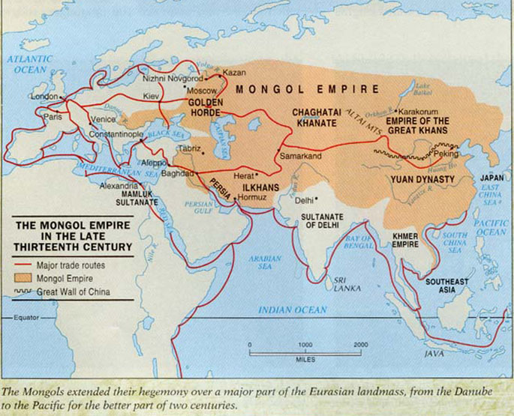

Slide 15
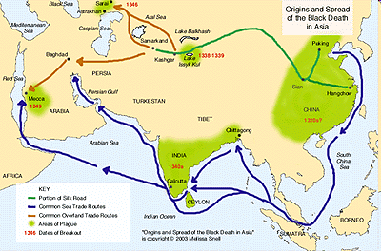

Slide 16
The Ming “Silver Century”: 1540-1640
Ming 1368-1644.
Inflation destroyed paper money and a new monetary system emerged based on silver and copper.
Emperor Yongle (1402-1424) moved the capital to Beijing: 1 million inhabitants.
Population in1500: 155 million; 1600: 231 million.
1571 “Single Whip Tax System.”

Slide 17
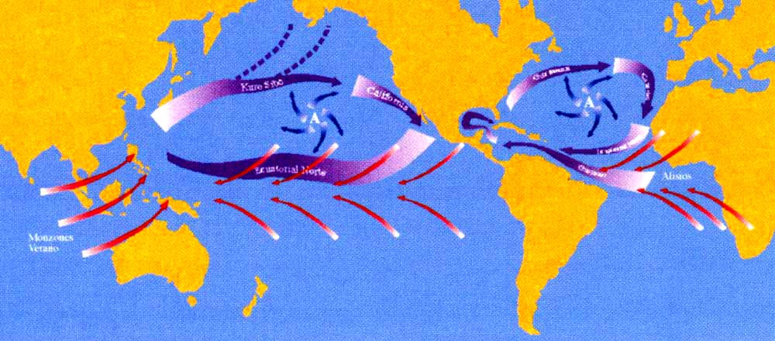
“The discovery of the Sea”

Slide 18
1492-Conquest of Granada; (“military revolution”).
1492-Arrival to America.
1519-1521-Conquest of México.
1519-1522-First voyage around the world.
1551-1533-Conquest of Perú.

Slide 19
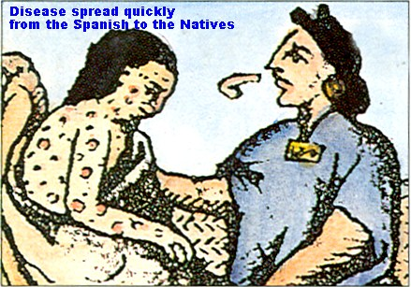

Slide 20
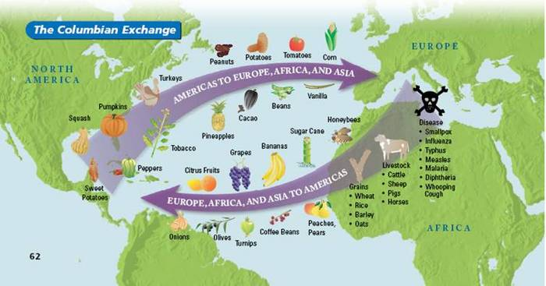

Slide 21
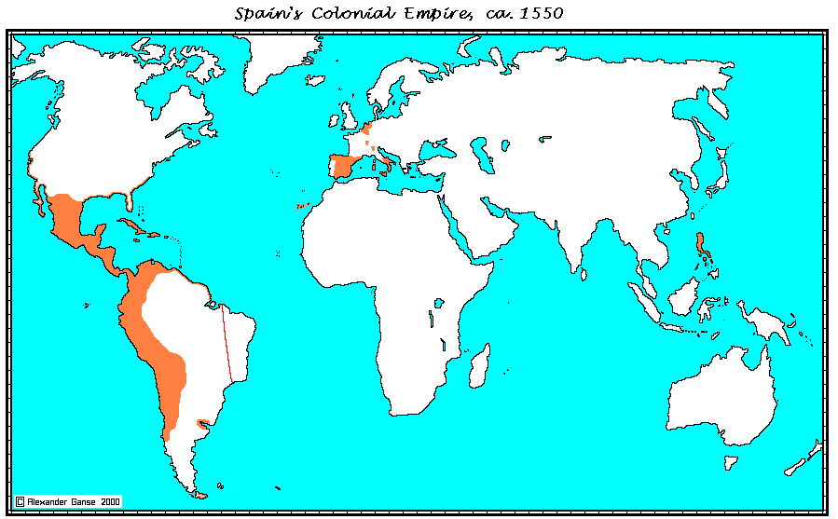

Slide 22
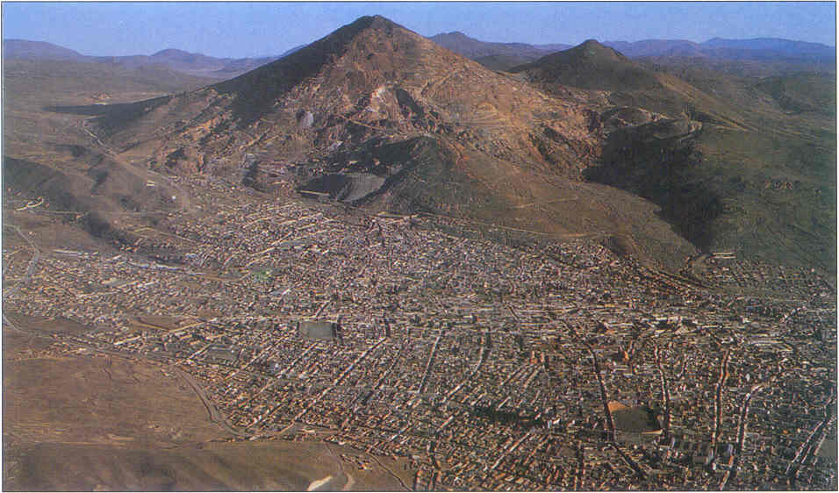
Potosí

Slide 23
Pieces of eight
25,36 grams of silver & 90% of silver content.

Slide 24
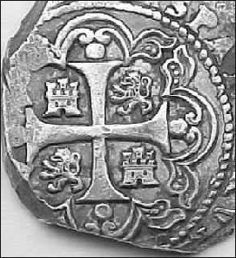
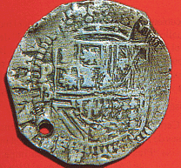
Pesos de a ocho

Slide 25
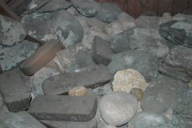
Barras de plata del “Atocha”

Slide 26
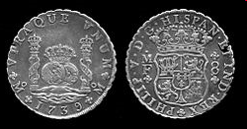

Slide 27
David Ricardo mechanism
In 1590. Canton plata/oro proportion 5.5:1 or 7:1. 10:1 Japan. 9:1 India. 12:1 España.
“Commonly a peso of gold is worth five and a half silver pesos, and if there is a shortage of silver [in China], it is brought from other parts and the price rises to six or six and a half silver pesos for one peso of gold ; and the most expensive that I have saw it go beyond this price, and here in Spain a peso of gold is commonly worth twelve of silver; therefore it is easy to see that bringing gold from China means a gain of more than seventy five or eighty percent” (Pedro de Baeza, 1609).

Slide 28
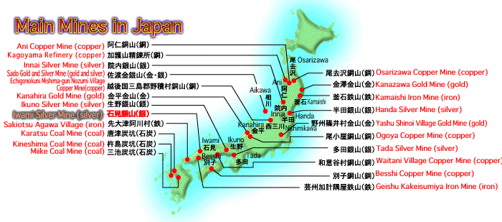

Slide 29
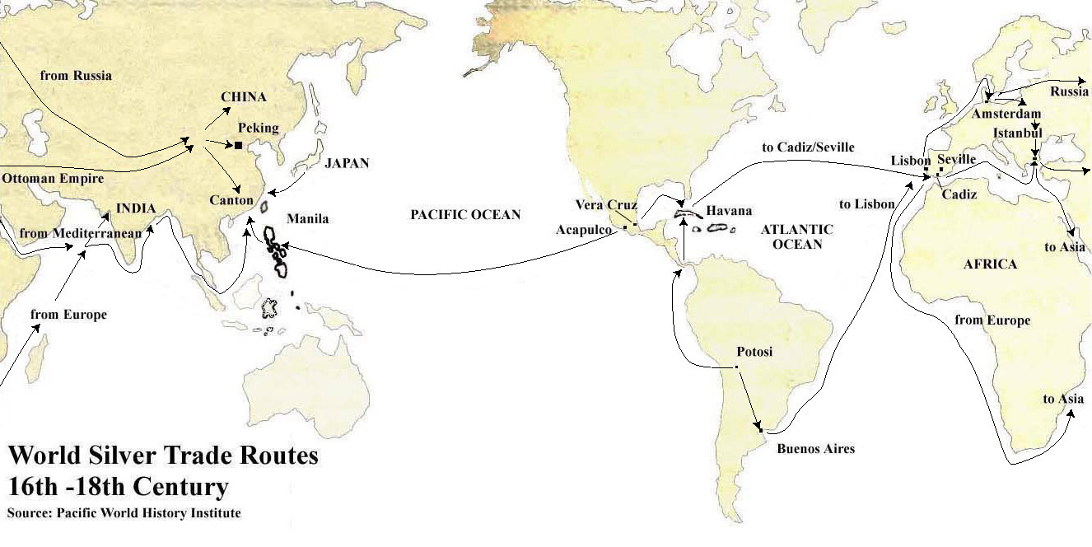
Silver routes

Slide 30
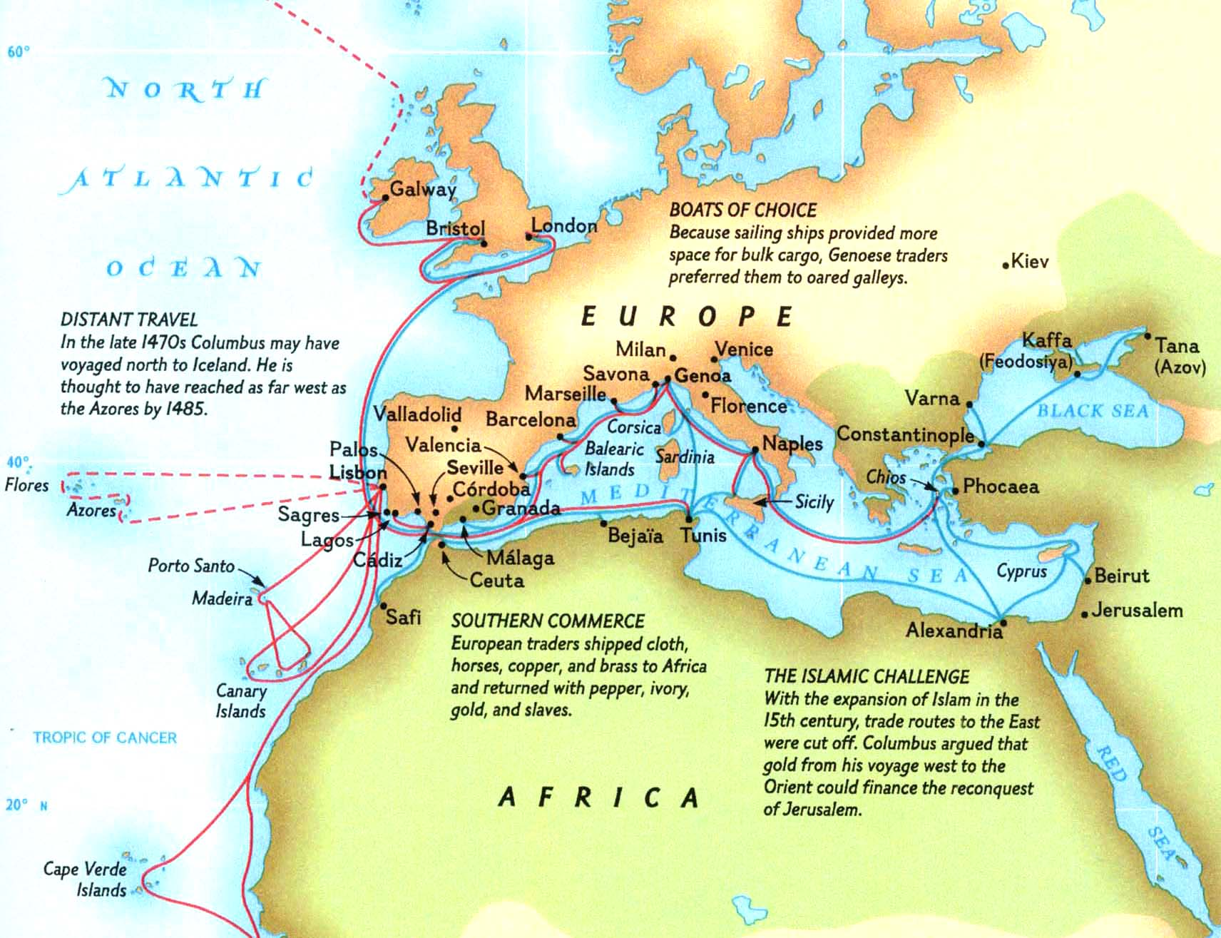
Silver routes in Europe

Slide 31
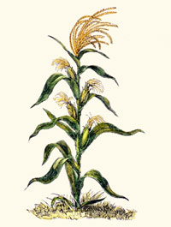
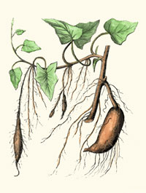
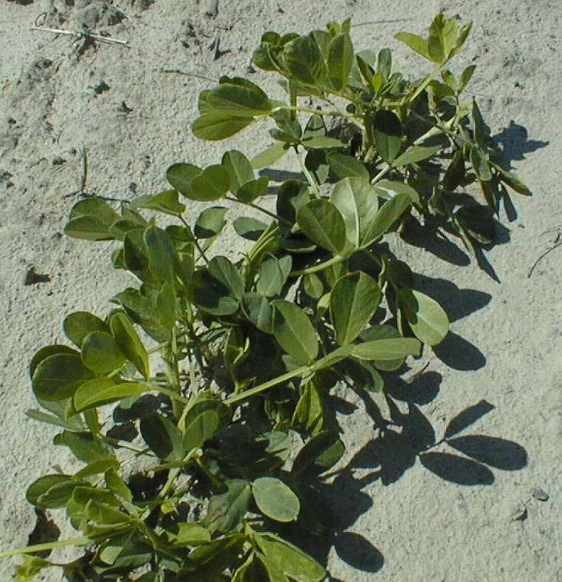
American plants in China

Slide 32
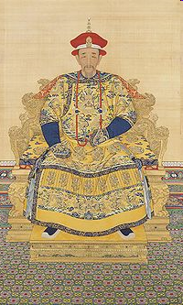
The Kangxi Emperor 1662-1722

Slide 33
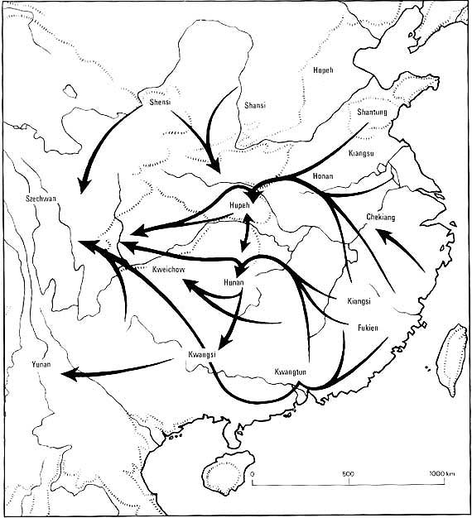
Chinese immigration 18th century.

Slide 34
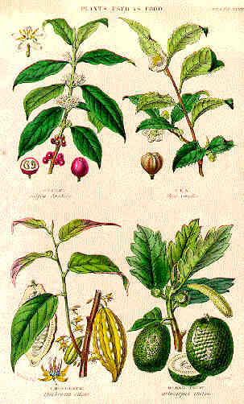
Tea plant.

Slide 35
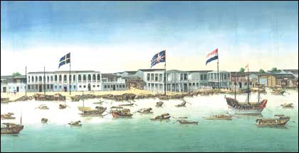
.
.

Slide 36
Silver exported to China
1760s | 3.0 million taels.
1770s | 7.5 million taels.
1780 | 16.0 million taels.

Slide 37
Period | Te exports from Canton (in million pounds) | British Imports | Percentage
1771-1780 | 180.6 | 59,5 | 32.9
1781-1790 | 299.4 | 148.2 | 53.6
1791-1800 | 313-6 | 233 | 74.3
1801-1810 | 370 | 294.5 | 79.6

Slide 38
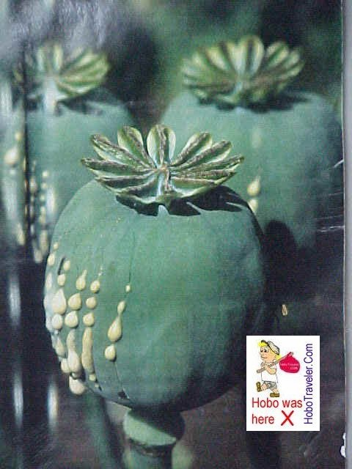
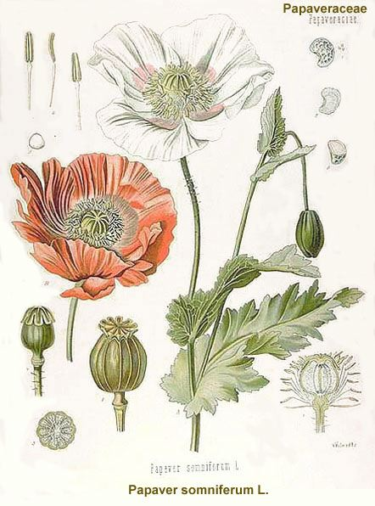
Opium plants.

Slide 39
Sales of Opium to China.
Year | Box 1=130/160libras.
1773 | 1,000
1790 | 4,054
1800 | 4,570
1810 | 4,968
1816 | 5,106

Slide 40
This drink not only quenched thirst, but also acted as a mild stimulant, making it an ideal refreshment for the British laborers. On top of it, the clever mixing of milk and sugar in tea produced a concoction far more delicious […]Tea and toast offered a new food to the Brave New World. According to a British economic historian J.C. Williamson, without tea “the poor diet of the factory-workers should not have kept them going” during the Industrial Revolution.
(Chung Tang China and the brave new world: a study of the origins of the Opium war (1840-42). P.77)

