Slide 1

Two Historic Houses in Warwickshire:
Packwood House and
Baddesley Clinton

Slide 2
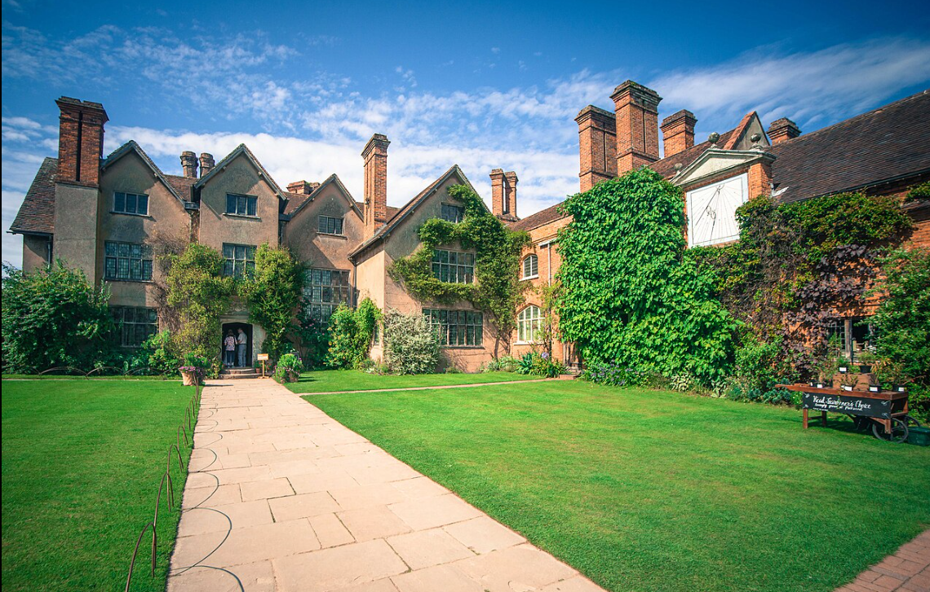
Packwood House

Slide 3
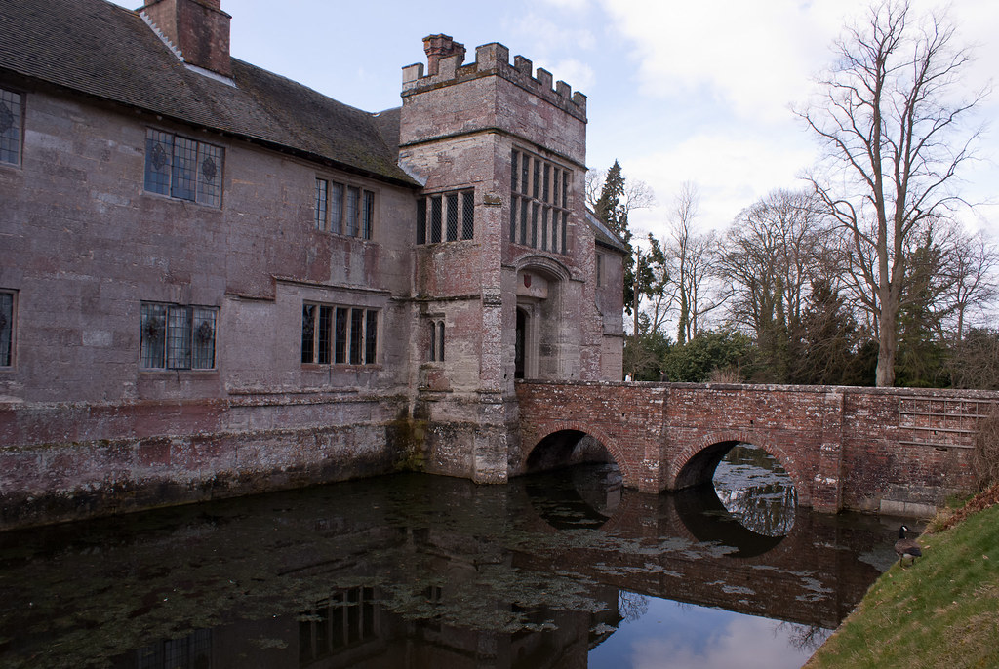
Baddesley Clinton
This Photo by Unknown Author is licensed under CC BY-SA-NC

Slide 4

The National Trust for Places of Historic
Interest or Natural Beauty
The Natural Trust was founded in 1895 by three philanthropists – Octavia Hill, Hardwicke Rawnsley and Robert Hunter – to preserve “the past and protect our heritage for future generations”.
The founders were deeply concerned about the lack of green spaces for working-class urban populations and the impact of industrialisation on the historical heritage of the nation. They created the Trust to preserve natural landscapes and historical properties from rampant industrialisation.
Legislation was passed in 1907 to ensure that the landscapes and properties of the Trust would be held in perpetuity for the benefit of the nation and would not be sold off or developed for private gain.

Slide 5
The National Trust, cont.
Properties were obtained by gift and sometimes by public subscription.
In the 20th century, particularly after the Second World War, many historic houses were donated by their owners who were unable to maintain them and keep them from falling into disrepair.
The National Trust is now one of the largest landowners in England, Wales and Northern Ireland.
It owns more almost 250,000 hectares of land and 1260 km of coastline, as well as 500 historic houses, castles, industrial monuments, parks, and nature reserves.
It is financed largely by its members – in 2023/24 it had 5.38 million members – and is supported by 53,000 volunteers.

Slide 6
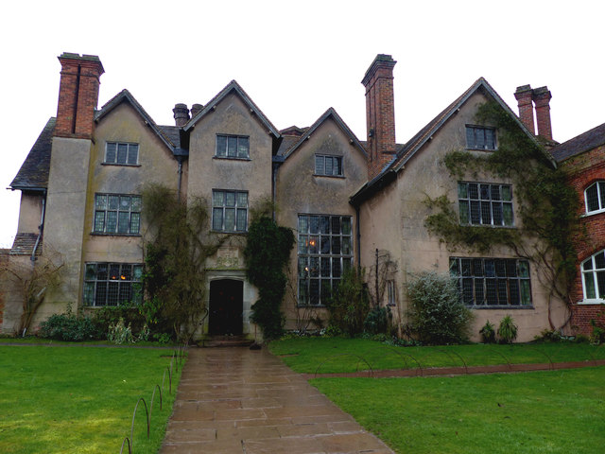
Packwood House
Originally a timber-framed farm house, built between 1556 and 1560
Graham Baron Ash inherited it in 1925 and decided to turn it into his vision of a Tudor manor house
Much of its present appearance is from extensive remodelling in the 1920s and 1930s

Slide 7
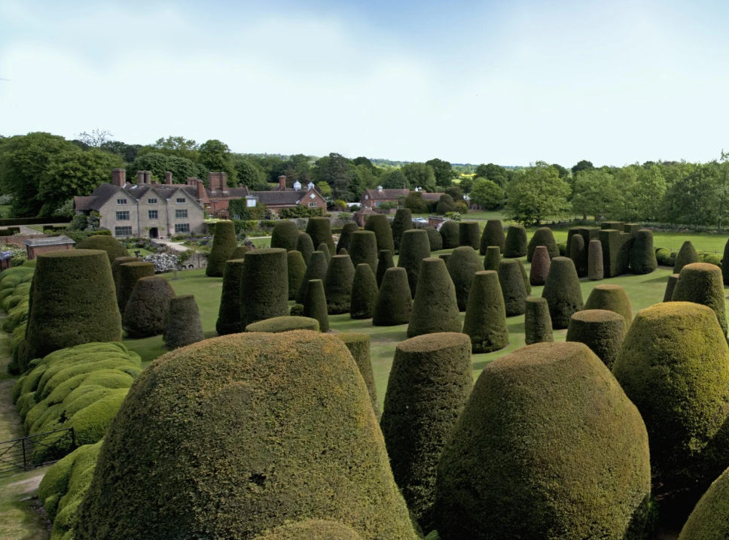
The Yew Garden of Packwood House
The Yew Garden is the most important feature of Packwood House.
Some of the yews date back to the 1660s.
The arrangement of yew trees and the winding path up to the mount are claimed to represent the Sermon on the Mount.

Slide 8
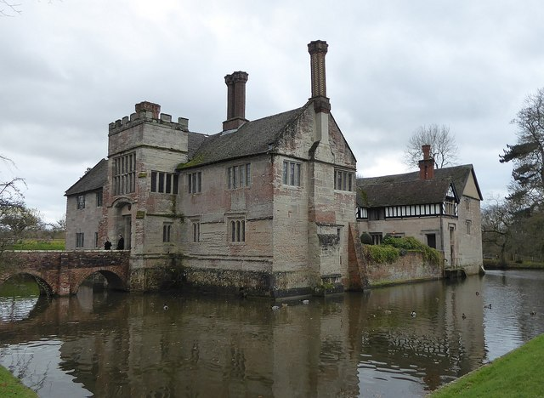
Baddesley Clinton
Built in the 13th century
Most parts date back to 15th century
Typical example of Tudor manor house
Belonged to the Ferrers family for more than 500 years
This Photo by Unknown Author is licensed under CC BY-SA

Slide 9
The Beginnings of the Protestant Reformation
Start of Reformation in Europe around 1517 with the publication of Martin Luther’s theses in the German town of Wittenberg.
Reasons for the Reformation in Europe
  - Desire for reform of the Roman Catholic Church
  Different approach to the Bible (scholastic learning vs. return to the original text of the Bible)
Reasons for the Reformation in England
  - The king of England needed a divorce

Slide 10
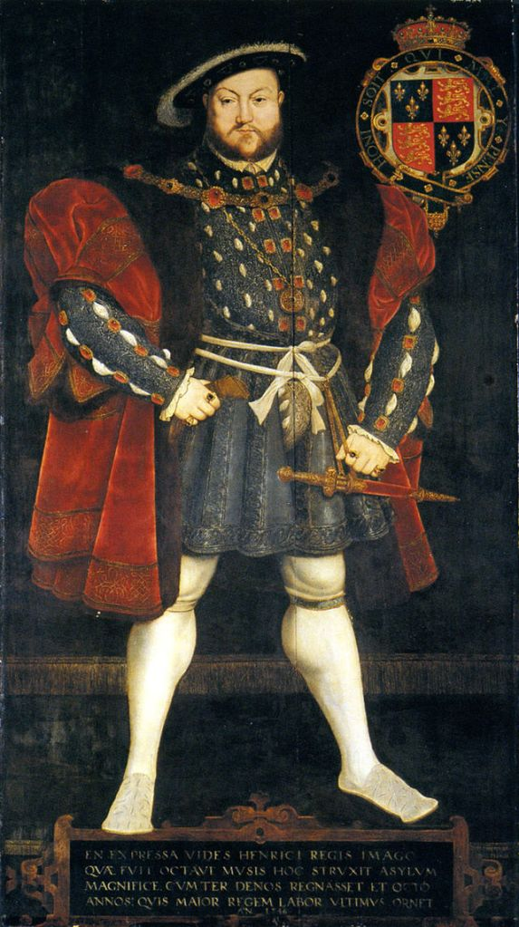
Henry VIII and the need for an heir
Tudor dynasty is a recent dynasty (1485 – 1603)
1509: Henry VIII accedes to the throne
Married to Catherine of Aragon (Spanish princess)
In 1529: no living male heir: must remarry to get a male heir
Needs the annulment of his marriage by the pope
Pope unwilling to give a divorce
The church in England was rich and the king was always short of money ...

Slide 11
Creation of the Church of England
1533 Henry VIII divorces his 1st wife Catherine of Aragon and marries Anne Boleyn
1534 Parliament passes the Act of Supremacy making Henry the Supreme Head of the Church of England
1536-41 Dissolution of the monasteries
1547 Henry VIII dies
Henry’s son Edward VI (1547-1553) from Henry’s third marriage establishes Protestantism as the foundation of the
Church of England

Slide 12
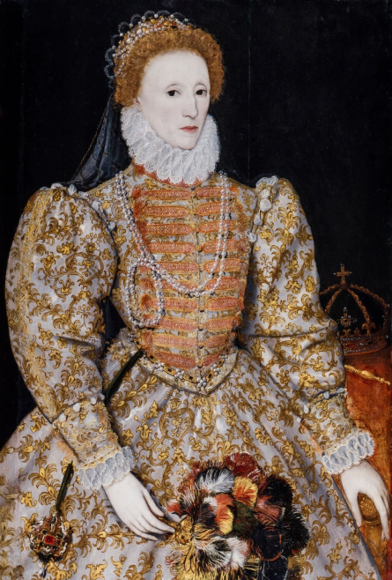
Elizabeth I and the problem with Catholics
Elizabeth I (1558-1603) born to Henry’s second wife Anne Boleyn
In the view of Roman Catholics, she was illegitimate
Excommunicated by the Pope in 1570
1580s: several Catholic plots to assassinate Elizabeth
Spain was England’s greatest enemy at the time (attempted invasion of England in 1588)
Roman Catholics were accused of supporting Spain

Slide 13
Anti-Catholicism in England
1534/1558 Act of Supremacy. Any person taking public or church office in England must swear allegiance to the monarch as supreme head of the church. Failure to do so constituted treason.
1559: Act of Uniformity. Worship in the Church of England is compulsory.
1641 a poll tax is levied. Catholics have to pay double.
1689 Bill of Rights & 1701 Act of Settlement: no future monarch may be a Catholic (has not been repealed; since 2013 the monarch is allowed to marry a Catholic).

Slide 14
Anti-Catholicism under Elizabeth I: Recusants
Elizabeth I became queen of England in 1558
Recusants were Roman Catholics who refused to renounce their faith and accept the new Church of England.
Many anti-Catholic laws were passed:
  The Roman Catholic mass was declared illegal and attendance at Anglican church servies was made compulsory.
  Non-attendance of Anglican (Church of England) services punishable by fines or imprisonment.
  In 1593, the Act against Popish Recusants limited their mobility of a 5-mile radius around their home. This meant that they needed to apply for permission to travel.
  Having Roman Catholic priests in the house was illegal.

Slide 15
... and Poursuivants: the “Priest-catchers”
Roman Catholic families still attempted to practice their religion but holding mass was illegal.
Roman Catholic priests travelled in disguise from safe house to safe house to minister to Catholic families. Recusant families built ‘priest holes’, secret rooms to hide RC priests.
Gangs of poursuivants or “priests-catchers’ would go to houses of recusants to try and catch the priests. Capture would mean certain death for any RC priest

Slide 16
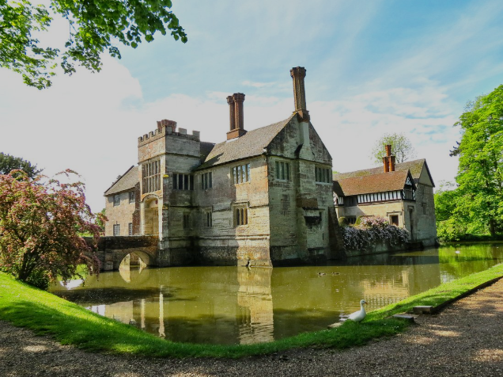
Baddesley Clinton: recusants and poursuivants
The Ferrers family of Baddesley Clinton remained a Catholic family
1580s: the house is rented out to 2 sisters, Anne Vaux and Eleanor Brooksby who were well-known recusants
Anne commissions the building of a priest hole
1591 a band of poursuivants arrive at the house and search it for 4 hours. They did not find the priests hiding in the house
Take a look at the priest hole in the kitchen

Slide 17
Catholic Emancipation
1791 Roman Catholic Relief Act. Mass becomes legal again. Catholics may become priests, run schools and serve in the army, but not as officers, enter the legal profession. Catholic churches may be built.
1829 Catholic Emancipation. RCs may become members of parliament and are no longer barred from high office in the judiciary or state.
Baddesley Clinton
There is now a Roman Catholic chapel on the first floor.

Slide 18
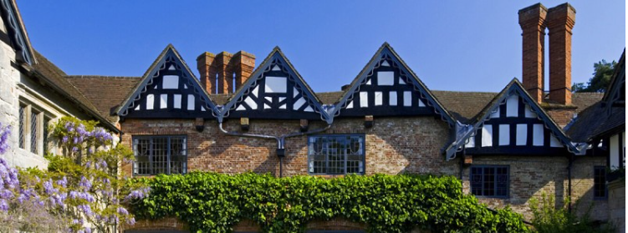
Thank you for your attention

