Slide 1

Ukrainian Diaspora Support for IDPs in Ukraine
by Maria Koinova &
Olena Miliienko

Slide 2

Key Argument:
We argue that diaspora engagement with IDPs has occurred primarily through informal transnational networks that connect families across borders, as well as communities in both host countries and places of origin.
This support has not been institutionalized; rather, it has been largely ad hoc and uncoordinated.
Economic assistance has taken the form of occasional labour market integration initiatives and support for entrepreneurship, particularly when facilitated by IOM programmes.
Social support has been more diverse but similarly unstructured, including humanitarian aid to regions with high concentrations of IDPs, assistance to orphanages, psychological and mental health initiatives, support for IDP hubs, indirect contributions through charitable organizations funded by diaspora members, and foreign language instruction.
When formal institutions—such as international or charitable organizations—have been involved, the role of diaspora engagement has typically been indirect and mediated.

Slide 3
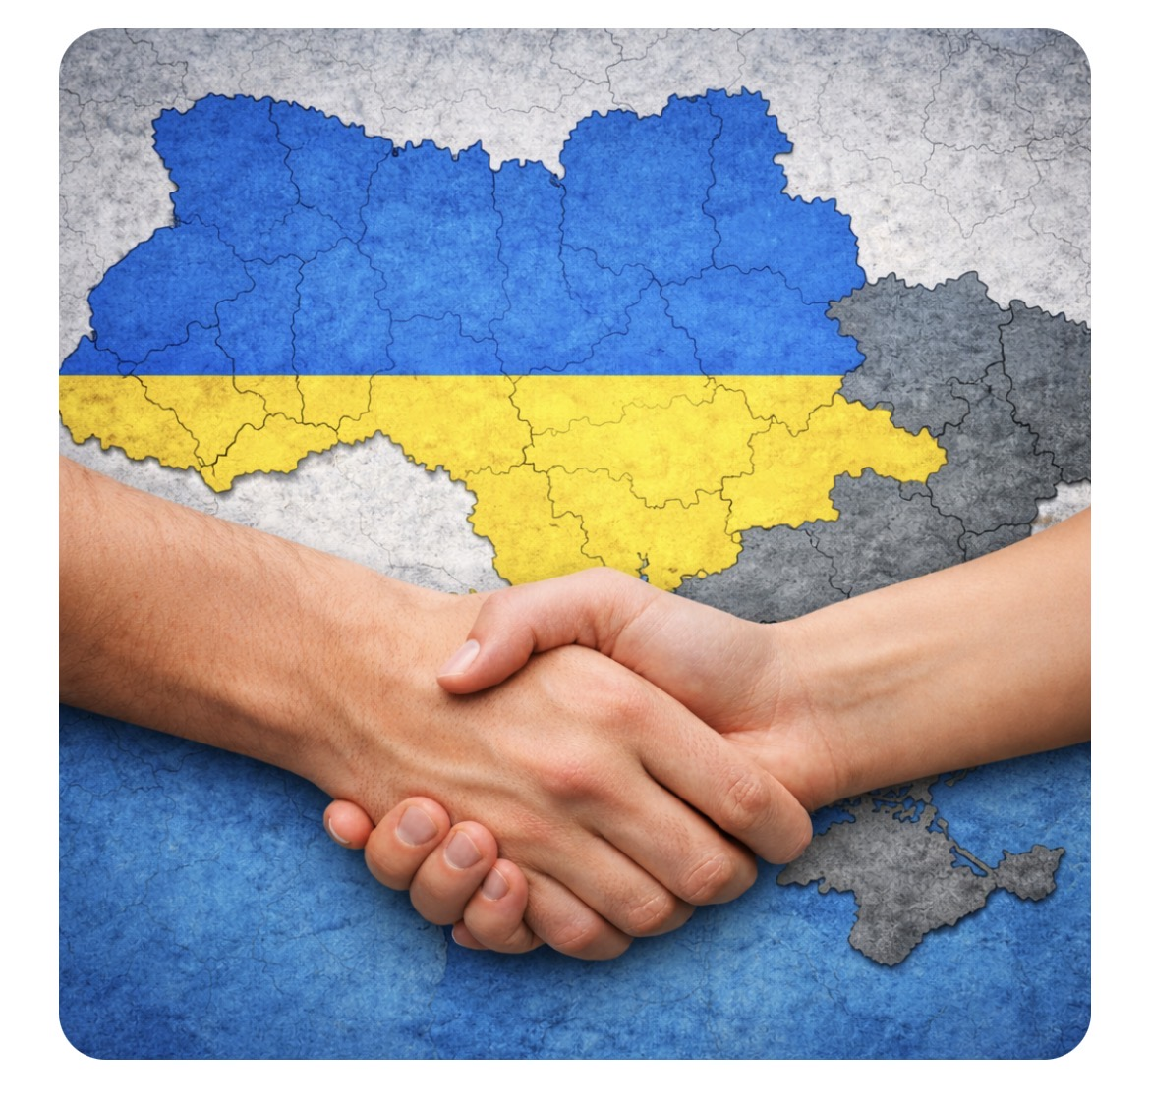
Two Key Questions Guide Our Study:
How have members of the Ukrainian diaspora supported—or refrained from supporting- IDPs in Ukraine since 2014, and particularly after the full-scale Russian invasion in 2022?
How have they supported IDPs specifically on two dimensions:
  (1) economic and
  (2) social?

Slide 4
The primary data was collected through online interviews:
Parameter | 🏠 IDPs in Ukraine | Ukrainian Diaspora in the UK
Sample Size | 10 participants | 10 participants
Gender | 👩 8 women, 👨 2 men | 👩 7 women, 👨 3 men
Age Range | 27 – 56 years old | 29 – 66 years old
Interview Period | March – April 2025 | April – August 2025
Sampling Method | Purposive (via IDP organizations) | Purposive (via UK diaspora organizations)
Profile / Waves | • 2014 wave: Crimea, Donetsk, Luhansk • 2022 wave: Kyiv, Sumy, Kharkiv regions | • 7 participants: Immigrated 1991–2014 • 3 participants: Second-generation They were born/their parents were born West (4 Lviv, 2 Ivano-Frankivsk,1 Ternopil), Centre (1 Cherkasy, 1 Kyiv), East (1 Zaporizhzhia)

Slide 5
In addition, information requests were sent to local authorities across Ukraine:
Out of 200 responses from hromadas, only 6 answered that local governments received assistance from the diaspora for IDPs. Of those who indicated that they received assistance from the diaspora for IDPs, they noted that it was humanitarian assistance from the diaspora from the USA, Great Britain, Poland, Germany, and pan-European religious and public associations of the Ukrainian diaspora.

Slide 6

Based on the results of responses from hromadas, interviews with IDPs and the diaspora, the main themes were highlighted: the lack of an obvious connection and channel of communication between IDPs and the diaspora, the problem of housing, jobs in the areas where IDPs have moved, the lack of connections with the diaspora, but receiving assistance from international funds and charitable organizations.
Out of 200 responses from communities, only 6 answered that local governments received assistance from the diaspora for IDPs. Of those who indicated that they received assistance from the diaspora for IDPs, they noted that it was humanitarian assistance from the diaspora from the USA, Great Britain, Poland, Germany, and pan-European religious and public associations of the Ukrainian diaspora.

Slide 7

This trend was also explained in the interview, where it was noted that assistance from the diaspora occurred at the personal level, IDPs also received assistance from international charitable organisations, and the diaspora reported that it sent funds to such charitable organisations.
The main cross-cutting theme that diaspora representatives mentioned in the interviews as an explanation for why they do not send aid to IDPs was distrust of the authorities and uncertainty that these funds would be used for good. All diaspora representatives noted during the interview that they were ready to provide funds for medical care in Ukraine. Two noted that they send donations to support the army. None of the interviewees considered investing in Ukrainian businesses, but all tried to buy Ukrainian-made products and would be ready to buy shares in Ukrainian companies if there were a transparent and understandable online platform for such investments.
Interviews with IDPs revealed that they would like the diaspora to actively influence the authorities in the countries where they live. IDPs point out that the best thing the diaspora can do is to be an active actor and, through broader international influence, return to fair international law on the inviolability of borders and restore the territorial integrity of Ukraine, and then IDPs will be able to return to their places of residence.

Slide 8
Diaspora Initiatives Supporting IDPs and Ukraine
Initiative Area | Key Diaspora Actions & Projects | Expectations / Barriers
📚 Culture & Education | • Ukrainian books sent to children in Eastern Ukraine • Free online language courses taught by diaspora • Scholarships & economic integration training | Expectations of more professional trainings with certificates that will be officially recognised and help to find a job
🏥 Humanitarian Aid | • Evacuation of orphanages from Eastern Ukraine • Funding for medical care and treatment • Relief supplies sent to high-density IDP areas | Expectations for medical aid for IDPs are only at the first stage, then psychological help is much more needed for IDPs
💼 Business & Investment | • SME support through IOM programs • Purchasing Ukrainian-made products | • Barrier: Diaspora have a lack of trust in investment for Ukrainian business, because of corruption and bureaucratic boundaries of authorities • Need: Transparent online investment in Ukrainian business platforms, available in different countries for diaspora
📢 Diplomacy & Advocacy | • Lobbying at the governments for political support • Advocating for international law and border integrity | • IDPs’ Goal: Interviews with IDPs revealed that they would like the diaspora to actively influence the authorities in the countries where they live. IDPs point out that the best thing the diaspora can do is to be an active actor and, through broader international influence, return to fair international law on the inviolability of borders and restore the territorial integrity of Ukraine, and then IDPs will be able to return to their places of residence.

Slide 9
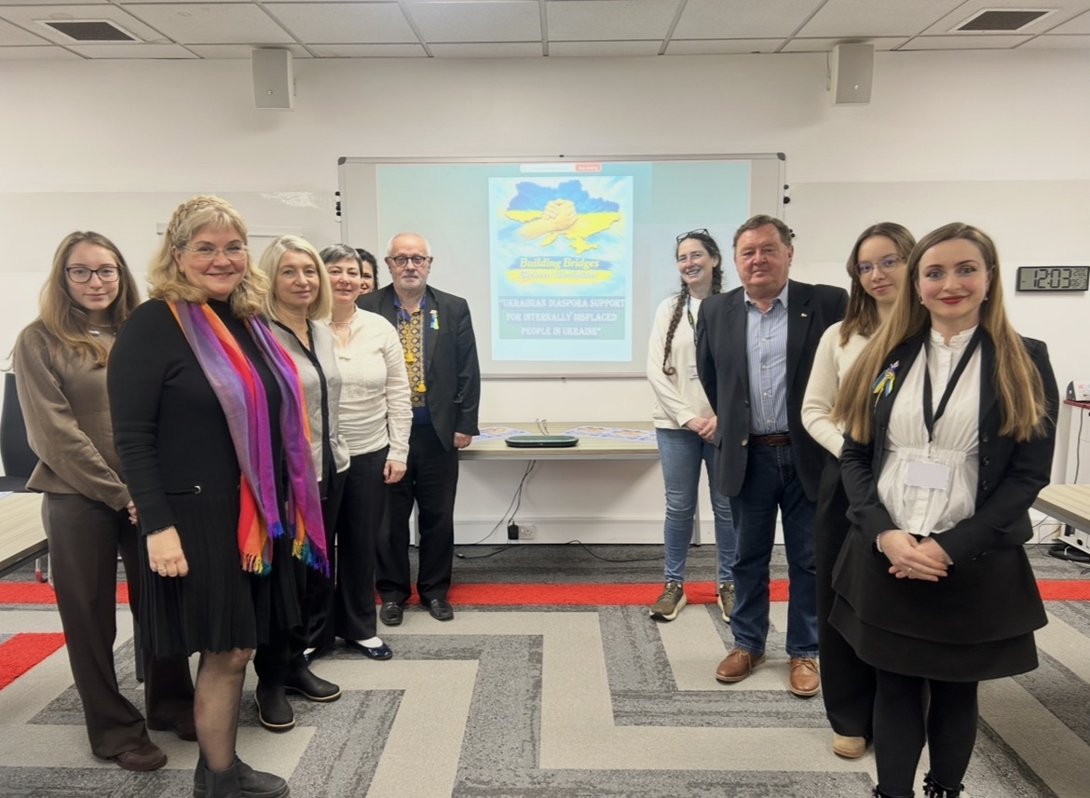
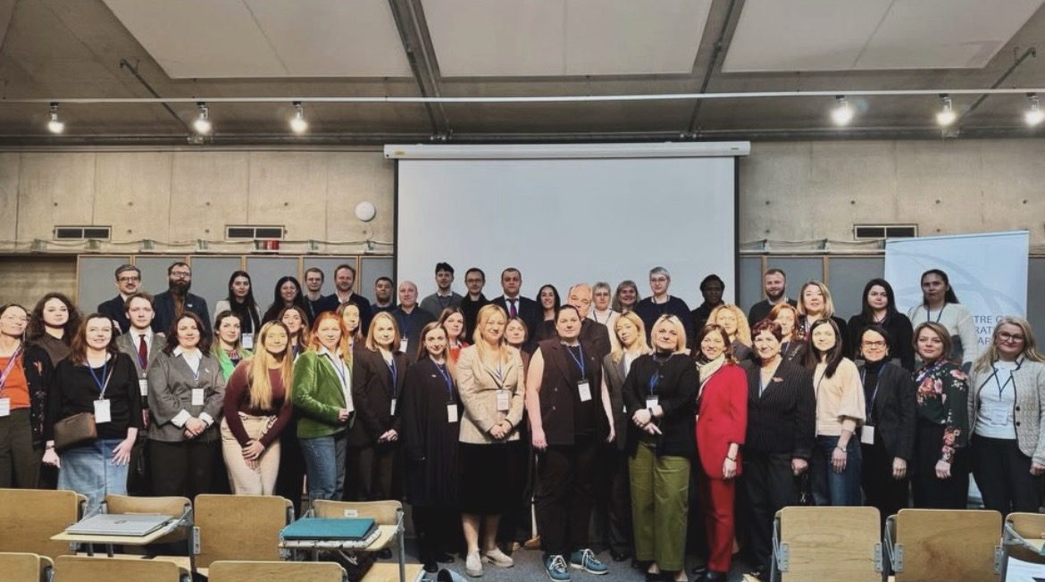
The international interdisciplinary events organised:
organised interdisciplinary workshop «Ukrainian Diaspora Support for Internally Displaced People in Ukraine», the University of Warwick, 2026;
co-organised with McGill University (Canada), Office of the UN Special Rapporteur on the Human Rights of IDPs/UNHCR, IOM, Centre of Migration Research, University of Warsaw, the international workshop “Internal Displacement in Ukraine: Action, Advocacy and Leadership”, 2026.

Slide 10
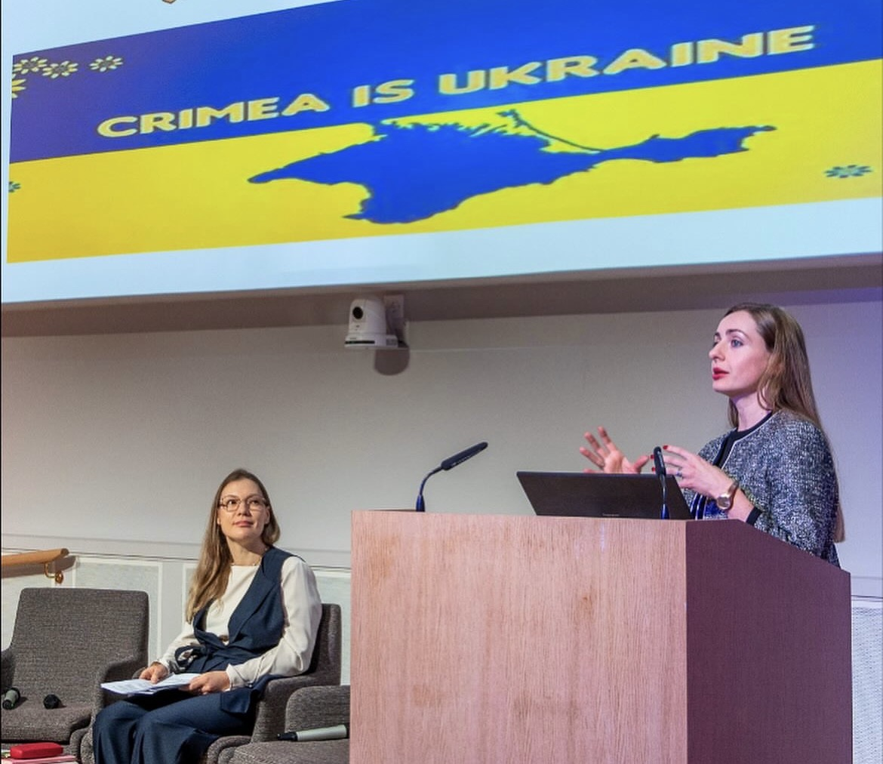
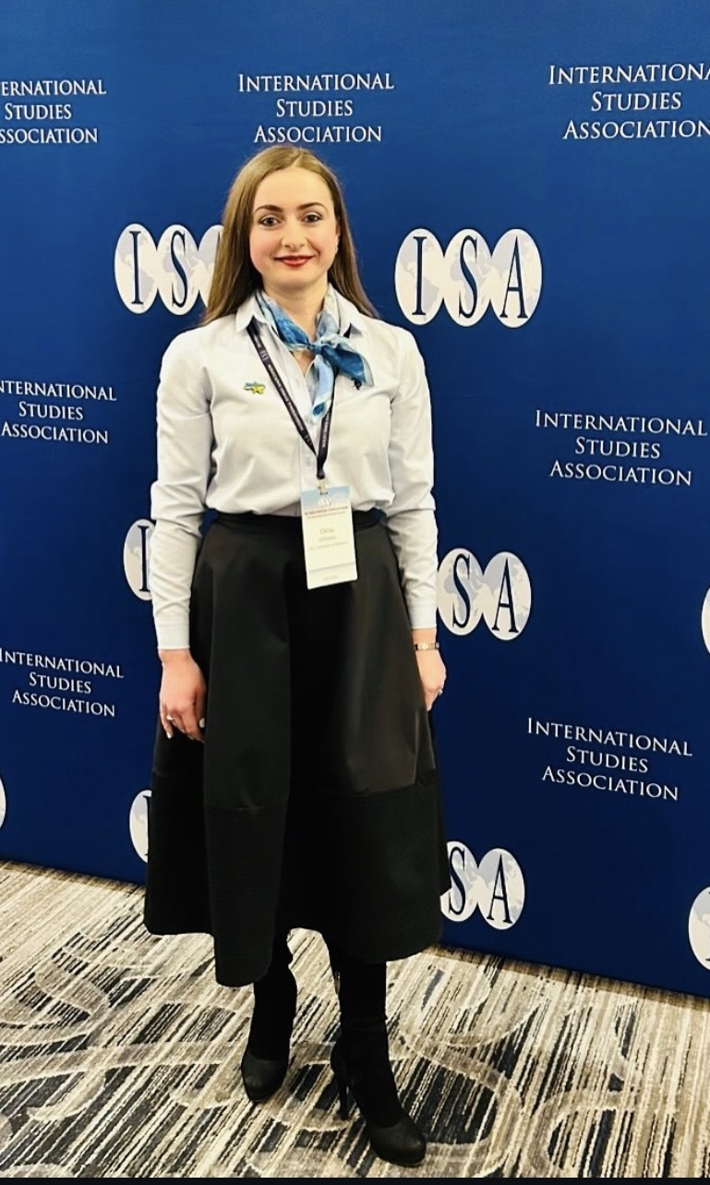
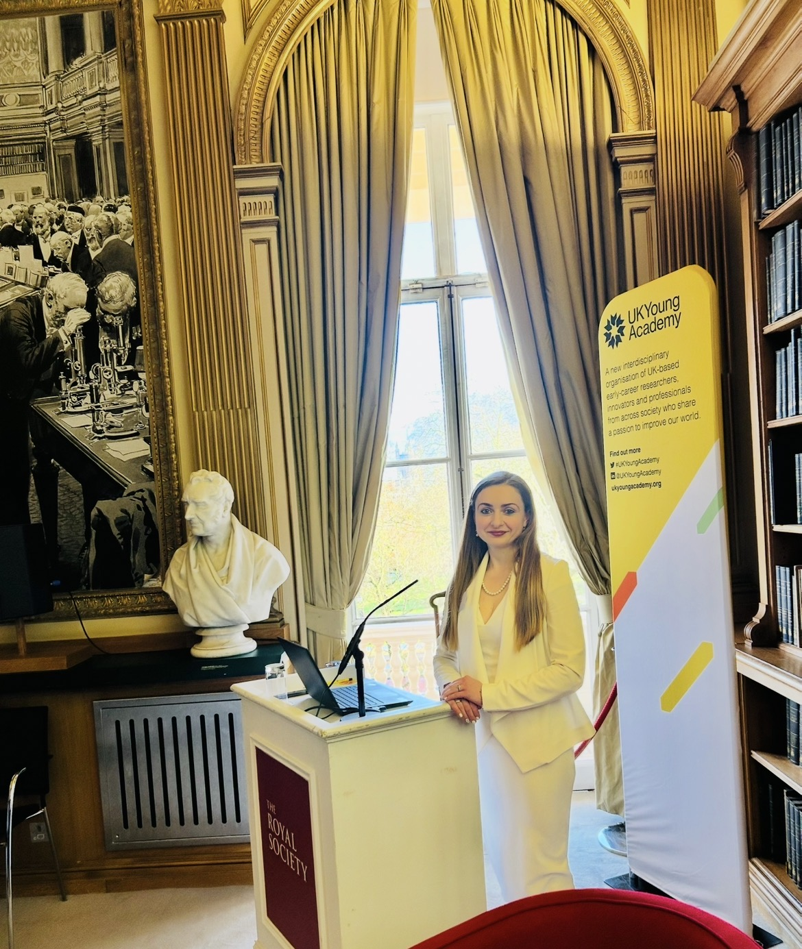
Had delivered numerous presentations, including
the Royal Society 2025,
the British Academy 2025,
the UNA-UK 2024,
the Annual Convention International Studies Association in San Francisco 2024,
the Annual Convention of the International Studies Association in Chicago 2025,
the Annual Convention of the International Studies Association in Columbus 2026,
Malmö University (Sweden) 2023,
the Institute of Law-Making and Scientific-Legal Expertise of the National Academy of Sciences of Ukraine 2023,
as well as at a comparative politics workshops and a research conferences in PAIS department, the University of Warwick 2023-2026.

Slide 11
Conclusions:
The connection between the diaspora, as well as to strengthening relations with partner states where they live, and Ukrainians in Ukraine, especially IDPs, is necessary to achieve a strategically important goal for the post-war demographic and socio-economic development of Ukraine.
Bridges between the diaspora and IDPs within Ukraine are just beginning to be built. Today, the territorial proximity of the diaspora to refugees from Ukraine who are in their host countries contributes to the diaspora focusing on this category of people, but with a favourable active policy of the authorities in Ukraine, the activity of IDPs, and the involvement of diaspora representatives in understanding the needs, the situation can significantly improve.

