Slide 1
War Remembrance
Tombs of the Unknown Soldier

Slide 2
Coronation of Charles III (BBC): https://www.youtube.com/watch?v=ajGRV5ZS9uQ
Coronation of Elizabeth II (BBC): https://www.youtube.com/watch?v=JJEUtX2_GwI
Wedding of William & Catherine: https://www.youtube.com/watch?v=5u6-CpU-1EY
Remembrance Sunday 2025: https://www.youtube.com/watch?v=P_2Zfaxfptk
Unveiling of the Cenotaph 1920 and burial of Unknown Warrior (US footage): https://www.youtube.com/watch?v=X50T-qRRn9k
Armistice Day 1921: https://www.youtube.com/watch?v=peEJiqXJ5jQ
Armistice Day 1945: https://www.youtube.com/watch?v=_v1a2M7rGck

Slide 3
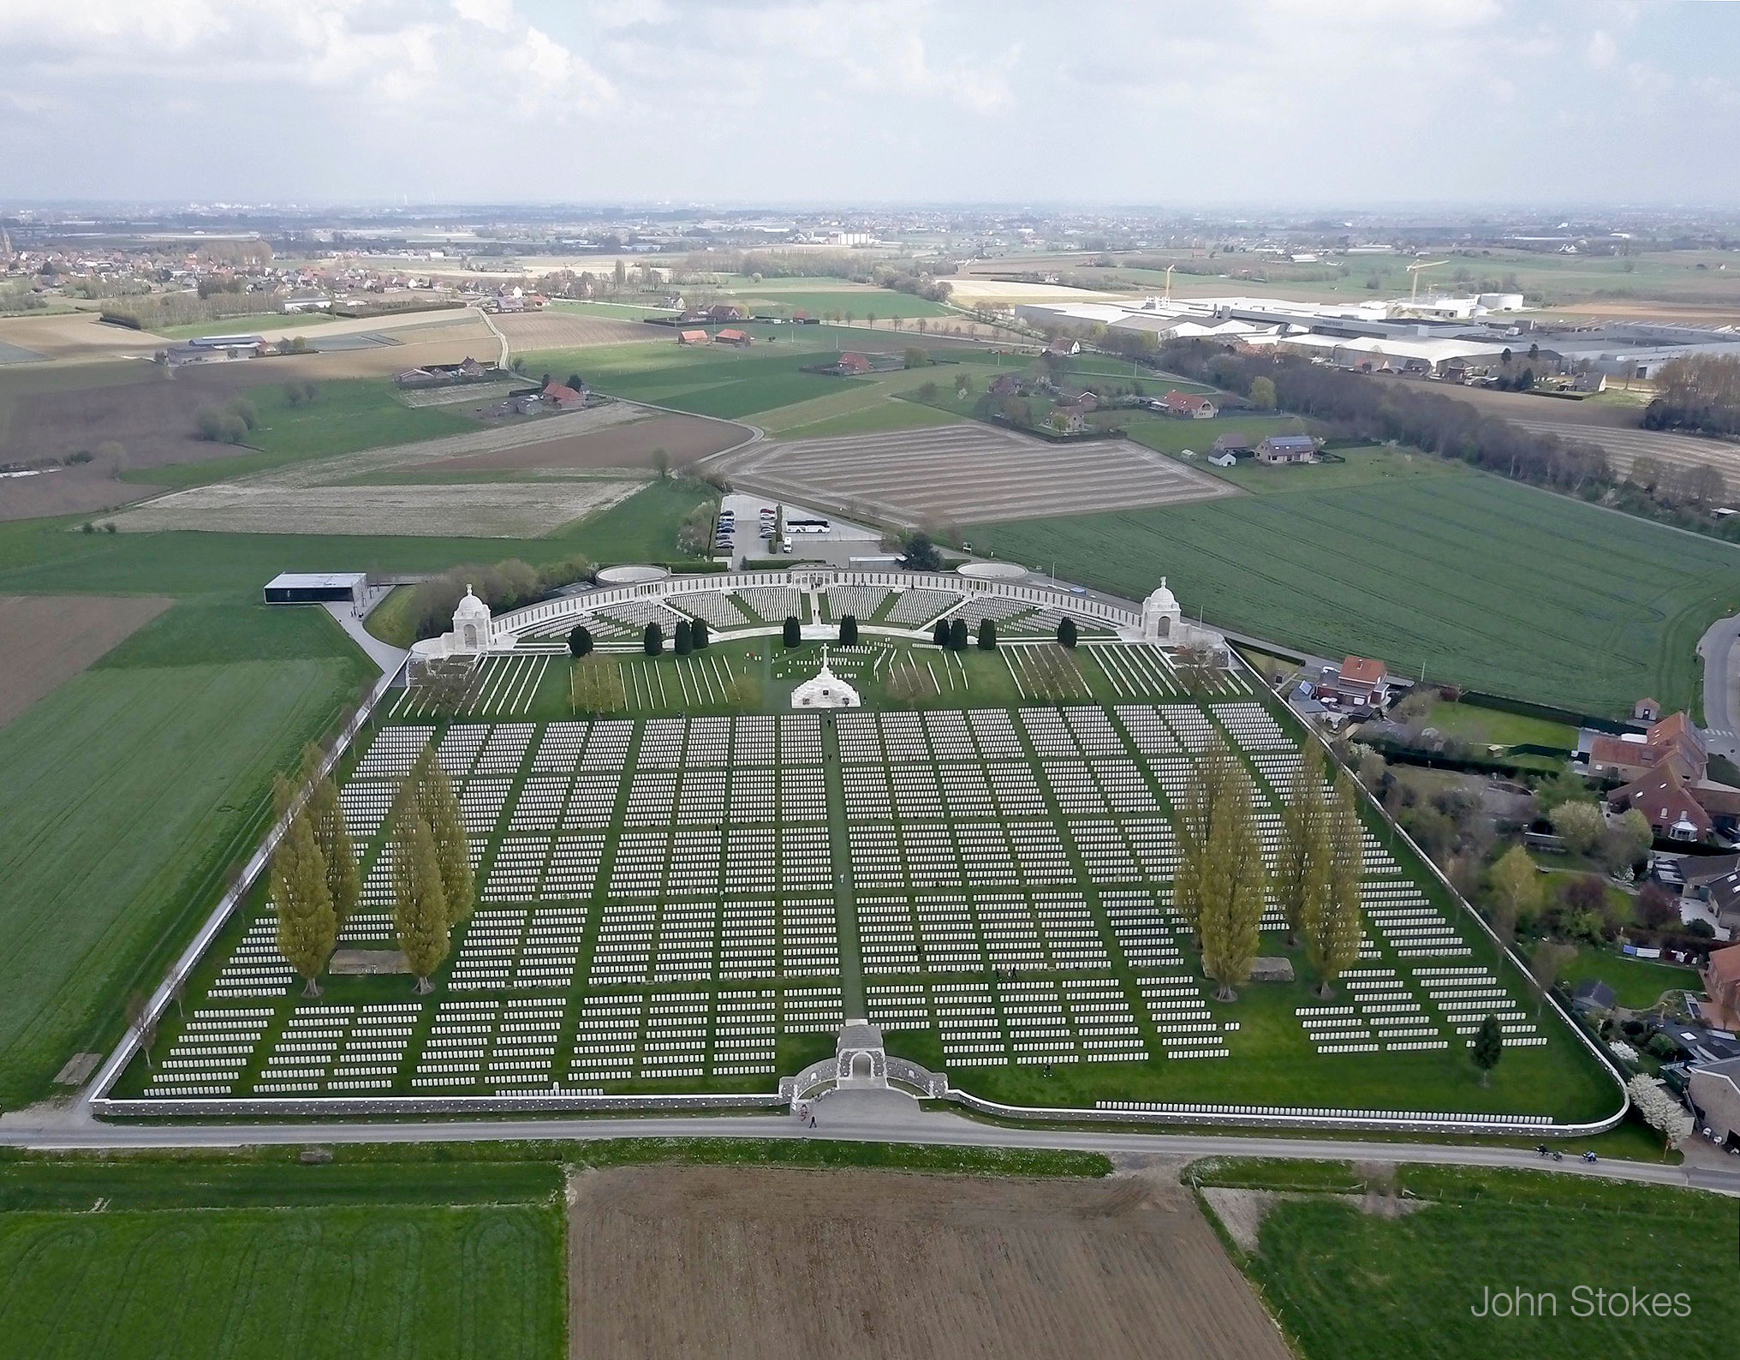
Tyne Cote
Tyne Cot Cemetery in Zonnebeke, Belgium

Slide 4
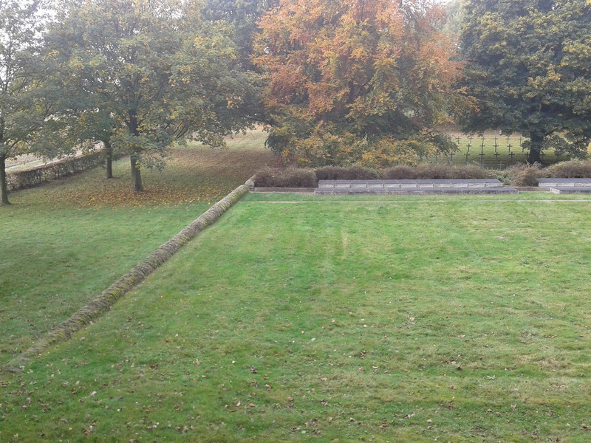
German Grave
Communal grave on the German military cemetery St.–Laurent-Blangy, near Arras, France

Slide 5
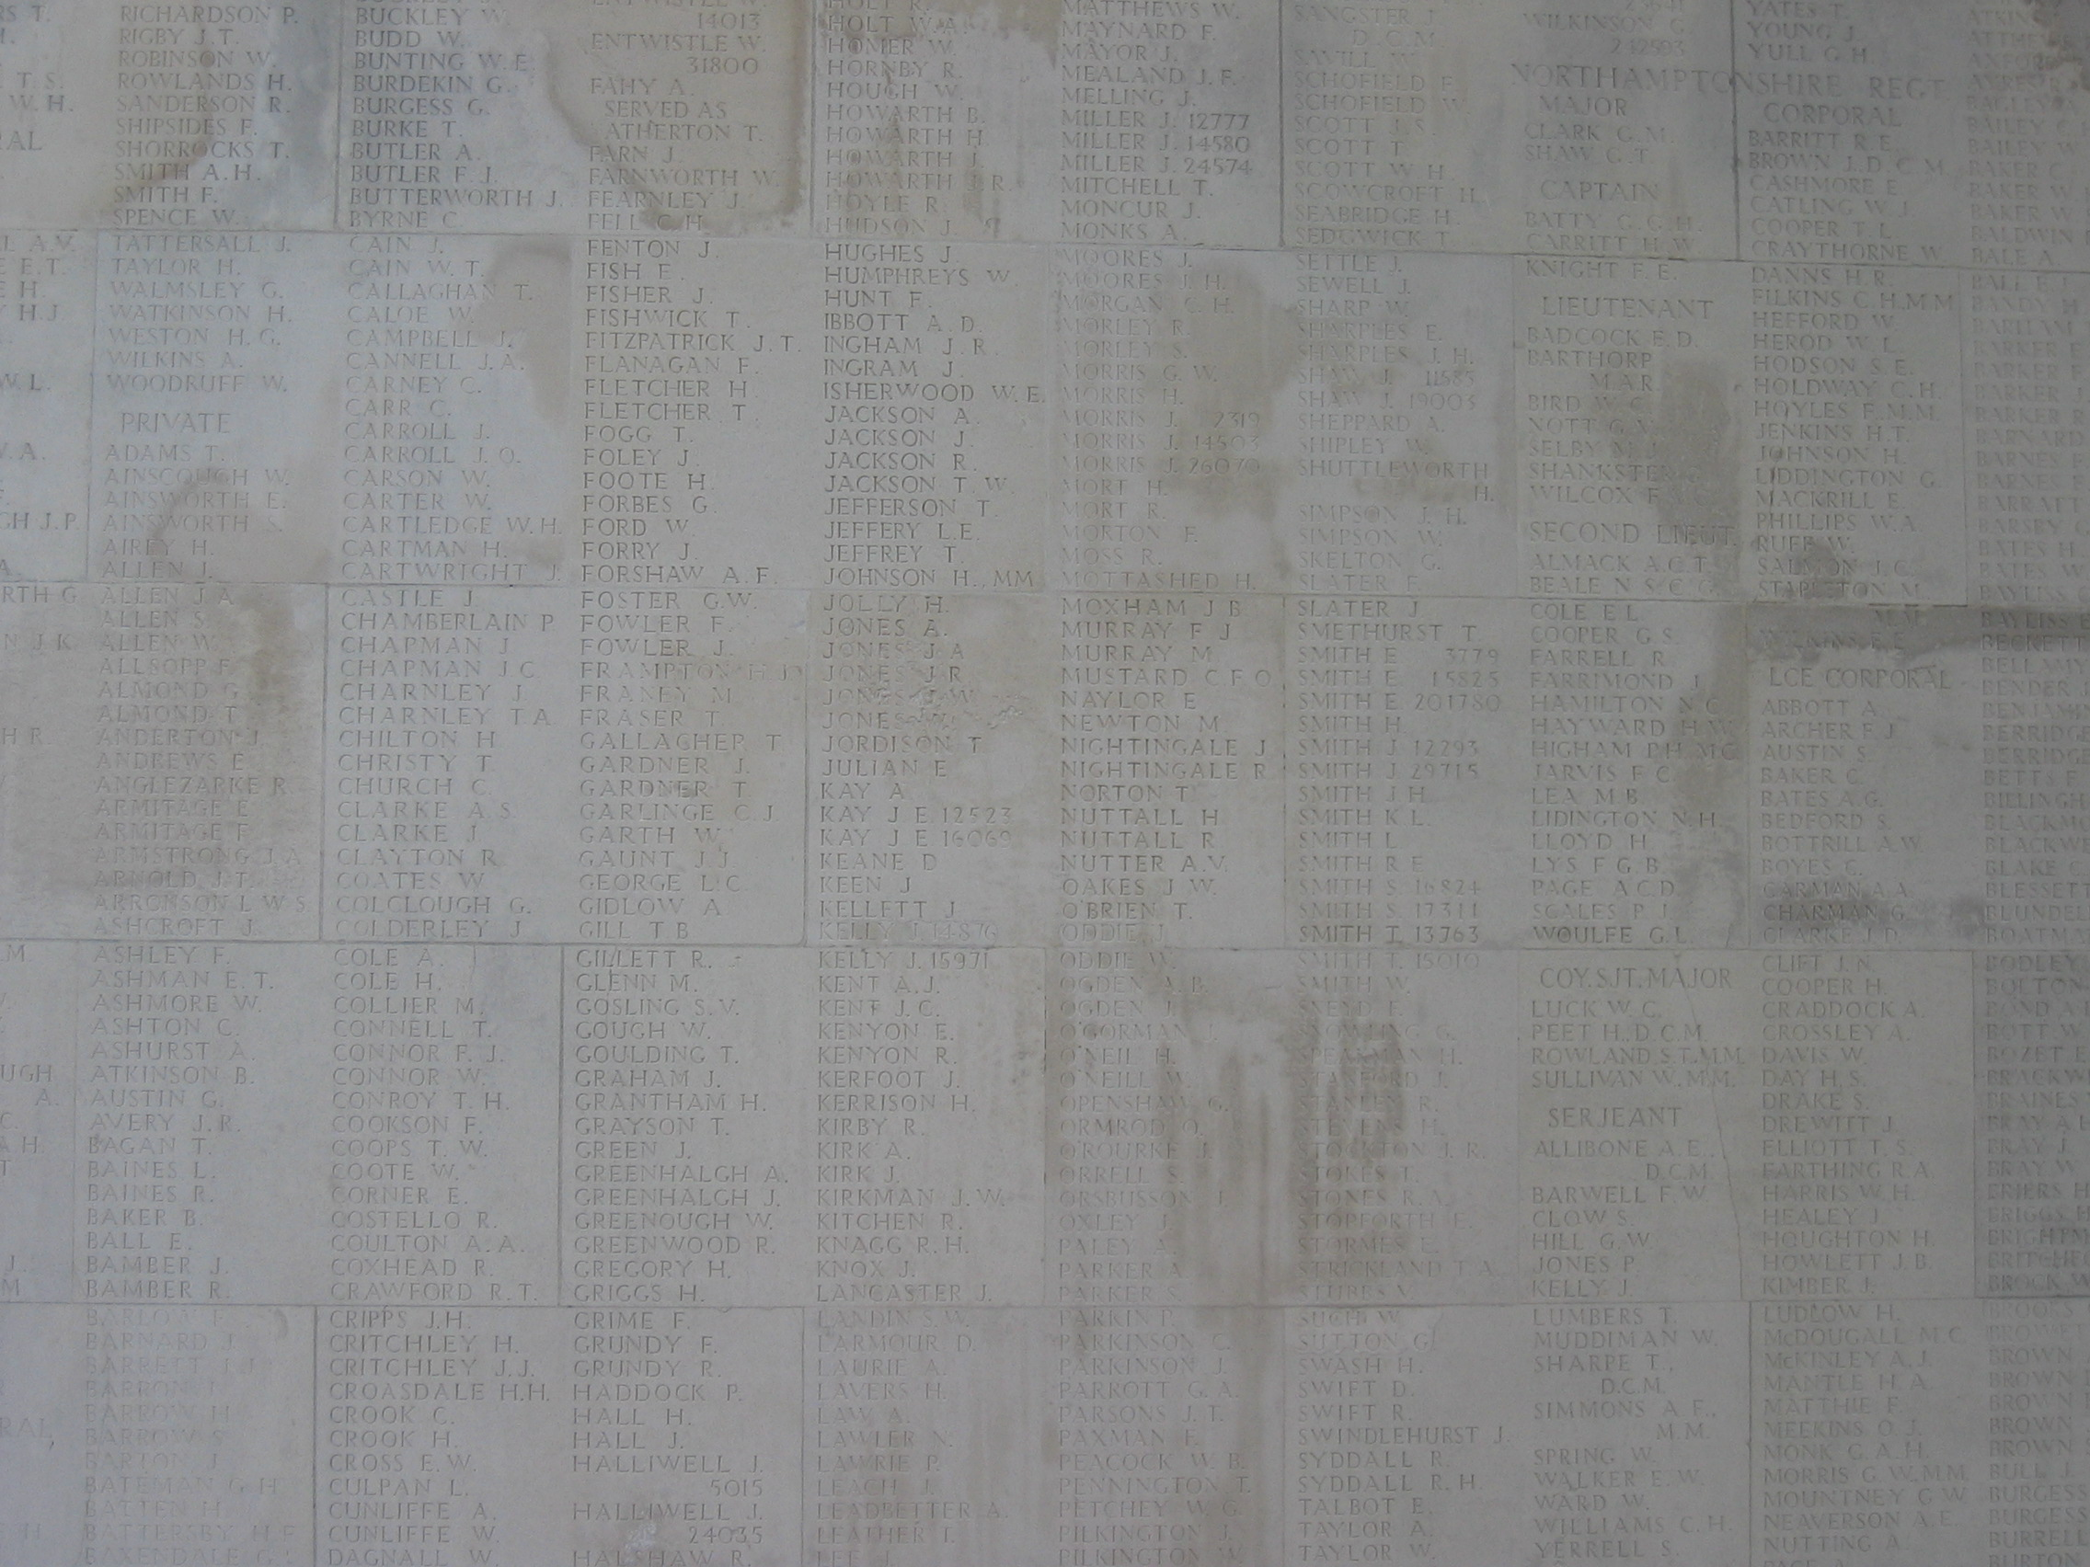
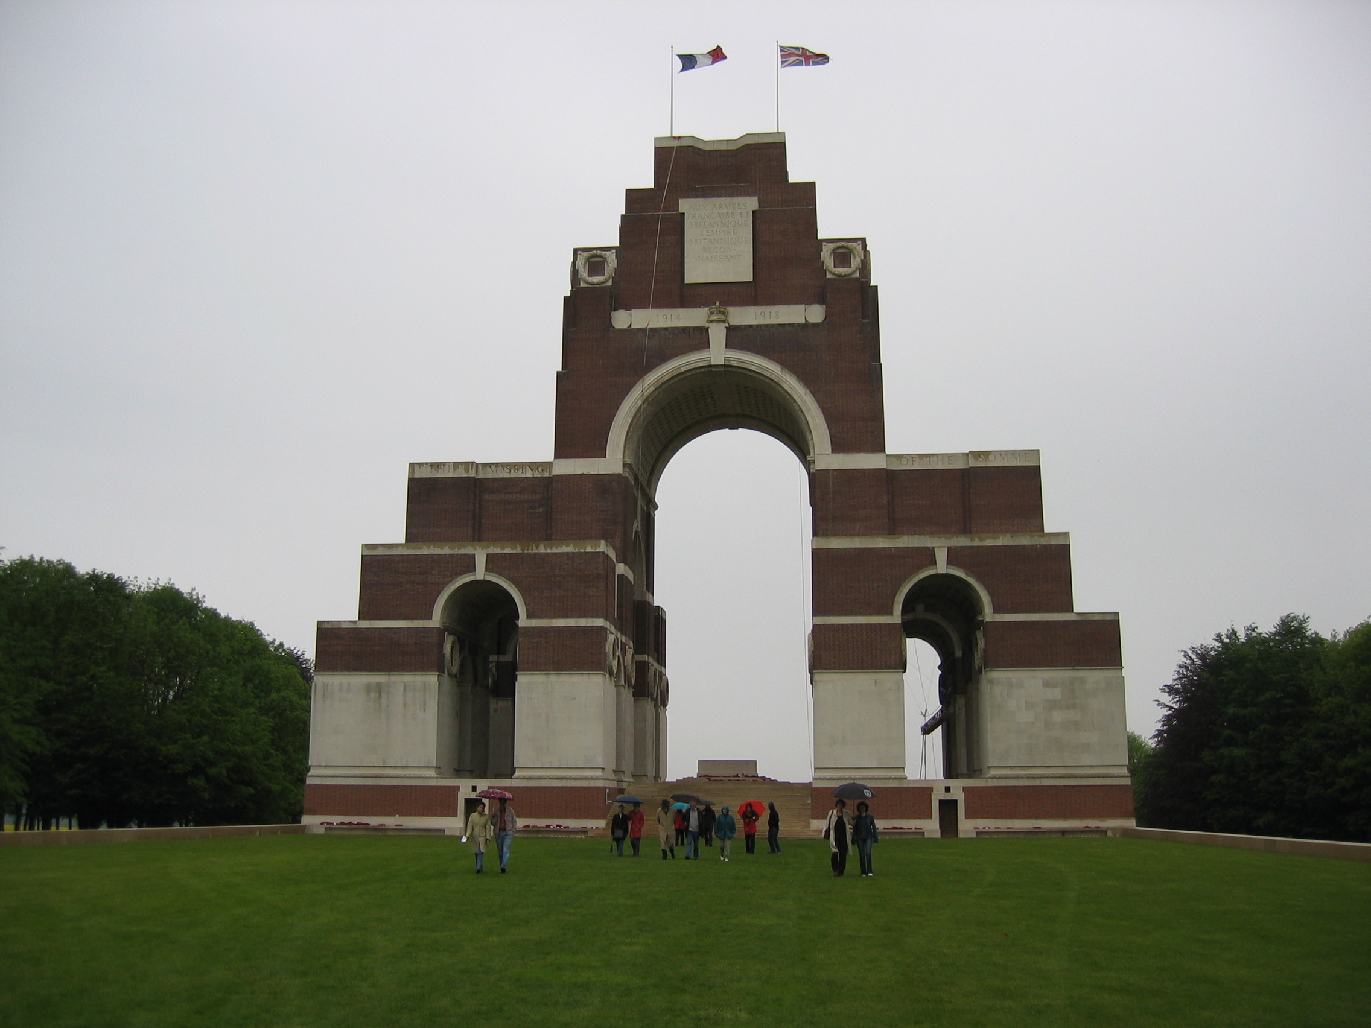
Thiepval Monument, Somme

Slide 6
Table: Tombs of the Unknown Soldier 1920-1939
Country | Location | Date of burial
British Empire | London, Westminster Abbey | 11 November 1920
France | Paris, Arc de Triomphe | 11 November 1920
Portugal | Batalha, Batalha Monastery | 10 April 1921
Italy | Rome, Altare della Patria | 4 November 1921
United States of America | Washington, Arlington Cemetery | 11 November 1921
Serbia | Mount Avala near Belgrade | * June 1922
Czechoslovakia | Prague, Town Hall | 1 July 1922
Belgium | Brussels, Colonnade du Congres | 11 November 1922
Romania | Bucharest | 17 May 1923
Poland | Warsaw, Saxon Square | 2 November 1925
Greece | Athens, Constitution Square | 25 March 1932

Slide 7
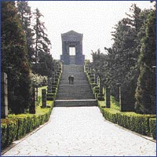
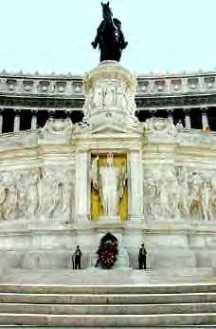
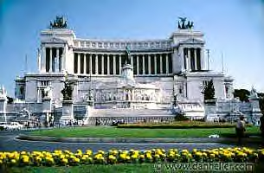
Yugoslavia, Belgrade, Mount Avala
Italy, Rome, Altare
Della Patria (Vittorio
Emanuel Monument)

Slide 8
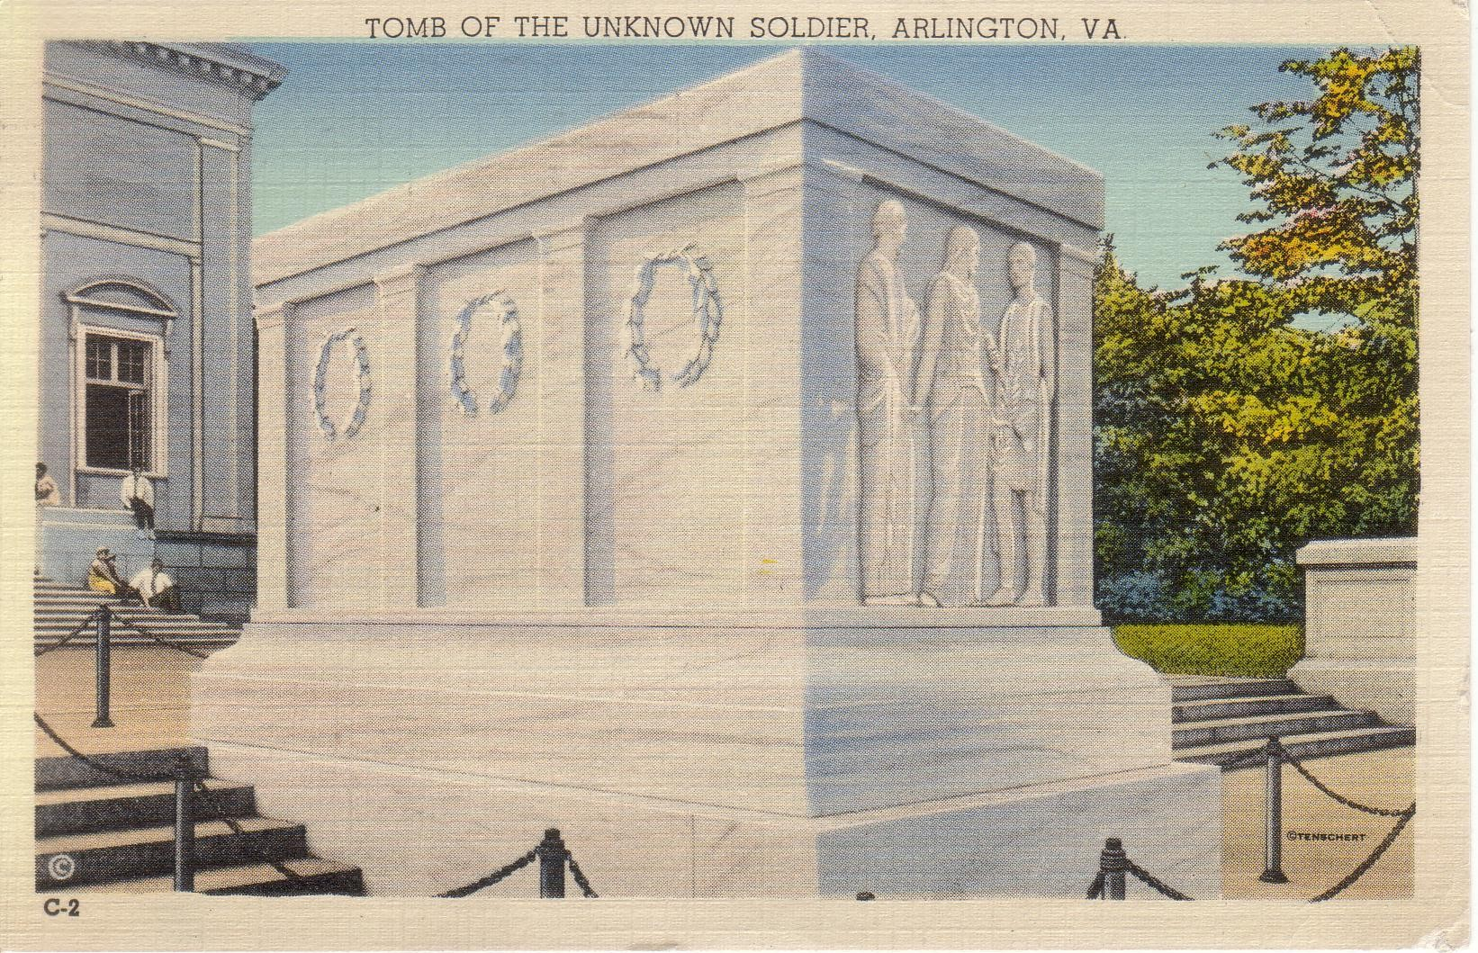
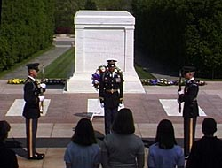
Postcard of the Tomb of the Unknown Soldier WW I, USA, Arlington, inaugurated 1921
In front of the sarcophagus: the tombs
of the Unknown Soldiers of
World War II, the Korean War and the
Vietnam War

Slide 9
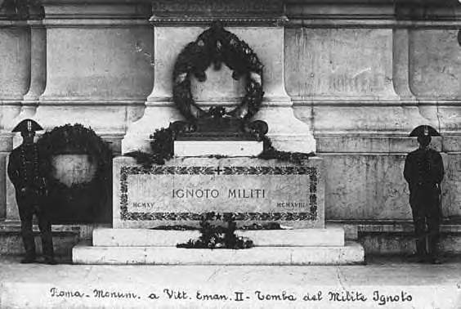
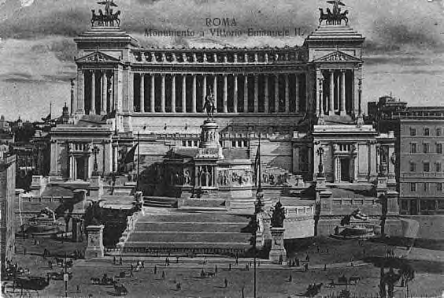
Italy, Rome, Altare
Della Patria (Vittorio
Emanuel Monument)

Slide 10
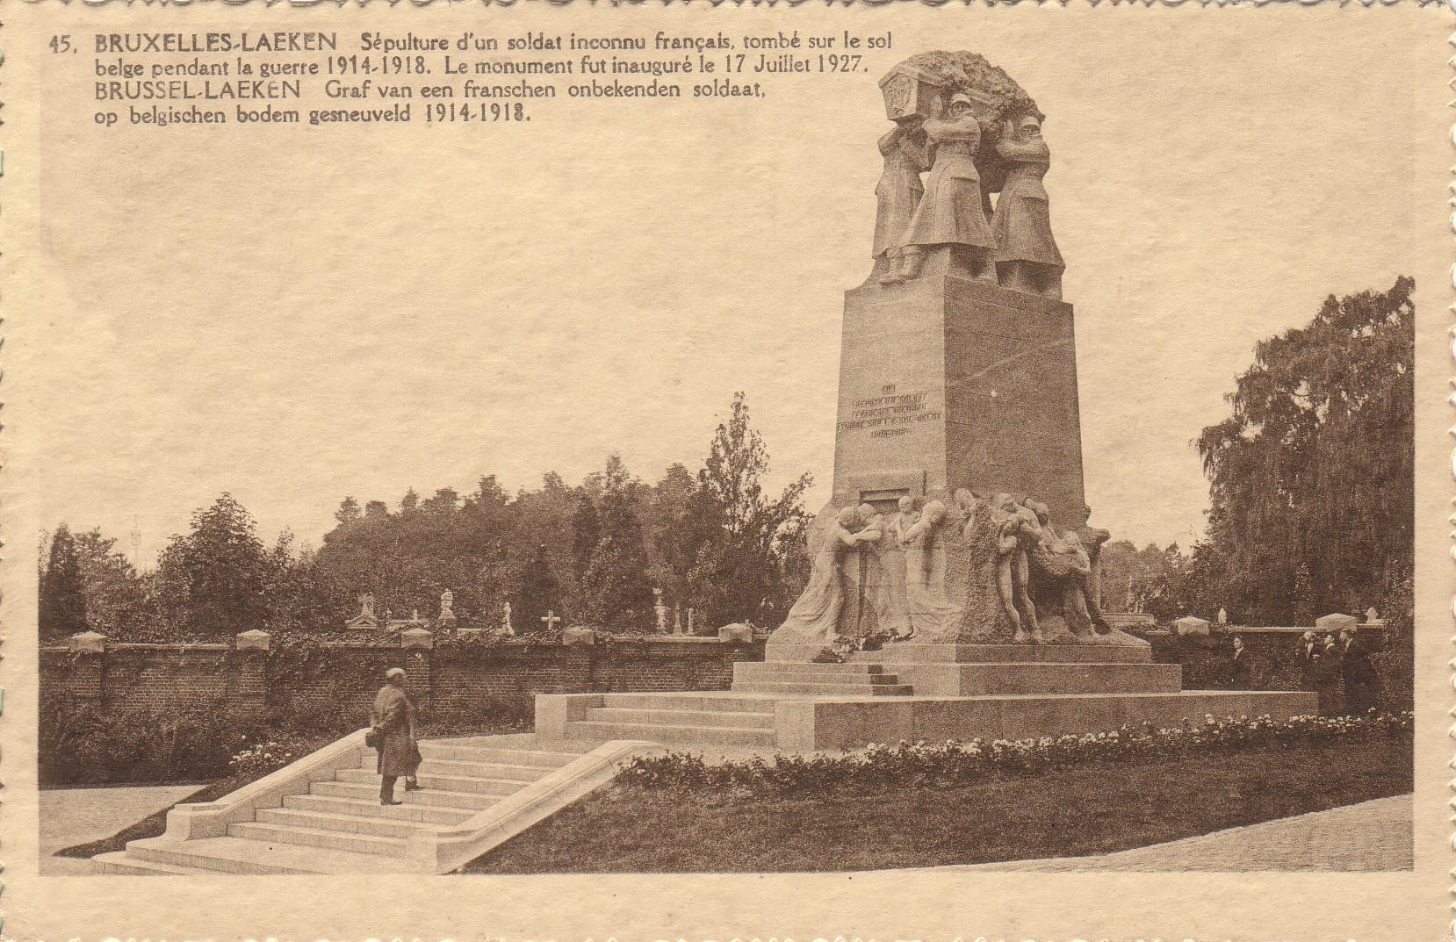
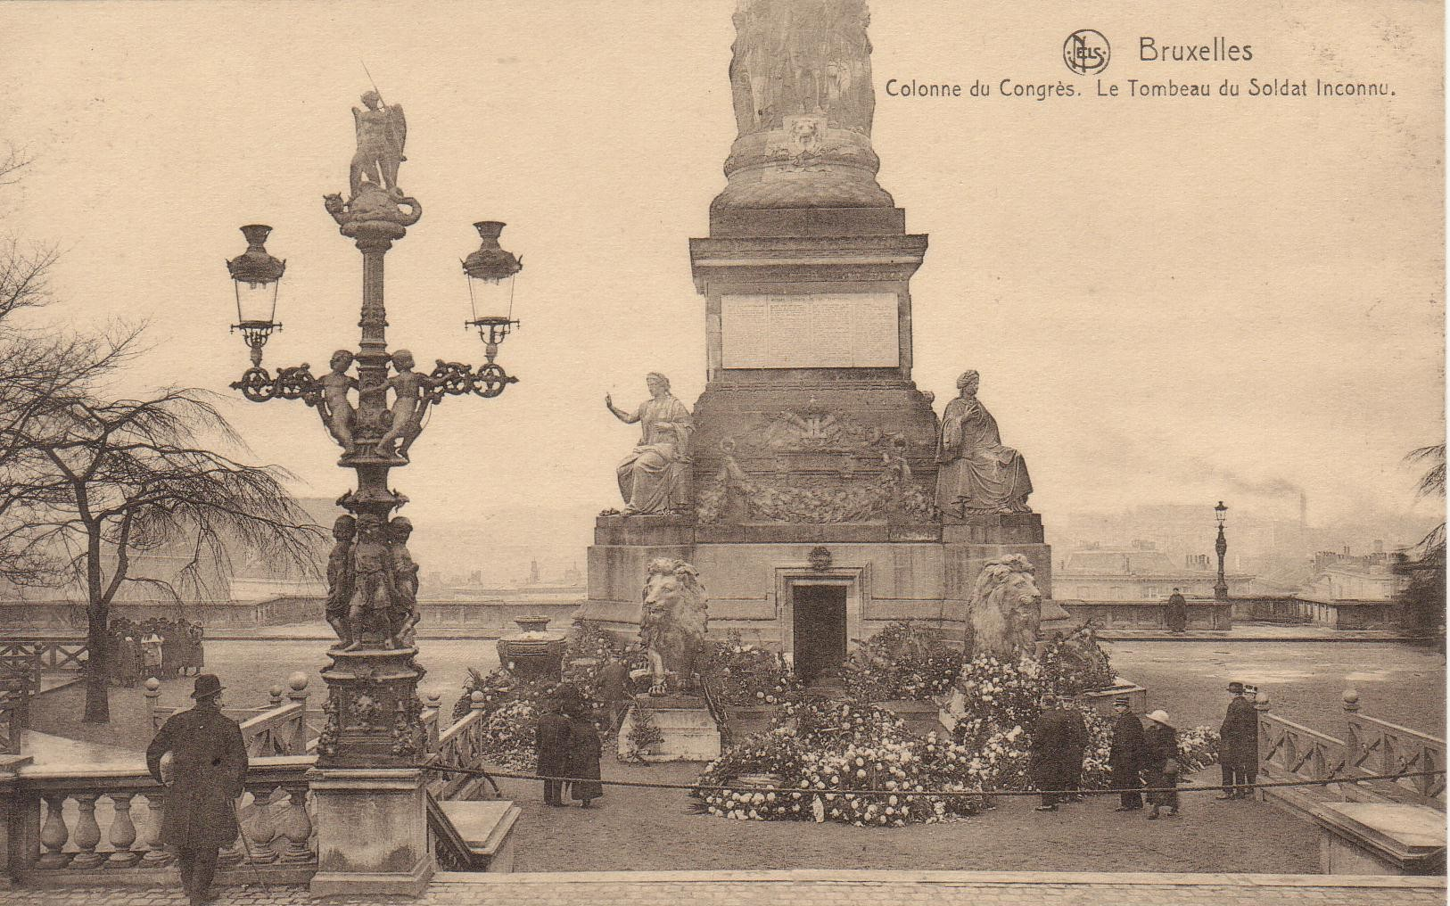
Postcard of the Tomb of the
French Unknown Soldier who fell in the defence of Belgian independence, Belgium, Brussels-Laeken,
inaugurated on July 17, 1927
Postcard of the Tomb of
the Belgian Unknown Soldier,
Brussels, 1923

Slide 11
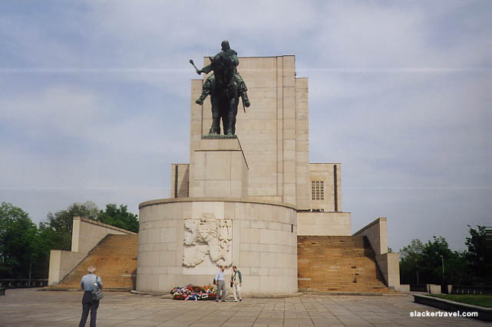
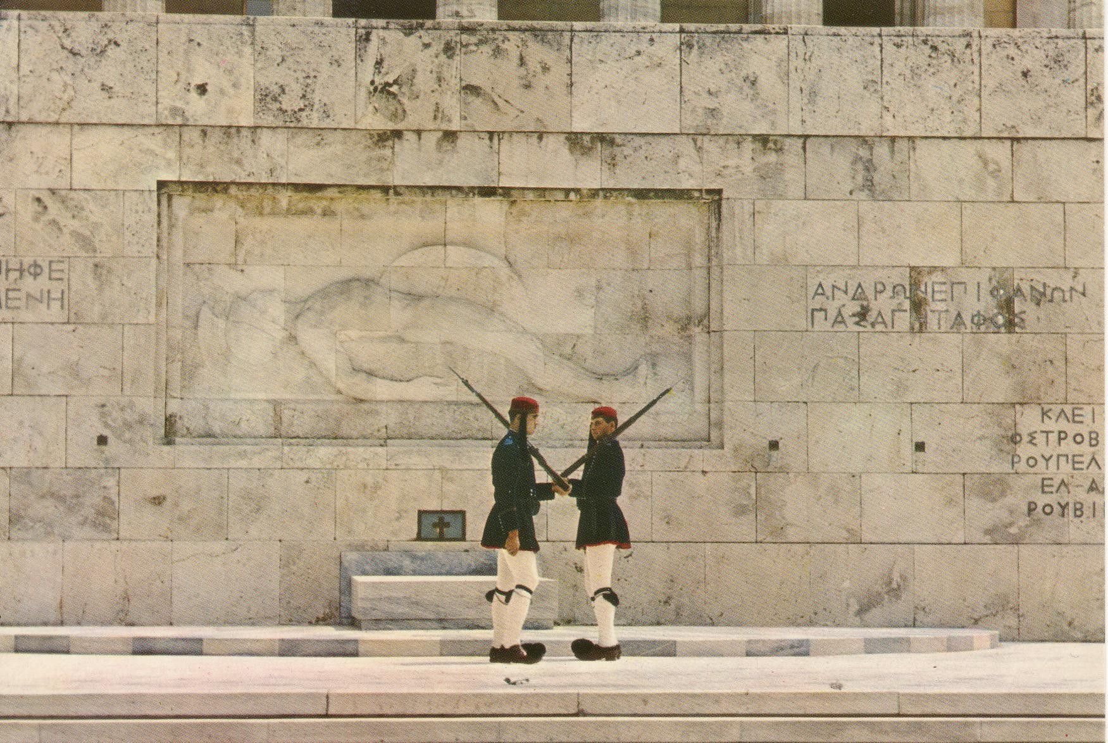
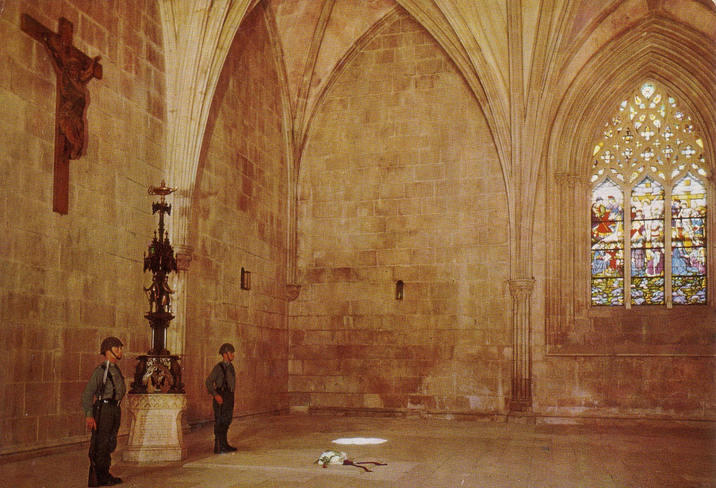
Czechoslovakia/Czech Republic,
Prague, Monument of Jan Zizka
Greece, Athens, Syntagma Square
Portugal, Batalha Monastery

Slide 12
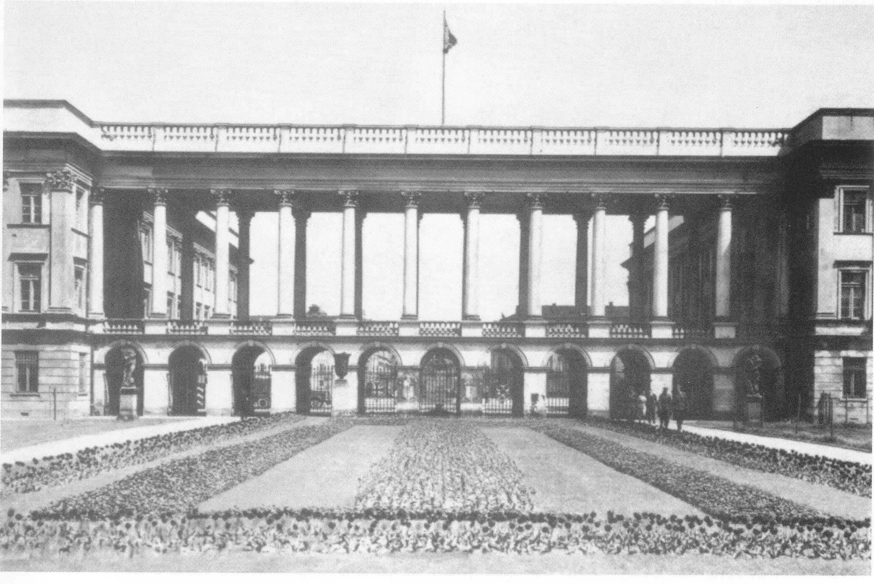
The Saxon Palace, Warsaw
Tomb of the Polish Unknown Soldier in the central arcades, 1925

Slide 13
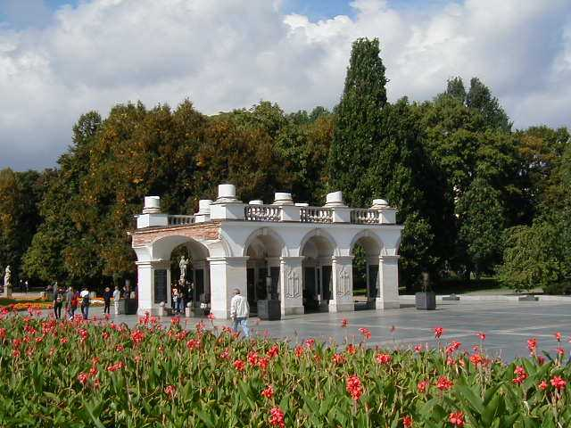
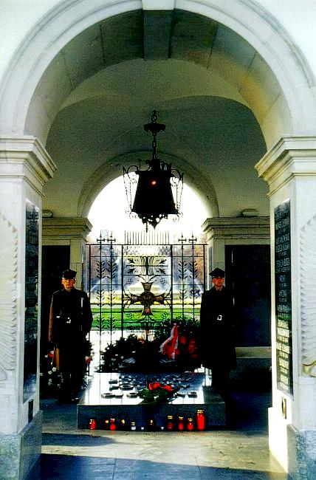
Tomb of the Unknown Soldier, Warsaw, 2001

Slide 14
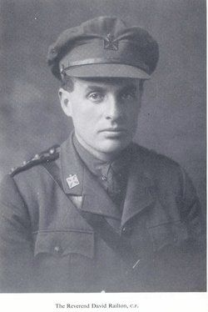
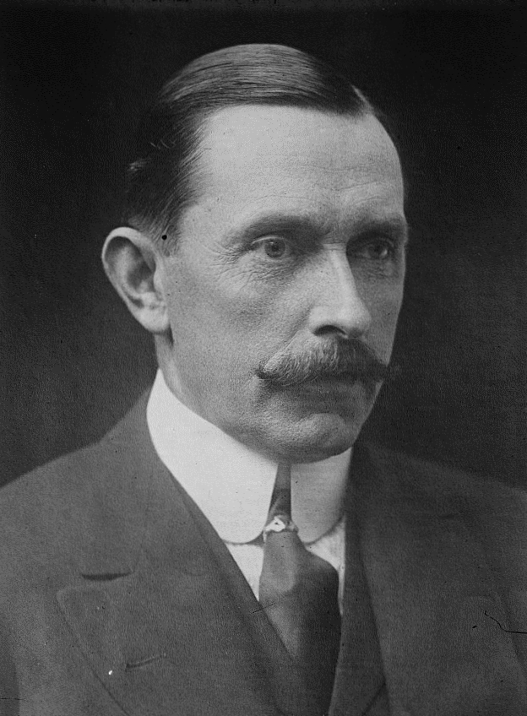
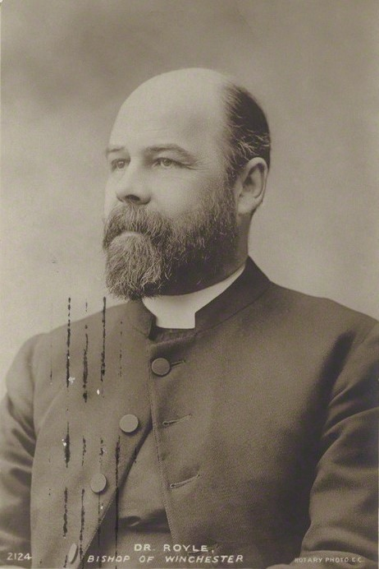
Reverend David Railton
1884-1955
Colonel Wilfrid Ashley, MP
1867-1939
Since 1932 Lord Mount Temple
Herbert Edward Ryle,
1856-1925,
Dean of Westminster 1911-1925

Slide 15
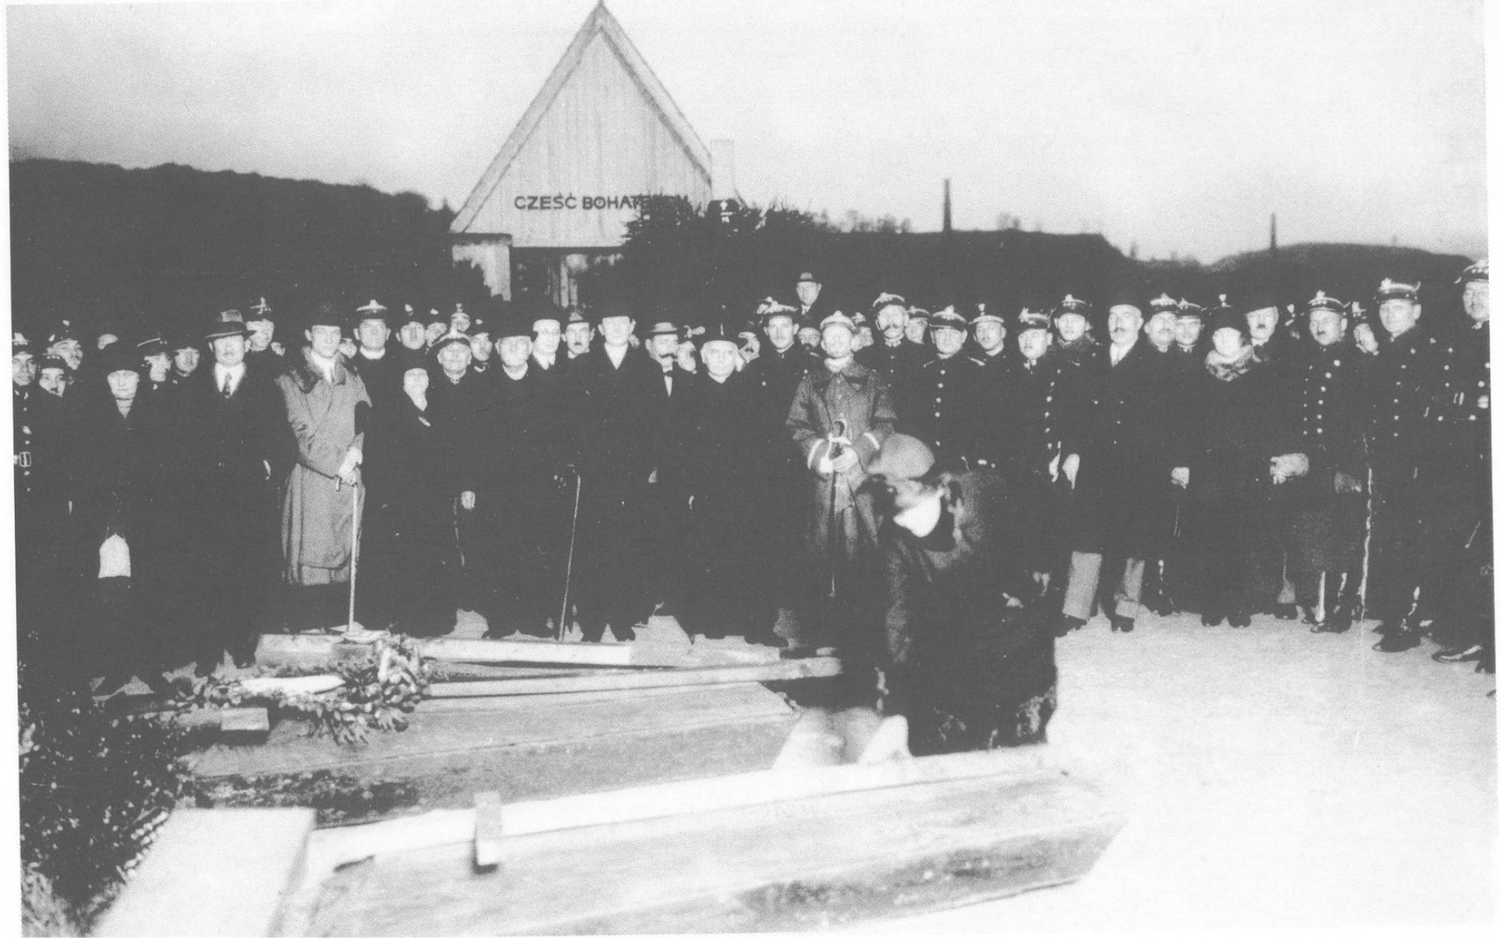
Lwów (Poland), today Lviv (Ukraine), 29 October 1925

Slide 16
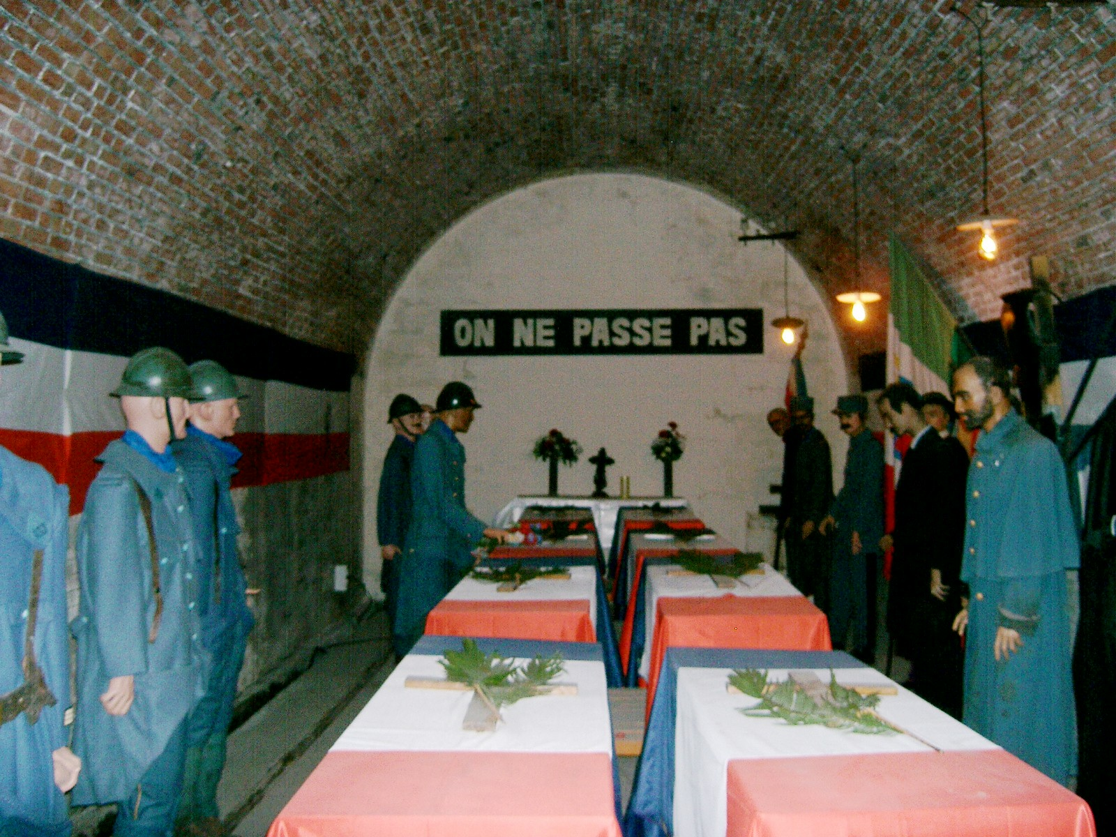
Selection of the French Unknown Soldier in Verdun, Exhibition

Slide 17
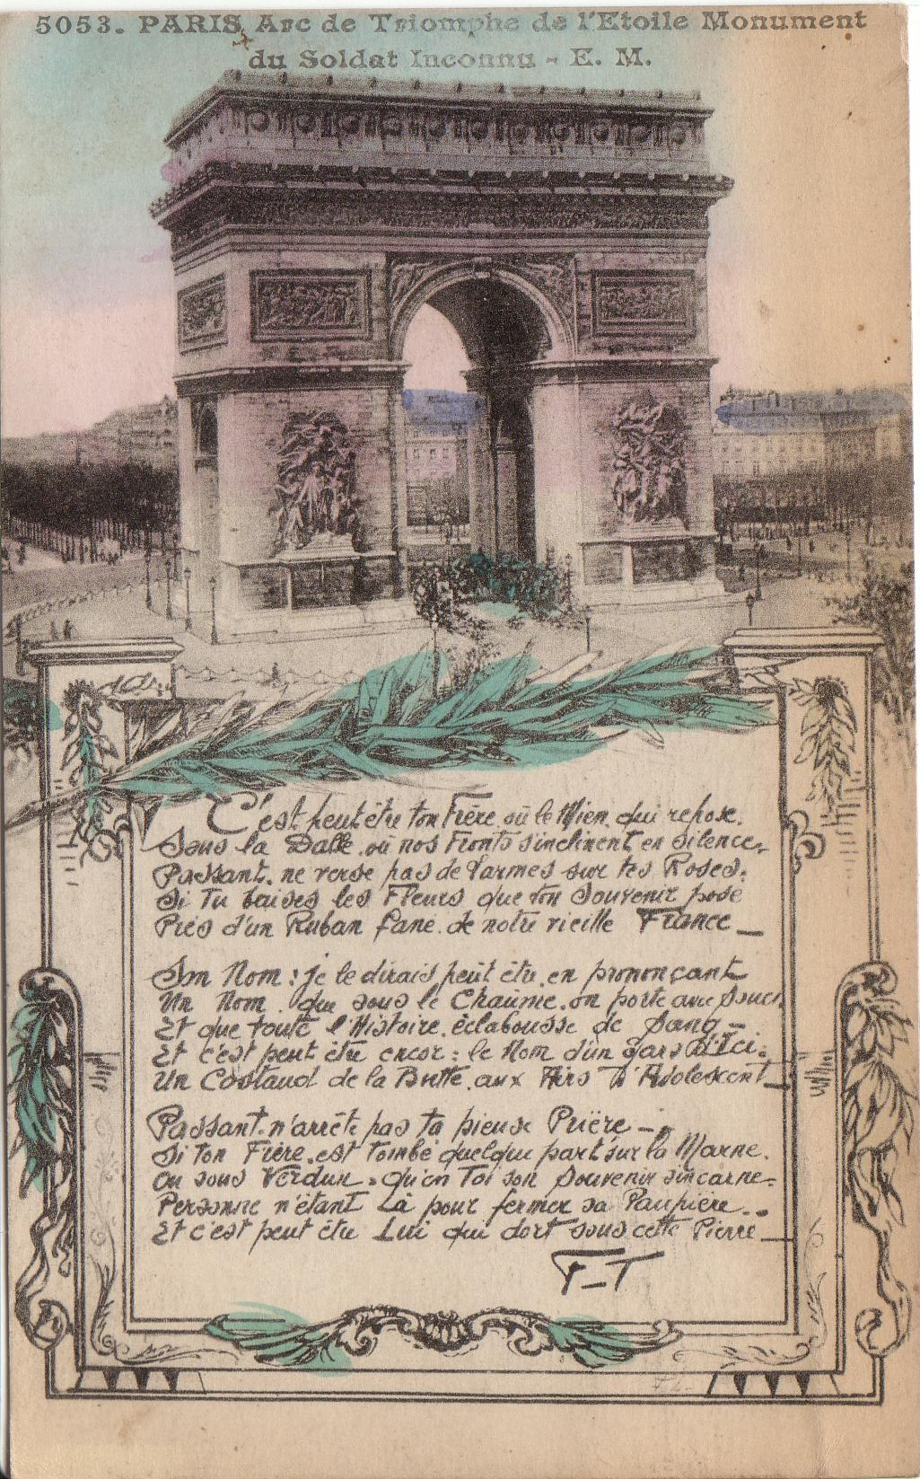
Postcard of the Tomb of the
French Unknown Soldier beneath
the Arc de Triomphe, Paris, 1920

Slide 18
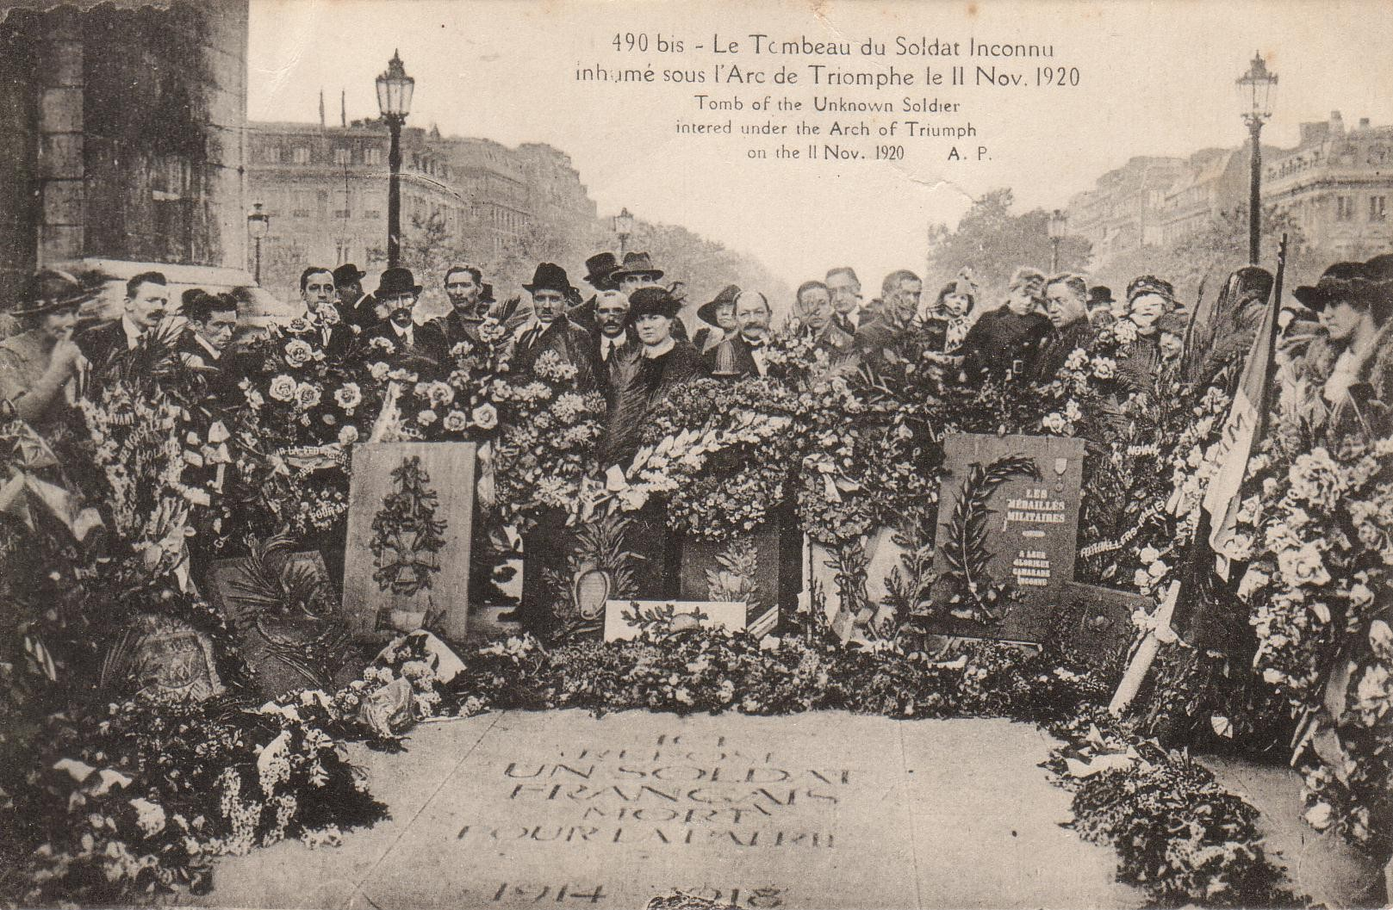
Postcard of the Tomb of the French Unknown Soldier, Nov. 11, 1920

Slide 19
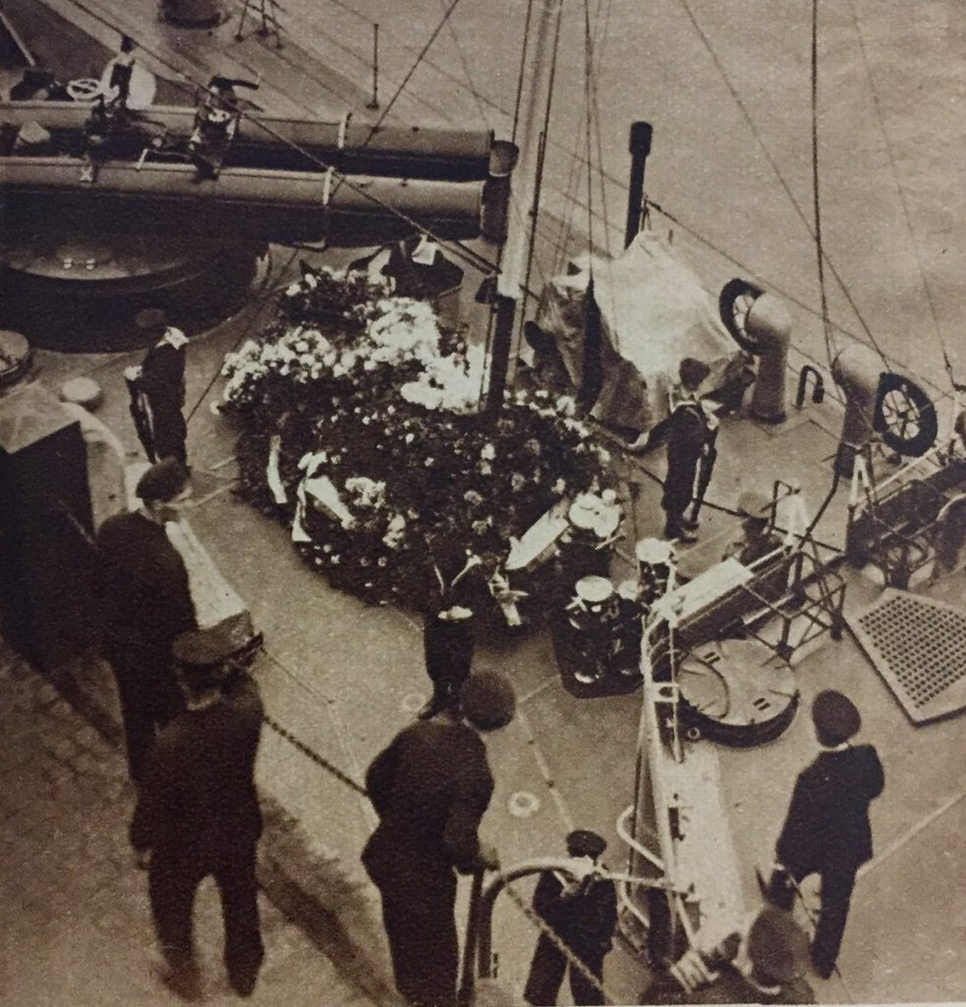
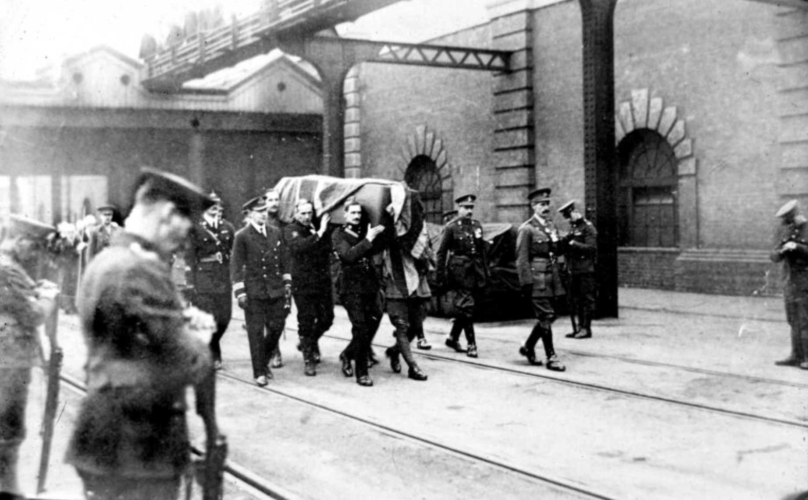
Arrival at the port of Dover on 10 November 1920
The coffin returning on HMS Verdun

Slide 20
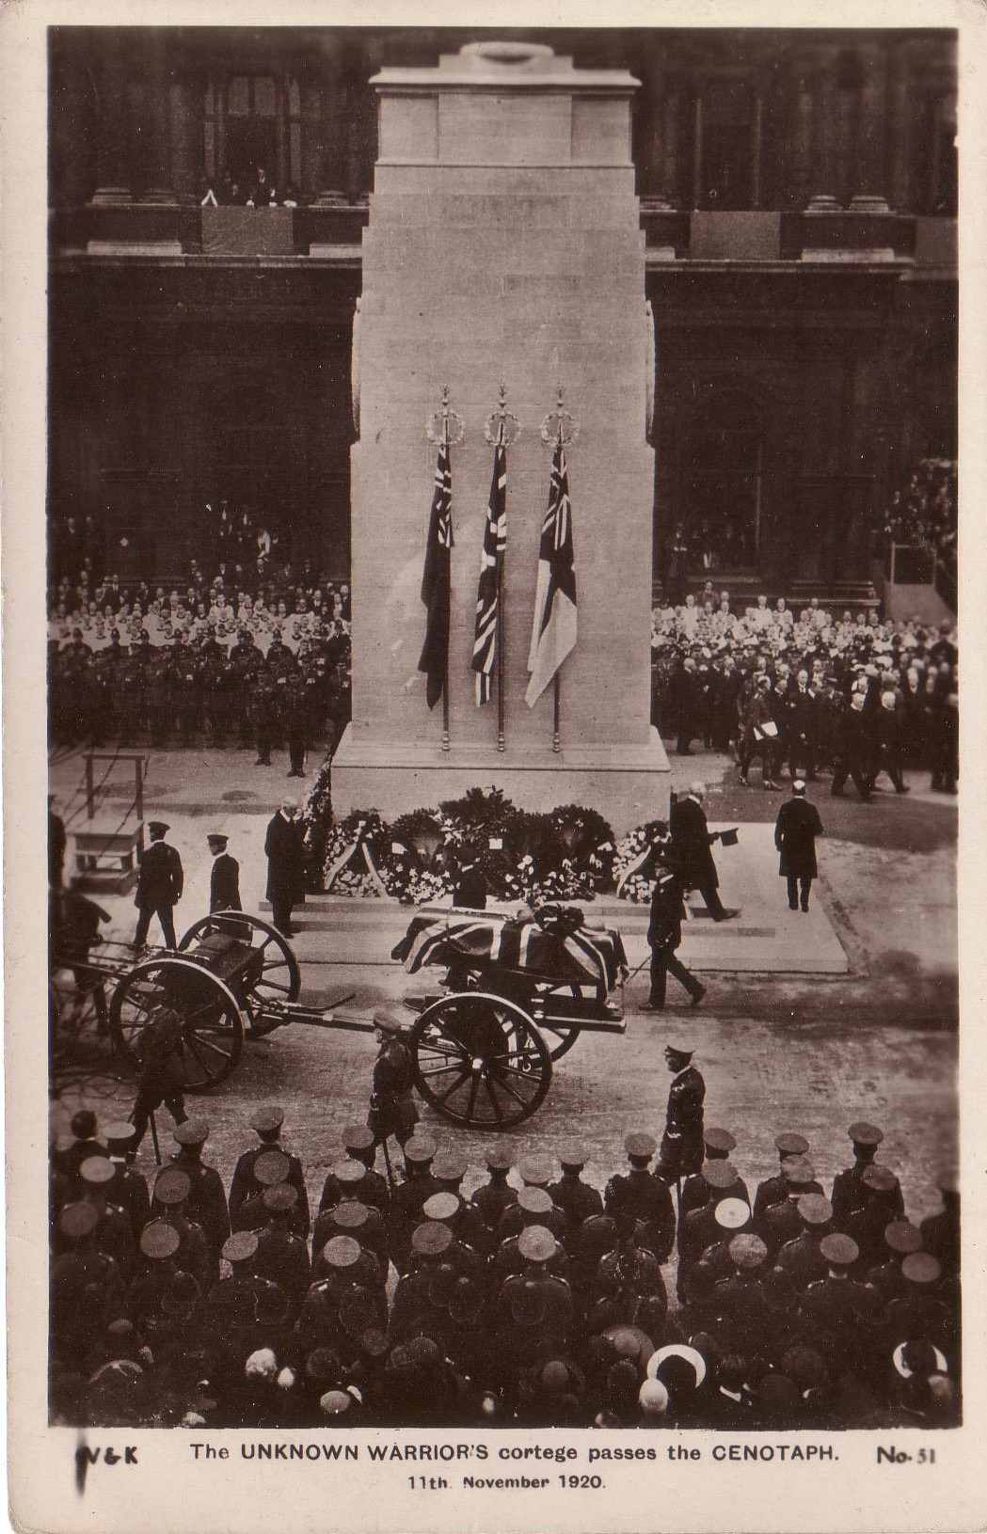
Photograph: The British Unknown
Warrior’s cortege passing the
Cenotaph, November 11, 1920

Slide 21
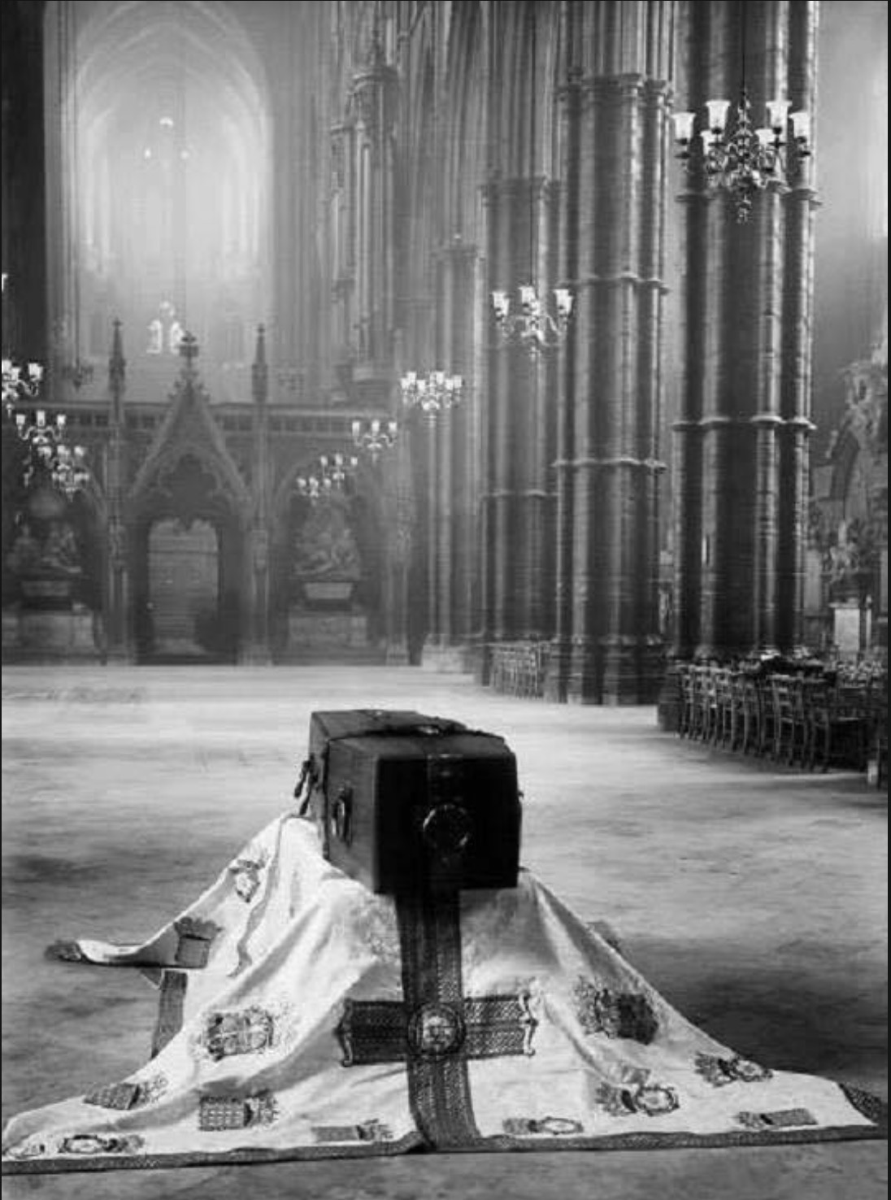
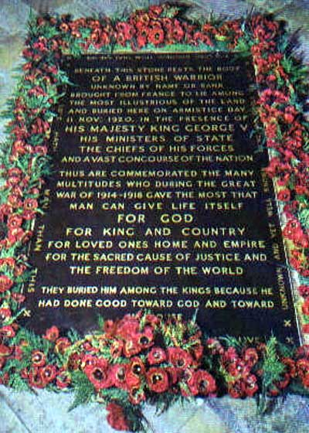
Westminster Abbey,
11 November 1920

Slide 22
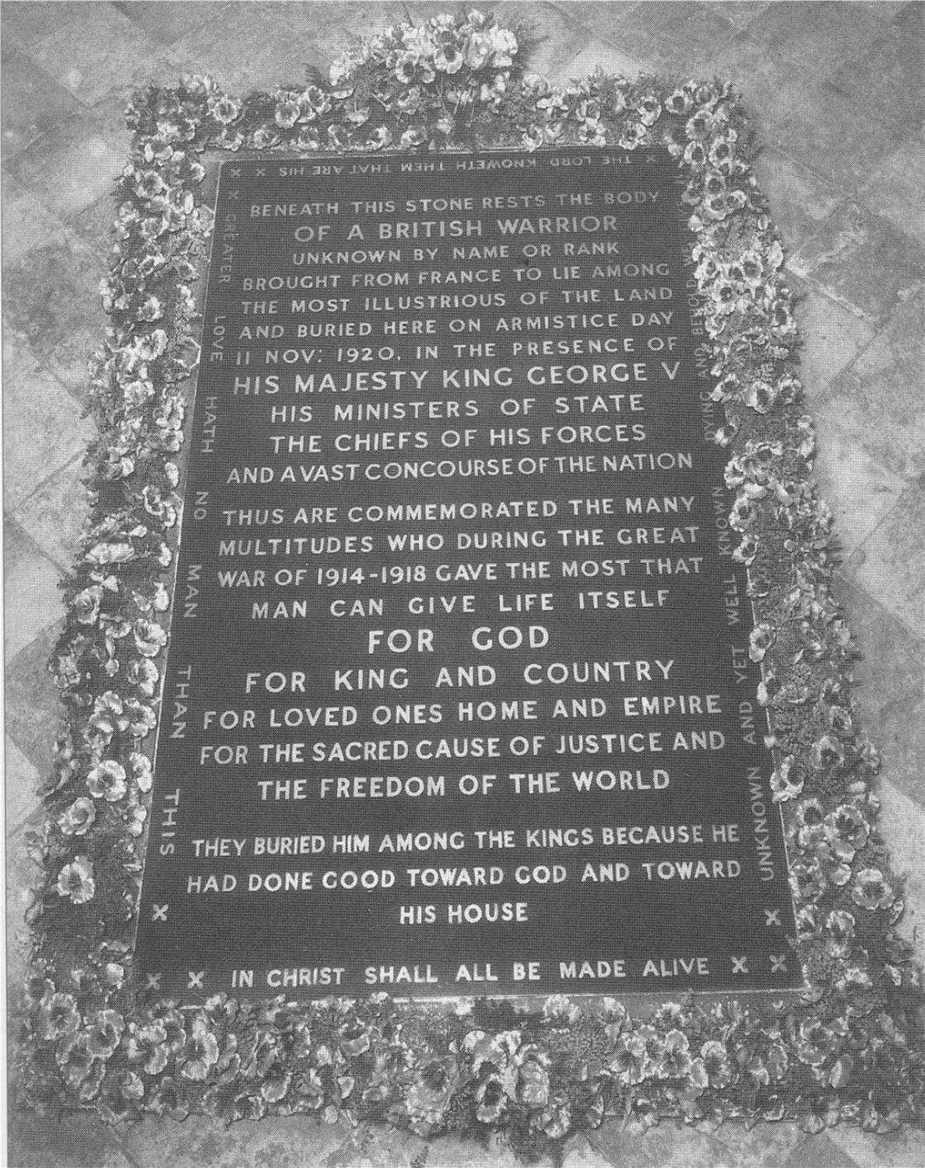
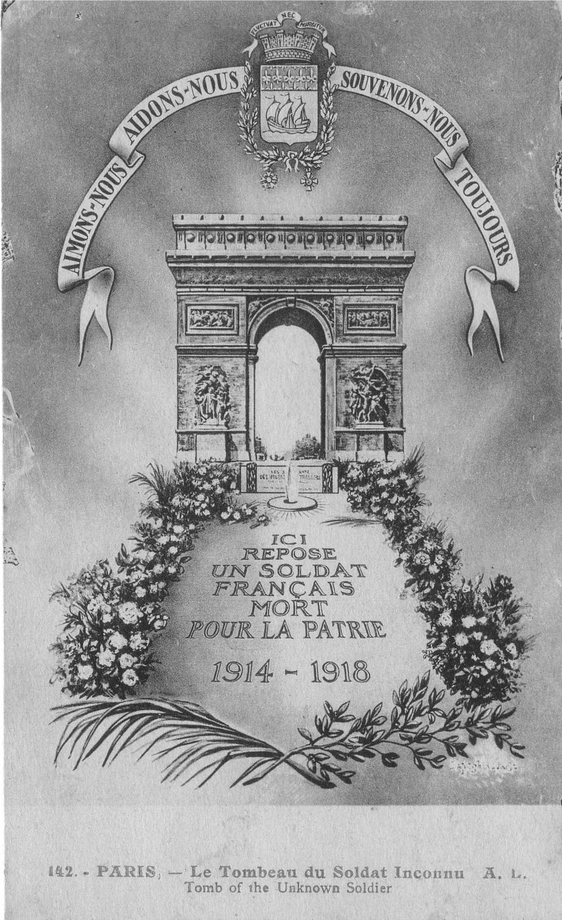
"BENEATH THIS STONE RESTS THE BODY
OF A BRITISH WARRIOR
UNKNOWN BY NAME OR RANK
BROUGHT FROM FRANCE TO LIE AMONG
THE MOST ILLUSTRIOUS OF THE LAND
AND BURIED HERE ON ARMISTICE DAY
11 NOV: 1920, IN THE PRESENCE OF
HIS MAJESTY KING GEORGE V
HIS MINISTERS OF STATE
THE CHIEFS OF HIS FORCES
AND A VAST CONCOURSE OF THE NATION
THUS ARE COMMEMORATED THE MANY
MULTITUDES WHO DURING THE GREAT
WAR OF 1914 - 1918 GAVE THE MOST THAT
MAN CAN GIVE LIFE ITSELF
FOR GOD
FOR KING AND COUNTRY
FOR LOVED ONES HOME AND EMPIRE
FOR THE SACRED CAUSE OF JUSTICE AND
THE FREEDOM OF THE WORLD
THEY BURIED HIM AMONG THE KINGS BECAUSE HE
HAD DONE GOOD TOWARD GOD AND TOWARD
HIS HOUSE "

Slide 23
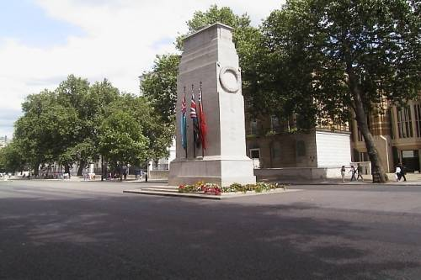

Slide 24
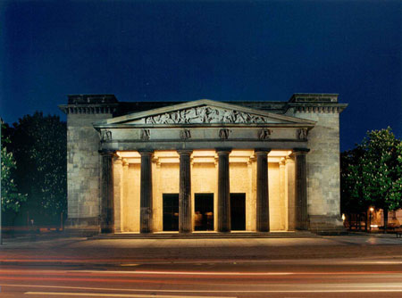
Neue Wache (New Guard House) in Berlin, since 1931 the Prussian (not German) war memorial

Slide 25
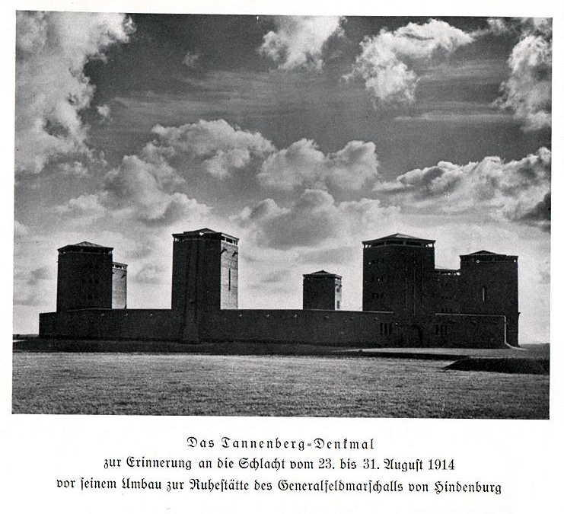
The Tannenberg monument in East Prussia, today Poland (built 1924-1927), commemorating the German victory in the Battle of Tannenberg (August 1914). This monument became the main war memorial of Nazi Germany

Slide 26
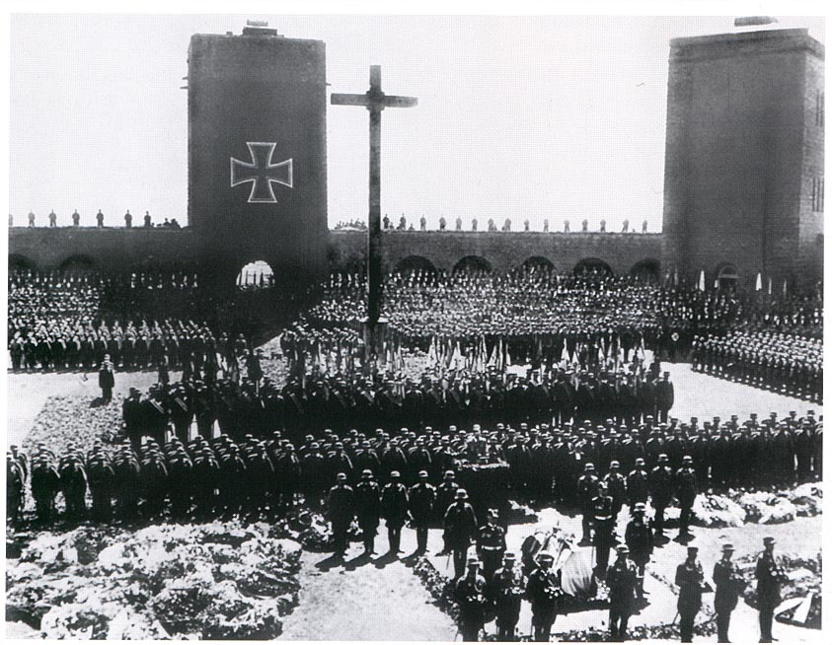
Funeral of the German president, Field Marshal Paul von Hindenburg, August 1934

Slide 27
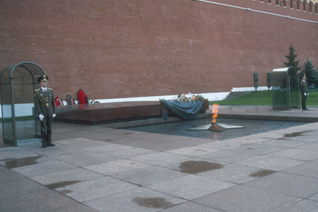
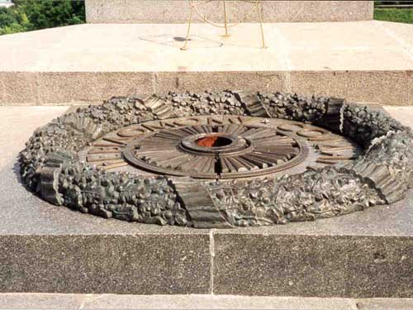
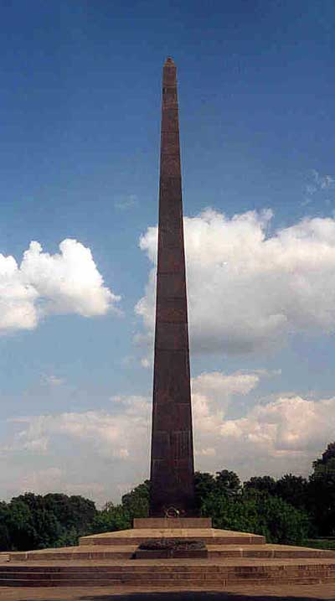
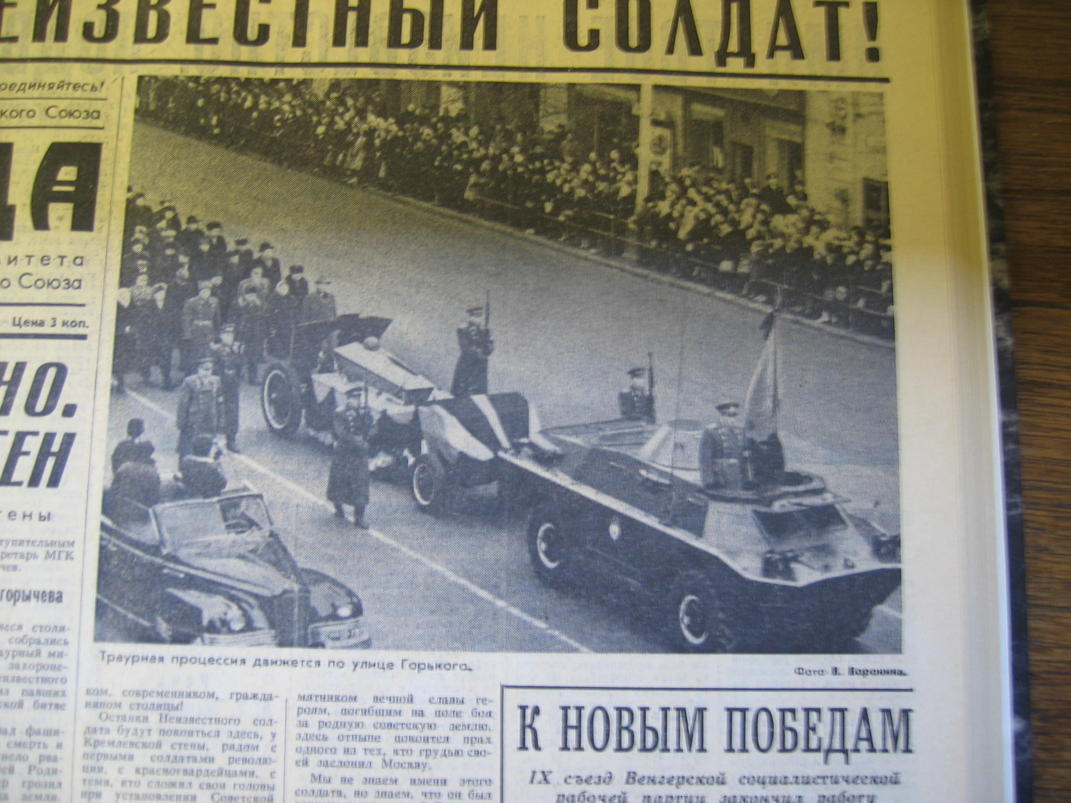
The Ukrainian Unknown Soldier, Kiev,
Park of Immortal Glory
The Soviet Unknown Soldier, Moscow
Kremlin Walls, Alexander Garden

Slide 28
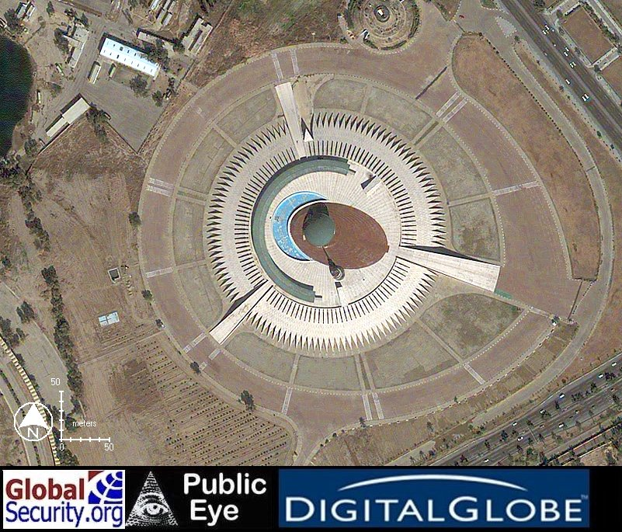
The Iraqi Unknown Soldier, Baghdad

Slide 29
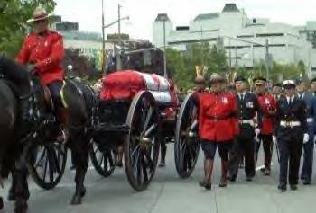
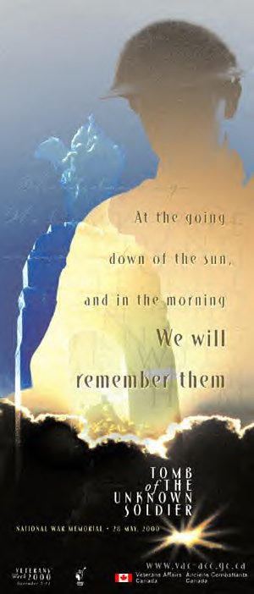
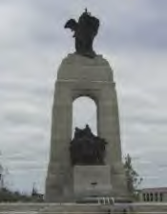
Canada

