Slide 1
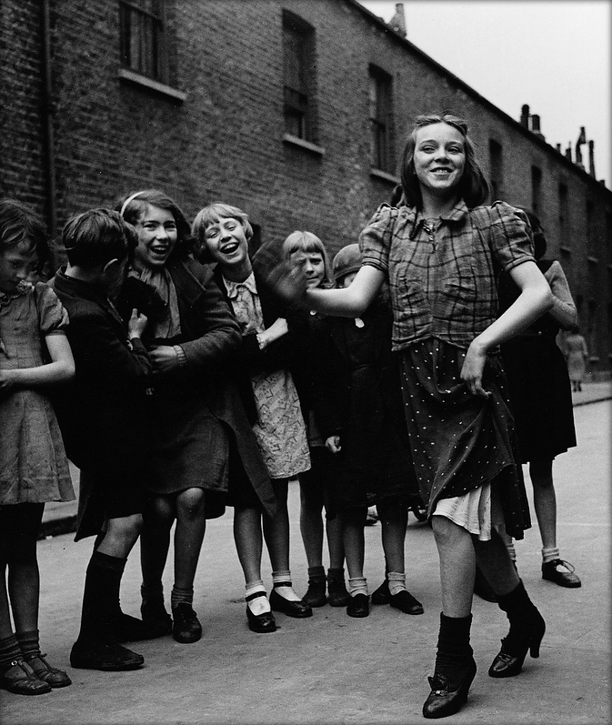
Bill Brandt, East End girl dancing the Lambeth Walk, 1939

Slide 2
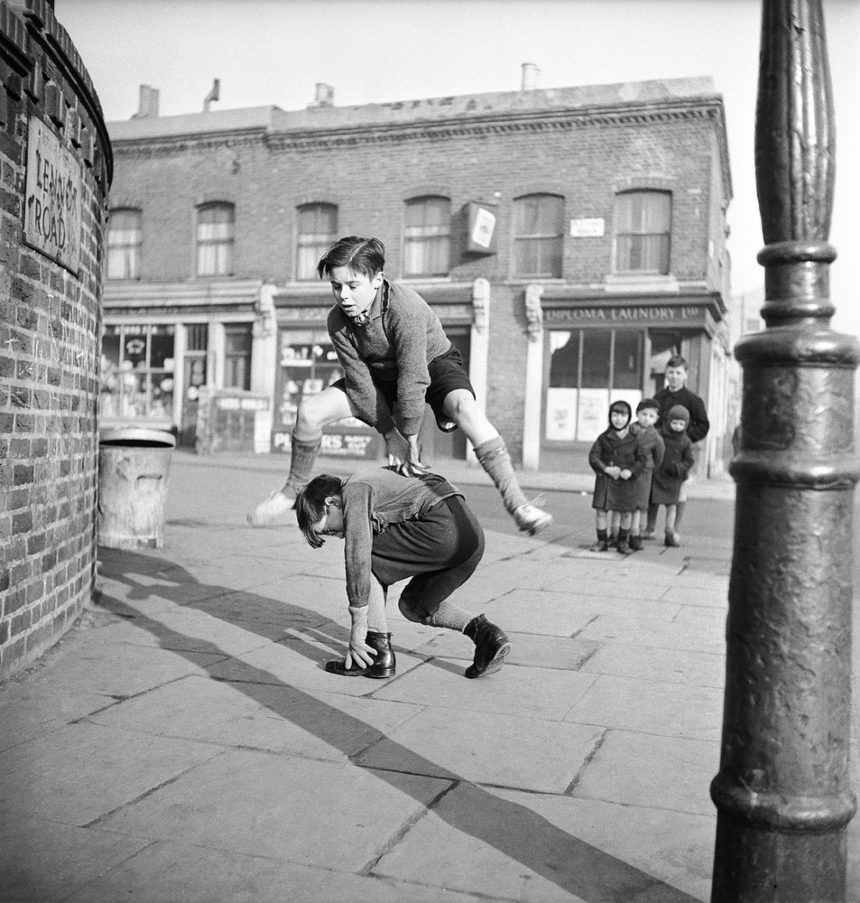
Bill Brandt, 1950

Slide 3
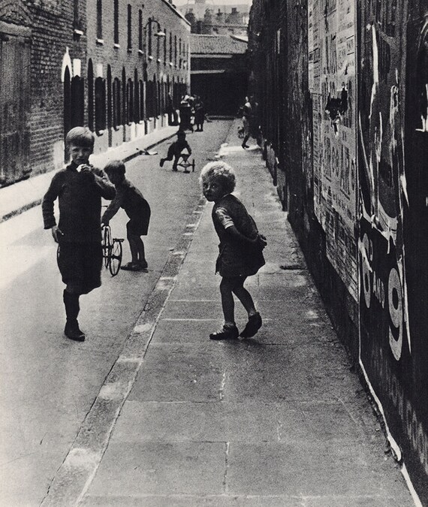
Bill Brandt, c1930s

Slide 4
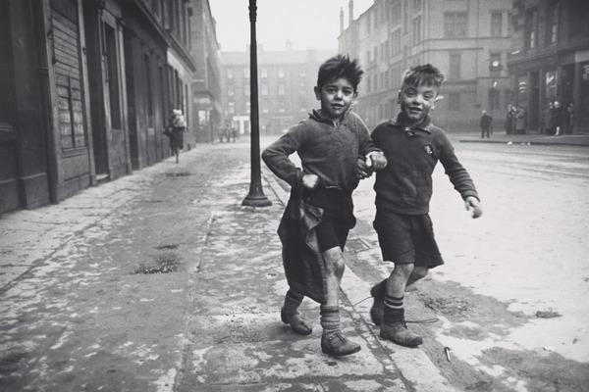
Bert Hardy, Picture Post, 1948

Slide 5
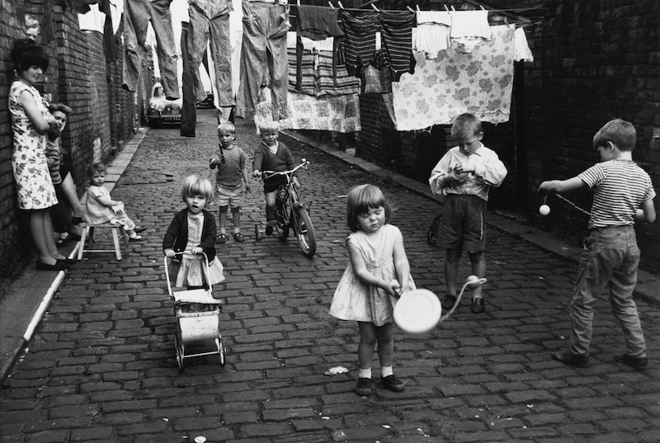
Shirley Baker, Manchester, 1966

Slide 6
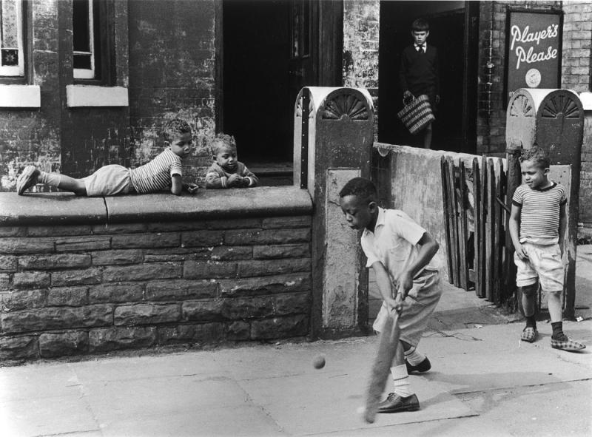
Shirley Baker, Manchester, 1964

Slide 7
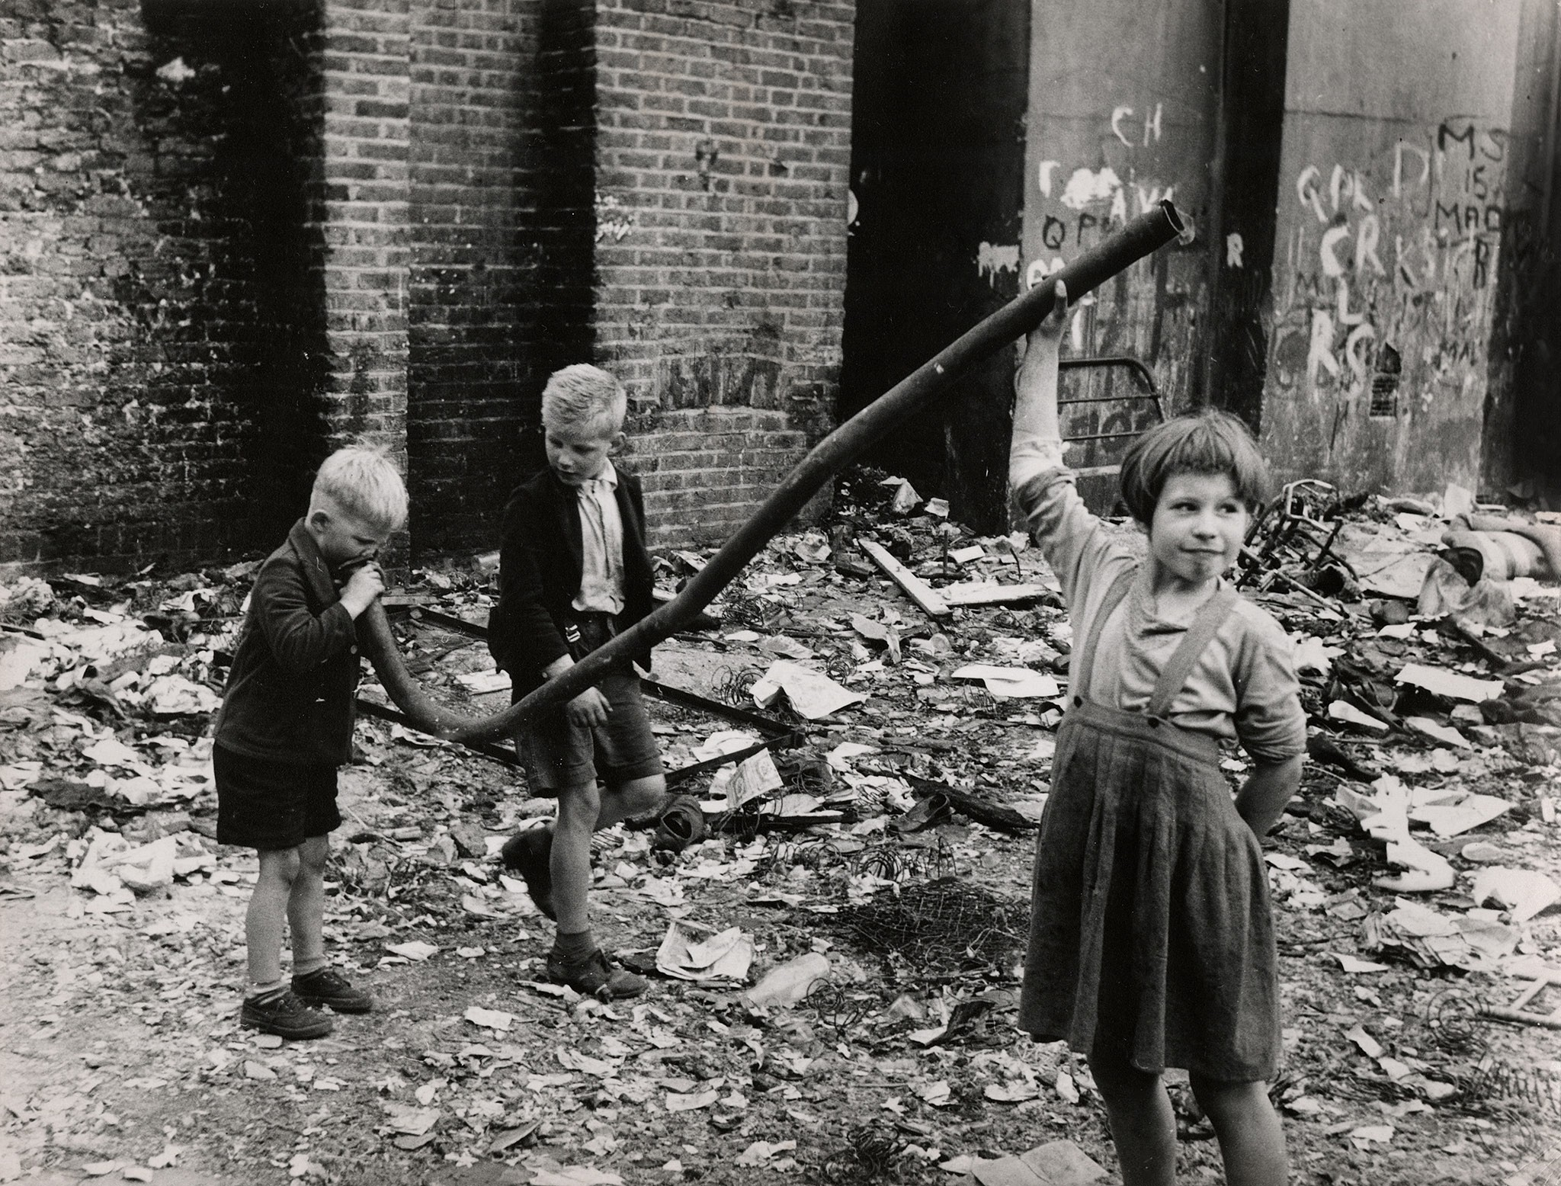
Roger Mayne, London,1957

Slide 8
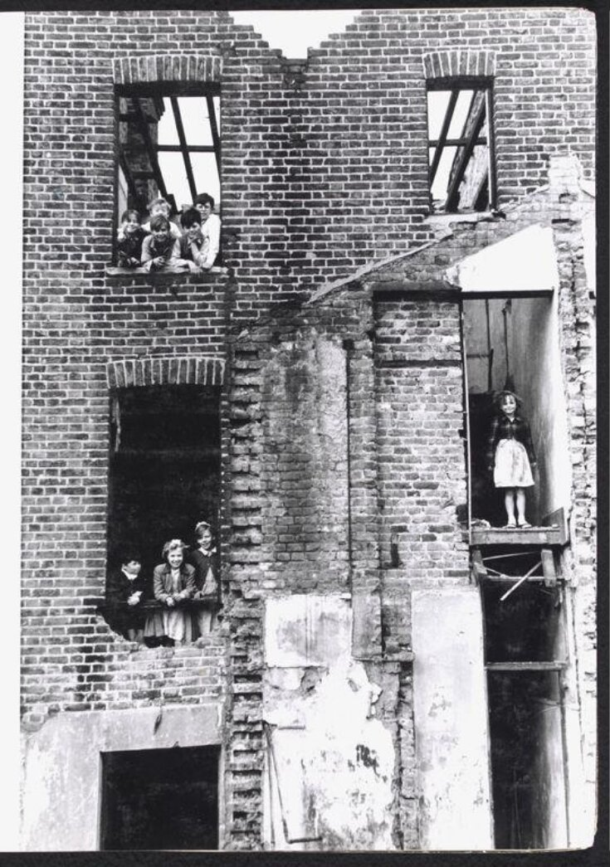
Roger Mayne, London,1956

Slide 9
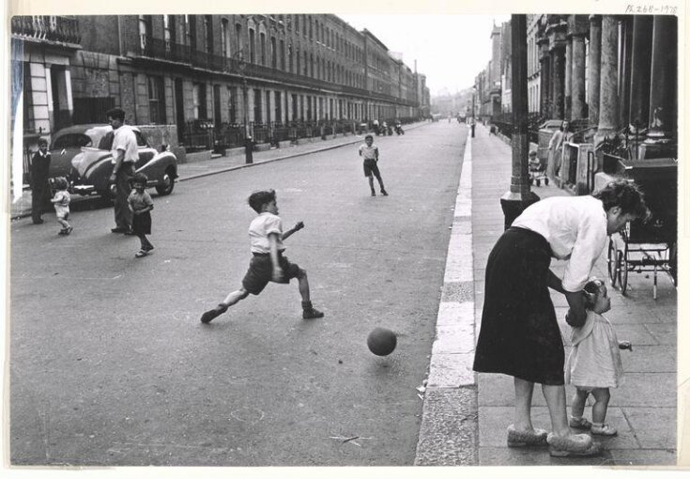
Roger Mayne, London,1956

