Slide 1
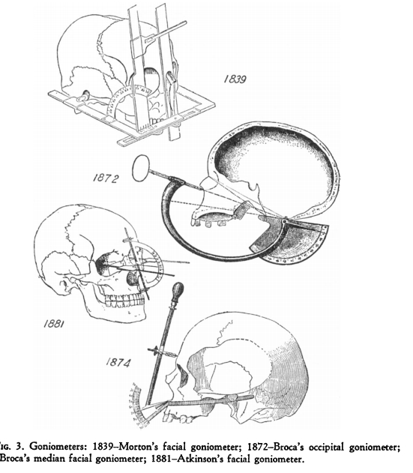

Craniometry and the Construction of Anti-Popular Racial Science in Victorian Britain
Elise Smith
University of Warwick
E.Smith.10@warwick.ac.uk
Lucile E. Hoyme, ‘Physical Anthropology and its Instruments: An Historical Study, (1953)

Slide 2
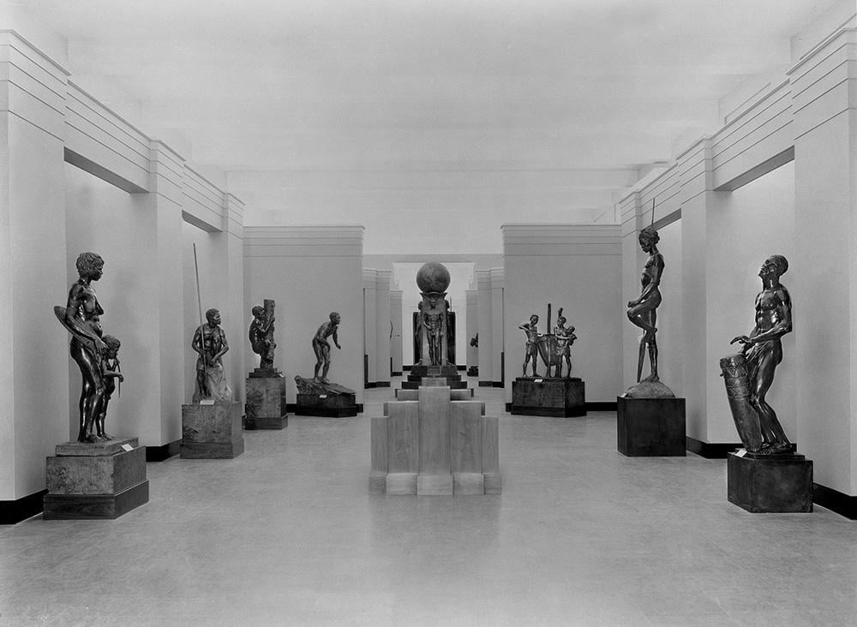
1933: The Races of Mankind
‘The eye, at a single glance, picks out the racial features more certainly than could a band of trained anthropologists, who depend on measurements to distinguish Negro, Indian, or Chinaman from European […] The aim of the professional anthropologist is to tabulate […] racial features and to measure them; but so numerous are they, so shifting and indeterminate in nature, that scientific measurement can never rival the accuracy and completeness of the rule of thumb method practiced by the man in the street.’
Arthur Keith, ‘Introduction’ in Henry Field, The Races of Mankind: An Introduction to Chauncey Keep Memorial Hall (1933)
The Races of Mankind
Chicago World’s Fair (1933)

Slide 3
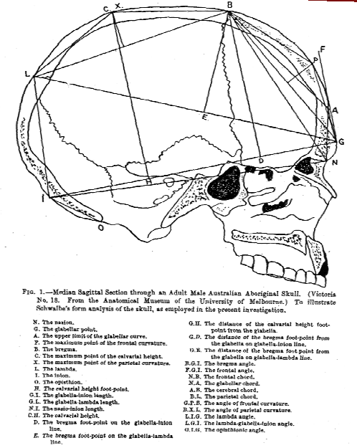
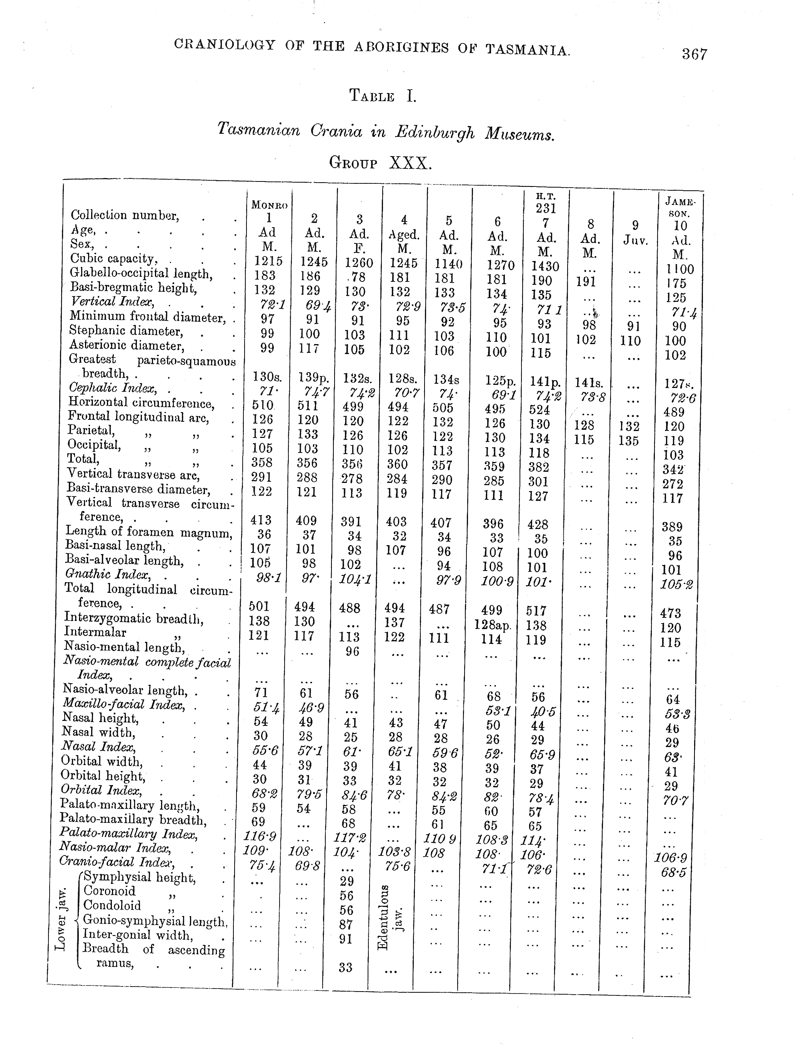
R. J. A. Berry and A. W. D. Robertson, ‘The Place in Nature
of the Tasmanian Aboriginal as Deduced from a Study of his Calvarium’ (1910-1911)
William Turner, ‘The Craniology, Racial Affinities, and Descent of
the Aborigines of Tasmania’ (1908)

Slide 4
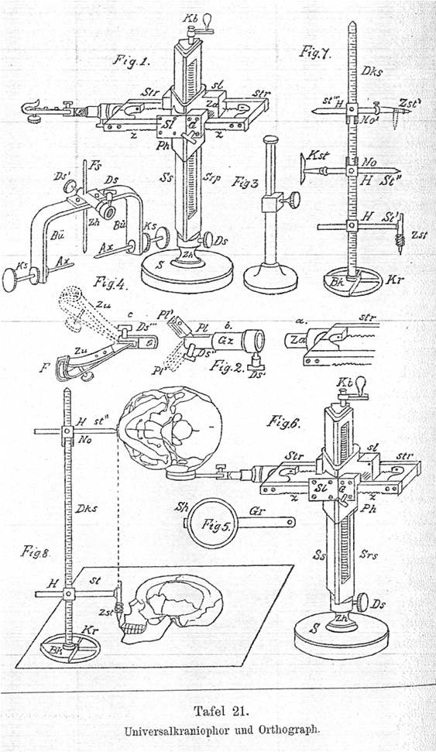
‘Universalkraniometer’
Aurel von Torok, Grundzüge einer systematischen Kraniometrie
(Stuttgart, 1890)

Slide 5
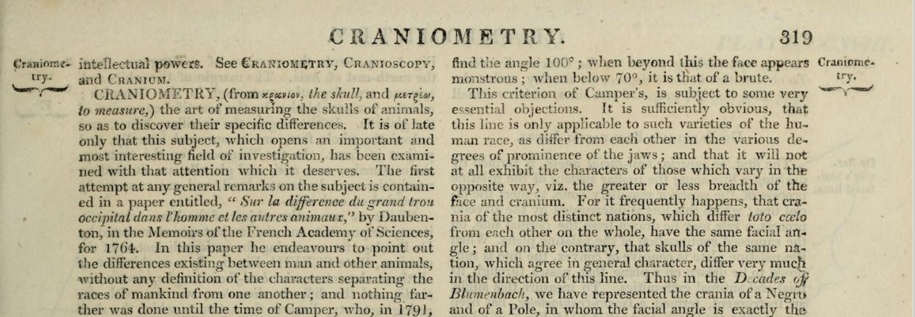
‘The Art of Measuring Skulls….’
William Elford Leach, ‘Craniometry’, Edinburgh Encyclopedia, (1830)

Slide 6
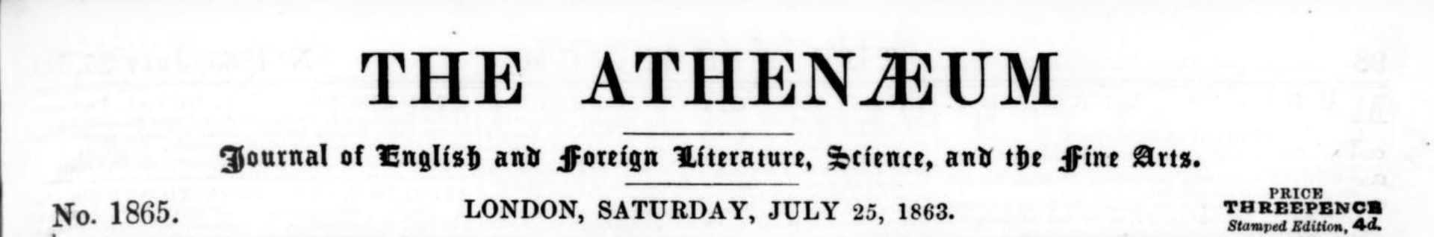
‘No science has suffered more from being played with by amateurs’ with the consequence that ‘the study of the people inhabiting our earth, is scarcely more than a confused mass of ill-observed facts and unsound conclusions. It can no longer be concealed that for truly scientific purposes all that has hitherto been written on the subject is little better than waste paper.’
Athenaeum, no. 1865 (25 July 1863), p. 106.

Slide 7
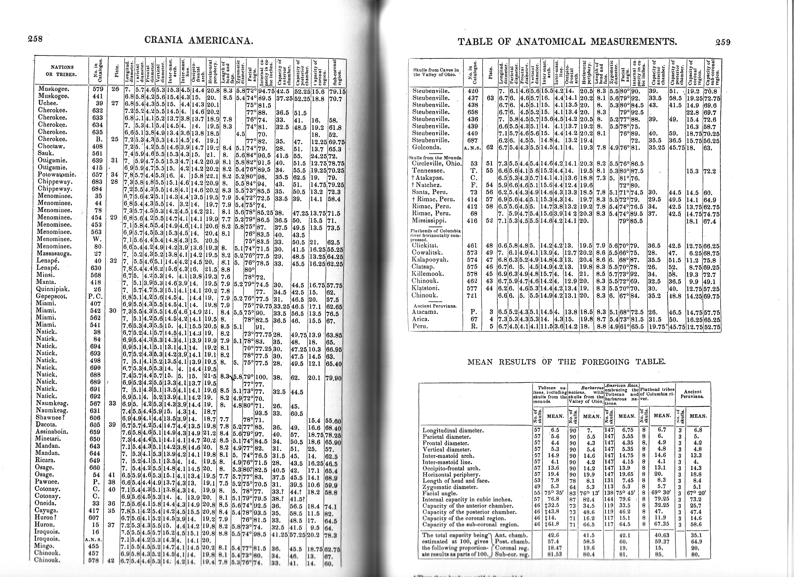
Samuel George Morton
Crania Americana (1839)

Slide 8
‘[Crania Americana is a work] equally remarkable for the profundity of its anatomical views, the numerical detail of the relations of organic conformation, the absence of those poetical reveries which are as the myths of modern physiology, and the generalizations with which your Introductory Essay abounds.’
-Alexander Humboldt to Samuel George Morton, 17 January, 1844
Craniometry as Humboldtian Science

Slide 9
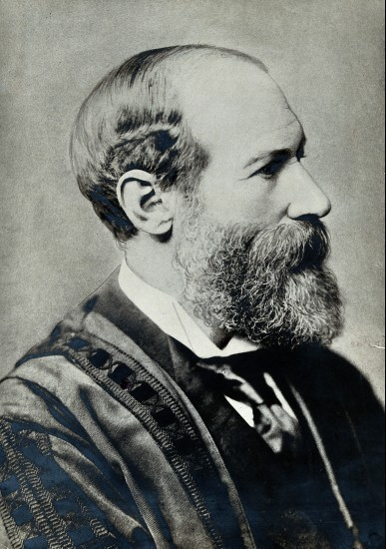
Craniometry as Stamp Collecting
‘‘[…] Craniometric literature is at present as unsatisfactory as it is dull. […] Scores of lines, arcs, chords, and indexes have been devised for this purpose, and the diagnosis of skulls has been attempted by a process as mechanical as that whereby we identify certain issues of postage-stamps by counting the nicks in the margin. But there is underlying all these no unifying hypothesis, so that when we, in our sesquipedalian jargon, describe an Australian skull as microcephalic, phaenozygous, tapeino-dolichocephalic, prognathic, platyrhine, hypselopalatine, leptostaphyline, dolichuranic, chamaeprosopic, and microseme, we are no nearer to the formulation of any philosophic concept of the general principles which have led to the assumption of these characters by the cranium in question […].’
-Alexander Macalister, ‘President’s Address to Section H: Anthropology’, Proceedings Of the British Association for the Advancement of Science (1892)
Alexander Macalister (1844-1919)

Slide 10
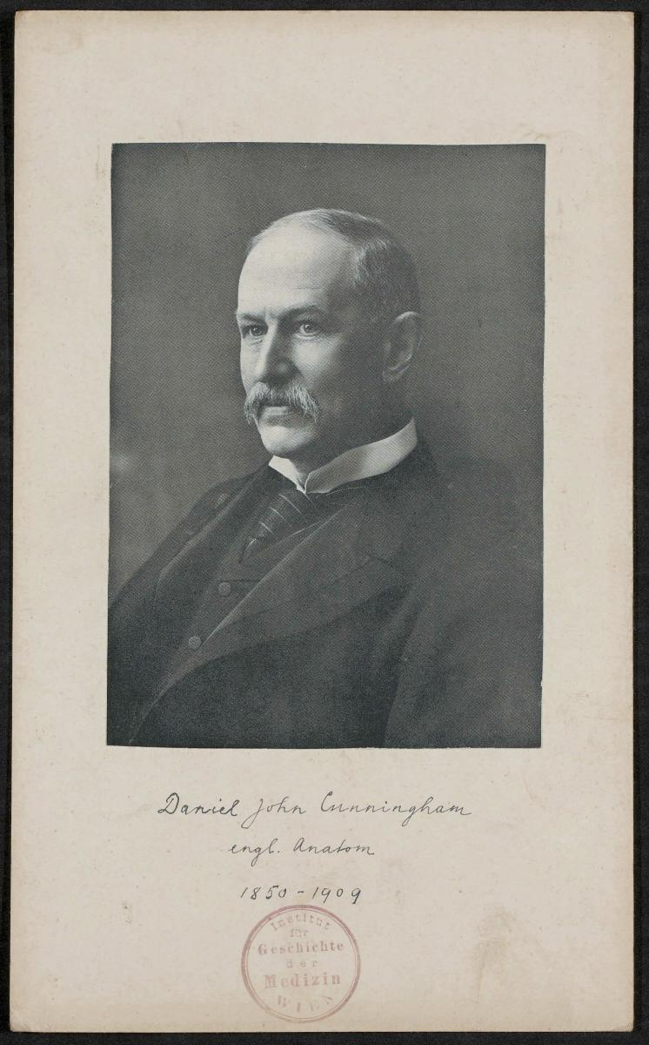
The ‘Spoiled Child of Anthropology’
‘[The average craniologist lies] buried beneath a mighty mountain of figures, many of which have little morphological value and possess no true importance in distinguishing the finer differences of racial forms.’
-Daniel John Cunningham, ‘Opening Address, Section H: Anthropology’ Nature (1901)

Slide 11
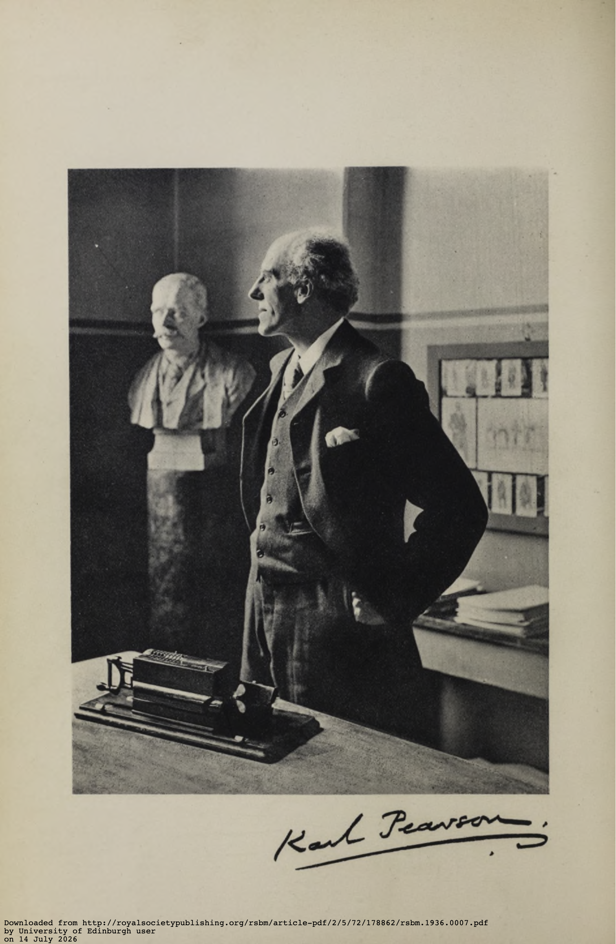
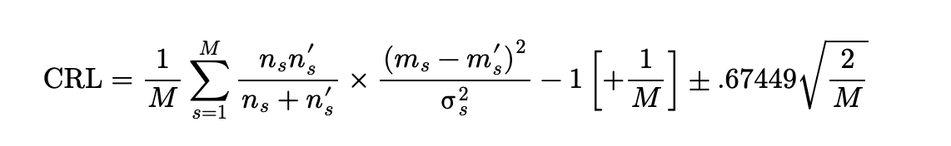
‘There is a mathematical science of statistics that must be learnt….’
Coefficient of Racial likeness:

