Slide 1
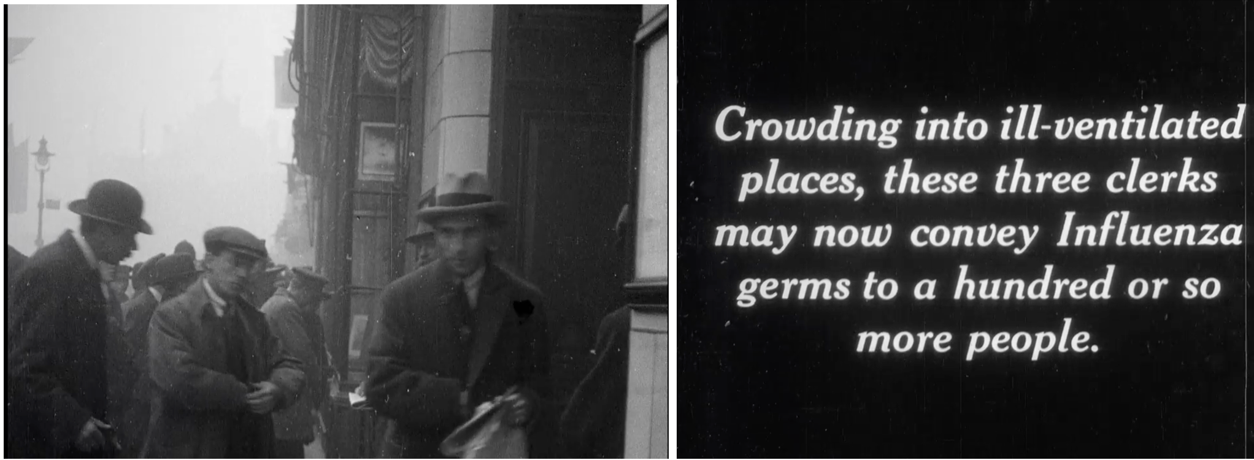
Track, Test, and Blame: Tracing ‘Contacts’ In British Contagion Narratives, c. 1850-1920
Elise Smith
Department of History
University of Warwick
e.smith.10@warwick.ac.uk

Slide 2

https://warwick.ac.uk/fac/sci/psych/research/lifespan/contain/

Slide 3
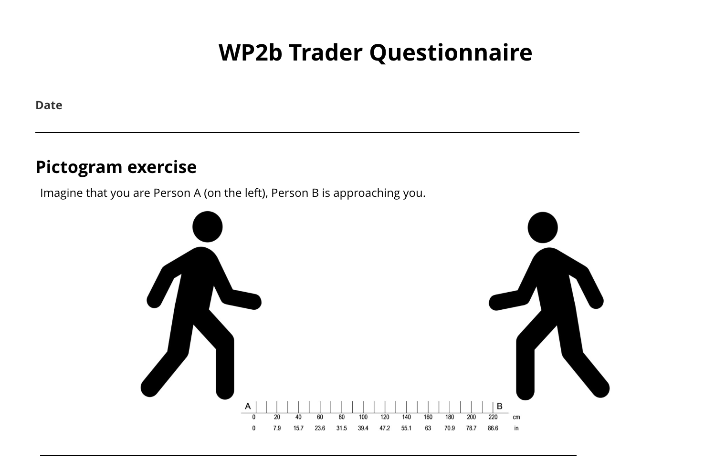

Slide 4
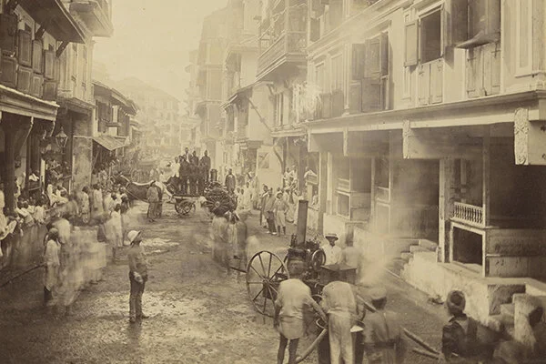
“In the general history here, there were three sepoys, who resided continuously from the first appearance of the epidemic, inhaling at every inspiration by day and night, mouthfuls of infection….
“Nor of six dooly bearers, changed daily, and who used to assist the sick into and out of the bath, and in every other way; thereby exposed to be infected with the disease, whether it is conveyed through the medium of the atmosphere, or by touch; and yet I have not known one instance of dooly bearers, friends, and attendants of the sick being so infected.”
Assistant Surgeon Whyte to Dr. Milne, 7th Sept 1818

Slide 5
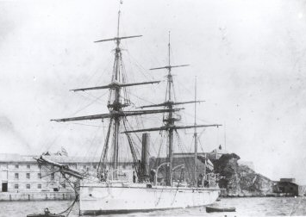
“One case had terminated fatally in the Naval Hospital on the 6'th of July, but whether the person had been exposed to the infectious emanations from the latter it is impossible to find out. It is sufficient to notice that the disease was not extinct in the neighbourhood […]”
-Alexander Bryson, ‘On the Recent Introduction of Yellow Fever Into Port Royal, Jamaica’ (1862)

Slide 6
‘It has thus been shown, on evidence which cannot well be disputed:
That the crew of the “Icarus” brought the fever to Port Royal.
That they infected the boat’s crew sent from the “Imaum” to remove the sick to the hospital.
That the boat’s crew next infected their shipmates in the “Imaum.”
The sick of the “Icarus” communicated the fever to the boat’s crew sent from the “Hydra” who infected their shipmates.
That the crew of the “Barracouta” were infected by the men and boys sent from the “Imaum”
The yellow fever patients sent to hospital infected other patients who had been in the hospital previously to the arrival of the “Icarus.”
‘Thus out of one focus or centre of infection three or four distinct centres were established within the space of a few weeks; each ship being capable of transmitting the disease to other ships, or to distant European colonies within the tropics, where, probably, it had never been heard of before.’

Slide 7
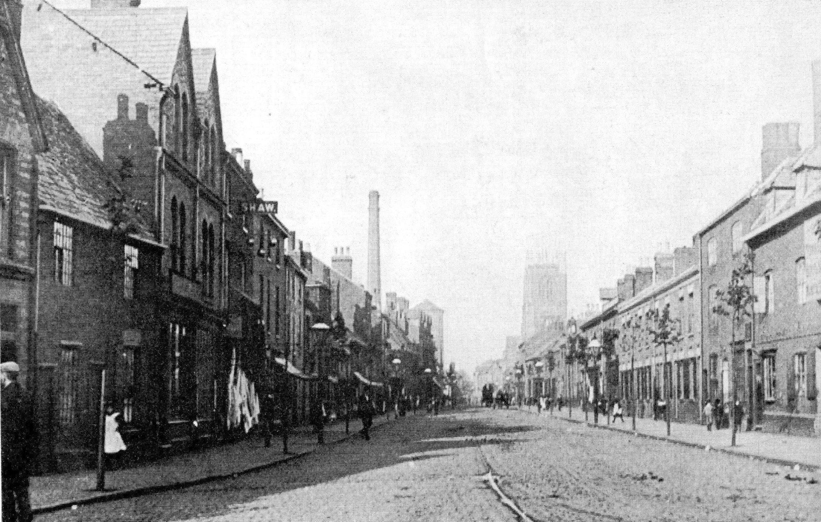
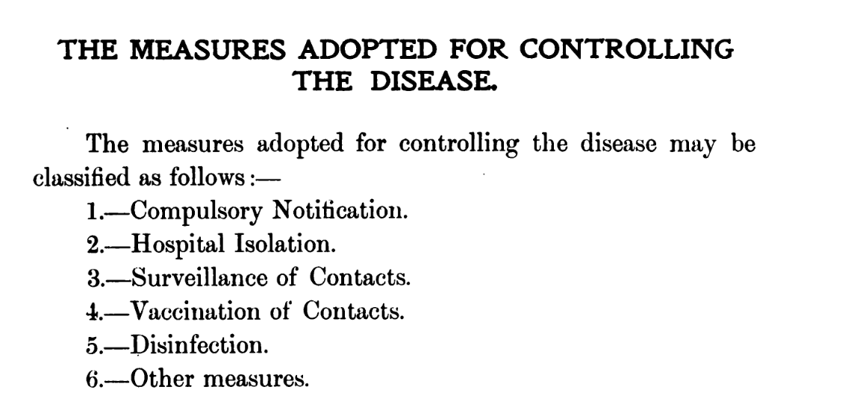
The Leicester Method
K. C. Millard, Report on the Smallpox Epidemic in Leicester in 1903

Slide 8
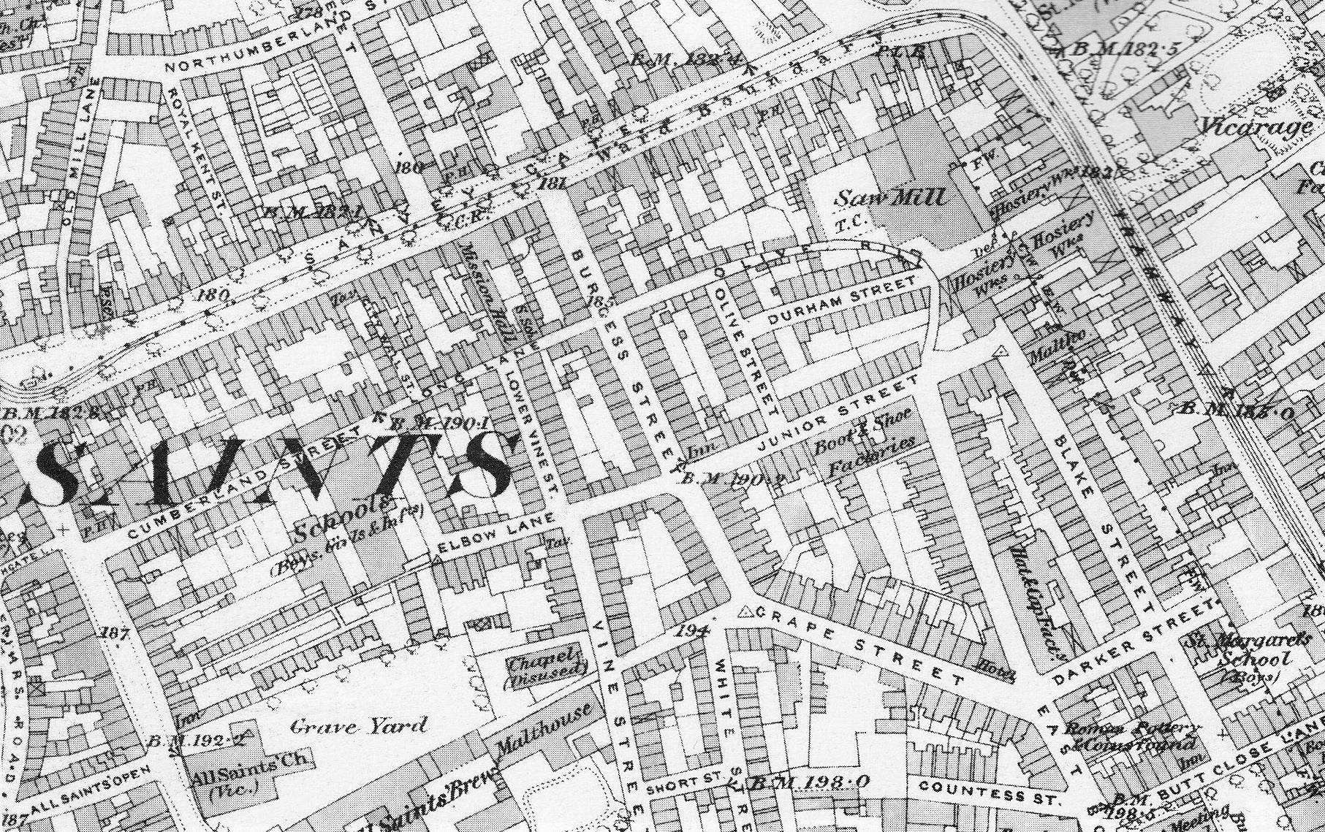
”When a case is reported, I at once go to the infected house and try to ascertain where the disease was contracted, where the patient has been working, where he has been visiting, and his movements generally for the last ten or twelve days. I also make a point of seeing all persons who have visited the infected house during the time stated; in addition, I visit all factories and workshops where other members of the family have been employed; and by this means have been able to get cases removed when the first symptoms of disease appeared… Up to the present time I have succeeded in getting almost every person connected with the infected houses into quarantine.’
-Francis Braley, The Lancet (1893)

Slide 9
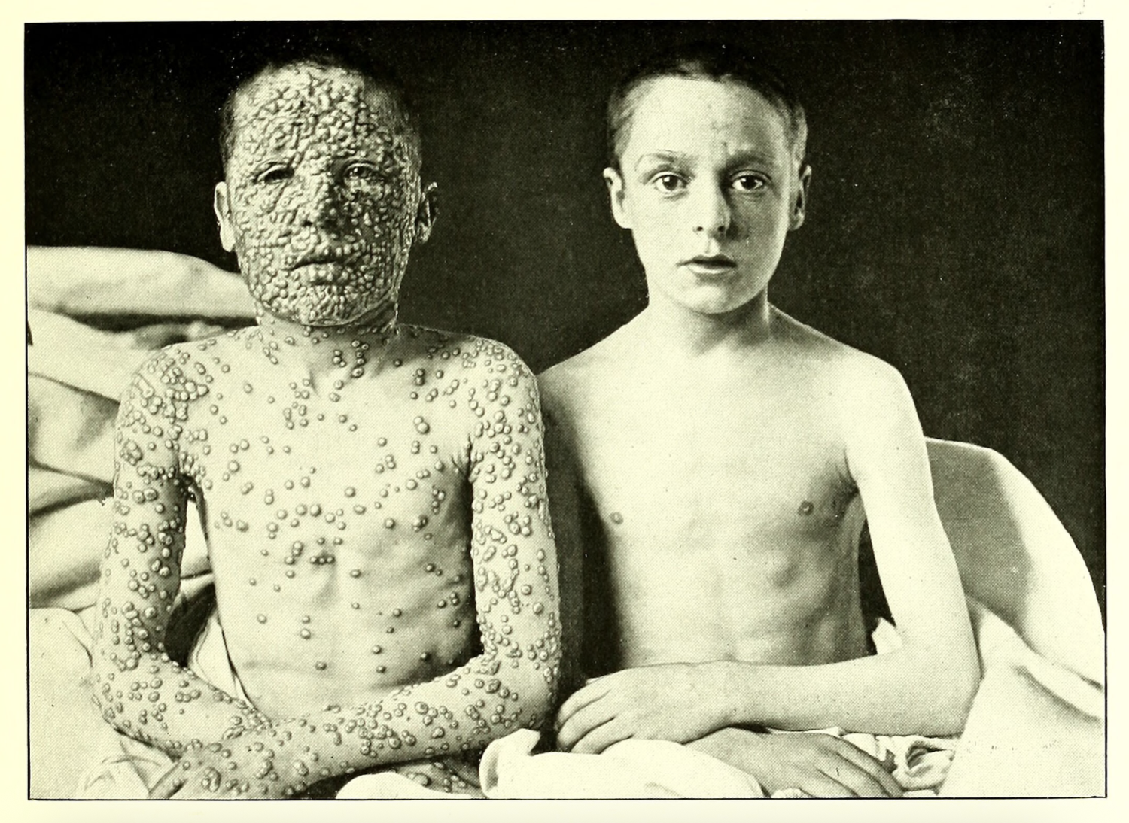
”I have not only had my own two children vaccinated, but I have publicly taken them into the Leicester Small-pox Hospital, and have photographed them there by the bedside of a small-pox patient… the photograph obtained has been, I believe, of far more use to me in making converts to vaccination, than would have been many pages of vaccination ‘literature’ or columns of statistics.”
-C. Killick Millard, ‘The Leicester Method of Dealing with Small-Pox’ (1904)
Photo by Allan Warner (1871-1952), Leicester’s chief medical officer of health.
An Atlas of Illustrations of Clinical Medicine, Surgery, and Pathology (1901).

Slide 10
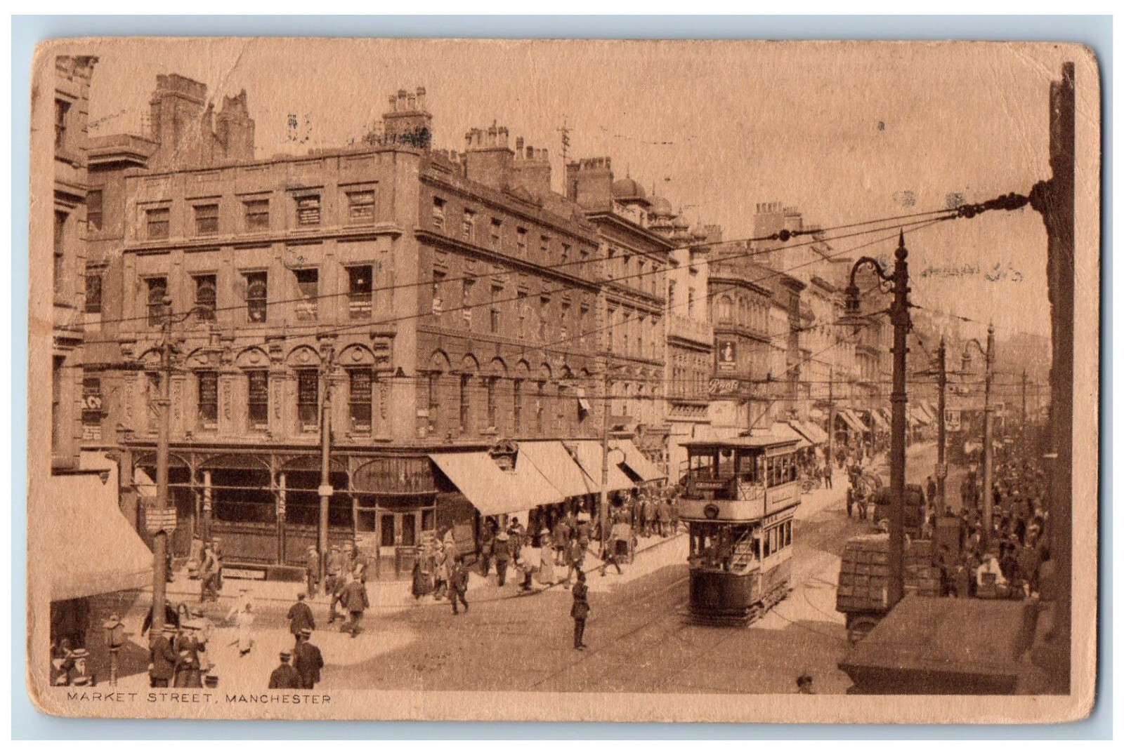
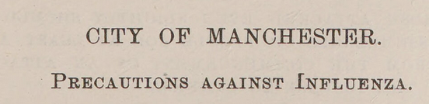
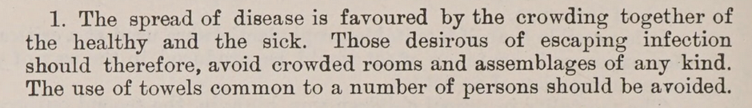
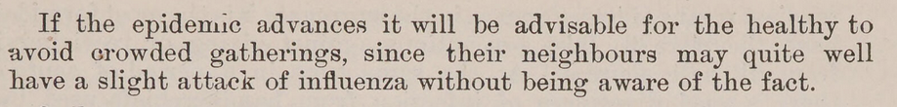

James Niven, Report on the Pandemic of Influenza, 1918-1919

Slide 11
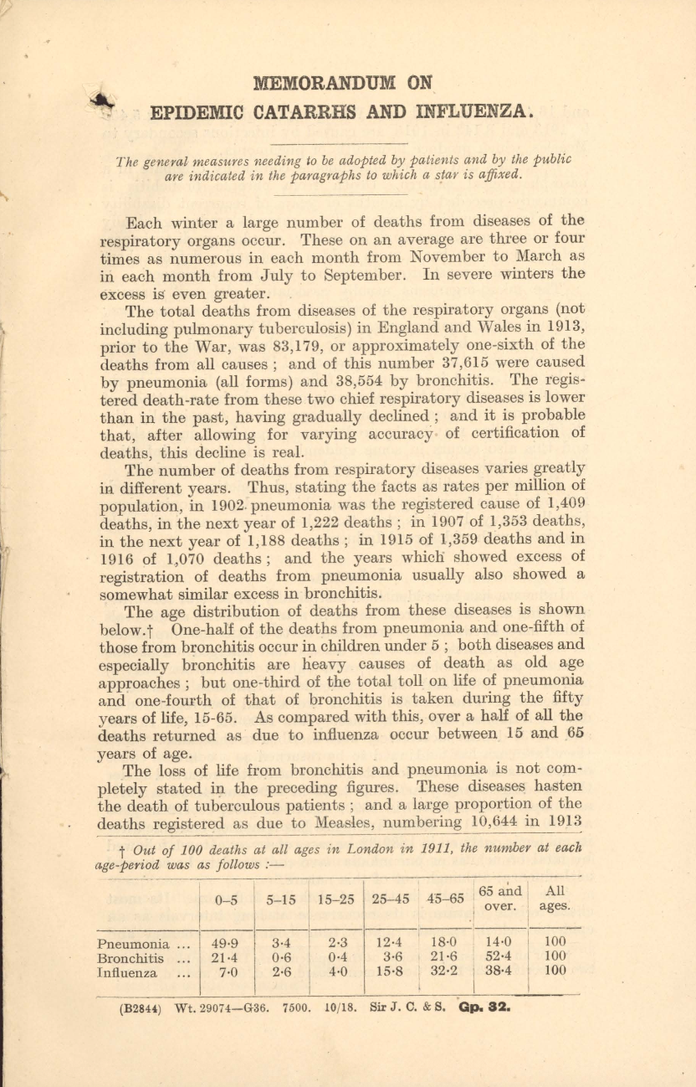
‘[If] every person who is suffering from Influenza […] recognised that he is a likely source of infection to others, that some of the persons inflected by him may die as the result of this infection, and took all possible precautions, the present disability and mortality […] would be materially reduced.’
-Arthur Newsholme, ‘Memorandum on Epidemic Catarrh and Influenza’ (1918)

Slide 12
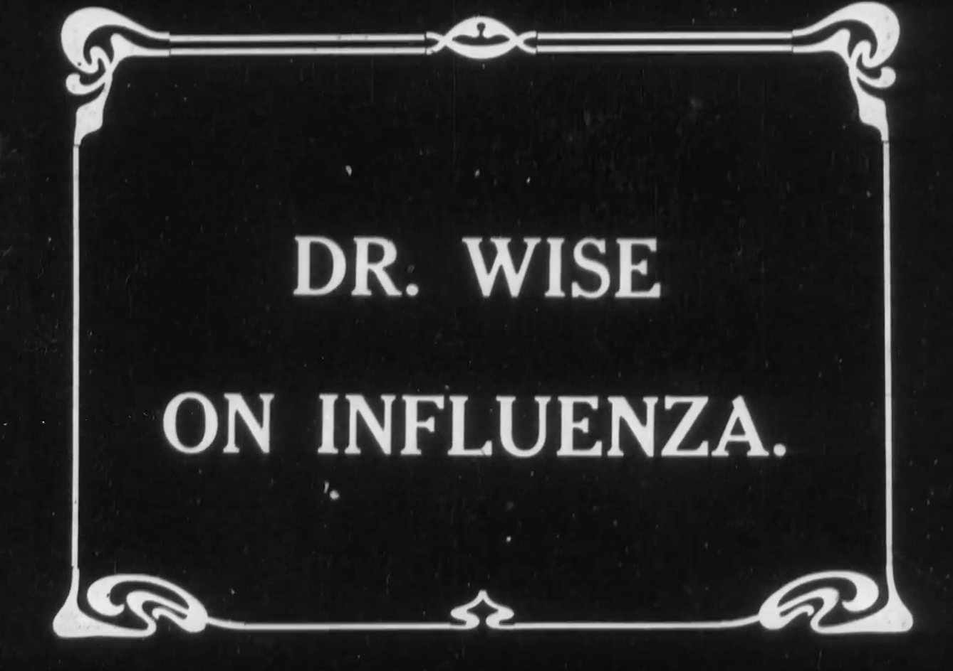
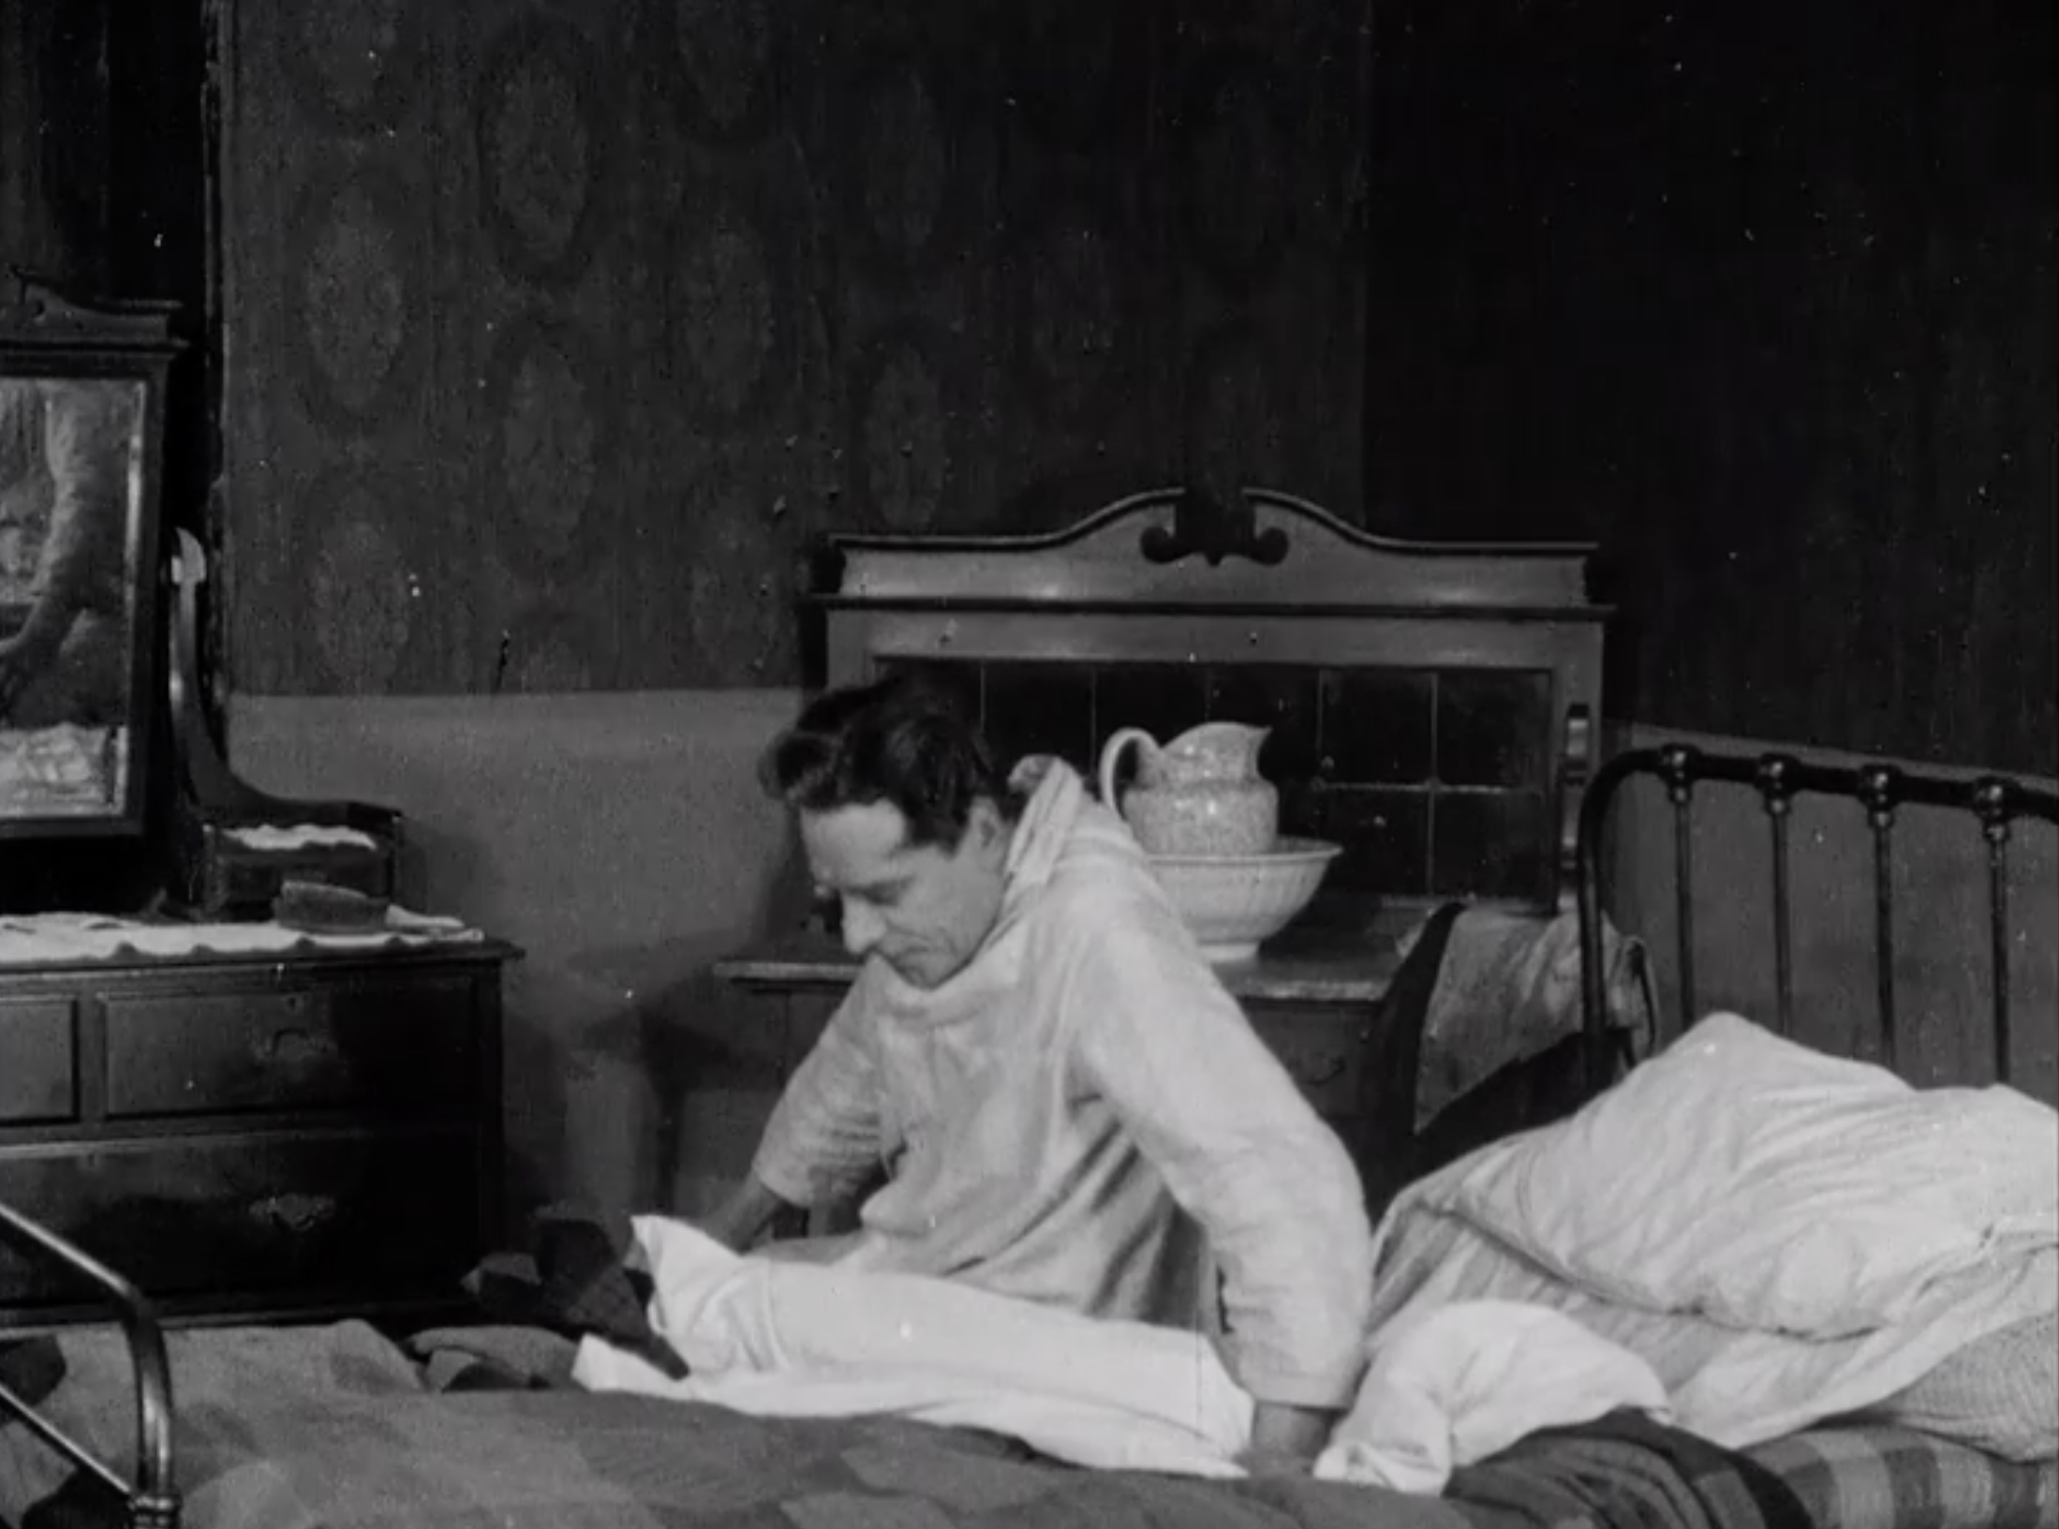

Slide 13
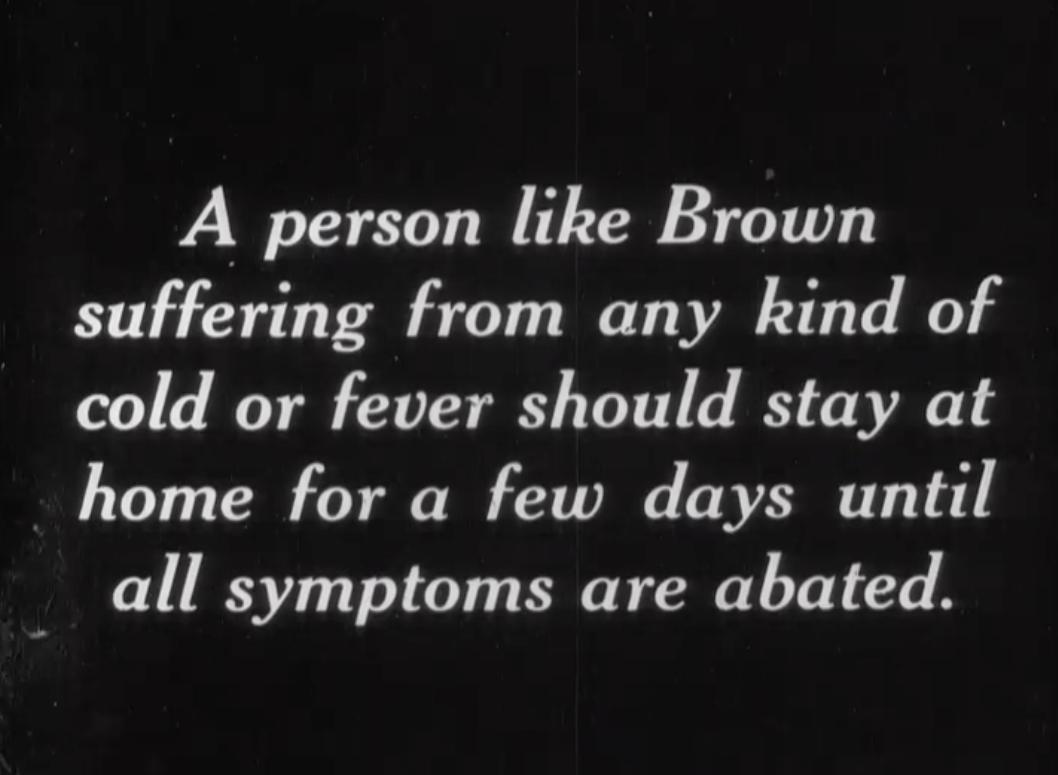
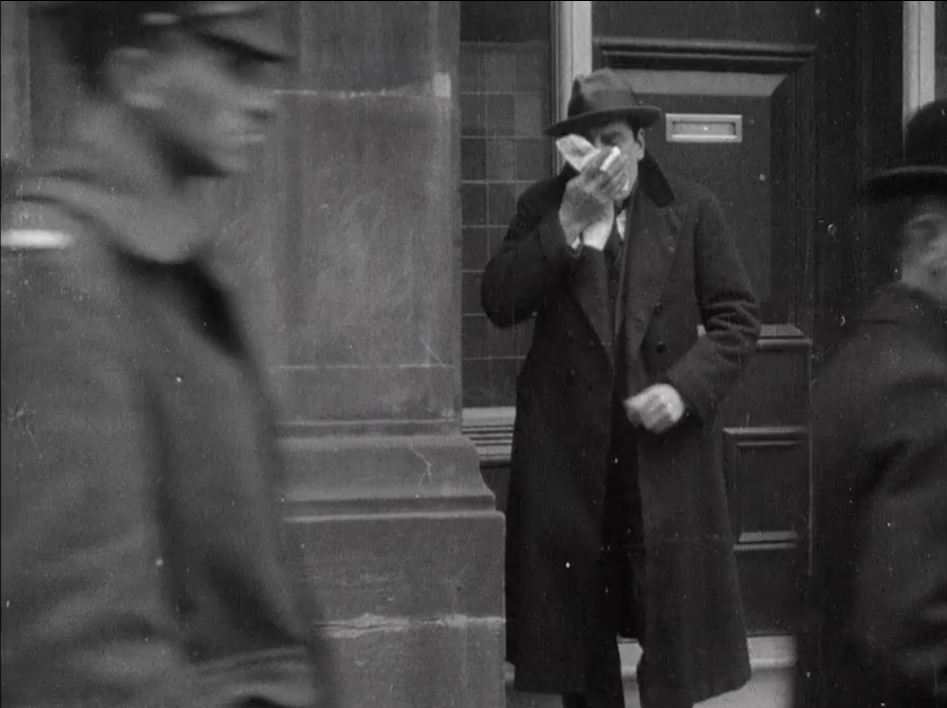

Slide 14
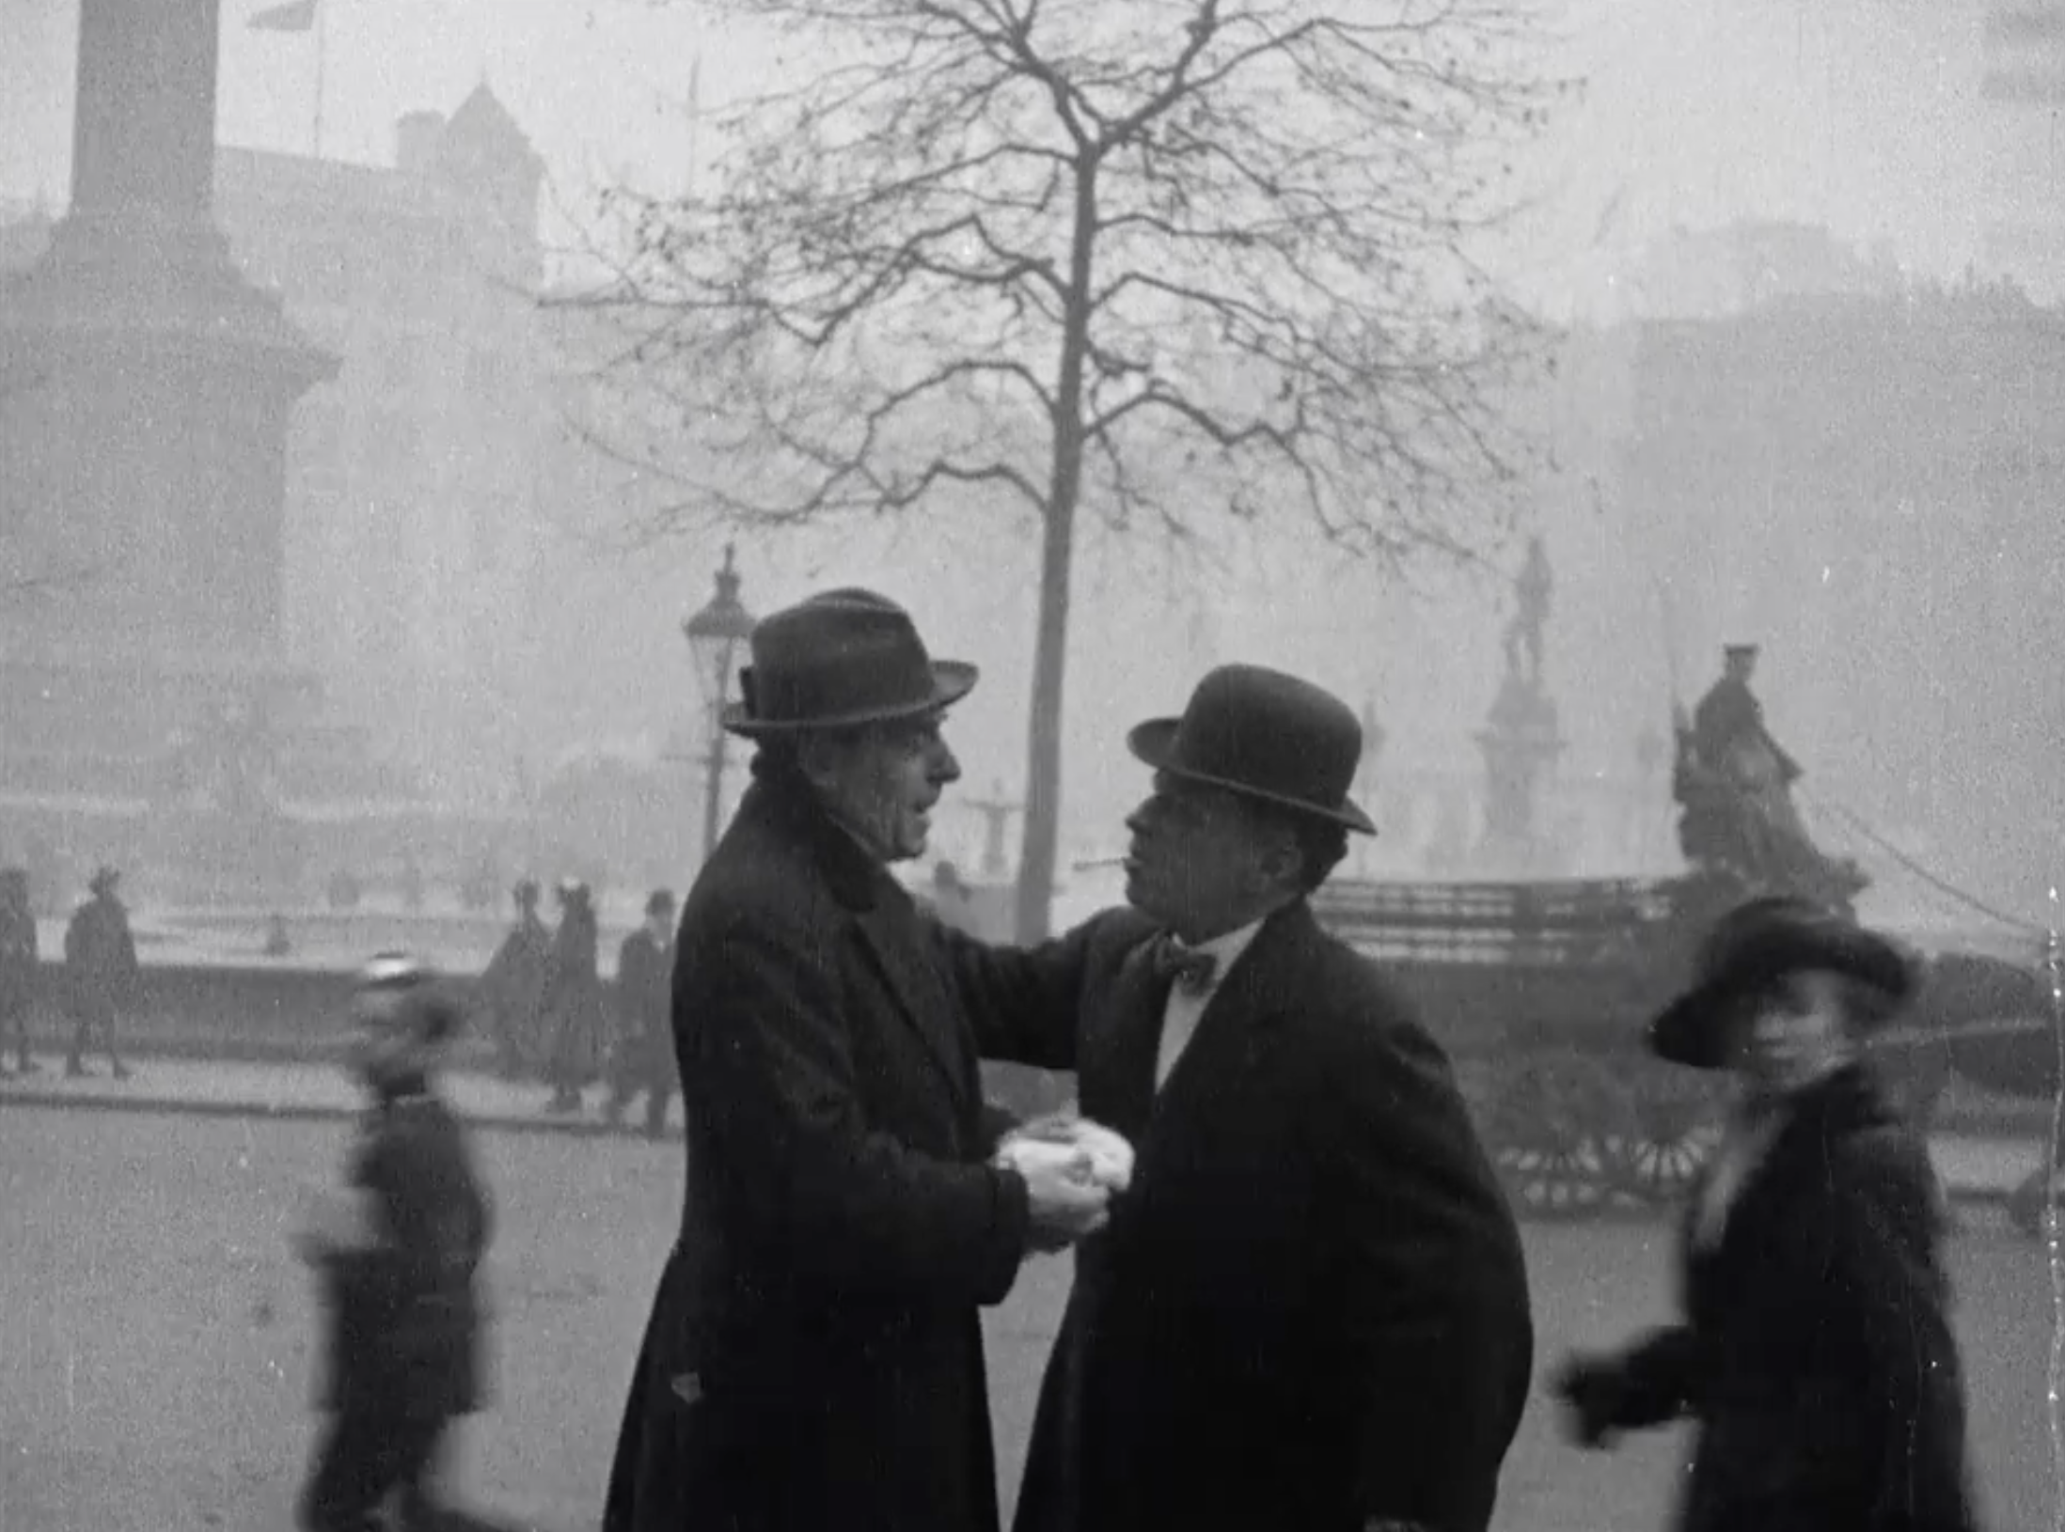
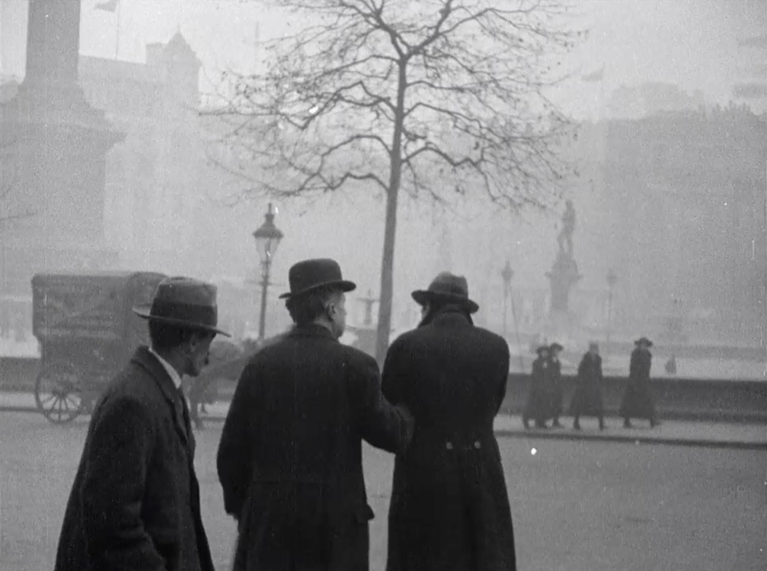
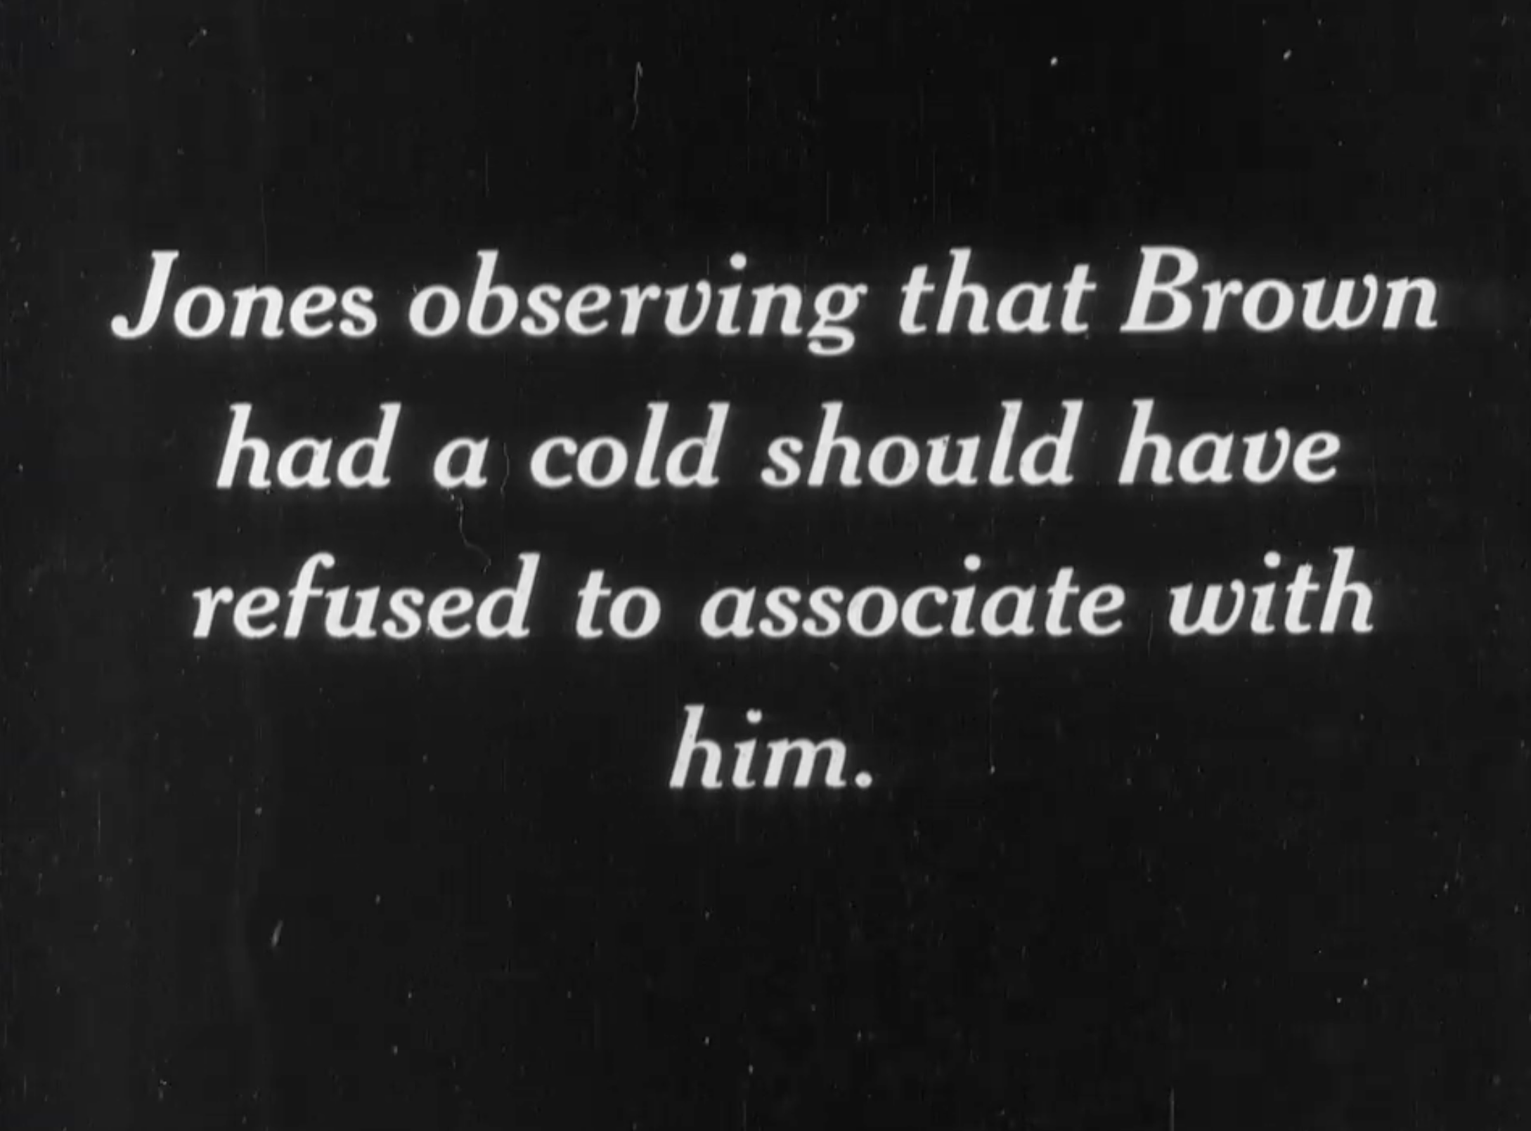

Slide 15
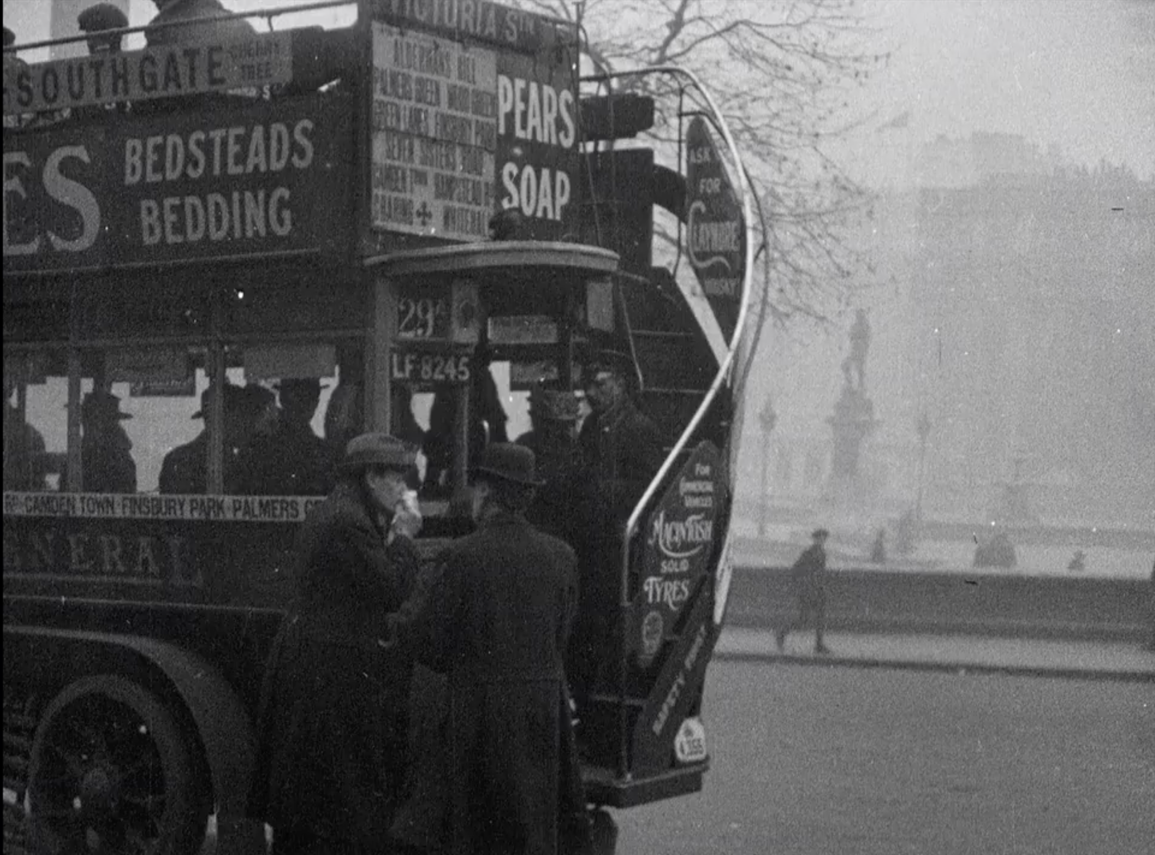
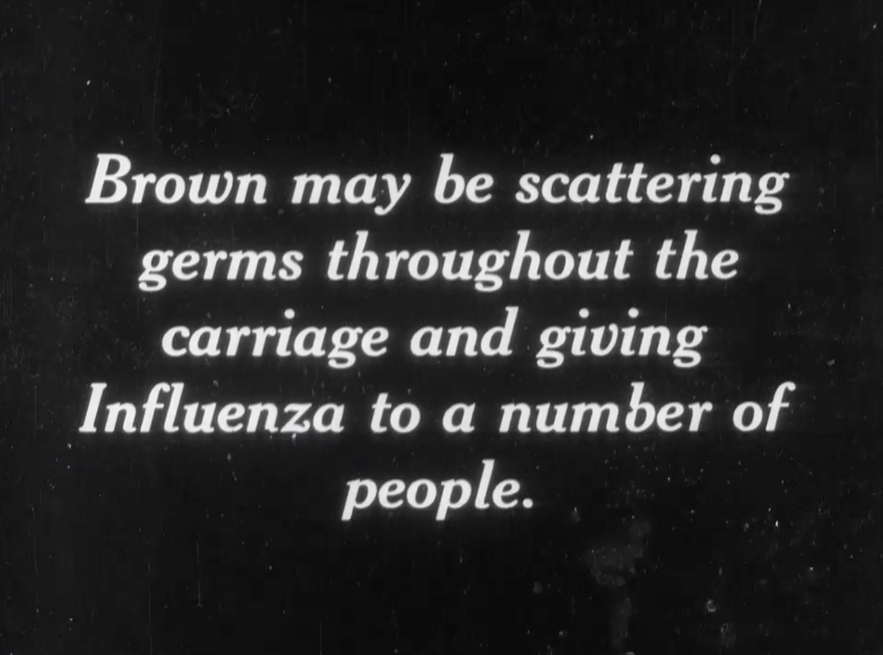

Slide 16
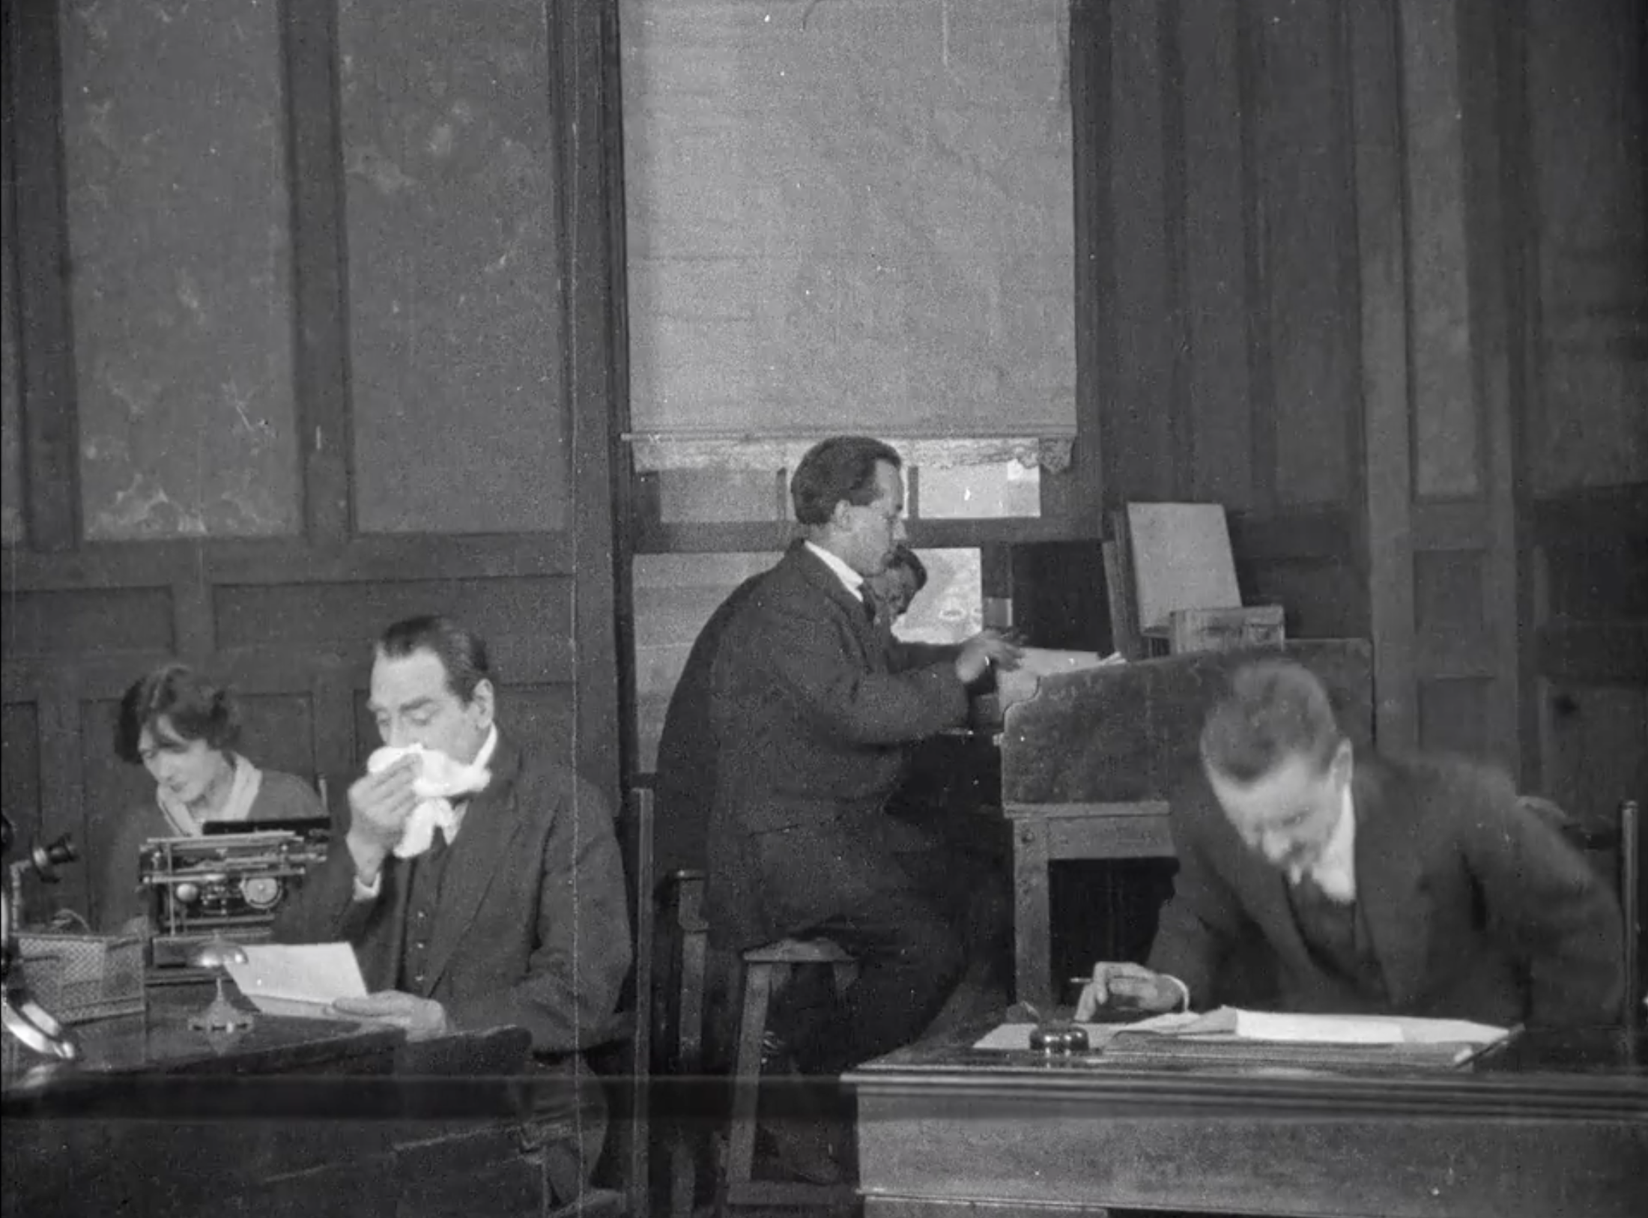
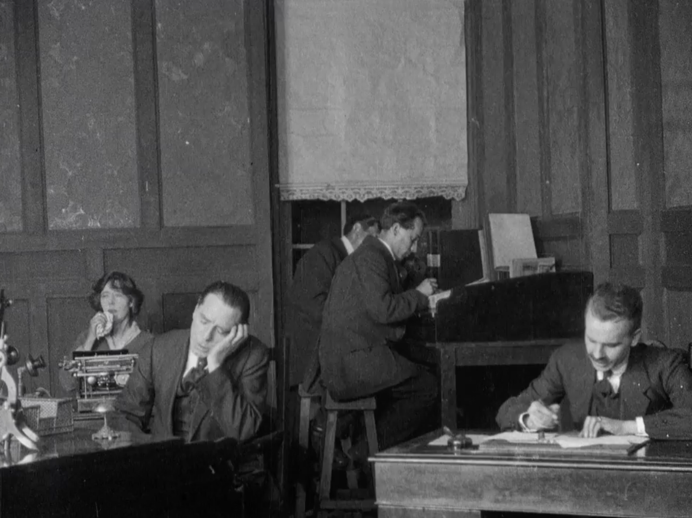

Slide 17
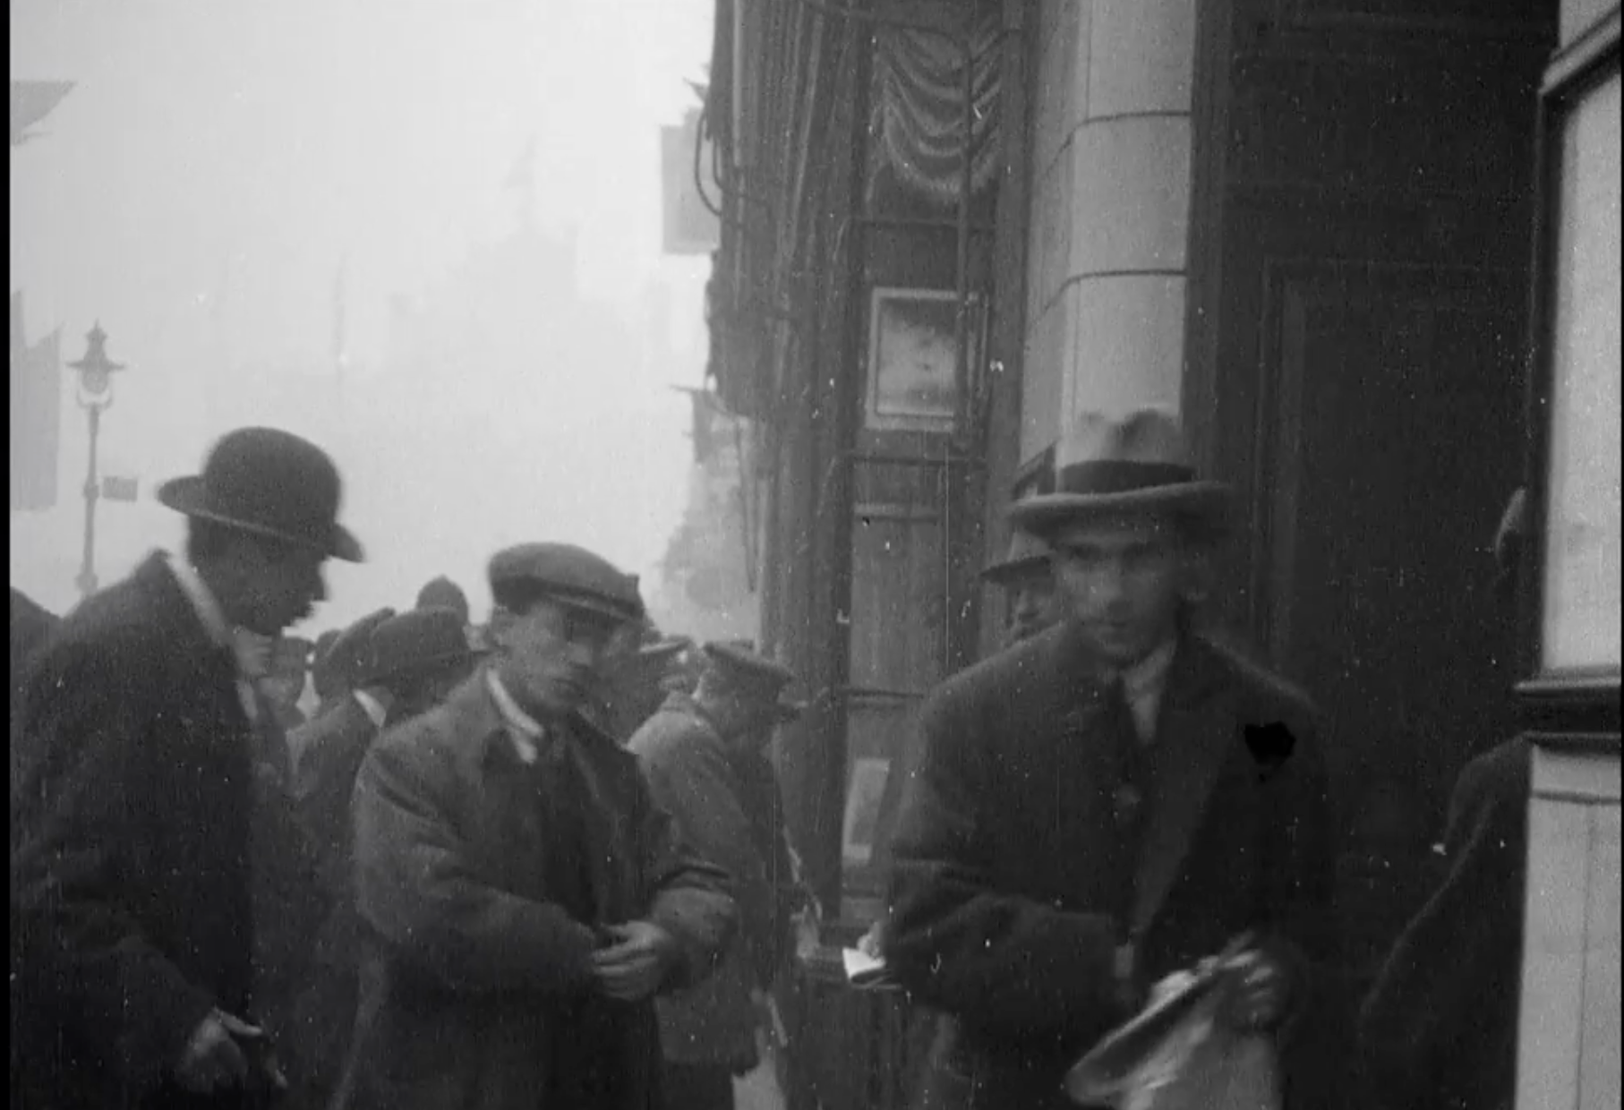
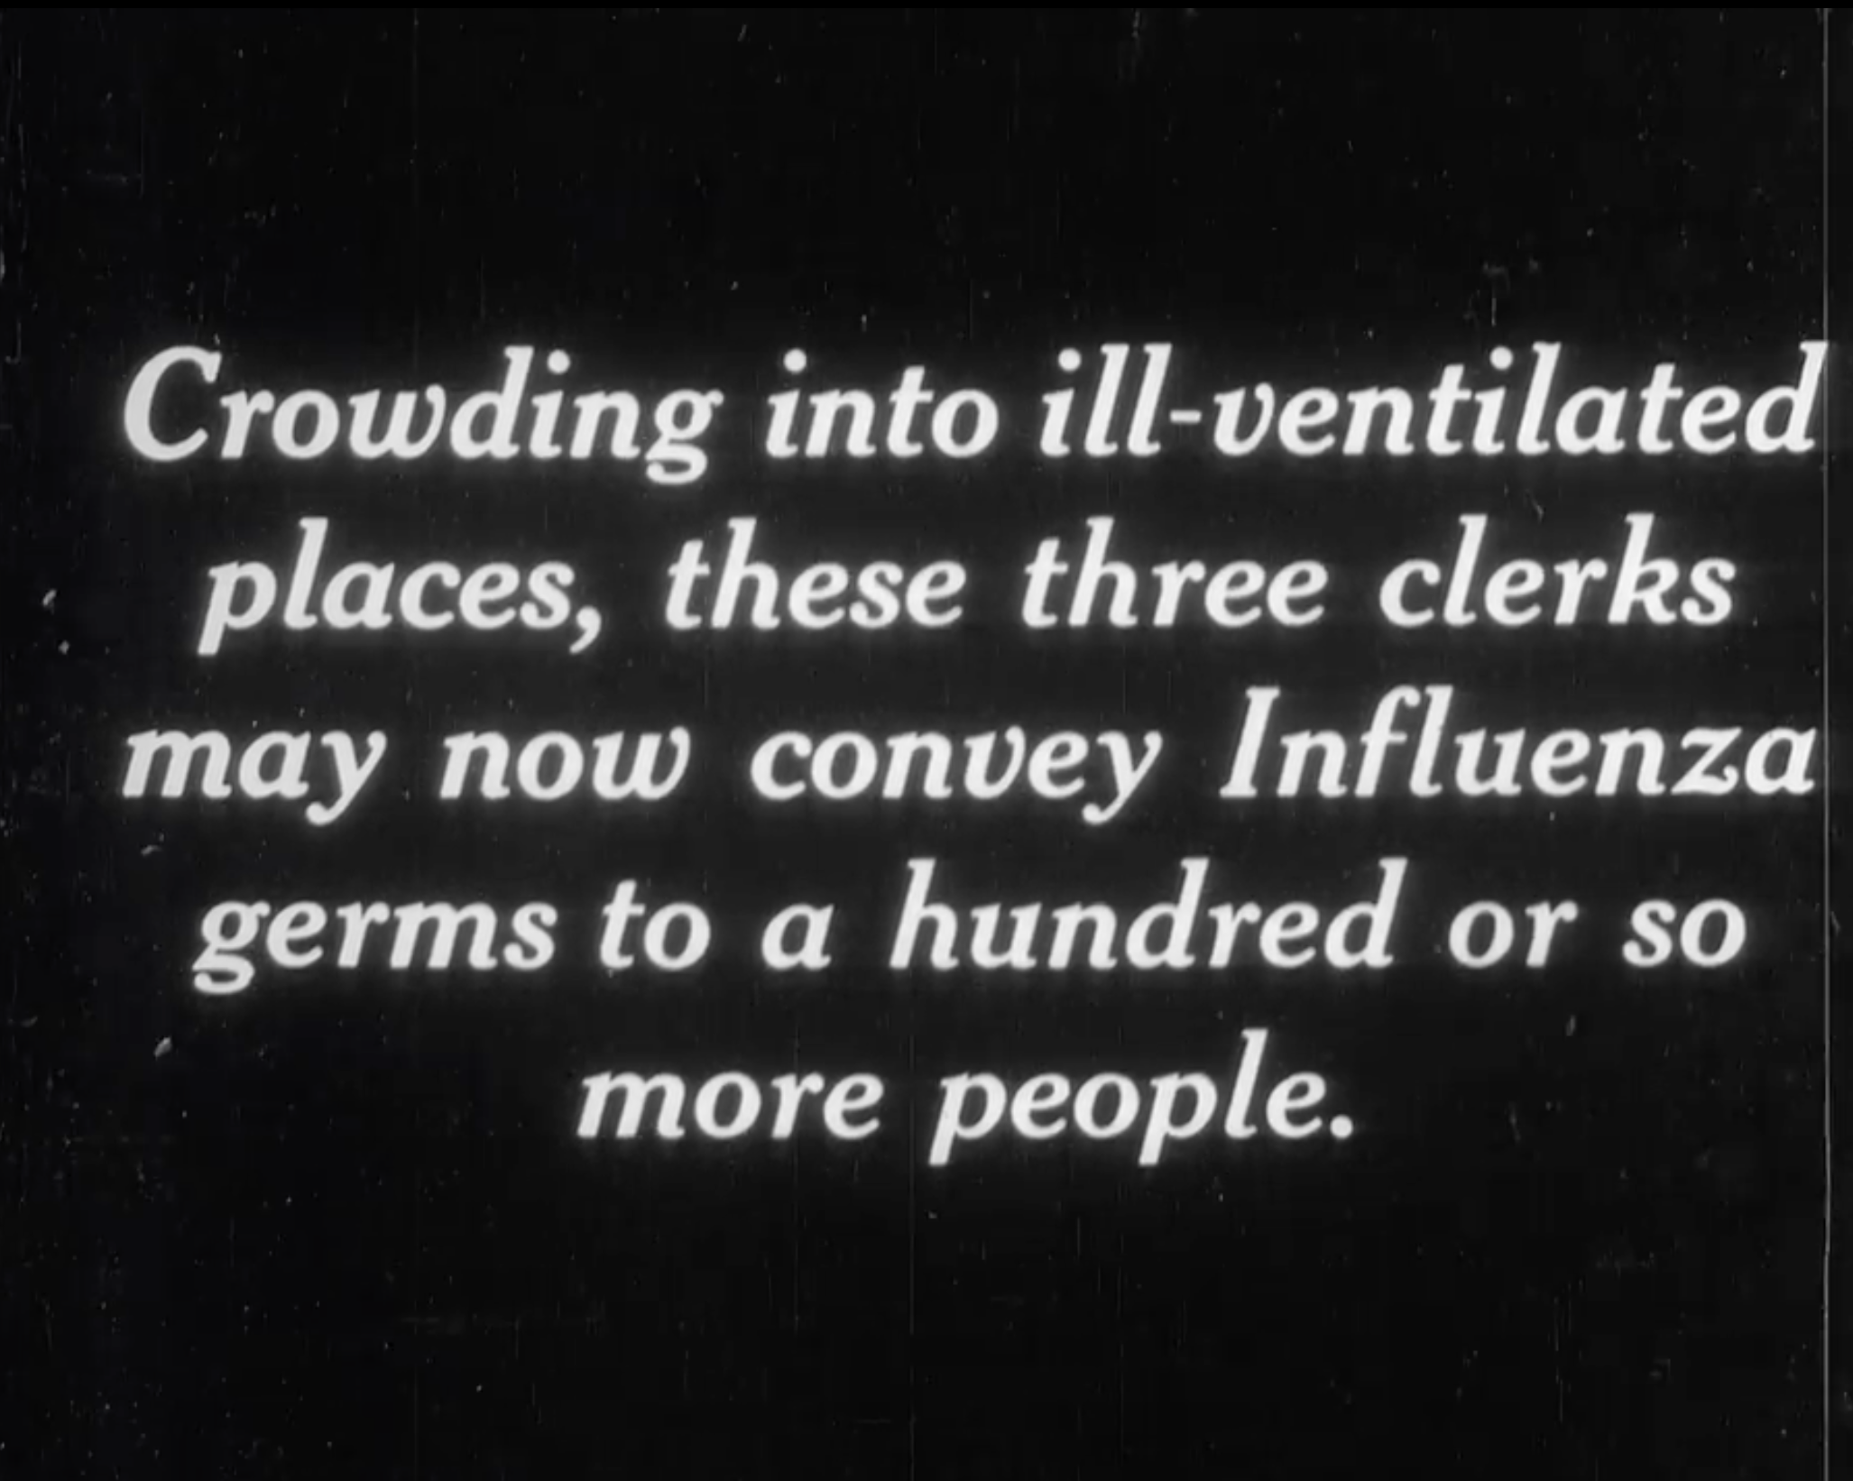

Slide 18
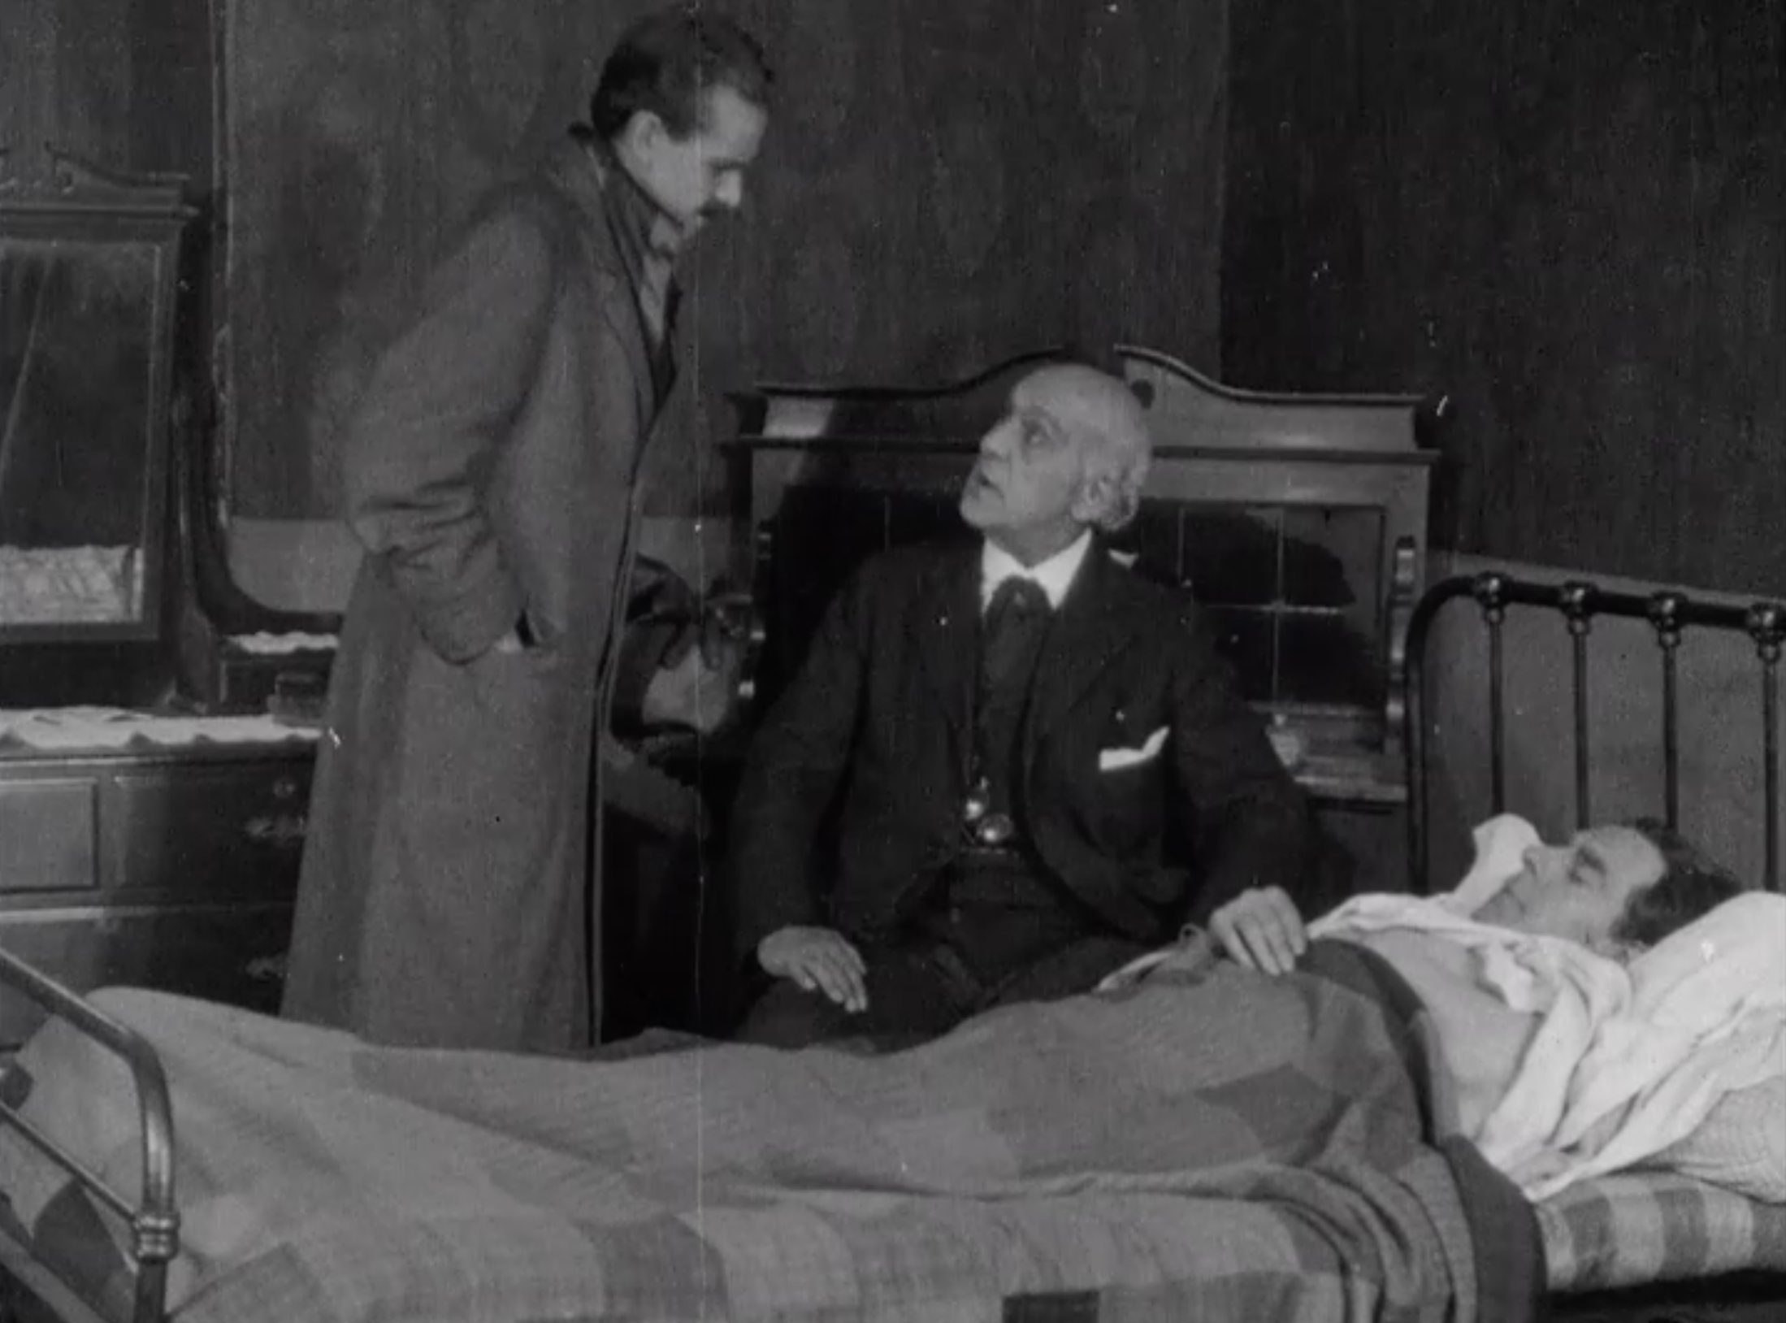
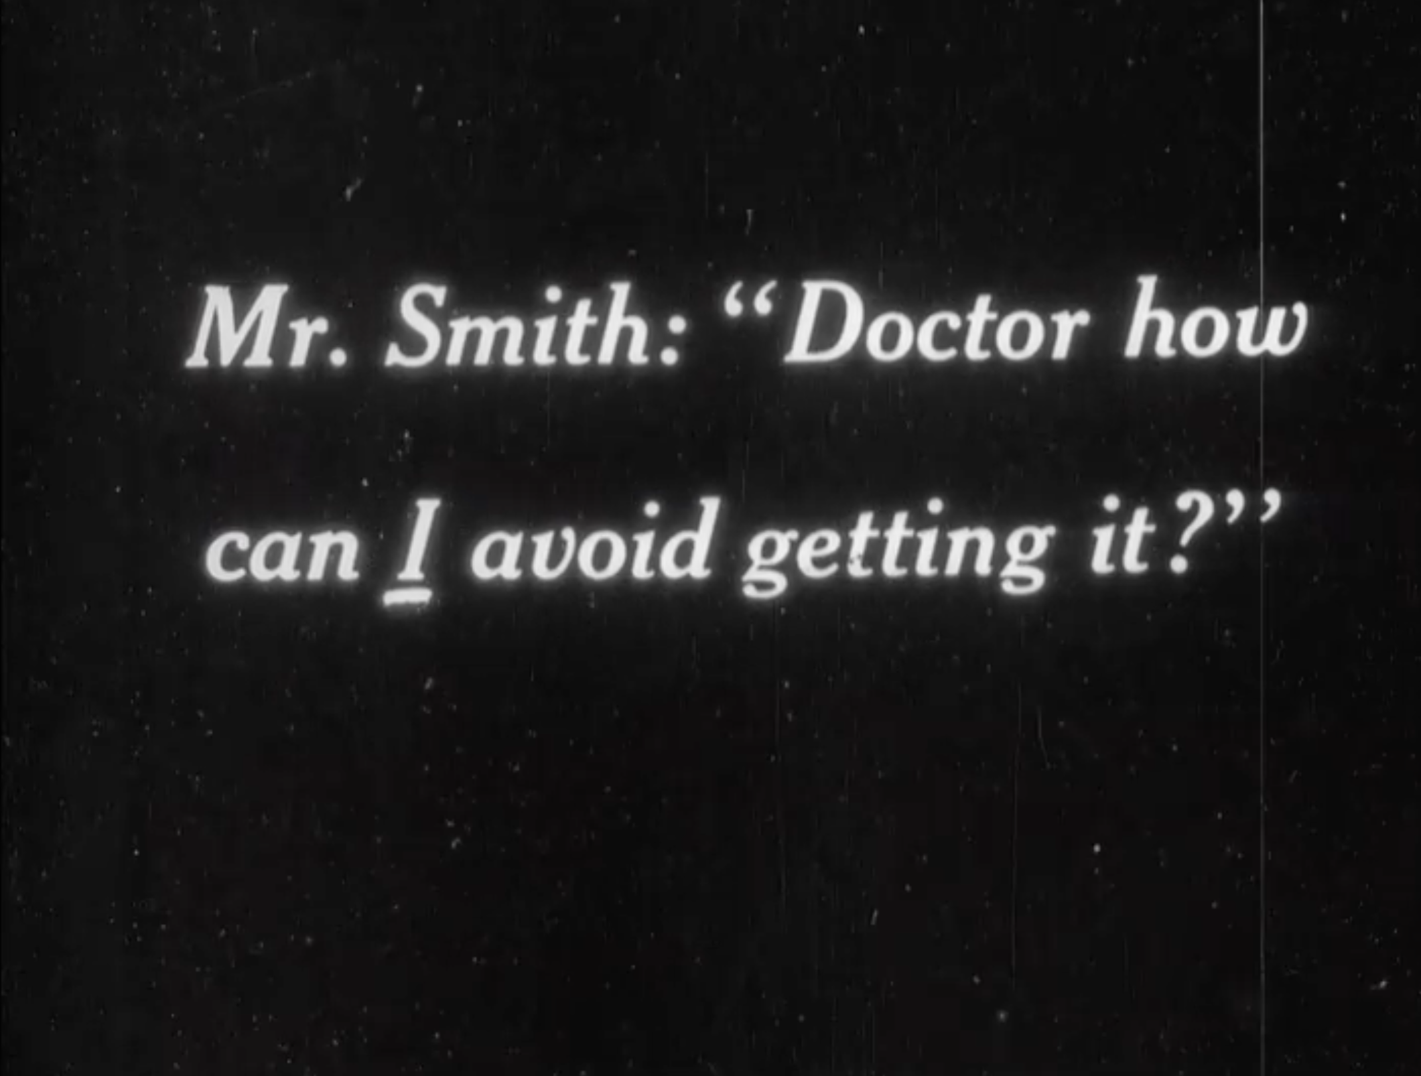

Slide 19
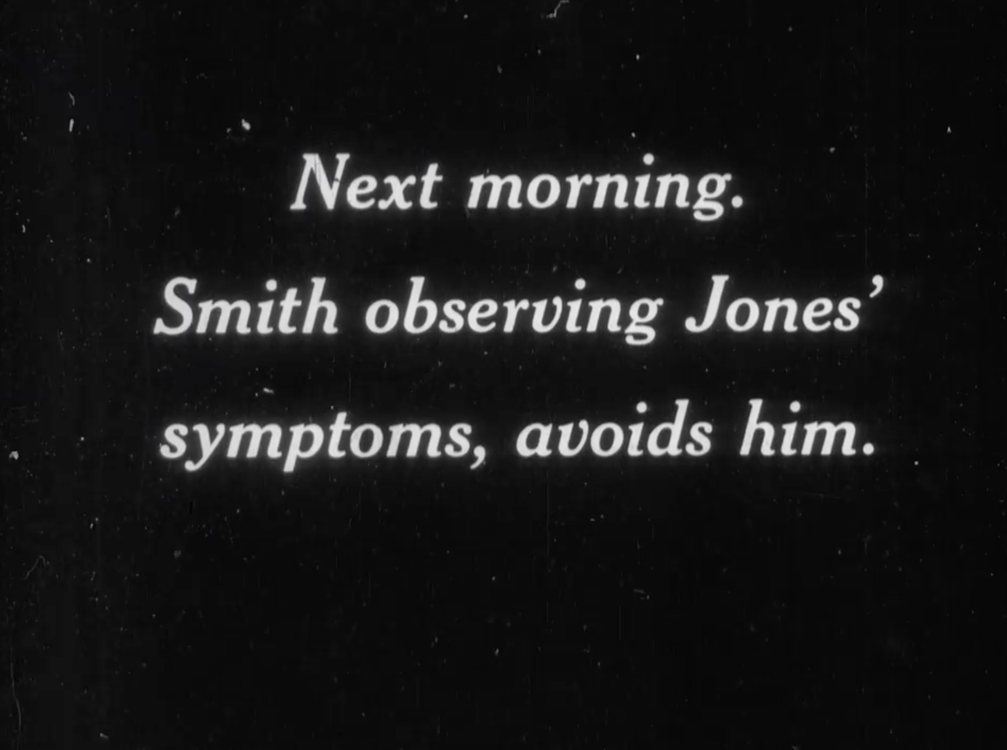
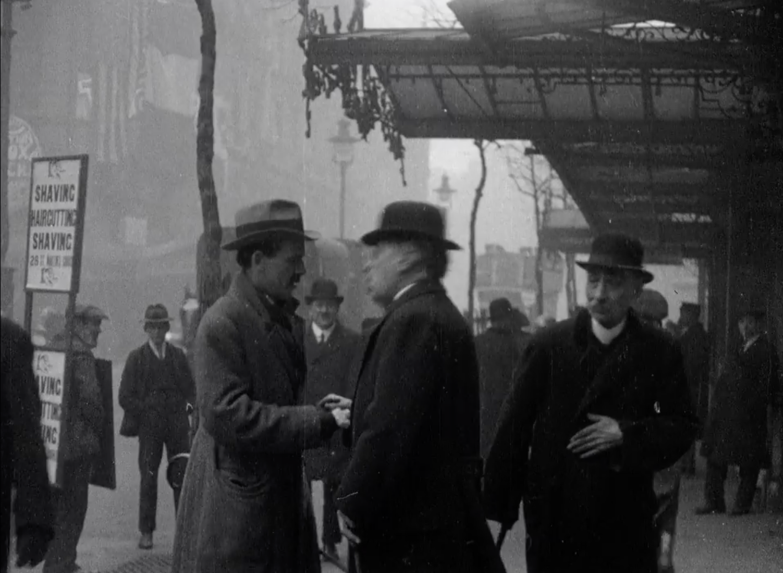

Slide 20
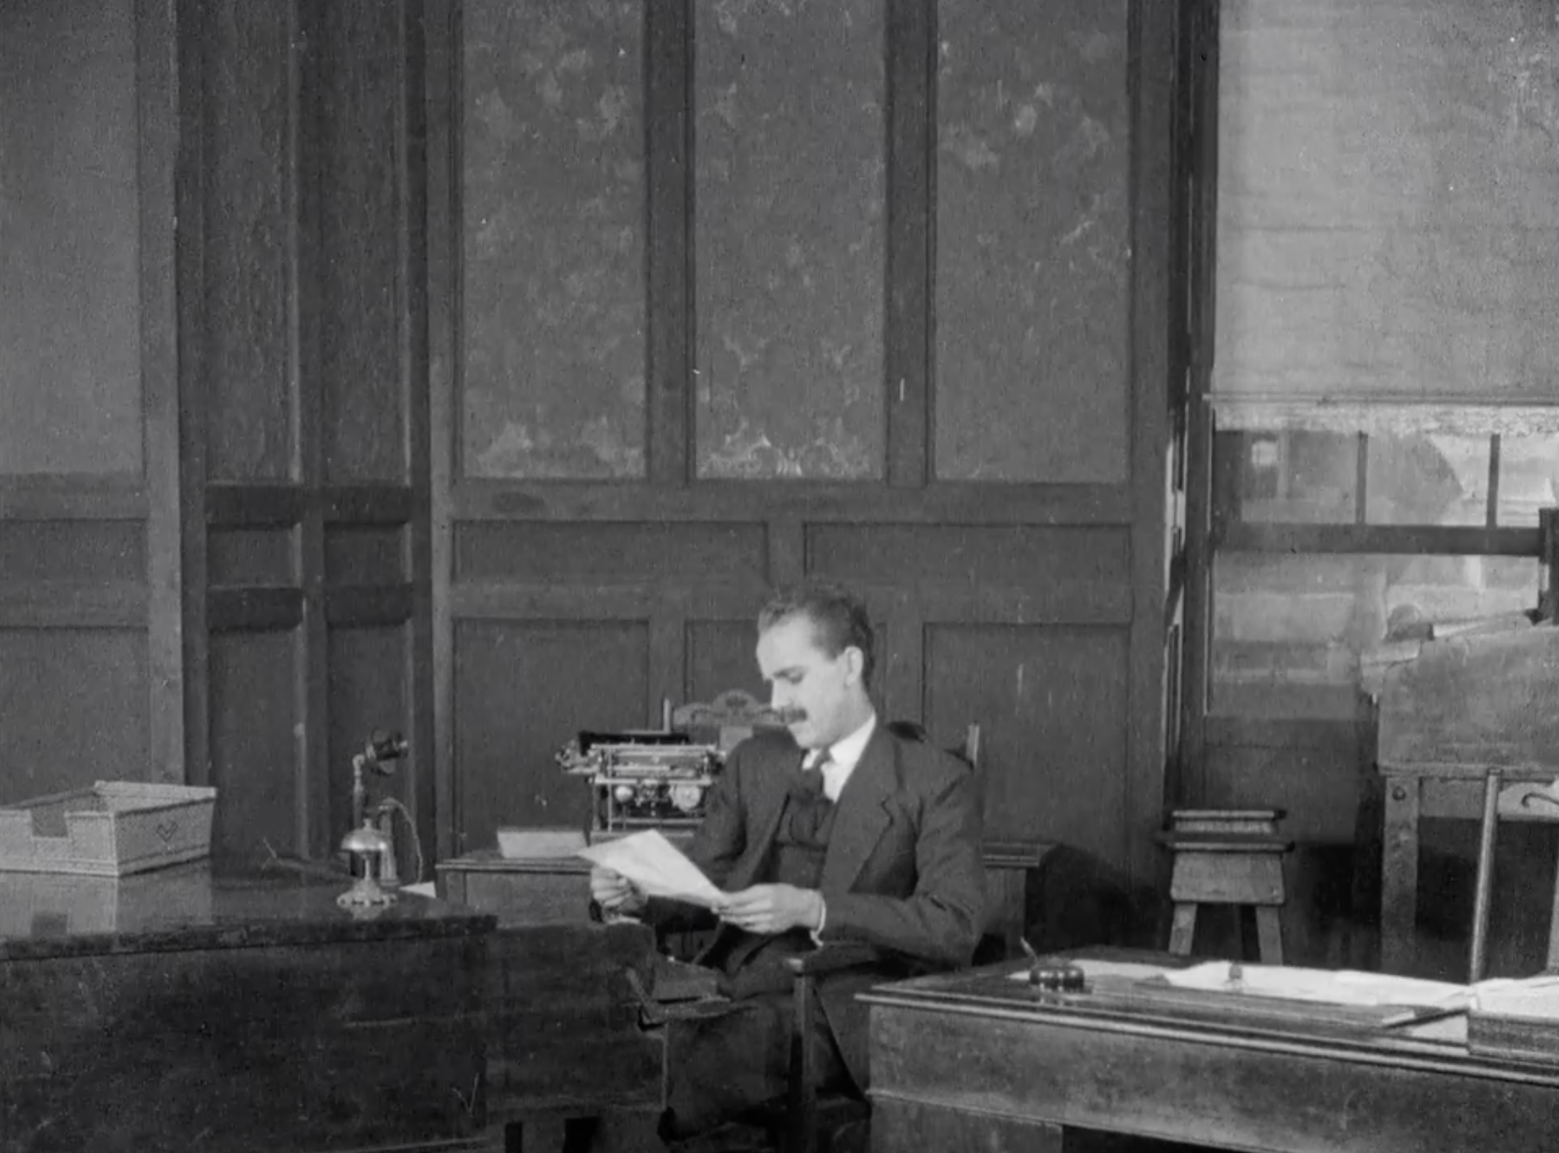
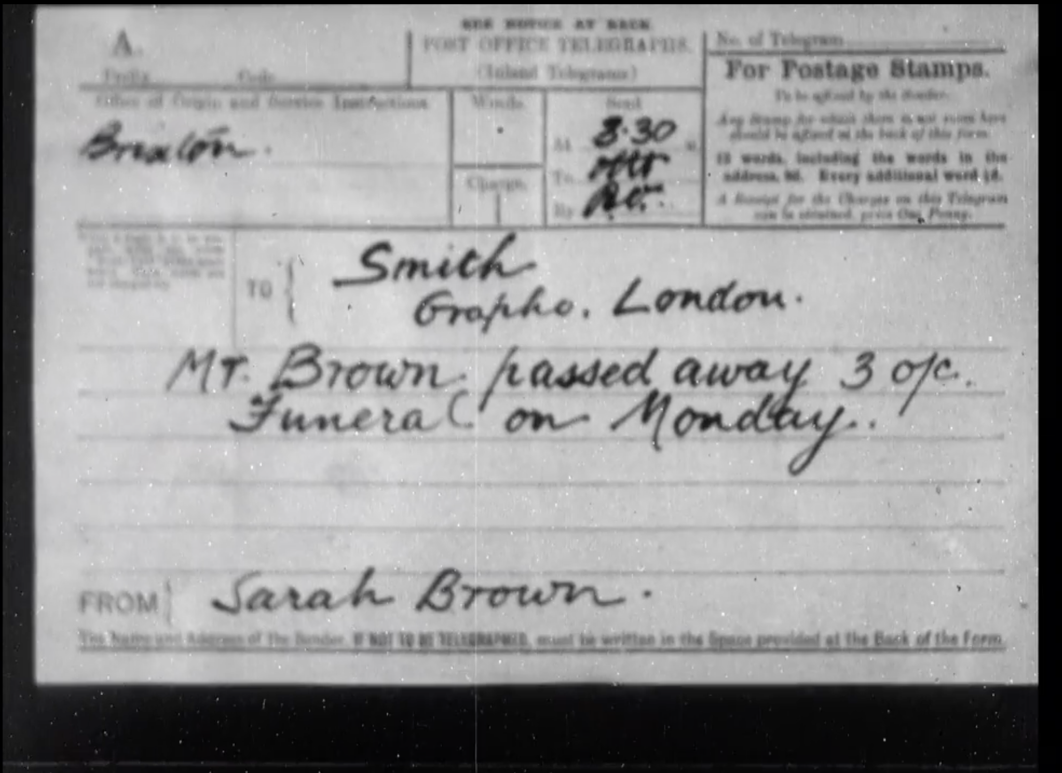

Slide 21
