Slide 1
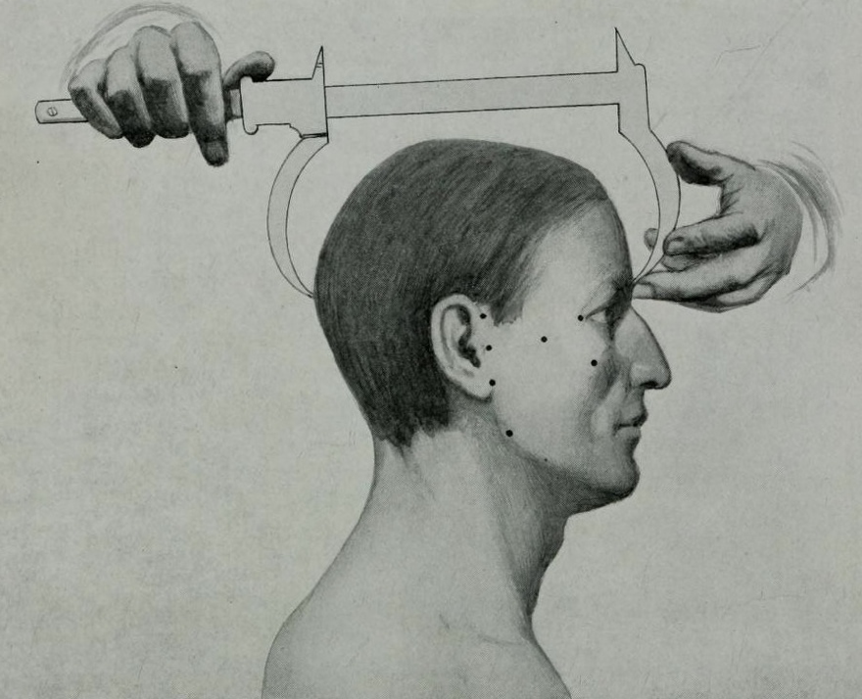
The History of Intelligence Testing 2026 Offer Day Interactive Seminar
Tutor: Elise Smith

Slide 2
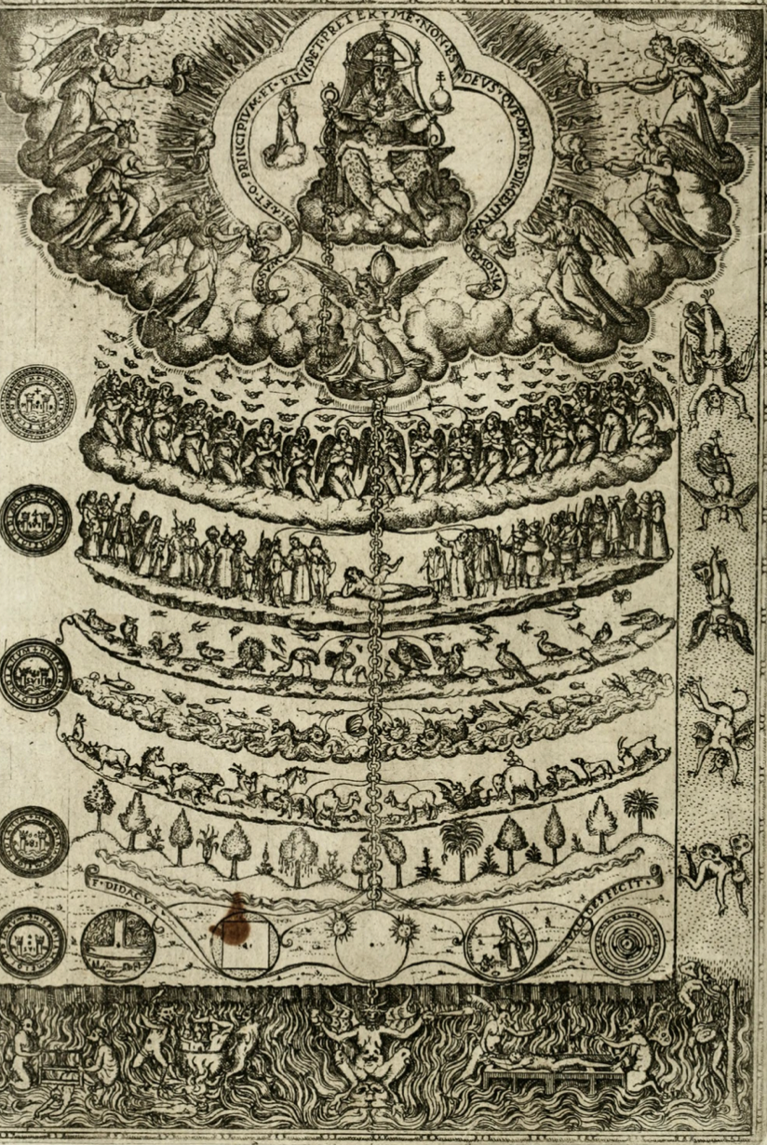
The Great Chain of Being, 1578
The Great Chain of Being, 1579

Slide 3
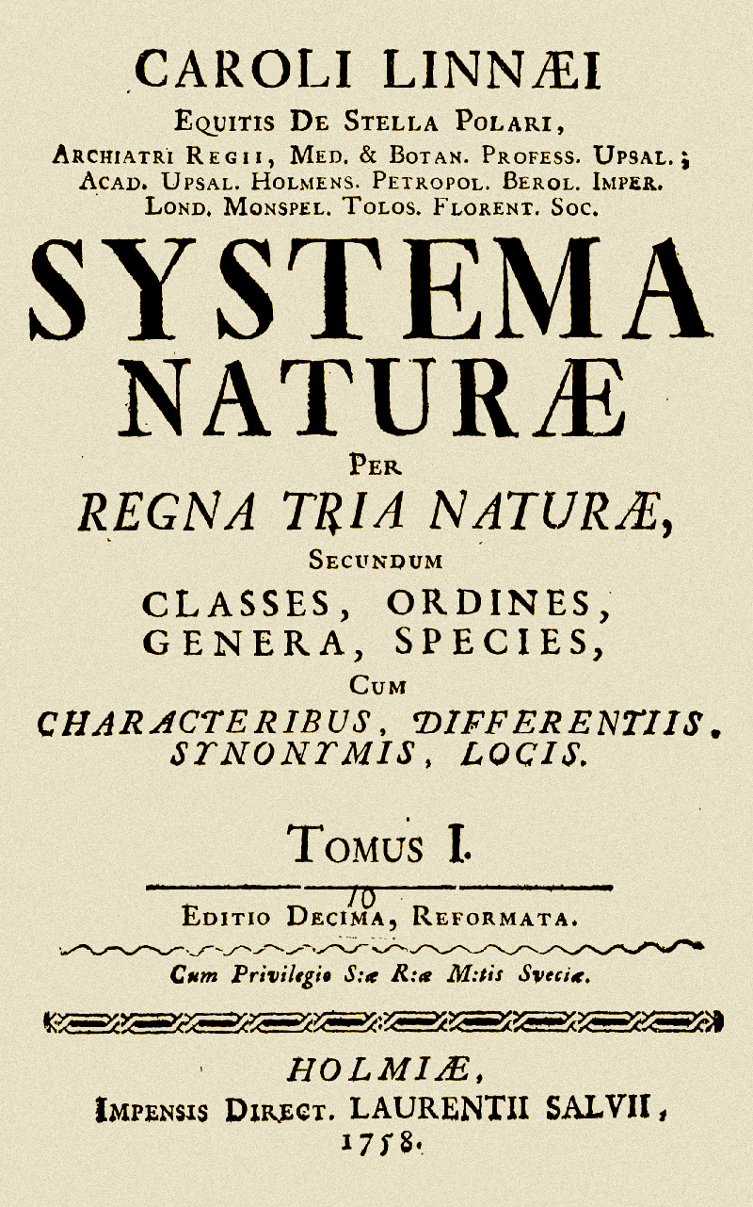
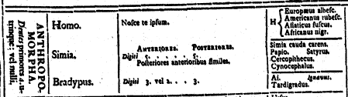
Linneaus: Classifying Humans

Slide 4
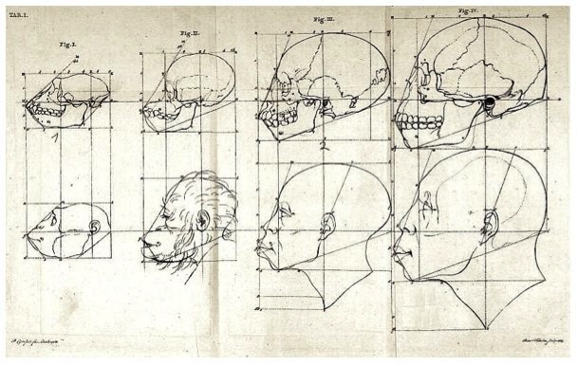
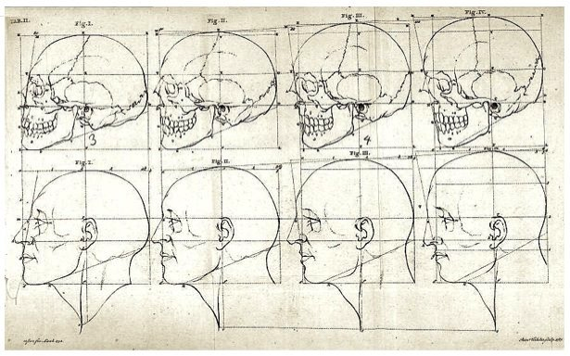
Petrus Camper (1722-1789) and the Facial Angle
Camper, Paul, Über den natürlichen Unterschied der Gesichtszüge (Berlin, 1792)]

Slide 5
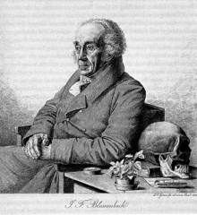
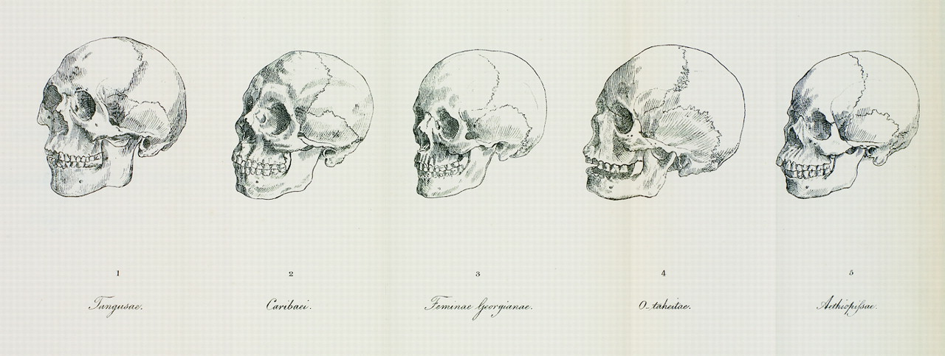
Johannes Blumenbach (1752-1840)
-Five racial types: Caucasian, Mongolian, Malayan, Ethiopian, American (1781)

Slide 6
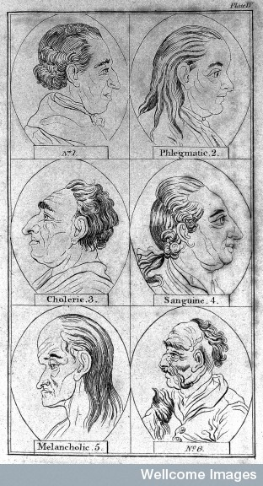
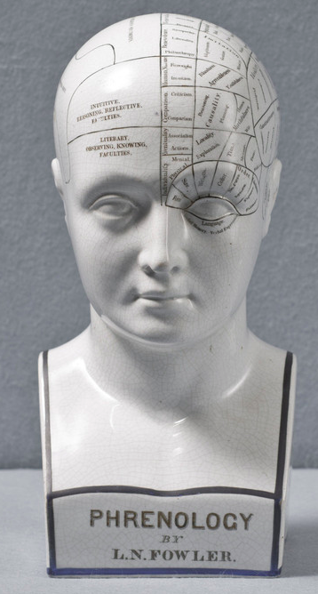
Physiognomy and Phrenology:
Matching external and internal traits
-Lavater’s Essays on Physiognomy (c.1775)
-Facial features reveal personality
-Gall and Spurzheim (c.1800)
-Head bumps correlated with character traits

Slide 7
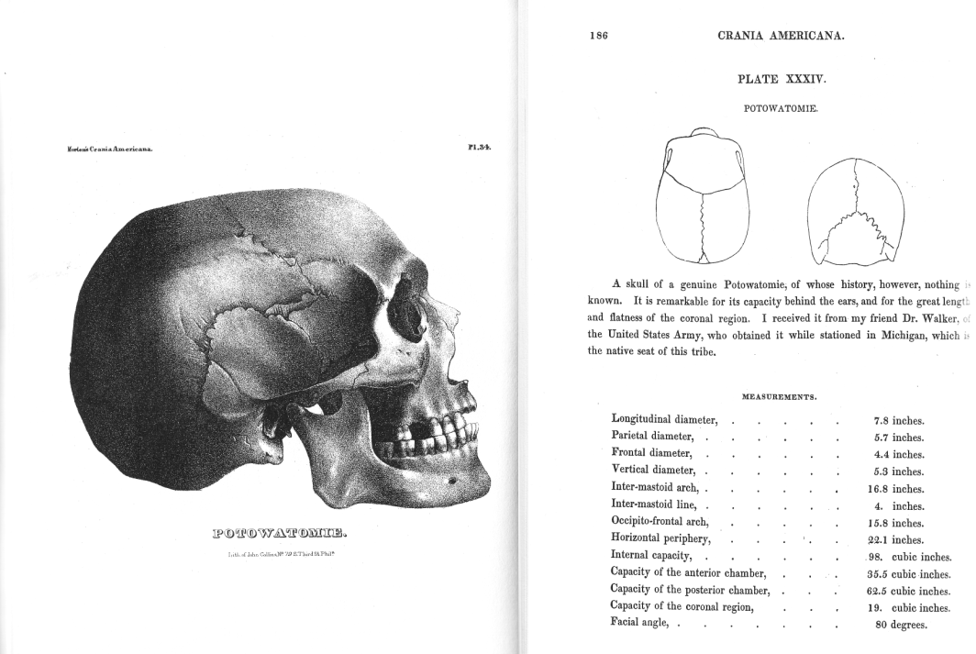
Samuel George Morton, Crania Americana (1839)
Samuel George Morton, Crania Americana (Philadelphia, 1839)

Slide 8
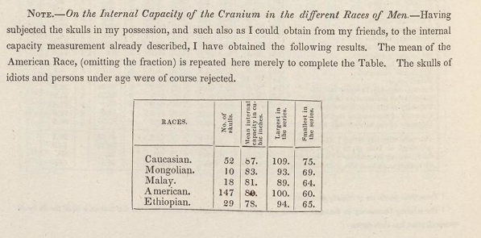
Samuel George Morton, Crania Americana (Philadelphia, 1839), p.260

Slide 9
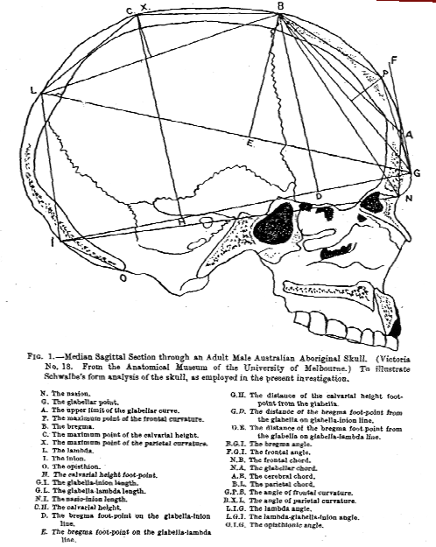
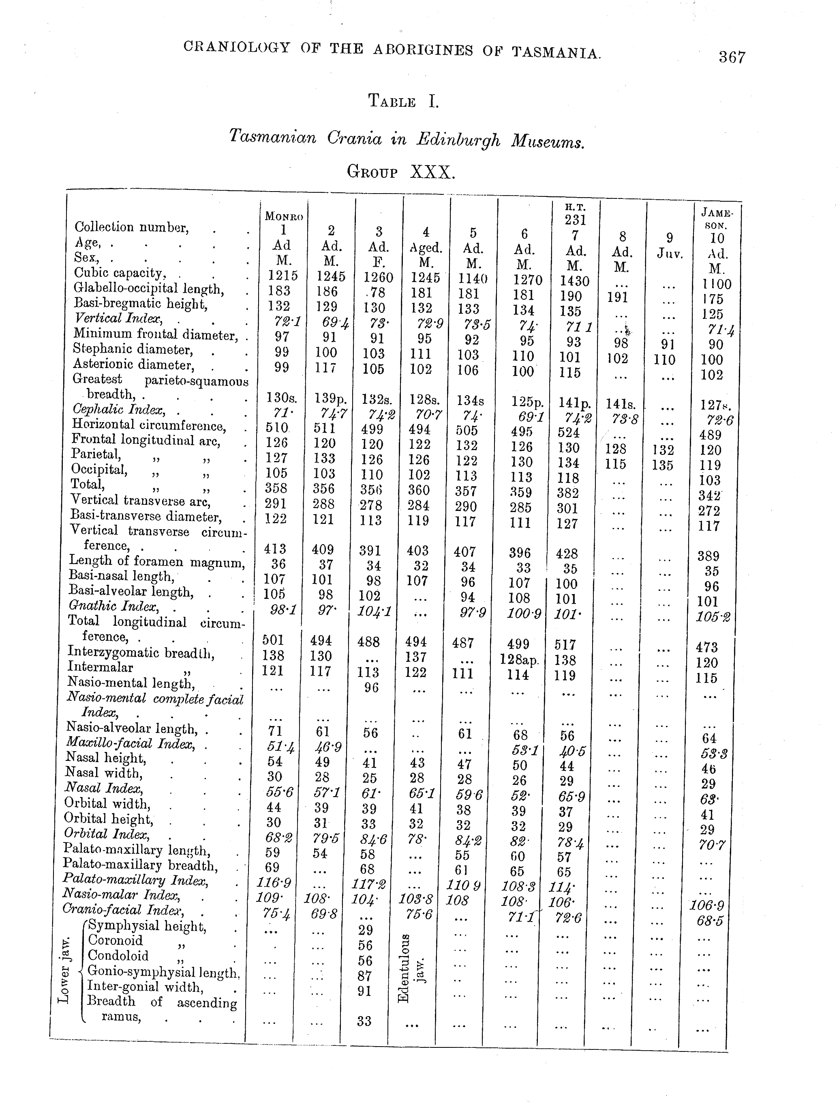
CRANIOMETRY: THE STUDY OF SKULL MEASUREMENTS
Berry, R. J. A. and A. W. D. Robertson, ‘The place in nature
of the Tasmanian Aboriginal as deduced from a study of his calvarium’ (1910-1911)
Turner, William, ‘The craniology, racial affinities, and descent of
the Aborigines of Tasmania’ (1908)]

