Slide 1
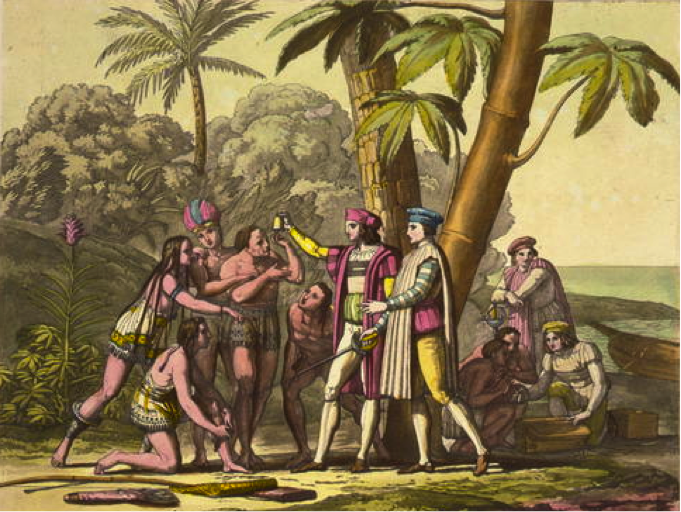
HI34i—Week 2
The Columbian Exchange
‘Why were the Europeans able to conquer America so easily?’
-Alfred Crosby, The Columbian Exchange (1972), p.35

Slide 2
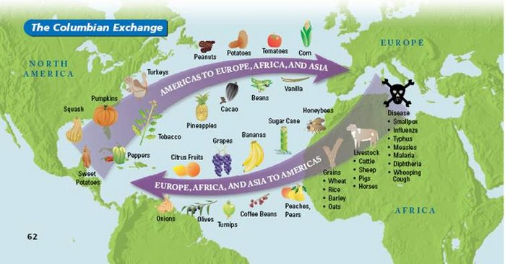

Slide 3
‘Why were the Europeans able to conquer America so easily?’
-Alfred Crosby, The Columbian Exchange (1972), p.35
Traditional interpretations:
Superior technology, military ability
‘Black Legend’: Butchery and brutality, especially by the Spanish
Growing population estimates complicate these narratives.
Crosby’s revisionism: infectious European diseases, particularly smallpox, played a major role in depopulating the Americas
Crosby uses modern epidemiological knowledge about smallpox and its incubation period and transmission rates to explain its probable effects in the Americas—argument hinges on how virulent smallpox is. (Could have killed 1/3 to ½ half of population)
Not only disease itself, but disorder caused by disease, weakens resistance to colonisation.

Slide 4
More biology: W. H. McNeill’s Plagues and Peoples (1976)
Builds on thesis that importation of disease disturbed the American ecosystem, leading to death of 90% of indigenous population within ~120 years of first contact.
High mortality led to societal breakdowns and low morale, facilitating conquest. Religious explanations would see the conquerors as ‘favoured’.
Expands on the disease-exchange narrative, pointing to importation of African diseases to the New World (yellow fever and malaria), and syphilis to Europe.
‘Europe’s expansion is such a central fact of modern history that we are likely to take it for granted and fail to recognize the quite exceptional ecological circumstances [that enabled it]… In all this vast process, bacteriology was at least as important as technology.’ (p.201)

Slide 5
‘Smallpox…does not behave like that’
-Francis Brooks, ‘The Impact of Disease’ p.155
Credits appeal of Crosby thesis to rising pre-contact population estimates, and contemporary knowledge of disease transmission, which could be applied historically.
How to account for 90% decline of American population? ‘Virgin soil’ concept meant diseases like smallpox could be particularly deadly.
BUT… WHO findings on smallpox from 1988 suggest smallpox is not that communicable and is slow to spread across large territories. Historians only assumed it was a likely cause due to contemporary accounts of devastating disease.
Brooks estimates smallpox mortality at only 20-30K, suggesting that pre-contact population is impossible to estimate. Direct and indirect causes of conquest, from trauma, malnutrition, to combat causalities, more likely to have caused millions of death.

Slide 6
‘…not only the blind determination of germs, but also no less deadly human forces.’
-M. Livi-Bacci
Pre-contact population estimates affect weight of attributable causes. Three potential explanations:
Confiscation of labour
Diffusion of disease
Conquest’s atrocities
Disease explanation has risen to make sense of higher population estimates, and in turn have made ever larger estimates possible.
Uses disease models to suggest that only 40% of population would contract smallpox, and subsequent generations even lower rates of transmission. Other factors need to be looked at.
Economic and social dislocation, exacerbated by falling birthrate, more likely. Wars, famines: all ‘human factors’ not biology.

Slide 7
Nun and Qian (2010): ‘The effects that the exchange had on the Old World’
Newly imported calorie rich foods from the Americans such as potatoes and maize led to improved nutrition amongst Europeans.
Trade in new plants such as tobacco, cocoa and vanilla proved prosperous.
New World ecosystem proved useful for growing traditional cash crops like sugar (temperate, fewer parasites).
Valuable commodities such as quinine (anti-malarial) and rubber helped Europeans to consolidate their gains and enabled conquests into other parts of the world.
Forcible migration of peoples, particularly through the slave trade, enabled the creation of exploitative labour systems that benefitted European economies.

Slide 8
Agreements
Population of indigenous Americans significantly declined following colonisation.
Disease played a role in this process.
Exchange of biological matter benefitted Europeans.
Disagreements
No consensus over pre-contact population figures, which changes parameters of the debate.
Some scholars think disease was the primary factor in depopulation of the Americas, others think it was overstated.
The role of smallpox as the major killer is particularly contested, making knowledge about how it currently transmitted more or less relevant.
Significance of other factors (war, displacement, etc) changes highlighted by historians who think disease was less lethal.

Slide 9
BLAME
Does the ‘Columbian Exchange narrative absolve colonisers of blame for the destruction of the indigenous American population? Does the history of imperialism become one of biological determinism?

Slide 10
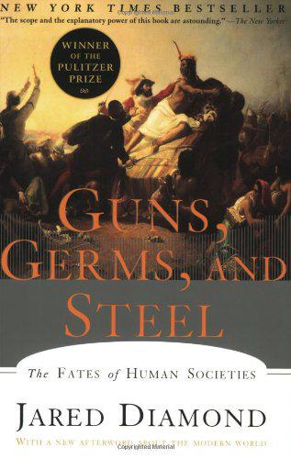
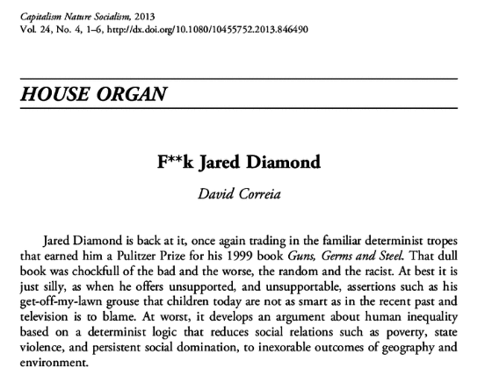

Slide 11
