Slide 1
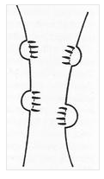
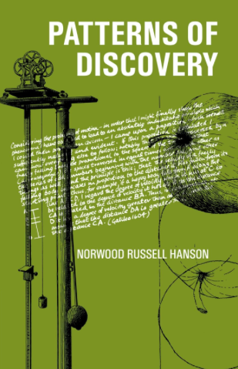
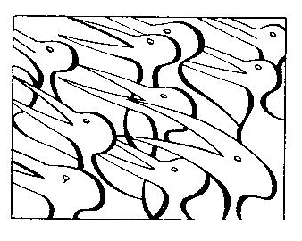
‘Observations are theory-laden’
-N. R. Hanson (1958)

Slide 2
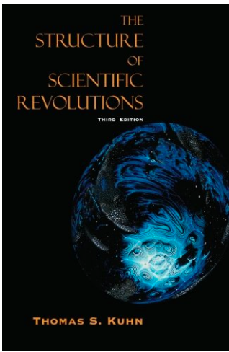
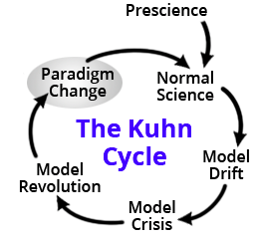
-Paradigm: theoretical model that frames scientific research and observations
-’Paradigm shift’
-Thomas S. Kuhn (1962)

Slide 3
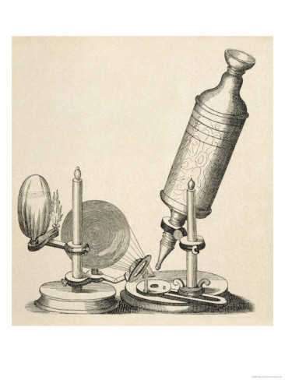
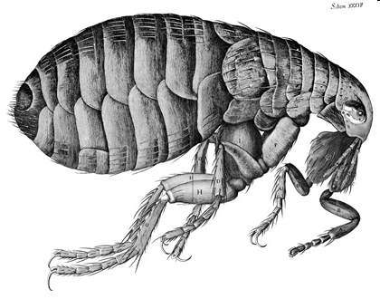
New ways of Seeing
Flea, from Micrographia
Robert Hooke’s Microscope
Micrographia (1665)

Slide 4
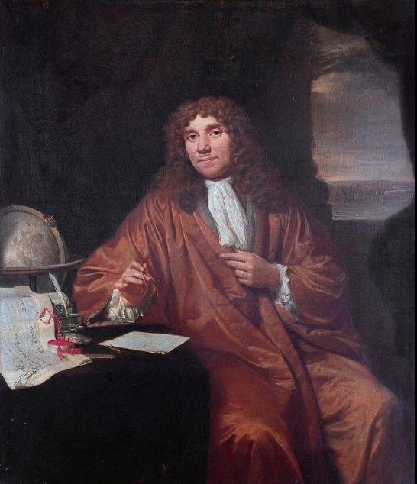
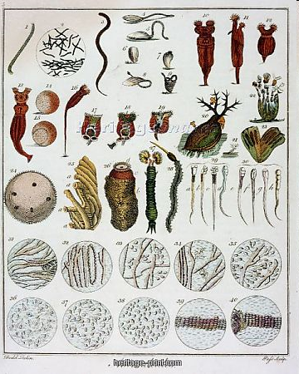
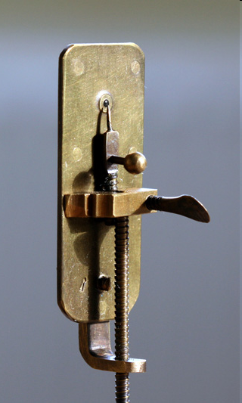
‘Animalcules’ (c.1670s)
Antonie van Leeuwenhoek (1632-1723)

Slide 5
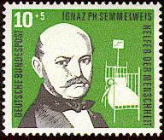
Ignaz Semmelweis (1818-1865): Antisepsis before germ theory
Reduction of puerperal fever by handwashing in chlorinated lime solution
Conflict with conventional medical practice
The right idea at the wrong time?
Observations need an established theoretical foundation?
German stamp 1956
Joseph Lister (1827-1912):
-Antiseptic Principle on the Practice of Surgery (BMJ 1867)
-Ideas gained acceptance with the the spread of germ theory
-Lister is feted and made a Baron, President of the Royal Society, etc

