Slide 1
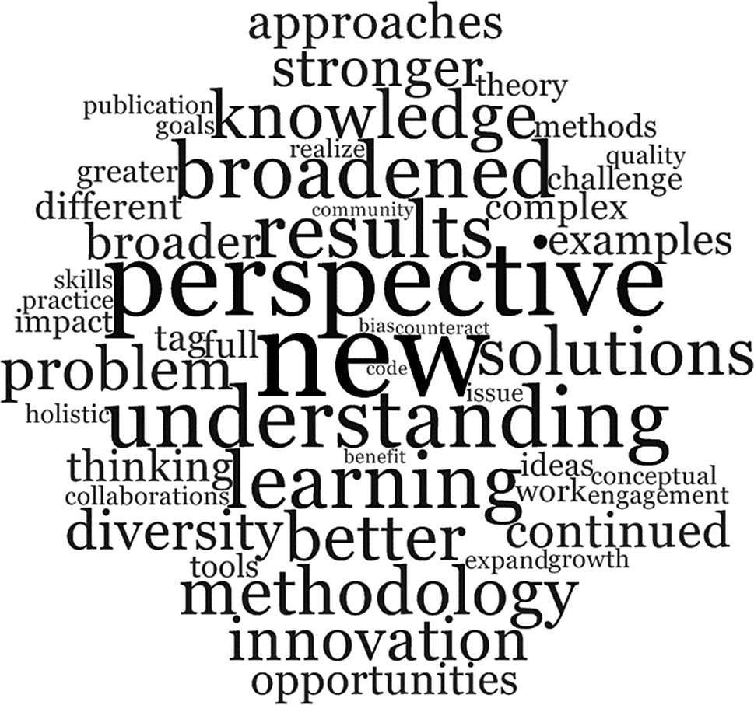
‘Interdisciplinarity’

Slide 2
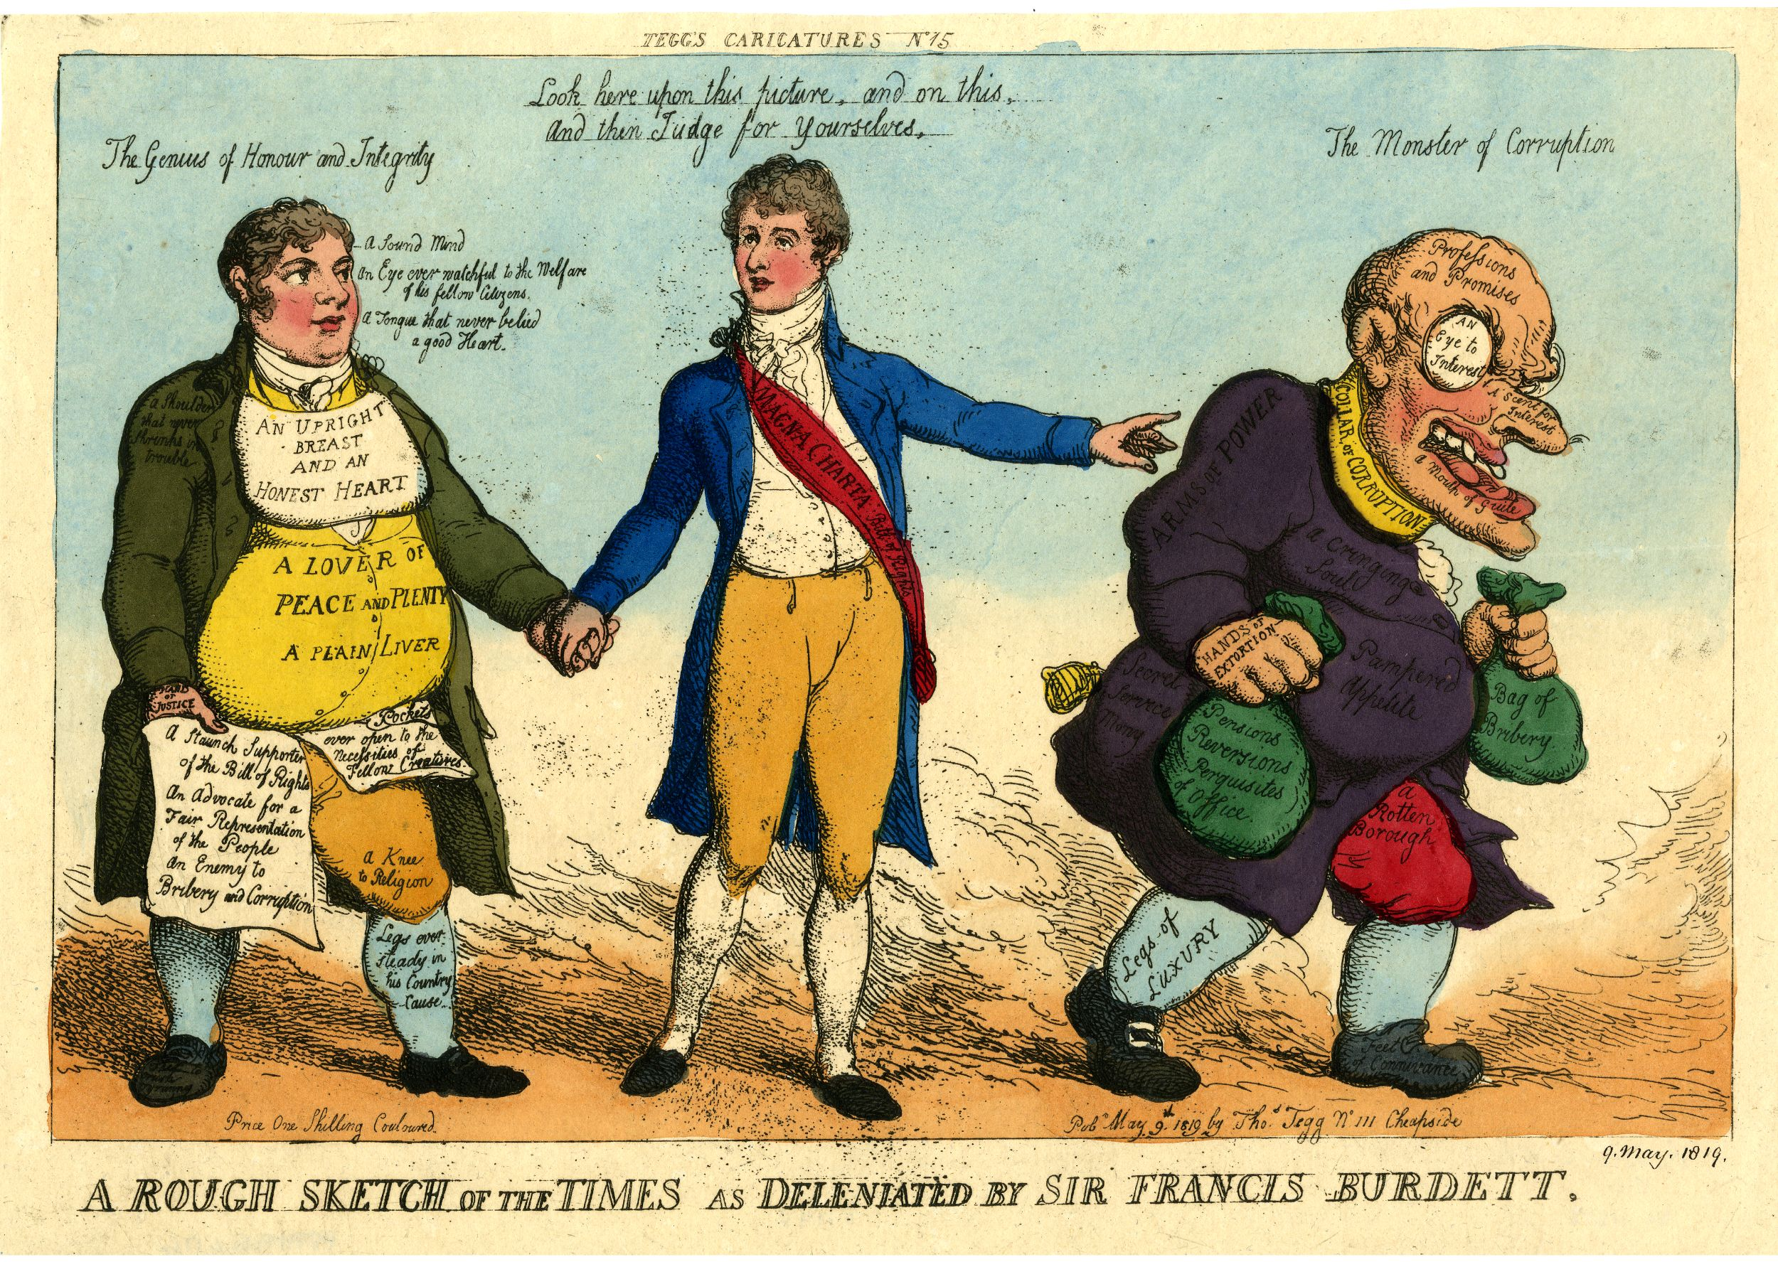
My own work
‘Commonwealth’ project
Corruption as a field: political science, social science (economics, anthropology, sociology), law, literature, art
Satire and laughter
teaching

Slide 3
Institutional support
Centre for Interdisciplinary Methodologies
Humanities Research Centre
Institute for Advanced Studies
GRPs Interdisciplinary Research (warwick.ac.uk) and now ‘spotlights’on Business and manufacturing; Heath; Society and Culture; Sustainability plus two themes that run across all those ‘Behaviour’ and ‘Digital’.
Cross-Faculty Studies School for Cross-faculty Studies - University of Warwick
Cross-faculty centres, projects & initiatives - University of Warwick

Slide 4
What is a discipline?
Communities of scholars who share a field of inquiry or discourse
These have a heritage/institutional structure
They may have specialised languages/terminologies or concepts or methods or customs/practices or scholarly traditions/bodies of work – and these can create borders or boundaries
They have a system of communication through journals, conferences etc

Slide 5
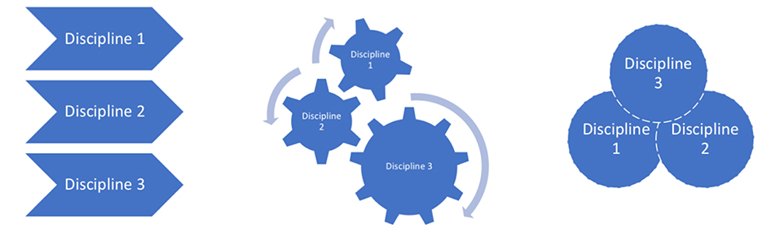
Definitions
Multidisciplinarity is understood to be an additive approach – using knowledge from more than one discipline which are not themselves transformed by being used in conjunction with one another.
Interdisciplinarity is characterized as interaction across and between disciplines. Becomes one activity.
Transdisciplinarity aspires to be a more holistic approach, and aims to displace disciplinary formations.

Slide 6
Types of interdisciplinarity
Three different forms of interdisciplinarity:
Integrative-synthesis;
Subordination-service (eg social sciences add ‘society’ to science);
Agonistic-antagonistic.
Barry, Born and Weszkalyns (2008)
In the third form interdisciplinarity emerges through interferences between disciplines and between disciplines and other forms of knowledge. Disciplines may be transformed in the process.

Slide 7
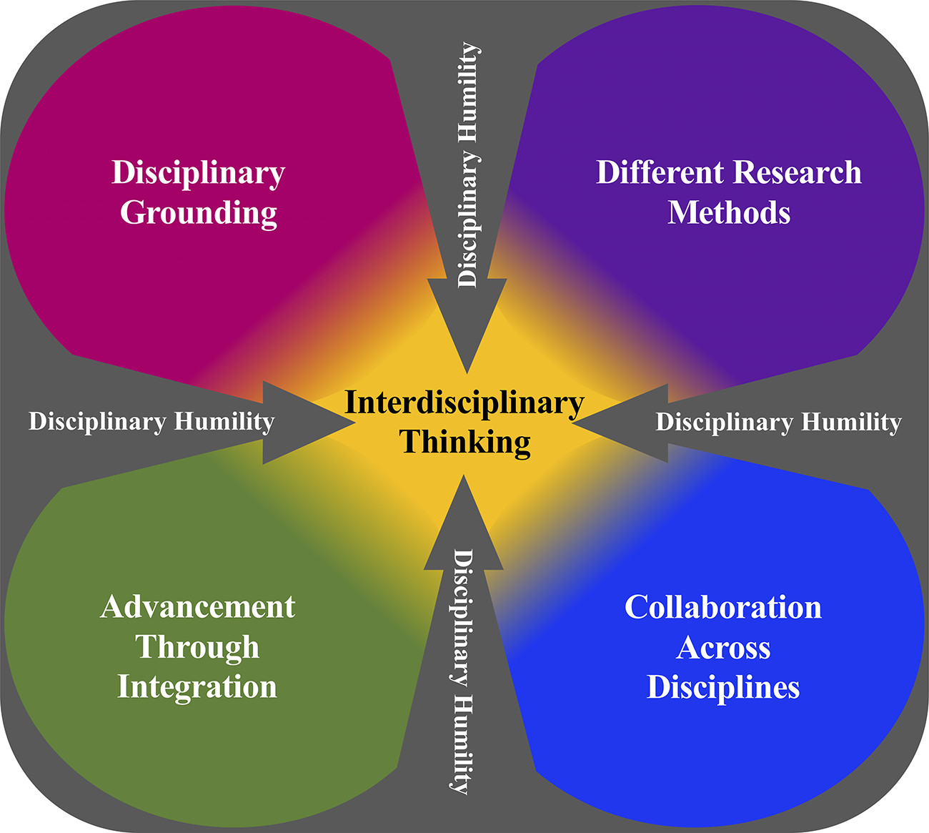
The value of interdisciplinarity
Boix Mansilla, Lamont and Sato (2016) identify the importance of what they call the cognitive-emotional-interactional platform of interdisciplinary research.
They use the term platform to describe what emerges when,
… researchers practically engage one another to work on a common problem … in this shared space, researchers define problems to study, exchange expertise, build personal relations, project and maintain academic self-concepts, and yoke for status; what they create together constitutes a basis that shapes how they collaborate with each other—such as shared language, key concepts, tacit rules of interaction, group culture and identity, and collective mission. (2016: 573)
The platform is ‘both a site of and springboard for collaborative activities—a dynamically co-constructed space with a set of rules and objectives that members develop—and both resultant of and contributing to collaboration’ (2016: 574).

Slide 8
Is History always interdisciplinary?
Different branches of history
Social, economic, intellectual, global etc
Historian on the Edge: What do we mean by ‘Interdisciplinarity’? (600transformer.blogspot.com): Guy Halsall.
‘What is at stake here is how one draws and defines the dividing lines on the map of the academy, and what is involved in intellectual exchange. I suggest, might be a more meaningful way of thinking about the fruitful confrontation of difference – a more interesting way of drawing the lines that sub-divide academia – is the confrontation of theoretical approaches’

Slide 9
The History of Interdisciplinarity
Interdisciplinarity itself has a long history
But it also has a more recent ‘rise’
Some writers – such as Richard Tabulawa (2017) - locate the current resurgence of interest in interdisciplinarity in relation to a global context of a growing instrumentalisation of knowledge, occasioned in part by the advent of the knowledge society.
Tabulawa’s suggestion is that interdisciplinarity is not some neutral, apolitical technical re-arrangement of knowledge. Rather, it is a political technology implicated in attempts to break academics' monopoly on the processes and products of higher education to form new academic identities and subjectivities that reflect a corporatist ethos.
It seeks to achieve this, he suggests, by wresting the power to control the processes and products of the university away from academics and forming new academic identities and subjectivities that support the needs of the market-based economy ie part of neoliberal agenda
From outside the arts and humanities? Making science accountable
Funding bodies encouraging it: UKRI, Wellcome

Slide 10
Routledge Handbook of Interdisciplinary research methods, ed Lury et al, 2018
Wedging - something that connects scholars with different interests. (Jane Calvert)
Deriving - to derive is not simply to come into possession of something, rather it is to acquire something by means of drawing it out from something else, and often in the endeavor of drawing it out, transforming it. We derive by extension. We derive by modification. … What we derive from design, as mode of making-as-inquiry, is not solutions, but rather productive glitches, difficulties, and complications. (Carl Disalvo)
Disrupting - The idea of disrupting, as we develop it here, refers to an improvisatory process that ‘corrupts’ ethnographic and design principles when they are brought together. (Yoko Akama and Sarah Pink)
Avoiding closure - (Priska Gisler)
Enabling engagement from a wide audience

Slide 11
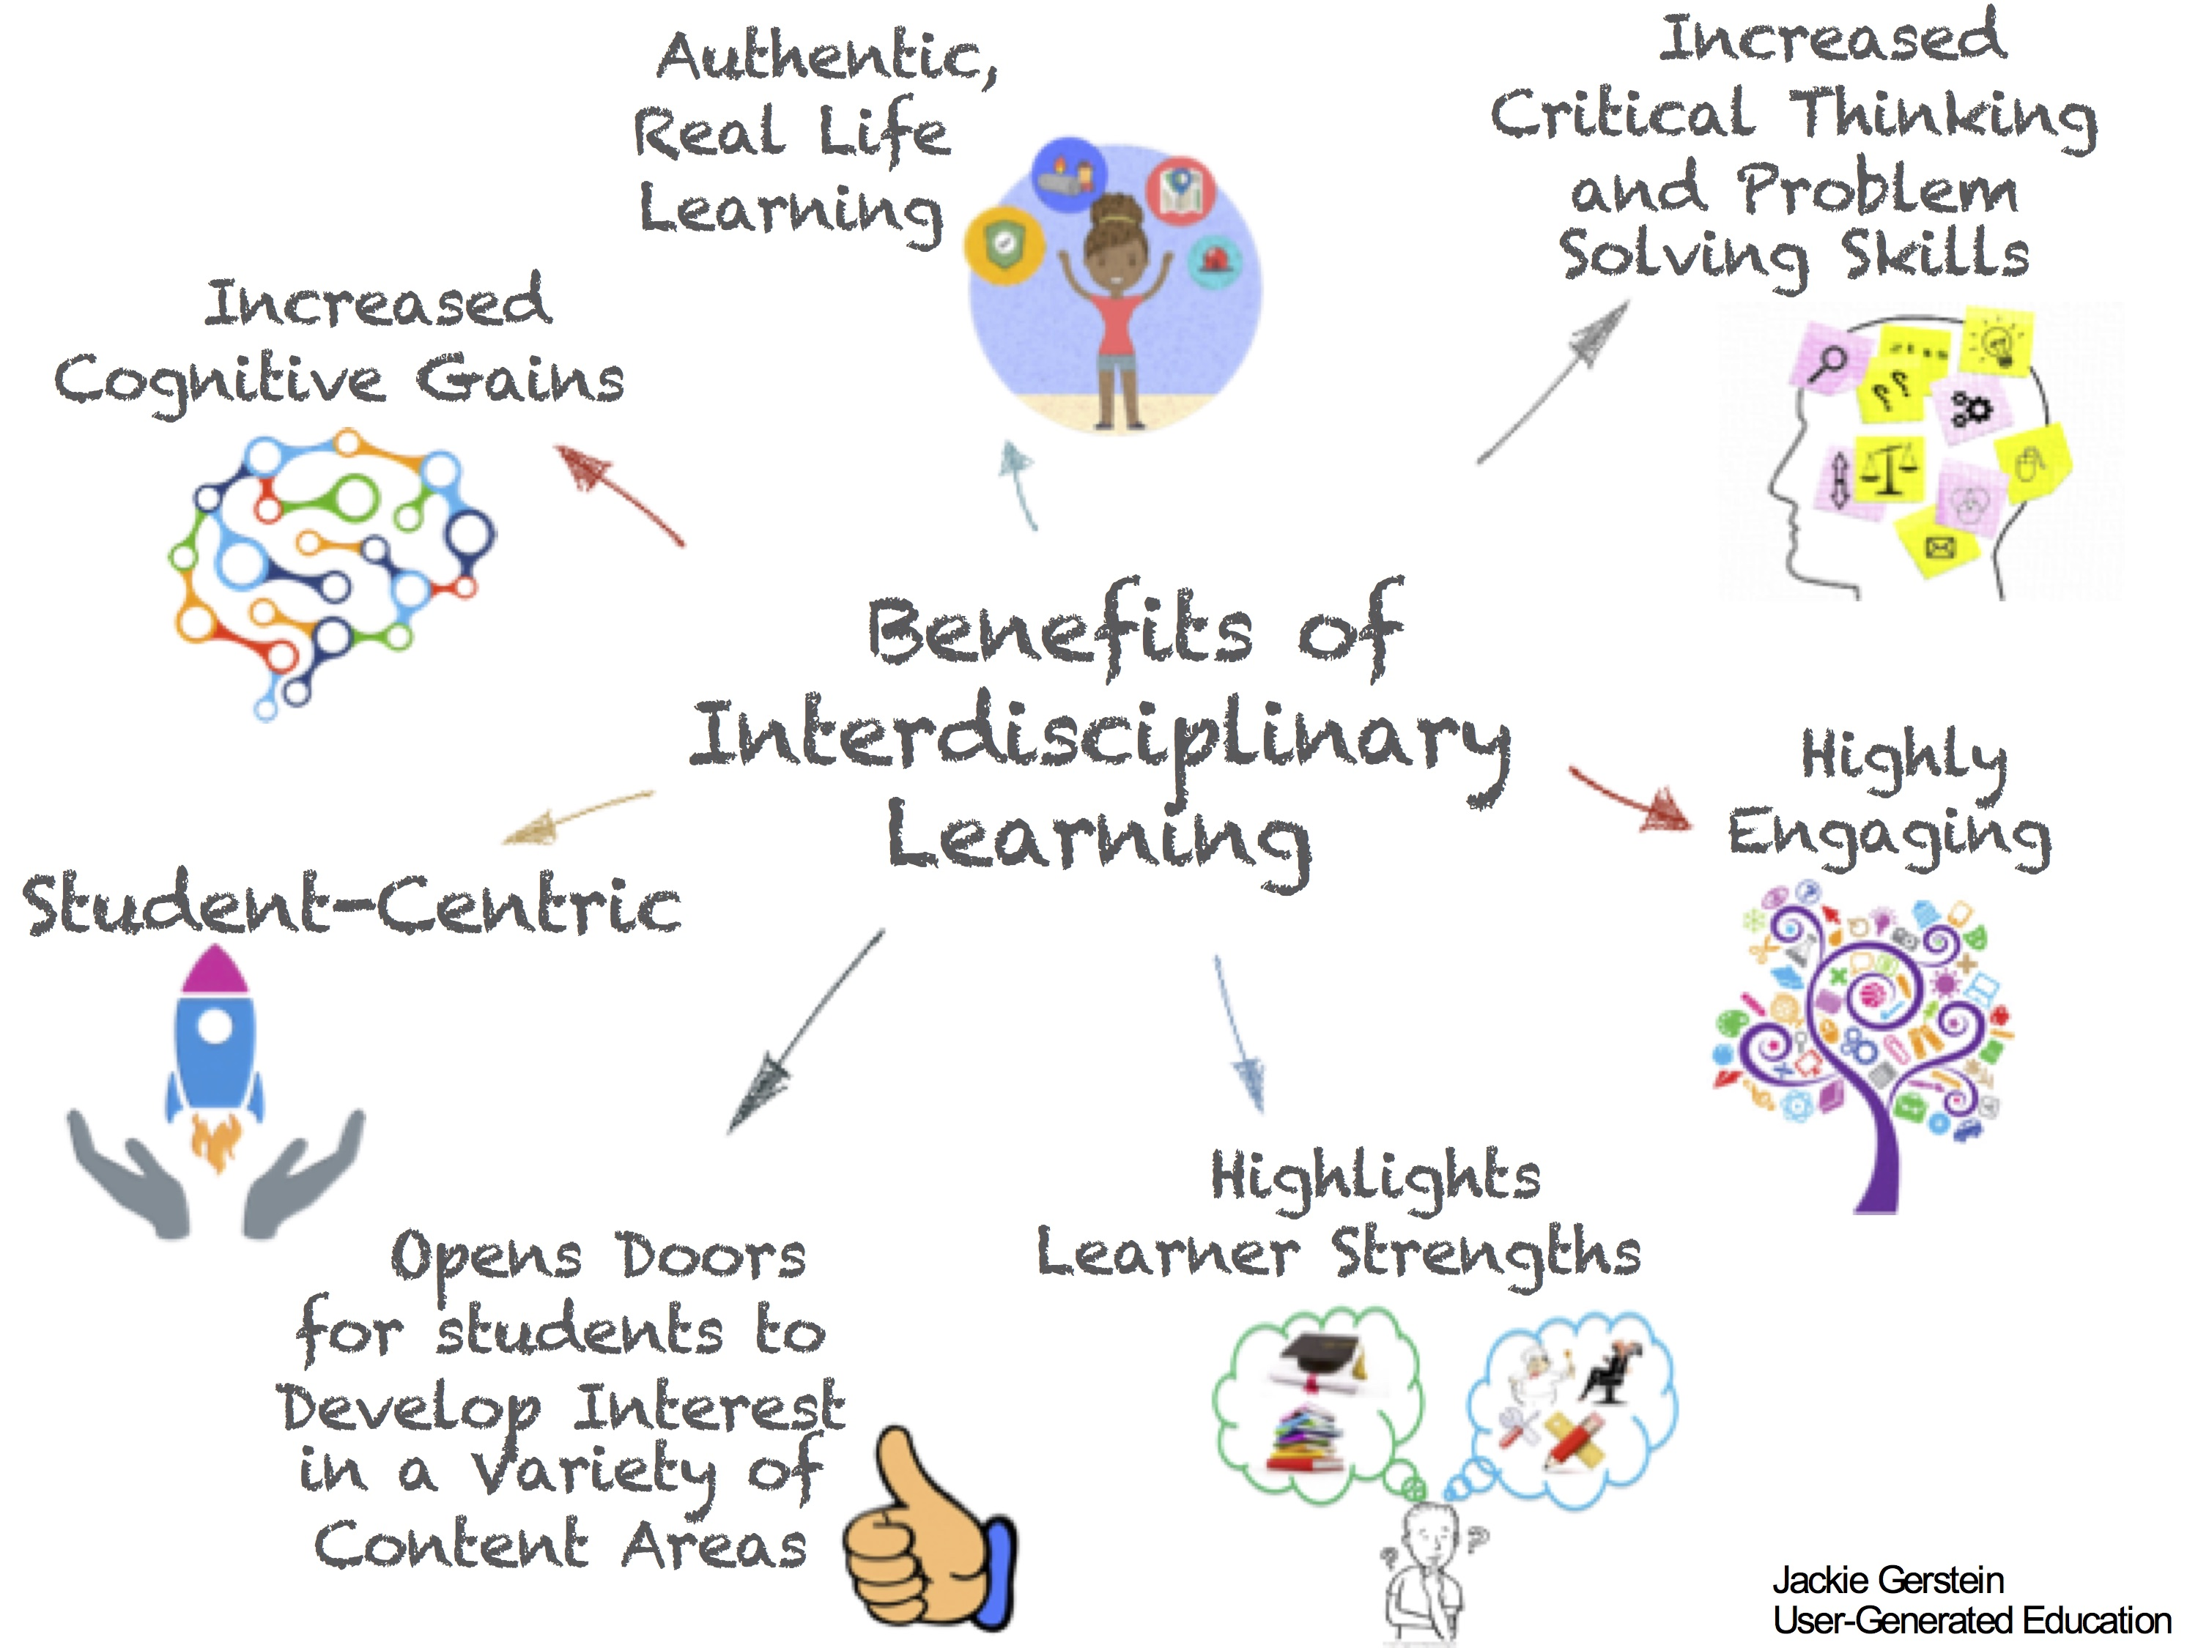

Slide 12
Challenges/difficulties
Different disciplinary training, conventions, expectations and modes of explanation
a sense of ‘loss’ (some art historians value ‘excellence’)
How to write collaboratively?
Mastering diverse literature
confidence
Institutional barriers

