Slide 1
Making of the Modern World:
Health, Medicine and Modernity
Part 1: Protecting Publics?
Roberta Bivins
Office: H3.30
Email: r.bivins@warwick.ac.uk

Slide 2

Welcome to Warwick, Welcome to MMW
What does medicine have to do with ‘Making the Modern World’, you ask?
Well… today we’ll discuss exactly that!
Historical precedents for unprecedented (Covid) times;
Constructing ‘the public’
Exploring the invention of ‘social and economic rights’
By the end of Part 1 , you will be able to draw a direct connection between the UK’s Covid response and the political philosophies of 19th century Britain…
Hi! I’m Roberta. This is what I look like – if you see me around, come say hi!

Slide 3
Free movement, free trade, and Britain’s ‘cholera years’, 1831-1866
← ‘John Bull defending Britain against the invasion of cholera; comparing the Reform Bill to the cholera epidemic’. Coloured lithograph, O. Hodgson, London (10 Cloth Fair) c. 1832
‘[O]ne of the most terrible pestilences which have ever devastated the earth … If this malady should really take root and spread in these islands, it is impossible to calculate the horror even of its probable financial results alone.’
Quarterly Review, 1832, vol 46, p 170
Versus:
‘Cholera humbug! – Inhabitants of Lambeth, be not imposed upon by the villainously false report that Asiatic Cholera has reached London. A set of half-starved doctors, apothecaries’ clerks, and jobbers in the parish funds, have endeavoured to frighten the nation into a lavish expenditure; with the Government they have succeeded in carrying a bill which will afford fine pickings. A ruinous system of taxation, starvation, and intemperance has long been carried on; … and disease is the natural result.’
Text of a placard displayed in Lambeth c 1831-2, see the notes.
And for more on Cholera and its impact on the 19th century and beyond, see this readable account: https://sickcityproject.wordpress.com/2013/03/11/john-snow-and-cholera/
‘I am jealous of the Glory of this new-imported Nabob, from the Indian jungles, his Serene Blueness, Prince of Air…’ S.T. Coleridge, ‘Cholera Cured Beforehand’ 1832.
Image Description: John Bull grasps the blue shrouded 'cholera' round its neck brandishing a club inscribed: "Heart of oak" and saying: "Now you rascal where are you going to". It replies: "I am going back again" while reaching for a scroll under Bull inscribed: "Reform Bill". The fence through which it squeezes reads: "The wooden walls of England" and bears two signs: "Beware of the Bull" and "Board of Health”. © Wellcome Library no. 12236i
Notes:
Quotation from placard reproduced from Alan Bewell, Romanticism and Colonial Disease (London: Johns Hopkins University Press, 1999) p.253

Slide 4
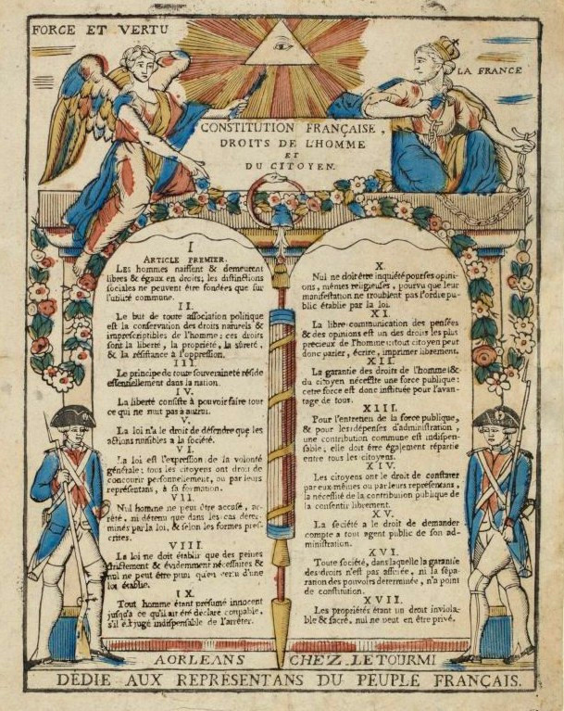
Declaration of the Rights of Man, 1789 (read the whole document in English translation here: https://avalon.law.yale.edu/18th_century/rightsof.asp)
Articles:
1. Men are born and remain free and equal in rights. Social distinctions may be founded only upon the general good.
2. The aim of all political association is the preservation of the natural and imprescriptible rights of man. These rights are liberty, property, security, and resistance to oppression. …
4. Liberty consists in the freedom to do everything which injures no one else; hence the exercise of the natural rights of each man has no limits except those which assure to the other members of the society the enjoyment of the same rights. These limits can only be determined by law. …
6. Law …must be the same for all, whether it protects or punishes. All citizens, being equal in the eyes of the law, are equally eligible to all dignities and to all public positions and occupations, according to their abilities, and without distinction except that of their virtues and talents. …
8. …no one shall suffer punishment except it be legally inflicted in virtue of a law passed and promulgated before the commission of the offense. …
10. No one shall be disquieted on account of his opinions, including his religious views, provided their manifestation does not disturb the public order established by law.
11. The free communication of ideas and opinions is one of the most precious of the rights of man. Every citizen may, accordingly, speak, write, and print with freedom, but shall be responsible for such abuses of this freedom as shall be defined by law. …
17. Since property is an inviolable and sacred right, no one shall be deprived thereof except where public necessity, legally determined, shall clearly demand it, and then only on condition that the owner shall have been previously and equitably indemnified.
‘Estampe Déclaration des droits de l'Homme et du citoyen de 17 articles votés par l'Assemblée Constituante en totalité le 26 août 1789.’ Créateur Letourmi (Orléans). Musée de la Révolution française.
Image by Milky - Musée de la Révolution française, CC BY-SA 4.0, https://commons.wikimedia.org/w/index.php?curid=78860432

Slide 5
What makes a ‘epidemic’? Counting and comprehending epidemic threats
William Farr, Report on the Mortality of Cholera in England, 1848-49 ... for H.M.S.O., 1852
Notes:
William Farr, Report on the mortality of cholera in England, 1848-49, London : Printed by W. Clowes ... for H.M.S.O., 1852
Covid deaths data from https://coronavirus.data.gov.uk/deaths

Slide 6
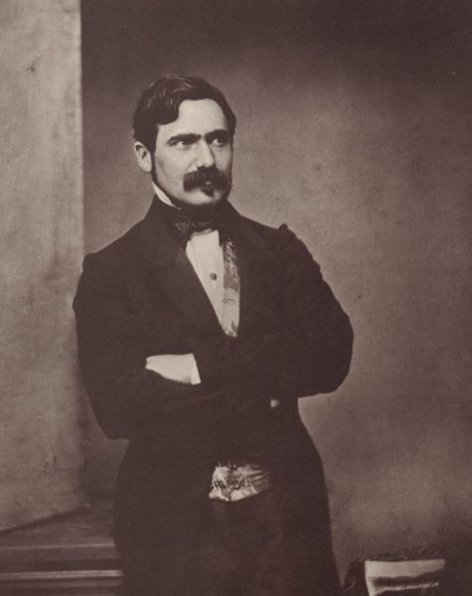
Epidemic scepticism and scientific disputes: not novel either!
Max Joseph von Pettenkofer (1818-1901), circa 1860 Wikimedia Commons (photographer: Franz Hanfstaengl)
‘Positively, we must find something; it won’t do to lose our Twenty guineas a day!’
Notes:
A London Board of Health hunting after cases like cholera. British Museum, Catalogue of political and personal satires, vol. 11, London 1954, no. 16963 Courtesy Wellcome Images.
For more on Max von Pettenkofer, see https://www.en.uni-muenchen.de/news/newsarchiv/2018/pettenkofer.html

Slide 7
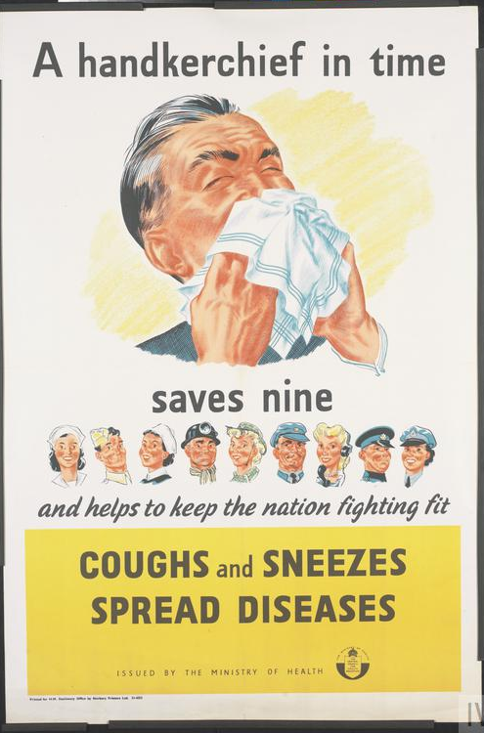
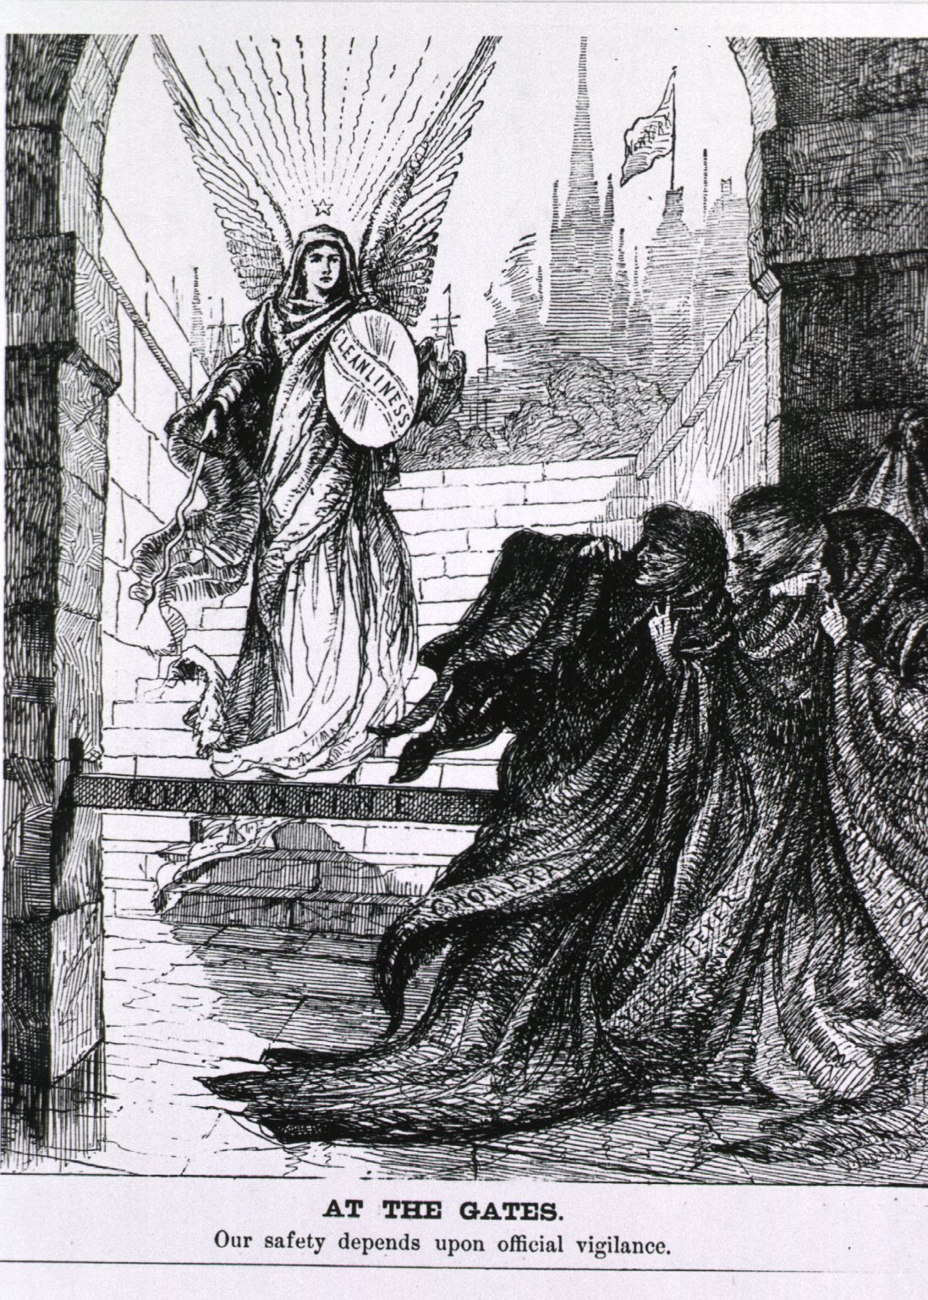
Who is responsible for health in epidemic times?
Individuals?
States?
‘A handkerchief in time saves nine and helps to keep the nation fighting fit COUGHS and SNEEZES SPREAD DISEASES ISSUED BY THE MINISTRY OF HEALTH THE MINISTRY OF HEALTH’ THE CENTRAL COUNCIL FOR HEALTH EDUCATION Printed for H.M. Stationery Office by Norbury Printers Ltd. 51-4253 Courtesy, Imperial War Museum.
‘At The Gates. Our safety depends upon official vigilance’, Harper’s Weekly, 1885, courtesy National Library of Medicine USA. For more, see https://www.nlm.nih.gov/exhibition/visualculture/introduction.html

Slide 8
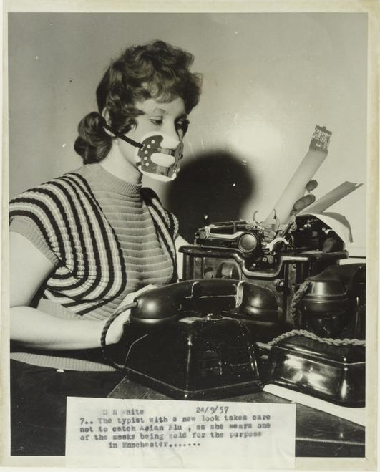
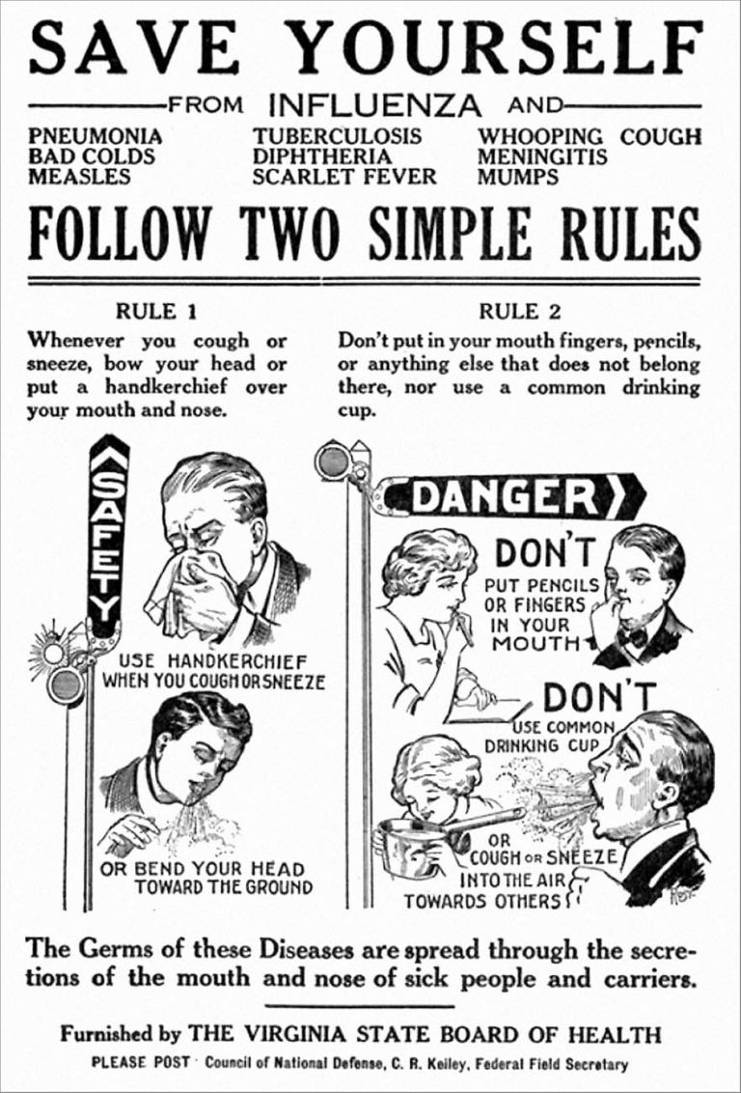
Epidemics and ‘the public’: Behaviour and blame in pandemic times
‘Responsibilization’ and Commodification
24 Sept. 1957: Daily Herald photograph by White showing a typist in Manchester wearing a mask designed to prevent catching Asian Flu.(c) Mirrorpix
Flyer warning about the spread of common infectious diseases made during the 1918 influenza epidemic. © US Library of Congress.
Notes:
Daily Herald Archive, National Science and Media Museum, object number 1983-5236/10427

Slide 9
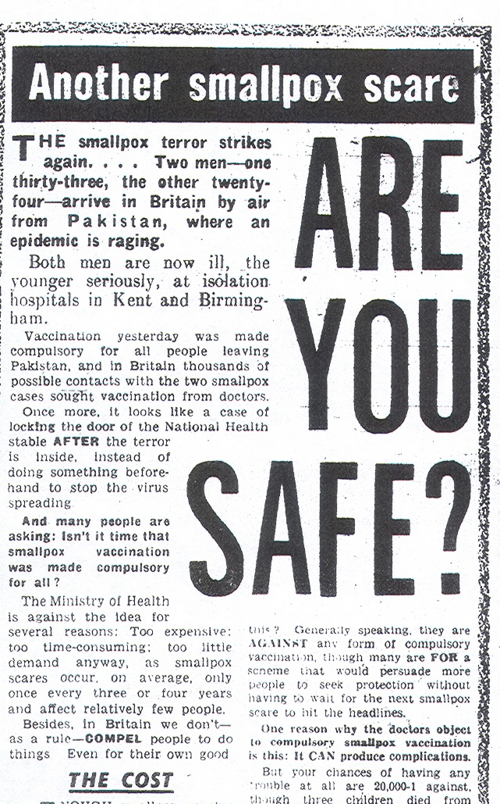
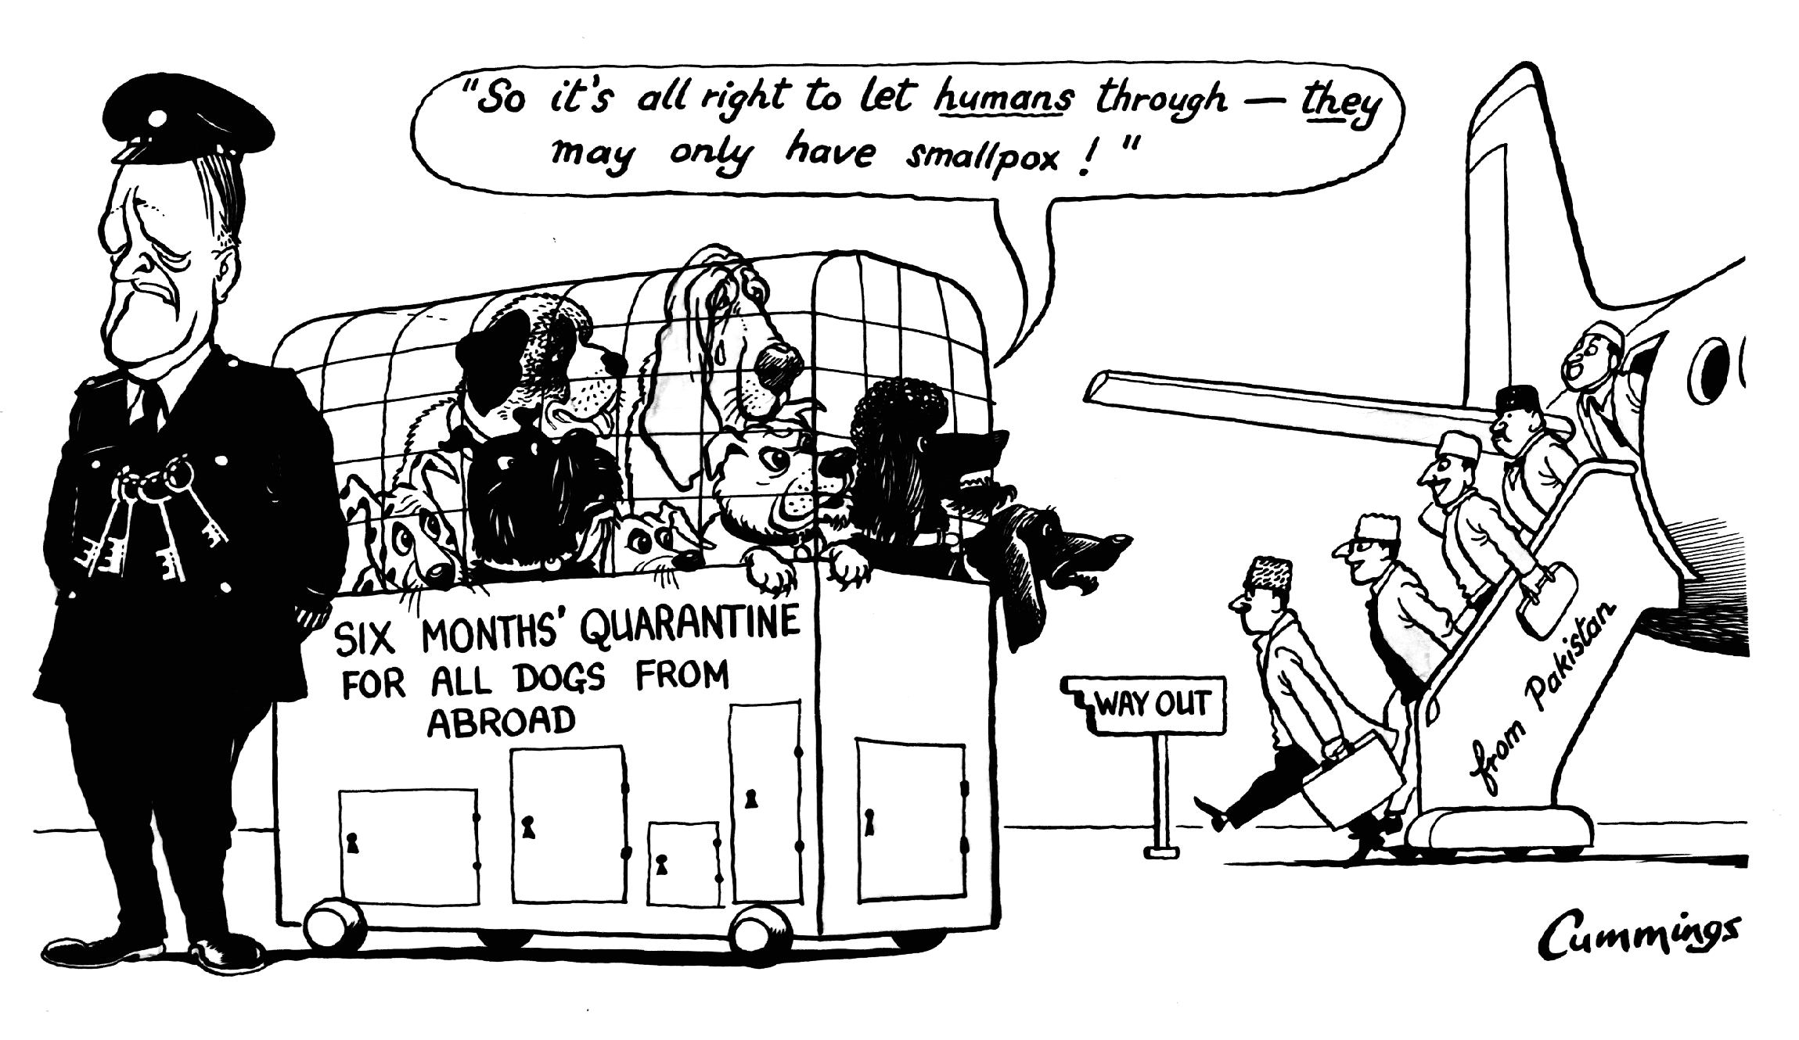
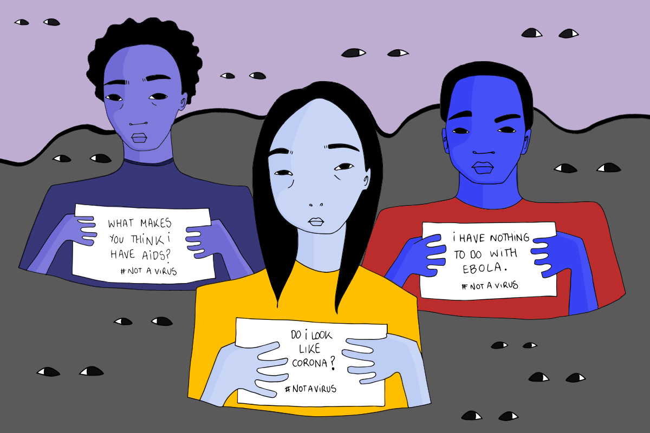
Who is (or isn’t) ‘the public’: what epidemics can tell us about race, rights, and ’imagined communities’
© Express Syndication Ltd., British Cartoon Archive, University of Kent, Michael Cummings, Daily Express, 17 Jan 1962
“CHECK! A foreigner brings smallpox into this country and a Ministry of Health spokesman admits that there is no check … against the terrible disease. Scandalous! A health check should be rigidly enforced, particularly when a person has come from an Eastern country.”
Daily Mirror, ‘Letters’ Jan 1 1962
© Aude Nasr #NotAVirus, https://gal-dem.com/racism-spreads-faster-than-most-epidemics/2 February 2020
Notes:
IMAGE FROM JAN 4 DAILY MIRROR
QUOTE FROM Daily Mirror letters, Jan 1

Slide 10
Thinking about the Part 1 Readings
Fairchild et al. (required):
Focused on the US — so in what ways do the authors’ findings and arguments apply more globally (e.g. to the UK)? Are there limitations due to its US-centric approach?
What do we learn about ‘the making of the modern world’ from the long timespan and varied examples covered here?
Who are the authors, and who is their audience?
Maglen (recommended background):
Why did Britain expand and then abolish port quarantines and then ‘port prophylaxis’ in the epidemic times of the 19th century?
What does looking at 19th century ‘cordons sanitaire’ practices tell us about trade, empire and ‘the making of the modern world’?
Who is the author and who is her audience?

Slide 11
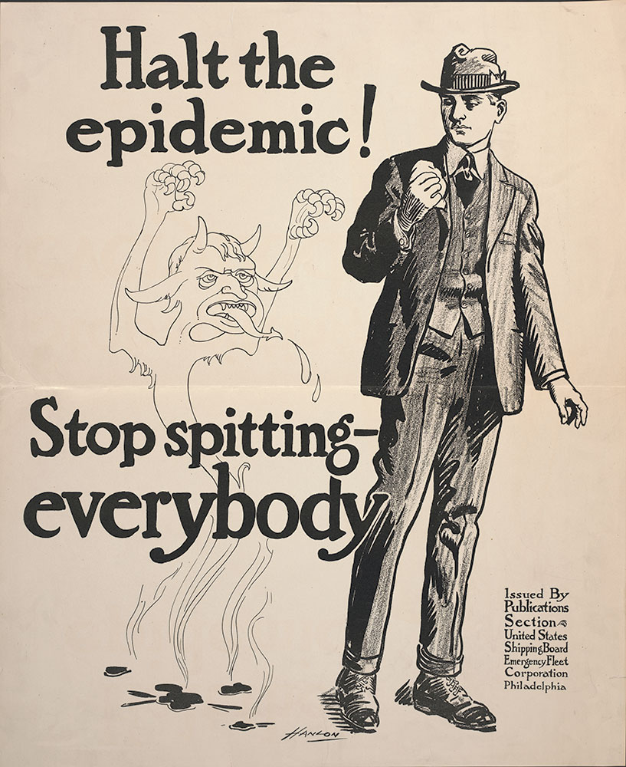
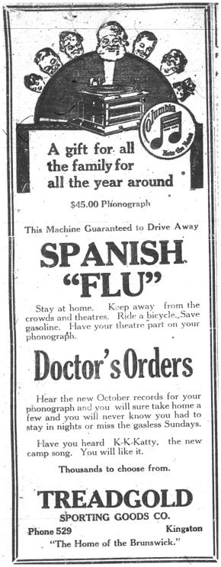
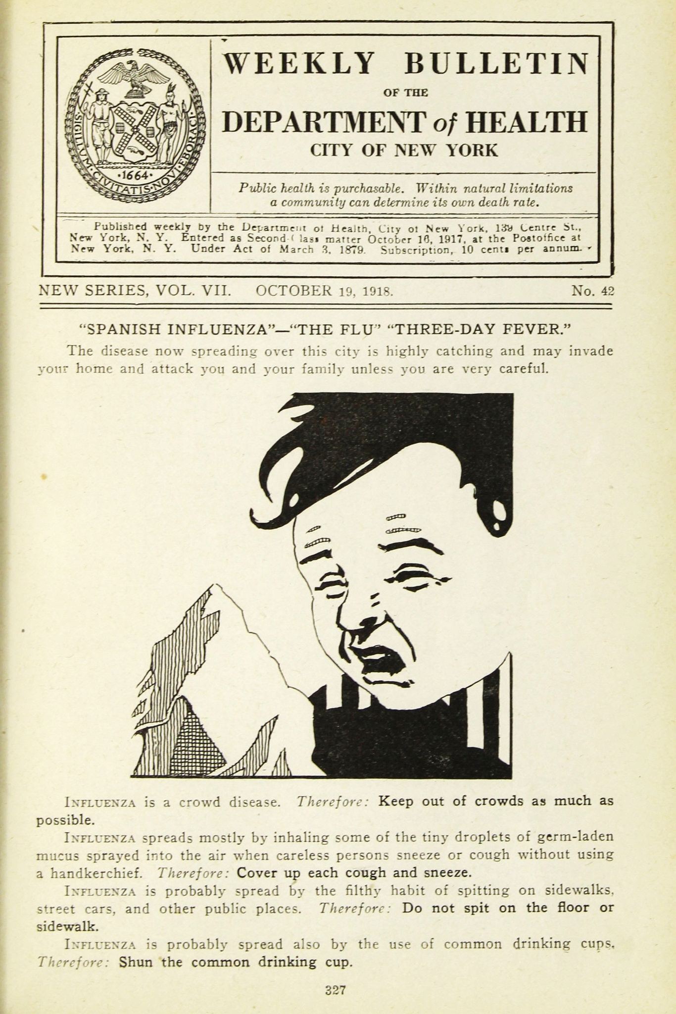
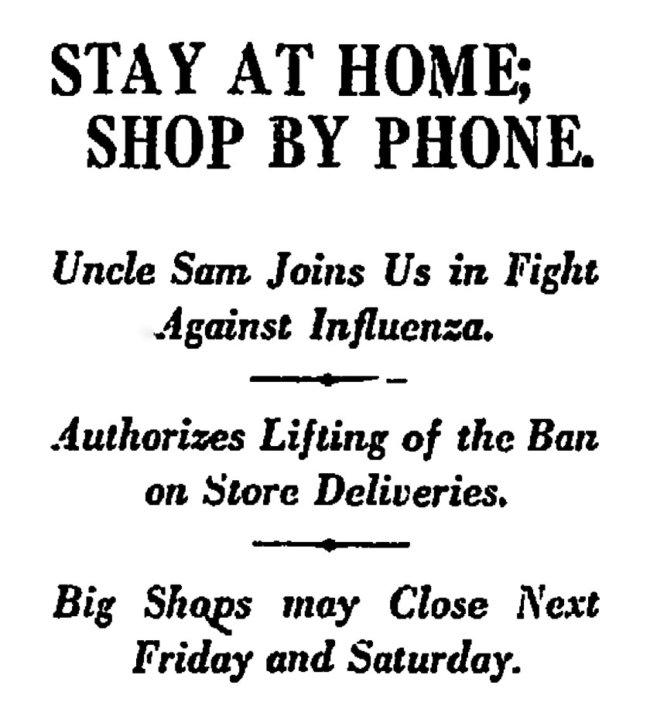
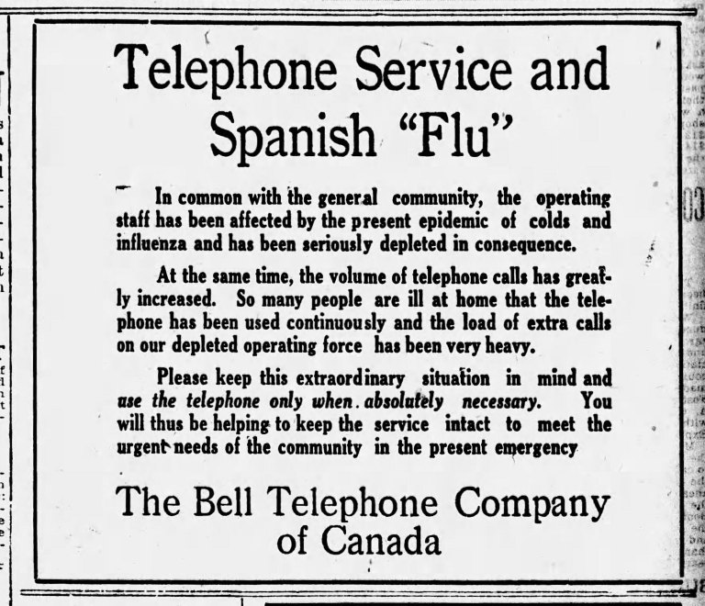
US Shipping Board Emergency Fleet Corporation - Publisher. (1918). Halt the epidemic! Stop spitting- everybody. Retrieved from https://libwww.freelibrary.org/digital/item/65051
A little something to think about for seminar… looking at all of these historical images, reflecting North American responses to the Spanish Flu pandemic of 1918-19, what looks familiar to you, living through Covid? Why might there be similarities, and what can they tell us? What is different?
LA Times, 1918
Columbia Records ad 1918 ©Museum of Healthcare
https://museumofhealthcare.wordpress.com/2017/05/19/the-infamous-spanish-influenza/
Ottawa Citizen, 15 Oct., 1918
© New York City Municipal Archives
Notes:
A clipping from The Ottawa Journal on Saturday, Oct. 19, 1918 found at https://kitchissippi.com/2020/04/05/quick-to-act-how-ottawa-quelled-the-spanish-flu-in-1918/

