Slide 1
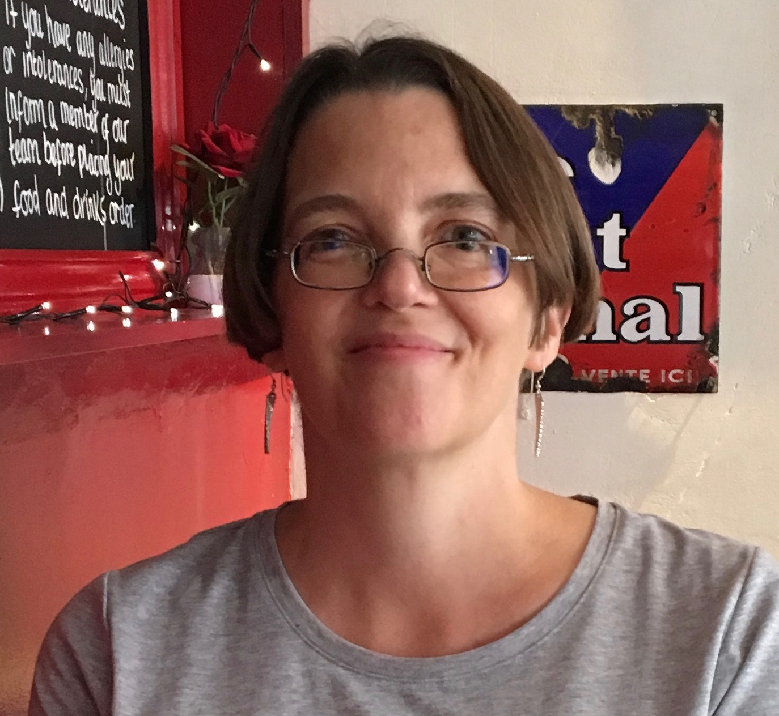
Making the Modern World: Health, Medicine and Modernity
Part 2: Making up (sick) people
Roberta Bivins
Office H3.30
Email: r.bivins@warwick.ac.uk
Hi: it’s me again!

Slide 2
Headline Ideas
Biomedicine, like public health (Part 1), is a part of the global society in which it operates. It is not neutral, morally or politically. This makes it a great window for ‘seeing’ both continuity and change in how we think about ourselves and others.
Today, biomedicine has a lot of ‘cultural capital’ and can be powerfully influential on politics, policy-making and society. This is not natural or inevitable: the authority we invest in medical science and medical practitioners has deep historical roots. Crucially for us, many of the phenomena that underpin biomedicine’s power and prevalence today ALSO helped to make the ‘modern world’ as we experience it today.
Notes:
So: in the first half of this unit, the lecture focused on the relationship between politics, scientific authority, and public health responses to epidemics of contagious disease. In this second half we are going to look a little more closely at the role biomedicine plays in society more generally. Here, I’m presenting you with two key ideas at the heart of our approach to this subject. Keep these in mind as we work through the rest of the lecture today.

Slide 3
Key concepts & unit case studies
Joe and Josephine, the average (mean) Americans, 1959
Concepts:
Medicalisation
‘Making up people’ (a phrase coined by philosopher Ian Hacking.
Pro Tip: you can read Ian Hacking talking about this himself here: https://www.lrb.co.uk/the-paper/v28/n16/ian-hacking/making-up-people ; his case study is ‘multiple personality’)
‘Biomedicine’ case studies:
Making up ‘the average man’
Making obesity ‘epidemic’
Making the eugenic diabetic (See your readings and be ready to discuss in seminar! ‘Starter’ primary sources are at the end of the lecture)
Henry Dreyfuss Associates, Whitney Library of Design, 1969 (first published 1959)
Notes:
So before we dig into the case studies to try to get a real sense of ‘how ‘biomedicine’ operates in the world, I want you to have two intellectual tools that work really well together to help you analyse these phenomena. The first is the idea of ‘medicalisation’: this is a way historians and others have come to refer to the process by which a set of physical or mental experiences, an identity, or a behaviour or behaviors move from being thought of as social and cultural – as emerging from personal choices, weaknesses, or beliefs, -- to being thought of as rooted in physical or physiological states. Why does this matter: well, first of all, actions and behaviors that result from personal choices or weaknesses are open to moral and community interventions and judgements. If you are a big drinker because you enjoy the taste of beer, or the feeling of being drunk, that’s on you. If it gets you into trouble, that’s your fault. But if being a big drinker is the result of family alcoholism, and is hereditary, then the problems you face because you get drunk a lot are medical problems, and society owes you care and support, not judgement. So that’s one key reason to keep an eye out for the process of medicalisation: it both reveals and can drive forward big social changes. But the other reason is about who it empowers. If a socially disfavoured condition like heavy drinking is the result of personal failings, then the people who are experts are moral and religious leadrs, and those who make and enforce laws that control damaging behaviour. But if it is a result of disordered physical, physiological or mental health, then the experts who society turns to are doctors. So ‘medicalisation’ is not neutral either: it shifts the balance of power over social behaviors away from one set of authorities to another.
Medical authority over the social and cultural has been growing, in part through the processes of medicalisation, at least since the 19th century.
OK. So that’s tool one. What about ‘Making up people’? Well, for our purposes, we can think of Hacking’s process as a refinement of ‘medicalisation’ though it is used far beyond this topic as well. Hacking argues (and historical research supports this) that societies and states operate through classifying groups and types of people – rich and poor, young and old, ‘belongers’ and foreigners, male and female -- and today other genders, and the like. The categories shift and interact, and the more we study those included in a category, the more the category changes and develops. SOMETIMES – and today, very often, because we have given the sciences a lot of power and authority in out culture – science create s a new category, to explain, understand and operate on people: it makes them up. Our case studies today will show you how this works.
Image courtesy CooperHewitt Deign Museum https://collection.cooperhewitt.org/objects/51497617/

Slide 4
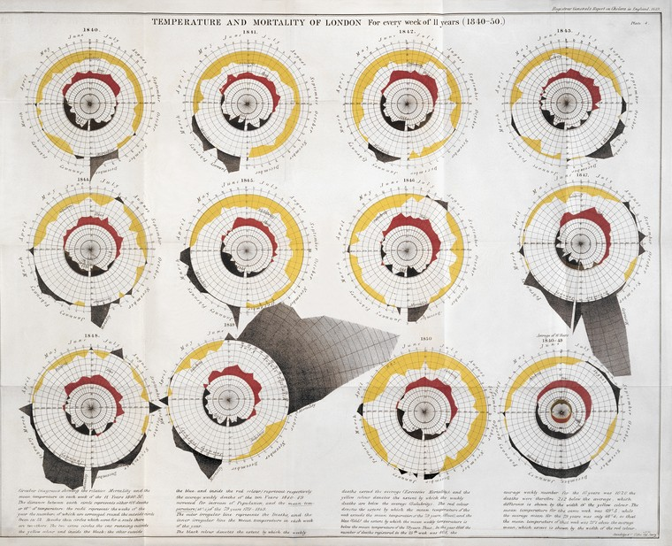
Making up l’homme moyen (‘the average man’) Context: A classifying, quantifying, measuring age…
Measurement comes to medicine with a vengeance in the 18th and especially 19th centuries
méthode numérique
méthode anatomo-clinique
statistics
Quantification is at the heart of these rapidly diffusing if controversial innovations.
Chart showing temperature and mortality of London for every week of 11 years, 1840-50. The shaded black colour denotes the extent by which the weekly deaths exceed the average; the yellow colour denotes the extent by which the weekly deaths are below the average; the red colour denotes the extent by which the mean temperature of the week exceeds the mean temperature of the years 1771-1849; the solid black denotes the extent by which the mean weekly temperature is below the mean temperature of the years 1771-1849.
William Farr, Report on the mortality of cholera … London: HMSO, 1852 courtesy Wellcome Library
Notes:
From the early 18th century, there is an increasing push in European medical thinking towards greater empiricism – that is, more attention to direct observations of the natural world of sickness, and to correlating these observations with medical theories, on one hand, and medical practices on the other. The method numerique did more or less what it said on the time: it involved meticulous counting and recording of cases and the conditions under which they were observed, and also how they responded to different medical interventions. Alongside these efforts of mass observation and enumeration of the living, the mid- to late 18th century also saw the emergence of closer studies mapping observations made of patients in sickness to discoveries made after the patients had died, through anatomical dissections. Symptoms were gradually linked to findings post-mortem, generating greater knowledge of the causes of disease, and also the effects of certain kinds of medical interventions before death. By the 19th century, medical statistics was becoming epidemiology as we know it today – not just for mapping epidemics as we saw it in part 1 and here on the slide above! – but for healthy and later chronically ill people.

Slide 5
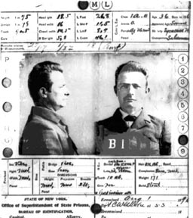
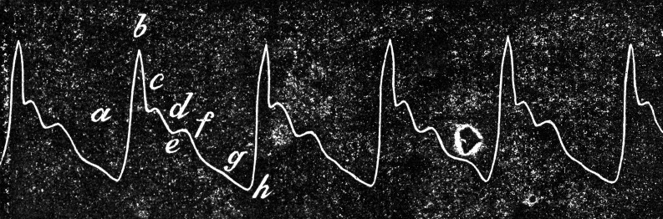
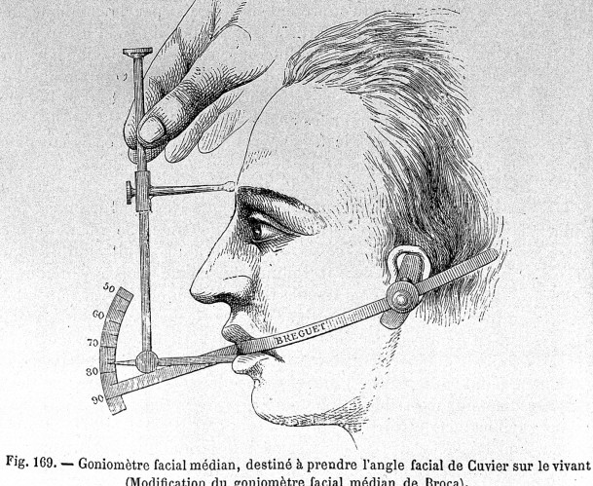
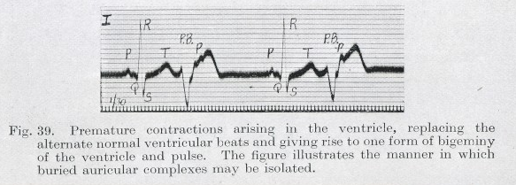
Context: Cultures of Quantification
Clockwise from top left
Bertillonage c. 1900s
Sphygmograph, 1882
Craniometry c. 1870s
Electrocardiograph, 1913
Notes:
A whole host of new tools helped extend the reach of what could be measured and counted, across the 19th century. On this slide I am showing you just a few of the new technologies of measurement that created what we can think of as a culture of quantification — of knowing objects and phenomena through counting and measuring them. Some will be familiar — the sphygmograph was a device for measuring blood pressure through the strength of the pulse, and of course the electrocardiograph is still in use today to diagnose heart abnormalities. Others, like the tool for measuring ‘facial angles’ in the bottom right was, in its day the state of the art tool for craniometry: the scientific measurement of skull size, volume, and shape in the mistaken believe that such measurements could reveal intelligence, and even the capacity of a person to learn or become ‘civilised’. Craniometry was a key part of scientific racism — one of the tools that ‘made up’ — in Hacking’s sense — the superior European male and the inferior everybody else. Finally, in the top left, you’ll see Bertillionage, a technique for generating fixed identities for criminal or criminalised people, through measuring and recording their most stable bodily features: head size, arm span, foot length, scars, tattoos and the like alongside a pair of photographs.

Slide 6
Making up l’homme moyen (‘the average man’): Quetelet
‘This determination of the average man is not merely a matter of speculative curiosity; it may be of the most important service to the science of man the social system. … The average man, indeed, is in a nation what the center of gravity is in a body; it is by having that central point in view that we arrive at the apprehension of all the phenomena...’
August Quetelet, 1830
‘The study of diseases and of the deformities, to which they give place, has shown the benefits derivable from corporeal measurements; but in order to recognise whatever is an anomaly, it is essentially necessary to have established the type constituting the normal or healthy condition.’
Auguste Quetelet, 1830
Quetelet, AD. 1870. ‘Tables Of Human Development: Echelle De La Croissance De L’Homme.’ In Sur l’homme et le développement de ses facultés ou essai de physique sociale. Plate. New York. New York Academy of Medicine Library.
Notes:
It is from this cultural and medico-scientific context, in which counting and knowing had become very tightly intertwined, that a Belgian mathematician and astronomer named August Quetelet strove to introduce the astronomical tools of probability and statistics into the social sciences, and from there into politics. He believed that in order to govern scientifically – and thus effectively -- states had to know their populations; and that in order to understand those populations, and to assess the degree to which they approached or deviated from normal health (for example), states had first to know what WAS normal. So he collected and analysed an enormous range of measurements from different segments of the population to define the mean value of those variables at different stages of human development. This was, he declared, ‘the average man’ – the figure around whom the state could plan and legislate. The quotations I’ve given you on this slide explain in Quetelet’s own words why he created this figure, the average man. While states did not necessarily adopt his idea immediately or comprehensively, both the idea an the technique would become central to a wide range of policies and indeed industries – not least the life insurance industry… and as we saw, eventually, almost every manufacturing industry producing consumer goods.
HT https://thefunambulist.net/architectural-projects/the-funambulist-papers-55-norm-measure-of-all-things-by-sofia-lemos Quote is from A. Quetelet, “Sur la Taille Moyenne de l’Homme dans les Villes et dans les Campagnes, et sur l’Age ou la Croissance est Complètement Achevée,” Annales d’Hygiène Publique,1830, 3 : 24 –26 quoted in Lawrence T. Weaver, ‘In the Balance: Weighing Babies and the Birth of the Infant Welfare Clinic,’ Bulletin of the History of Medicine, Volume 84, Number 1, Spring 2010, pp. 30-57 – this is a great article too, by the way!
See also J. Rosser Matthews, Quantification and the Quest for Medical Certainty (Princeton, N.J.:

Slide 7
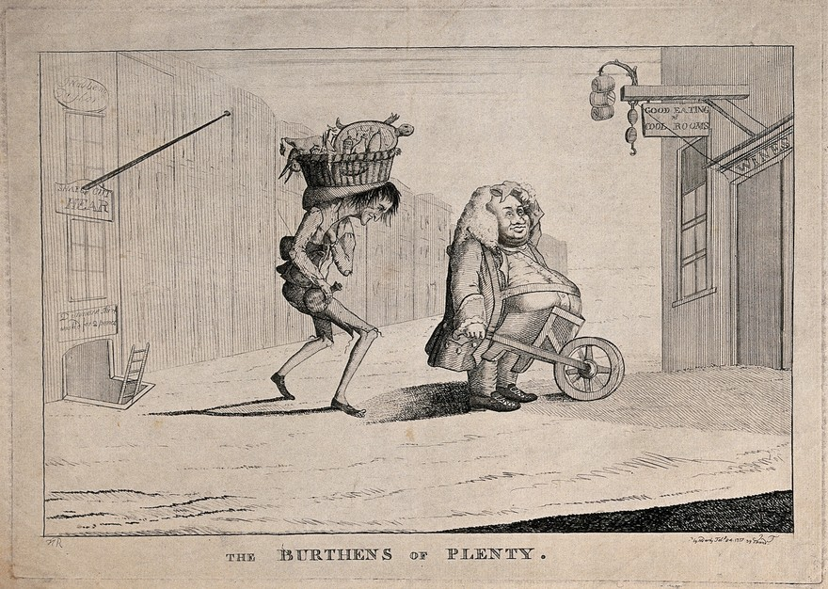
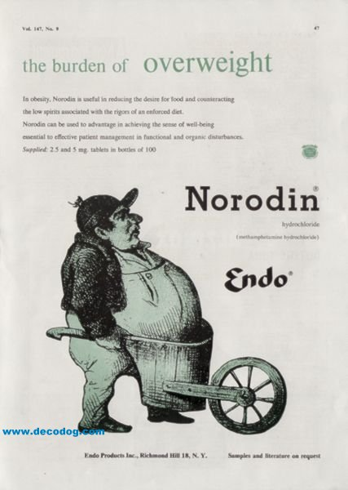
Making up the Obese
‘A fat man who is supports his stomach on a wheelbarrow is followed to a restaurant by a poor, thin man carrying a basket of food on his head’. London (59 Strand): M. Darly, Feby 24 1777. Courtesy Wellcome Library
1951 Pharma ad encouraging doctors to prescribe appetite suppressant Norodin (metamphetamine): “useful in reducing the desire for food and counteracting the low spirits associated with the rigours of an enforced diet”
Notes:
Even notably extreme over weight in the 18th and early 19th century was conceptualised in terms of wonderment rather than stigma or disease, and while those of merely average overweight did face criticism from society and indeed from their doctors for their want of self-control, their corpulence was also seen as proof of their wealth and social standing. The leaflet on the left of this slide presents highly favourable biographies of19th c. Britain’s two fattest men, while the satirical cartoon on the right hand side uses the relative weights of its two national personifications to sharply critique the claims of French revolutionaries. The very fatness of John Bull is proof of his nation’s well-being, notwithstanding its undemocratic form of government.

Slide 8
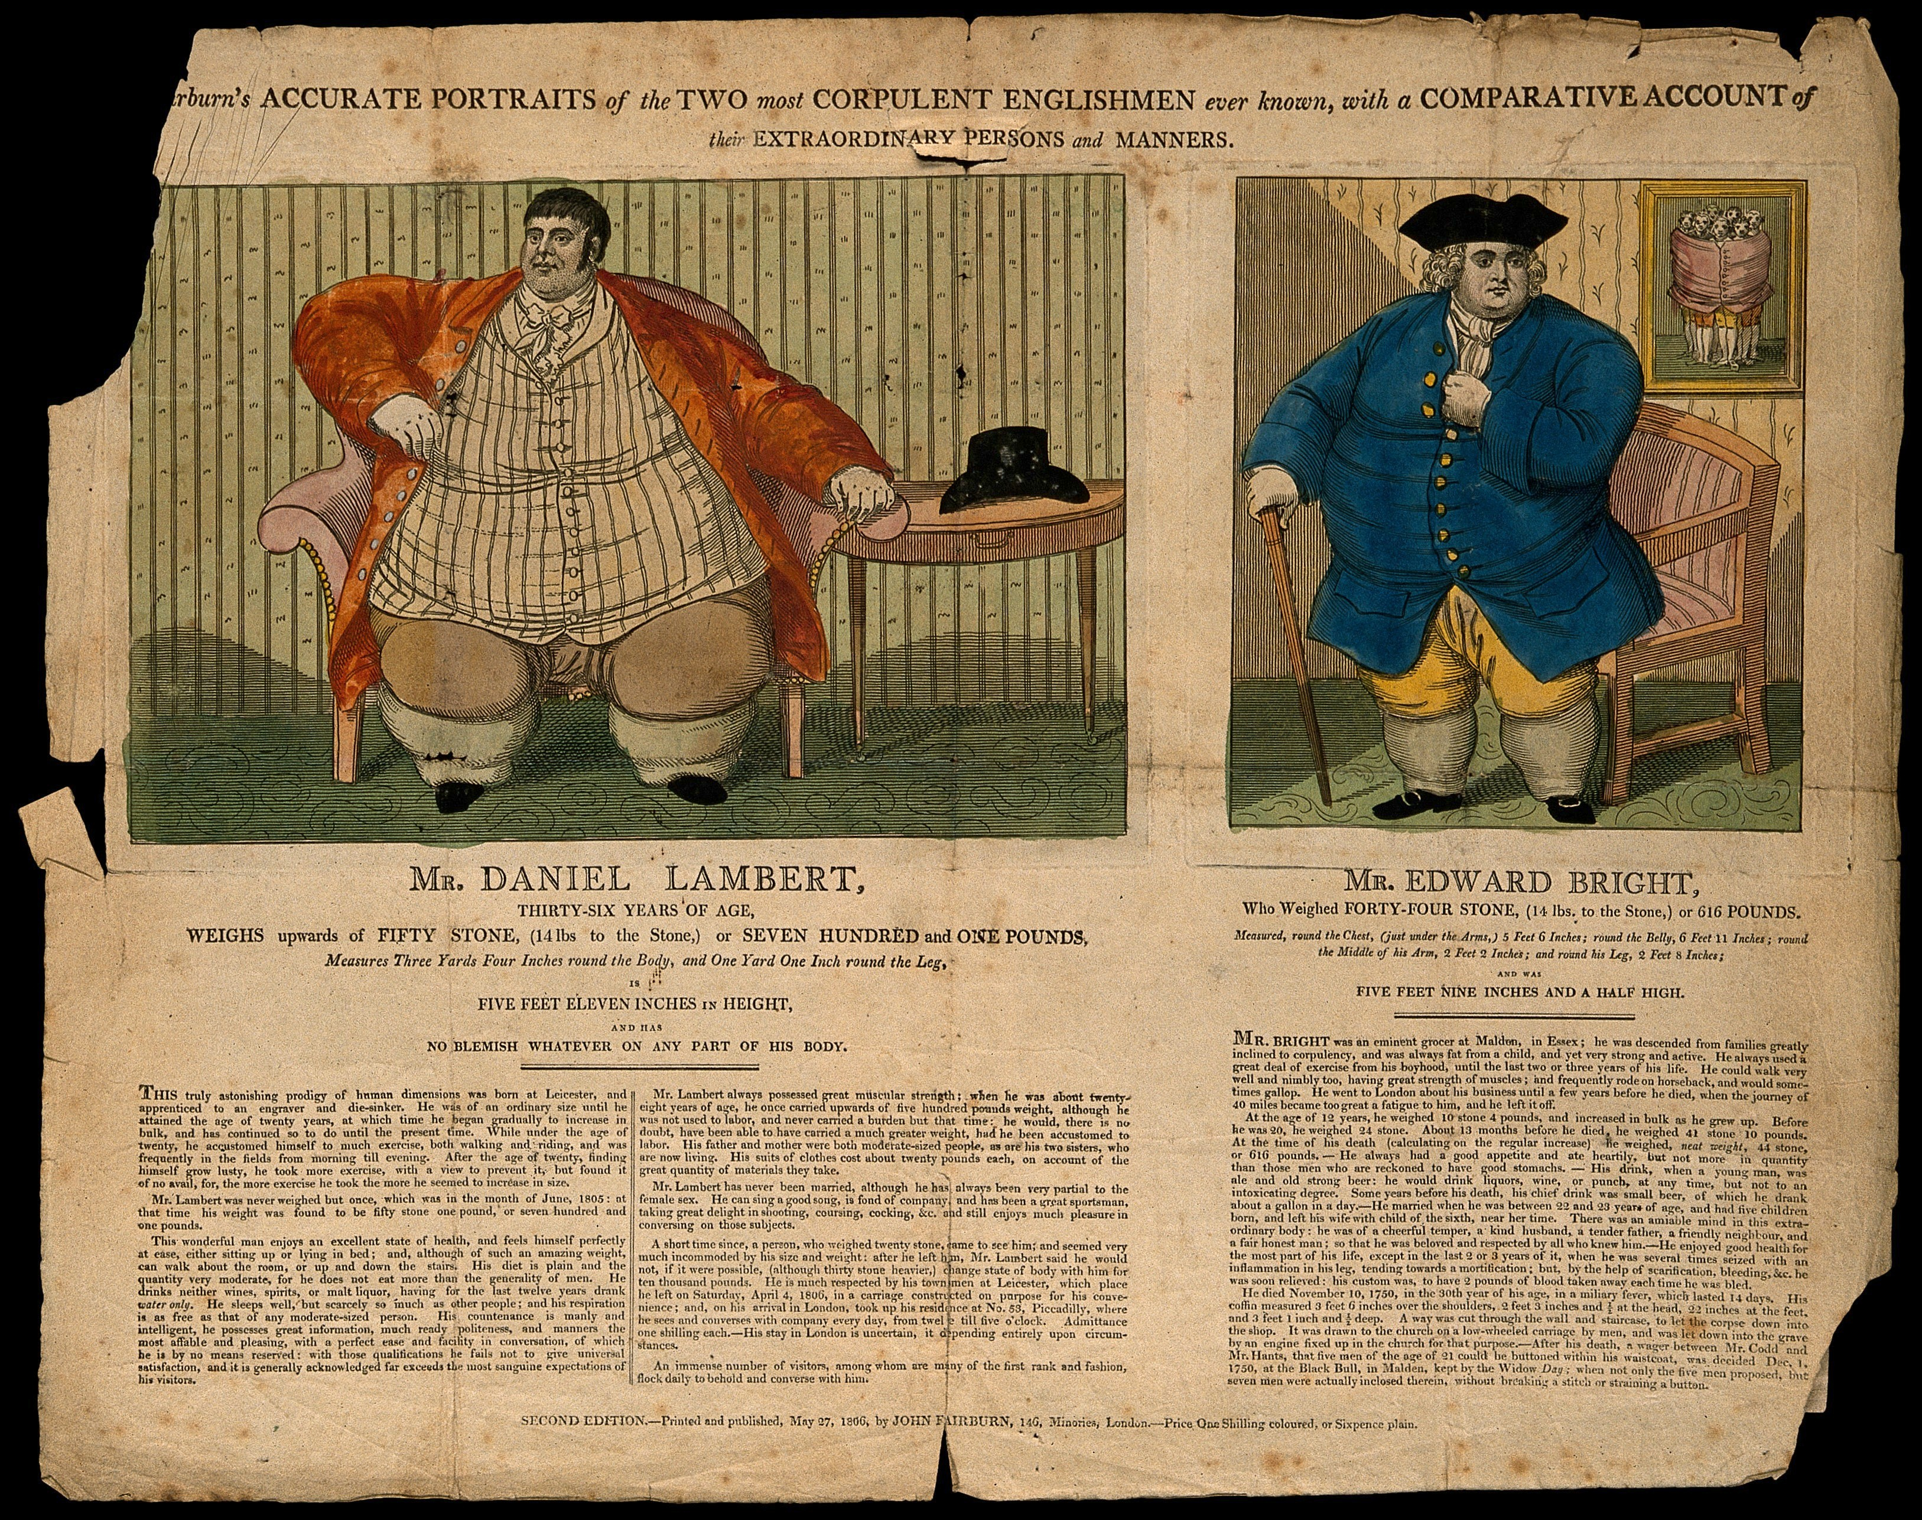
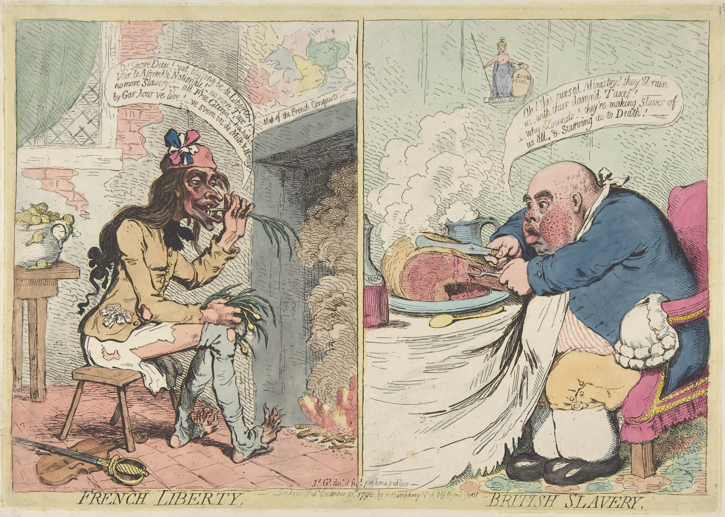
From corpulence as a wonder and symbol of prosperity…
James Gillray, London, 1792 – Undernourished leek-eating (revolutionary) Frenchman extolls liberty; over-fed beef-eating Briton complains about his taxes. Wellcome Images.
Biographical leaflet praising the ‘extraordinary persons and manners’ of England’s fattest men, John Fairburn, London, 1806. Wellcome Images.
Notes:
Description
On the sitters see Dictionary of National Biography The Daniel Lambert section of this item appears also catalogued in record 853
Publication/Creation
London (146 Minories) : Printed and published by John Fairburn, 27 May 1806.
Physical description
1 print : line engraving with etching
Lettering
Fairburn's accurate portraits of the two most corpulent Englishmen ever known, with a comparative account of their extraordinary persons and manners. ...
Edition
second edition.
Reference
Wellcome Library no. 2348i

Slide 9
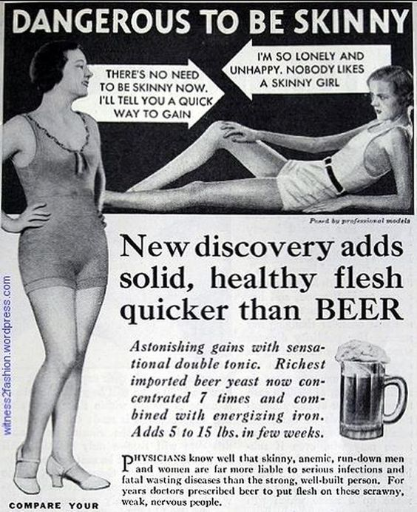
To healthy roundedness… (and dangerous deprivation)
“The popular expression applied to persons of a rounded form, moderate embonpoint, clear skin, and a ruddy color,—that they are ‘in good condition,’—accords with science. This condition is most commonly accompanied by healthy internal organs, a very desirable and hopeful state. . .”
“In so far as lightweights are concerned we must confess that we are more afraid of them than of over‐ weights” (Edward H. Hamill 1907)
Delineator, March 1933, page 97. “Dangerous to be skinny.” Ad for Ironized Yeast Courtesy witness2fashion.wordpress.com

Slide 10
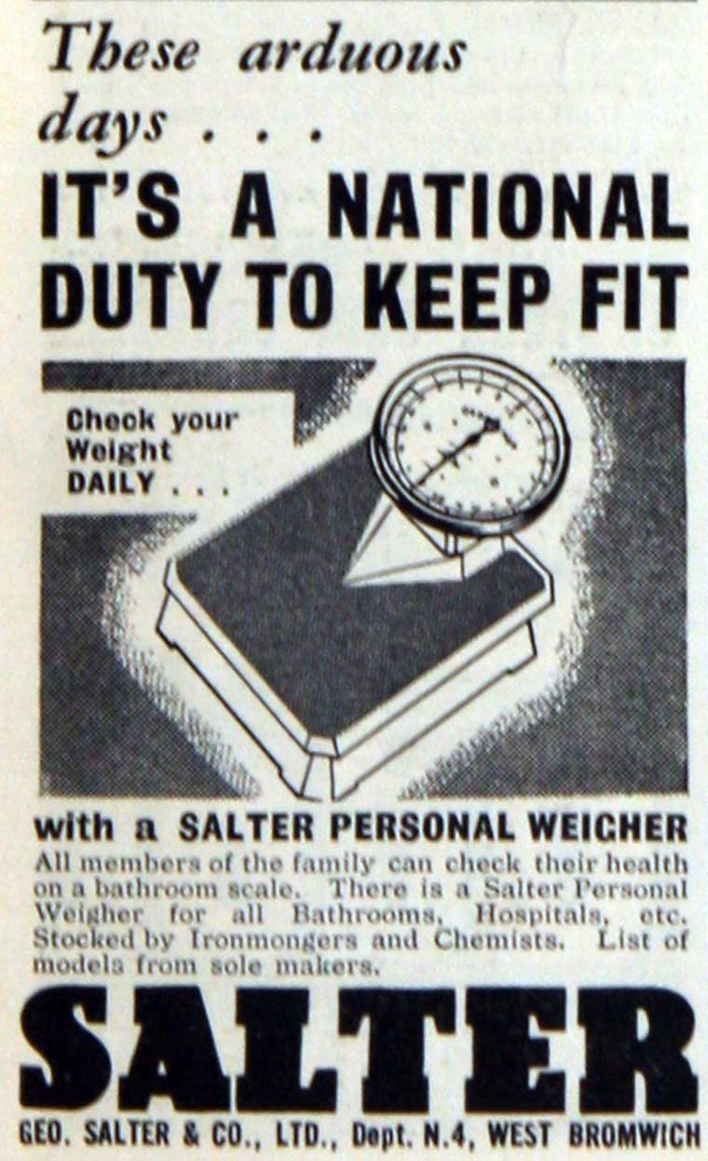
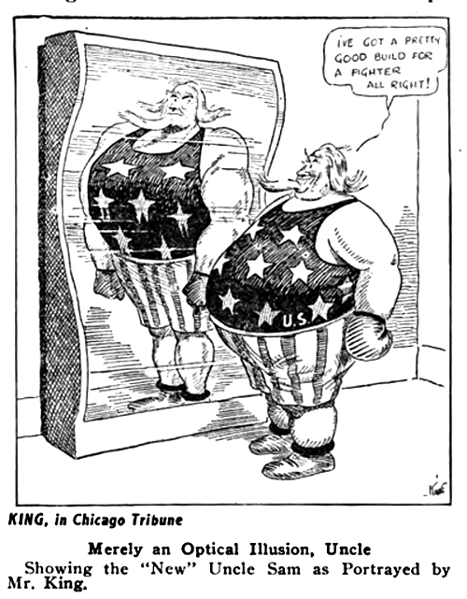
… to unpatriotic obesity...
“The cartoons of Mr. King are correct representations of Uncle Sam as he really is. They might possibly indicate a little more amiability and moral quality, both of which the spirit of this nation possesses. They could not possibly exaggerate the fact that our idealized Uncle Sam requires more tape to measure his waist than his chest. …It is in a way immoral for this nation to continue to regard itself as typified by a gaunt, muscular, forgiving, but powerful figure… able, when aroused in just cause, to admonish and punish the lesser and brawling nations of the earth …”
Editors, Chicago Tribune, November 1915
“Obesity, or excessive corpulence, is not only an unlovely condition, it is a dangerous condition: it increases susceptibility to a number of diseases . . . [and] reduces life expectancy.”
Michael G. Wohl (1945: 791) Temple University School of Medicine
Notes:
From Cartoons Magazine, November 1915: ‘ KING'S UNCLE SAM AGAIN (http://strippersguide.blogspot.com/2020/02/what-cartoonists-are-doing-november.html) A Rev. M.R. Todd, of Elvaston, Ill., writes to the Chicago Tribune complaining about Frank King's “insipid, unpatriotic, unmanly cartoons.” Mr. King, specimens of whose work are reproduced elsewhere in this magazine, has created a “new” Uncle Sam, flabby and corpulent and rich. Says the Tribune in reply to Mr. Todd: “The cartoons of Mr. King are correct representations of Uncle Sam as he really is. They might possibly indicate a little more amiability and moral quality, both of which the spirit of this nation possesses. They could not possibly exaggerate the fact that our idealized Uncle Sam requires more tape to measure his waist than his chest. “It is in a way immoral for this nation to continue to regard itself as typified by a gaunt, muscular, forgiving, but powerful figure, slow to wrath but dreadful in it; able, when aroused in just cause, to admonish and punish the lesser and brawling nations of the earth. “That is the favorite Uncle Sam of the American imagination, and he is in truth a dreadful figure—but dreadful to the persons who believe and trust in him. “The lovers of a defiant Uncle Sam are the persons who never think of themselves as sustaining a bullet wound in the abdomen. That bullet is to rip open some other abdomen, and they are to live in the gratification of a pleased dignity. “The Rev. Mr. Todd's subscription does not expire for nearly a year. If he will continue that long we promise him that the cartoons of Uncle Sam will record any improvement made in the shape and disposition of Uncle Sam. We hope, knowing what new spirit is filling the American people, that by August, 1916, Uncle Sam will be not a bit less just and peaceable, but a terrific lot more able to make his righteous indignation effective.” To which the Milwaukee Sentinel adds: “Cartoonist King has invented an 'Uncle Sam,' new style; a figure of Falstaffian girth and obese unfitness for anything in the way of a physical encounter, to take the place of the lean, powerful and sinewy 'Sam' and ‘Jonathan' of the stock cartoon, slow to anger, but terrible as Achilles and fit to whip his weight in wildcats, when roused. “Mr. Todd considers it 'unmanly and unpatriotic' to portray Uncle Sam as fat and helpless. “But what about the fact, Mr. Todd? Would 'twere otherwise. The thing to do is to make it otherwise; and to impress it on this nation that it must be made otherwise, and that is the end and purpose of the offending cartoons. Mr. King is telling some hard truths in a galling and rather ribald but effective way.”

Slide 11
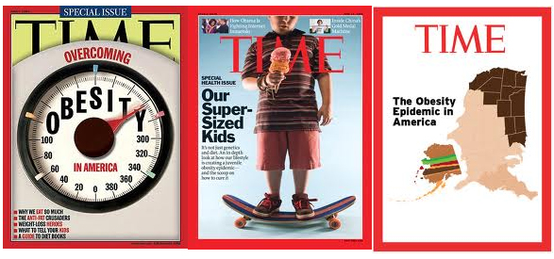
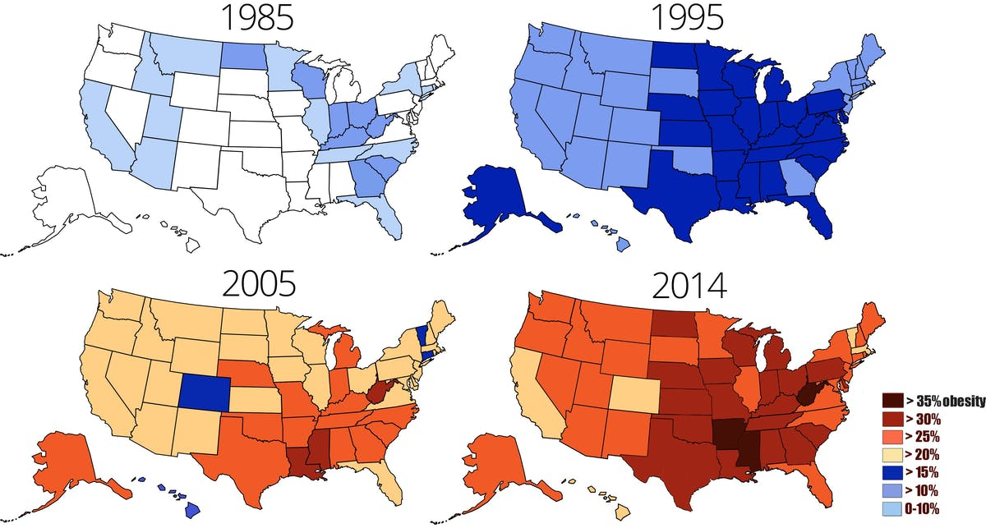
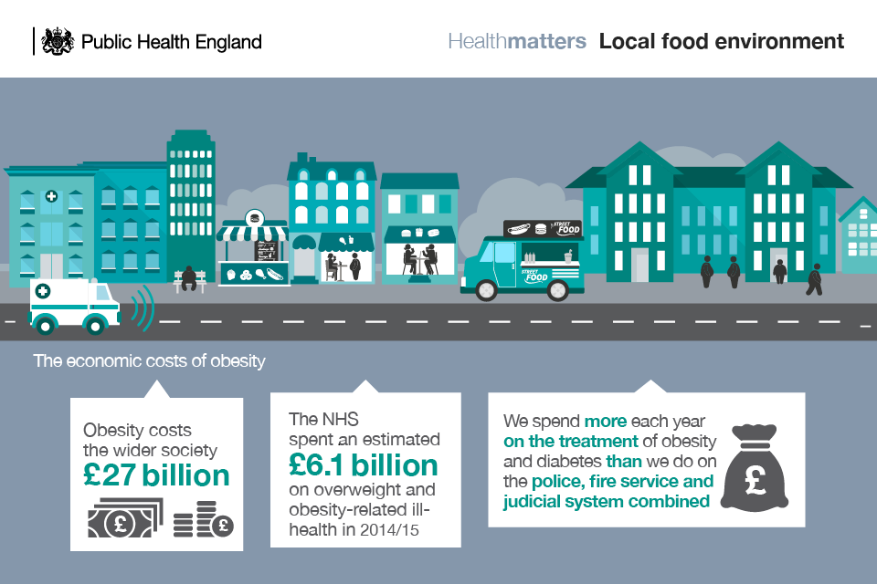
…to the ‘obesity epidemic’
Andrew Davey, ‘UK, the Fat Man of Europe’, The Sun 2010
https://www.cdc.gov/obesity/data/prevalence-maps.html
Notes:
Description
On the sitters see Dictionary of National Biography The Daniel Lambert section of this item appears also catalogued in record 853
Publication/Creation
London (146 Minories) : Printed and published by John Fairburn, 27 May 1806.
Physical description
1 print : line engraving with etching
Lettering
Fairburn's accurate portraits of the two most corpulent Englishmen ever known, with a comparative account of their extraordinary persons and manners. ...
Edition
second edition.
Reference
Wellcome Library no. 2348i

Slide 12
A word about the readings…
Arlene Tuchman
Classic historical approach to a topic – in this case, related to 20th c. biomedicine. So be prepared for a section setting up the ‘facts on the ground’ and establishing the historical and intellectual context. There will be names, dates and lots of footnotes setting the scene!
Once that strong platform is in place, Tuchman gets to the ‘good’ stuff – the interpretation of her evidence, and answering the question, ‘Why weren’t diabetics a problem for eugenics?’ Look out for class and race here…
J. Eric Oliver
On the flip side, here is a classic political science approach to biomedicine, using it as a lens to scrutinize and map the political sphere: look out for broad arguments first, direct evidence later, and a lot less specificity. If you are Joint Honours student, think about the differences in style and content between your disciplines when you are writing your own essays.
Look too at how Oliver uses visual evidence and analogy (ideas=viruses) alongside textual and other forms of evidence.

Slide 13
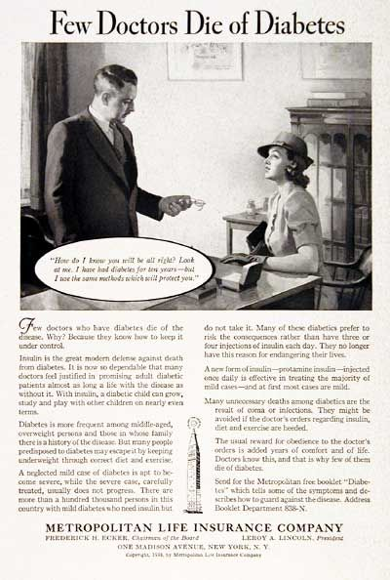
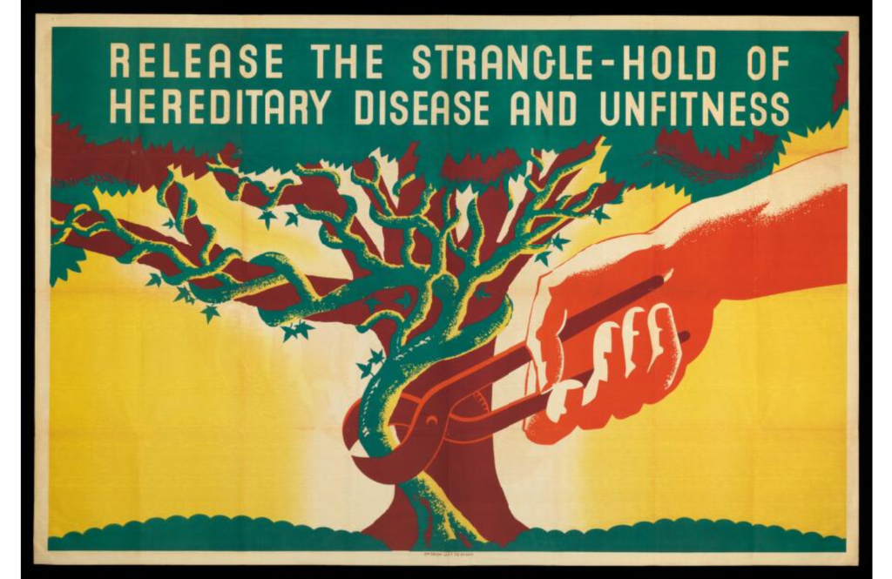
Seminar conversation starters (to go with Tuchman reading)
“How do I know you will be all right? Look at me. I have had diabetes for years – but I use the same methods that will protect you.”
‘Few doctors who have diabetes die of the disease. Why? Because they know how to keep it under control … Diabetes is more frequent among middle-aged overweight persons and those in whose family there is a history of the disease. But many people predisposed to diabetes may escape it by keeping underweight through correct diet and exercise. … There are more than a hundred thousand people in this country with mild diabetes who need insulin but do not take it. Many of these diabetics prefer to risk the consequences rather than have three or four injections of insulin each day. They no longer have this reason for endangering their lives… The usual reward for obedience to the doctor’s orders is added years of comfort and life. Doctors know this, and that is why few of them die of diabetes.’
Learn more about this image here! Start practicing your research skills by finding out the producer and date of this poster for seminar… https://wellcomelibrary.org/collections/digital-collections/makers-of-modern-genetics/digitised-archives/eugenics-society/ and https://wellcomelibrary.org/item/b16239246#?c=0&m=0&s=0&cv=0&z=-0.5279%2C-0.0379%2C2.0557%2C0.7573
This American 1938 life insurance ad tells us a lot about perceptions of diabetes and diabetics. Does it fit with Tuchman’s claims?

Slide 14
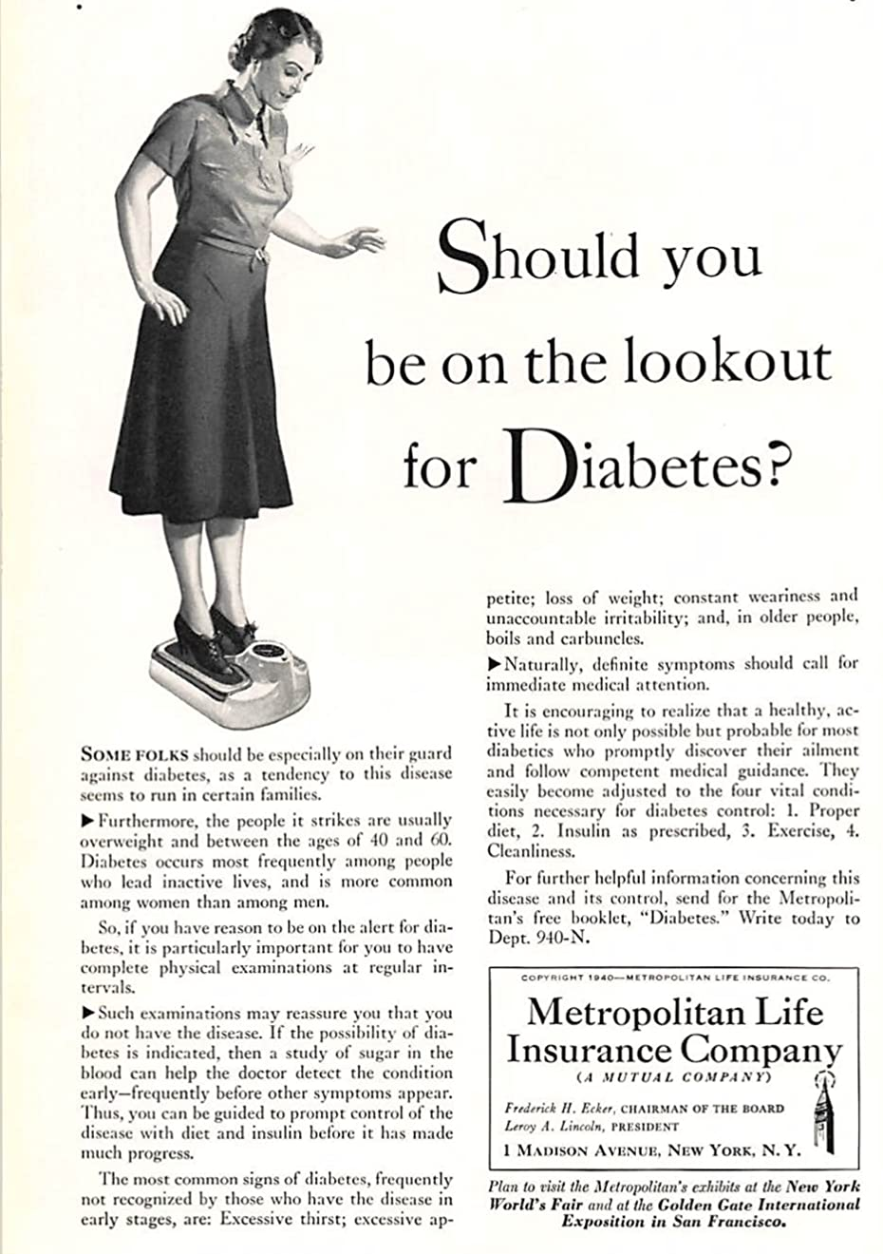
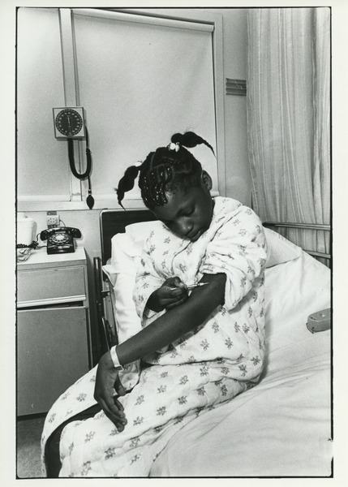
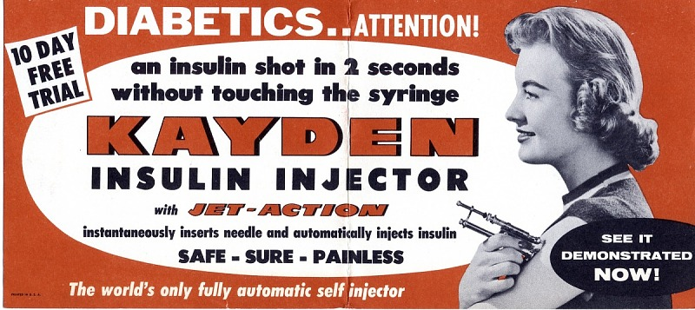
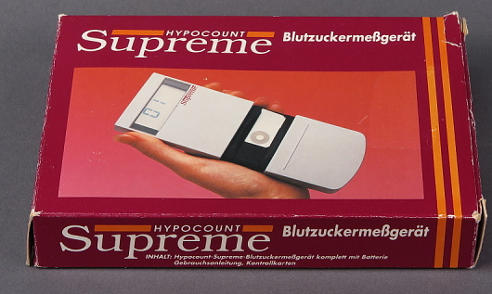
More seminar conversation starters
Material culture (STUFF) and marketing are great sources for historians. What can these examples tell you about understandings of diabetes?
1955 Insulin Jet-Injector Advertisement, National Museum of American History
And what can this very different source tell us? Diana Mara Henry (photographer). Child self-administers insulin, ca. 1975. https://credo.library.umass.edu/view/full/muph051-s01b-i00361
1940 Magazine Advertisement, Metropolitan Life Insurance Company (Who is this FOR?)
1991 Blood Glucose Meter, National Museum of American History

Slide 15
A few more fun extras:
https://www.theatlantic.com/magazine/archive/2007/11/the-war-on-fat/306506/ This ‘general readership’ article explores the long and contradictory history of overweight in America. Read it for: the propaganda of ‘fat’ in the Cold War… “We shall match the Russians potato for potato, calorie for calorie. We shall fight on the beaches; we shall fight on the picnic grounds; we shall fight in the all-night hamburger stands. We shall never surrender! And if the American nation should last a thousand years, history will say, "This was their fattest hour!”
Want to see the ‘stuff’ of the diabetes story? Have a look at the collections of the National Museum of American History, and the Science Museum!
Are you thinking about using photographs as evidence? Read this: http://blog.royalhistsoc.org/2020/09/07/photographs-sensitive-sources/

