Slide 1
History on the Move: How do we tell the story of migration?
Roberta Bivins
Department of History
University of Warwick
r.bivins@warwick.ac.uk

Slide 2
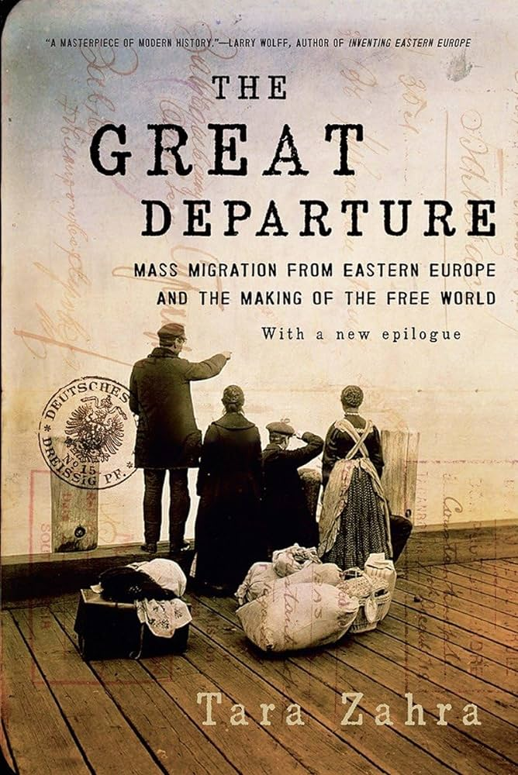


When you think about the history of migration…
What do you think it will look like?
Who does it discuss?
Where does the history happen?
When does it happen?
What stories would you want to hear or tell?
Do you want to read more (for fun) ? Try these books.

Slide 3
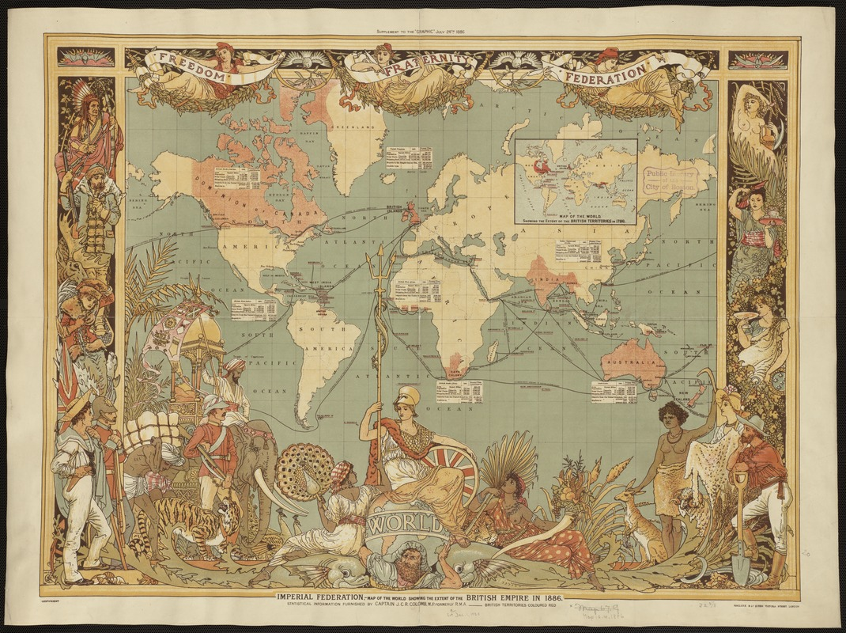
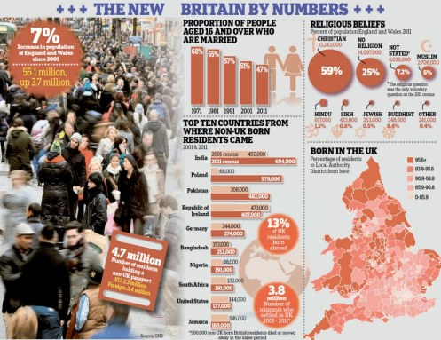
Migration-nation Britain?
Imperial Federation, map of the world showing the extent of the British Empire in 1886, published in The Graphic, a popular newspaper.
Daily Mail, 12 December 2012

Slide 4
How do historians write the history of migration in Britain?
Traditionally:
Parliamentary debates
Border and Census Data
Newspaper coverage
Legislation
Policy documents
Inclusively:
Visual representations – photos, film, television, cartoons
Oral history
Diaries/Memoirs/Letters
Community documents

Slide 5
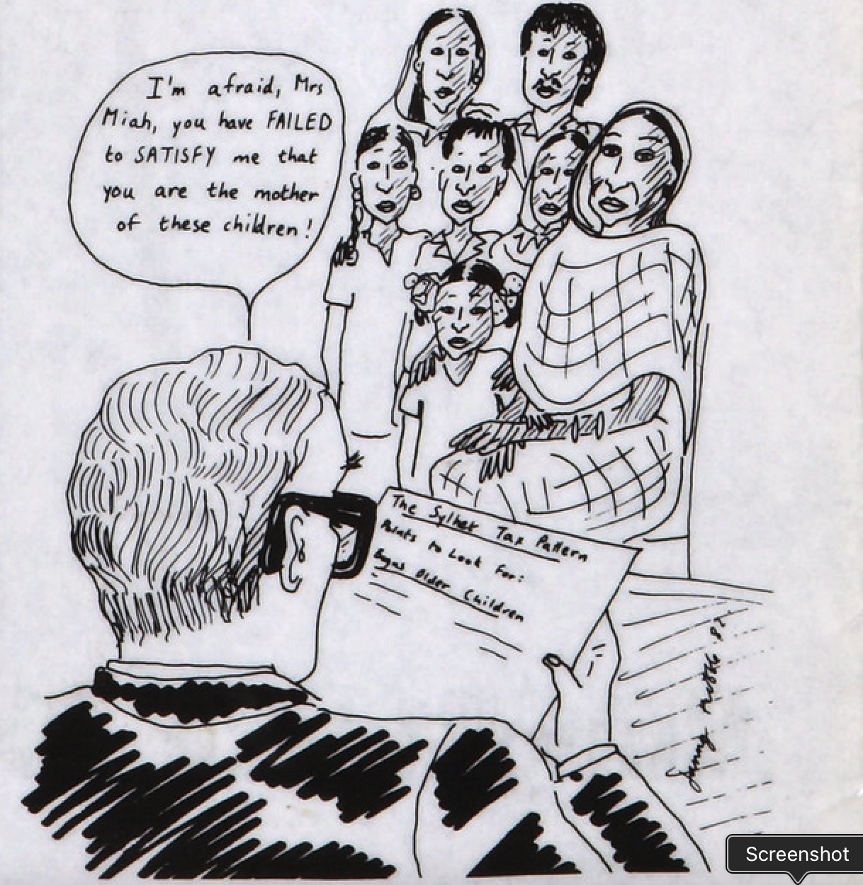
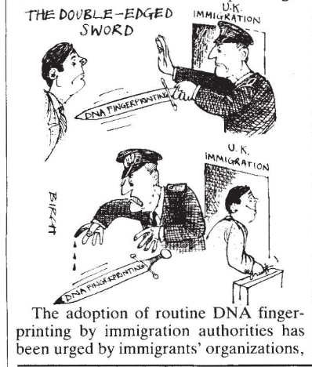
Looking at migration through STEM lenses
Bureaucratic Technologies, Bangladesh Divided Families Campaign, 1980s
Biological Technologies
Nature, 1988

Slide 6
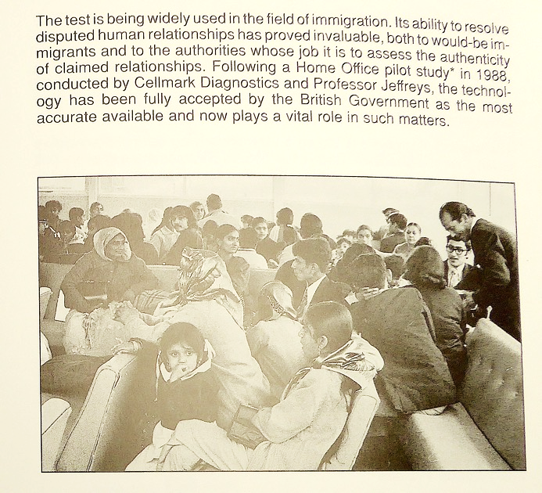
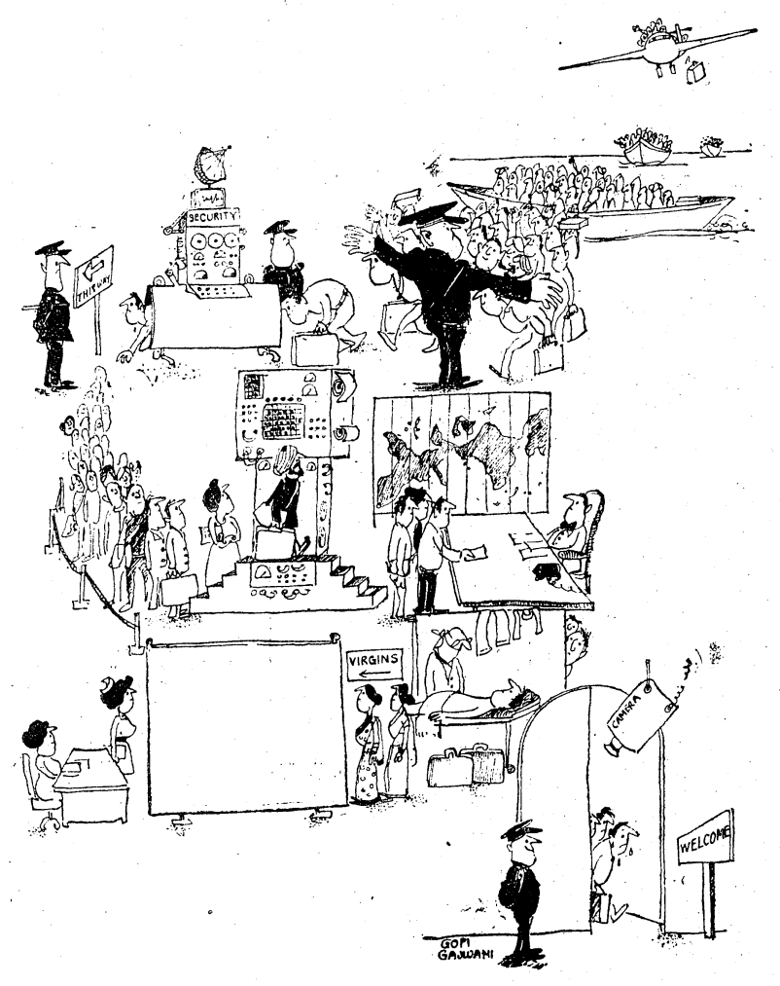
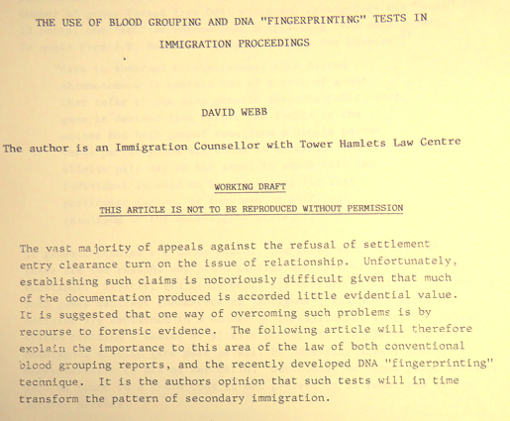
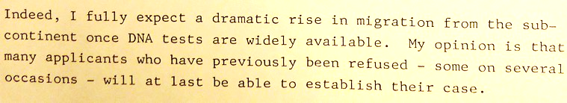
'Machining’ the citizen-to-be
Cellmark Information Brochure, 1987

Slide 7
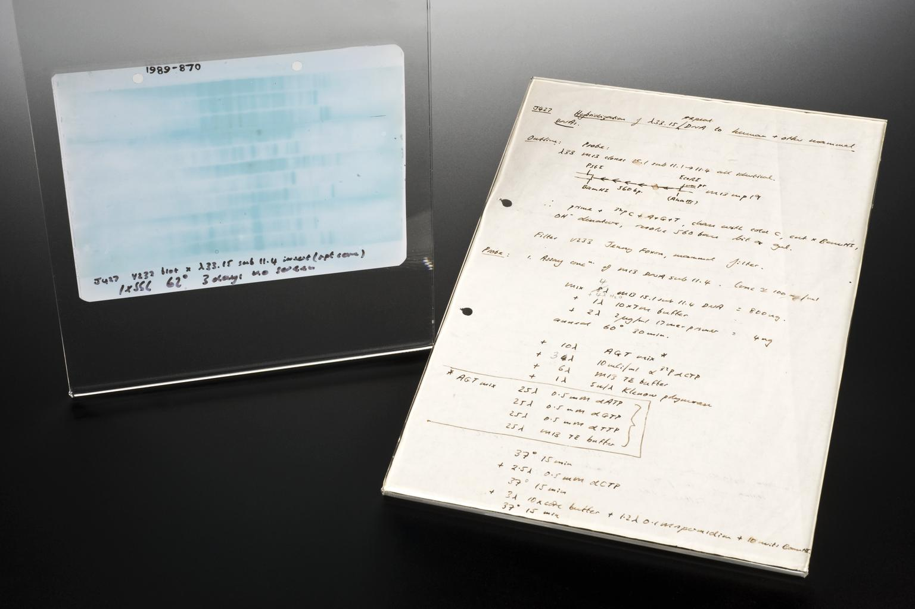

From seizing certainty to losing agency
Women and the introduction of genetic profiling
1985: Seona York and Christiana Sarbah recruit Alec Jeffreys to support Sarbah’s appeal against the deportation of her young son on the grounds that she is not his mother.
1989: Home Office replaces proof or familial relationship with economic capacity to support as primary barrier to reunification migration
1989: Women demand acceptance of DNA evidence in cases of rape and affiliation
1995: CSA begins to use DNA to claw back costs of mothers’ income support from ‘feckless fathers’

Slide 8
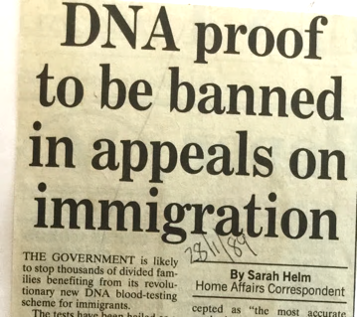
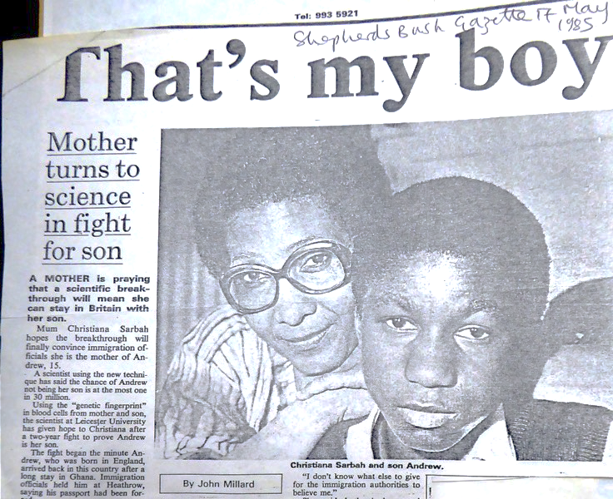
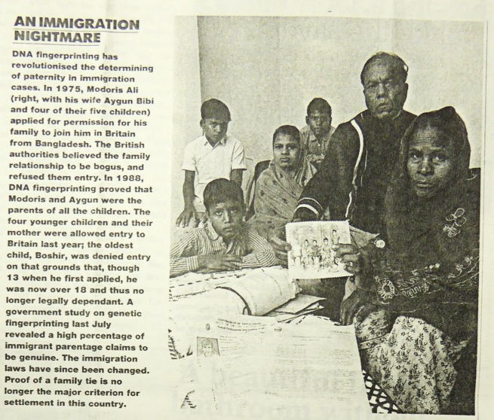
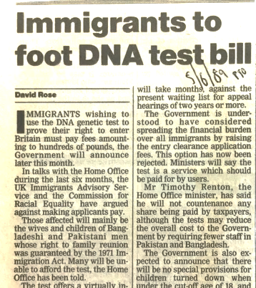
So what happened next?
‘A government study on genetic fingerprinting last July revealed a high percentage of immigrant parentage claims to be genuine. The immigration laws have since been changed. Proof of family ties is no longer the major criterion for settlement in this country.’
Jon Trux, ‘A Case of Unmistakeable Identity’, Observer, 13 August 1989

Slide 9
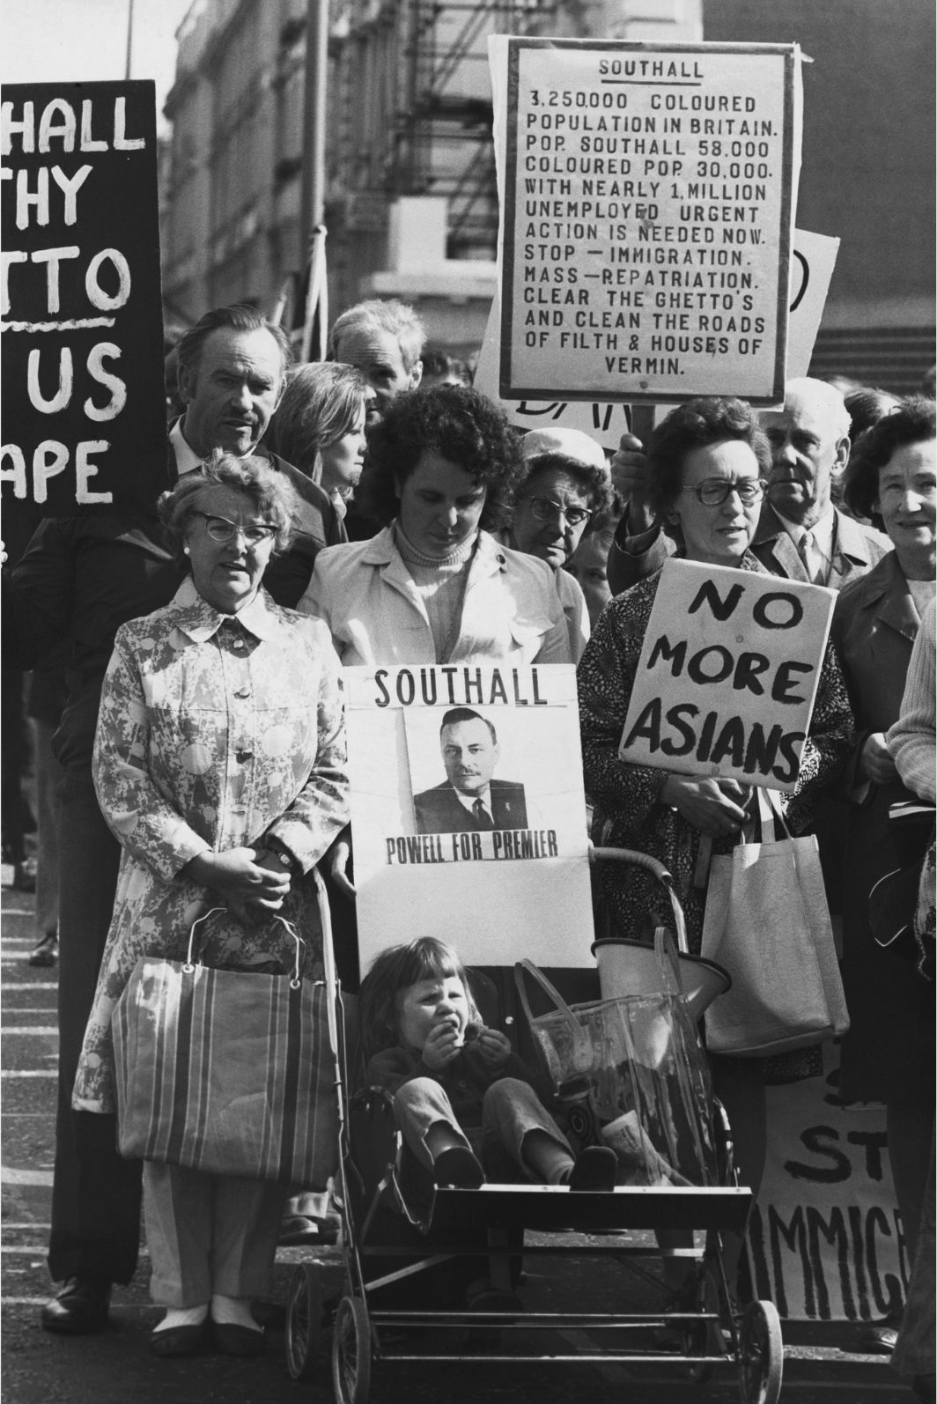
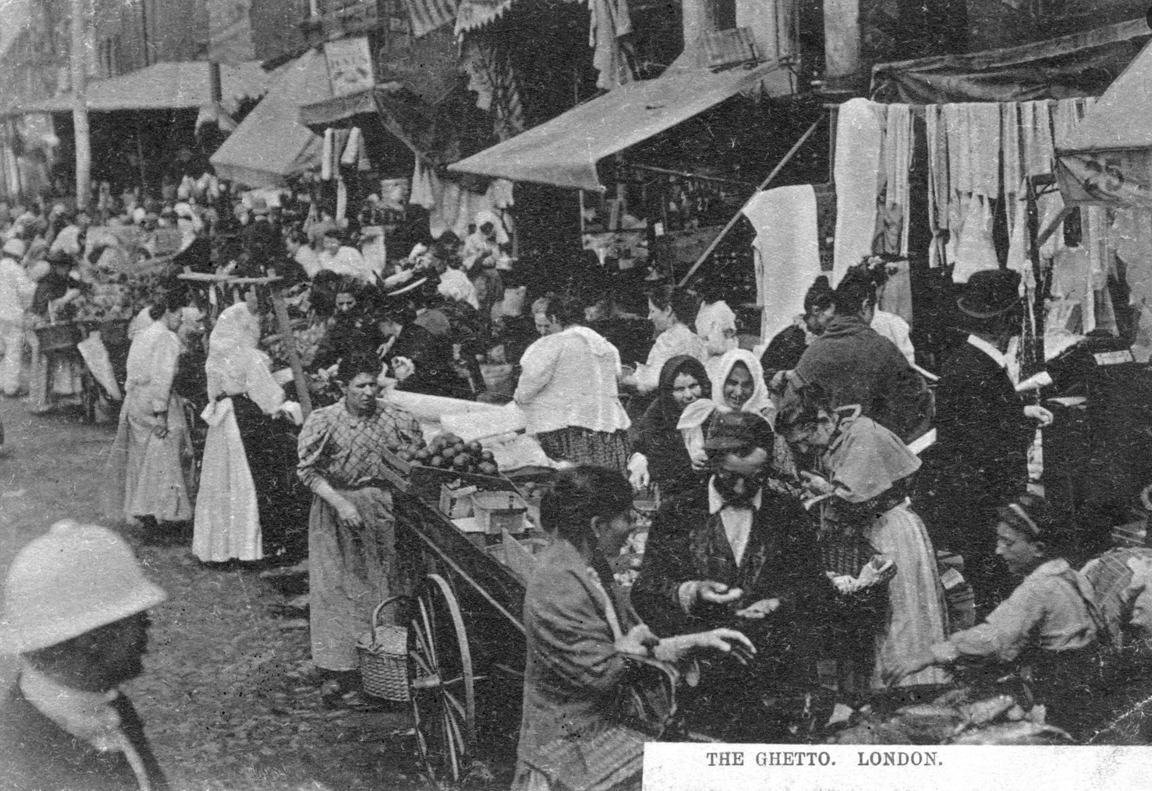
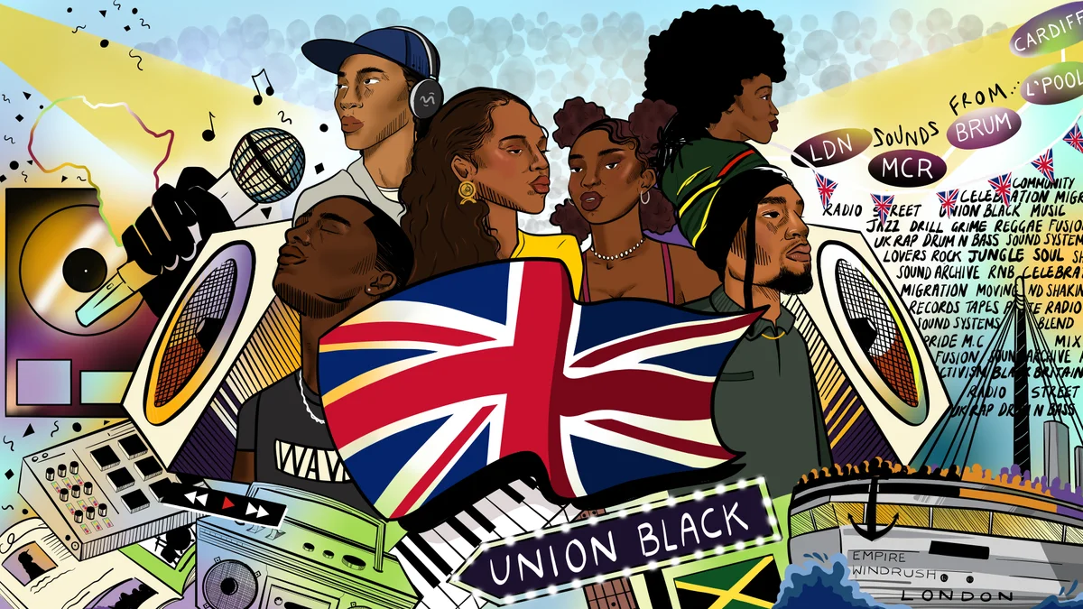
An estimated 150,000 Eastern European Jews settled in Britain between 1881 and 1914, in many cases after escaping persecution in pogroms across the Russian and Hapsburg empires. Credit...Jewish Chronicle/Heritage Images, via Getty Images

Slide 10
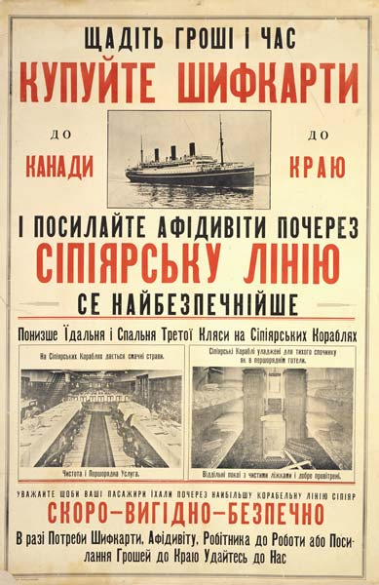
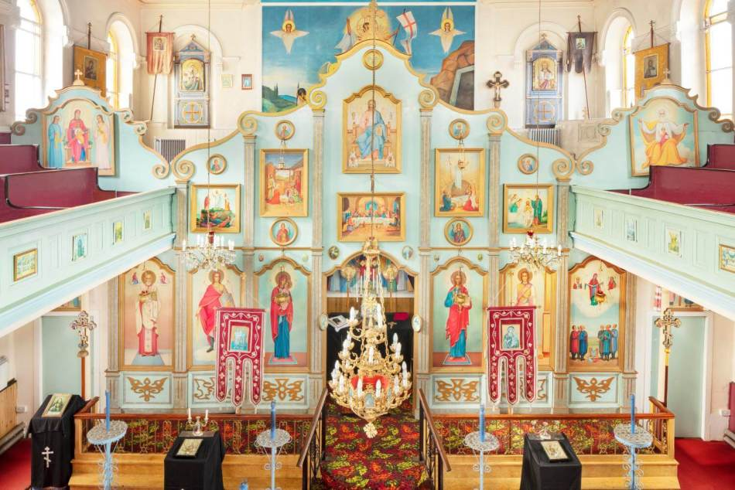
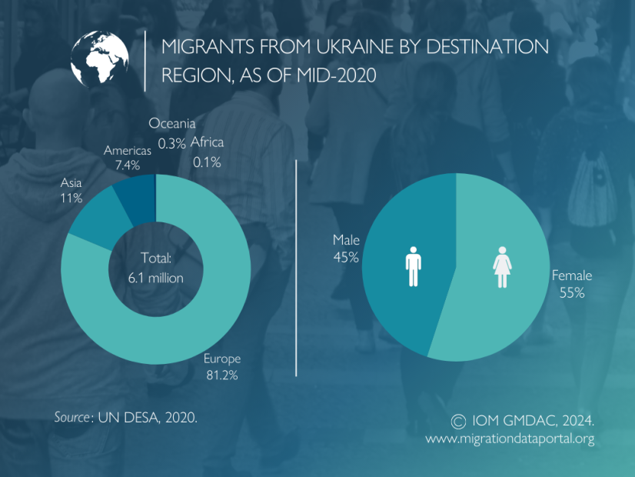
Tell me: What do histories of migration look like in Ukraine?
The iconostasis in St Mary Protectress Ukrainian Orthodox Church in Bradford, West Yorkshire. © Historic England Archive. View image DP371835.
Click for more data on migration and Ukraine today.
Poster published by the Canadian Pacific Railway between 1910 and 1930, advertising ocean passage to potential Ukrainian immigrants. Glenbow Museum Archives Poster-32
Notes:
https://heritagecalling.com/2023/05/10/a-history-of-ukrainians-in-england/

