Slide 1

Germs, Genes and History: Getting Traction on Global Health Exchanges
Roberta Bivins, Professor of History
r.bivins@warwick.ac.uk
Office: FAB 3.54
(Please note that I am on research leave this year, so if you need to see me, do email first).

Slide 2
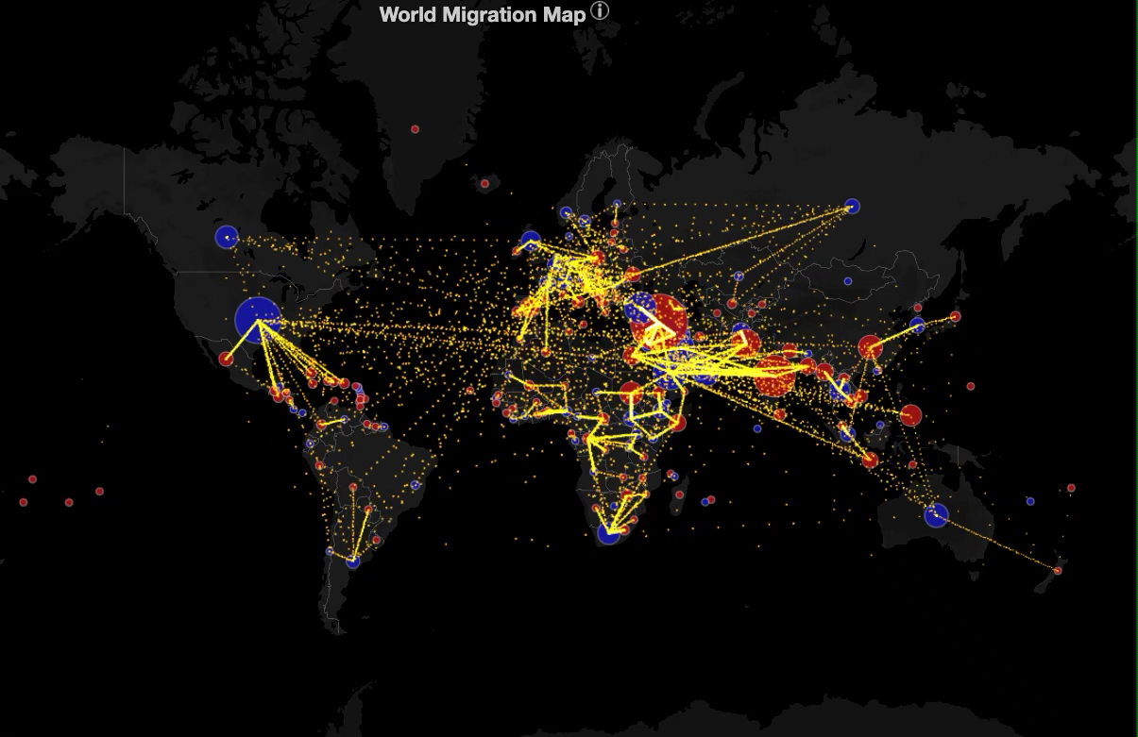
By the end of this session you will be able to:
Identify key moments and types of global exchange related to human mobility and health;
Generate testable hypotheses about the contemporary impacts of human mobility on the health environment.
To watch a full video of this map of human population movement, see https://www.youtube.com/watch?v=uSM74Pqi288
To learn more about the map and the UN data underlying it, and for interactive links to specific countries, click this link:
http://metrocosm.com/global-immigration-map/ data visualisation © Mapbox and© OpenStreetMap

Slide 3
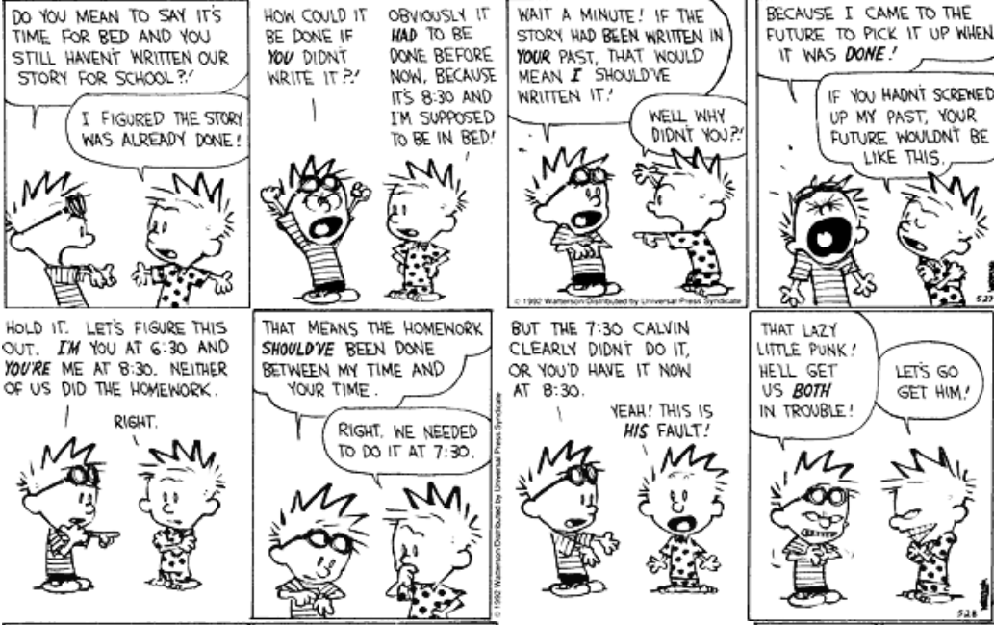
Preparation:
If you have not already looked at the Consortium of Universities for Global Health resource ‘Global Health in Historical Perspective: The Uses of History’, please take a look here: https://citeseerx.ist.psu.edu/viewdoc/download?doi=10.1.1.676.3922&rep=rep1&type=pdf We’ll be expanding on some of this material in today’s lecture.
There are two readings related to this lecture. You can read them in advance or afterwards (so no need for time-travelling).

Slide 4
Content
This lecture will discuss key themes from the GHEC unit you have reviewed, and develop its questions by looking at how human migration fits into the long history of global health and interactions between genetics/genomics and health environments.
Questions to think about:
What constitutes a health ‘environment’? (Try answering this one now! What would you include to fully comprehend the systems that affect human health?)
How does human migration, particularly mass migration, shape the health environment materially, culturally, and politically?
Can we reasonably compare the effects of migration in the past with those of the present or future? Why or why not?

Slide 5
What is a ‘health environment’?
Macroscopic (External) Elements
Physical environment: e.g. climate, geography, flora and fauna, hydrology, mineral and soil resources;
Built environment: e.g. housing, transport networks, sanitary networks, energy networks, surveillance structures (both epidemiological and enforcement);
Social environment: e.g. legal and political structures; population density and diversity; access to work and welfare; economic opportunities; safety from violence and conflict; levels of gender and racial equality; etc.
Cultural environment: e.g presence/absence of psychosocial stressors; prevailing cultures of health and healthcare; dietary, activity, and clothing practices, etc.

Slide 6
How does migration shape health environments across these elements?
Example 1. The Irish potato famine
Example 2. ‘Globalizing’ Tuberculosis
The movements:
Potato to Europe via Spanish empire
Potato introduced to Ireland to feed the poor, freeing up land for lucrative grain cropping and exports
Potato blight comes to Ireland from USA via Belgium
Failure of potato crop in 1847-52 prompts starvation and mass emigration esp. to Britain, Canada and USA (not to mention the 1848 social revolutions across Europe
The movements
TB, endemic in urban Europe, travels along the pathways of empire.
TB introduced to rural and First Nation communities as a ‘disease of civilisation’.
TB prevalence is amplified by conditions of imperial labour, urbanization, and social disruption.
Better living conditions, public health surveillance, and later antibiotics (nearly) eradicate TB in western Europe. Colonies do not share these benefits equally.
Inadequate TB treatment in Global South enables rise of MDR-TB; migration, business travel and tourism return it to Europe.

Slide 7
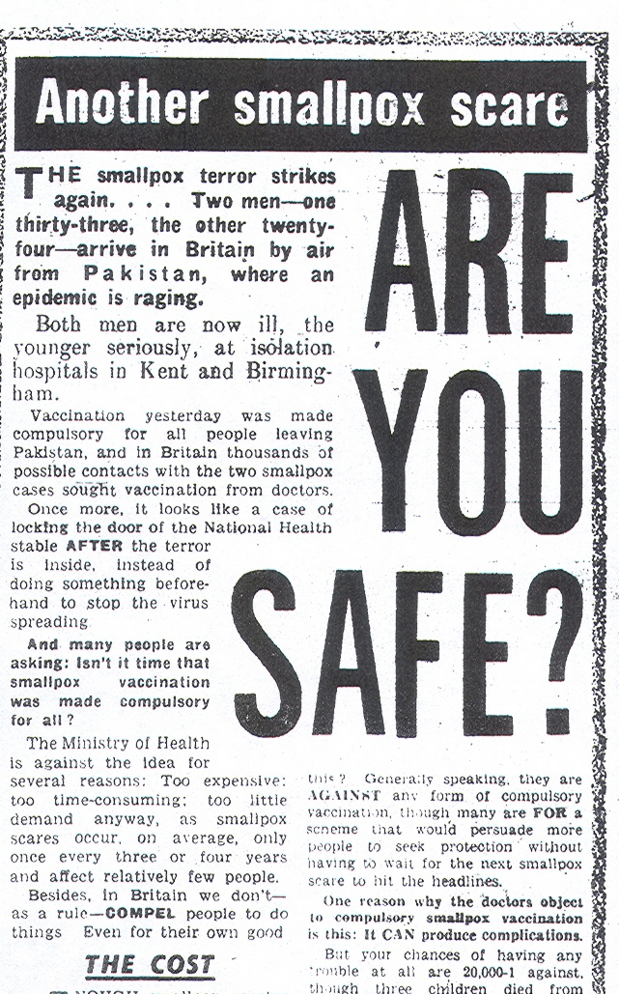
‘Imported Evil’:
2004
‘CHECK! A foreigner brings smallpox into this country and a Ministry of Health spokesman admits that there is no check… Scandalous!’
‘Once more it looks like a case of locking the door of the National Health stable AFTER the terror is inside…’
1962
2001
Notes:
IMAGE FROM JAN 4 DAILY MIRROR
QUOTE FROM Daily Mirror letters, Jan 1

Slide 8
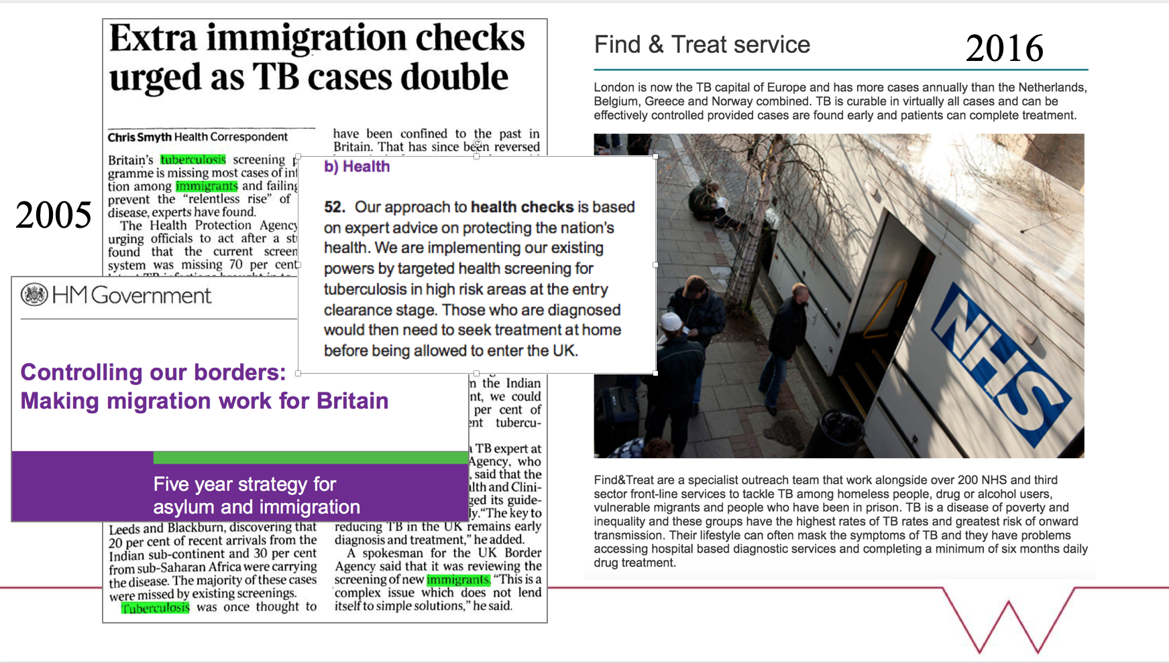

Slide 9
Examples of global human movement and interaction
between health environments
1. ‘World Wars’ (from the Crusades to the ‘war on terror’)
Crusaders embark for the Levant, 1337
Forbes Magazine report, 2020
US Navy Health Poster for WWII Pacific Campaign, 1945
Notes:
Left image: Crusaders embark for the Levant. From ‘Le Roman de Godefroi de Bouillon’, France, 1337. (Bibliothèque Nationale / Bridgeman Images)
Centre Image: https://www.forbes.com/sites/niallmccarthy/2020/09/15/report-americas-war-on-terror-displaced-37-million-people-infographic/
Right Image: Washington, D.C. : Navy, Bureau of Medicine and Surgery] : U.S. G.P.O., 1945 http://resource.nlm.nih.gov/101438600

Slide 10
Examples of global human movement and interaction between health environments
2. Exploration: e.g. the ‘Columbian Exchange’
Smallpox imported from Europe by the Conquistadors disrupts Aztec nation (c. 1576).
Smallpox imported from Europe by British and French settlers strikes the Lakota people c.1780
See notes for image credits. Images not for reproduction.
Notes:
Image Left: Illustrated panel from the Florentine Codex, a compendium of information on Aztec people and history by Bernardino de Sahagún, a 16th-century Spanish Franciscan missionary. Courtesy Granger Collection, New York
Image Right: ‘Winter Count’ document titled “The eruption and pains in the stomach and bowels; smallpox used them up winter,” created by Lakota artist Battiste Good Year c. 1779-1780, recorded another outbreak of smallpox. Courtesy National Anthropological Archives, Smithsonian Institution
https://www.nlm.nih.gov/nativevoices/timeline/232.html
For more information on the holistic health environmental effects of European colonization of the Americas, see https://www.sciencedirect.com/science/article/pii/S0277379118307261 Alexander Koch, Chris Brierley, Mark M. Maslin, Simon L. Lewis,
Earth system impacts of the European arrival and Great Dying in the Americas after 1492,
Quaternary Science Reviews,
Volume 207,
2019,
Pages 13-36,
ISSN 0277-3791,

Slide 11
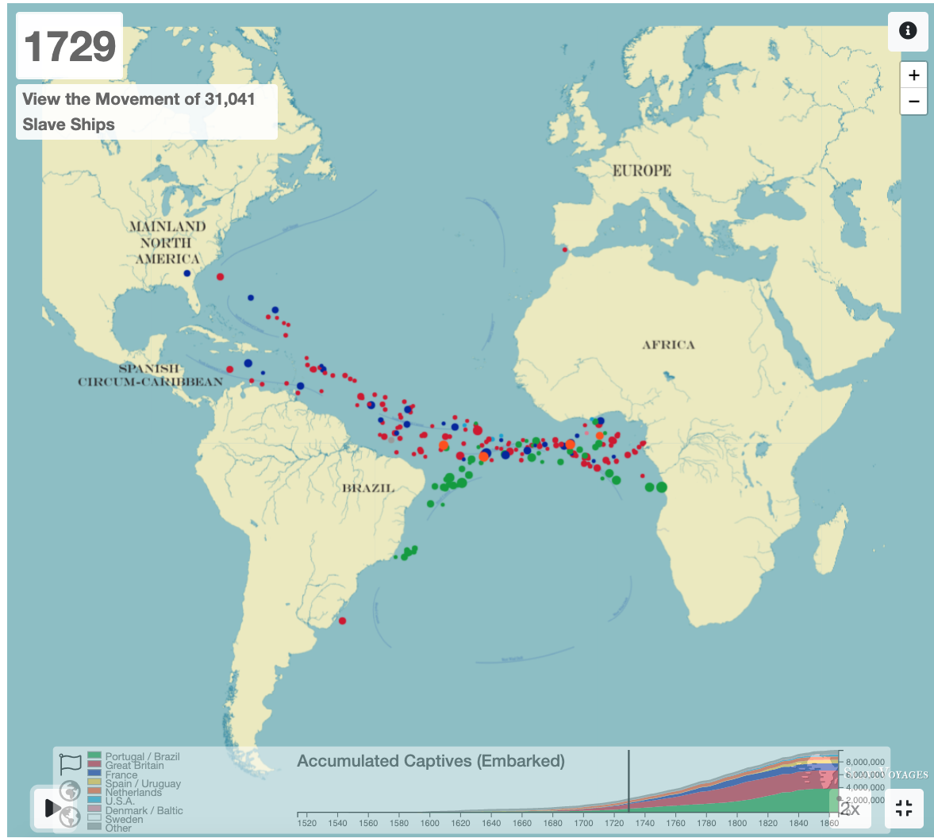
Examples of global human movement and interaction between health environments
4. Enslavement e.g. ‘the triangle trade’
5. Imperialism and Colonialism
Trading colonies
Settler colonies
Extraction colonies
Highways of Empire, MacDonald Gill, Empire Marketing Board, 1927 © National Archives of Britain
View and explore this time-lapse map of the trans-Atlantic Slave trade:
https://www.slavevoyages.org/voyage/database#timelapse

Slide 12
Examples of global human movement and interaction between health environments 6. ‘We are here because you were there’: postcolonial mass migration
Commonwealth migrants from the ‘Open Door’ to the ‘Hostile Environment’
Migration in the Americas from the ‘Monroe Doctrine’ to the ‘War on Drugs’
Winning the Cold War; wooing the non-aligned nations
Migration aftermaths of the ‘War on Terror’

Slide 13
Examples of global human movement and interaction between health environments
Don’t forget the impacts of human movements and cultural exchanges not just on contagious disease, but on
food environments and chronic illness;
on biomedical research climates and areas of activity; and
on the presence or absence of genetic conditions.
We will talk about these in the next lecture.

Slide 14
Examples of global human movement and interaction between health environments
What might change patterns of human movements, and significantly affect health environments in the future?
→ Pause and have a guess before you click to see a few suggestions from me!
Neo-globalization of commodities and labour?
Tourism?
Belt and Road Initiative?
Environmental Refugees?
Water Wars?
Intensification of animal/human interactions as ecosystems are disrupted by development?

Slide 15
Thinking either of your OWN examples, or of my suggestions,
Generate a hypothesis about the impacts of human mobility on the contemporary health environment in Britain, 2030.
Consider: will the impacts of human mobility on health environments change in the wake of Covid-19? That is, have ‘lessons been learned’? Should they be?
If you wanted to improve the UK’s present and future health environment, would human mobility be a priority factor in your plans?
We will discuss your hypotheses and address these questions when we meet together in May! See you soon!

