Slide 1
Writing for other audiences:
A case study
Professor Roberta Bivins
Centre for the History of Medicine
University of Warwick
www.peopleshistorynhs.org

Slide 2
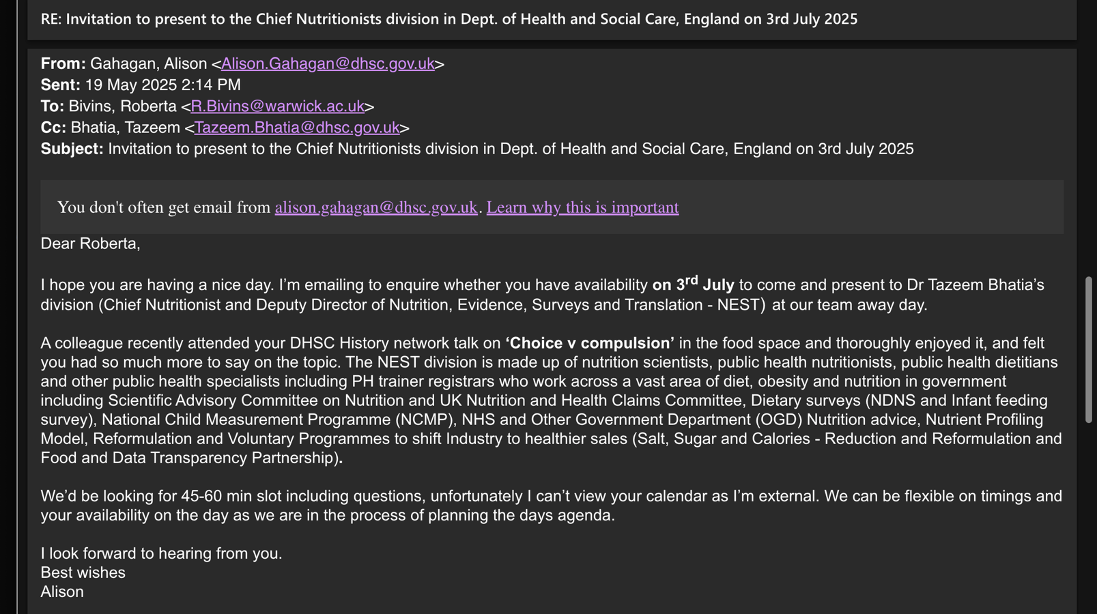
The Ask: a 45 minute talk to Dept of Health nutritionists

Slide 3

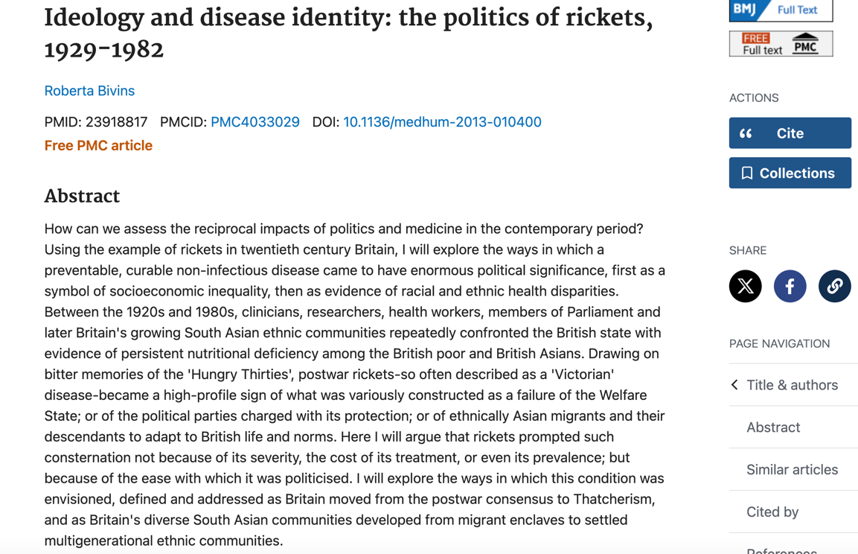
The academic history

Slide 4
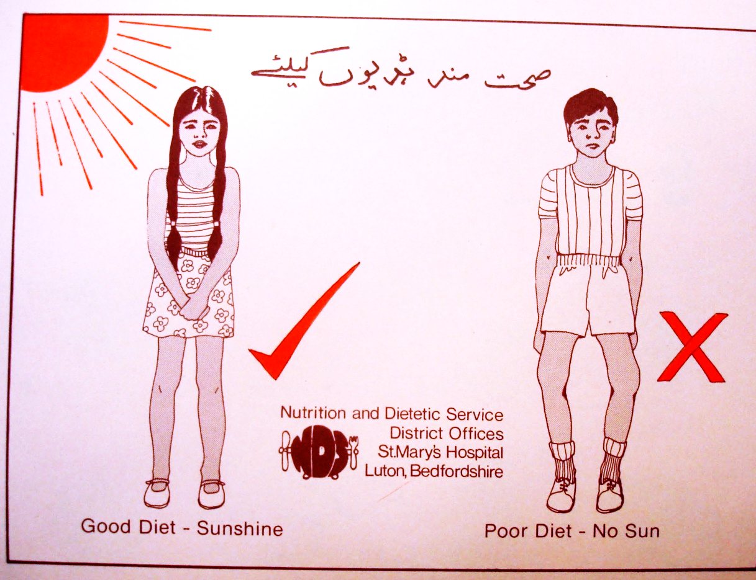
Converting the Case-Study:
‘Asian’ Rickets and the NHS, 1963-1983 – what can it tell us for today?

Slide 5



How to do it?
Think about what this audience needs? Who are they? What kinds of authority and language do they trust?
Think about what your work can genuinely offer them, focus closely on that, and be confident in your judgement.
Read around the topic for the contemporary problems they want to solve.

Slide 6
Culture and Co-Production in Migrant Health Programmes
Professor Roberta Bivins
Centre for the History of Medicine
University of Warwick
www.peopleshistorynhs.org

Slide 7
The Problem:
Even ‘Free’ is not Enough
Providing appropriate, accessible health services to migrants and refugees is challenging
  Politically
  Structurally
  Culturally

Slide 8

What is on THEIR plate?

Slide 9
The Context: Economic and Crisis Migration during a Global Recession
1961-2 Shift to restrictive immigration policies in Britain prompts ‘beat the ban’ mass migration
1968 Kenya Asian crisis renews flood of migrants, this time forced migrants from ‘Africanizing’ Kenya,
1972-3 Ugandan Asian crisis
All cases:
Prompt local sympathy but also fear/hostility
Trigger political debate
Expose new and existing health problems
Kenyan Asians, 1968 © Getty Images

Slide 10
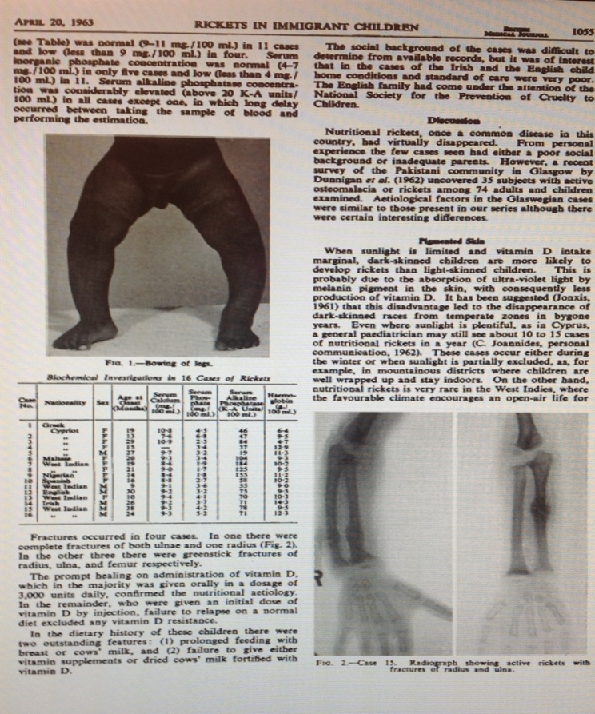
General Information about Primary Rickets
A global problem (inc. 77% of ‘dark-skinned migrants’; higher among pregnant women).
At-risk populations: infants; young children; pregnant/breastfeeding mothers; housebound elderly.
BUT especially those with dark skin; cultural practices of seclusion/modest dress; sedentary/indoor lifestyles; UV avoidance.
SO: migrant AND local populations at risk
Notes:
The prevalence of vitamin D deficiency among dark-skinned populations according to their stage of migration and region of birth: A meta-analysis
Original Research Article
Nutrition, Volume 32, Issue 1, January 2016, Pages 21-32
Catherine A. Martin, Usha Gowda, Andre M.N. Renzaho

Slide 11
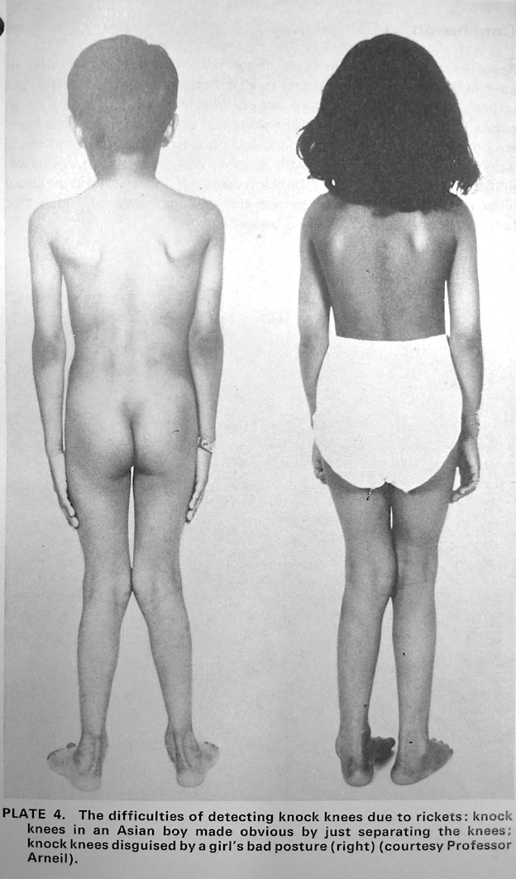
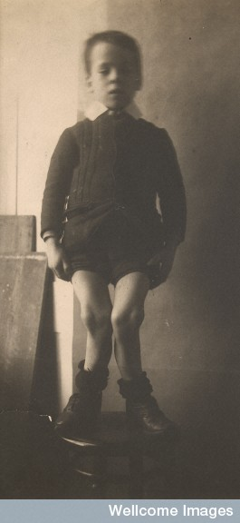

From ‘The English Disease’ ...
…via mass wartime fortification and supplementation programme…
To ‘Asian Rickets’

Slide 12
First Response
Migrants: Assimilate for Health
‘The problem of this racial group is circumscribed and ought to be evanescent.’
  G. C. Arneil and J.C. Crosbie, Lancet, 1963
‘The solution lies in adequate education of Asian women immigrants firstly to speak English and secondly in the elements of child care in this climate.’
Lancet, 1963
‘Rickets had been almost completely eliminated from this country since the war … but rickets appeared again with people …who … had no idea of the uses of welfare foods.’
Guardian, 1965

Slide 13
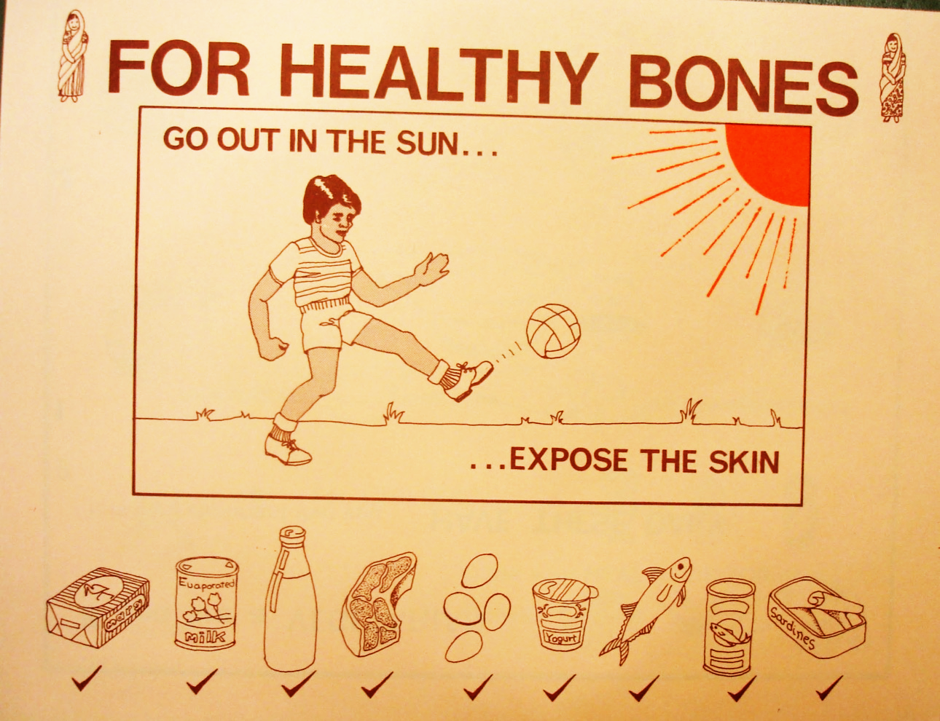
Dress and play like us;
Do not cover; Change diet;
Eat foods already selected for fortification. (all chosen to ensure health of poor British families)
Bedfordshire Local Health Authority c. 1970s
Notes:
From MH160-1453 Samples of locally produced nutritional guidance sent to Vaughan (to remind him of the importance of nutritionists in stopping rickets. This is from Lancashire Area Health Authority c. 1981

Slide 14
‘Asian Rickets’: Blaming ‘Cultural’ Difference
‘the lack of sunshine in the UK is not … entirely at fault, so much as the dietary habits and social customs which prevent the necessary exposure to sunlight here as in their own countries.’
COMA(Nutrition) Panel on Child Nutrition, January 1976

Slide 15
‘Asian Rickets’: Factors Identified by Migrants
‘The racial violence and panic are so high that the Immigrant adults or children, no one can come out in the park for fresh air or in the sun shine to have ultraviolet irradiation.’
‘overcrowding; damaged environment; no ventilation; no sun shine facilities; repeated attacks of infections.’
Dr Qudratul Islam to Minister Gerard Vaughan, 10 March 1981
© Getty Images

Slide 16
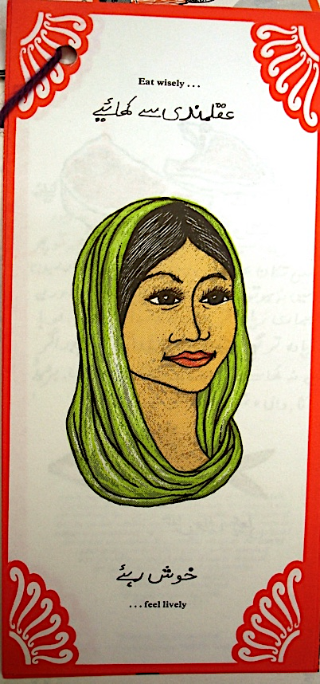
From ‘Assimilation’ to Cultural Awareness
‘The first important thing was communication with the community. Second thing was to understand their culture and beliefs… having understood their culture and beliefs … we tried to educate them by telling them what the problem was … so that a need, a felt need comes from the community themselves … we had to get the co-operation of the Asian community and it is by involving them in our decision that we were able to get their confidence … and their goodwill.’
Dr Rafik Gardee, Glasgow, 1979

Slide 17
A New Solution? Community Consultation
‘This condition was virtually eradicated until the late 1960s and the early 1970s. At the moment, it is almost entirely a problem of immigrants. … We are having meetings with the leaders of the immigrant community to see how best we can bring the education aspects of this matter to the attention of members of immigrant groups. I believe that this will be successful and that we shall see the end of rickets in this country once again.’
‘We are not asking anyone to change their way of life, their diet or their dress. There are several ways of preventing rickets, at least one of which should be acceptable to anybody, whatever their culture.’
Gerard Vaughan, Minister for Health, 1980
Notes:
NATIONAL HEALTH SERVICE
HC Deb 23 January 1980 vol 977 cc454-580 at column 573-4.

Slide 18

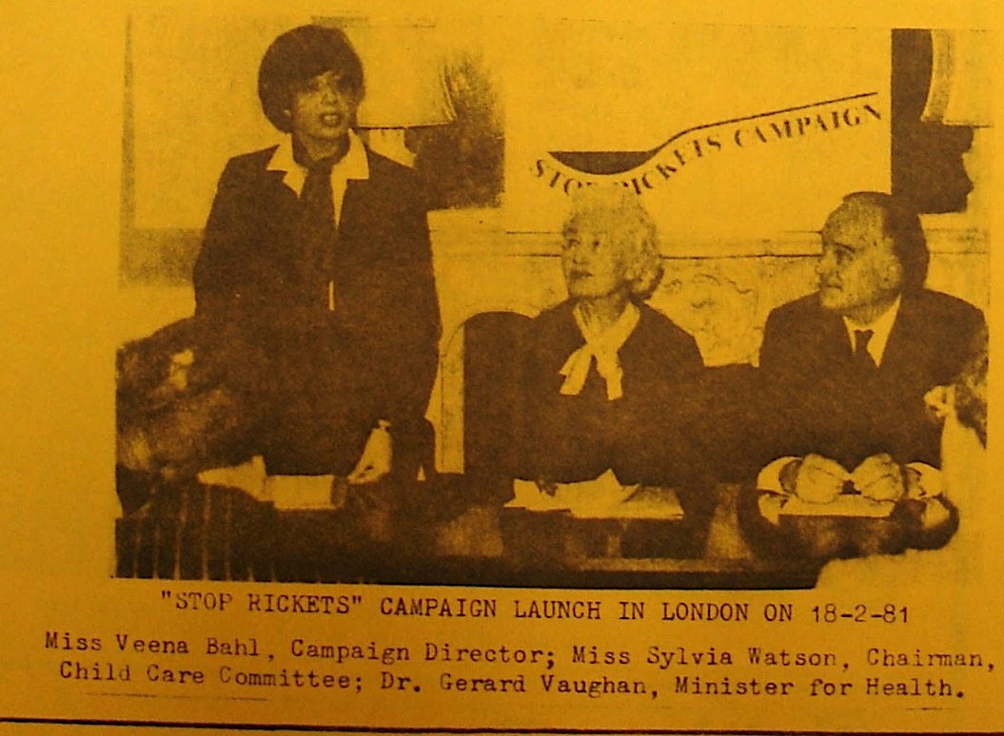
Direct consultation with (male, elite) community members
Campaign led by NGO, fronted by a professional from and familiar with target population groups
Local populations directly engaged in sponsoring, selecting campaign events

Slide 19
Results: Not perfect, not long-term… but a start
‘The campaign, as well as proving effective in tackling a wholly preventable disease, has, to Dr Vaughan's delight, had some beneficial side effects. It has greatly improved links with the Asian community and, best of all these days, has not cost a lot of money. Apart from the communications link, which is proving valuable in helping improve race relations generally, one of the other reasons Dr Vaughan is carrying on with the scheme is that it has brought a lot of other illnesses to light, including active TB and various dietary and malnutrition problems.’
‘Smiles about rickets’ BMJ, Jan 1982
Notes:
Success stories are sufficiently rare these days not to allow even quite a little one to pass unremarked, and Dr Gerard Vaughan is enthusiastic about this one anyway. The "Stop Rickets" campaign, which the Minister of Health launched last year and was due to end in March… is to carry on and provides the story. Most people are probably unaware that it has been taking place because it has been aimed at the immigrant population, particularly the Asians, among whom rickets is prevalent. The campaign, as well as proving effective in tackling a wholly preventable disease, has, to Dr Vaughan's delight, had some beneficial side effects. It has greatly improved links with the Asian community and, best of all these days, has not cost a lot of money. … Of all the immigrant communities, the Asians tend to be the most isolated, partly because they cling to their traditional social habits, which means that women remain firmly within the family unit and simply do not know about diet deficiencies, and partly because of language problems. Rickets among the population generally was eradicated during the last war and to most people is a thing of the past. Dr Vaughan says that some of the health authority chairmen he has talked to insisted that they did not have it in their areas but when pressed to investigate came up with quite a different picture. In Sheffield, for instance, four general practitioners found 17 patients with rickets "just like that,“ and in Glasgow, where the disease was once commonplace, the Scottish Home and Health Department found that about one-third of Asian children were vulnerable. Apart from the communications link, which is proving valuable in helping improve race relations generally, one of the other reasons Dr Vaughan is carrying on with the scheme is that it has brought a lot of other illnesses to light, including active TB and various dietary and malnutrition problems. The trouble is that a diet suitable to the Indian subcontinent simply does not contain the vitamins and oils needed in Britain's climate, and the campaign helps people understand what changes they must make. Dr Vaughan's pleasure at the economical nature of it all stems from the fact that the first year's budget of £70 000 is not yet exhausted, and that, of course, makes getting next year's money to allow it to carry on rather easier.

Slide 20
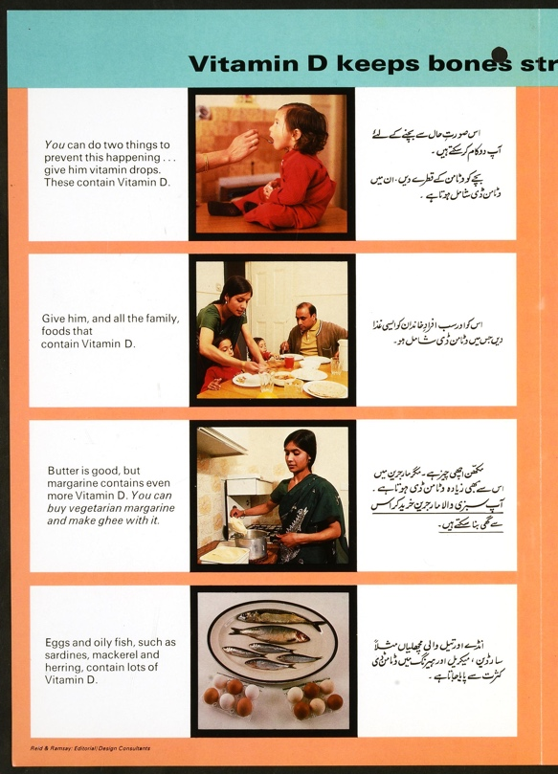
Responses to ‘Stop Rickets’
‘This is the first time a Government Minister has taken such a measure, almost entirely aimed to the Asian Community; a preventive health education exercise which will have far reaching effects in the community as a whole. We are very grateful.’ Leicester Stop Rickets Team
‘The whole Asian community in Britain is indebted to the Health Minister … for his unique contribution to save their children.’ Andhra Association
BUT:
‘There are never enough interpreters, there is never any recognition of our own cultural needs, instead the health service is used against us to control us and intimidate us. All efforts at Health Education are on the state’s terms and not ours…’ Sheffield Black Women’s Group
Notes:
TNA MH160/1451 ‘Rickets Campaign – Press Launch Notes for MS(H)’s Speech’, 18 February 1981

Slide 21
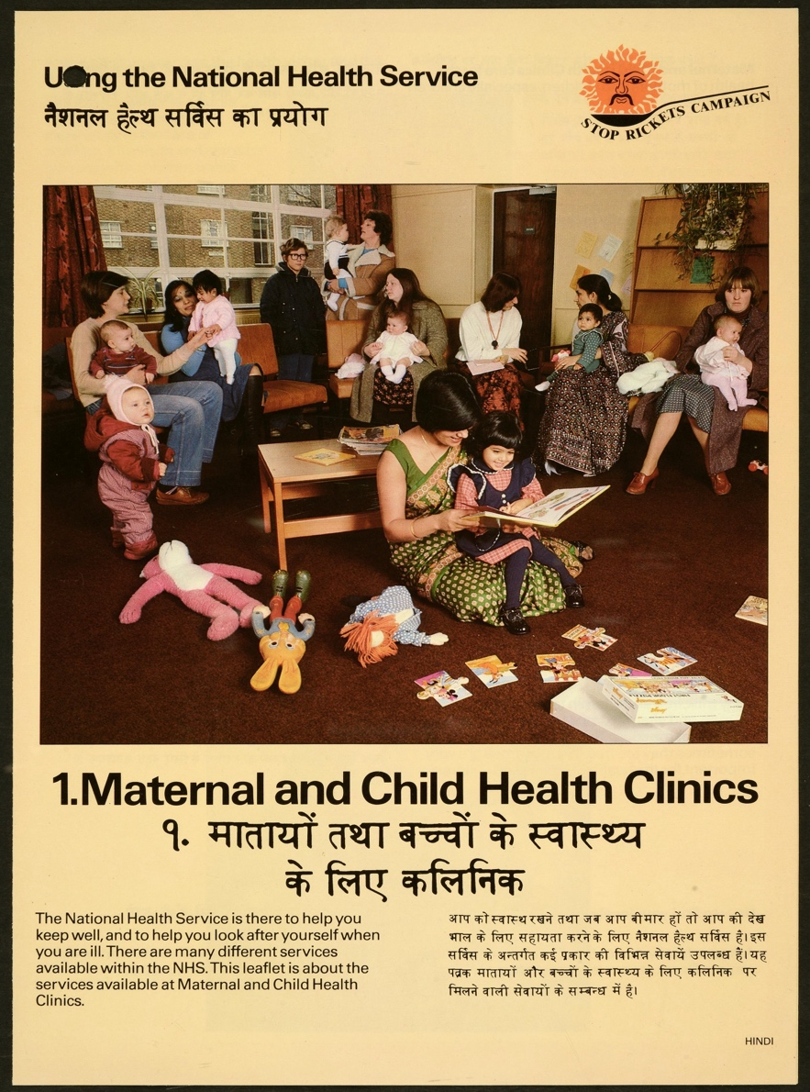
Outcomes
Short Term
Spike in Diagnoses
Increased community AND professional awareness of rickets (tested one year later)
Long Term
Reshaped expectations about role of cultural awareness in health provision for migrants
Viewed migrants as assets in health education, NHS as not ‘transparent’
Incorporated migrants into the ‘public’ of public health, e.g. ‘Asian Mother and Baby’ campaign 1983
Notes:
Michael Goldacre, Nick Hall, David G R Yeates, Hospitalisation for children with rickets in England: a historical perspective
The Lancet 15–21 February 2014, 597-598

