Slide 1
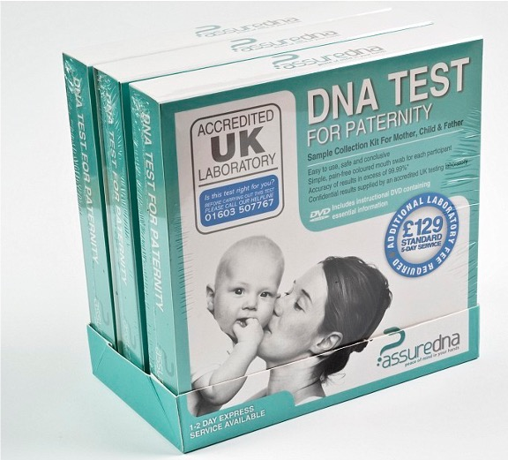
Come to Daddy:
‘Fingerprints’ of Familiality in Thatcher’s Britain
Roberta Bivins
Centre for the History of Medicine University of Warwick

Slide 2
Genetics, Identity and Parenthood in an age of certainty
The legal framework in Britain before 1991
Parenthood and Citizenship
Parenthood and ‘Custody and Control’
Pre-1914 Nationality descends to infants from fathers in the case of marriage, and from mothers only in the absence of marriage. Children born in British Isles treated jus soli.
1914-22 Transmission of subject status along legitimate male line for Britons born overseas
1948-1981 Gradual development of UK citizenship linked inheritance of citizenship from legitimate fathers with marriage; and right of abode with financial provision.
1981 British mothers gain right to pass on nationality to children born overseas
1981 ‘Fatherhood’ for transmission of nationality assigned to the husband of the mother at the time of child’s birth.
1983 Jus soli replaced by jus sanguinis
Only in 21st c. do illegitimate children born abroad to UK fathers gain citizenship by birth if paternity can be proven.
Filius nullius and ‘mater semper certa est’: paternal ‘custody and control’ the protected norm except in cases of ‘bastardy’ – ‘fathers’ rights negated the possibility of mothers’ rights’ (de Manneville vs de Manneville, 1804).
1834 New Poor Law strips paupers of key parental rights, fearing ‘hereditary pauperism’ and enabling state ‘custody and control’ that also subordinated (poor) children’s welfare to welfare of the state. ‘Bastardy Clause’ de facto dilutes responsibility of fathers to illegitimate children
Late 19th and early 20th c. guardianship laws create a judicial duty to child welfare).
1973 Parental equality in matters of custody and control finally established.
1987 legal equalisation of ‘legitimate’ and ‘illegitimate’ (citizen) children (but not completely for citizenship purposes until 2025)
1990 Social Security Act enables DSS to claw income support costs back from non-resident parent
1991 Child Support Act establishes Child Support Agency (CSA)
1995: CSA empowered to use DNA to claw back mothers’ income support from ‘feckless fathers’
Notes:
1857 Creation of the Divorce Court, which regularly challenged the sanctity of paternal rights to ‘control and custody’ where husbands had not performed their ‘marital duty’ to provide religious education and financial support.
1886 Guardianship of Infants Act formally introduces a legal responsibility for courts to consider welfare of children in their adjudication of custody. This is in order to control abuses while not recognising ‘rights’ for women or children according to Ben Griffin paper.

Slide 3
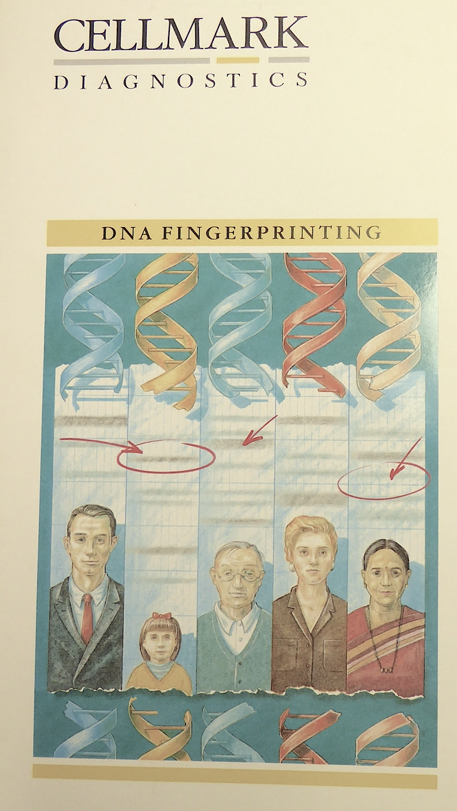
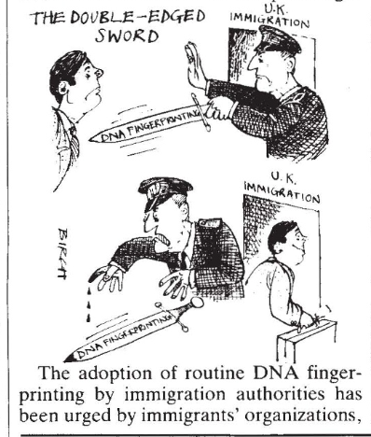
The Risks and Benefits of Certainty
DNA profiling and the biologisation of (racialised) kinship
Inequalities and ‘imperial suspicion’
Driven to DNA: betting on ‘certainty’
A Bangladeshi man, settled here for 20 years and now a full British citizen, experiences a two year delay in the processing of his wife and children’s application to join him only to have it eventually refused because the High Commission officer does not believe that his family is related to him as he claims. Yet an EEC national, working in the UK for perhaps even only a matter of months, has little difficulty in obtaining a residence permit for children, spouse (male or female) and even grandparents.’
Nony Ardill, North Islington Law Centre, 1983

Slide 4
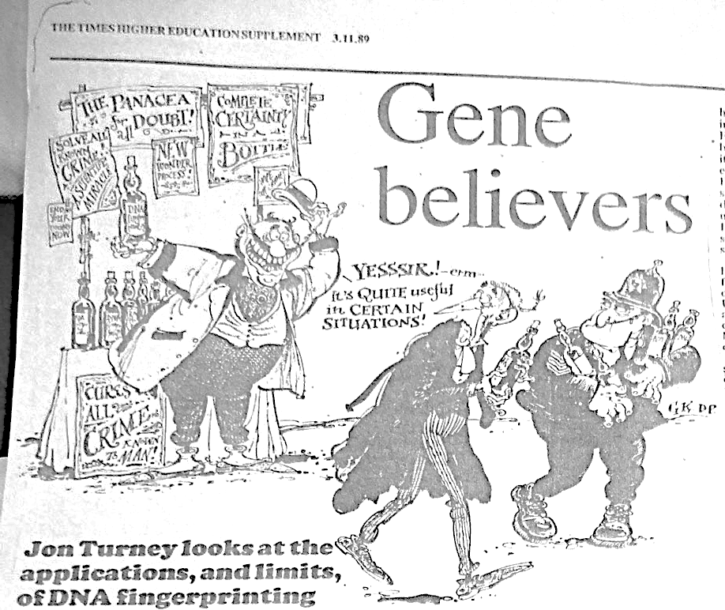
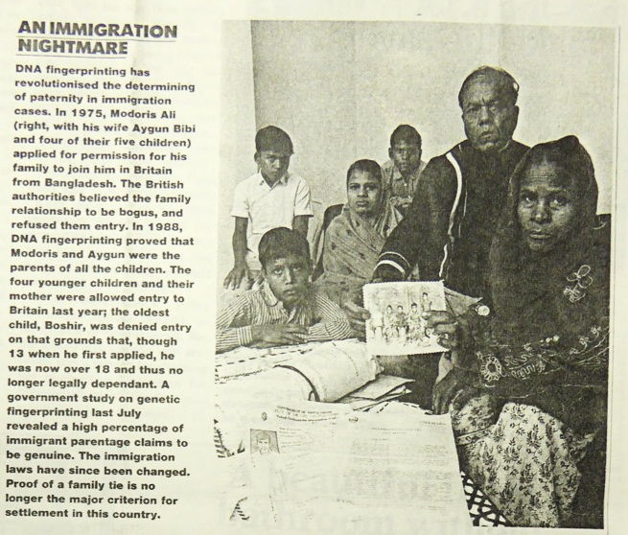
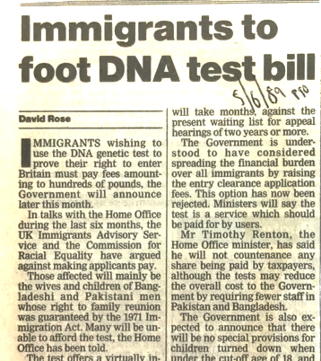
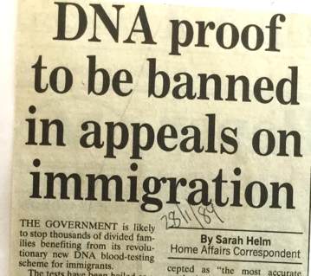
Certainty for ‘certain situations’ – but for whom?
‘A government study on genetic fingerprinting last July revealed a high percentage of immigrant parentage claims to be genuine. The immigration laws have since been changed. Proof of family ties is no longer the major criterion for settlement in this country.’
Jon Trux, ‘A Case of Unmistakeable Identity’, Observer, 13 August 1989

Slide 5
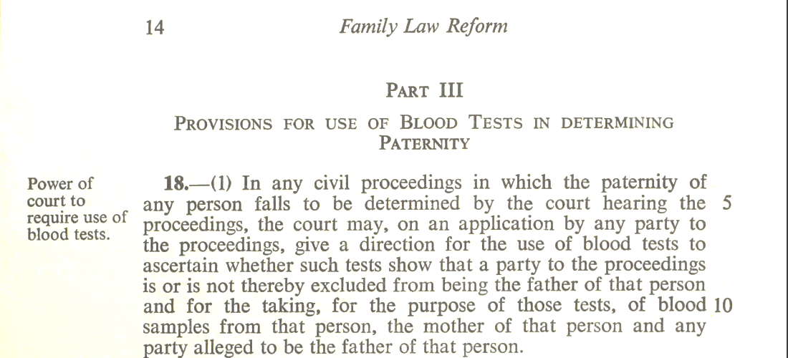
Blood testing in familial law before DNA
‘In the interests of the child’?
‘It is true that the enforcement of a blood test in civil (generally divorce) proceedings could operated [sic] to the disadvantage of a child under sixteen (who is not able to consent or refuse) in the sense that it may provide evidence to bastardise him but equally it may have the reverse effect.
Personally, I see no objection to this provision and indeed I approve of it. … I would regard Section 24 more important which lowers the standard of proof required for rebutting the presumption that the Law has always made that everyone is born legitimate until it is proved to the contrary.’
Peter Bayliss, Esq., to P.H. Addison, MRCS, Medical Defense Union, 24 April 1969.
Family Law Reform Bill, 1969
Gave illegitimate children the same rights of succession in intestacy as legitimate children. Part of a wider effort to reduce – for citizen children – the distinction between legitimate and illegitimate birth.
Explicitly empowers judges in civil courts (where most family law cases are were decided) to require a blood test to determine (non)paternity. Crucially, if a person relying on the presumption of legitimacy refused to comply with testing, the court was enabled to overturn that presumption.
Notes:
Family Law Reform Bill (blood tests and paternity) (E.6)
Date:1969 Reference:SA/MWF/H.36

Slide 6
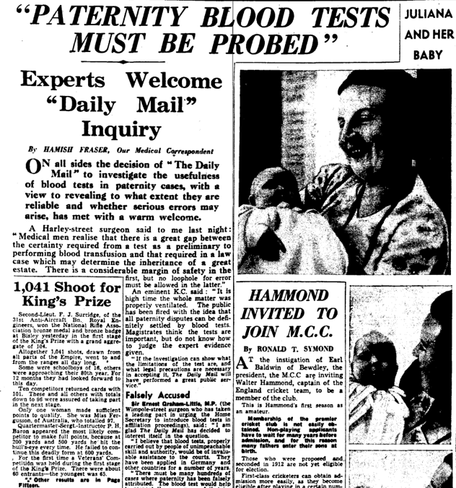
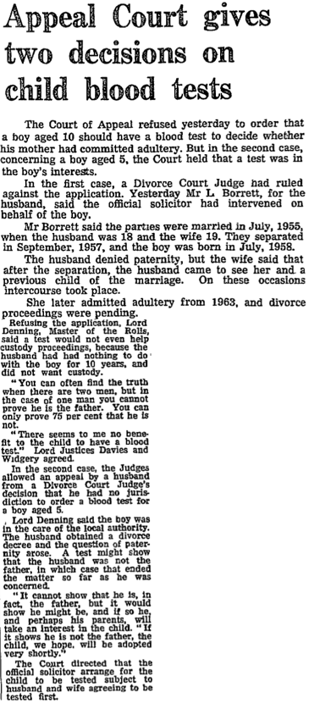
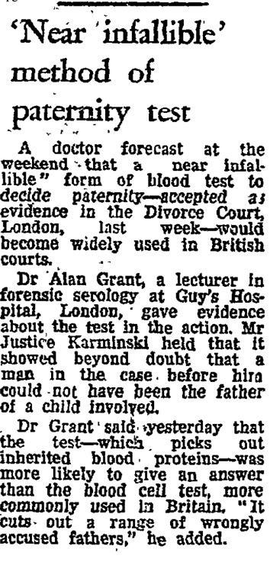
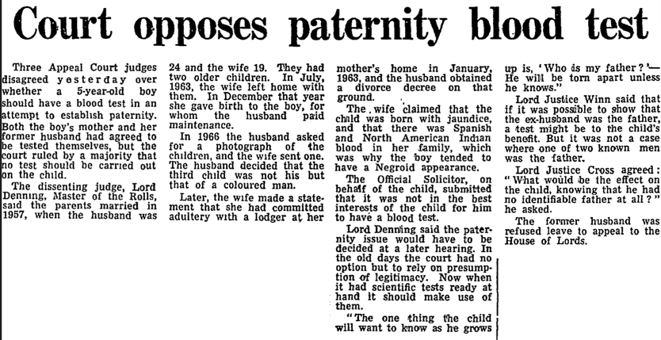
Testing for Paternity:
Attitudes towards blood tests before genetic certainty and bioborders
‘Not in the best interests of the child…’
‘It is best [for the child]
that truth will out’
‘When it comes to the crunch,
Justice must prevail’
‘Blood testing is not a sure
way of discovering parentage’
Daily Mail 1970
‘Cuts out a range of wrongly
accused fathers…’
Guardian 1966
‘In the old days, the court had no option but to
rely on presumption of legitimacy. Now when it
had scientific tests ready a hand, it should make
use of them’ Guardian, 1969
‘Serious lapses of justice may occur and bring discredit on scientific discoveries which if properly used, can save 1000 innocent men a year…’ Daily Mail, 13 July 1938

Slide 7
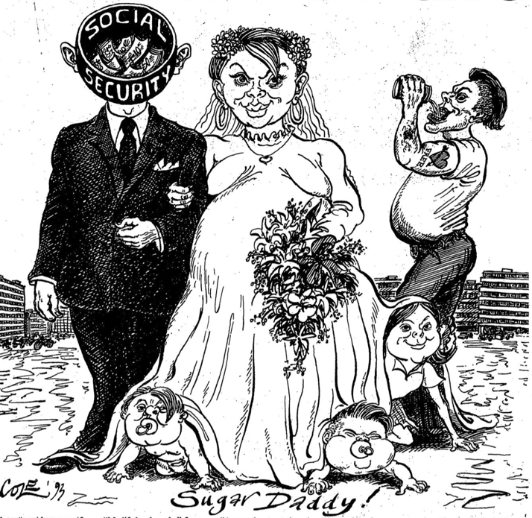
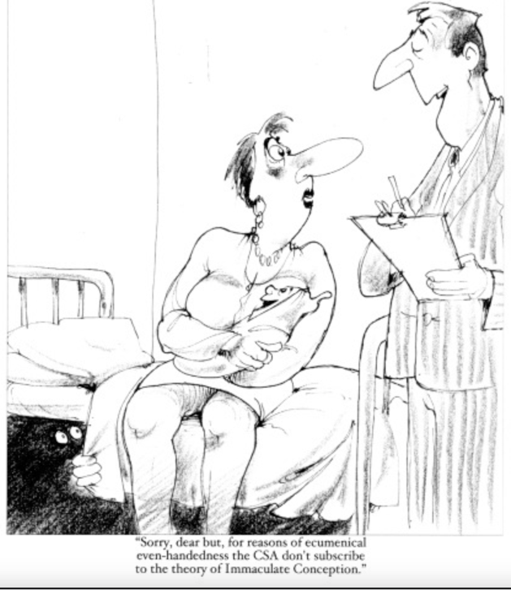
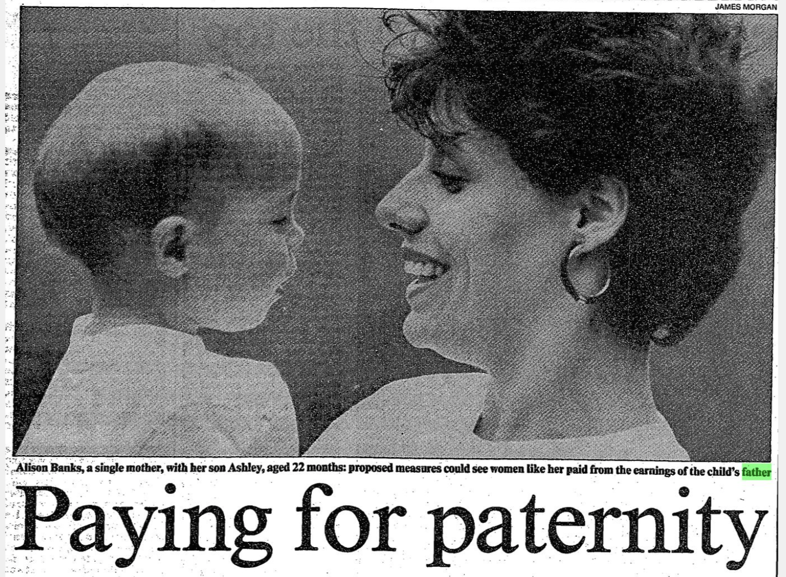
DNA for Deadbeat dads:
After the immigrants, the ‘underclass’?

Slide 8
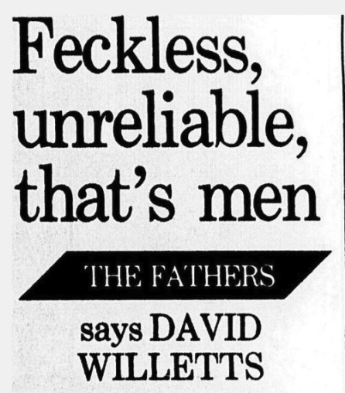
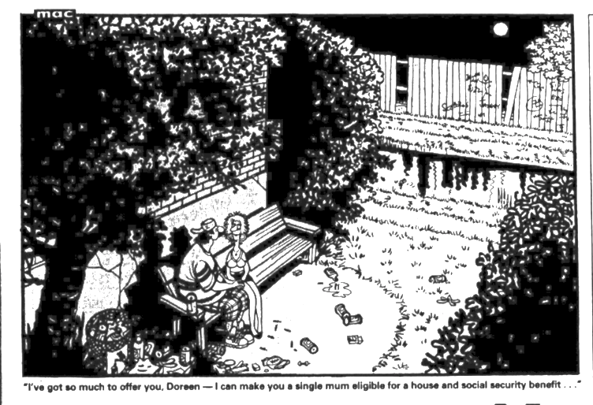
From ‘imperial suspicion’ to ‘Darkest England’:
Creating the ‘feckless father’
‘The welfare state has taken over the traditional roles of the husband: it provides housing and a steady income. If there are not many reliable men, you can in effect marry the state instead.
None of this is the fault of the single mothers. Indeed it is striking how much responsibility these women, often still only girls in their teens, are taking on. They are leading tough, demanding, tiring lives. I believe that it is the men who are feckless and unreliable.’
David Willets, ‘Feckless, Unreliable, that’s men’ Daily Mail, 6 July 1993

Slide 9
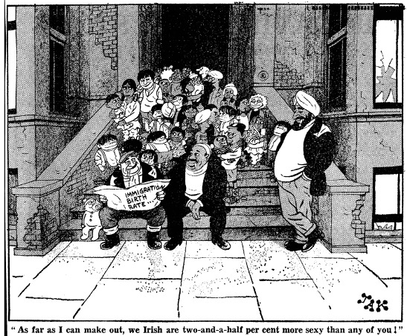
From ‘imperial suspicion’ to ‘Darkest England’:
Creating the ‘feckless father’
‘Lambeth … has the largest proportion of children born outside marriage in the country, 46.3 per cent according to the Office of Populations Censuses and Surveys. In a breakdown of families with dependent children into ethnic groups, the NCOPF report says that 56.6 per cent of West Indian families have two parents and 43.4 per cent are one-parent, compared to 88.2 percent of white families … and 11.8 percent.
Social scientist Gus John, director of education in Hackney, East London says “The notion that this is because all these people are used to running around Jamaica and Trinidad breeding like rabbits without let or hindrance is a racist myth this country continues to manufacture. … To suggest establishing paternity through blood tests is an absurd notion, though I support is is a sign of the times. How do they propose to go about it – with thumb screws and tie them down on a rack?”’
Heather Kirby ‘Paying for Paternity, The Times May 26, 1989.

Slide 10
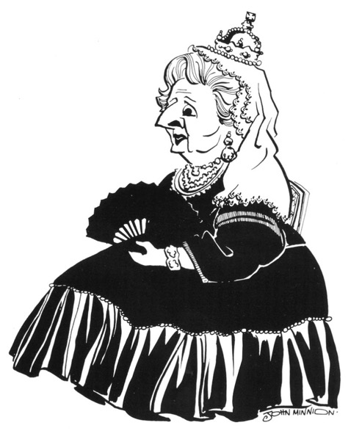
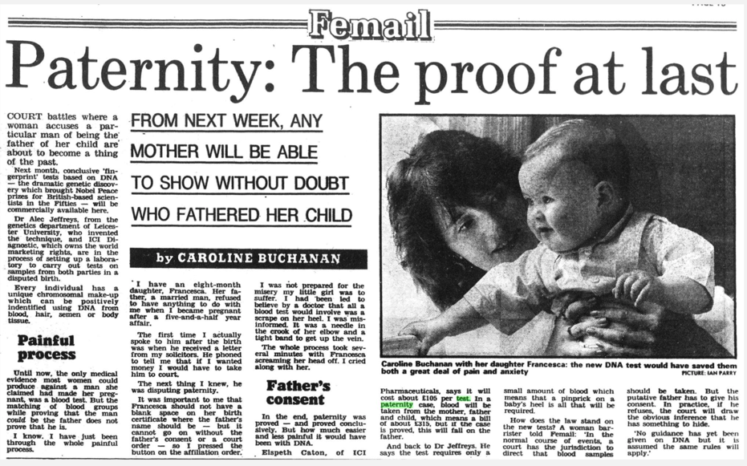
After-effects: From genetics at the border to DNA for Deadbeat Dads
‘Appalled at the size of the bill left behind by
Fathers…’
‘Family life is under threat’
‘the absent male’
‘Nearly 1 in seven families’
‘Mothers struggling…’
‘Moved by the plight of the
growing number of children of
broken marriages…
determined to make errant
fathers pay …’

Slide 11
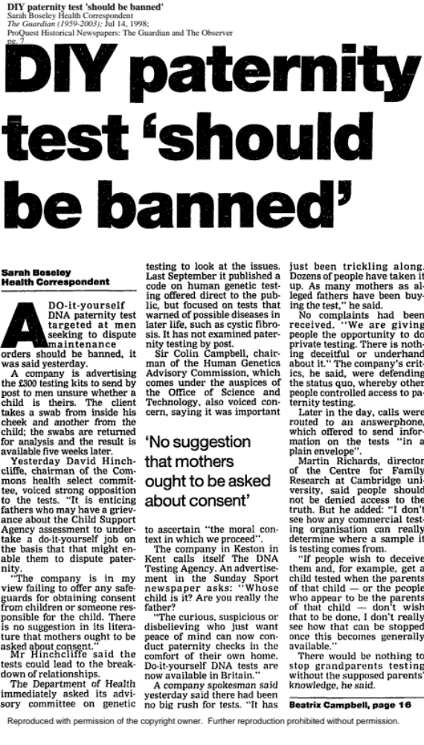
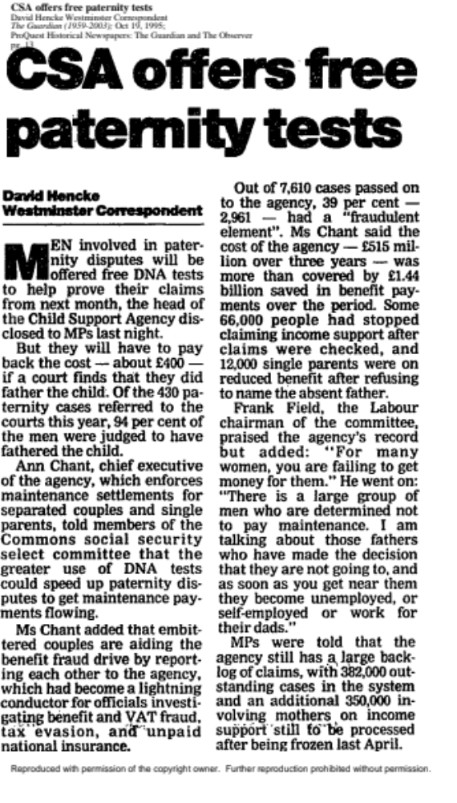
The Rise and Risks of Certainty
The Ad: "Whose child is it? Are you really the father? The curious, suspicious or disbelieving who just want peace of mind can now conduct paternity checks in the comfort of their own home. Do-it-yourself DNA tests are now available in Britain.”
The Chair of Commons Health Select Committee: "I hope the Government will find some way to block the activities of this agency and other agencies undertaking similar testing. … I want to see it stopped. Clearly there is a huge gap in law here where there is no provision in respect of non-medical use of DNA.”
The ‘DNA Testing Agency’: "They [critics and the government] are defending the position where they are controlling the tests in this country. We are giving people the opportunity to do private testing. There is nothing deceitful or underhand about it."
http://news.bbc.co.uk/1/hi/health/131744.stm 1998

Slide 12
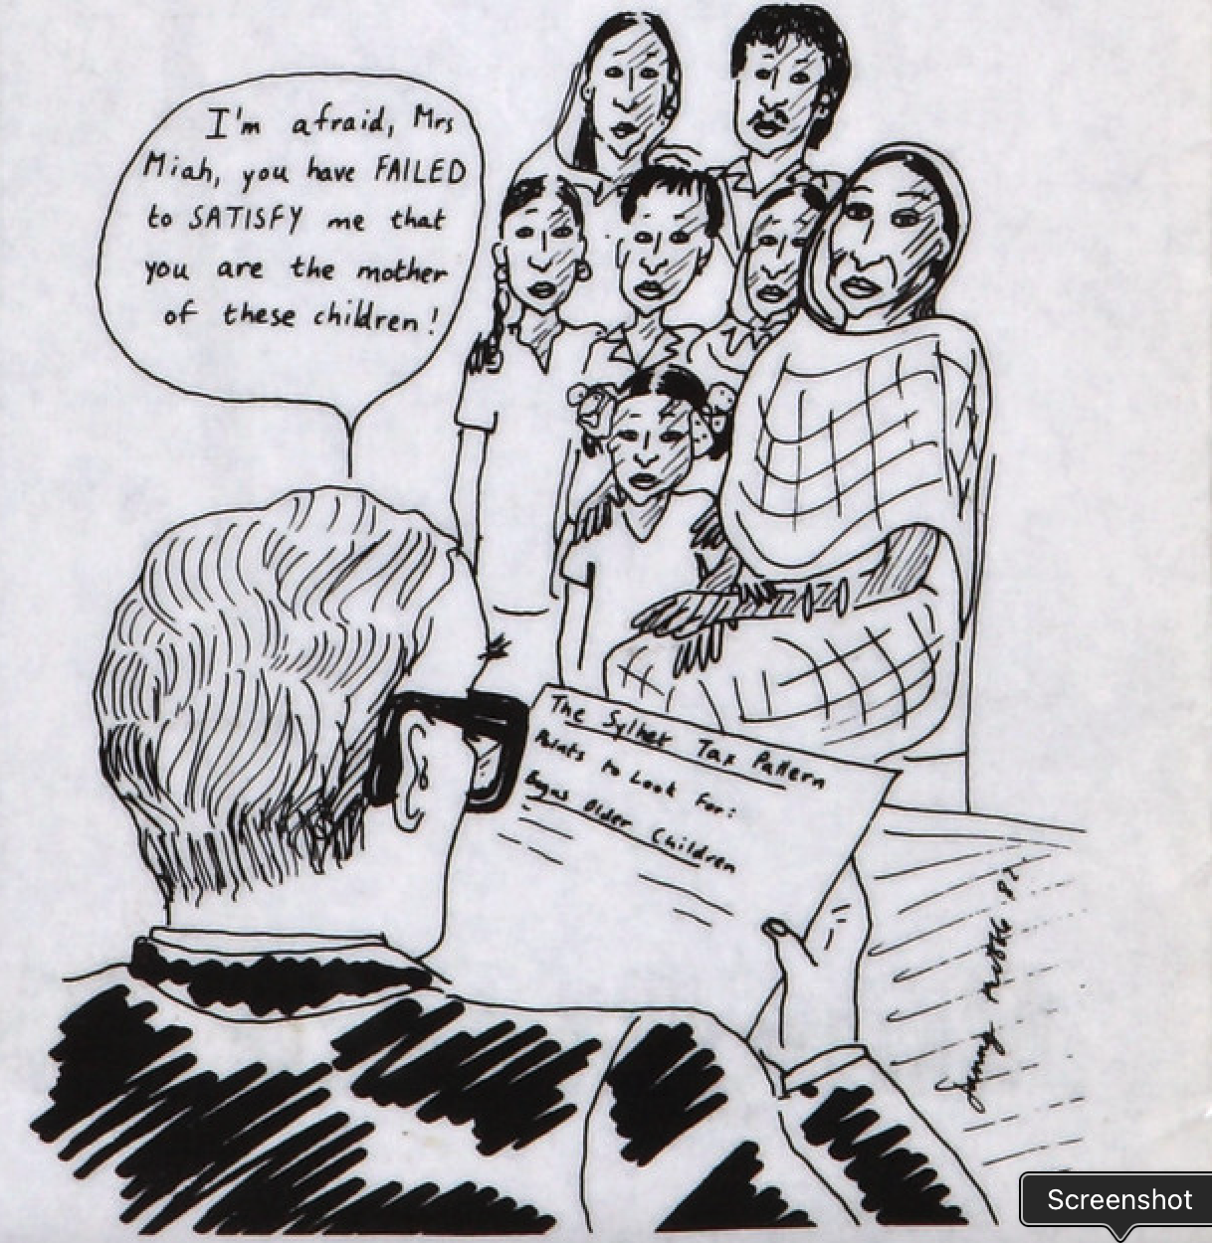
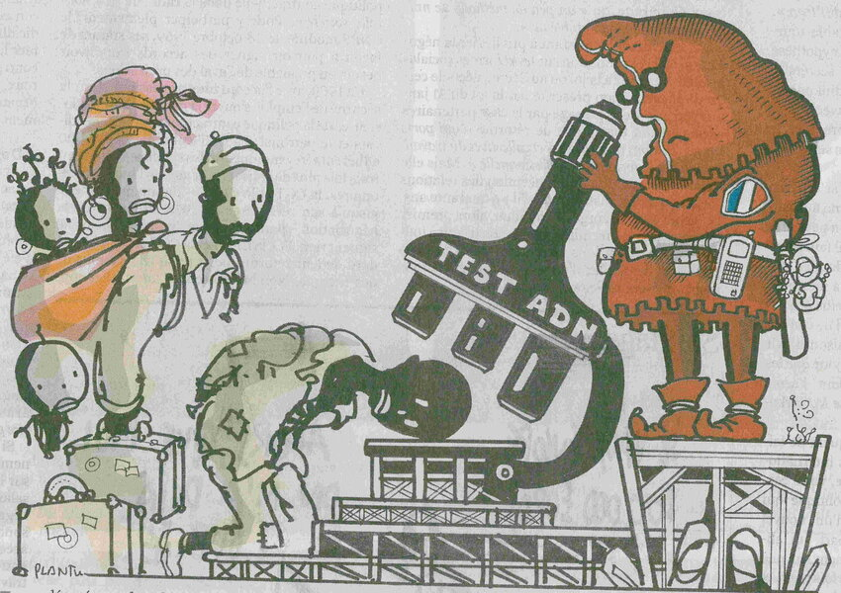
So what does the history of DNA profiling tell us?
About the putative disruptive power of technology,
Tools and power migrate with stigma… technological ‘disruptiveness’ is probably temporary
Ultimately, the goal of the state is to define, delimit and discipline the citizen-body

Slide 13
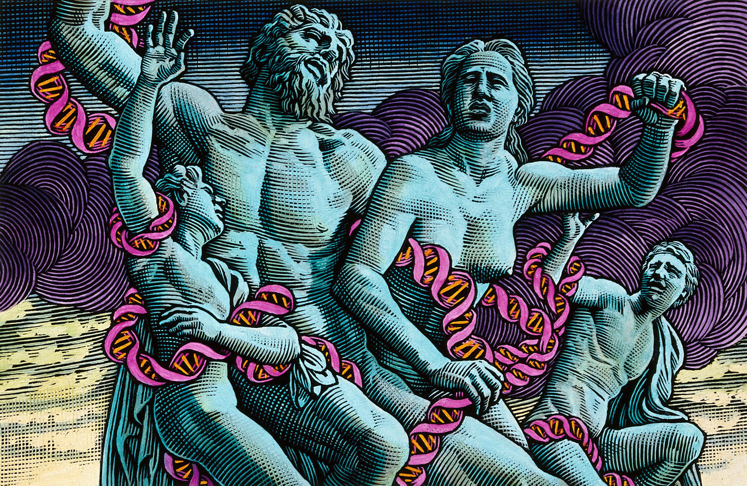
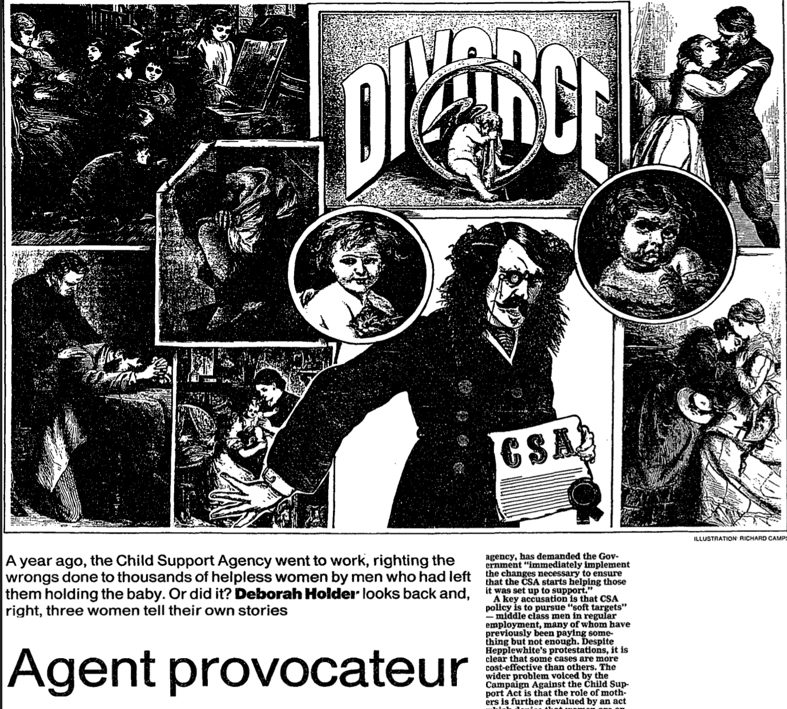
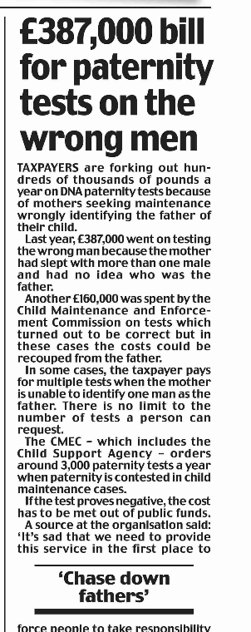
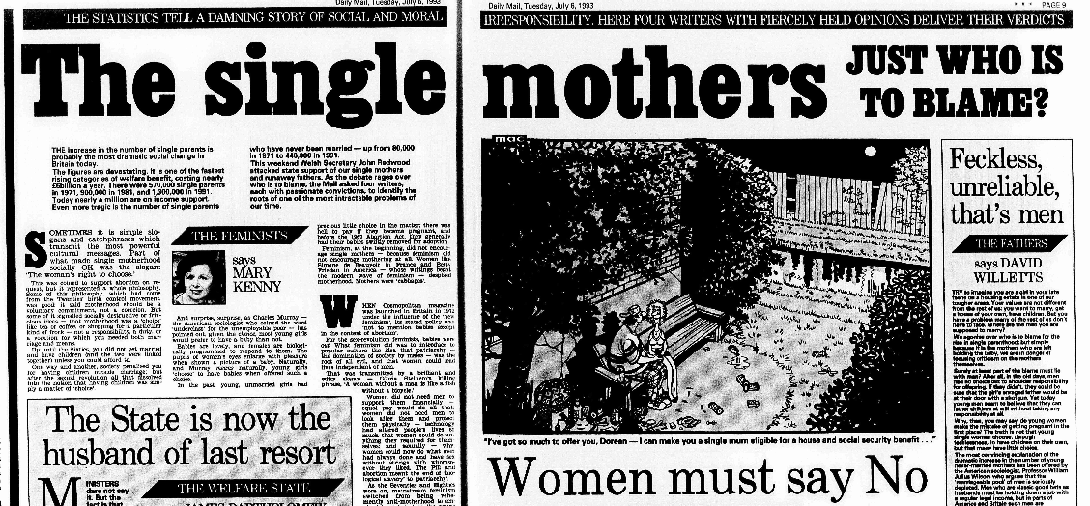
So what does the history of DNA profiling tell us?
About the state as a family maker or family breaker?

