Slide 1
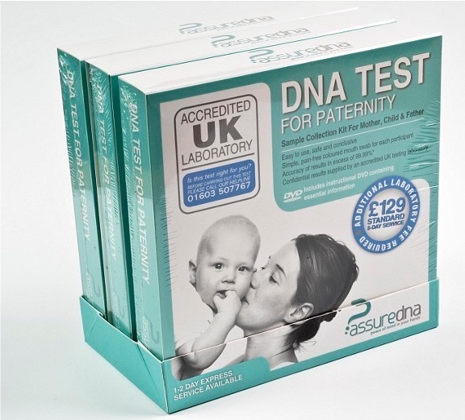
From Deceitful mums to deadbeat dads:
DNA 'fingerprinting' and state family-making in Thatcher's Britain
Roberta Bivins
Centre for the History of Medicine University of Warwick

Slide 2
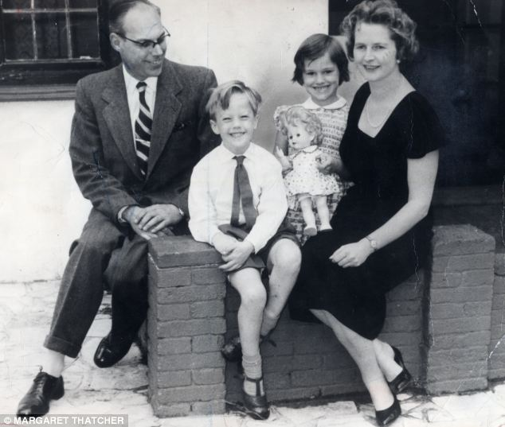
What constituted a family in Thatcher’s Britain?
(and for whom?)
For racialised migrants
For territorial British citizens
Based on policies and practices in family reunification:
There must be a legally settled parent-sponsor.
Parenting units may include no more than two (heterosexual) legally married persons.
Children must be the biological offspring of their sponsoring parent, and must (pre-DNA fingerprinting) have been born to them in marriage.
Children must be financially dependent on sponsoring parent.
‘Family’ does not include siblings, cousins, grandparents, or children who are not biologically related to the sponsoring parent.
Based on policies in affiliation and support cases:
Families include a heterosexual adult couple (at least one of whom, ideally male, is in work) and their progeny, including socially-parented adopted children.
Husbands are legal parents of all children born within a marriage unless they can prove incapability beyond a reasonable doubt.
Unmarried biological donors are responsibilized as ‘parents’ to the children if those children are supported by the state.
‘Parents’ are financially responsible for their children until age of 18 (or end of formal education).

Slide 3
Identity and Parenthood in an age of certainty
The legal framework in Britain before 1991
Parenthood and Citizenship
Parenthood and ‘Custody and Control’
Pre-1914 Nationality descends to infants from fathers in the case of marriage, and from mothers only in the absence of marriage. Children born in British Isles treated jus soli.
1914-22 Transmission of subject status along legitimate male line for Britons born overseas
1948-1981 Gradual development of UK citizenship linked inheritance of citizenship from legitimate fathers with marriage; and right of abode with financial provision.
1981 British mothers gain right to pass on nationality to children born overseas
1981 ‘Fatherhood’ for transmission of nationality assigned to the husband of the mother at the time of child’s birth.
1983 Jus soli replaced by jus sanguinis
Only in 21st c. do illegitimate children born abroad to UK fathers gain citizenship by birth if paternity can be proven.
Filius nullius and ‘mater semper certa est’: paternal ‘custody and control’ the protected norm except in cases of ‘bastardy’ – ‘fathers’ rights negated the possibility of mothers’ rights’ (de Manneville vs de Mannville, 1804).
1834 New Poor Law strips paupers of key parental rights, fearing ‘hereditary pauperism’ and enabling state ‘custody and control’ that also subordinated (poor) children’s welfare to welfare of the state. ‘Bastardy Clause’ de facto dilutes responsibility of fathers to illegitimate children
Late 19th and early 20th c. guardianship laws create a judicial duty to child welfare).
1973 Parental equality in matters of custody and control finally established.
1987 legal equalisation of ‘legitimate’ and ‘illegitimate’ (citizen) children (but not completely for citizenship purposes until 2025)
1990 Social Security Act enables DSS to claw income support costs back from non-resident parent
1991 Child Support Act establishes Child Support Agency
Notes:
1857 Creation of the Divorce Court, which regularly challenged the sanctity of paternal rights to ‘control and custody’ where husbands had not performed their ‘marital duty’ to provide religious education and financial support.
1886 Guardianship of Infants Act formally introduces a legal responsibility for courts to consider welfare of children in their adjudication of custody. This is in order to control abuses while not recognising ‘rights’ for women or children according to Ben Griffin paper.

Slide 4
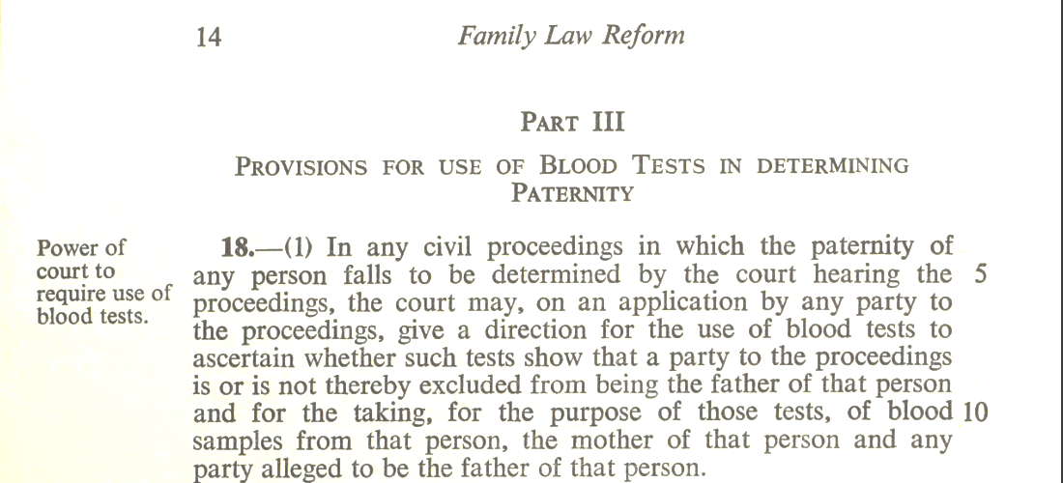
Blood testing in familial law before DNA
‘In the interests of the child’?
‘It is true that the enforcement of a blood test in civil (generally divorce) proceedings could operated [sic] to the disadvantage of a child under sixteen (who is not able to consent or refuse) in the sense that it may provide evidence to bastardise him but equally it may have the reverse effect.
Personally, I see no objection to this provision and indeed I approve of it. … I would regard Section 24 more important which lowers the standard of proof required for rebutting the presumption that the Law has always made that everyone is born legitimate until it is proved to the contrary.’
Peter Bayliss, Esq., to P.H. Addison, MRCS, Medical Defense Union, 24 April 1969.
Family Law Reform Bill, 1969
Gave illegitimate children the same rights of succession in intestacy as legitimate children. Part of a wider effort to reduce – for citizen children – the distinction between legitimate and illegitimate birth.
Explicitly empowers judges in civil courts (where most family law cases are were decided) to require a blood test to determine (non)paternity. Crucially, if a person relying on the presumption of legitimacy refused to comply with testing, the court was enabled to overturn that presumption.
Notes:
Family Law Reform Bill (blood tests and paternity) (E.6)
Date:1969 Reference:SA/MWF/H.36

Slide 5
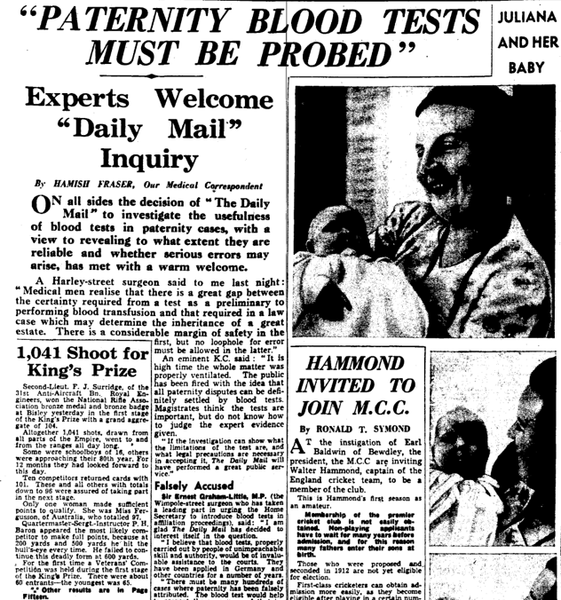
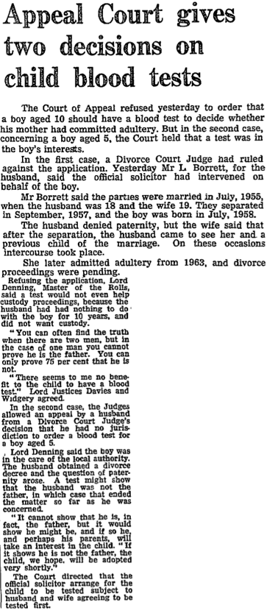
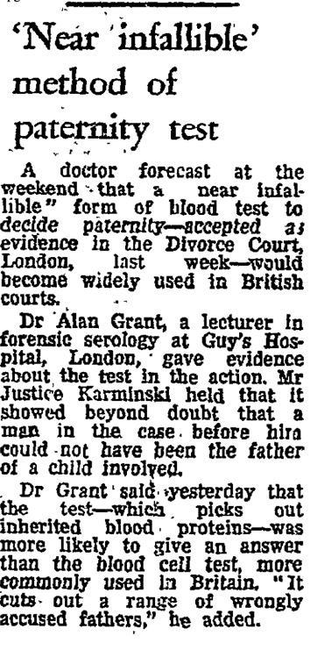
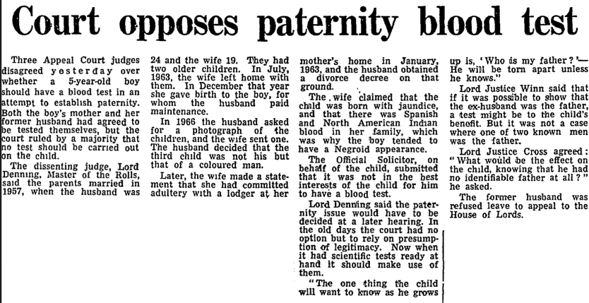
It’s a scientific father who knows his own son?
Ambivalence towards blood tests for (white British) paternity
‘Not in the best interests of the child…’ 1969
‘It is best [for the child]
that truth will out’
‘When it comes to the crunch,
Justice must prevail’
‘Blood testing is not a sure
way of discovering parentage’
Daily Mail 1970
‘Cuts out a range of wrongly
accused fathers…’
Guardian 1966
‘In the old days, the court had no option but to
rely on presumption of legitimacy. Now when it
had scientific tests ready a hand, it should make
use of them’
Guardian, 1969
‘Serious lapses of justice may occur and bring discredit on scientific discoveries which if properly used, can save 1000 innocent men a year…’ Daily Mail, 13 July 1938

Slide 6
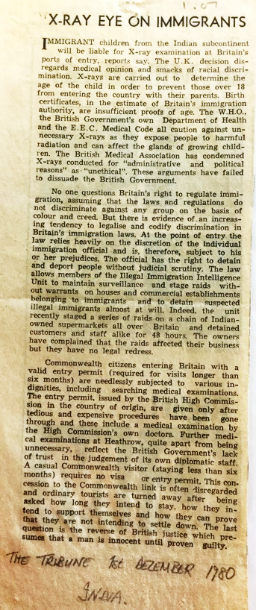
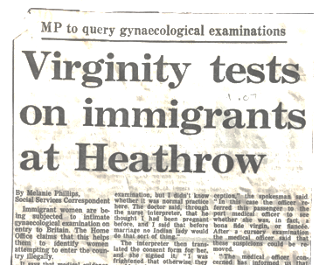
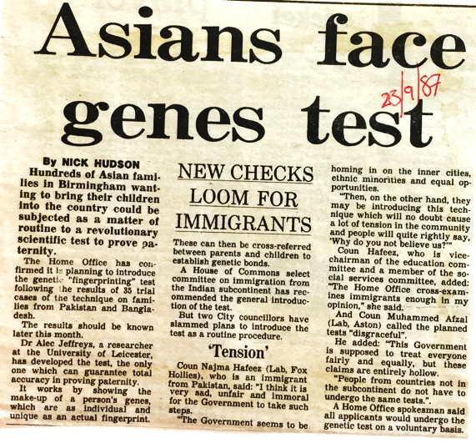
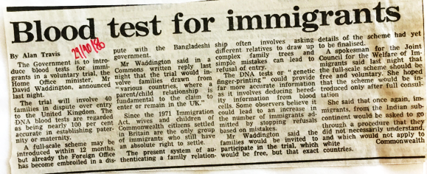
But on the borders (and for migrant bodies), biomedical innovation was common and often welcome
NB: Not ‘health checks’, but identity checks

Slide 7
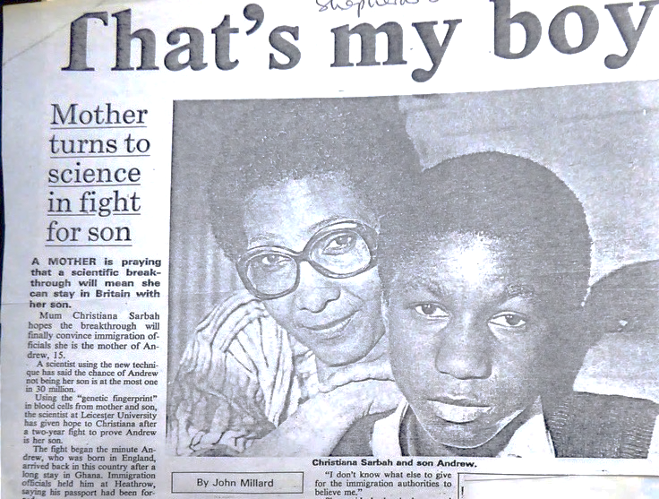
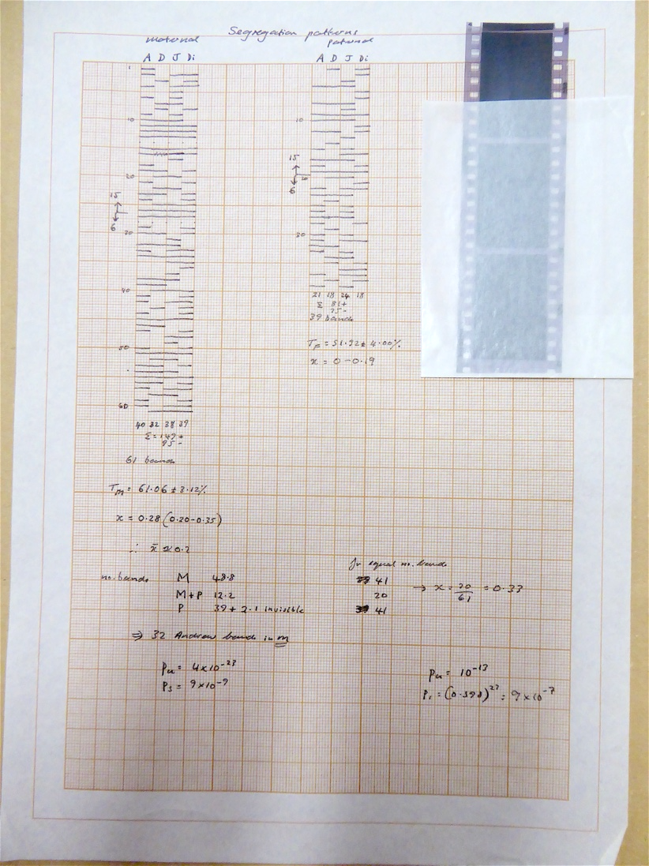
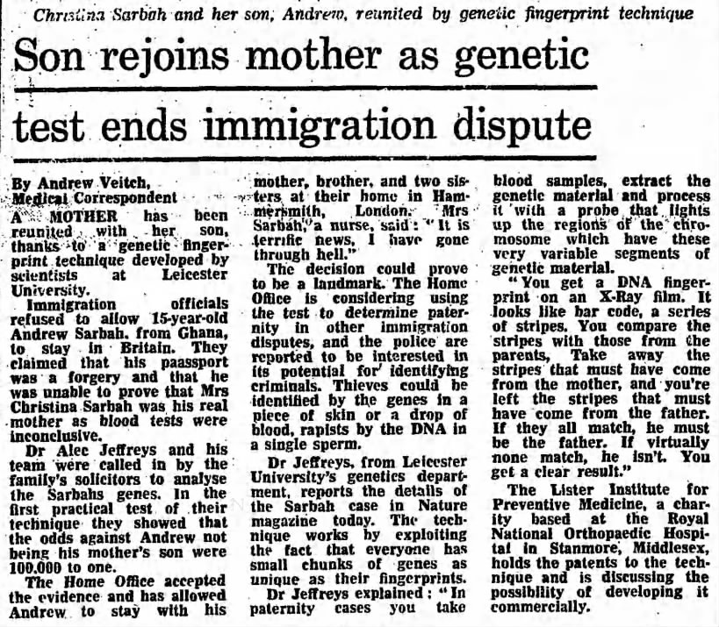
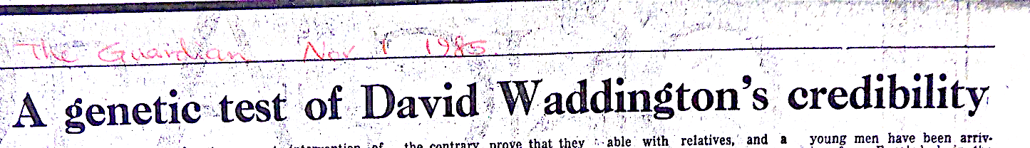
Christine Sarbah
Migrant, African, ‘lone’ parent of four…
‘The mother was certain that the boy was
her son, but she was not certain about his
paternity’
Alec Jeffreys,
Draft of ‘Positive Identification
Using Human DNA Fingerprints:
an immigration test case’, 1985
‘Andrew is British by birth and does not need
permission to enter his home country, yet his
readmission was achieved against all the odds…
There was in fact already a mass of evidence
about his identity … yet this was disregarded… It
was only incontrovertible scientific proof which
forced the Home Office to conceded.’
Margaret Biggs,
Hammersmith and Fulham Community Law Centre, 1985

Slide 8
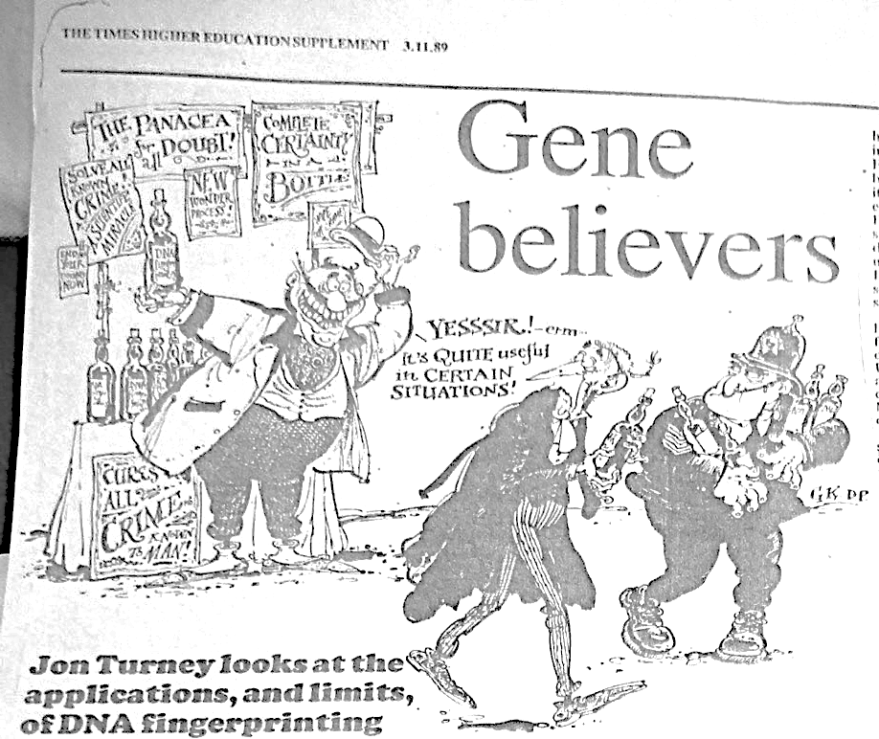
Certainty for ‘certain situations’ – but for whom?
‘The striking ability of the [‘genetic fingerprinting’] techniques to resolve individual cases – to the great joy of the protagonists in immigration disputes, or mothers seeking child maintenance for example – does not give firm ground for the wilder predictions… A technical novelty can change the basis of arguments in the courtroom, but is unlikely ever to eliminate them.’
Turney, Times Higher Ed, November 1989
‘A government study on genetic fingerprinting last July revealed a high percentage of immigrant parentage claims to be genuine. The immigration laws have since been changed. Proof of family ties is no longer the major criterion for settlement in this country.’
Jon Trux, ‘A Case of Unmistakeable Identity’, Observer, 13 August 1989

Slide 9
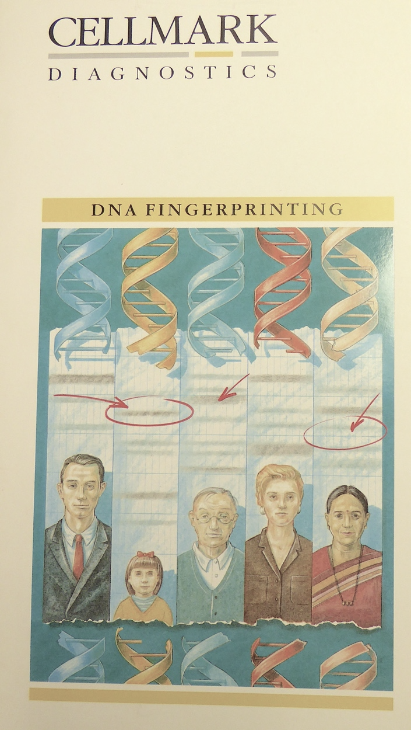
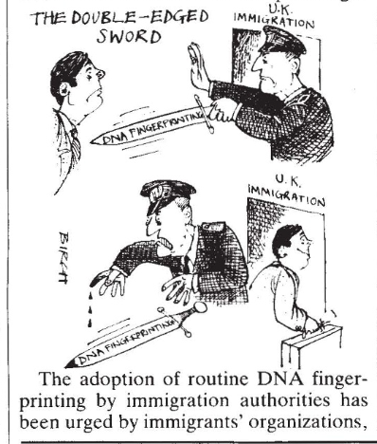
The Risks and Benefits of Certainty
DNA profiling and the biologisation of (racialised) parenthood
Inequalities and ‘imperial suspicion’
Driven to DNA: betting on ‘certainty’
A Bangladeshi man, settled here for 20 years and now a full British citizen, experiences a two year delay in the processing of his wife and children’s application to join him only to have it eventually refused because the High Commission officer does not believe that his family is related to him as he claims. Yet an EEC national, working in the UK for perhaps even only a matter of months, has little difficulty in obtaining a residence permit for children, spouse (male or female) and even grandparents.’
Nony Ardill, North Islington Law Centre, 1983

Slide 10
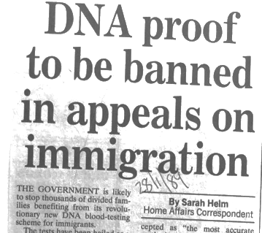
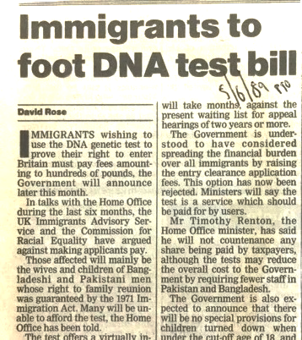
Pilot trial shows 86% of tested families (already refused at least one) were ‘genuine’
ICI reports that 860 subsequent samples confirm relationships in 90% of cases: ‘immigration officers got it wrong’.
‘ministers unwilling to accept DNA proof as reason for overturning earlier rejections’. Fear is of ‘sudden rise in immigration figures’…
Home Office ‘will not countenance’ taxpayer-funded DNA testing (but pays Legal Aid paternity DNA testing costs)
2018-9 and still polluting ‘The big thing about DNA evidence… is that, first of all, it's obviously offensive to be asked’ (Colin Yeo, immigration Barrister, 2018)
‘Home Office pledges to address “systemic challenges” following DNA testing scandal’: 1351 applications affected.
Notes:
2019 headline: Smith, Beckie.Civil Service World; London (Jun 14, 2019). Proquest historic newspapers
Still polluting quote
Wright, Robert.Financial Times; London (UK) [London (UK)]05 July 2018: 2.

Slide 11

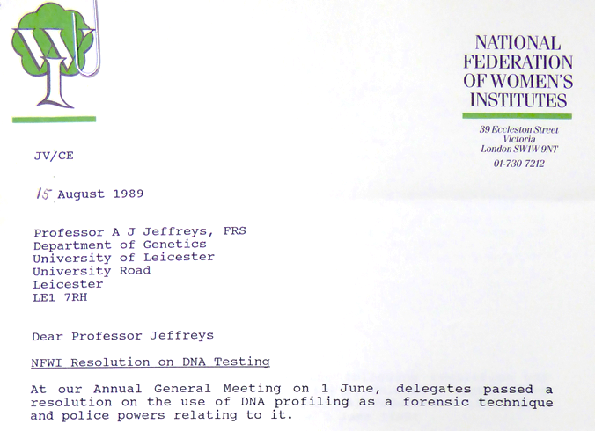
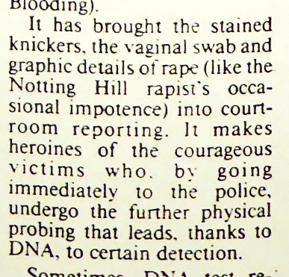
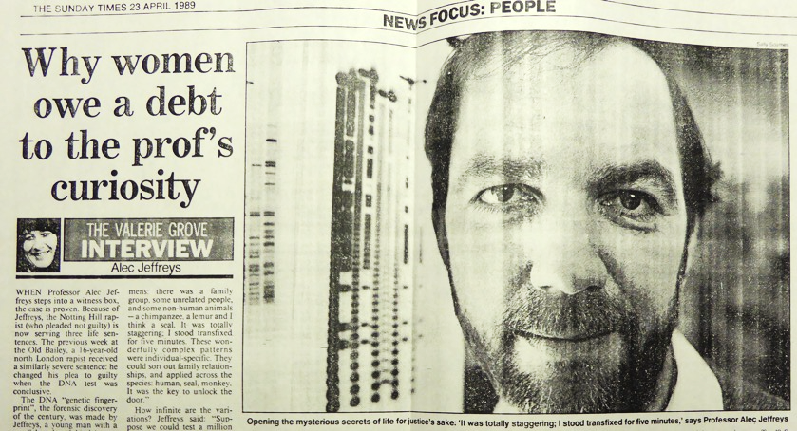
From seizing certainty to losing agency
Women and the introduction of genetic profiling
1985: Seona York and Christiana Sarbah recruit Alec Jeffreys to support Sarbah’s appeal against the deportation of her young son on the grounds that she is not his mother.
1989: Home Office replaces proof of familial relationship with economic capacity to support as primary barrier to reunification migration
1989: Women demand acceptance of DNA evidence in cases of rape and affiliation
1995: CSA begins to use DNA to claw back costs of mothers’ income support from ‘feckless fathers’

Slide 12
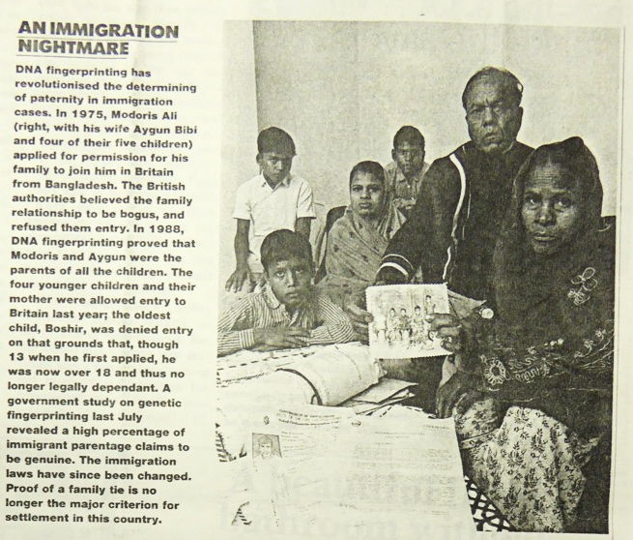
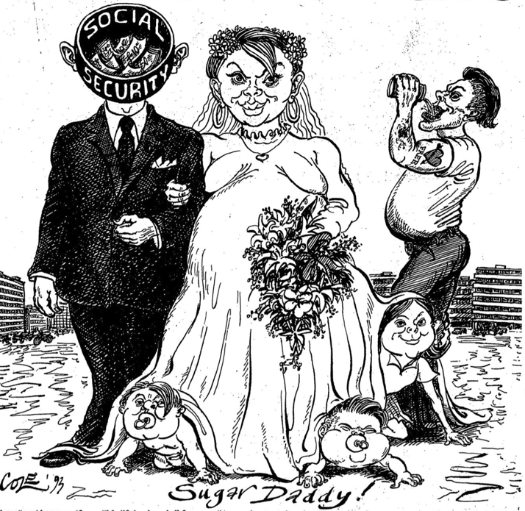
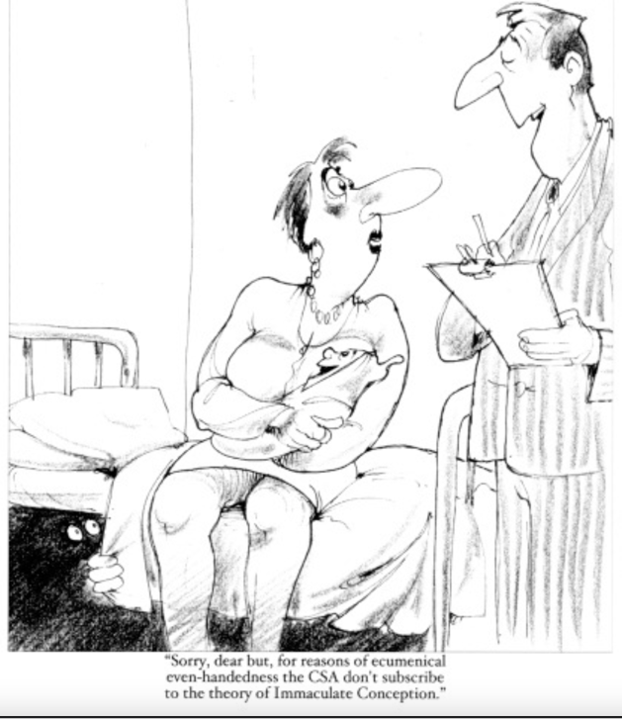

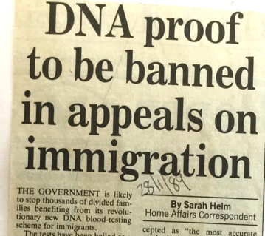
DNA for Deadbeat dads:
After the immigrants, the ‘underclass’?

Slide 13
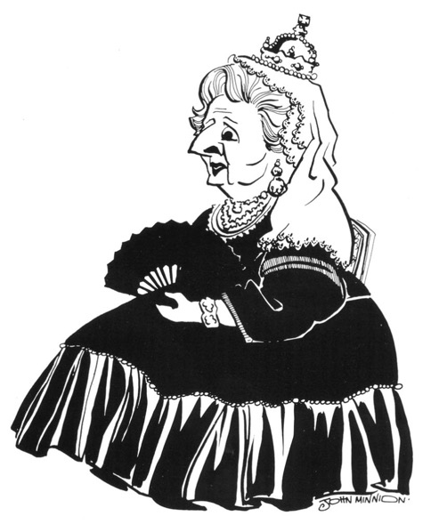
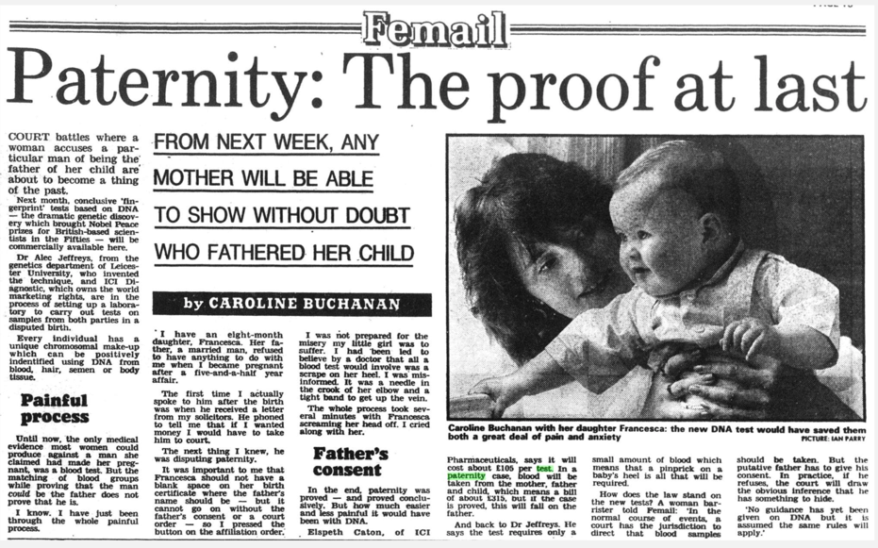
After-effects: From genetics at the border to DNA for Deadbeat Dads
‘Appalled at the size of the bill left behind by
Fathers…’
‘Family life is under threat’
‘the absent male’
‘Nearly 1 in seven families’
‘Mothers struggling…’
‘Moved by the plight of the
growing number of children of
broken marriages…
determined to make errant
fathers pay …’

Slide 14
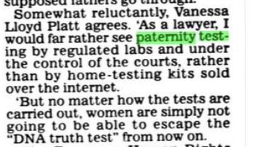
‘Women are far more clever at keeping secrets than
men… Sometimes if they get pregnant, they make a
calculated decision to go for the man who can offer
them financial security.’

Slide 15
The Rise and Risks of Certainty
The Ad: "Whose child is it? Are you really the father? The curious, suspicious or disbelieving who just want peace of mind can now conduct paternity checks in the comfort of their own home. Do-it-yourself DNA tests are now available in Britain.”
The Chair of Commons Health Select Committee: "I hope the Government will find some way to block the activities of this agency and other agencies undertaking similar testing. … I want to see it stopped. Clearly there is a huge gap in law here where there is no provision in respect of non-medical use of DNA.”
The ‘DNA Testing Agency’: "They [critics and the government] are defending the position where they are controlling the tests in this country. We are giving people the opportunity to do private testing. There is nothing deceitful or underhand about it."
http://news.bbc.co.uk/1/hi/health/131744.stm 1998

Slide 16
